Slide 1
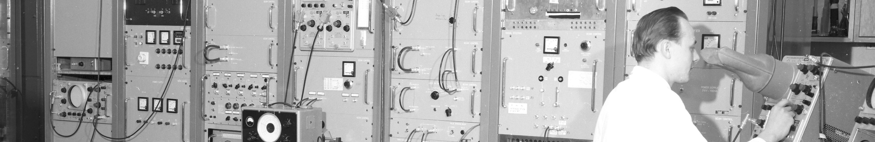
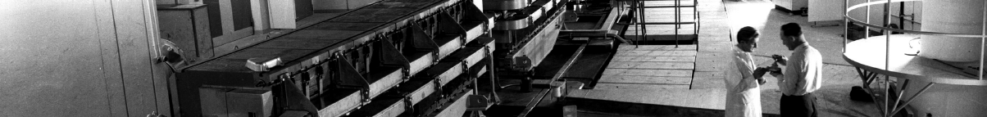
PS Report week 19
Many thanks
to the PS OP and coordination teams as well as all equipment experts and support teams!

Slide 2
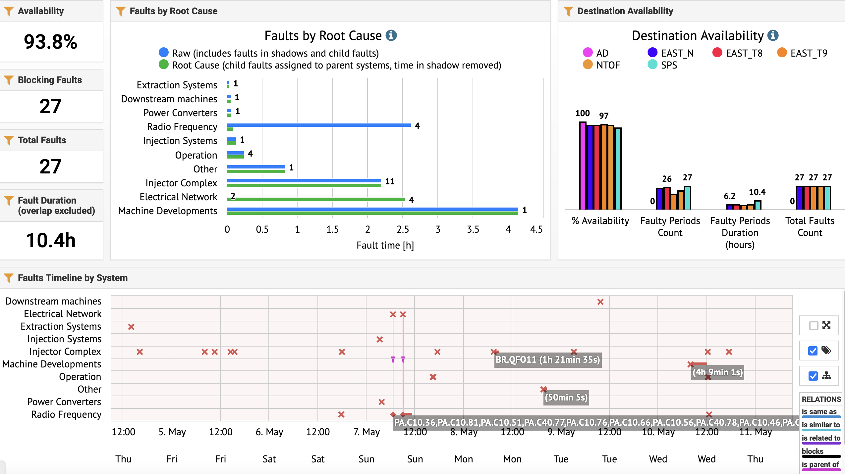
Beam availability W18/19
Electrical glitches
L4-PSB dedicated MD

Slide 3
Main Issues
2 electrical glitches brought down the cavities on Sunday
Dedicated Linac4-PSB MD yesterday 8h-12h
  Time period to be excluded from downtime
Phase oscillations affecting LHC-type cycles (since last weekend)
  Intermittent phase jump of 40 MHz cavity 77 due to bad cavity controller re-synchronisation –> broken cable identified and exchanged
  Rephasing of C40-77 required
  Phase oscillations observed locally in open loop between cavity drive and return signals
  Removed 10 dB of attenuation in cavity return signal and exchanged another suspicious cable

Slide 4
Beams
TOF
  A new version with optimized working point and 4 extraction bumpers is sent to nTOF since Friday (similar work was done for AD cycle) → reduced losses in PS ring
  Yesterday evening, RP made calibration measurements for the nTOF RP monitors at varying beam flux
  m-TOF: timing modification on Monday to prepare for double-injection TOF cycle; will require some more modifications –> ongoing
5-BP cycle revived for ion life-time measurements and a few observation issues being followed up

Slide 5
Status of operational beams
Fixed target beams | Status | Comment
SFTPRO (core only) | Operational | Sent to SPS at 50 ∙ 10¹⁰ p/p
SFTPRO (5 turn extraction) | Operational | Available up to 1.5 ∙ 10¹³ p/p
AD | Operational | Available up to 1.5 ∙ 10¹³ p/p ; FTA line commissioned (tbc this weekend)
TOF | Operational | 850 ∙ 10¹⁰ p/p and (28-)40 ns bunch length at extraction (4 extraction bumpers + optimized vertical working point since Friday)
EAST | Operational | Beam slow extracted to T9, N targets and to IRRAD, fast extraction and parasitic TOF (first version with 1.4 GeV injection setup)
LHC-type beams | Status | Comment
LHCPILOT, LHCINDIV | Operational
LHC25 (3bp, 72b) | Operational | Sent to SPS at 2.4 ∙ 10¹¹ p/b; Pushed up to 2.6 ∙ 10¹¹ p/b
LHC25 (2bp, 12b to 48b) | Operational | Sent to SPS at 1.9 ∙ 10¹¹ p/b; Pushed up to 2.6 ∙ 10¹¹ p/b
LHC25 BCMS (48b) | On hold | OK at 1.4 ∙ 10¹¹ p/b; Pushed up to 2.3 ∙ 10¹¹ p/b
LHC25 8b4e (56b) | Operational | Pushed up to 2.1 ∙ 10¹¹ p/b
AWAKE | Operational
HiRadMat | Operational | Single bunch AWAKE-like prepared at 2 um transverse emittance
ILHC (1b), ILHC (4b)

Slide 6

PS Coordinator for week 18 – Denis Cotte
PS Coordinator for week 19 – Bettina Mikulec
PS Coordinator for week 20 – Alexander Huschauer
Questions and Comments
9:00 live meeting at the CCC on Wednesday and Friday
Zoom link to follow the meeting on remote: https://cern.zoom.us/j/9372114100?pwd=L29BcmlHUENCdFBRSytXYVcrM1B4Zz09
Meeting ID : 937 211 4100
Passcode: 525463

