Slide 1
SPS status
Arthur Spierer for the SPS team
11th of May 2022, PS-SPS users meeting

Slide 2
SPS week 19
  Coordinator next week: Carlo Zannini
  Coordination meeting on Monday 11.30
  Very good overall availability this week
  SFTPRO
    T2/T4/T6/T10 : 25/55/113/31 at the moment of writing
    From 15th: 90/60/60 as planned
    50 and 100 Hz automatic compensation accelerated on GPU from Friday onwards
  HiRadMat (Week 22)
    Access to TT61/TJ7/TNC will take place during the LHC access 8.30 to 12.30 on Friday
  AWAKE
    Proposal of compensation for MD to follow
    Details of the Sequences in the minutes
  Next week:
    MDs and AWAKE continuing

Slide 3
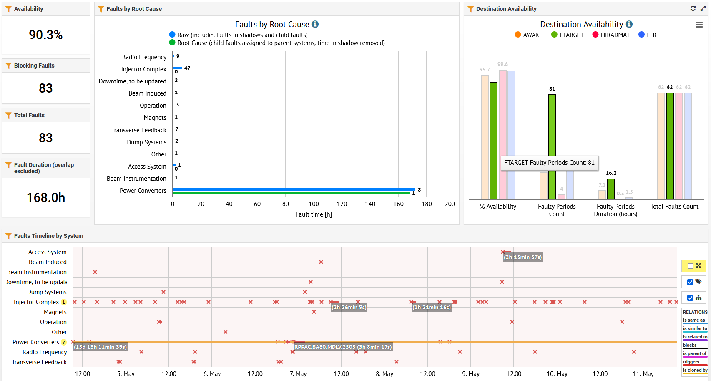
SPS availability overview

Slide 4
Cycles composition
  Thursday MD sequence:
    SFTPRO: 17b, LHCMD25: 20bp, MD1: 3bp
    1xSFTPRO/32bp
  AWAKE compensation sequence:
    2xSFTPRO: 17bp, 3xAWAKE: 6bp, 2xMD1: 3bp
    2xSFTPRO/42bp
  AWAKE standard sequence:
    2xSFTPRO/36bp

