Slide 1
Impedance WG status report
Carlo, Christine, Thomas and Patrick (in 2017), Leo, Elena, Niky, Alice, Rama, Giulia, Giovanni, Benoit
Many thanks
to our colleagues from BI for the teamwork (William, Federico, Jonathan, Manfred)
and to the IWG members for the help and advice
IPP – 5 May 2023

Slide 2
Context
Systematic SPS wire scanner failure in parking position
Talk of Carlo at last IPP: https://indico.cern.ch/event/1276147/contributions/5360049/attachments/2633054/4554377/Moving%20towards%20HL-LHC%20intensities.pptx
Talk of Federico at last IEFC: https://indico.cern.ch/event/1272497/contributions/5380889/attachments/2637711/4563923/2023-04-28-SPS_BWS@IEFC.pptx
Talk at last IWG: https://indico.cern.ch/event/1281453/contributions/5383477/attachments/2639673/4568381/SPS%20wire%20scanner%20breakage.pptx
Evidence points to excessive beam induced heating in parking position
Emergency work by many colleagues in BI, RF and ABP to understand the issue and try to find solutions

Slide 3
Agenda
Simulations
Possible mitigations
Bench measurements
Beam measurements

Slide 4
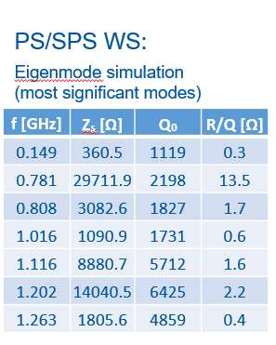
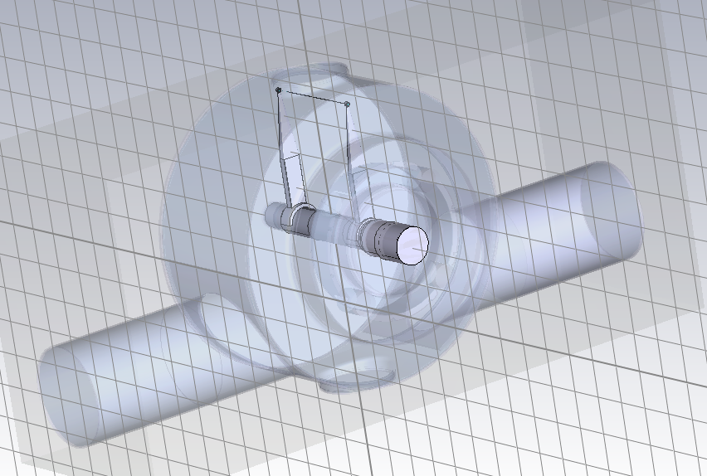
Model of Thomas from 2017
https://indico.cern.ch/event/616762/
→ First mode power loss is hardly on the wire, and does not change as much with bunch length
→ With such high Q (>2000), hard to explain that mode for all scanners hits the beam spectrum lines at the same time
(Deltaf~300 kHz)

Slide 5
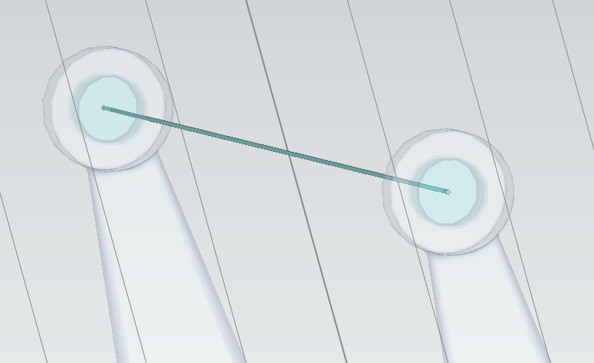
Model from Thomas from 2017
Reduced wire conductivity (9000 S/m)
Added Macor between wire and fork
Left the wire with no connection
Mode much broader
Eigenmode :
f=786 MHz
Q=250
Rsh=3.2 kOhm

Slide 6
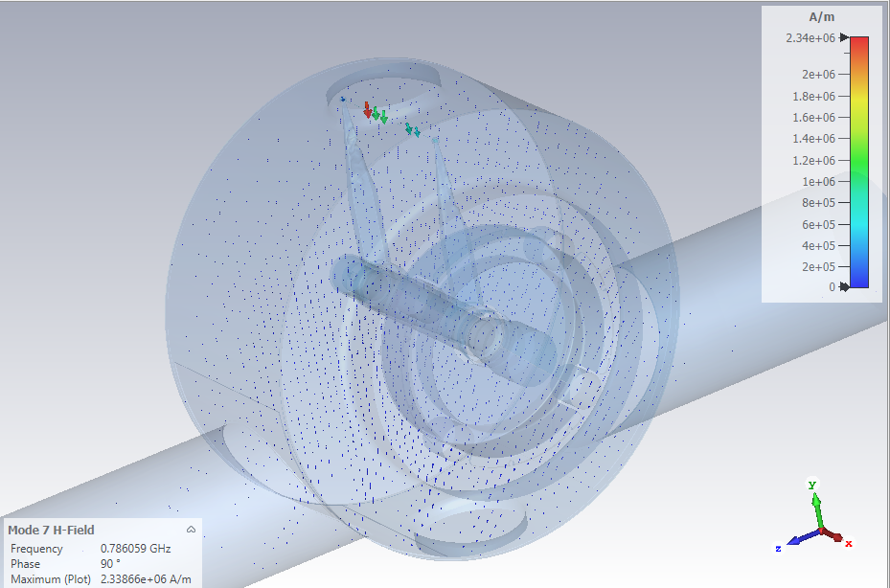
Model from Thomas from 2017
Reduced wire conductivity (9000 S/m)
Added Macor between wire and fork
Left the wire with no connection
→ Mode much broader
Eigenmode :
f=786 MHz
Q=250
Rsh=3.2 kOhm
(89% dissipated on the wire)

Slide 7
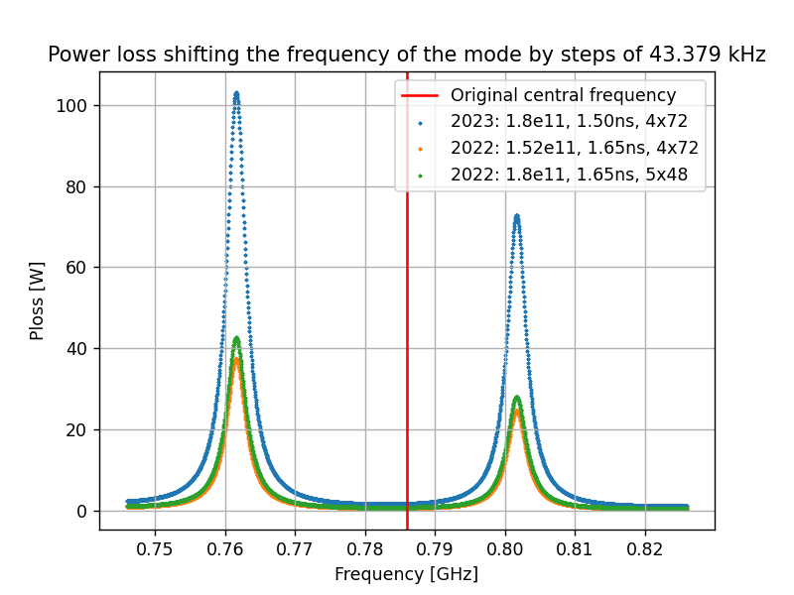
Power loss expected from mode at ~780 MHz
Power dissipated in the device
at exact frequency:
2023: 1.62 W (1.44 W on the carbon wire)
2022: 0.59 W (0.52 W on the carbon wire)
- 2022: 0.71 W (0.63 W on the carbon wire)
Power dissipated increased by more than a factor 2 in 2023 compared to 2022
Depending on frequency of the mode w.r.t. beam spectrum line, can increase from ~2W to more than 100W

Slide 8
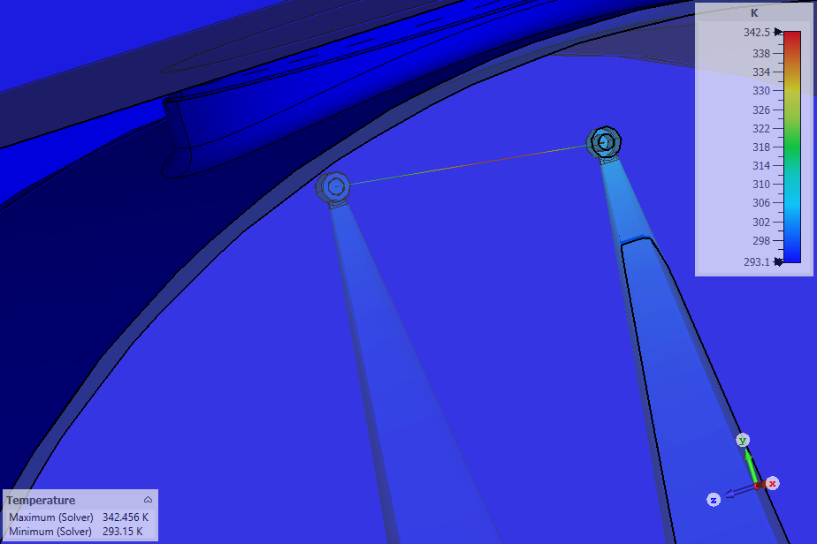
Thermal simulation with CST
Steady state
Assumed 1W dissipated
→ 50C increase on the wire

Slide 9
Modes without ferrite
Frequency | Rsh | Q | On the wire | Power loss at freq | Power loss at freq on the wire | Max power loss | Max power loss on the wire
149 MHz | 0.275 kΩ | 894 | [21%] | 0.27 W | 0.06W | 184 W | 38 W
542 MHz | 0.250 kΩ | 423 | [20%] | 0.32 W | 0.06 W | 44.1 W | 9 W
786 MHz | 3.2 kΩ | 250 | [89%] | 1.61 W | 1.43 W | 44.1 W | 39 W
→ 3 modes are able to generate significant losses on the wire

Slide 10
Modes without ferrite
Frequency | Rsh | Q | On the wire | Power loss at freq | Power loss at freq on the wire | Max power loss | Max power loss on the wire | Injection at freq | Injection max
149 MHz | 0.275 kΩ | 894 | [21%] | 0.27 W | 0.06W | 184 W | 38 W | 0.02 W | 108 W
542 MHz | 0.250 kΩ | 423 | [20%] | 0.32 W | 0.06 W | 44.1 W | 9 W | 0.001 W | 0.20 W
786 MHz | 3.2 kΩ | 250 | [89%] | 1.61 W | 1.43 W | 44.1 W | 39 W | 0.0077 W | 0.012 W
→ 3 modes are able to generate significant losses
1st mode would likely have been too strong at injection energy for 2.3E11 p/b (that we had in 2022)
2nd mode could also be responsible
3rd mode seems the worst

Slide 11
Agenda
Simulations
Possible mitigations
Bench measurements
Beam measurements

Slide 12

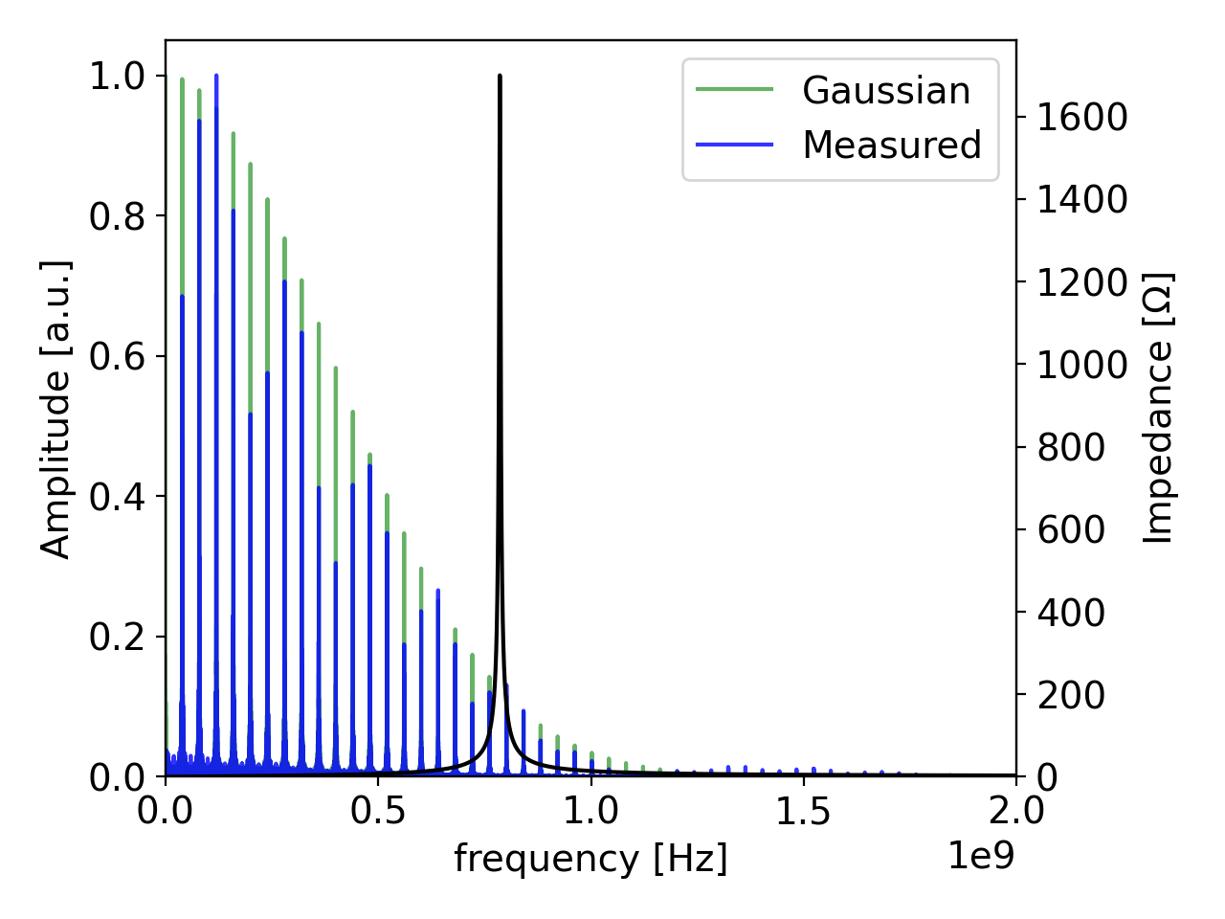
Possible solutions to reduce power loss to the wire
power dissipated on the wire ~ [normalized beam spectrum] * [real longitudinal impedance] * [% on the wire]
[Assuming bunch length, bunch intensity and number of bunches constrained by performance reach]
Reduce beam spectrum at mode frequency
  Change longitudinal profile
  Push impedance to higher frequency (change geometry)
  Put impedance in-between 40 MHz spectral lines (adapt geometry, need measurement)
Reduce shunt impedance of mode
  Change geometry
  Change materials
Relocate losses elsewhere than wire
  Add damping material
  Add coupler

Slide 13
Possible solutions to reduce power loss to ferrite
Reduce beam spectrum at mode frequency
Can the bunch profile be shaped to reduce components beyond 500 MHz? Flattened bunches?
Can try to reduce the critical duration when bunch length is minimal?
→ not clear if feasible
Reduce impedance
Geometry already very constrained → not clear anything can be done
Mode present without wire and with forks in dielectric → not clear anything can be done
Wire in tungsten?
Relocate losses elsewhere
Ferrite → see next slides
Mode coupler → to be checked in measurements (could see if PSB wire scanner fork can be used)
Add another wire → from 80% to 60% on the wire
Shielding plate → not very promising

Slide 14
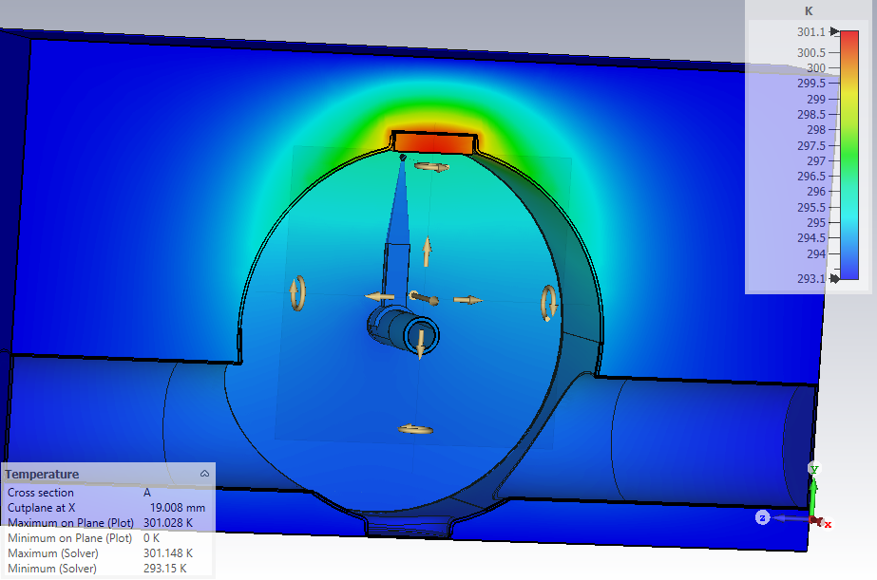
With ferrite
TT2-111-R facing parking position
For 1 W dissipated
Eigenmode with ferrite:
f=783 MHz
Q=218
Rsh=2.6 kOhm
17% on the wire, the rest on the ferrite
But power relocated mostly to the ferrite
(wire at 298K)
→ Need to cool the ferrite, or check that it
does not heat too much

Slide 15
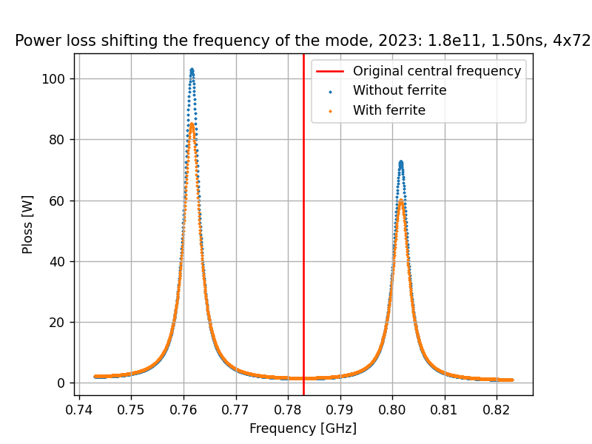
Power loss expected from mode at ~780 MHz
Power dissipated in the device at exact frequency:
With ferrite: 1.61 W (0.28 W on the wire)
Without ferrite: 1.62 W (1.44 W on the wire)
Maximum power to the device: more than 80W
  14 W on the wire
  70 W on the ferrite
Important to check that the mode is far from
spectral lines in measurements!
Need to study options for ferrite cooling

Slide 16
Agenda
Simulations
Possible mitigations
Bench measurements
Beam measurements

Slide 17
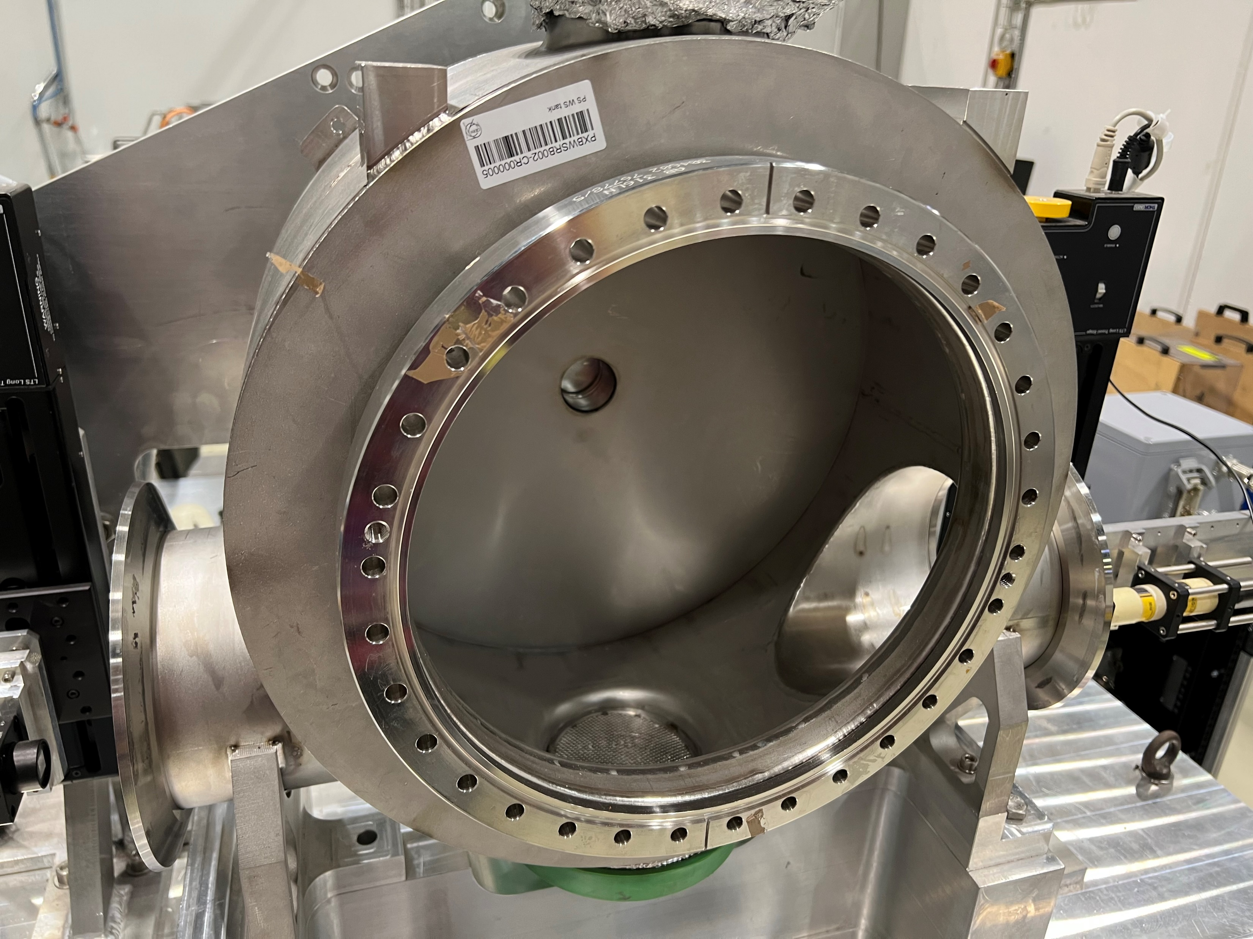
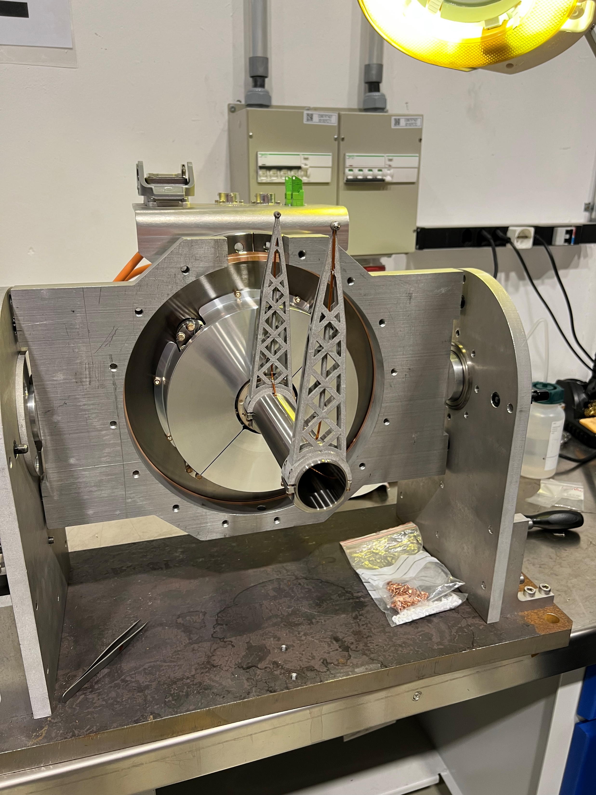
Bench measurements
→ Set up by William and ready for measurements

Slide 18
Goals for bench measurements
Check frequencies of resonant modes
Identify those with large coupling
Test mitigation measures
→ Planned for the coming days (Christine, Michael and Carlo)

Slide 19
Agenda
Simulations
Possible mitigations
Bench measurements
Beam measurements

Slide 20
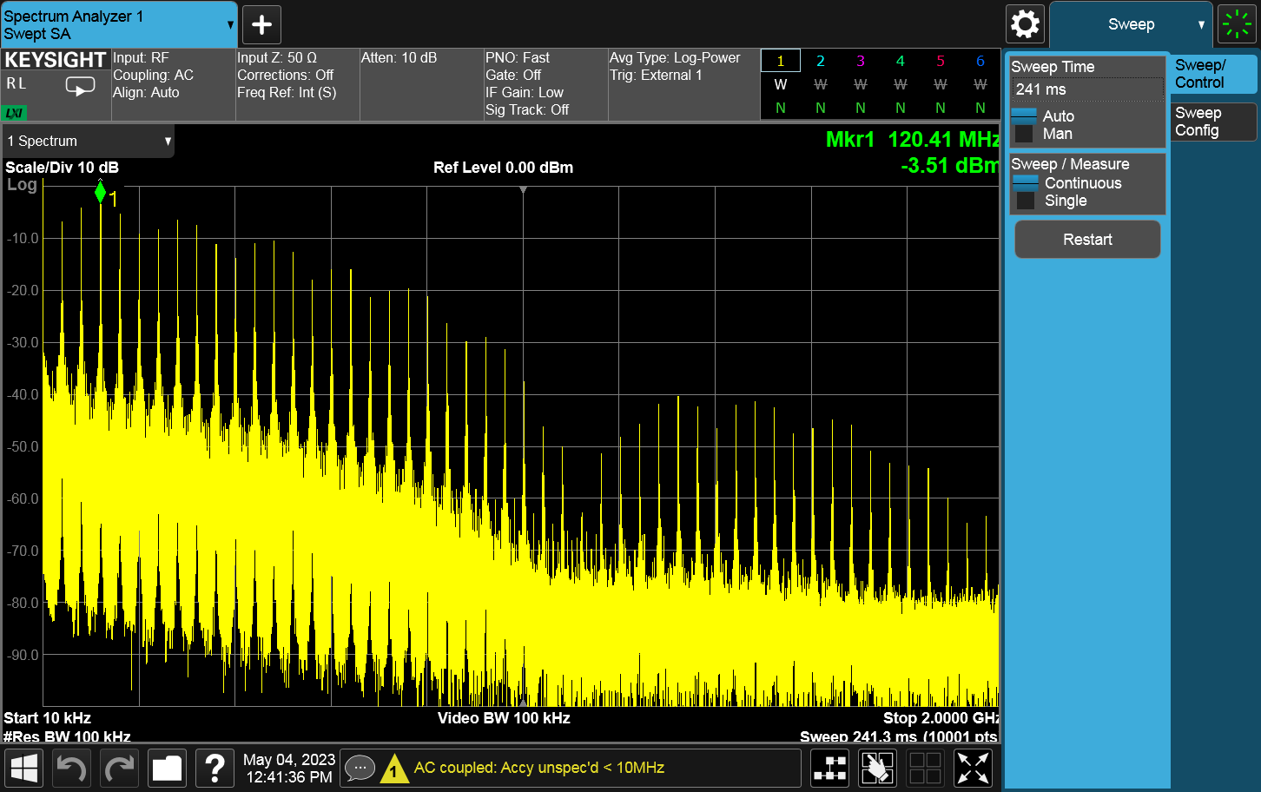
Beam measurements
(by Alice and Niky with the help of Giulia and Rama and SPS OP crew)
Measured beam spectrum, bunch length and bunch profiles along the cycle with same conditions as for the last wire breakage (except bunch intensity at 1.5E11 p/b)
→ evolution along the cycle can be correlated with voltage induced signal on the carbon wire
→ check measured power spectrum at resonant frequencies and compare to prediction
Some aspects to be clarified (e.g. transfer function, undersampling)
Comforted us in the use of the Gaussian bunch shape to estimate power loss at the mode frequency → to be continued

Slide 21
Action plan (from Wednesday IWG)
Impedance measurement of a spare SPS wire scanner with carbon wire to
  Confirm frequency, quality factor and coupling from beam to the carbon wire of the resonant modes [planned with William to start this week] → instrument received, measurements to start
  See if mitigation measures could reduce the impedance and/or divert the heat load from the carbon wire to somewhere else (other wires, ferrites, couplers), and whether another parking position could reduce the heat load to the wire → measurements to start
Check the beam spectrum along the cycle [planned with Giulia for Thursday] → Done!
and see if we could reduce the high frequency spectrum component with RF settings → to be done
Continue impedance simulation campaign at parking position with potential mitigation measures [started right after the first breakage]. → ongoing
  Still a lot of assumptions in there (fork in stainless steel, no connection of the carbon wire and no measurement wire)
  Need to consolidate and benchmark results
Note: If we consider ferrite a viable option,
  need to identify quickly which ferrite type (magnetic losses and vacuum compatibility)
  start checking procurement possibilities
  Check how it could be positioned in H and V scanners (clamping? Left laying on the bottom?)
  → to be followed up by task force

Slide 22
SPS linear wirescanners
Thanks Jonathan!
Hidden behind a slit (no ferrite)
Very different situation in parking position

Slide 23
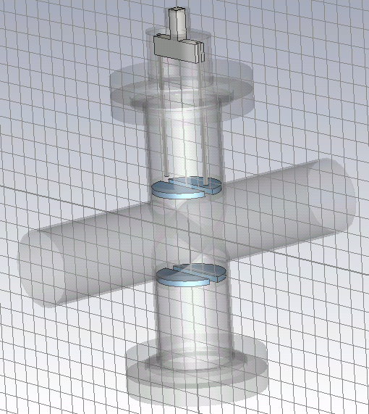
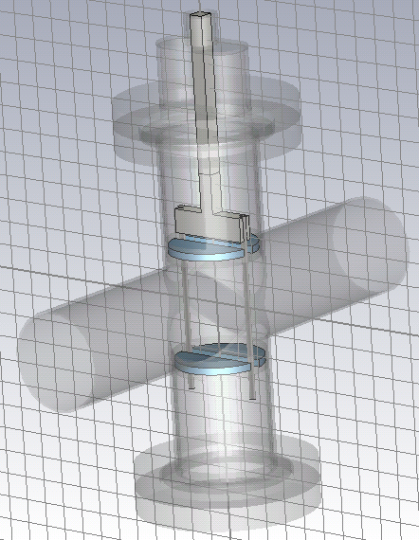
LHC wire scanner
Model for wire OUT
Model for wire IN
fork
ferrite
Hidden behind a slit (no ferrite)
Very different situation

Slide 25
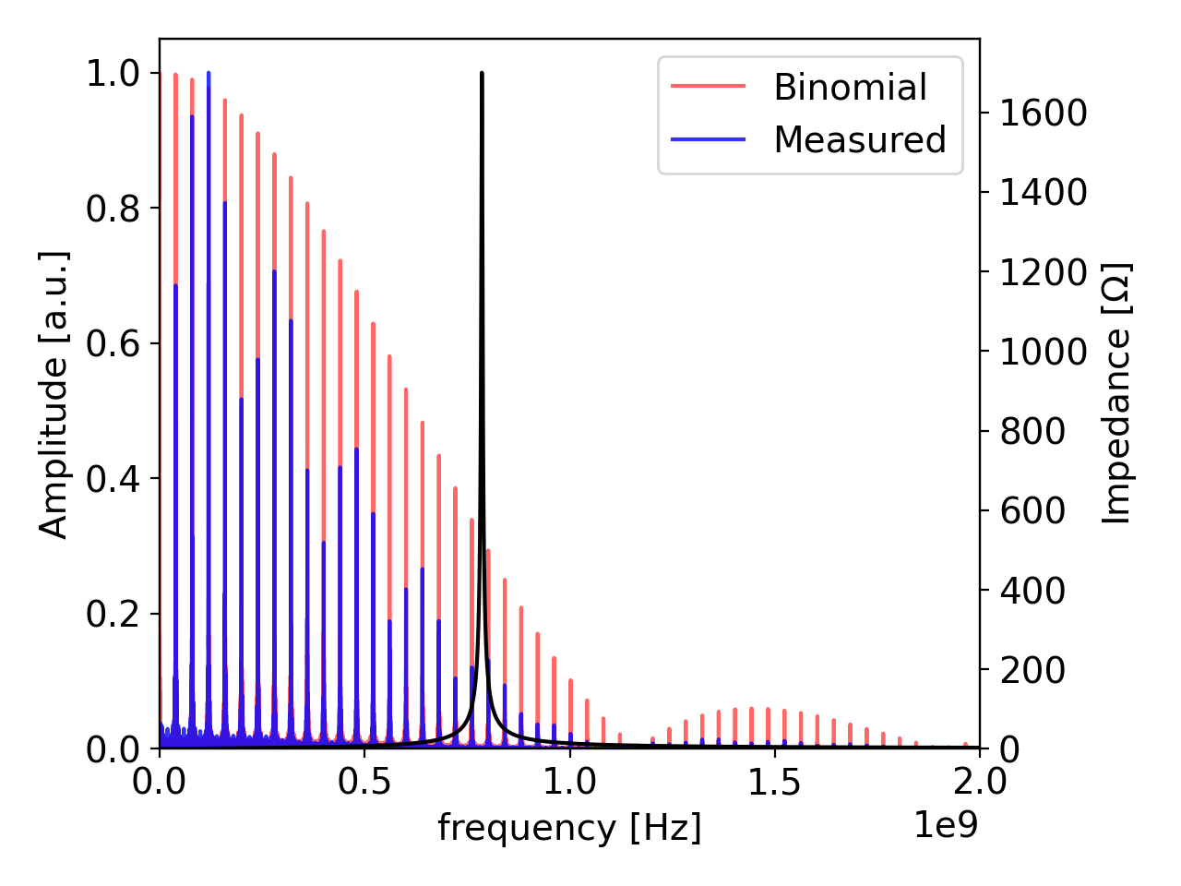
Difficult to fit spectrum with binomial distribution → to be followed up

