Slide 1

SPS WS wire breakage

Slide 2

First results from C wire imagery
The C wire is present on all four forks
Sharp fracture breakage presents in most of the sample, in one case a necking is visible
More results in the coming days

Slide 3
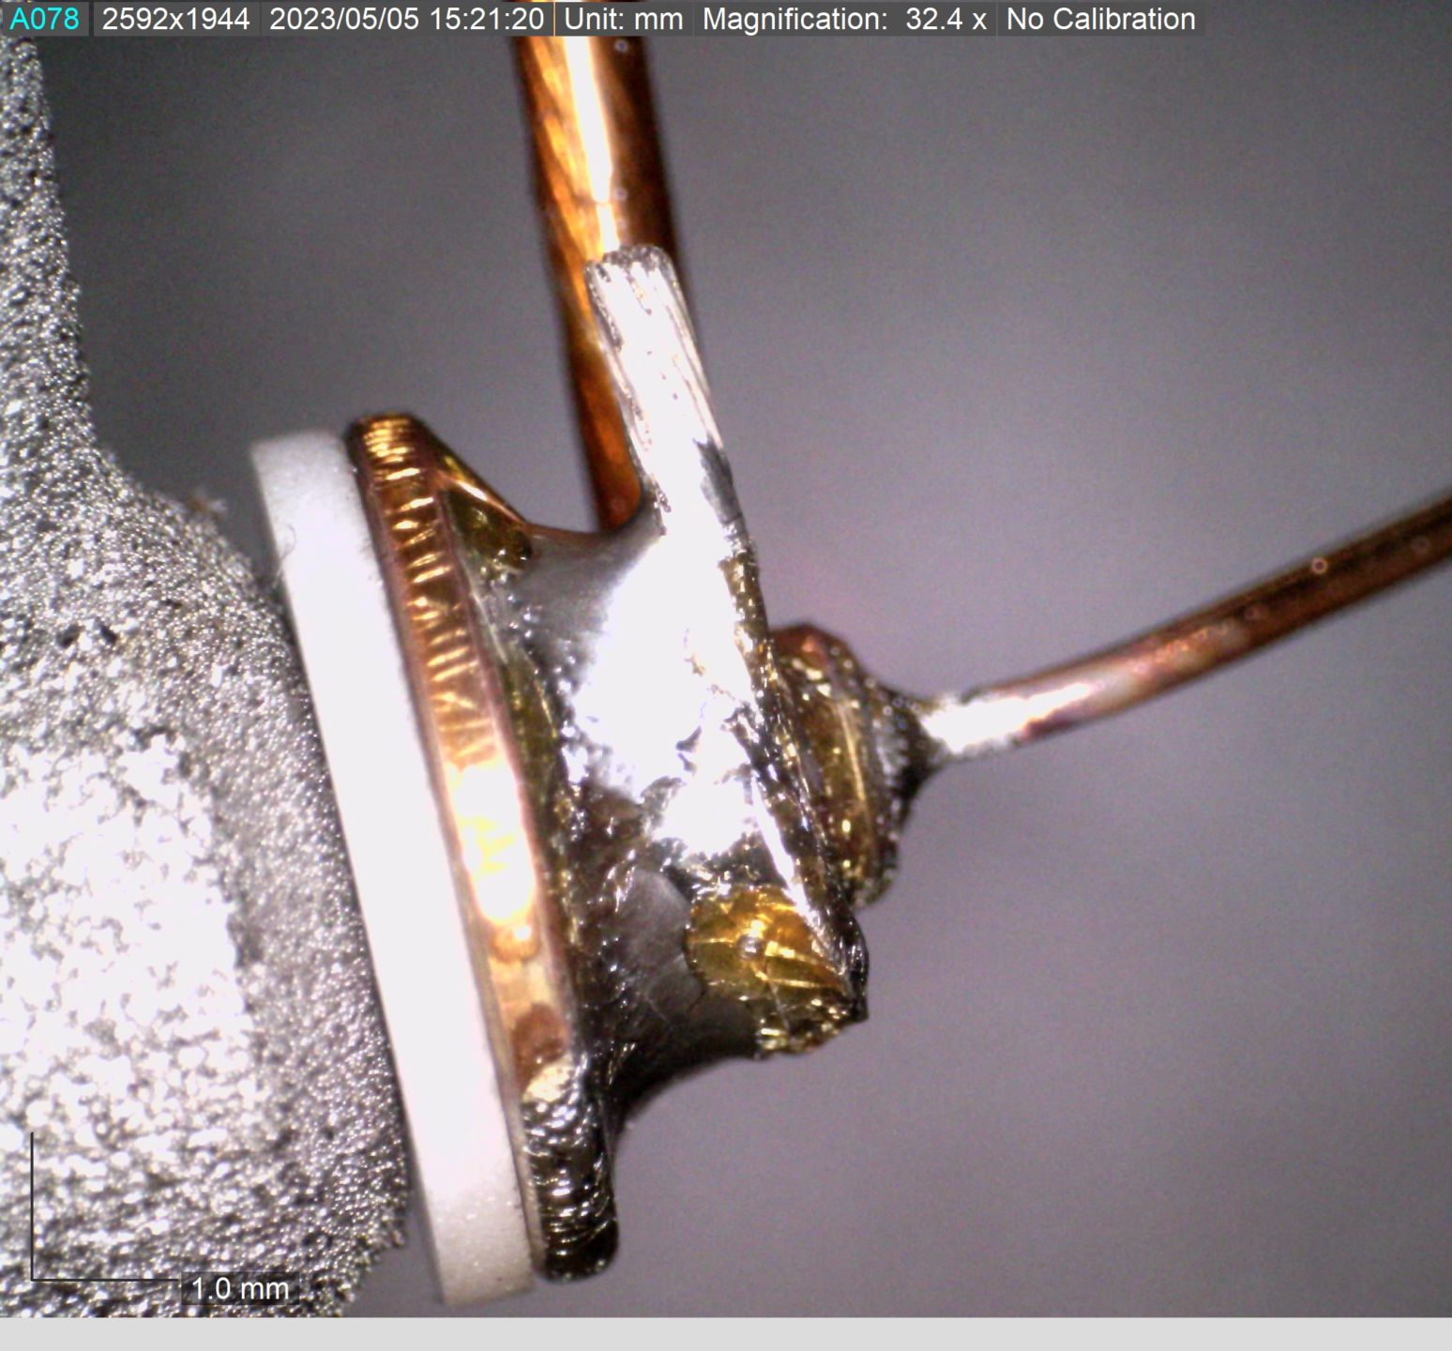
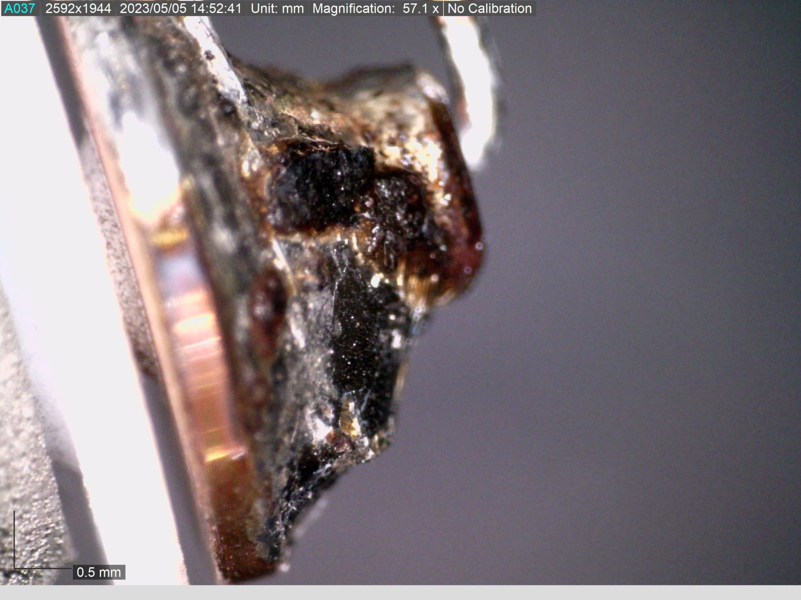
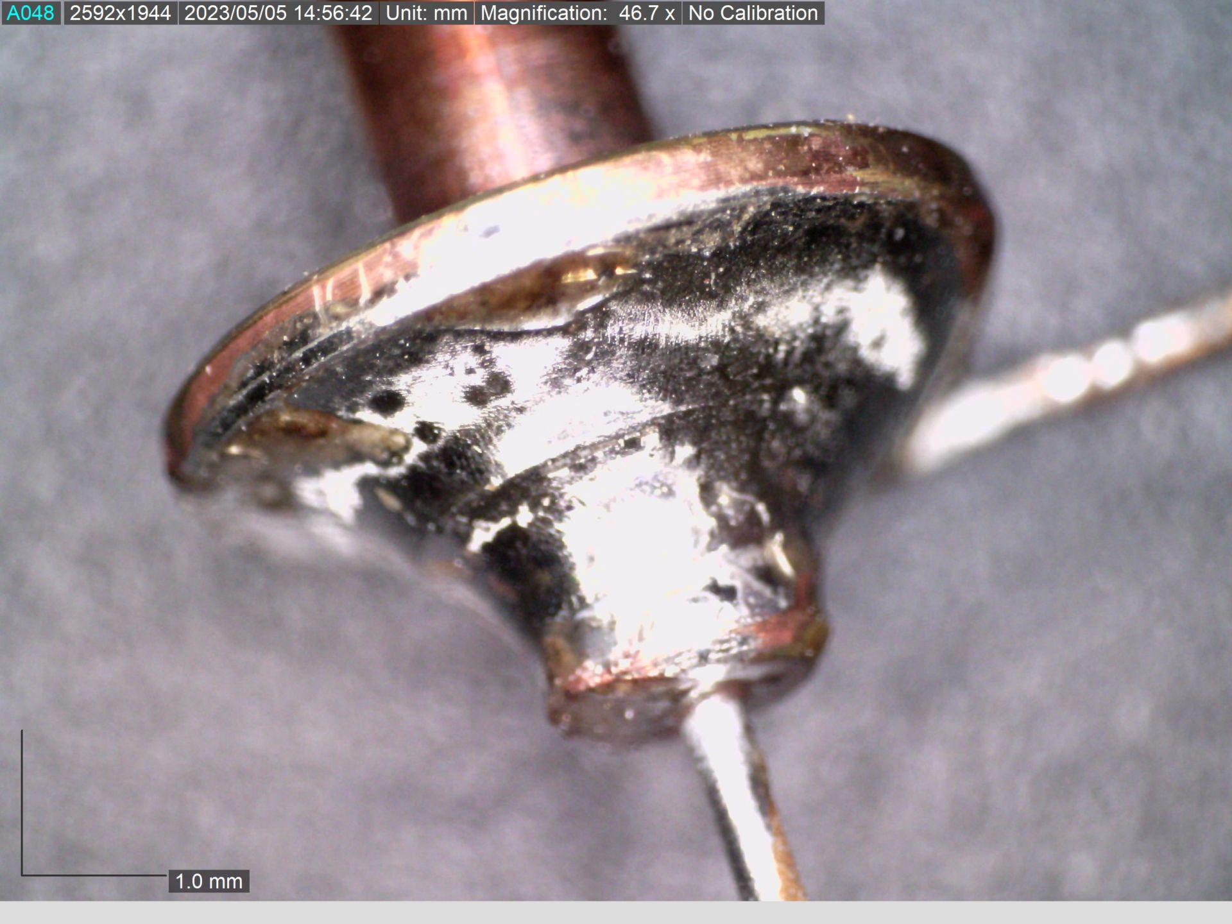
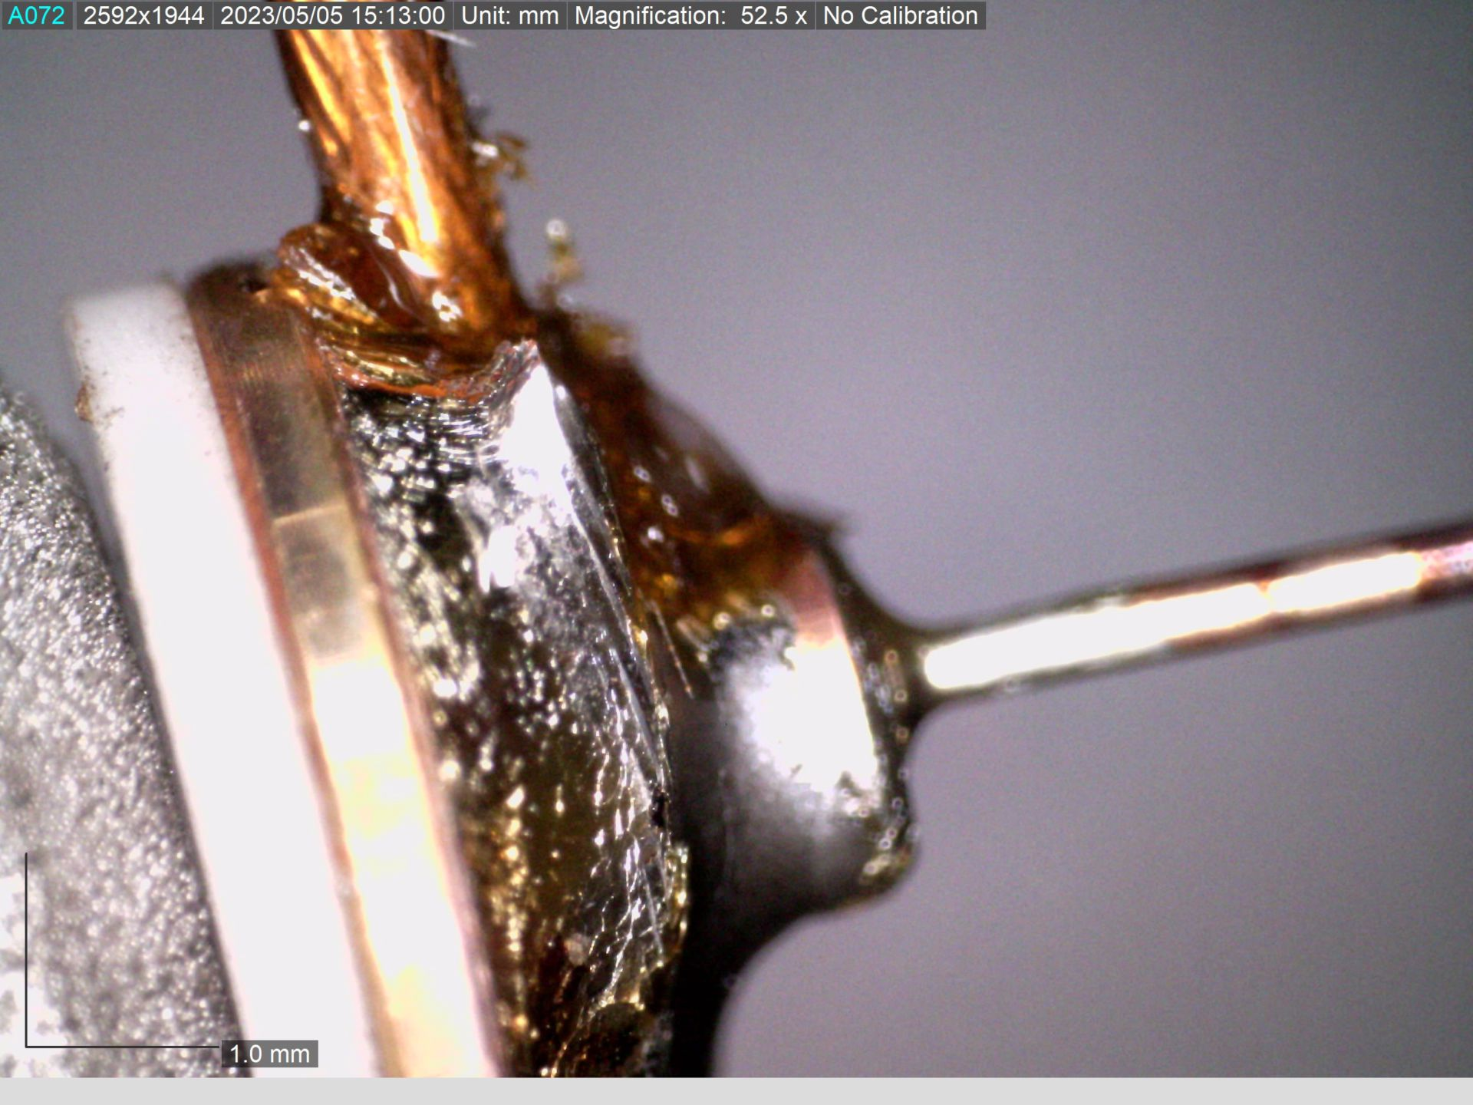

Slide 4
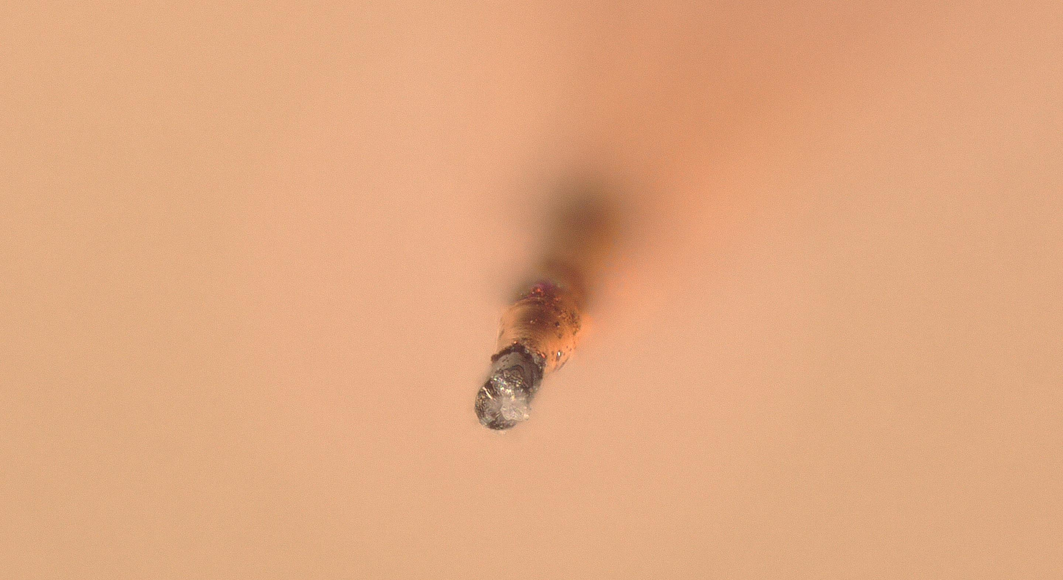
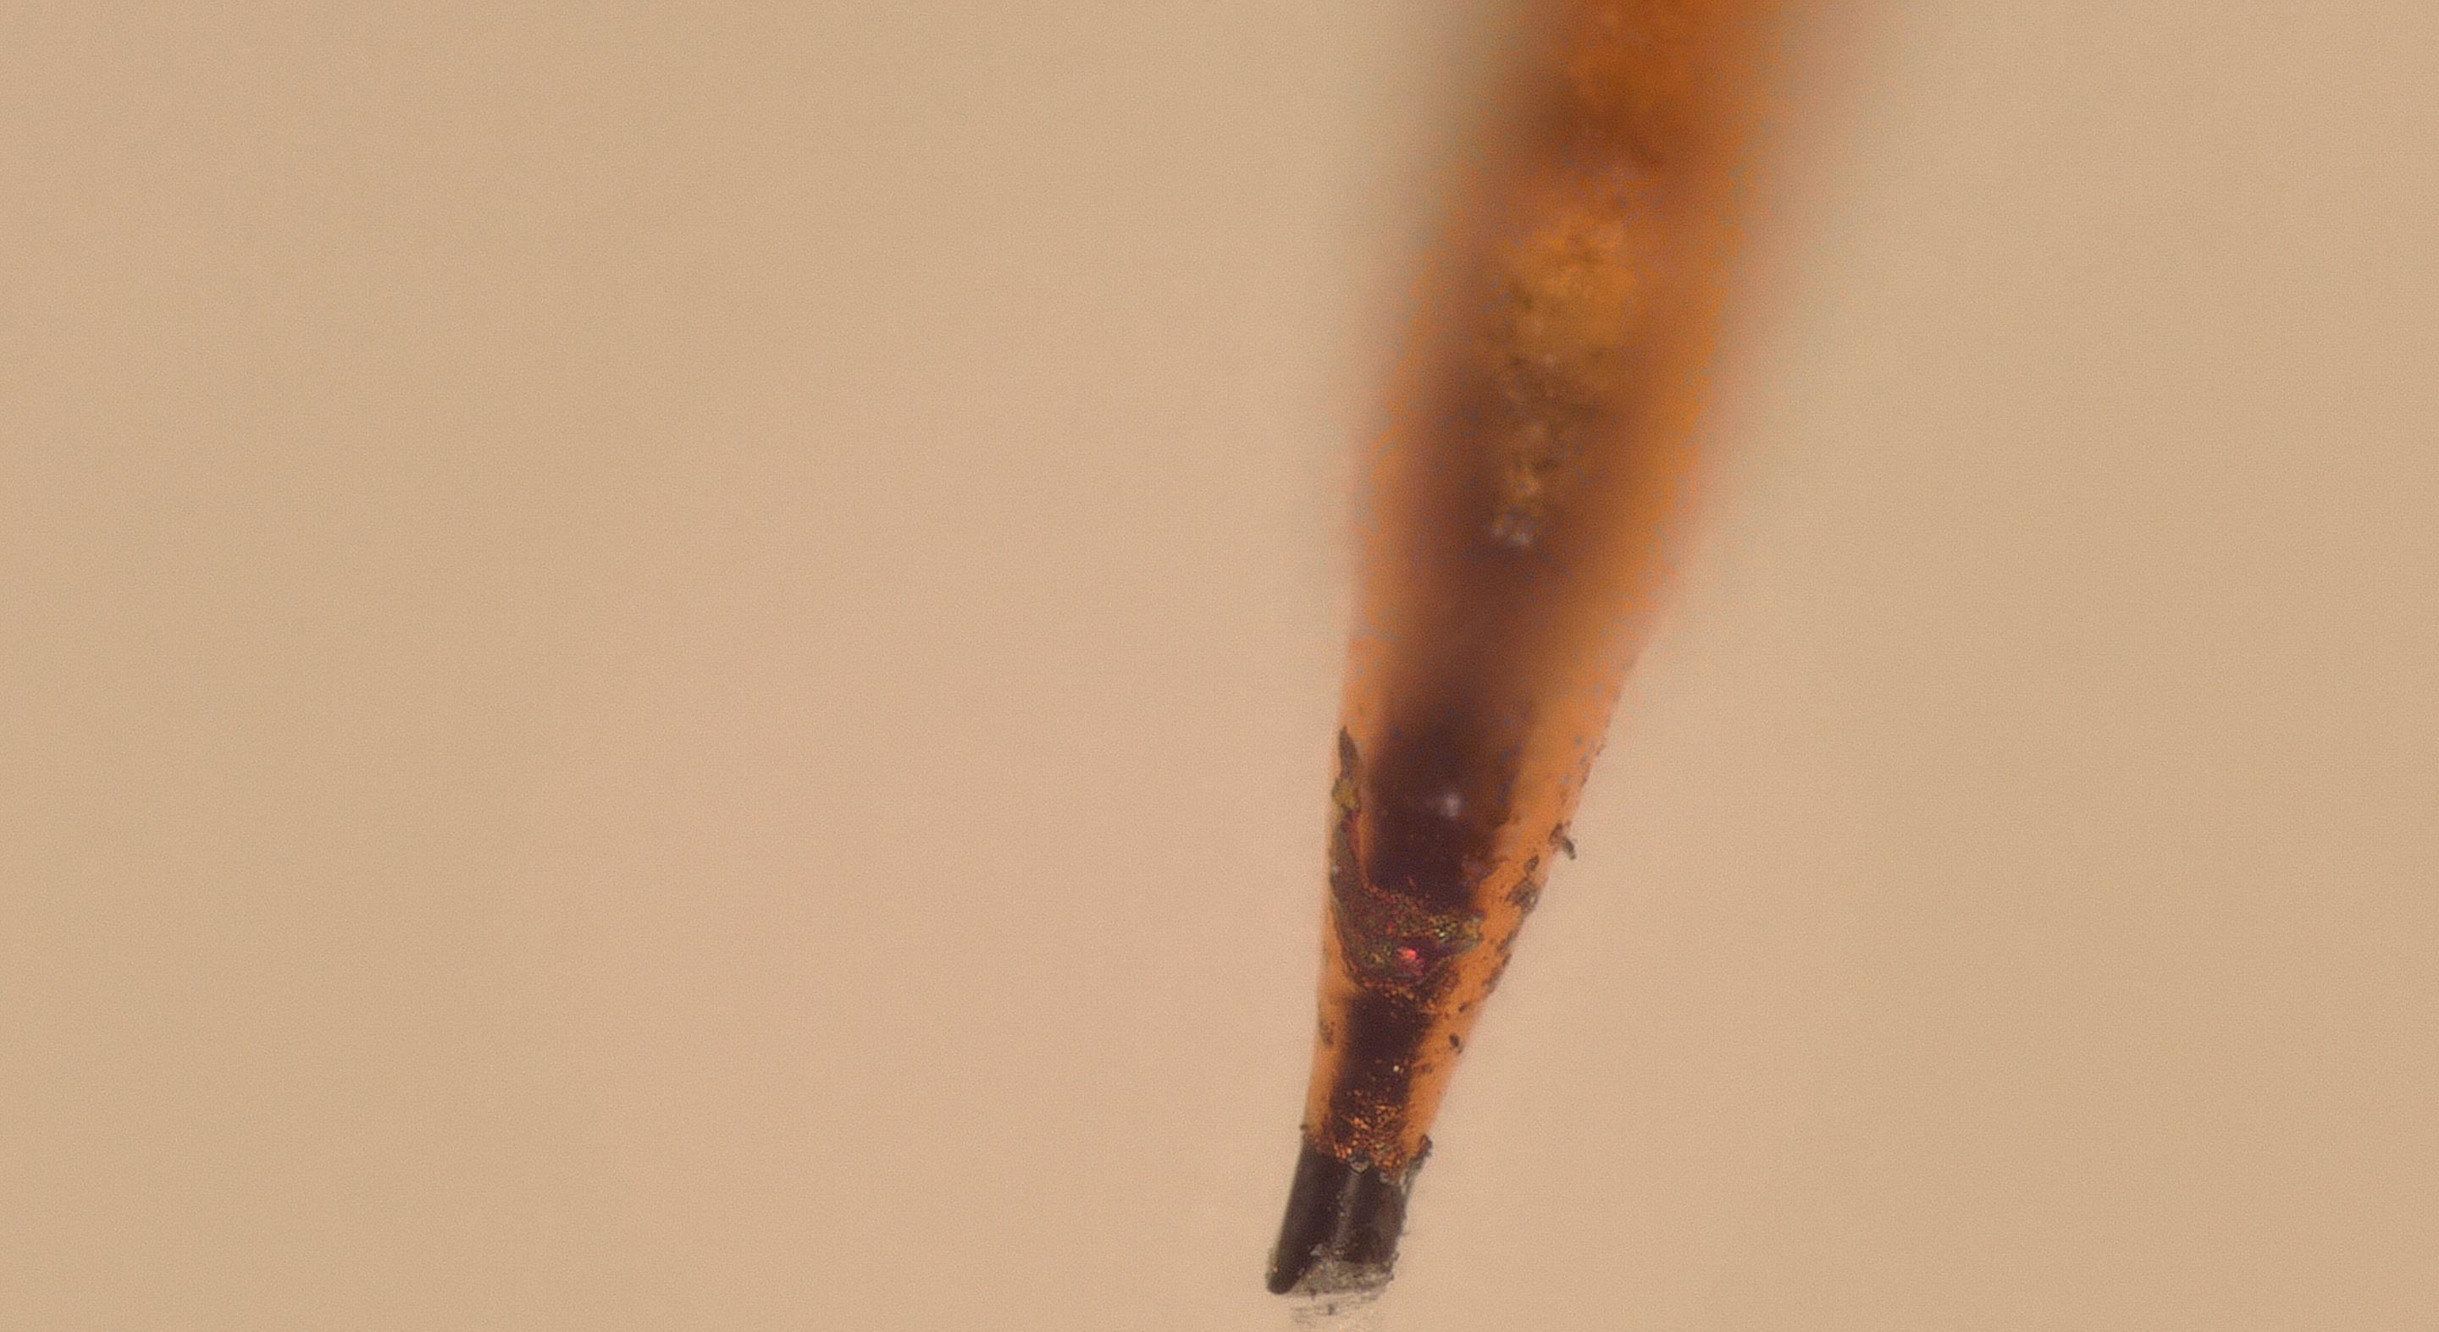
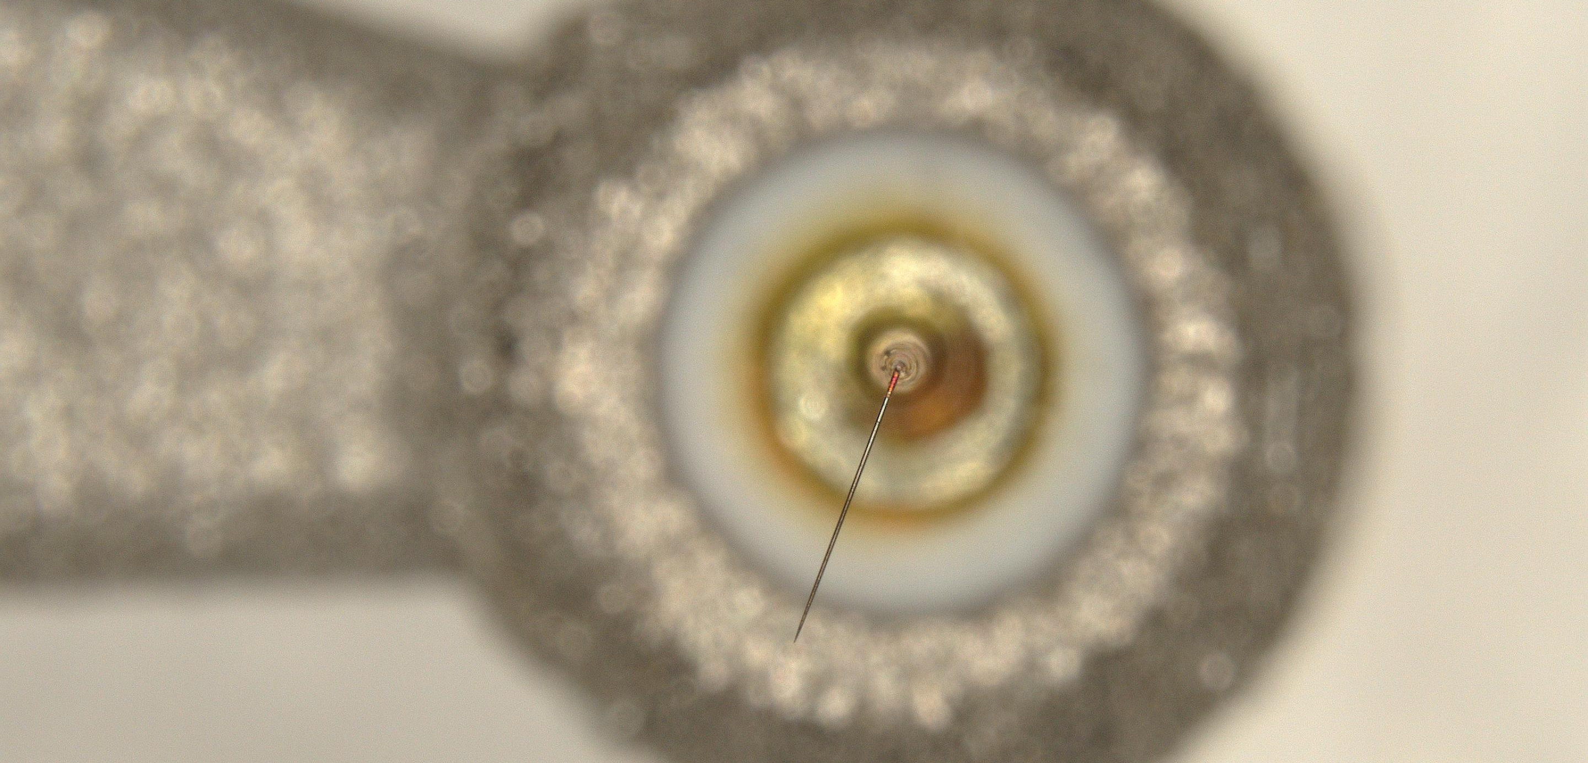
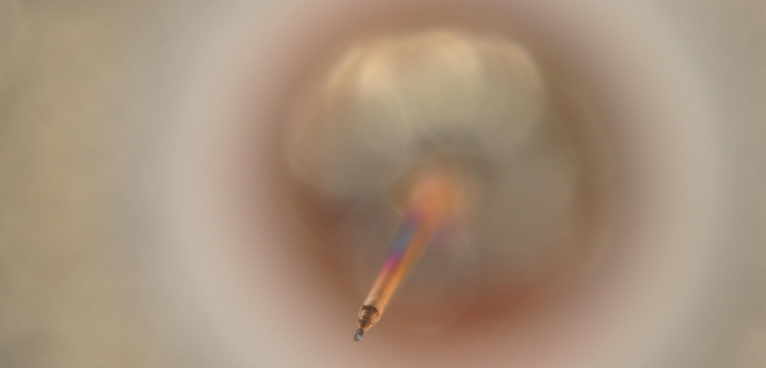

Slide 5
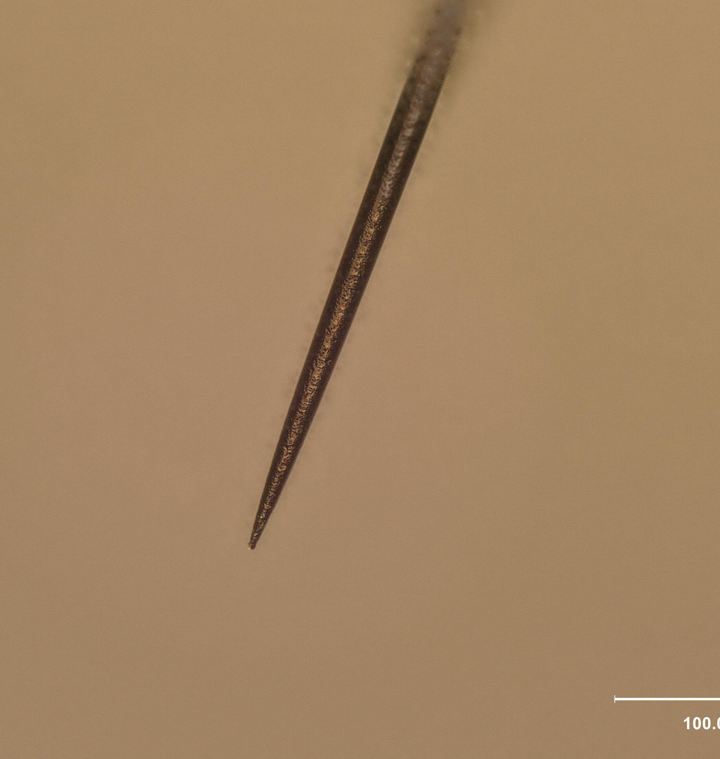
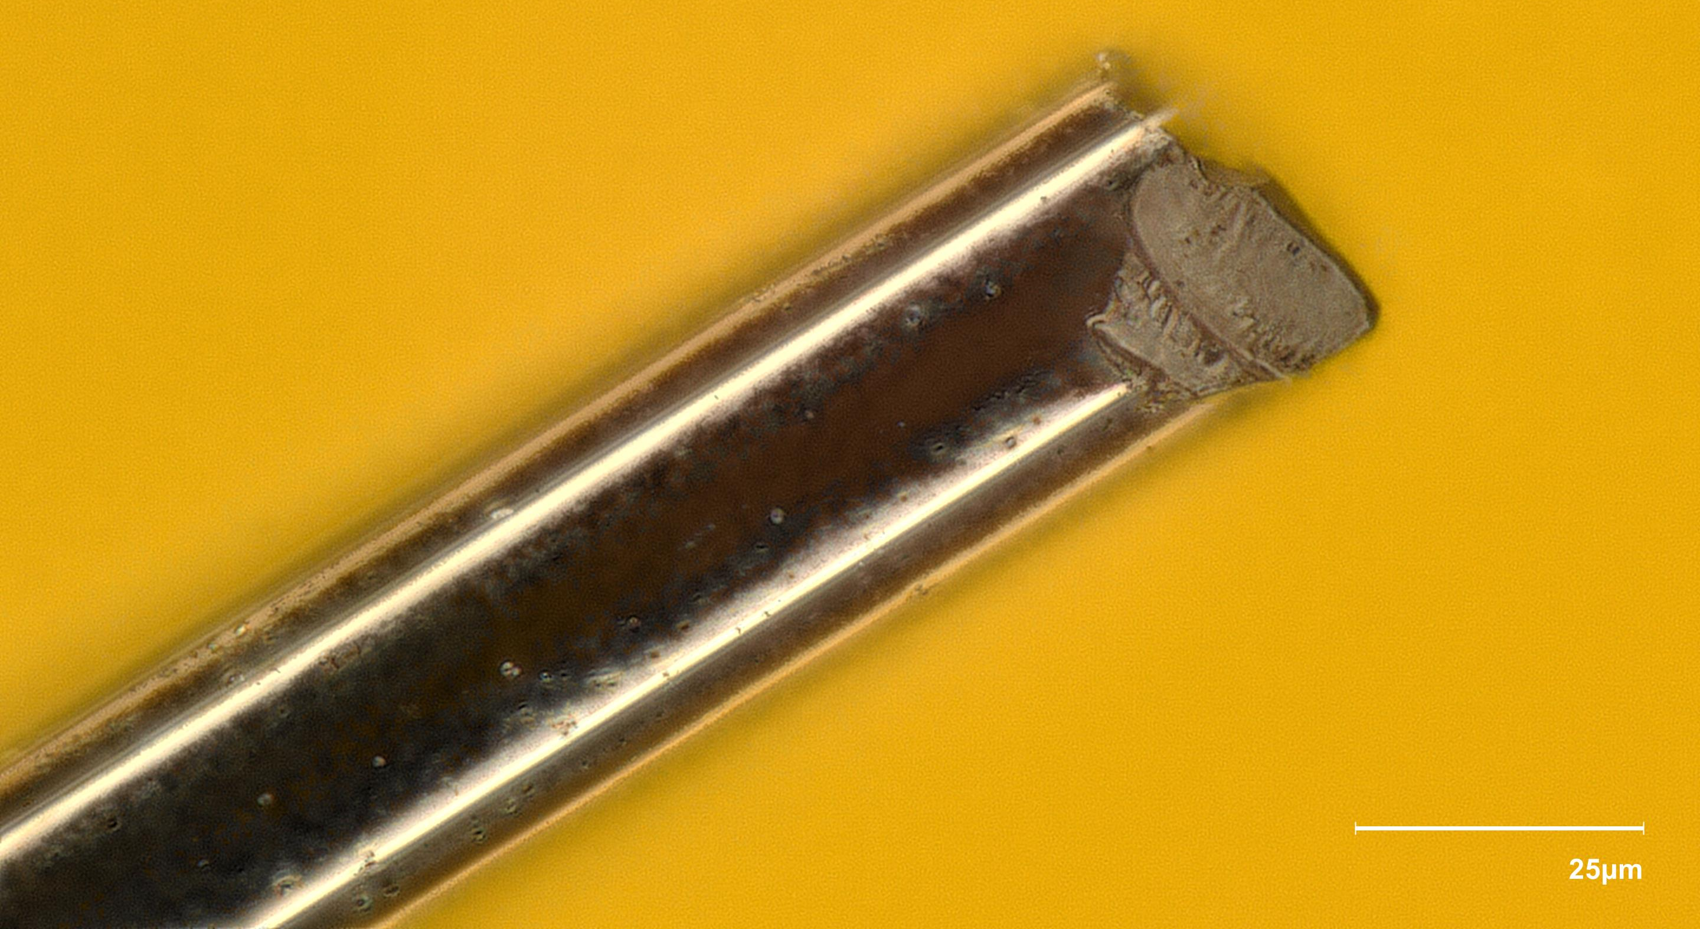
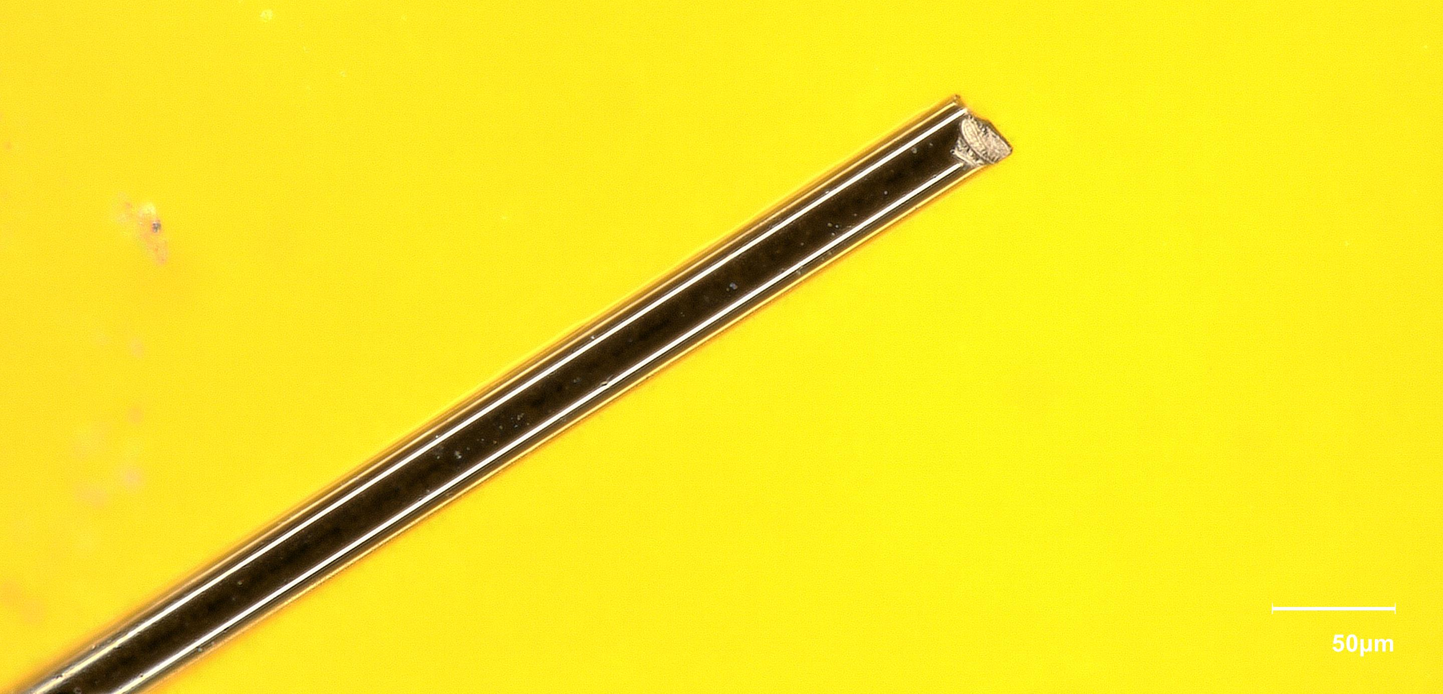

Slide 6
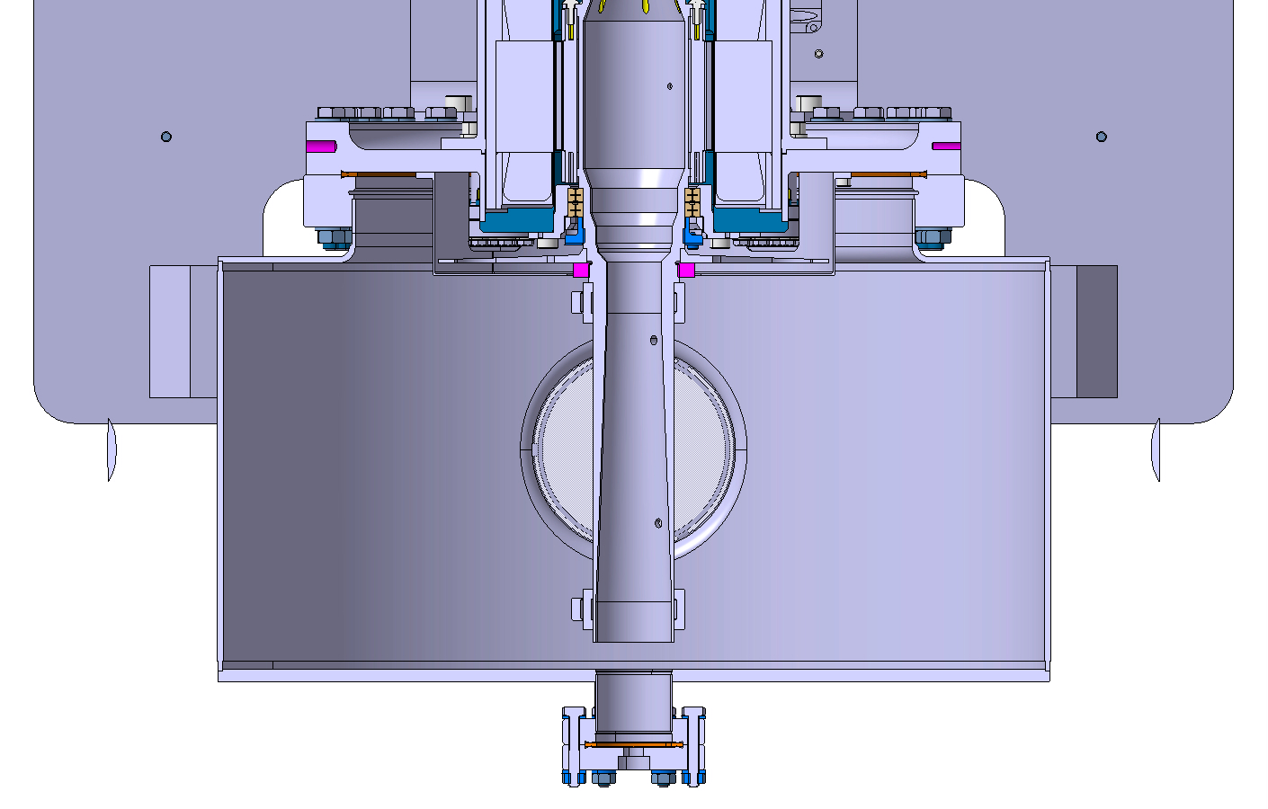
First solution to be tested with measurements in 867
Option 1: electrical feedthrough plug with RF contact

Slide 7
First solution to be tested with measurements in 867
Option 2:rotating plug with rotating RF contact

