Slide 1
CERN & the Environment, GRI & SDGs
Anna Cook
Sustainable accelerators panel, 25 May 2023
EDMS

Slide 2

Context
CERN’s strategy with respect to the environment and sustainability is based on three lines of action:
Reduce the laboratory’s impact on the environment
Reduce energy consumption and increase energy re-use,
Develop technologies that can help society to preserve the planet.
Minimise the impact of the laboratory's activities on the environment with defined priority actions
Focus on energy:
consume less, improve efficiency, and recover more
Identifying and developing CERN technologies that would help mitigate society's impact on the environment

Slide 3


Context
CERN as a role model for environmentally responsible research.
CERN actively monitors and reports on its environmental footprint:
  to Host States and relevant authorities
  on diverse subjects (RP, Water etc.)
Public-facing environment reports since 2020 :
  1st public environment report 2017-2018:
  established reporting frameworks and set concrete goals.
  2nd report 2019-2020: turning words into action.
  3rd report 2021-2022: to be published end 2023.
Continued high quality reporting on established priorities according to GRI Global Reporting standards
  NB: GRI covers three areas of sustainability: environmental, social and economic (governance).
  The CERN reports currently and deliberately focus on environmental aspects only.
https://hse.cern/environment-report

Slide 4

CERN & the environment
Environmental policy integrated in CERN’s Safety policy
Guiding managerial bodies:
  SAPOCO: Safety Policy Committee
  CEPS: CERN Environmental Protection Steering Board
  EMP: Energy Management Panel
  EN-EMP: Enlarged EMP
Tripartite Agreements with Host-States:
  CTE: tripartite committee on the environment
Aligning with the UN-Sustainable Development Goals.
CERN Environmental Protection strategy, leading to environmental objectives.
Regular Environmental reporting decided by the CERN Directorate in 2019.
2016
https://international-relations.web.cern.ch/stakeholder-relations/international-organizations

Slide 5

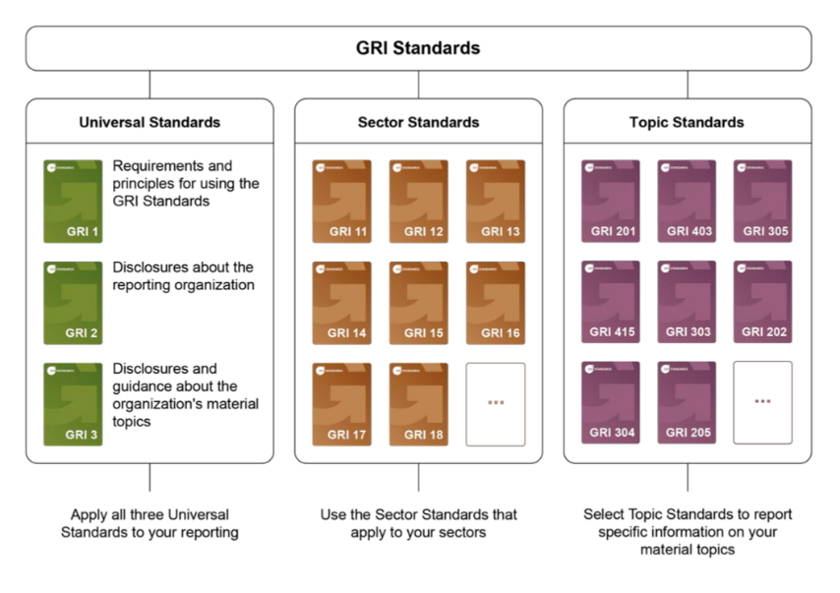
Global Reporting Initiative (GRI)
Methodology used worldwide:
        73% of the world’s top 250 companies refer to GRI as part of their sustainability reporting
        168 public policies in 67 countries and regions refer to GRI standards
        Nearly 450 organizations from 68 countries are active in the GRI community
The GRI provides:
A methodology to conduct a «materiality assessment»
with stakeholders that determines the topics of priority
for the reports
Guidelines for reporting
The GRI builds reputation and trust.

Slide 6

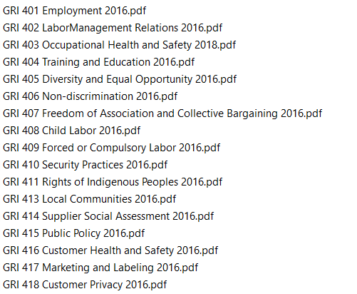

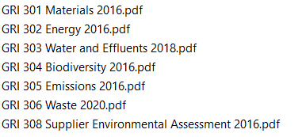
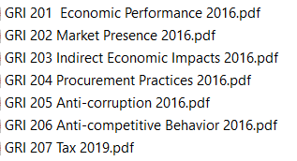
GRI disclosures
Universal GRI
S
GRI-4
NB: List of exhaustive topics
Relevance/inclusion/prioritisation is determined via the materiality assessment exercise
G
GRI-3
E
GRI-2
Future report
Future report
25/05/2023
6

Slide 7
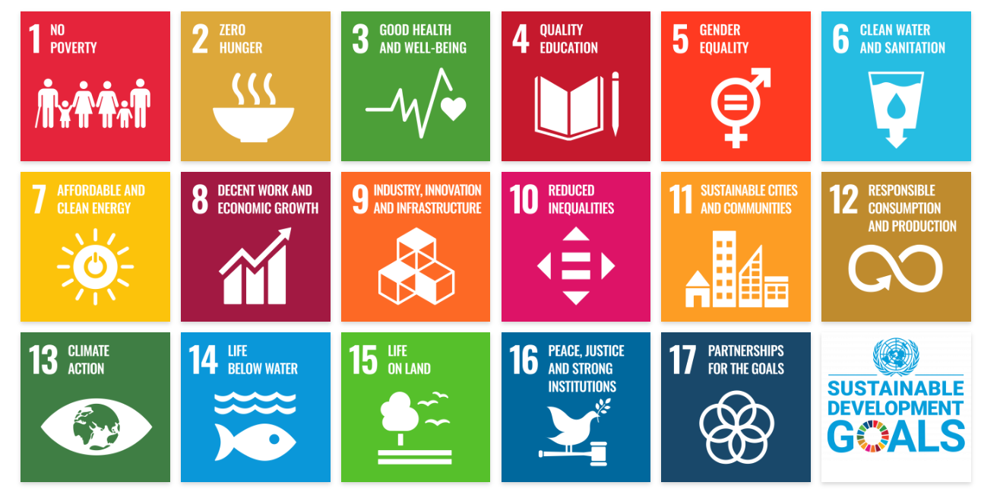
The UN SDGs
Endorsed by all 193 United Nations Member States in 2015, the 2030 Agenda and its Sustainable Development Goals focus global efforts and attention on 17 pressing issues.

Slide 8

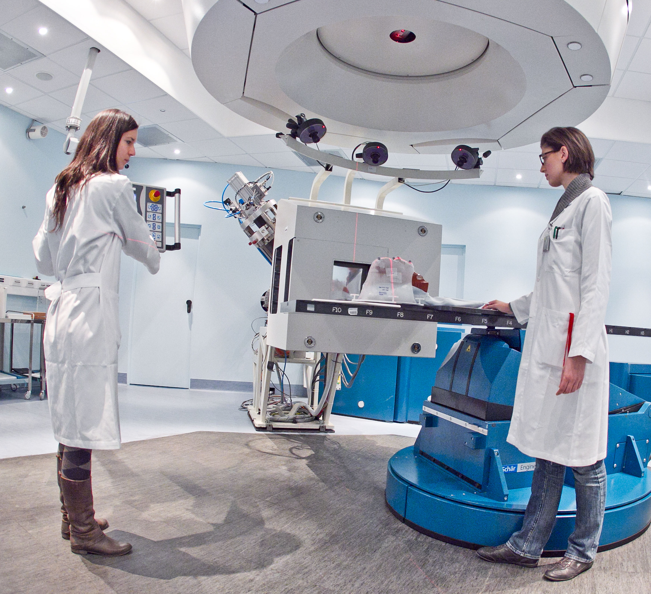
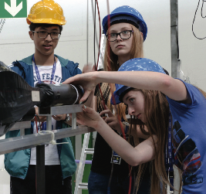
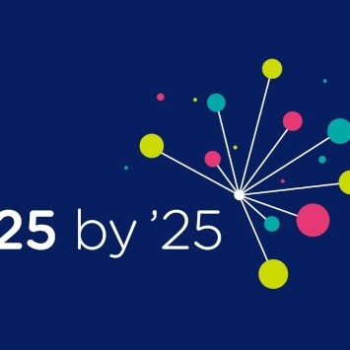
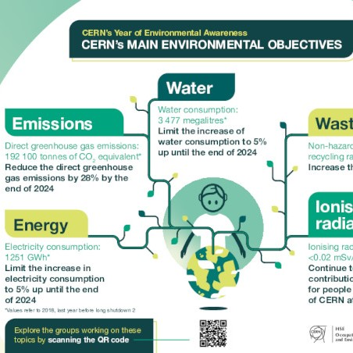
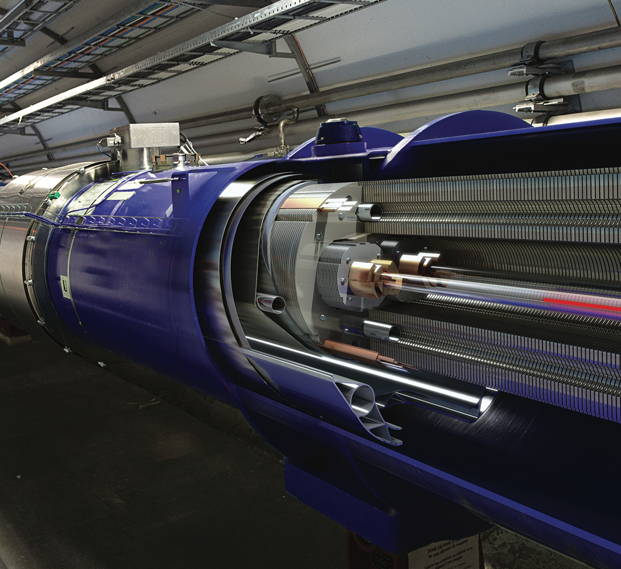
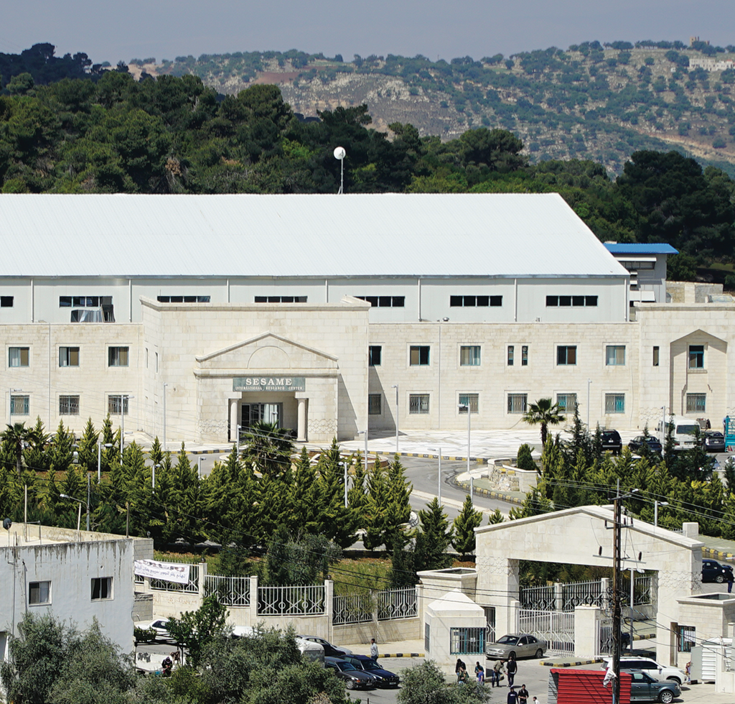
CERN and the SDGs
SDG 3 - HEALTH
CERN helps to develop technologies that contribute to better healthcare for all, such as medical imaging and hadron therapy.
SDG 4 - EDUCATION
Education is one of CERN’s core missions. We offer high quality programmes that inspire thousands of students, teachers and young researchers each year.
SDG 5 - GENDER
Diversity is a core value for CERN. Our diversity policy aims at leveraging the added value that comes from bringing together people of different nationalities, genders, professions and ages.
SDG 7 - ENERGY
CERN develops strategies for minimise the increase of energy consumed by the installations, increase energy efficiency and implement energy recovery.
SDG 9 - INNOVATION
CERN inventions are brought to industry through knowledge transfer, to have a positive impact on society and innovation.
SDG 16 & 17 - INTERNATIONAL COOPERATION
CERN is a successful model for international collaboration. CERN gathers researchers from all over the world, contributing to human knowledge and peace, for the benefit of all.
THERAPY
Accelerators provide particle beams for more targeted cancer treatment.
BEAMLINE FOR SCHOOLS
COMPETITION
Students from the two winning teams spend a week at CERN to carry out their experiment using a CERN accelerator.
25 BY 25 DIVERSITY & INCLUSION INITIATIVE
First ever targets-based strategy to boost the nationality and gender diversity within the Staff and Fellows population.
.
HEATING LOCAL HOUSING
Heat recovered from CERN's accelerator cooling systems to heat a new residential area in the town of Ferney-Voltaire, benefiting up to 8000 people.
A MAGNET IN THE LHC TUNNEL
Exploring the universe requires new technologies and ingenious engineering to build the machines that explore physics at a new frontier.
SESAME
This new synchrotron light source in Jordan started operation in 2017. It is a unique collaboration between eight Middle East members, modelled on CERN’s governance structure.
Notes:
Just by carrying out our core mission, CERN contributes globally to five of the 17 SDGs.
Goal three aims to ensure health and well-being (medical scanners and accelerators for hadron therapy.)
Goal four is about universal access to education, a mission very close to our hearts at CERN (educational programmes for students and educators from around the world, and inspire new generations to take up careers in STEM subjects through our guided visits.)
Goal nine promotes innovation, which we cover with our knowledge transfer activities and the growing number of business incubation centres, the CERN BICs, in our Member States.
Goal 16 seeks to promote peaceful and inclusive societies, which is not only in our DNA at CERN, but also in our governing convention.
Goal 17 aims to strengthen the means of implementation of the preceding 16 goals by revitalising the global partnership for sustainable development. Here, we could be a template: CERN is a model for global cooperation in science, which continues to inspire and provide practical guidance in different areas of science and in other regions.
The SDGs can also be seen as a positive driver to set internal goals in the everyday life of countries or international organisations.
For example: clear targets on gender (goal five), water management (goal six), sustainable energy (goal seven) or land protection (goal 15).
https://home.cern/news/opinion/cern/cern-fully-engaged-sustainable-development-goals

Slide 9
Environment report and SDGs
Second environment report:
  “At CERN, we aspire to contribute to the achievement of some of the environment-related UN Sustainable Development Goals (SDGs) by improving our performance and forging partnerships with others.”
  “Active contribution are Affordable and Clean Energy (SDG 7) and Industry, Innovation and Infrastructure (SDG 9)”
Several chapters, in meeting given GRI disclosures, map to associated SDGs
Diverse tools available to help companies link the two

Slide 10
Mapping SDGs and GRI disclosures
SDG number | SDG name | Target number | Target explanation | GRI-disclosures CERN has reported on
3 | Good health and well-being | 3.9 | By 2030, substantially reduce the number of deaths and illnesses from hazardous chemicals and air, water and soil pollution and contamination. | 305-1; 305-2; 305-3; 306-1; 306-2; 306-3; 306-4; 306-5
5 | Gender Equality | 5.5 | Ensure women’s full and effective participation and equal opportunities for leadership at all levels of decision-making in political, economic and public life | 2-9; 2-10
6 | Clean water and sanitation | 6.3 | By 2030, improve water quality by reducing pollution, eliminating dumping and minimizing release of hazardous chemicals and materials, halving the proportion of untreated wastewater and substantially increasing recycling and safe reuse globally | 303-1-a; 303-1-c; 303-2-a; 303-4; 306-1; 306-2-a; 306-2-b; 306-2-c
6 | Clean water and sanitation | 6.4 | By 2030, substantially increase water-use efficiency across all sectors and ensure sustainable withdrawals and supply of freshwater to address water scarcity and substantially reduce the number of people suffering from water scarcity | 303-1-a; 303-1-c; 303-3-c; 303-5-a; 303-5-b
6 | Clean water and sanitation | 6.6 | By 2030, protect and restore water-related ecosystems, including mountains, forests, wetlands, rivers, aquifers and lakes | 304-4-a;
6 | Clean water and sanitation | 6.A | By 2030, expand international cooperation and capacity-building support to developing countries in water- and sanitation-related activities and programmes, including water harvesting, desalination, water efficiency, wastewater treatment, recycling and reuse technologies | 303-1-a; 303-1-c
6 | Clean water and sanitation | 6.B | Support and strengthen the participation of local communities in improving water and sanitation management | 303-1-a; 303-1-c

Slide 11
Mapping SDGs and GRI disclosures
SDG number | SDG name | Target number | Target explanation | GRI-disclosures CERN has reported on
7 | Affordable and clean energy | 7.2 | By 2030, increase substantially the share of renewable energy in the global energy mix | 302-1; 302-2
7 | Affordable and clean energy | 7.3 | By 2030, double the global rate of improvement in energy efficiency | 302-1; 302-2-a; 302-3-a
8 | Decent work and economic growth | 8.4 | Improve progressively, through 2030, global resource efficiency in consumption and production and endeavour to decouple economic growth from environmental degradation, in accordance with the 10-year framework of programmes on sustainable consumption and production, with developed countries taking the lead | 302-1; 302-2-a; 302-3-a; 306-2-a
8 | Decent work and economic growth | 8.5 | By 2030, achieve full and productive employment and decent work for all women and men, including for young people and persons with disabilities, and equal pay for work of equal value | 2-7; 2-8
8 | Decent work and economic growth | 8.8 | Protect labour rights and promote safe and secure working environments for all workers, including migrant workers, in particular women migrants, and those in precarious employment | 2-30;
10 | Reduced inequalities | 10.3 | Ensure equal opportunity and reduce inequalities of outcome, including by eliminating discriminatory laws, policies and practices and promoting appropriate legislation, policies and action in this regard | 2-7; 2-8
11 | Sustainable cities and communities | 11.6 | By 2030, reduce the adverse per capita environmental impact of cities, including by paying special attention to air quality and municipal and other waste management | 306-1; 306-2-a; 306-2-b; 306-2-c; 306-3-a; 306-4-a; 306-4-b; 306-4-c; 306-4-d; 306-5-a; 306-5-b; 306-5-c; 306-5-d
12 | Responsible consumption and production | 12.2 | By 2030, achieve the sustainable management and efficient use of natural resources | 302-1; 302-2-a; 302-3-a
12 | Responsible consumption and production | 12.4 | By 2020, achieve the environmentally sound management of chemicals and all wastes throughout their life cycle, in accordance with agreed international frameworks, and significantly reduce their release to air, water and soil in order to minimize their adverse impacts on human health and the environment | 303-1-a; 303-1-c; 305-1; 305-2; 305-3; 306-1; 306-2-a; 306-2-b; 306-2-c; 306-3-a; 306-4-a; 306-4-b; 306-4-c; 306-4-d; 306-5-a; 306-5-b; 306-5-c; 306-5-d
12 | Responsible consumption and production | 12.5 | By 2030, substantially reduce waste generation through prevention, reduction, recycling and reuse

Slide 12
Mapping SDGs and GRI disclosures
SDG number | SDG name | Target number | Target explanation | GRI-disclosures CERN has reported on
13 | Climate action | 13.1 | Strengthen resilience and adaptive capacity to climate-related hazards and natural disasters in all countries | 302-1; 302-2-a; 302-3-a; 305-1; 305-2; 305-3
14 | Life below water | 14.2 | By 2020, sustainably manage and protect marine and coastal ecosystems to avoid significant adverse impacts, including by strengthening their resilience, and take action for their restoration in order to achieve healthy and productive oceans | 304-4-a;
14 | Life below water | 14.3 | Minimize and address the impacts of ocean acidification, including through enhanced scientific cooperation at all levels | 305-1; 305-2; 305-3
15 | Life on land | 15.1 | By 2020, ensure the conservation, restoration and sustainable use of terrestrial and inland freshwater ecosystems and their services, in particular forests, wetlands, mountains and drylands, in line with obligations under international agreements | 304-4-a;
15 | Life on land | 15.2 | By 2020, promote the implementation of sustainable management of all types of forests, halt deforestation, restore degraded forests and substantially increase afforestation and reforestation globally | 305-1; 305-2; 305-3
15 | Life on land | 15.5 | Take urgent and significant action to reduce the degradation of natural habitats, halt the loss of biodiversity and, by 2020, protect and prevent the extinction of threatened species | 304-4-a;
16 | Peace, justice and strong institutions | 16.3 | Promote the rule of law at the national and international levels and ensure equal access to justice for all | 2-23-a; 2-23-b; 2-26; 2-27; 307-1-a
16 | Peace, justice and strong institutions | 16.6 | Develop effective, accountable and transparent institutions at all levels | 2-11; 2-15; 2-20
16 | Peace, justice and strong institutions | 16.7 | Ensure responsive, inclusive, participatory and representative decision-making at all levels | 2-9; 2-10; 2-11-b; 2-12: 2-13;

Slide 13
15/17 UN SDGs covered through our mission

