Slide 1
History of r134a cross-sections
S. F. Biagi Rd51 eco gas meeting May 2023

Slide 2
The original r134 a cross-section set was created in 2001 and due to lack of experimental data only a rough estimate was made using scaled C2F6 cross-sections. The data of Basile et al 1991 on the drift velocity and townsend coefficients were available but did not measure mixture data with Argon.
This 2001 cross-section set was created due to demand from the RPC community to have some idea on the processes involved in RPC detectors. The data set was used by Veenhof , Riegler and Lippmann in some published papers in the early 2000s to show that the detectors gain was reduced by the space charge of the ions produced in the avalanche.
The simulation could not be improved until some numerical transport data was published in 2009 for the mixture of r134a in Argon and also in the pure gas:
Urquijo et al Eur.Phys.J .D. 51 2009 241.
The data on the pure gas was consistent with Basile et al which gave some confidence in the accuracy of the measurements.
In 2010 two analyses were completed :
Sasic et al which fitted the data to about +- 10% for both the drift velocity and the Townsend coefficient. The Sasic analysis used the Magboltz 2001 cross-sections and adjusted them to fit the data. However the adjusted cross-sections are not physically reasonable.
The r134a cross-section in magboltz was also updated in 2010 and still remains the most accurate cross-section set. The fit to the drift velocity data was typically +-3% and the fit to the Townsend gain and attachment coefficients +10 /-5 %.

Slide 3
Note the following papers by the same group
1) Sasic et al J Phys D 46 2013 32501
Bosnjakovic et al J.I.N.S.T 9 2014 p09012
Bosnjakovic et al J.Phys D 47 2014 435203
They continued to use the badly copied version of r134a from Magboltz 2002
in their publications in 2013 and 2014 when the correct 2010 update had been available for 4 years.
This poor situation was further compounded by a statement in their J.Phys D 2014 paper which implied Magboltz was incorrect. The statement is shown to be incorrect in the following tables in which the flux and bulk velocities calculated by Magboltz are displayed.
These papers caused considerable uncertainty in the detector modelling community
at the time and the papers should be ignored .
See next page.
The analysis of experiments in terms of bulk or flux drift velocities will be discussed
in the workshop and shown to be equivalent. However bulk (TOF) drift velocities tend to be less accurately measured in experiments than flux (mean arrival time) drift velocities in contradiction to the statement in the J.Phys.D paper.

Slide 4
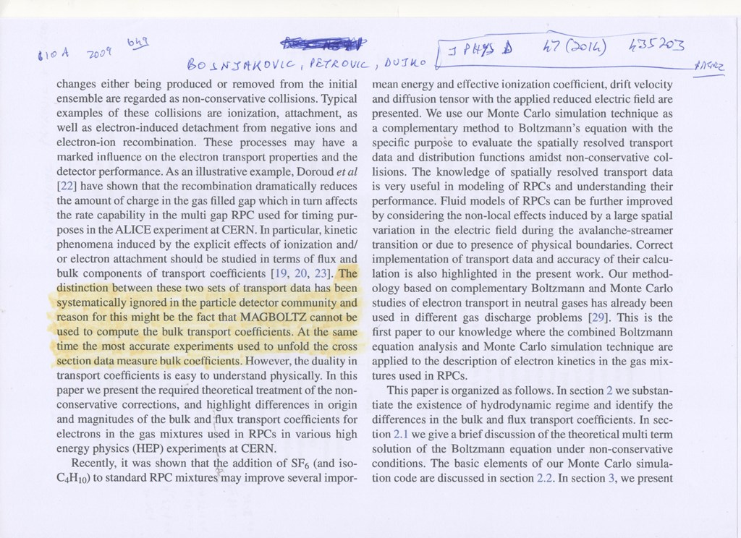
Highlighted text in yellow is incorrect.

Slide 5
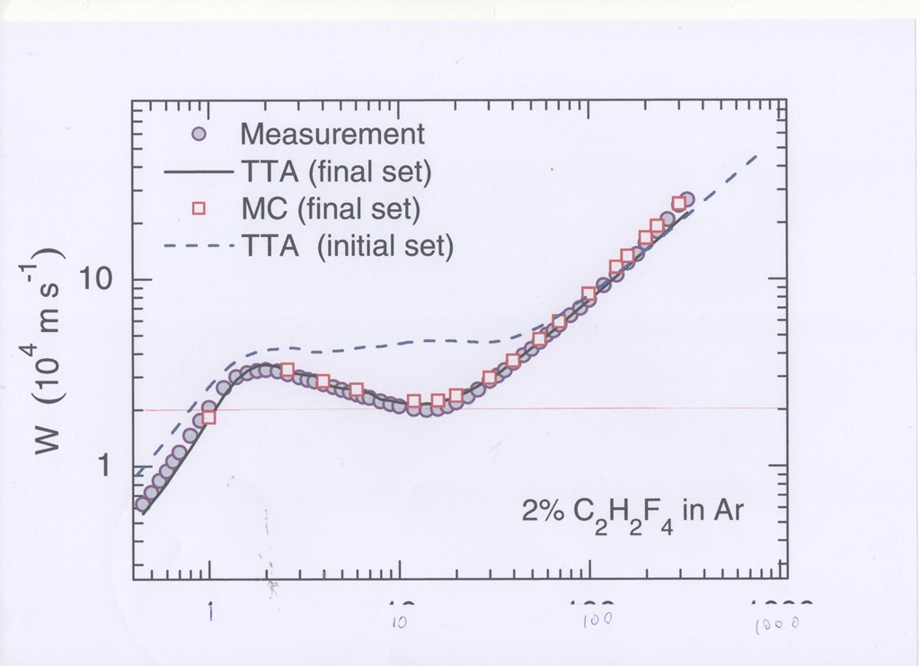
Sasic et al Note data point size is about +-10%
2010 magboltz cross-section fits to about 1% at minimum

Slide 6
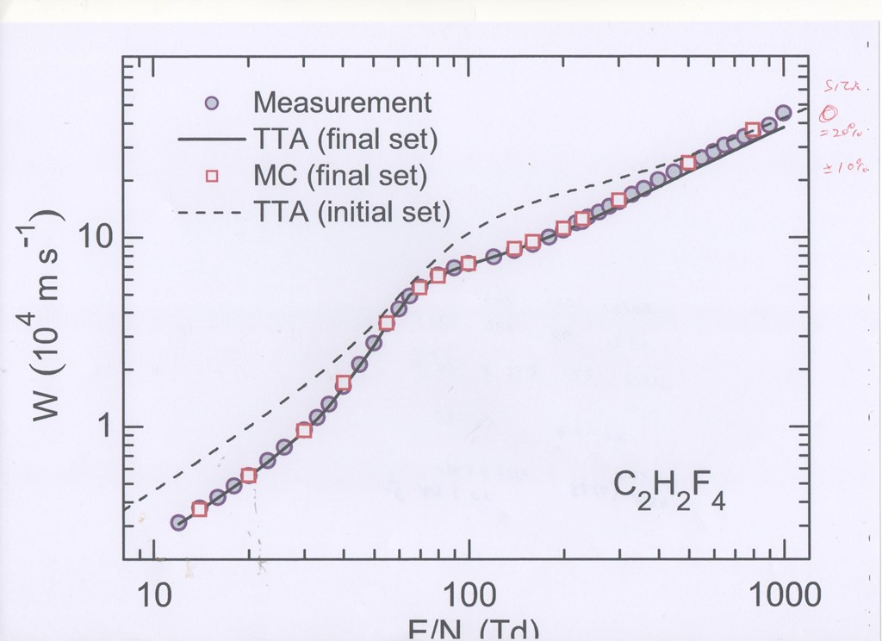
Blue circles original 2002 cross-section calculation

Slide 7
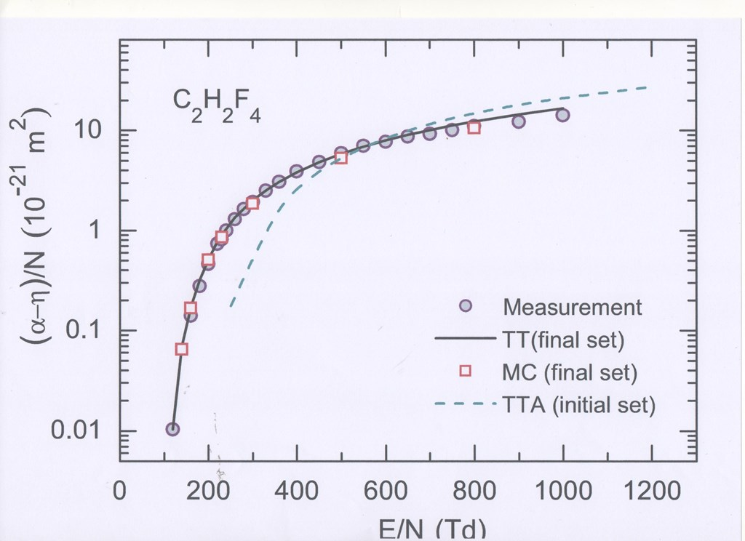
Original 2002 cross-section set

Slide 8
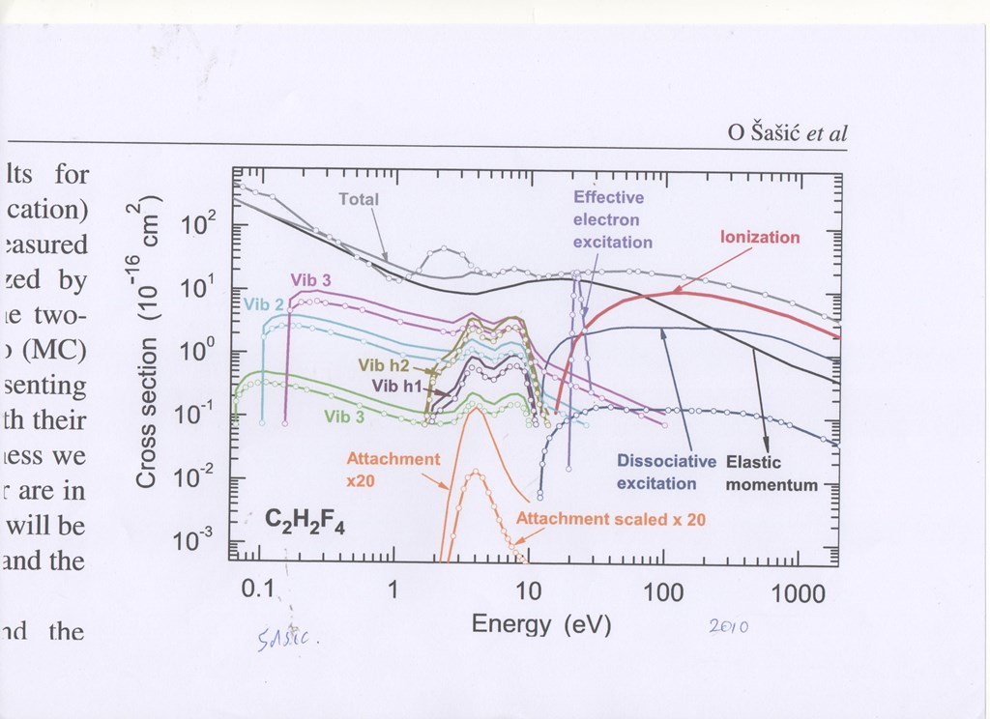
Plasma.Sources.Science and Tech 19(2010) 034003
Excitation cross-section would give W ev/ion pair =15 ev unphysical triplet
unphysical elastic scattering

Slide 9
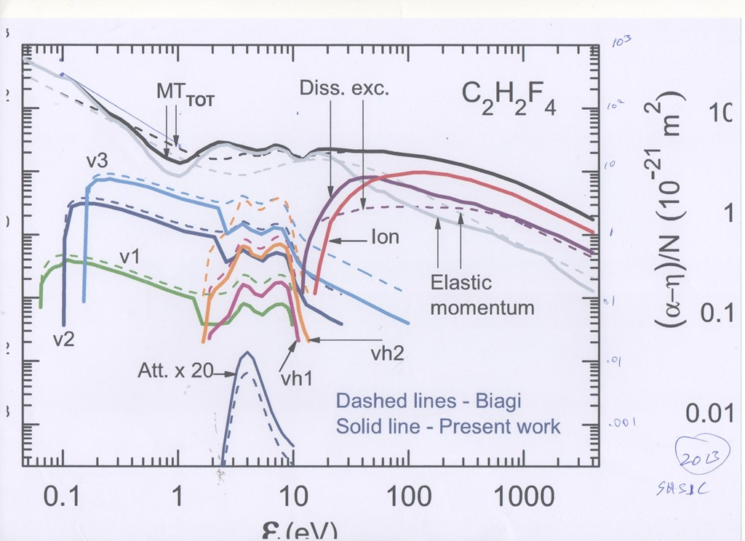
Updated sasic now introduces unphysical vibrations …

Slide 10
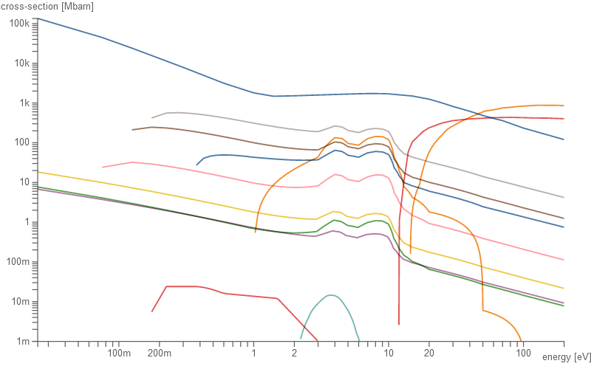
R134a 2010 Still the most accurate cross-section set in 2023
note C-H stretch at 0.37 ev which is missing in Sasic et al

Slide 12
Calculation of r134a transport using 2010 cross-section set
Experimental data from Urquijo
Efield Td | V ( Flux) | V (bulk) |  | Vd Exp | ( calc-Exp)/Exp % |  | (Alpha-Neta) cm**-1 calc | (Alpha-Neta) exp
1 | 0.215
4 | 0.875
10 | 2.38
12 | 2.95 |  |  | 3.12 | -5.9
14 | 3.54 |  |  | 3.72 | -5.1 |  | -1.3
16 | 4.17 |  |  | 4.23 | -1.5 |  | -1.3
18 | 4.83 |  |  | 4.87 | -0.8 |  | -1.3
20 | 5.53 |  |  | 5.52 | 0.2 |  | -1.4
23 | 6.66 |  |  | 6.61 | 0.8 |  | -1.3
26 | 7.92 |  |  | 7.77 | 1.9 |  | -1.6
30 | 9.82 |  |  | 9.61 | 2.2 |  | -1.5
33 | 11.45 |  |  | 11.2 | 2.2 |  | -1.6
36 | 13.36 |  |  | 13.1 | 2 |  | -1.7
40 | 16.42 |  |  | 16.2 | 1.4 |  | -2
45 | 21.19 |  |  | 21.2 | 0 |  | -2
50 | 27.14 |  |  | 27.5 | -1.3 |  | -2.2
55 | 34.02 |  |  | 34.8 | -2.2 |  | -2.4
60 | 41.29 |  |  | 41.8 | -1.2 |  | -2.4
65 | 48.13 |  |  | 48.8 | -1.4 |  | -2.3
70 | 54.25 |  |  | 54.7 | -0.8 |  | -2.4
80 | 63.63 |  |  | 63.2 | 0.7 |  | -2.4
90 | 69.89 |  |  | 68.7 | 1.7 |  | -2.4
100 | 74.31 |  |  | 72.7 | 2.2 |  | -1.7
120 | 80.81 |  |  | 78.8 | 2.6 |  | 2.9 | 2.6
140 | 86.85 |  |  | 84.9 | 2.2 |  | 16 | 12
160 | 94.6 | 94.9 |  | 91.8 | 3.1 |  | 40 | 35

Slide 13
Continuation from previous slide
180 | 102.6 | 103.1 |  | 100 | 2.6 |  | 74 | 69
200 | 110.9 | 112.1 |  | 109 | 1.7 |  | 119 | 115
220 | 119.5 | 121.4 |  | 119 | 0 |  | 172 | 184
240 | 128.3 | 131.5 |  | 128 | 0 |  | 232 | 250
260 | 137 | 141.5 |  | 136 | 0.7 |  | 299 | 325
280 | 146.4 | 151.6 |  | 146 | 0 |  | 372 | 410
300 | 154.8 | 162.3 |  | 154 | 0 |  | 448 | 482
330 | 168.8 | 178.2 |  | 168 | 0.5 |  | 571 | 625
360 | 182.2 | 194.5 |  | 181 | 0.7 |  | 700 | 772
400 | 200.7 | 216.3 |  | 201 | 0 |  | 882 | 980
450 | 222 | 243.9 |  | 221 | 0.5 |  | 1122 | 1215
500 | 242.5 | 271.4 |  | 244 | -0.6 |  | 1368 | 1488
550 | 265.2 | 298.8 |  | 263 | 0.8 |  | 1625 | 1762
600 | 286.1 | 326.6 |  | 282 | 1.4 |  | 1880 | 1935
650 | 307.9 | 354.1 |  | 306 | 0.6 |  | 2145 | 2177
700 | 327.3 | 381.1 |  | 315 | 3.9 |  | 2408 | 2313
750 | 346.4 | 407.9 |  | 339 | 2.2 |  | 2675 | 2525
800 | 366 | 434.5 |  | 357 | 2.5 |  | 2940 | 2775
900 | 402.2 | 486.4 |  | 390 | 3.1 |  | 3462 | 3050
1000 | 438.4 | 536.9 |  | 451 | -2.9 |  | 3995 | 3550

Slide 14
Calculated drift properties of rpc trigger gas mix using r134a 2010 cross-sections
KV/cm | Ws (flux) | Wr (bulk) | Alpha/cm | Neta/cm |  | Dt (Volts) | Dl (Volts)
30 | 81.1 | 80.5 | 7.9 | 50.7 |  | 2.2 | 1
40 | 93.3 | 93.5 | 53.8 | 19.5 |  | 3.1 | 1.7
48 | 105.2 | 106.6 | 125 | 12.2 |  | 3.5 | 2.4
50 | 109 | 110.2 | 147 | 11.1 |  | 3.6 | 2.5 |  |  | 94.7% c2h2f4
52 | 112 | 113.6 | 169 | 10.1 |  | 3.6 | 2.7 |  |  | 0.3% sf6
54 | 116 | 117.5 | 193 | 9.6 |  | 3.9 | 2.5 |  |  | 5.0% isobutane
60 | 125.5 | 129 | 273 | 7.7 |  | 3.9 | 2.9
70 | 142.5 | 148.5 | 425 | 5.6 |  | 4.3 | 3.5
80 | 160.5 | 169.5 | 593 | 4.5 |  | 4.7 | 3.8
90 | 177.5 | 190.5 | 776 | 3.8 |  | 4.7 | 4
KV/cm | Ws (flux) | Wr (bulk) | Alpha/cm | Neta/cm |  | Dt (Volts) | Dl (Volts)
30 | 81.1 | 80.5 | 7.9 | 50.7 |  | 2.2 | 1
40 | 93.3 | 93.5 | 53.8 | 19.5 |  | 3.1 | 1.7
48 | 105.2 | 106.6 | 125 | 12.2 |  | 3.5 | 2.4
50 | 109 | 110.2 | 147 | 11.1 |  | 3.6 | 2.5 |  |  | 94.7% c2h2f4
52 | 112 | 113.6 | 169 | 10.1 |  | 3.6 | 2.7 |  |  | 0.3% sf6
54 | 116 | 117.5 | 193 | 9.6 |  | 3.9 | 2.5 |  |  | 5.0% isobutane
60 | 125.5 | 129 | 273 | 7.7 |  | 3.9 | 2.9
70 | 142.5 | 148.5 | 425 | 5.6 |  | 4.3 | 3.5
80 | 160.5 | 169.5 | 593 | 4.5 |  | 4.7 | 3.8
90 | 177.5 | 190.5 | 776 | 3.8 |  | 4.7 | 4

Slide 15
Calculation of drift properties of rpc timing gas using r134a 2010 cross-sections
KV/cm | Ws (flux) | Wr(Bulk) | Alpha/cm | Neta/cm | Dt (Volts) | Dl (volts)
65 | 138.3 | 140.2 | 354 | 178 | 4.1 | 3.2
70 | 146.5 | 150.1 | 432 | 156 | 4.3 | 3.4 |  |  | 85% c2h2f4
80 | 162.5 | 171 | 604 | 126 | 4.5 | 3.6 |  |  | 10% sf6
90 | 180.1 | 191.5 | 787 | 105 | 4.8 | 4 |  |  | 5% isobutane
100 | 197.3 | 212.6 | 979 | 88 | 5.1 | 4.3
110 | 213.7 | 234.3 | 1180 | 77.1 | 5.3 | 4.6
120 | 231.8 | 255.8 | 1384 | 68 | 5.6 | 5

Slide 16
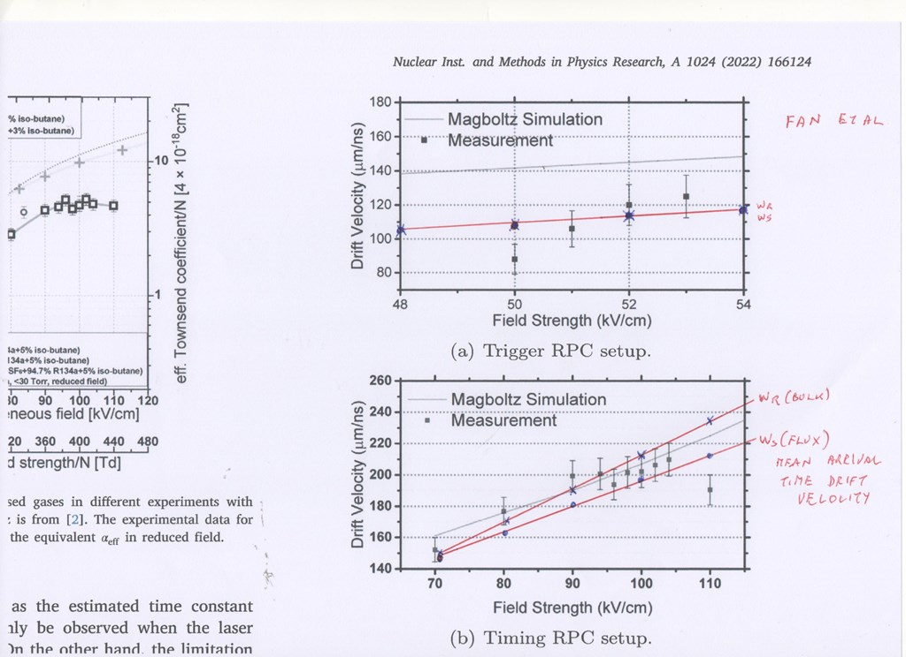

Slide 17
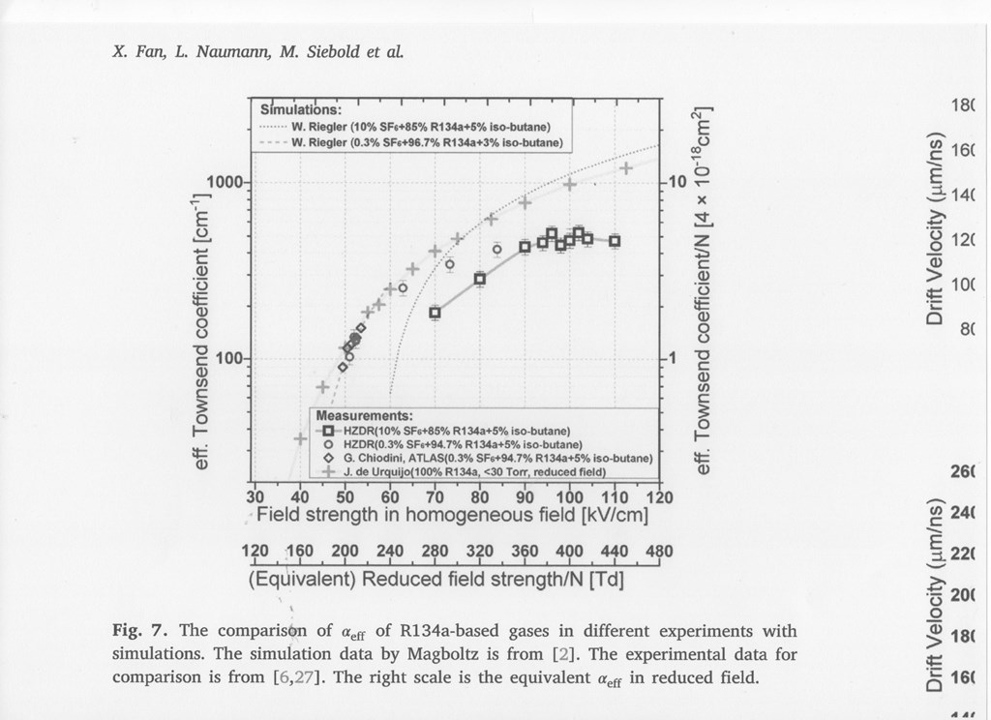

Slide 18
Future work:
New measurements will/are being made of the transport in pure r134a and also
Argon mixtures of between 0.5 and 5% by the ETHZ Zurich / CERN collaboration.
Note the accuracy of the mixing ratio is important and the mixing ratio of the minor component needs to be accurate to +-1% ..
I.E. For the 99/1 mix the accuracy of the minor component should be 1% +- 0.01 %
Note the Urquijo measurements do not quote the accuracy of the mixing ratio and the 99/1 mixture in the Urquijo paper is estimated to be in error by 50%.
The measurements will extend to electric fields below 10Td where there is no previous measurements in Urquijo et al and Basile et al.
The mixture data will also be extended to lower electric fields in the Argon mixtures.
The low electric field measurements are essential to extend the sensitivity to the rotational cross-section. The lack of rotational cross-section in the previous analysis prossibly explains the increased difference between the calculation and experiment at low electric field.
The measurements will also be extended to the highest possible electric fields in order to improve the calculation of the Townsend coefficients.
It should be possible with new data to improve the fit to +-2% on the drift velocity and
+-3% on the Townsend coefficients.

Slide 19
The cross-section analysis will be extended to a few MeV in order to allow the inclusion
of the cross-section set into the program Degrad. The further analysis using Degrad
will allow a more accurate description of the excitation cross-sections above the
Ionisation energy by the fitting of the calculated W (ev/ion pair) and second Fano
Factor to the measured value.
New measurements and analysis of HFO1234ze will then be completed by the
collaboration. The C3F8 2023 cross-section set will form a starting point for the
analysis of HFO combined with a copy of the C2H4 PI excitation cross-section
which should be similar to the PI excitations of the HFO C=C double bond.
A discussion on the Fano factor follows in the next talk on atomic and molecular
physics required in the analysis of drift gases. Some details of
3-body attachment physics which may be applied to HFO will also be introduced.

Slide 20
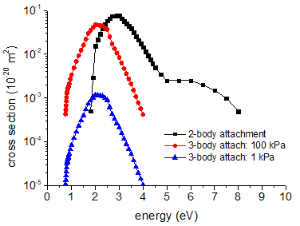
C3F8 2022 2 and 3 body attachment cross-sections

Slide 21
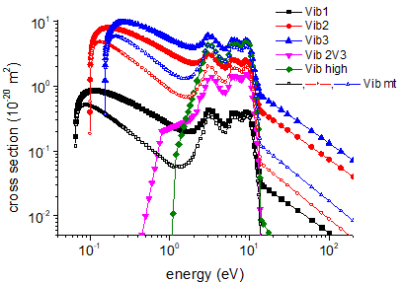
C3F8 2022 vibrational cross-sections

Slide 22
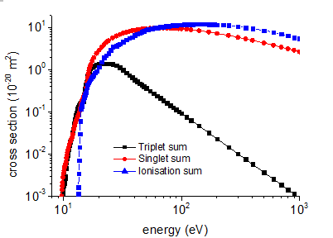
C3F8 2022 summed excitation and ionisation cross-sections

Slide 23
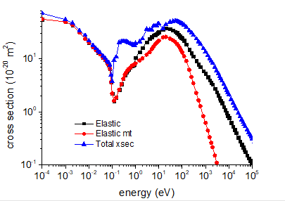
C3F8 2022 elastic cross-sections

