Slide 1



Study of
Streamer Development in
Resistive Plate Chamber
Presented By
Jaydeep Datta
Homi Bhabha National Institute, Mumbai, India
C0-workers
Sridhar Tripathy, Supratik Mukhopadhyay, Nayana Majumdar
Saha Institue of Nuclear Physics, Kolkata, India
Homi Bhabha National Institute, Mumbai, India

Slide 2
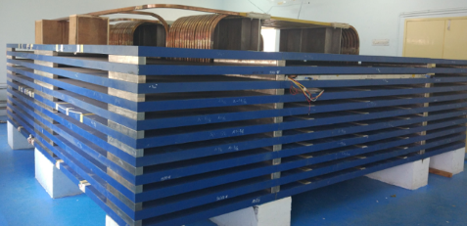
Motivation
India-Based Neutrino Observatory (INO) is an underground laboratory to study neutrino properties.
One of the experiments to be housed in the facility is magnetized Iron Calorimeter (ICAL) consists iron plates interspersed with Resistive Plate Chambers (RPCs).
To make sure that the RPCs are working in avalanche mode, a mixture of R134a, isobutane and SF₆ in a proportion 95.5 : 4.3 : 0.2 is being used.
The main component of the mixture, R134a, has a huge negative impact on the environment, which in turn motivates the search of an eco-friendly substitute of the mixture.
The substitute mixture should also give good efficiency and less streamer probability to achieve the physics goal of the experiment.
This work tries to establish a simulation framework to find out streamer probability of any gas mixture from the gas properties.
Mini-ICAL

Slide 3
Outline of The Work
We have considered a 2D model of RPC to simulate streamer.
COMSOL Multiphysics, MAGBOLTZ and HEED are used for simulation.
For simulation 94 GB RAM, 2.4 GHz*8 computational resource is used.
The result of simulation is then compared with experimental data.
The experiment is carried out using a glass RPC. The gas mixture used for the experiment and simulation is R134a : isobutane = 95 : 5.

Slide 4
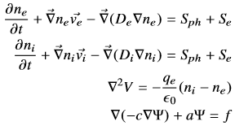
Simulation Model
We have used hydrodynamic model to study streamer in RPC.
The basic idea was followed from the model described in RD51 –NOTE-2011-005, by P. Fonte.
For our work we have made some changes
To match with RPC geometry instead of a 2D axisymmetric geometry,
we have built a 2D model.
We have used anisotropic diffusion coefficient.
For ions we have incorporated convection also.
We have incorporated two stop conditions.
1. The first stop condition is, when the number of electron in the geometry is less than one.
2. The simulation stops when the electron density reaches 10⁻⁴ (mol/m^3) at the cathode.

Slide 5
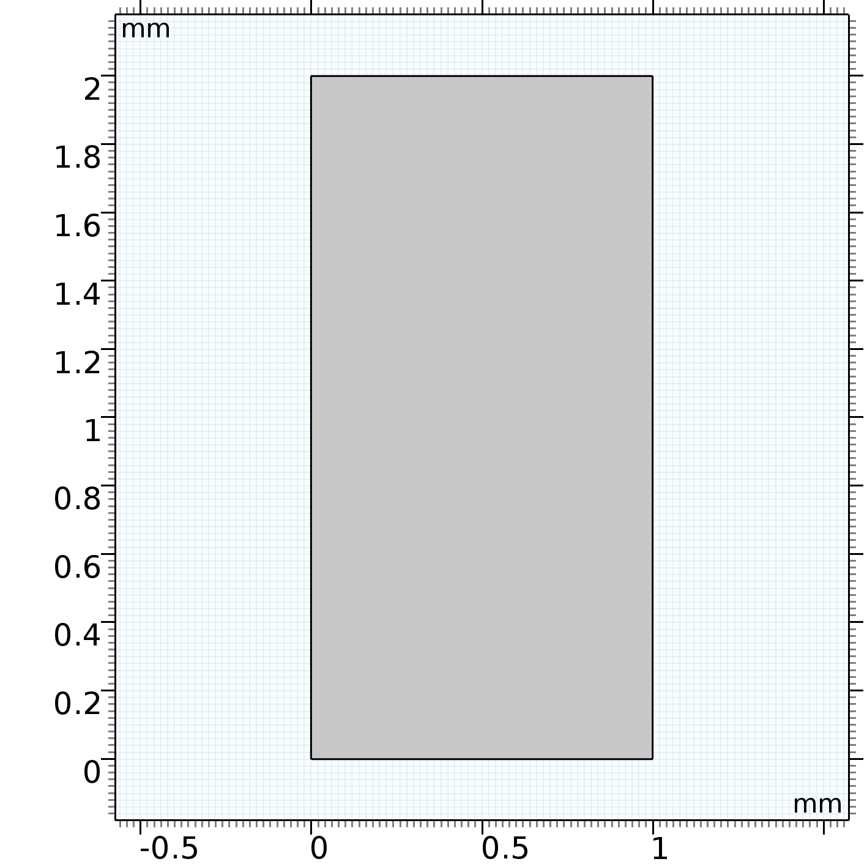
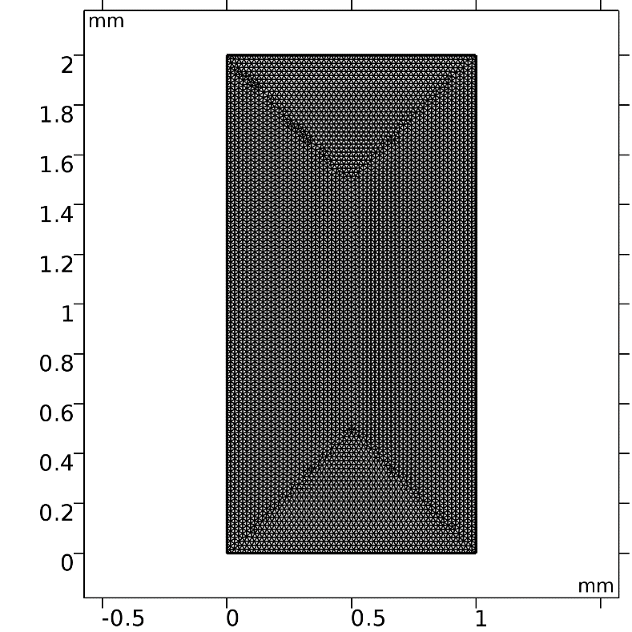
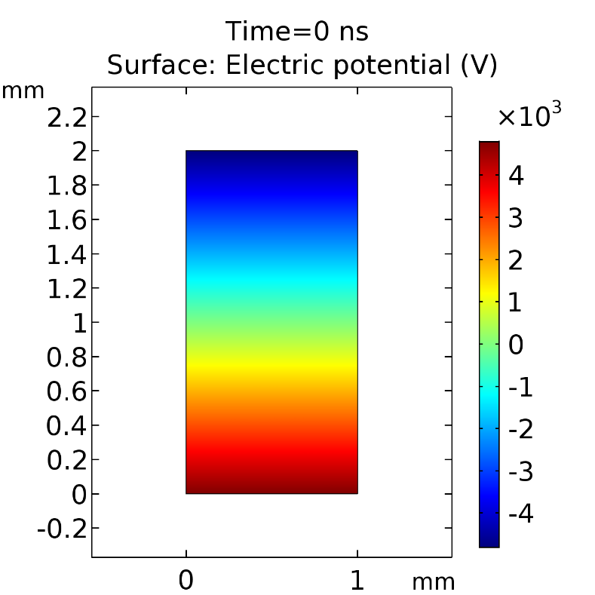
Simulation Model
Model Geometry
Model Mesh
Initial Voltage Distribution

Slide 6
Information of Primary Electrons and Gas Properties
To have an idea of the streamer probability we have used information about primary electron number and their positions from HEED.
For the above, we have generated muon with energy between 1 GeV to 10 GeV following a energy dependent flux (E^{-2.7} ).
Mostly vertical muons are chosen to find the number of primaries.
MAGBOLTZ is used to find the electron transport properties in the gas for different electric field.

Slide 7
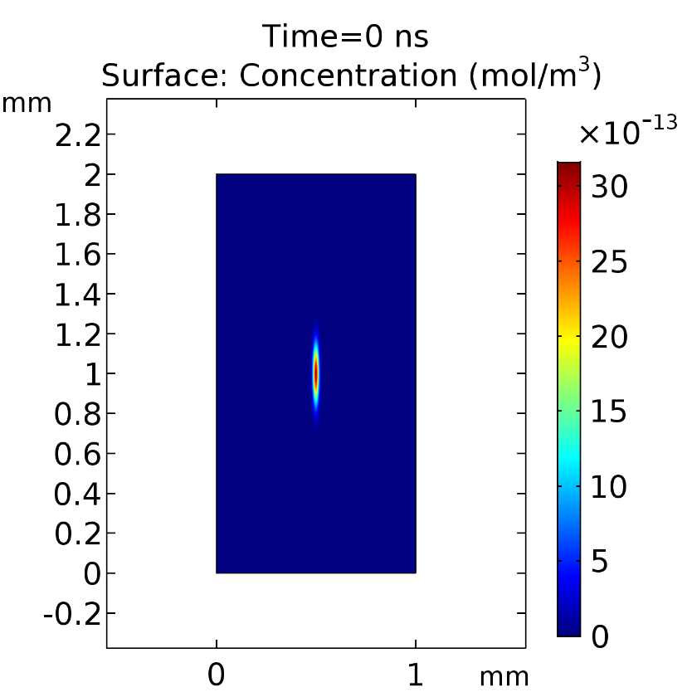
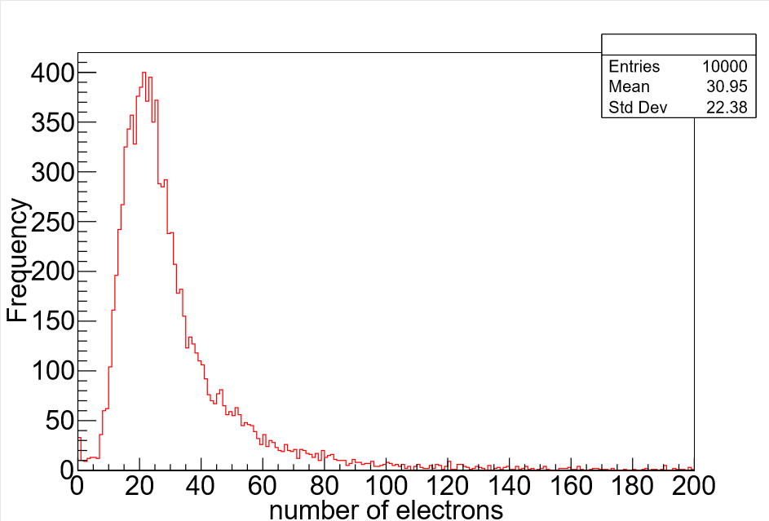
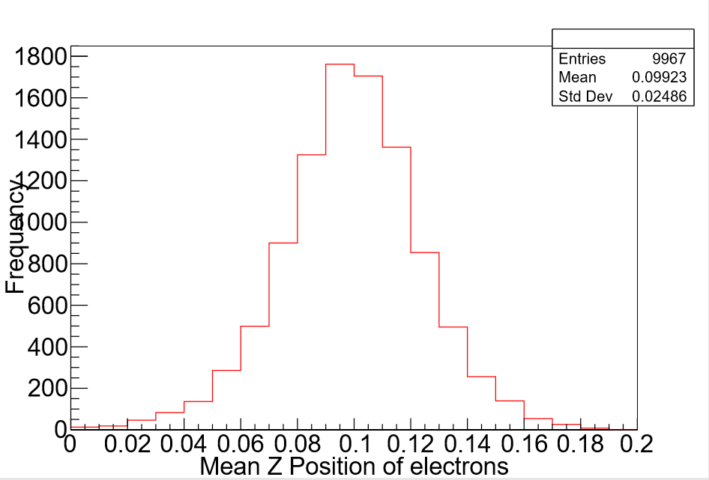
Inclusion of Primary Electrons
Number of Primary Electrons
Mean Z Position of Electrons
Initial Electron Distribution
No. of electrons = 10
σ_{x} = 0.01 mm, σ_{y} = 0.1 mm

Slide 8
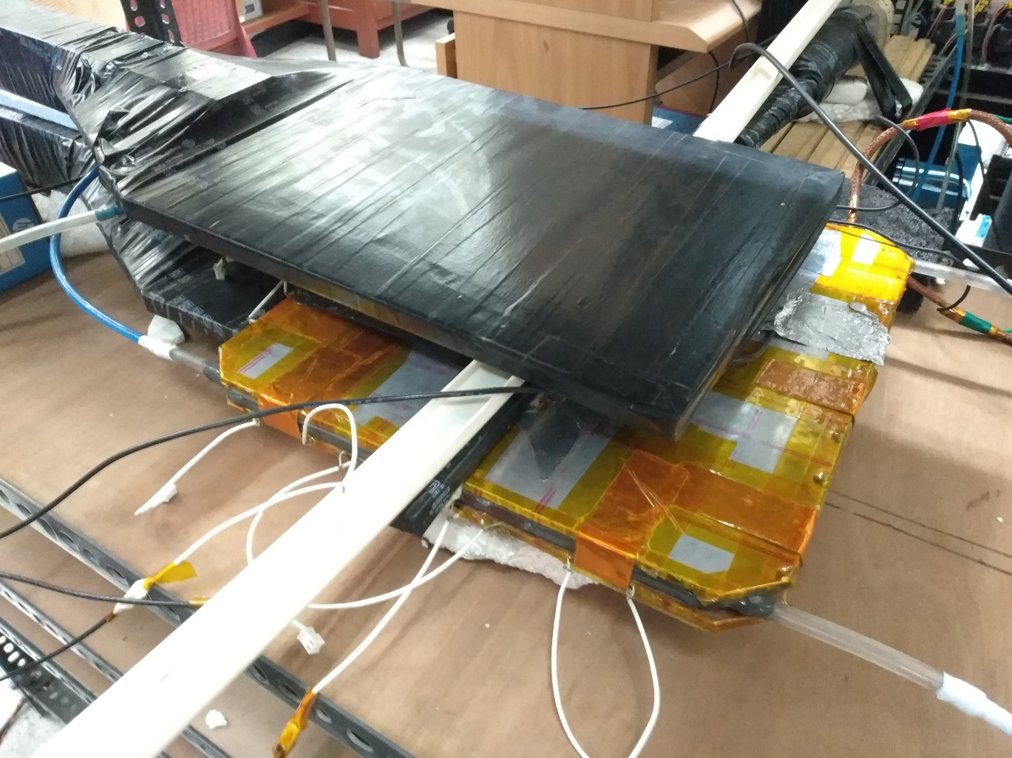
Experimental Procedure
We have used a 30 cm x 30 cm glass RPC.
Coincidence of three scintillator signals are used as muon trigger.
We have made spatial coincidence of the scintillators with one of the RPC strip.
Data acquisition has been done for the coincident strip and one strip from either side of it, using oscilloscope and python based code on a computer.
Data analysis has been done offline using ROOT and C++ based code.

Slide 9
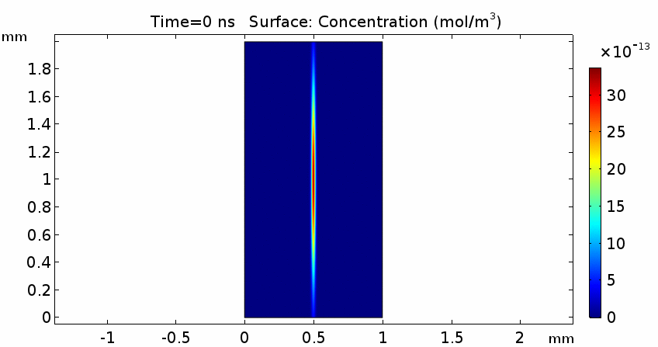
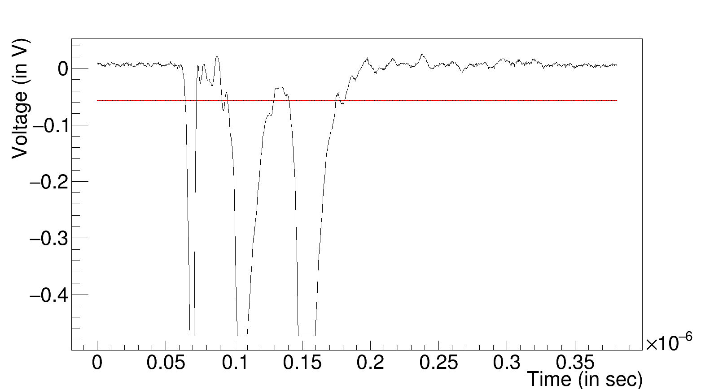
Streamer Probability Calculation
In simulation, use different number of primaries for each voltage. Find out streamer occurs or not, which is defined by the situation that the electrons have reached the cathode.
Find out the probability of occurrence of that number of electrons from the HEED primary electron information. Add up the probabilities.
For experiment, first find out whether more than one pulse has come or not, if yes then whether the amount of charge is more than 20 pC or not, which is equivalent to Raether Limit.
Streamer simulated
Streamer signal from experiment

Slide 10
Result
The following table compares the streamer probability from simulation and experiment.
Sources of error in simulation:
The relative tolerance was set to 0.01.
The initial position of the electron distribution was taken at the middle of the whole gap. But there is a distribution of that. So error due to the initial position will affect the result.
While calculating the streamer probability we have divided the number of events which will give streamer by the total number of events simulated in HEED. So fluctuation in that will also add up in the error.
Voltage (in V) | Streamer Probability from Experiment | Streamer Probability From simulation
9400 | 0.00087 +/- 0.00011 | 0.008
9600 | 0.00091 +/- 0.00015 | 0.008
9800 | 0.00411 +/- 0.00181 | 0.0135
10000 | 0.02681 +/- 0.00052 | 0.0224

Slide 11
Conclusion
The streamer probability from simulation and experiment follows same trend.
We may have over estimated some parameters in simulation.
We need more data to support the experiment.

Slide 12
Acknowledgement
I like to thank the organizers for giving me the opportunity to present my work here.
I like to express my gratitude towards INO collaboration for helping me throughout the work.
I thank my lab-mates and ANP division of Saha Institute of Nuclear Physics for their help.

Slide 13
Thanks

Slide 14
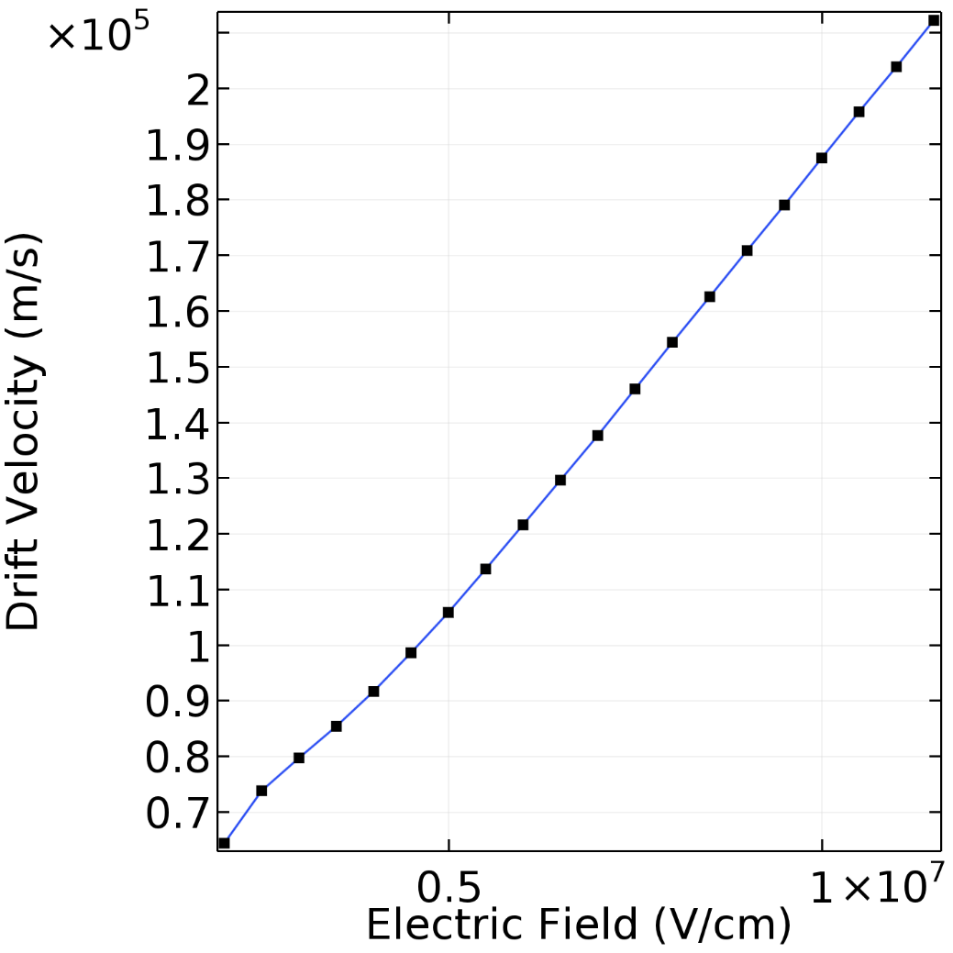
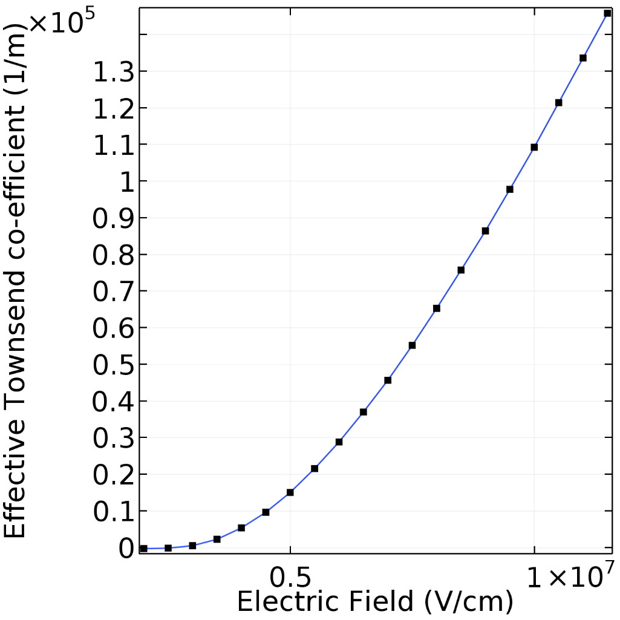
Magboltz plots

