Slide 1






MuCol WP6 (RF Systems)
(CEA, INFN, UROS, Uni. Lancaster,
CERN, Uni. Strathclyde)
Claude Marchand – CEA Paris-Saclay
WP6 coordination meeting #2, July 5, 2023
Funded by the European Union under
Grant Agreement n. 101094300

Slide 2
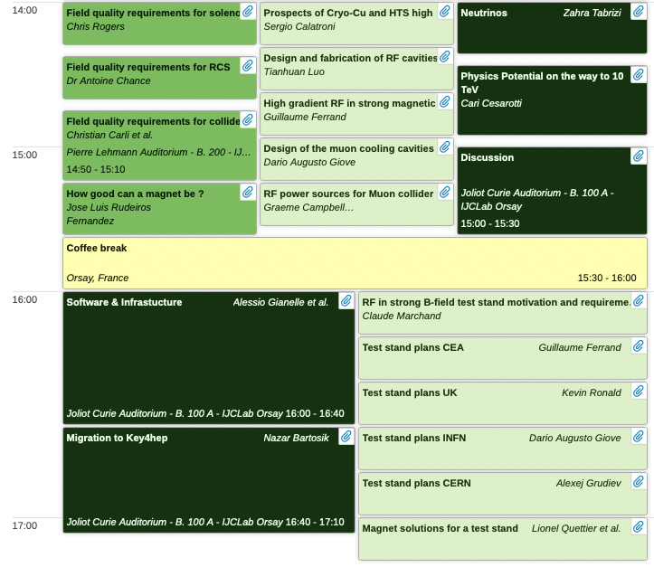
RF presentations at IMCC annual meeting June 20, 2023
Connected to MUCOL WP6.2
MUCOL WP6.3
MUCOL WP6.2
MUCOL WP6.4
Muon collider RF WP +
MUCOL WP6.3 + WP8
2

Slide 3
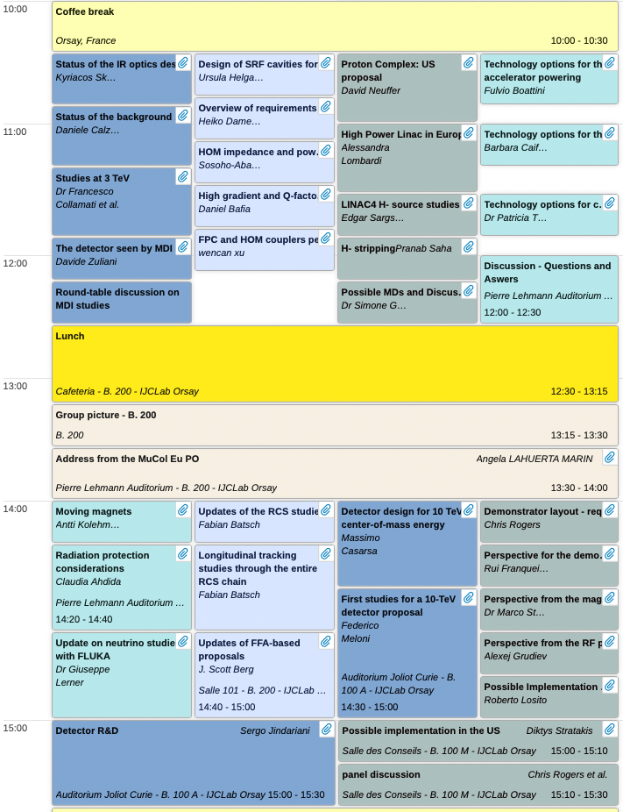
RF presentations at IMCC annual meeting June 21, 2023
MUCOL WP6.1
Connected to MUCOL WP6.1
Connected to MUCOL WP6.2
3

Slide 4
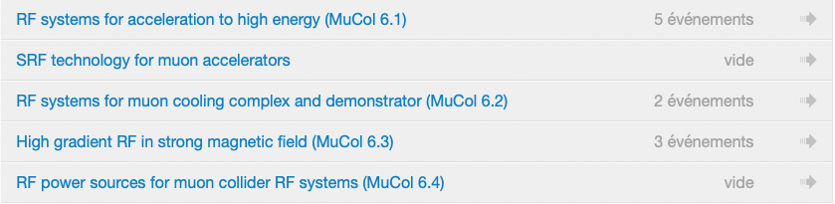
Coordination of work for WP6
  https://indico.cern.ch/category/12831/
  Regular Task meetings to coordinate work for each task
  WP6 coordination meetings every two months
    coordinate with other WP’s (e.g. parameters table, specs, etc.)
    evaluate global advance of work in WP6
    keep record of assigned manpower
    discuss publications and presentation at conferences, report to IMCC
    prepare input for MUCOL annual reports
4

Slide 5
Development plan for WP6
(let’s not reinvent the wheel ;-) )
5

Slide 6
Task 6.1: Concept of RF systems for acceleration to HEC (RCS’s)
(UROS, INFN, CERN, CEA)

Slide 7
Task 6.1 Contributions (to be refined)
MuCol participants contributing:
  CEA – Beam loading & FPC study
  CERN – Beam dynamics simulations for the RCSs
  INFN LASA – Frequency sweep and HOMs
  UROS* – SRF cavity design, incl. HOM couplers - so far:
  *Funded by EU with 24 person months; additionally: Gentner-funded PhD student started 06/23
Open for further contributions from other IMCC members!

Slide 8
Task 6.2: Concept of RF systems for the muon cooling complex
(INFN, CEA, CERN)

Slide 9
Task 6.3: Break-down mitigation studies for muon cooling cell cavities
(CEA, INFN, Strathclyde)
Only this stricto sensu in the scope of MUCOL WP6

Slide 10
Task 6.4: Concept of high efficiency and high power RF sources
(Uni. Lancaster, CERN)

Slide 11
Thank you
for your attention

