Slide 1
Parametric analysis for 14+ T magnet based on block coils
Ezio Todesco
Technology Department
European Organization for Nuclear Research (CERN)
Acknowledgements to J. C. Perez and S. Izquierdo Bermudez
for feedback and discussions

Slide 2
CONTENTS
Previous dipoles based on block coils (see Appendix)
Two features of block coils and main parameters
Sensitivity analysis

Slide 3
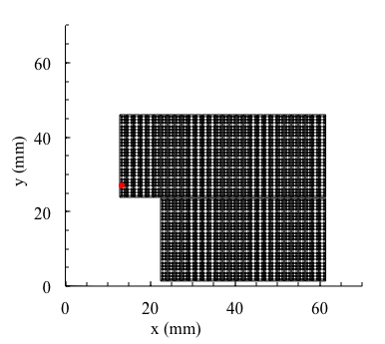
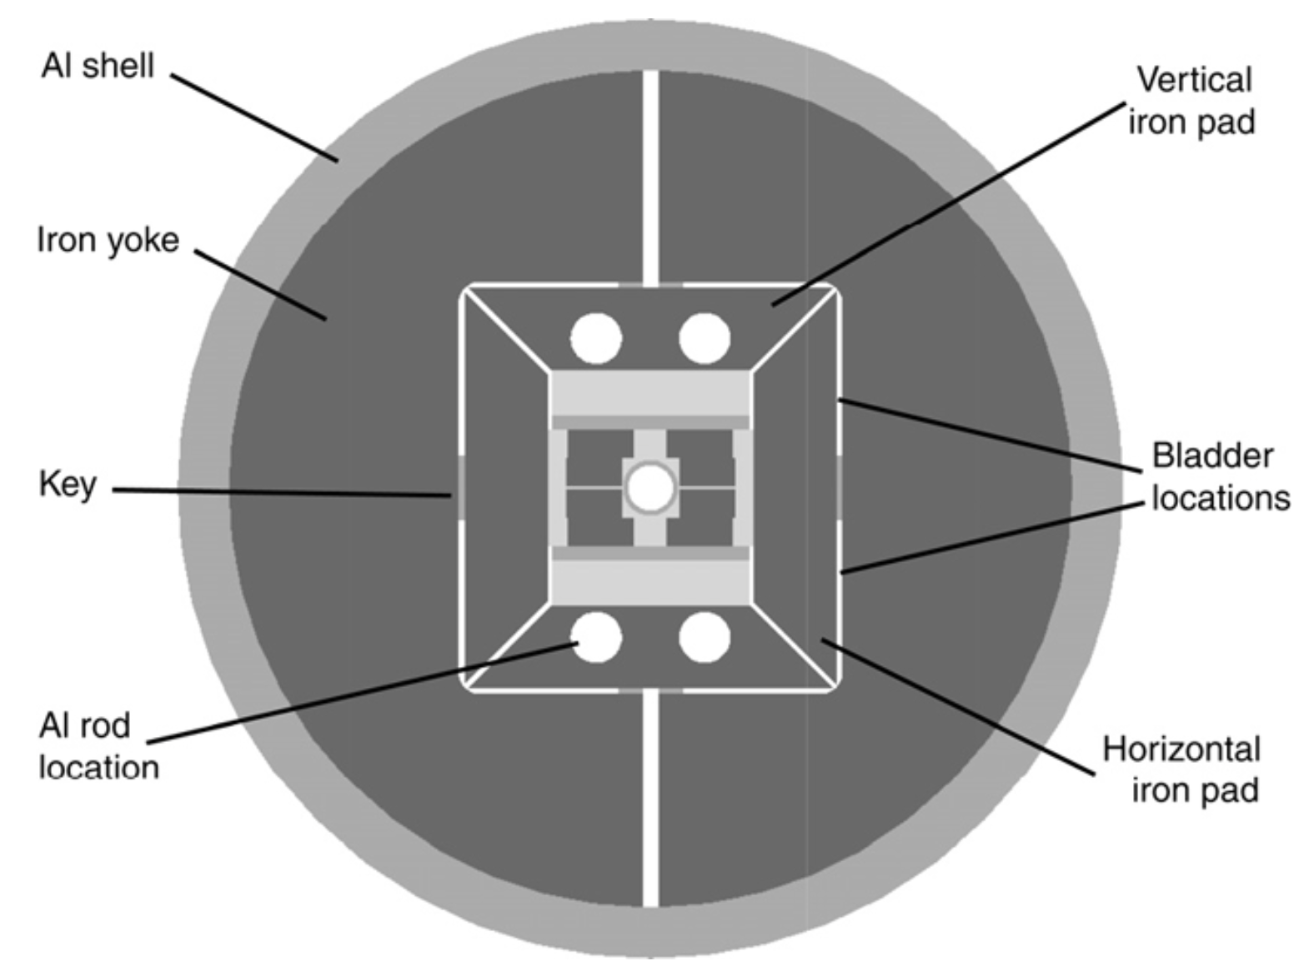
PREVIOUS DIPOLES ON BLOCK COILS
HD2
      13.74 T reached at 4.5 K, never tested at 1.9 K
      45 mm equivalent coil width
      480 A/mm2 overall current density at 15 T

Slide 4
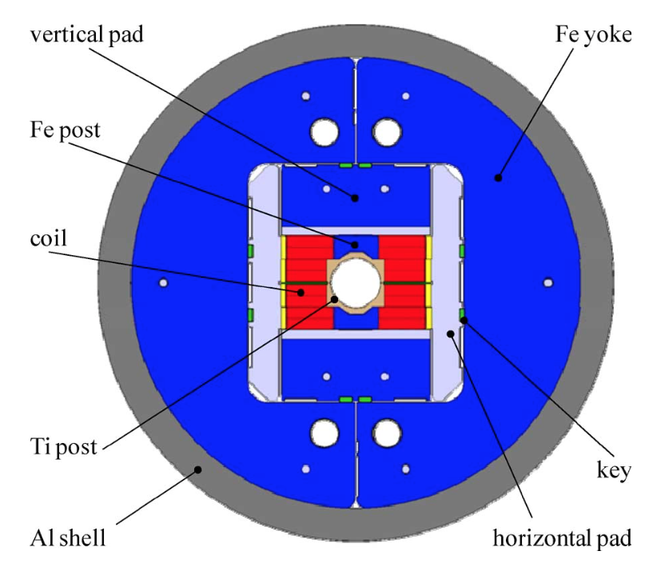
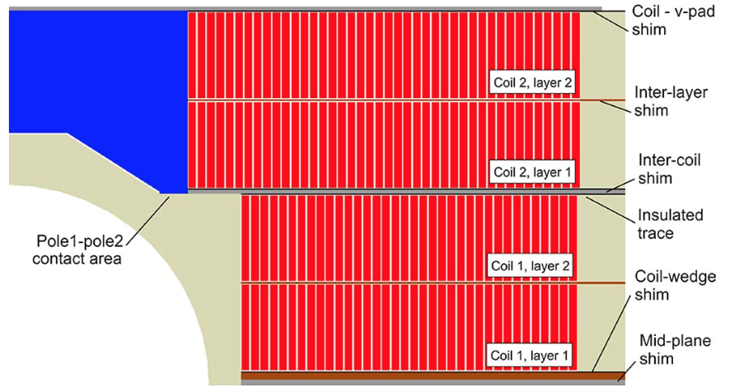
PREVIOUS DIPOLES ON BLOCK COILS
FRESCA2
      14.6 T reached at 1.9 K
      80 mm equivalent coil width
      220 A/mm² overall current density at 13 T

Slide 5
CONTENTS
Previous dipoles based on block coils
Two features of block coils and main parameters
Sensitivity analysis

Slide 6
TWO FEATURES OF BLOCK COILS
AND MAIN PARAMETERS
Two features of block coils
  The ratio between peak field and bore field
  Coil efficiency
Parameters of magnetic design
  Iron contribution
  How much to share the 14 T between coil width and current density
  The two in one effect

Slide 7
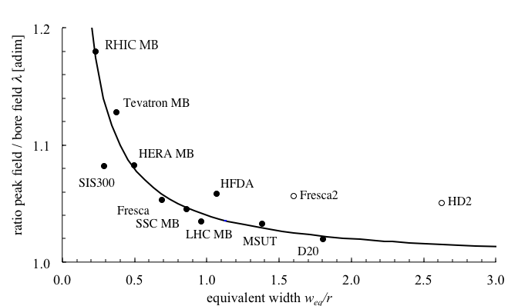
PEAK TO BORE FIELD RATIO
For large coils width/bore width, the ratio λ=peak field/bore field goes to 1 (it is 1.03 in LHC MB)
  Block coils in general have a less favorable peak/bore field ratio
  Here, having coils width/bore width = 2, we should aim a peak field 2% more than bore field, but we will probably get more (4-6%)
  Message: check that the ratio λ is not too large …
14+ T

Slide 8
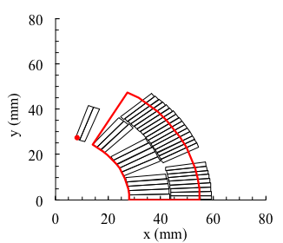
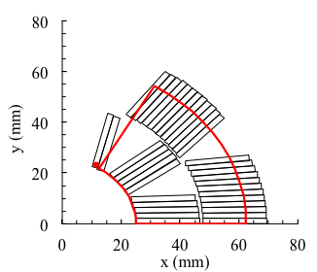
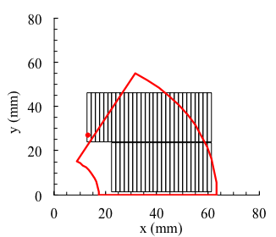
EQUIVALENT COIL WIDTH DEFINITION
Equivalent coil width is defined as the width of the sector coil that has the same quantity of conductor of the actual coil
  LHC dipole: 27 mm
  FalconD and 12 T: 37-40 mm
  D20 and HD2: 45-46 mm
  FrescaII: 80 mm
LHC MB
FalconD
HD2

Slide 9
COIL EFFICIENCY
Coil efficiency γ_{c} is defined as the the field divided by overall current density (over insulated coil) and equivalent coil width
  For naked sector coils: γ_{c}=0.00066 T/(A/mm)
  Tevatron: 0.00069 (removing iron)
  LHC MB and MBPCT1: 0.00066 (removing iron and grading)
For block coils the efficiency is about 10% lower, we can expect 0.00060 from previous designs
  γ_{c}=0.00059 T/(A/mm) for HD2 (removing iron)
  γ_{c}=0.00061 T/(A/mm) for FrescaII (removing iron)
  (see Lecture notes chapter 4, section 4.4 and 4.5)

Slide 10
IRON CONTRIBUTION
Iron contribution for sector coil
with
  r aperture radius
  w coil width
  R_{I} iron radius
Can be as large as 30%, but there is saturation – I would rather consider 15%

Slide 11
COIL WIDTH SELECTION
Since one has
To get 14 T:
With 50 mm coil width, you need 400 A/mm²
With 55 mm coil width, you need 360 A/mm²
With 60 mm coil width, you need 320 A/mm²
  Note: MQXF has 460 A/mm²
I would not go below 50 mm

Slide 12
LOADLINE FRACTION AND SHORT SAMPLE
LHC dipole: 86% (but they work today at 83.5%)
MQXF: 77%
  These fractions computed on specified critical current, the production is better
I would place the magnet at 80% of short sample
  14/0.8=17.5 T short sample
To operate at 14 T, short models should reach systematically more … how much ?
  For MQXF, with 11.3 T peak field, we went in 6 out of 7 models up to 13 T and above
  For 14 T, we should have the possibility of testing up to 15 T – this has implications on current (is it possible to go above 20 kA?) and on protection and mechanics

Slide 13
CONTENTS
Previous dipoles based on block coils
Main parameters
Sensitivity analysis

Slide 14
FACTOR X
The factor X is an analytical tool to estimate the sensitivity of short sample on magnet parameters
  Geometrically, is defined as the slope of the critical surface divided by the slope of the loadline
  It is an adimensional parameter
  κ: fraction of sc in the insulated coil
  s: slope of the sc critical surface
  w_{eq}: equivalent coil width
  γ_{c}: coil efficiency, see previous slides
  Δ_{I}: iron contribution
Factor X is 1-1.5 for magnets with 10-mm-coil widths like RHIC or MCBXF
Factor X is around 3.7 for LHC dipoles (28 mm coil width)

Slide 15
FACTOR X
The larger is X, the less you gain in short sample field improving the design by
  Adding conductor (more coil width w_{eq})
  Adding superconductor (increasing the sc fraction in the strand κ)
  Improving the critical surface (increasing the slope s)
  (see notes chapters 8 and 9)
  For LHC dipole, increasing the cable width or the critical current, or the sc content, by 20%, you gain in short sample only 20%/(1+3.7), i.e. 4%
  How much is the factor X for 14+ T dipole?

Slide 16
FACTOR X
Slope at 17.5 T: 250 (A/mm²)/T
  Every additional tesla you lose 250 A/mm²
  This is half of the slope of Nb-Ti
Filling factor: fraction of sc in the insulated cable
  With 0.9 Cu fraction, 1.1 mm diameter and 0.15 mm insulation: 0.36
  With 0.9 Cu fraction, 1.0 mm diameter and 0.15 mm insulation: 0.34
  With 1.2 Cu fraction, 0.85 mm diameter and 0.15 mm insulation: 0.29
Coil width: let us take 55 mm
Iron contribution: 15%
Factor X is around 3.2

Slide 17
SENSITIVITY ANALYSIS
Dependence on strand critical current
  A gain of 10% in critical current gives 10%/4.2=2.4% more short sample field (0.4 T)
Dependence on coil width
  Increasing 9% coil width from 55 to 60 mm you gain 2.2% in short sample (0.4 T) – that is you have 2% more margin on the loadline
  Decreasing 10% coil width from 55 to 50 mm you lose 2.4% in short sample (0.4 T) – that is you have 2% less margin on the loadline
Dependence on copper ratio of the strand
  Going from the 1.0 mm strand with 0.9 copper ratio to MQXF strand (0.85 mm with 1.2 copper):
  Filling factor lowers from 0.34 to 0.29 (-15%)
  You lose in short sample 15%/4.2=3.5%, i.e. 0.6 T, i.e. 3% on margin on the loadline

Slide 18
CONTENTS
Previous dipoles based on block coils
Main parameters
Sensitivity analysis
A few remarks on mechanics and protection

Slide 19
PROTECTION
Protection requirements: stick to the 40 ms of time margin at 300 K as set for FCC
Relevant variables (with values from preliminary estimates from S. Izquierdo Bermudez)
  Stored energy density on the insulated coil (100 mJ/mm³ in MQXF, here we will be between 80 and 90 mJ/mm³)
  Cu current density (1300 A/mm² in MQXF, 1300-1100 in our case even for strand with 0.9 of Cu)
  Overall current density (460 A/mm² in MQXF, here we will have 350-420 A/mm²)
That’s why the protection with a strand of 0.9 Cu ratio could be viable (to be confirmed by full simulations)

Slide 20
MECHANICS
The block design removes the issue of accumulation of stress in the midplane
  With the price of a structure inside
The relevant stress becomes the radial (horizontal), not the azimuthal
  The peak is on the upper deck

Slide 21
APPENDIX
Previous dipoles based on block coils (see Appendix)

Slide 22
LNBL HD2
Scope: R&D Nb₃Sn magnet based on block coils
  Name: HD2
  Reference field: 15 T*
  Design: LBNL
  Production: LBNL
  Period: 2005-2010
  Units: one short model HD2
    a-b-c tests, plus d-e without cold bore,
    i.e. with 43 mm aperture
  Length: 1 m
  Material: Nb₃Sn
  Op. temperature: tested only at 4.5 K
  Aperture diameter: 35 mm
    Including the inner structure
  Outer diameter: 600 mm
    Note: reference field not defined, papers establish a target of 15.0 T bore field
    13.74 T reached at 4.5 K
    A second iteration on the design was done, named HD3 (2010-2014)

Slide 23
LNBL HD2
Main features
  A dipole with accelerator features based on blocks
  No wedges needed in the coil
  Two layer coil, limiting the free aperture at 35 mm
  Saddle ends to give space to the aperture
    A similar paradigm adopted for FrescaII, but with four layers (no wedges, saddle ends

Slide 24
LNBL HD2
Strand diameter | (mm) | 0.800
Filament size | (μm)
N strands |  | 51
Cu/No_cu |  | 0.95
Critical current density | (A/mm²) | 1250 (16 T, 4.22 K)
Cable width | (mm) | 22
Eq. coil width | (mm) | 45.9
Cable mid thickness | (mm) | 1.400
Keystone angle | (°) | 0.000
N. turns |  | 54
N. blocks |  | 2
Insul. thickness (az/radial) | (mm) | 0.11/0.11

Slide 25
LNBL HD2
Main parameters
  Current: 17400 A
  Loadline fraction: 0.96 (4.5 K)
  0.88 (1.9 K)*
  Temperature margin: --
  Equivalent coil width: 44.1 mm
  Inductance: 5.6 mH
  Stored energy: 0.75 MJ
  Grading: no
  Distance coil to iron: few mm
  Iron contribution to field: 15%
  Saturation: 10%
  Overall current density: 483 A/mm²
  *never tested at 1.9 K

Slide 26
LNBL HD2
Mechanical structure
  Bladder and keys and Al shell
  Iron is very close to the coil (few mm)
  Radial (horizontal) stress: 107/154 MPa (lower/upper deck)
    This estimated via the Fx value given in the literature divided by the cable width
Protection
  Energy extraction and quench heaters

Slide 27
FRESCA2
Scope: dipole for cable test station at CERN
  Name: FRESCA2
  Reference field: 13 T, with 15 T as ultimate
  Design: CERN
  Production: CERN and CEA
  Period: 2012-2019
  Units: one
    Coil replacement
  Length: 1.2 m
  Material: Nb₃Sn
  Op. temperature: 1.9 K
  Aperture diameter: 100 mm
  Outer diameter: 1030 mm
    14.6 T reached

Slide 28
FRESCA2
Main features
  Unprecedented coil width (80 mm equivalent)
  Very low overall current density to achieve the 13 T target (220 A/mm²)
  A large aperture dipole with accelerator features based on blocks
  No wedges needed in the coil
  Four layers coil, required by the large aperture of 50 mm
  Saddle ends to give space to the aperture
    Same paradigm adopted for HD2

Slide 29
FRESCA2
Strand diameter | (mm) | 1.000
Filament size | (μm) | 48
N strands |  | 40
Cu/No_cu |  | 1.3
Critical current density | (A/mm²) | 1400 (15 T, 4.22 K)
Cable width | (mm) | 21.32
Eq. coil width | (mm) | 81.6
Cable mid thickness | (mm) | 1.890
Keystone angle | (°) | 0.000
N. turns |  | 156
N. blocks |  | 4
Insulation thickness (az/radial) | (mm) | 0.200/0.200

Slide 30
FRESCA2
Main parameters
  Current: 10900 A
  Loadline fraction: 0.72
  Temperature margin: 5.8
  Inductance: 50 mH
  Stored energy: 4.6 MJ
  Distance coil to iron: 20 mm
  Iron contribution to field: 15%
  Overall current density: 220 A/mm²

Slide 31
FRESCA2
Mechanical structure
  Bladder and keys and Al shell
  Radial (horizontal) stress: 80/100 MPa (lower/upper deck)
    This estimated via the Fx value given in the literature divided by the cable width
Protection
  Energy density on the insulated coil: 0.122 J/mm³
  Energy extraction and heaters

