Slide 1
AMORE
Status, new features & Discussions

Slide 2
Outline
Christmas shutdown activities and changes
Pending points (previous meetings) + new developments
  AMORE & GUI09
  DAQ/QA agents
  QA online
News on AMORE feedback to offline (aka thresholds)

Slide 3
Christmas shutdown activities and changes
Move from SLC4 to SLC5
Move from 32 bits architecture to 64 bits
New DQM nodes
  Blades with 16 cores and 16 GB of RAM
  At least 1 blade per detector
New DQM shifter station
New version of all the DQM related softwares
➔ Many important changes,
yet the restart was pretty smooth !

Slide 4
Pending points: AMORE, GUI
Amore gets stuck at the same cycle number. No updates of MOs from there on ✗
  Under investigation ✗ DIM, DNS issues?

Slide 5
Pending points: DAQ/QA agents
Agents not correctly restarted. The agent is not properly killed
  Under investigation ✗DIM, Kill function fails ?

Slide 6
Pending points: QA
Read the OCDB at SOR and not at load time ✗
Instantiate the correct muon QADataMakerRec ✗
QA framework: Not strictly DQM, but QA related, QA would be much more useful if we’d have a merging of the output root file per run ✗

Slide 7
Pending points: misc
Add some general reconstruction QA for the DQM shifter (e.g. reconstruction) ✗
TRD request: keep long-term metrics in a database (within amore)
  A solution is being tried by Sylwester Radomski. See Sylwester’s followup next
Request to access DCS data from AMORE and the other way around (TPC, SPD, DCS)

Slide 8
Event Species
Proper event species identification at P2
➔ each histo is published 4 times
➔ summary image contains 4 times the histos
Logical as we can’t know what histos will be filled before run
But identification issue in histograms. Proposals?
DQM shifter currently look at LowMultiplicity
➔ switch the default layouts when HI runs

Slide 9
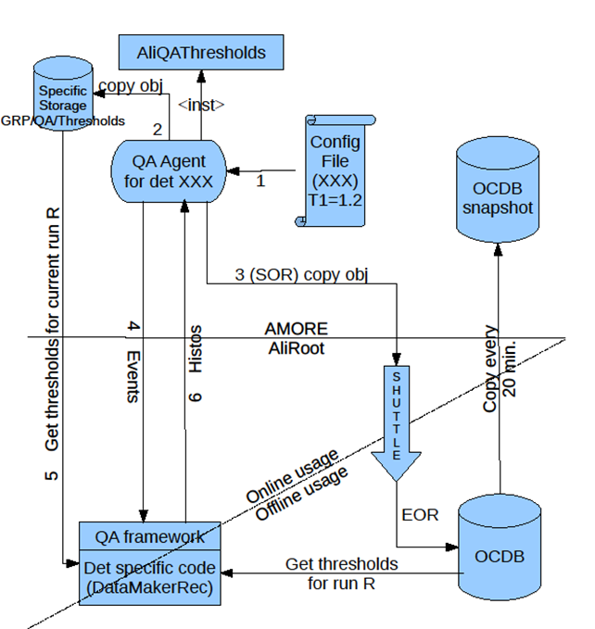
QA & DQM : thresholds status

Slide 10
QA & DQM : thresholds status
Make sure that the class AliQAThresholds committed in AliRoot (STEER) and ported to the release
In coordination with the offline activate and test the thresholds feature at P2
Proceed to the online activation and tests

Slide 11
Questions
Announcements
Time for questions and remarks

Slide 12
Backup

