Slide 1

My CERN internship
Anastasia Kudzeshvili

Slide 2
Table of content
What did I do?
How did I do it?

Slide 3
What did I do?
Date, version & platform -> CSV file
Version diagram
Platform diagram

Slide 4
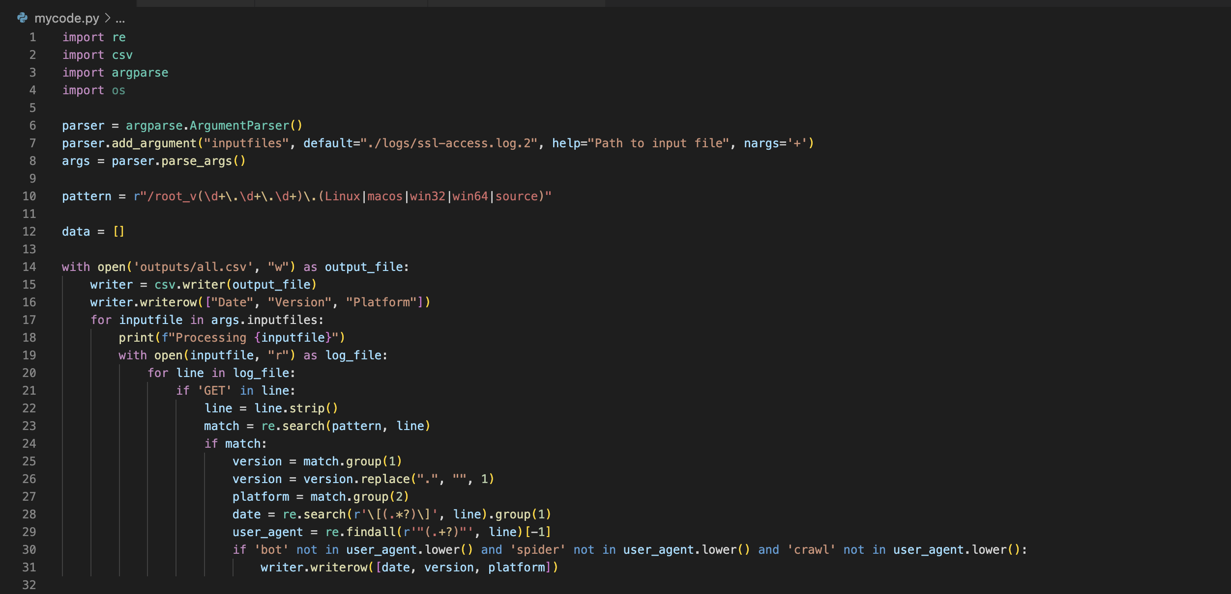
Date, version & platform -> CSV file

Slide 5
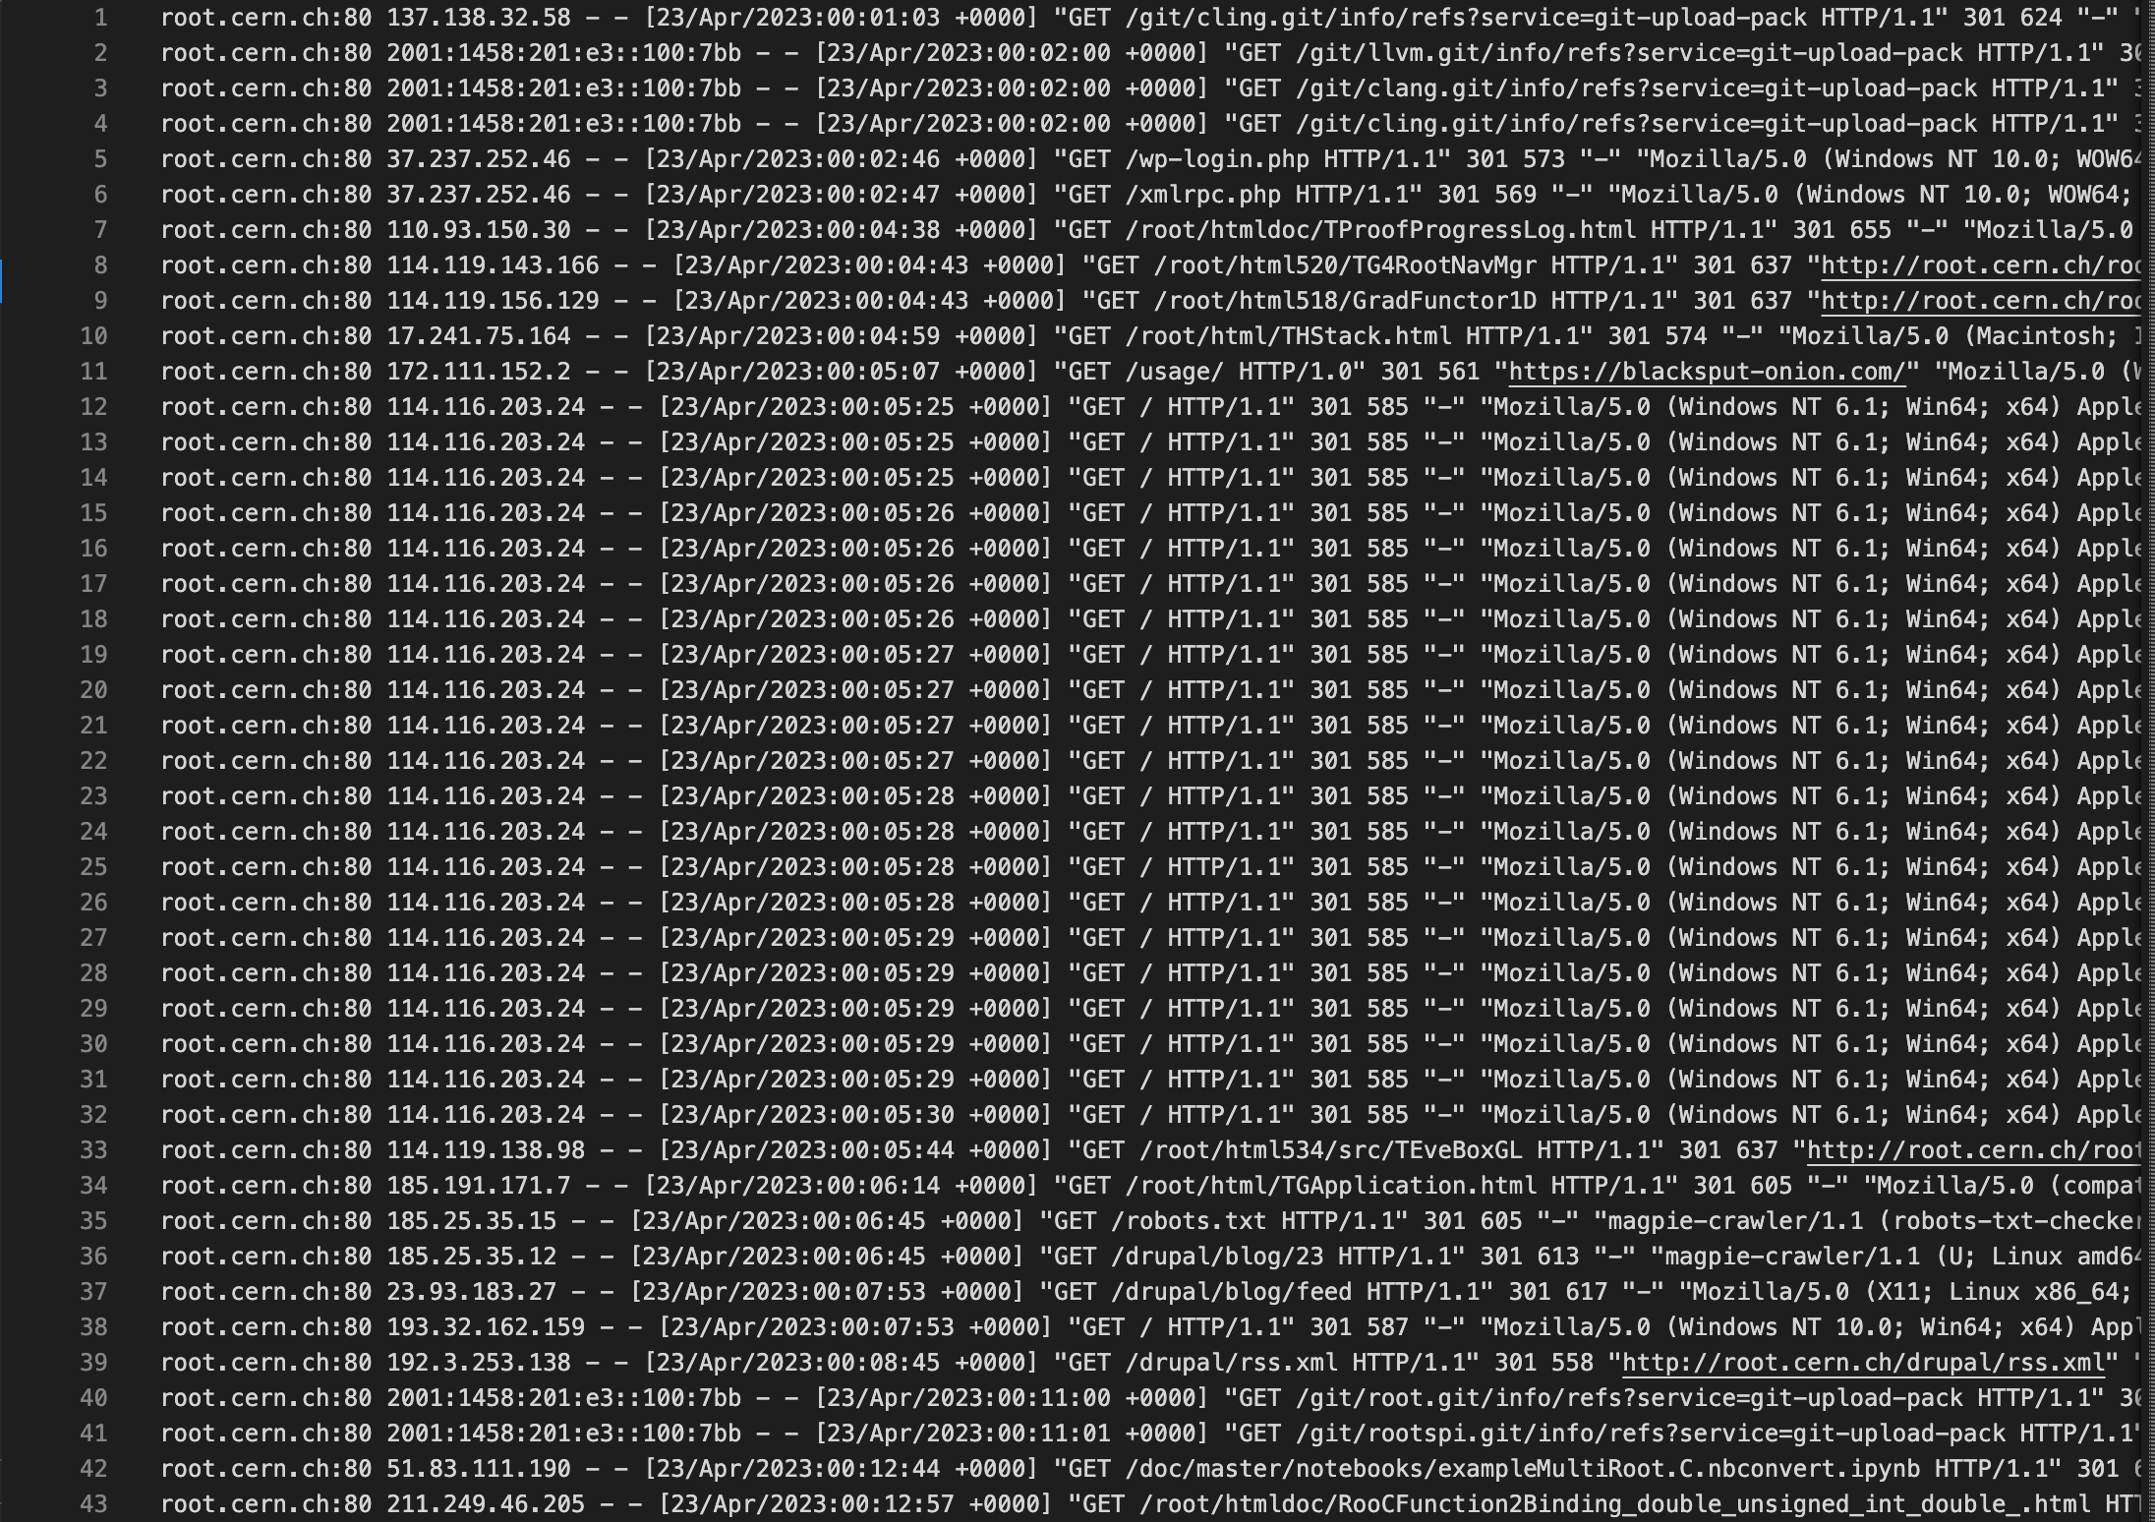
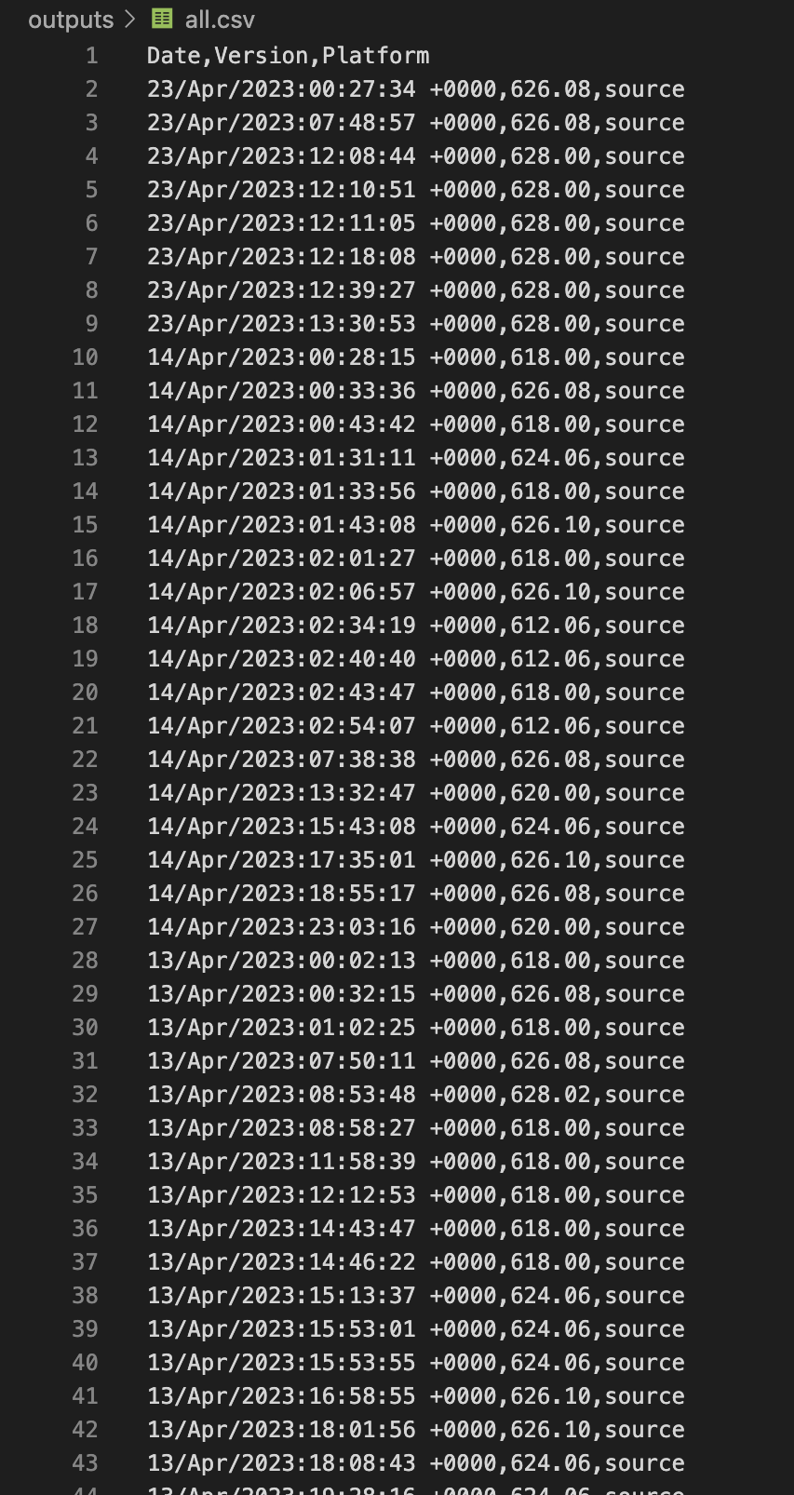

Slide 6
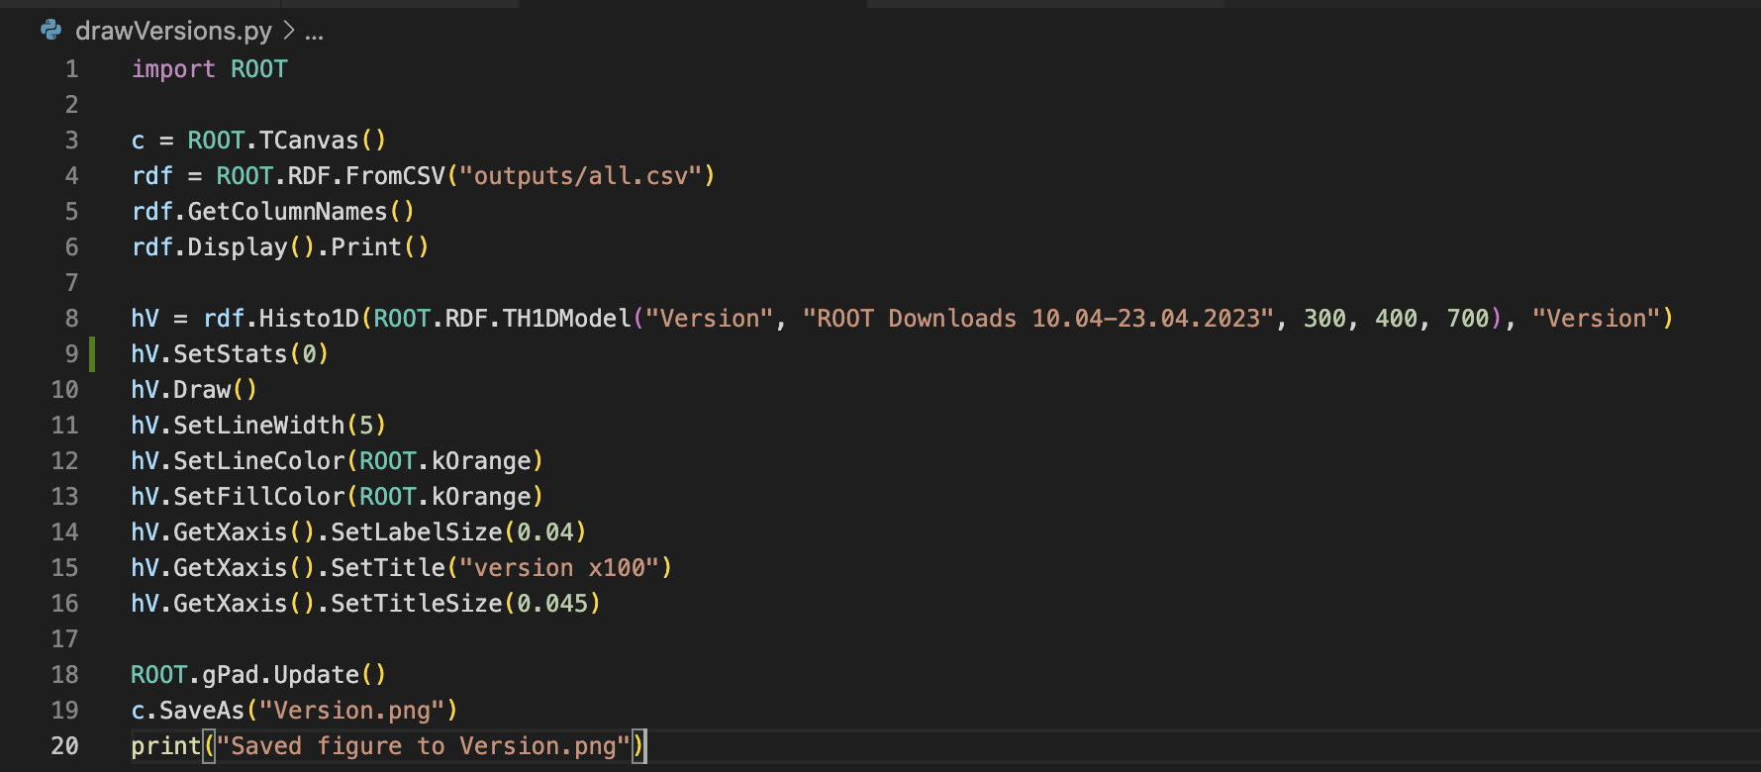
Version diagram

Slide 7
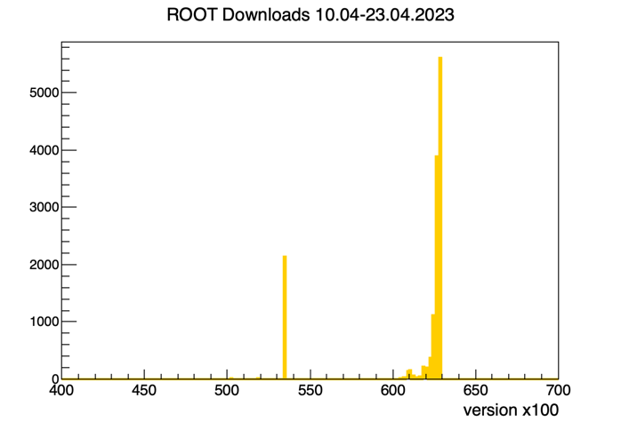

Slide 8
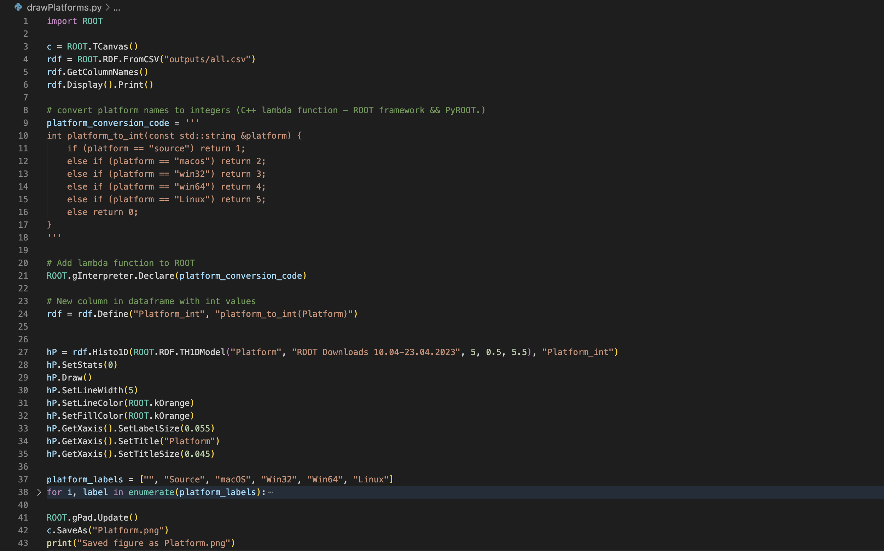



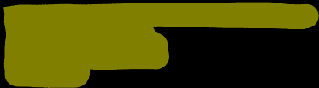
Platfrom diagram

Slide 9
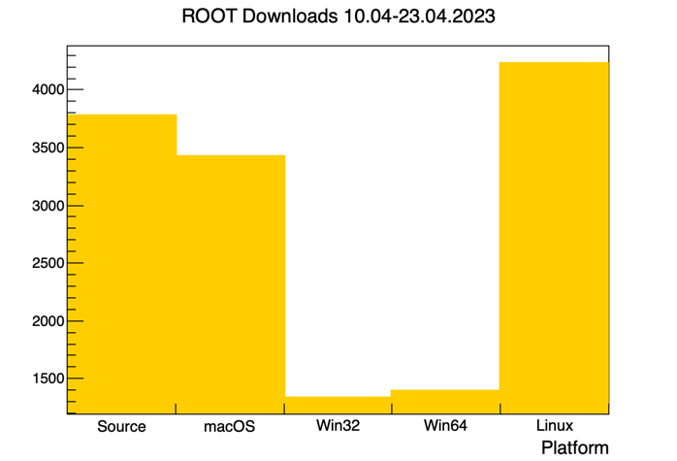

Slide 10
Thank you for your attention

