Slide 1
PS/SPS user meeting
C. Zannini for the SPS team

Slide 2
Physics beam
SFTPRO
  Automatic optimization for 50Hz correction successfully running
  As requested, intensity step/adjustment on Monday (from 30 to 90 units on T2 and reduction to 60 units in T6)
  Adjustment of RF settings to improve beam quality
  MD on empty bucket channeling and TT20 optics ongoing today
HiRadMat
AWAKE
  This week is a semi-dedicated AWAKE week (possibility to run AWAKE in a dedicated manner for a certain time between LHC fill)
    Any interest to implement this?

Slide 3
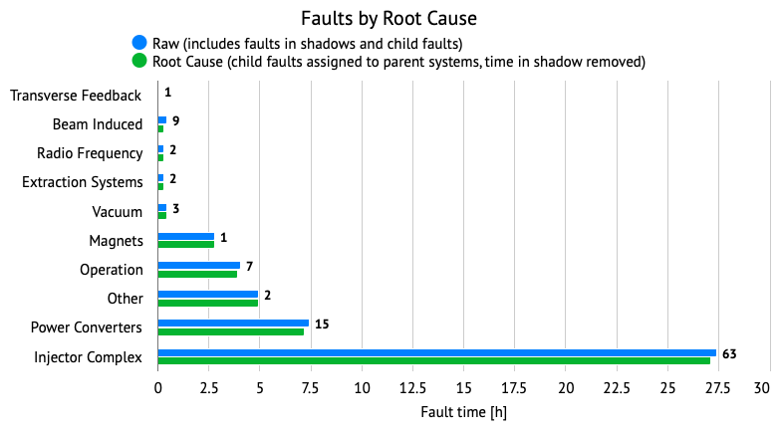
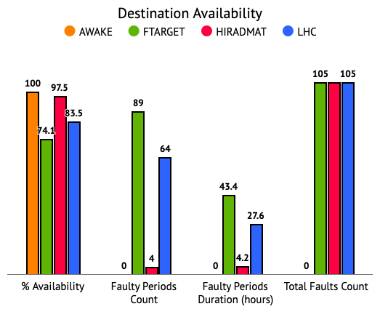
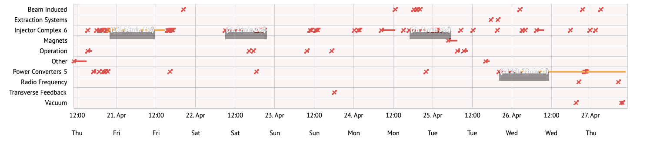
Th.-Th. availability

