Slide 1
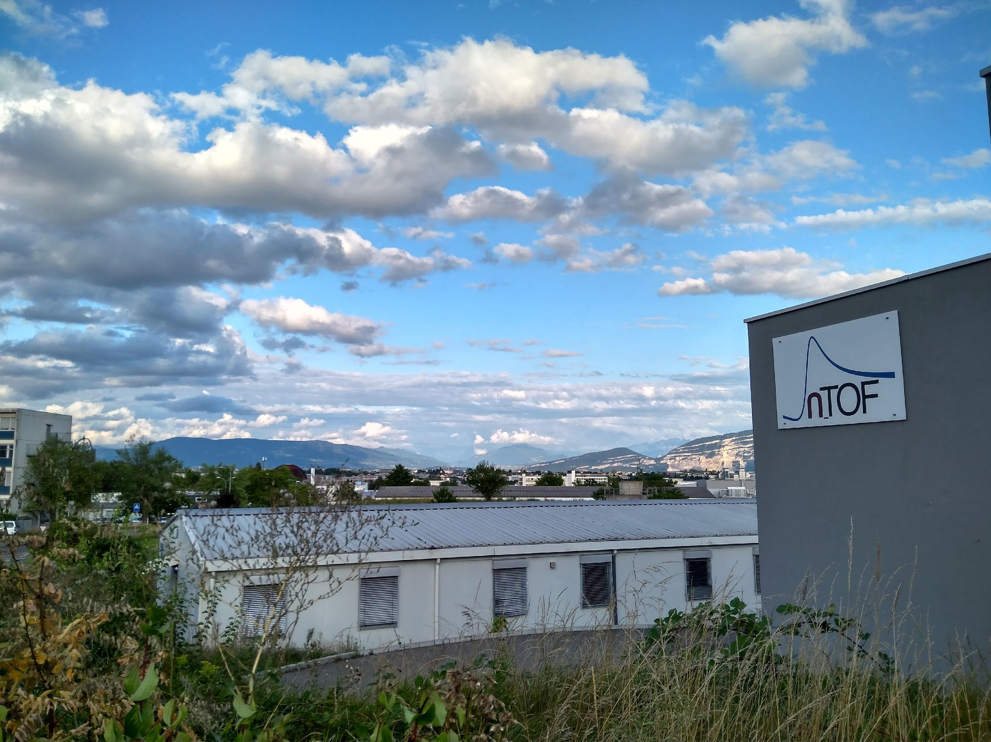



STATUS REPORT OF THE n_TOF FACILITY
Nikolas Patronis n_TOF Physics Coordinator CERN & Univ. of Ioannina | Michael Bacak n_TOF Run Coordinator CERN

Slide 2
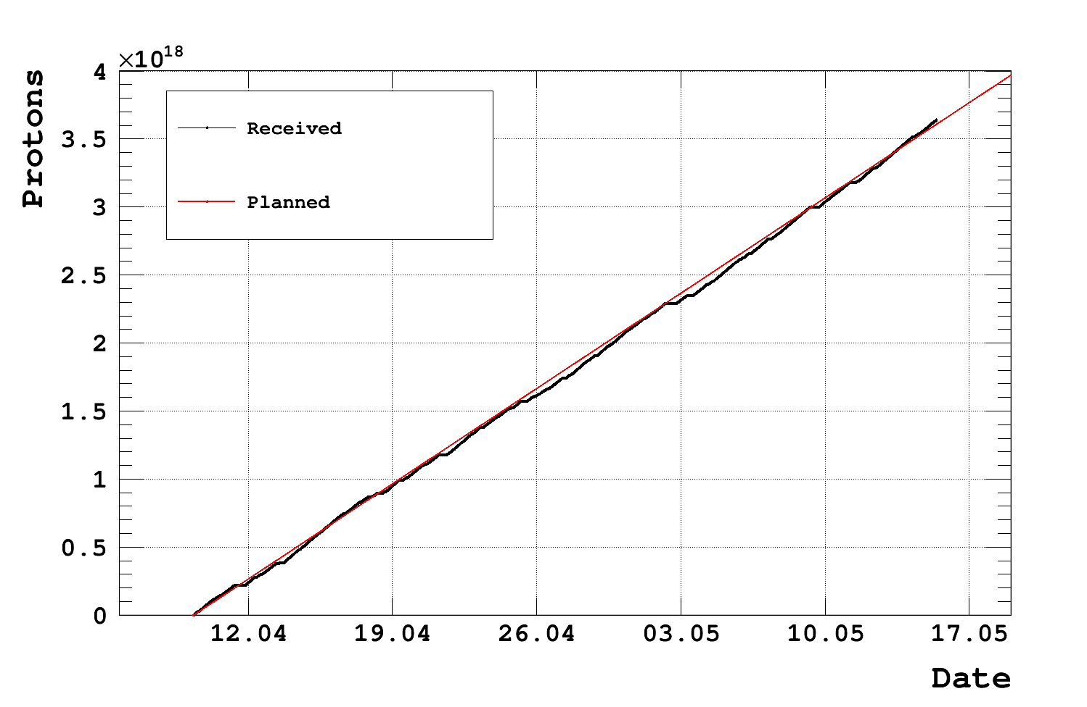
Week 20 Status
Total Physics PoT: 3.7E18

Slide 3
Week 20 Status
EAR1: Smooth data taking for the ¹⁸¹Ta(n,γ) reaction study
EAR2: One more week of auxiliary capture setup measurements.
NEAR: No irradiation in the activation area.
PoT: 3.7E18; According to our expectations. Many thanks to the PS teams!
Scheduled beam-off Wednesday 24.05.2023 -> 09:00 - 14:00 (5h); mounting NEAR irradiation setup to ⁸⁹Y(n,g) with 5mm B4C filters

Slide 4
Thank you
iTED @ EAR1
sTED @ EAR2

