Slide 1
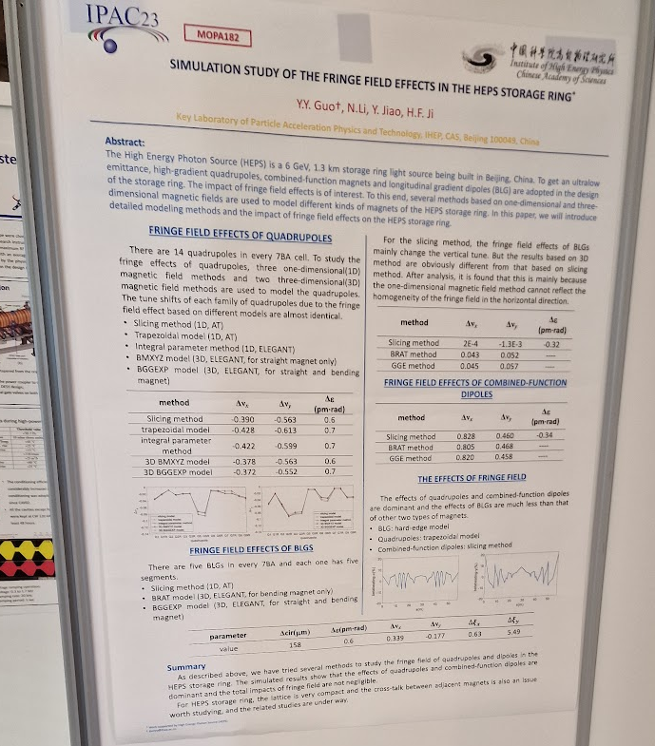
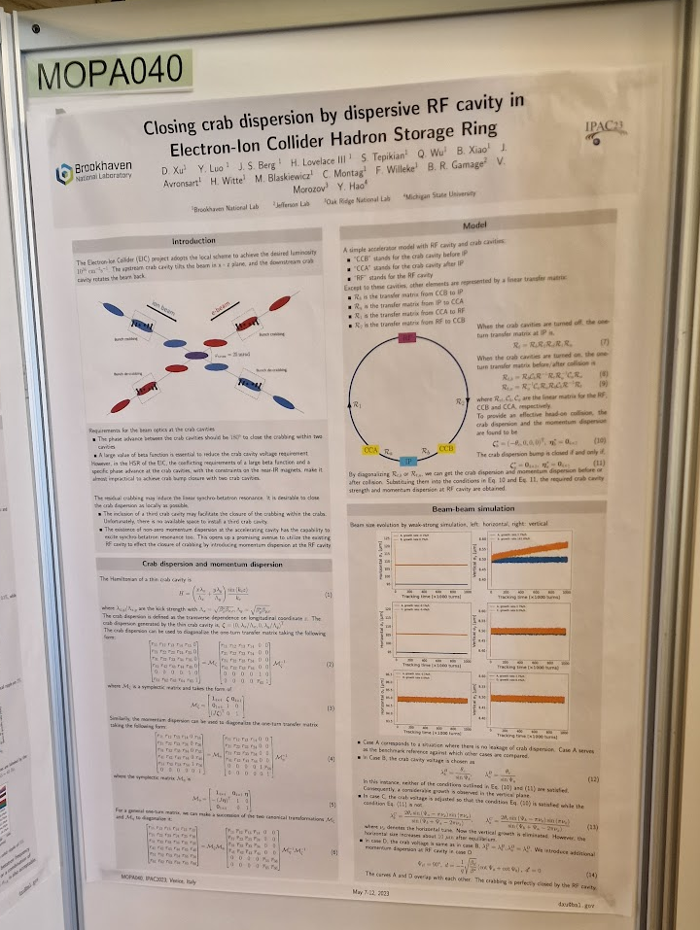
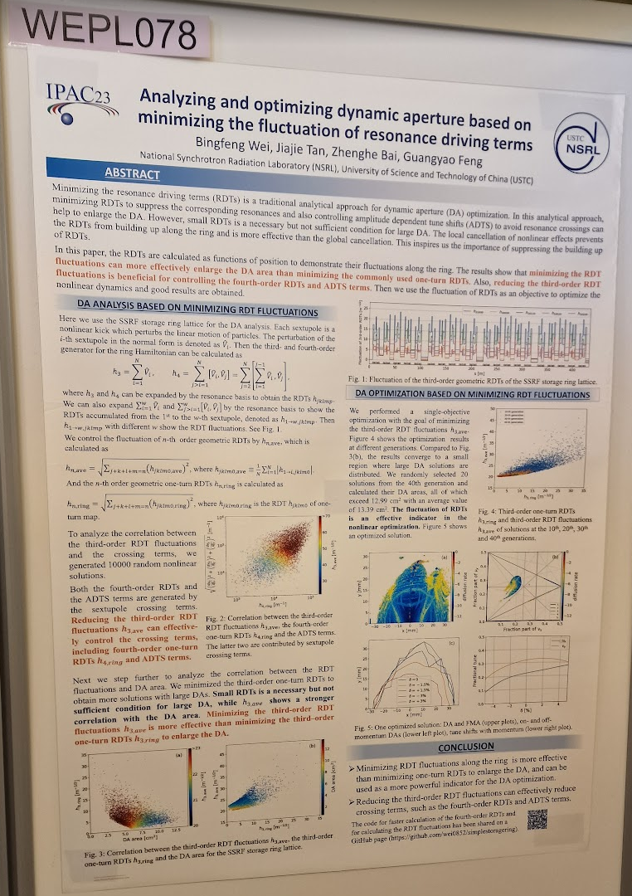
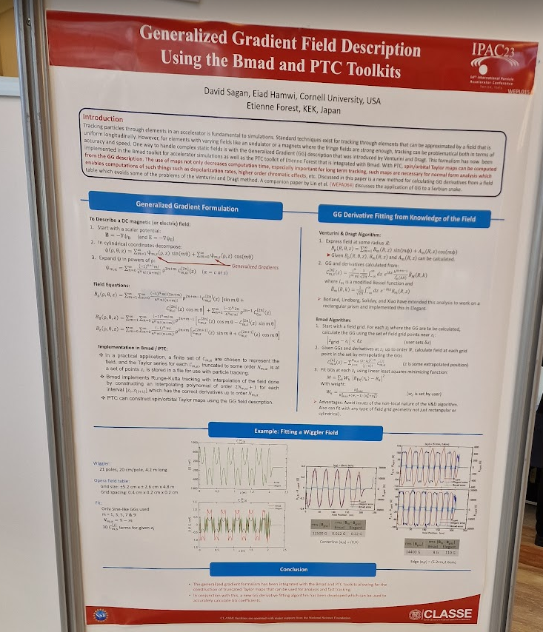
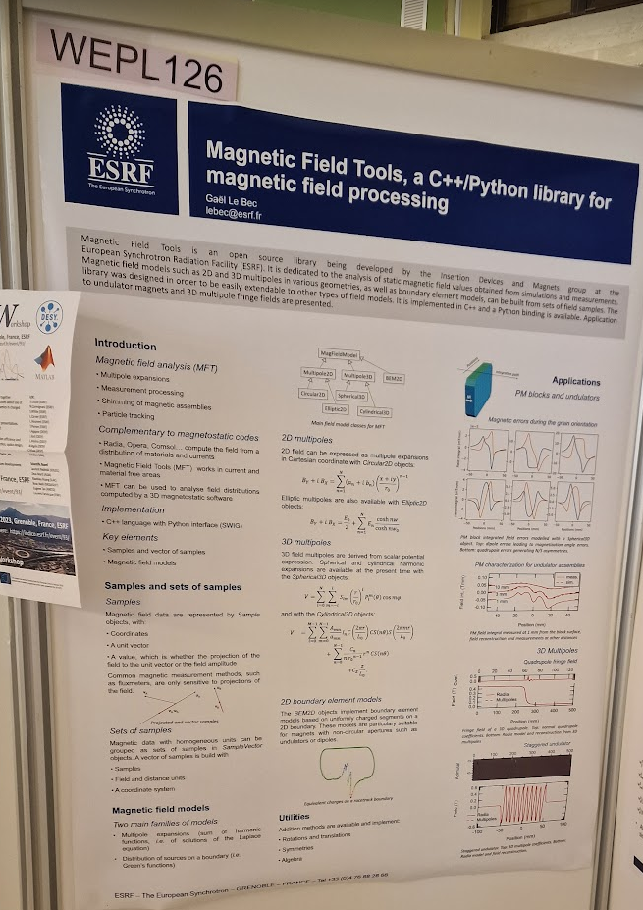
IPAC'23 highlights
Talks:
Accelerators for Particle Physics – Beate Heinemann, DESY
Performance with the Upgraded LHC Injectors – Malika Meddahi, CERN
Overall Status of the HL-LHC Project – Oliver Bruning, CERN
Accelerator Physics Challenges for EIC – Vadim Ptitsyn, BNL
SRF Cavities for Crabbing at the Electron-Ion Collider – Todd Satogata, TJNAF
Timepix and Medipix Detectors and Their Applications – Michael Campbell, CERN
Accelerator Technology for Quantum Computing – Anna Grassellino, Fermi National Accelerator Laboratory

