Slide 1
RFQ2 Update
L. Millar, A. Grudiev
CERN, SY-RF-MKS Section
26/05/2023

Slide 2


Recap
Q factor of the first RFQ was 6772, The Q factor of the new RFQ (RFQ2) seems to be ~5200.
Last time we agreed to:
Look inside the cavity with a borescope.
Measure Q₀ vs tuner position (simulate and compare with measurement).
Investigate how individual tuners affect Q while forming the matrix which will be used for tuning (in progress) .

Slide 3
1: Borescope Investigation

Slide 4
Borescope Investigation
Inspection performed on 25/05/2023, photos and videos not included in this presentation. To summarise, no obvious problems were visible.

Slide 5
2: Q₀ vs Tuner Position (with simulation results)

Slide 6
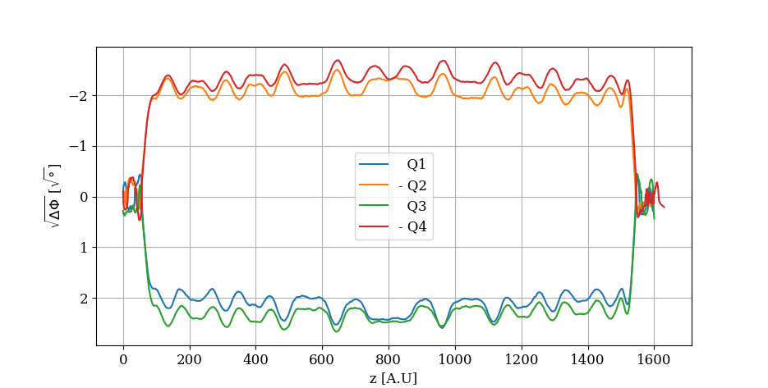
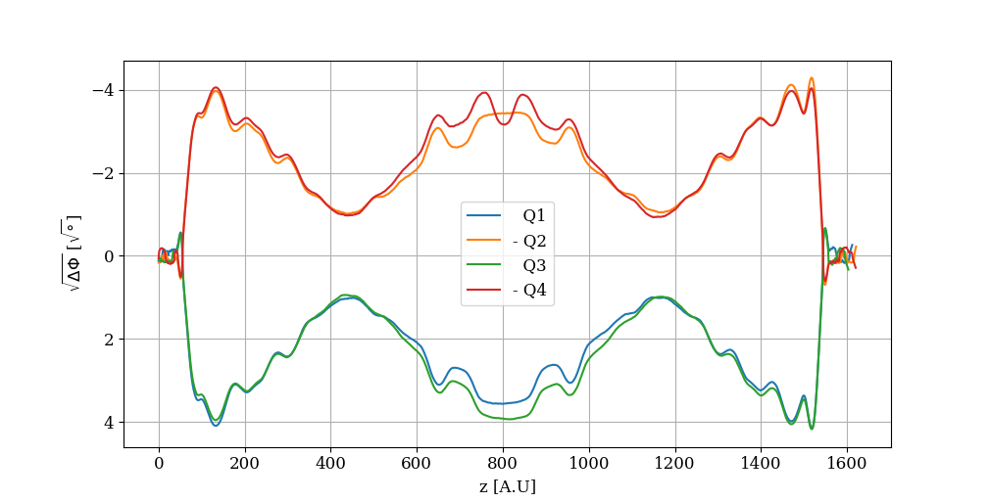
A Reminder..
Two quadrupole modes measured:
Mode 1 (operating mode)
Mode 2

Slide 7
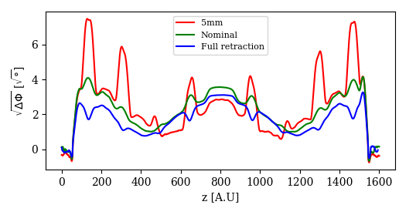
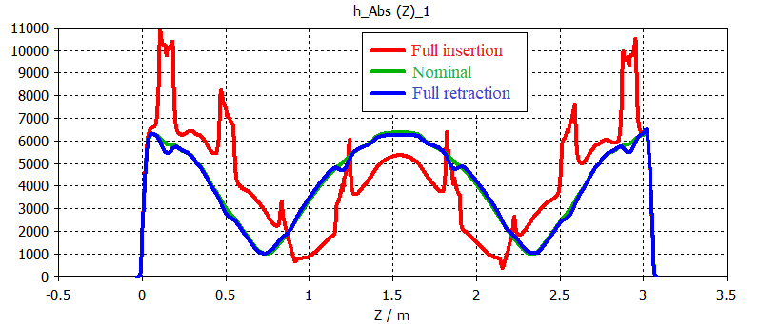
Mode 2
Measurement
CST
Note: Absolute values shown in simulation, simulation setup is not entirely identical to the measurement setup.

Slide 8
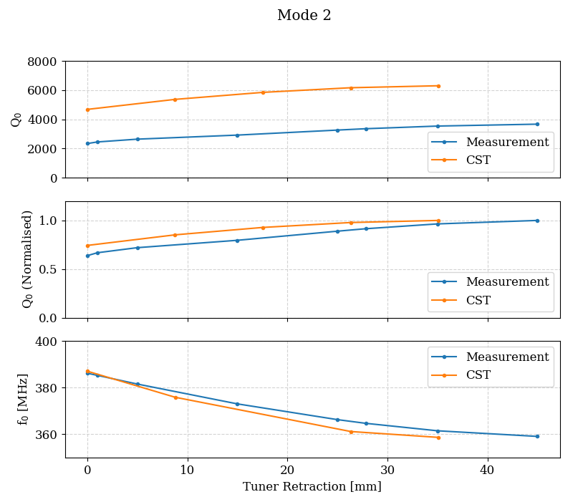
Mode 2
Absolute Q₀ values are different.
Reasonable tracking of normalised Q and frequency.

Slide 9
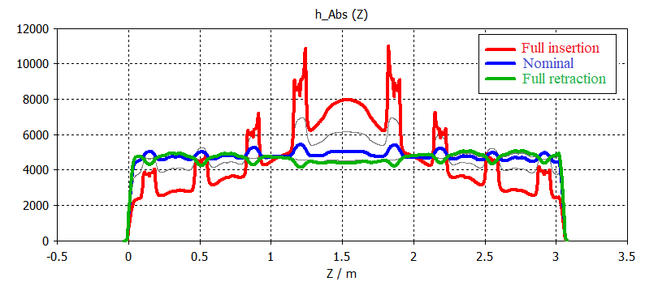
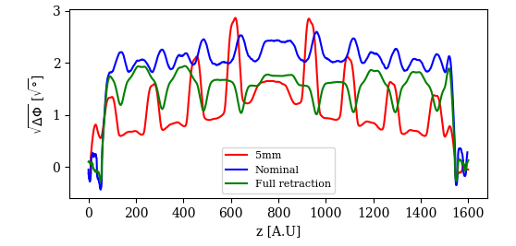
Mode 1
Measurement
CST
Note: Absolute values shown in simulation, simulation setup is not entirely identical to the measurement setup.

Slide 10
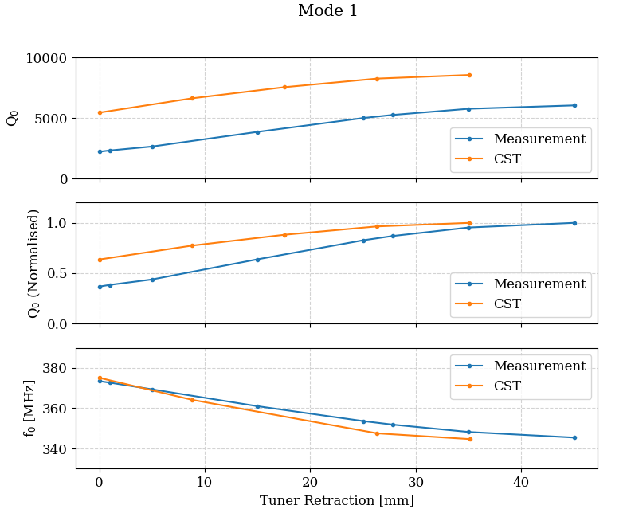
Mode 1
Relative losses higher at full insertion (when field is concentrated around central module).

Slide 11
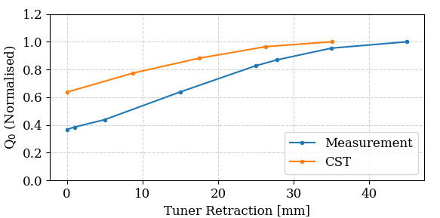
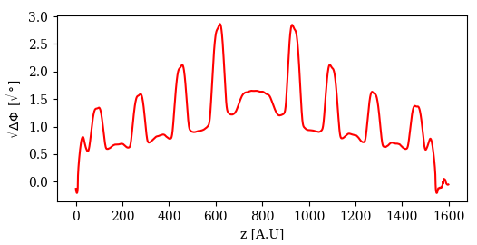
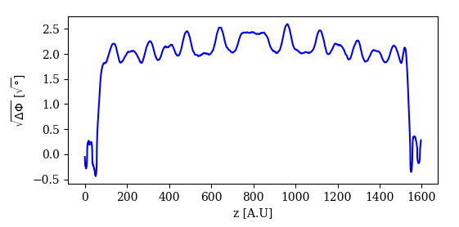
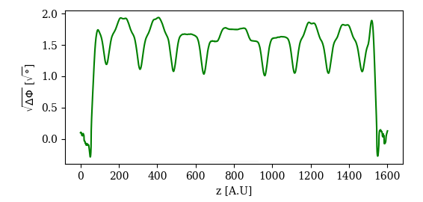
Mode 1
More lossy when field is concentrated in central module.

Slide 12

3: Effect of Individual Tuners

Slide 13
Effect of Individual Tuners
Idea is to measure how individual tuners affect Q₀:
Field and surface current change as tuners are moved. By measuring Q₀ we can “localise” losses to an extent.
Can use this data to form the matrix we need for tuning. This needs to be done anyway, no time lost!

