Slide 1
Meeting
Research – MagRES project
June 2023
Pascal Studer
Laboratory for Soft Materials
Notes:
Small update over chemistry work on epoxies

Slide 2
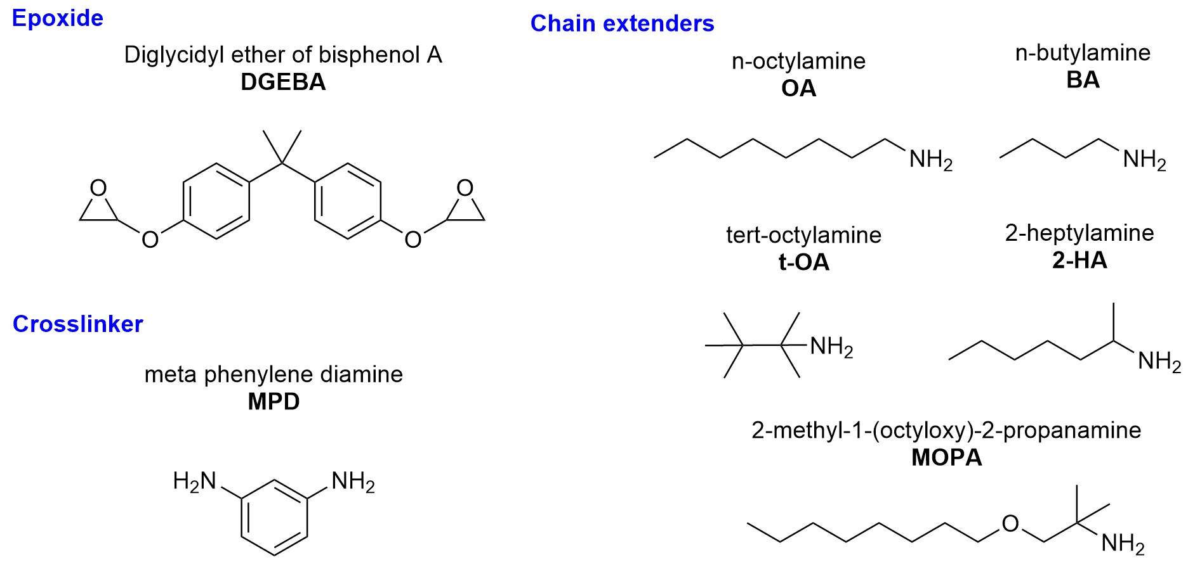
Toughness – SiO2 nanofiller system
Base system

Slide 3
Toughness results – SiO2 nanofiller

Slide 4
TEM imaging – SiO2 nanofiller
60 nm cut thickness
~20 nm particles
7.5 vol. % particles (butylamine system)

Slide 5
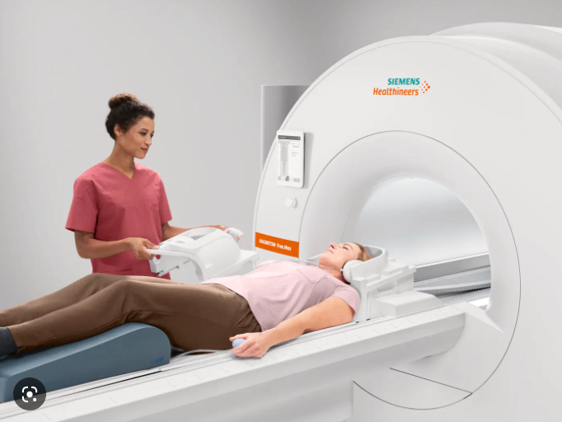
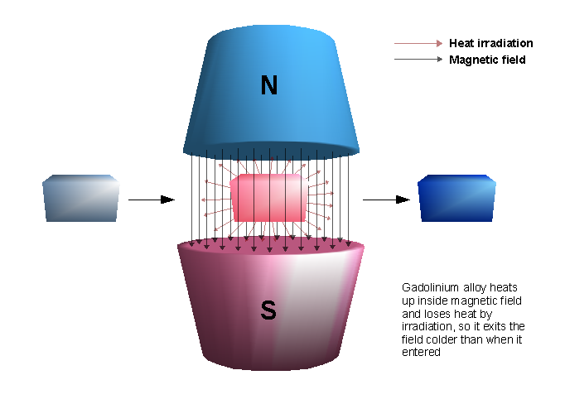
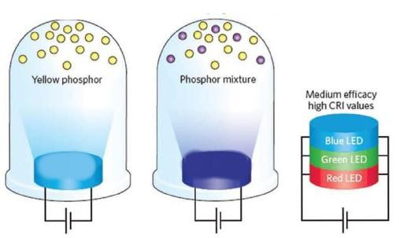
Project INSITU
Polyol synthesis of Gd2O3 NP
Crosslinking of polyol without purification
Final Epoxy resin
Dispersion & mechanical breakup of particle agglomerates is obsolete (particles pre-dispersed)
Gadolinium Oxide nanoparticles
MRI imaging (High magnetic moment)
Magnetic refrigerant (Magnetocaloric effect ~2-20K)
Fluorescent phosphor (Doping with other RE’s)

Slide 6
Classical Polyol method recap
Classical polyol method
Polyalcohol solvent + NaOH + Gd-Salt
Dissolution of precursor, heating 100-200°C
Gives nanoparticles + NaCl
Low conversion efficiency
Not easy to separate particles
NaOH / NaCl /…
Particles
Fig.1 : Initial classical polyol syntheses, SEM of product after
Solvent exchange & drying

Slide 7
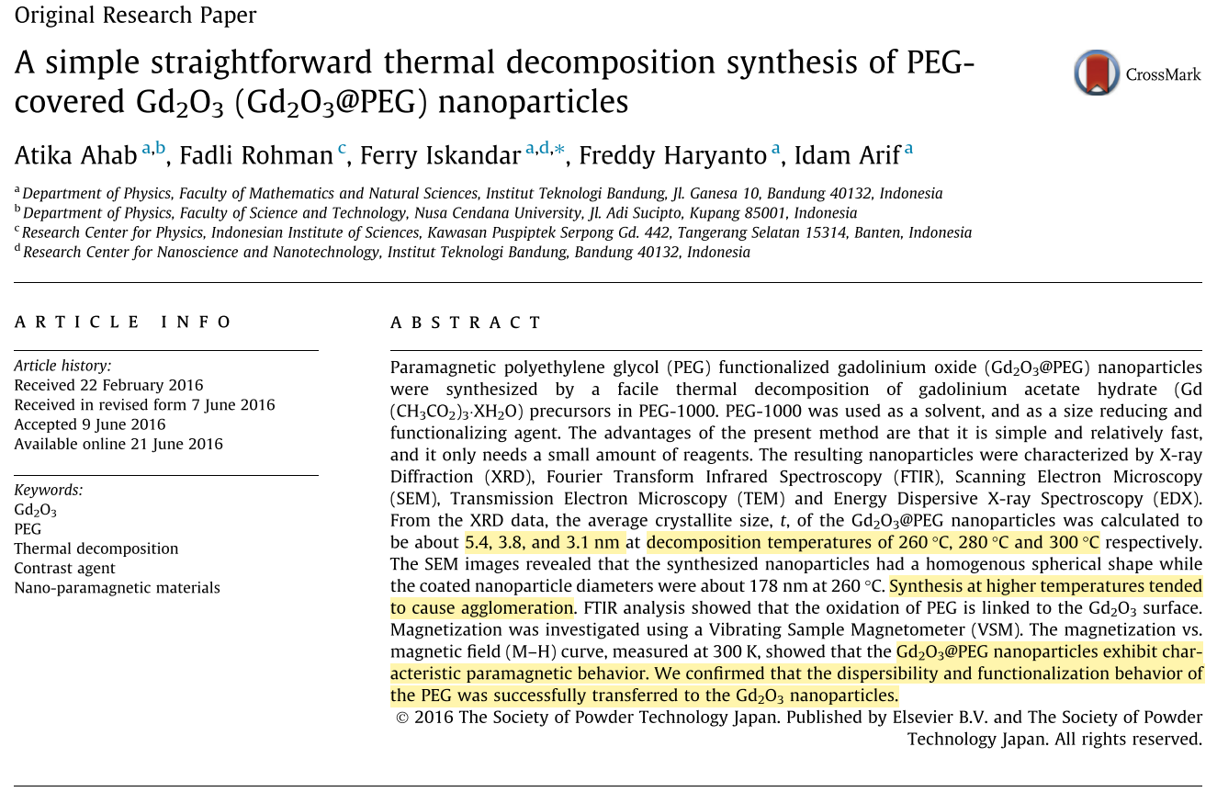
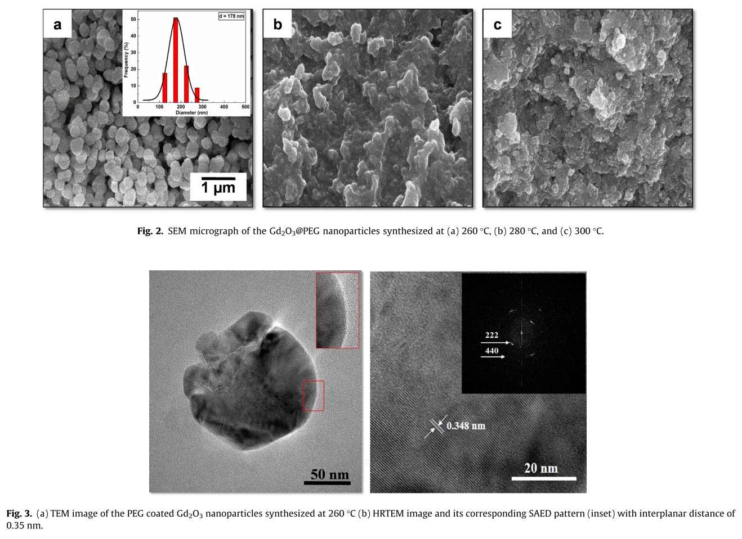

Thermal decomposition paper
Basis research paper
Thermal decomposition of Gd(CH3COO)3 hydrate at 260°C
Solvent: PEG-1000
Particle sizes: ~200 nm
Crystallite sizes: ~4 nm
Gd2O3 confirmed
PEG-1000 partially decomposes & acts as surface capping agent
Research paper on which based new approach
Replace PEG-1K by EG (ethylene glycol)

Slide 8
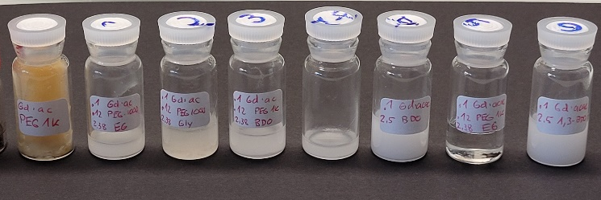
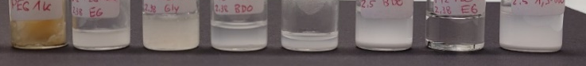
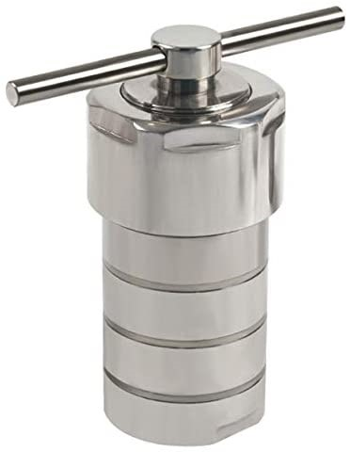
Basic experiments
Blank | Gd-ac, PEG-1K
S1 | 0.1g Gd-ac, 0.12g PEG-1K, 2.38g EG | Complete Dissolution at 150C Instantaneous formation of particles at 250°C
S2 | 0.1g Gd-ac, 0.12g PEG-1K, 2.38g Glycerol | Complete dissolution of pellets at 150°C No particle formation when heated to 250°C+
 | 0.1g Gd-ac, 0.12g PEG-1K, 2.38g 1,4-BDO | Dissolution of pellets from 160-170°C Sudden nanoparticle formation at 170-180°C
S4 | 0.1g Gd-ac, 2.5 1,4-BDO | Dissolution of pellets at 165°C "Particle formation" when cooled, but just precipitation of precursor probably Particle formation when heated to 200-250 with heatgun
S5 | 0.1g Gd-ac, 0.12g PEG-1K, 2.38g EG | Dissolution of pellets at 150°C No particles are formed when heated upto 200°C for 5 minutes in oil bath (Compare with sample3!)
S3-2 | sample 3 heated to 260°C | No visible change
S6 | 0.1g Gd-ac, 2.5g 1,3-BDO | Pellets dissolve at 165-170°C Sudden particle formation at 180-190°C
Ethylene glycol works, butanediol too, glycerol doesn’t
Ethylene glycol particles formed at 250°C (boiling point: 190°C)
Some PEG-1K stabilizes particles

Slide 9
Scanning electron micrographs
Particles synthesized in ethylene glycol, without PEG-1K
Hydrothermal reactor @ 250°C
Particles synthesized in ethylene glycol, with 5 wt. % PEG-1K
Hydrothermal reactor @ 250°C
Less prone to sedimentation

Slide 10
Scanning electron micrographs
Particles synthesized in 1,4-butanediol, with 5 wt. % PEG-1K
250°C
Particles synthesized in 1,3-butanediol, with 5 wt. % PEG-1K
250°C

Slide 11
TGA of commercial VS synthesized powders

Slide 12
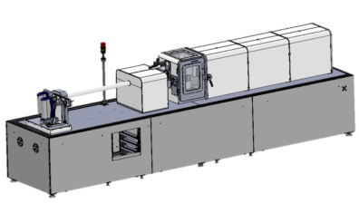
Wide-angle XRD Setup (Xeuss 3.0, G-floor, XRD platform)
Detector
Moving axis
High Flux beam profile
45 mm detector-sample distance
3 Detector positions
3 * 30 min irradiation time
Sample: 0.5 mm washer with kapton foil
Slits
Sample
Source
CuKa
1.54 A

Slide 13
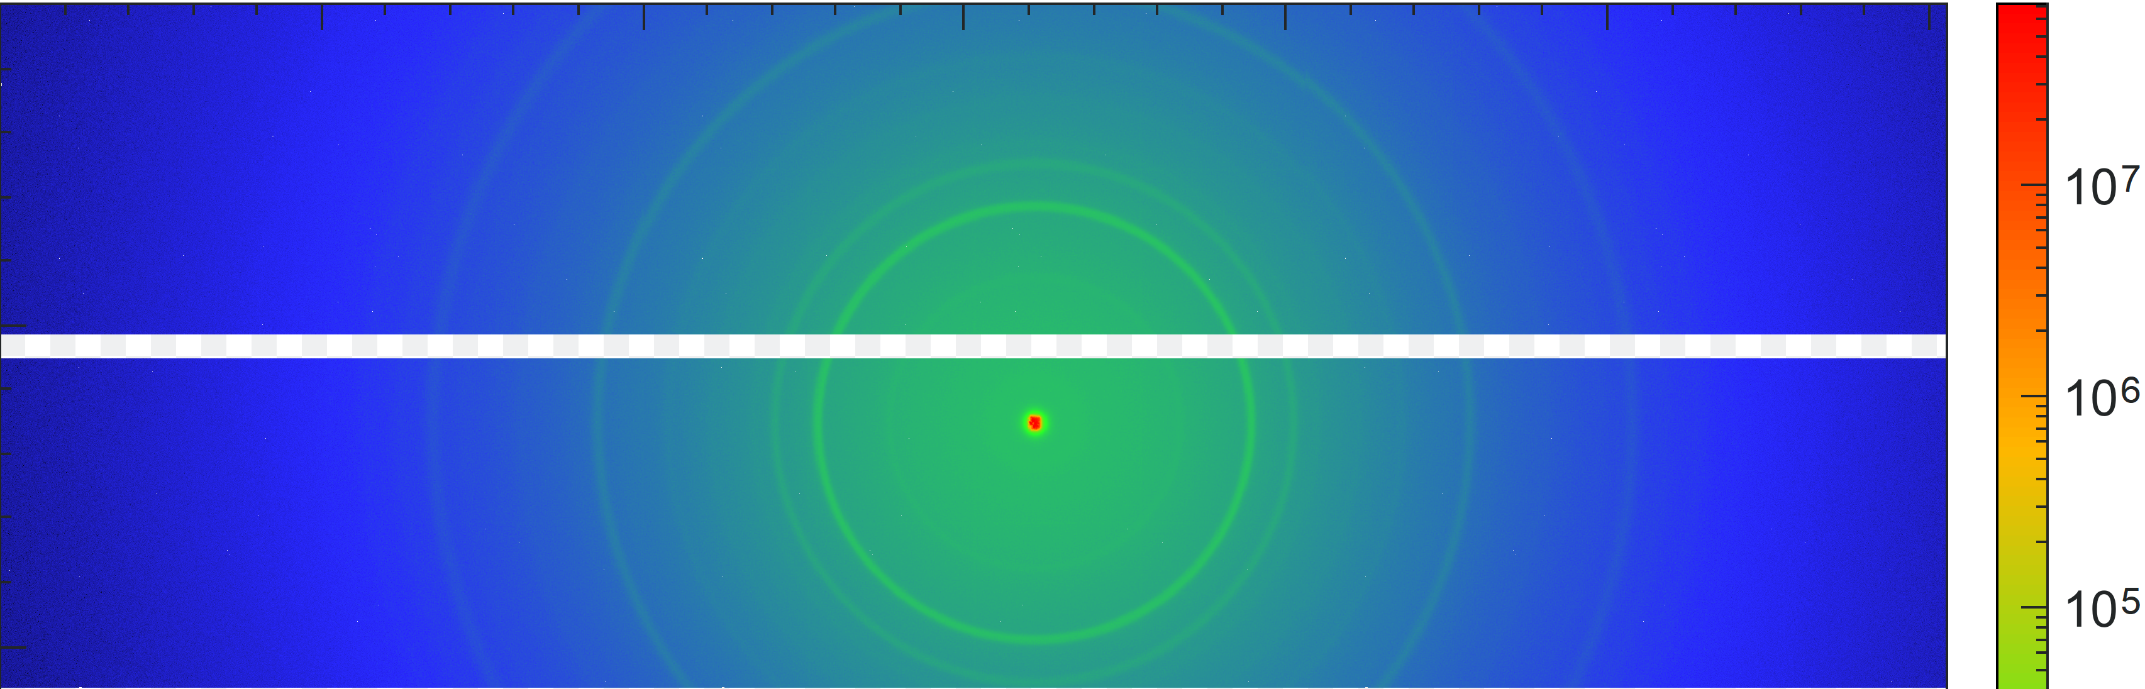
Wide-angle XRD before/after annealing at 800°C for 2 hours – Commercial powder
After annealing
Before annealing
Main peaks of cubic Gd2O3 present after annealing
Before annealing not
45 mm detector-sample distance, 3*30 min irradiation, Hi-Flux beam profile
Before annealing
(222)
(440)
(400)
(622)

Slide 14
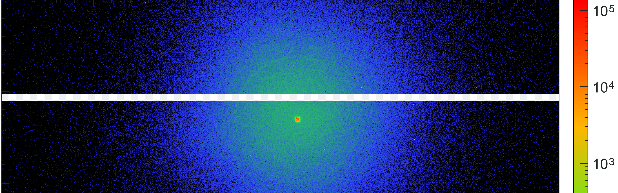
Wide-angle XRD before/after annealing at 800°C for 2 hours
After annealing
Main peaks of cubic Gd2O3 present after annealing
Beam transmission: Factor 1000 lower (?!) Denser packing?
Less prominent than for the commercial particles
Before annealing
(222)
(400)
(440)
(622)

Slide 15
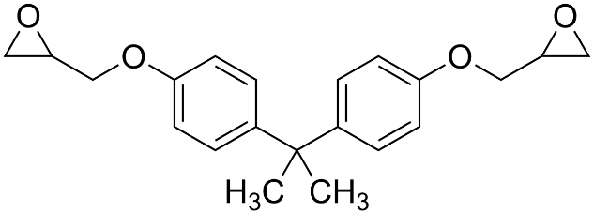
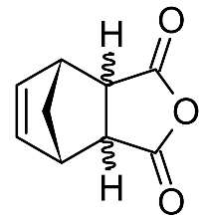
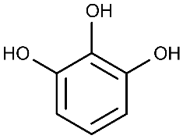
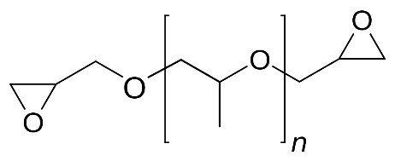
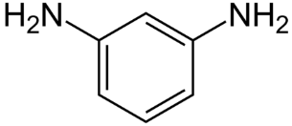
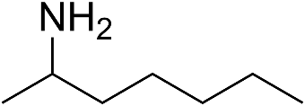
Resins
Custom weak acidic resin
→ CryoSet III
CryoSet II Resin
Commercial resin (CTD-101K)
+Accelerator
DGEBA, Pyrogallol, PPG-DGE
Weakly acidic (aromatic –OH)
Extremely long pot-life
PPG-DGE adjusts toughness & Tg
DGEBA, MPD, 2HA
Long pot-life
High toughness
Alkaline
Industry standard resin
Functionalized vs non-functionalized samples
Commercial vs synthesized
Two (or three) resins
→ 2*2*2 = 8 samples
USAXS / SEM(TEM) / Mechanical properties / Drop-test

Slide 16
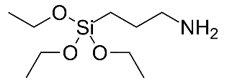
Particle functionalization
Alkaline surface funcitionalization → Isoelectric point > 7
→ Better stabilization in acidic media
-NH2 crosslinkable to
Epoxides
Isocyanates
EtOH
24h
+

Slide 17
Gd2O3 nanoparticles Characterization
XRD: Crystal structure & Material ✔
USAXS: Dispersion quality of composite June/July
SEM/TEM: Dispersion quality of composite June/July
SEM: Particle shape & size ✔
Isoelectric point of Gd₂O₃: 7.5-9.5
At this pH, no net charge on particle surface → agglomeration most probable
Move pH away from IEP → increase acidity of surrounding medium

