Slide 1
EXALAT Benchmarking
Ed Bennett
ExaTEPP Workshop, 2023-06-22

Slide 2
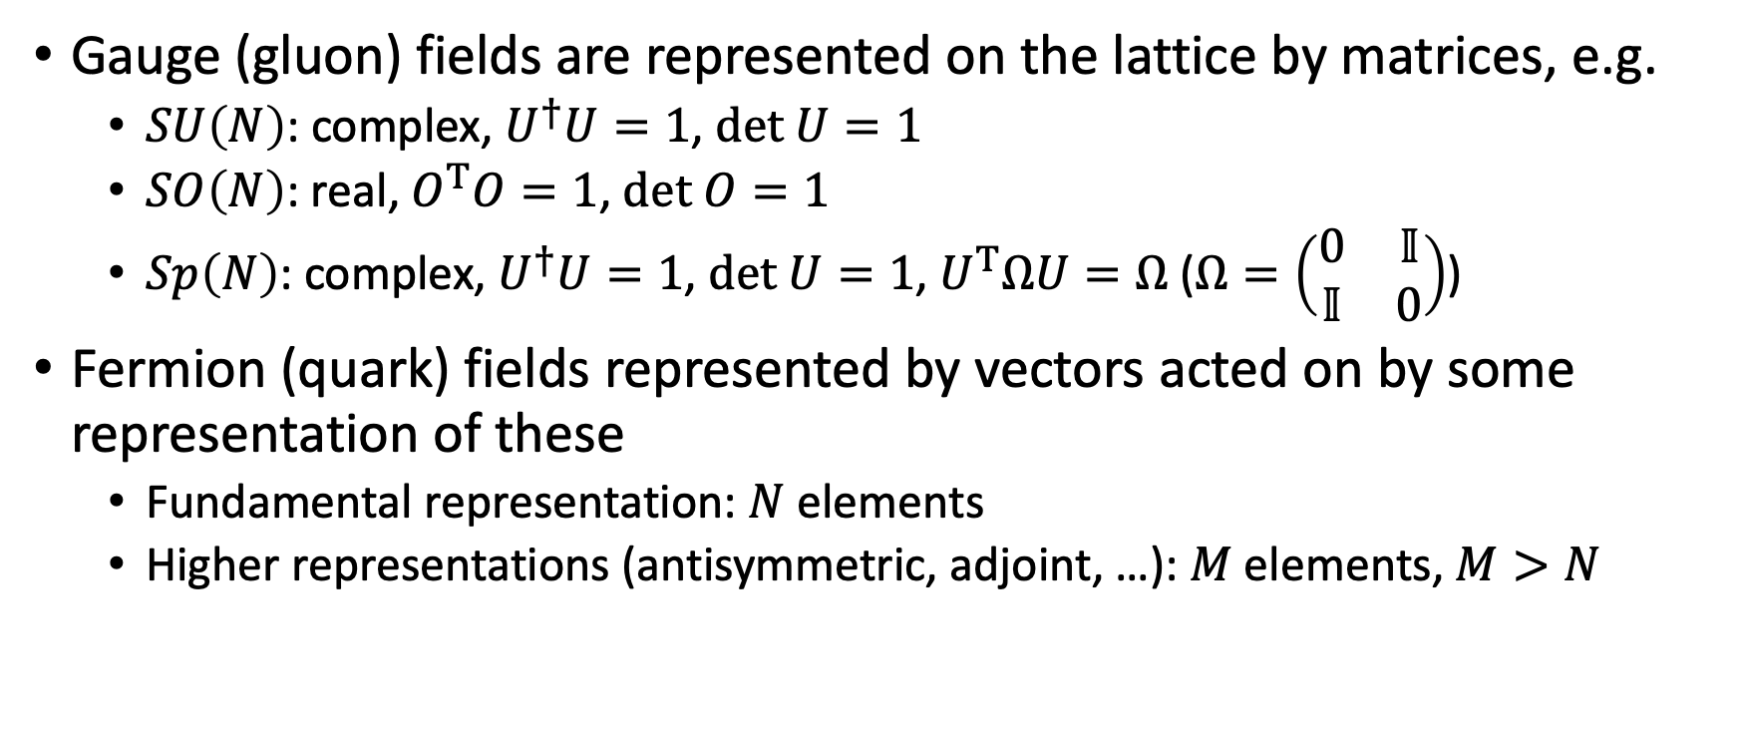
Group theory
Gauge (gluon) fields are represented on the lattice by matrices, e.g.
  $SU\left(N\right)$: complex, $U^{†}U=1$, $det U=1$
  $SO\left(N\right)$: real, $O^{T}O=1\text{, }det O=1$
  $Sp\left(N\right)$: complex, $U^{†}U=1$, $det U=1$, $U^{T}ΩU=Ω$ ($Ω=\left(\begin{matrix}0 & 𝕀 \\ 𝕀 & 0\end{matrix}\right)$)
Fermion (quark) fields represented by vectors acted on by some representation of these
  Fundamental representation: $N$ elements
  Higher representations (antisymmetric, adjoint, …): $M$ elements, $M>N$

Slide 3
Codes for Lattice QFT
HiRep
Grid
Pica et al.
Boyle et al.
Started ~2007
C, with C++/Perl code generator
Heavy use of preprocessor macros
Support general SU(N), SO(N)
  Sp(2N) theories in fork, since 2018
Supports general 2-index rep
Historically CPU-only
Started ~2013
C++
Heavy use of templating, expression templates
Supports SU(N) (esp. SU(3))
  Sp(2N) theories in fork, since 2023
Supports general 2-index fermion representation
  Bias towards fundamental rep
CPU (AVX2/512/QPX), GPU (CUDA, HIP, SYCL)

Slide 4

Jarno Rantaharju, Supercomputing Wales
Benchmarks the CG inversion of the Dirac operator
  Primary consumer of FLOPs in production code
  Fixed iteration count
Tests six different theories (varying gauge group, fermion rep)
  Changes the relative demands on on-node compute, inter-node comms
Strips down HiRep
  Removes code generator
  Removes unused function
  <10k SLOC
First version released 2018

Slide 5
Shoplifter
Michele Mesiti, EXALAT
Extracting by hand is time-consuming
Instead, use pycparser to extract and prune call graph
Automatically generate headers and remove any dead code
Shoplifter then generates a packaged SOMBRERO

Slide 6
Grid benchmarks
Extensive set of unit benchmarks built into Grid
  Dirac operator application (at various volumes, fermion formulations)
  Disk I/O
  Memory bandwidth

Slide 7
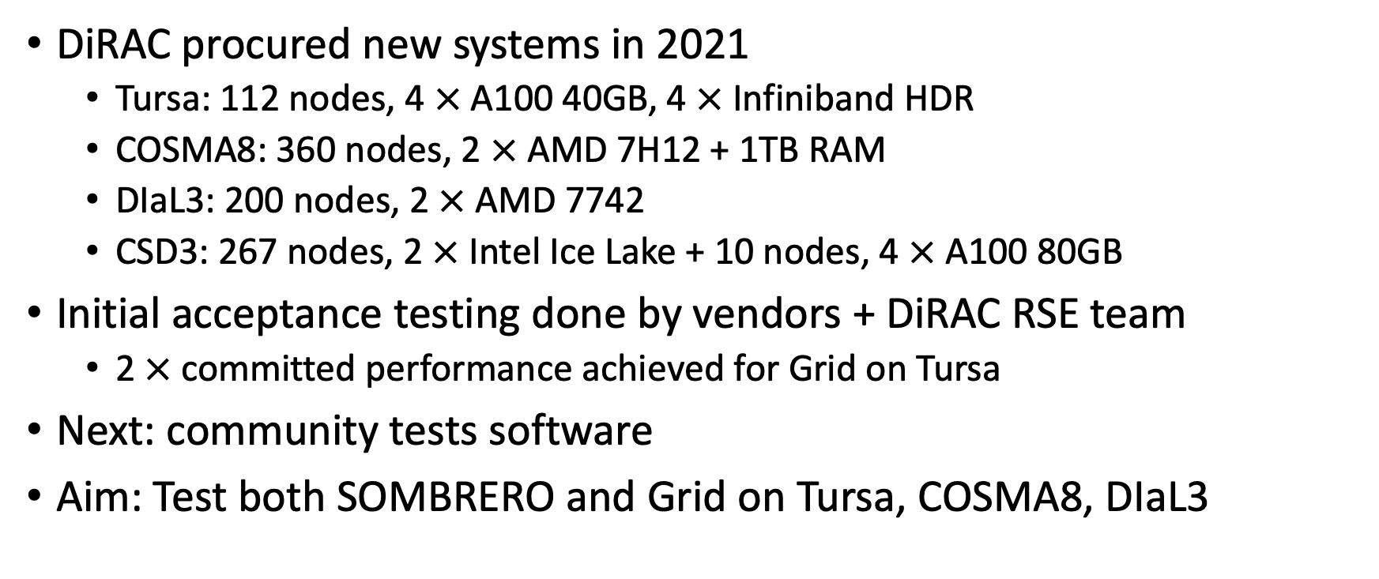
DiRAC Technical Commissioning
Michele Mesiti + EB, EXALAT
DiRAC procured new systems in 2021
  Tursa: 112 nodes, 4 $×$ A100 40GB, 4 $×$ Infiniband HDR
  COSMA8: 360 nodes, 2 $×$ AMD 7H12 + 1TB RAM
  DIaL3: 200 nodes, 2 $×$ AMD 7742
  CSD3: 267 nodes, 2 $×$ Intel Ice Lake + 10 nodes, 4 $×$ A100 80GB
Initial acceptance testing done by vendors + DiRAC RSE team
  2 $×$ committed performance achieved for Grid on Tursa
Next: community tests software
Aim: Test both SOMBRERO and Grid on Tursa, COSMA8, DIaL3

Slide 8
DiRAC Technical Commissioning: Approach
Test all available compilers, MPI implementations
  On 1 node; on many nodes
Test scaling of best-performing setup
Collate data from output files to create comparison plots
Automate as much as possible
  Shell scripts, Jupyter notebooks
Push all data and scripts to DiRAC Technical Commissioning repo

Slide 9
Comparing compilers for SOMBRERO
Higher is better

Slide 10
Comparing compilers for Grid
Higher is better

Slide 11
Scaling for SOMBRERO
Higher is better; flat = no improvement

Slide 12
Scaling for Grid
Higher is better; flat = perfect scaling

Slide 13
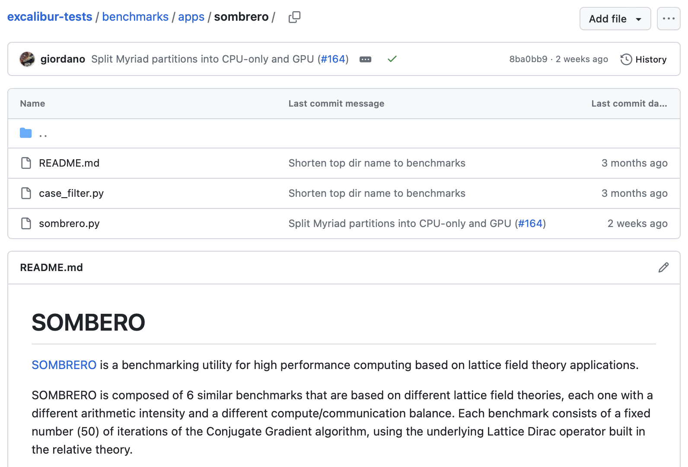
ExCALIBUR Benchmarking
Michele Mesiti, EXALAT
Quasi-automated benchmarking suite based on Spack and ReFrame
SOMBRERO adapted into this framework

Slide 14
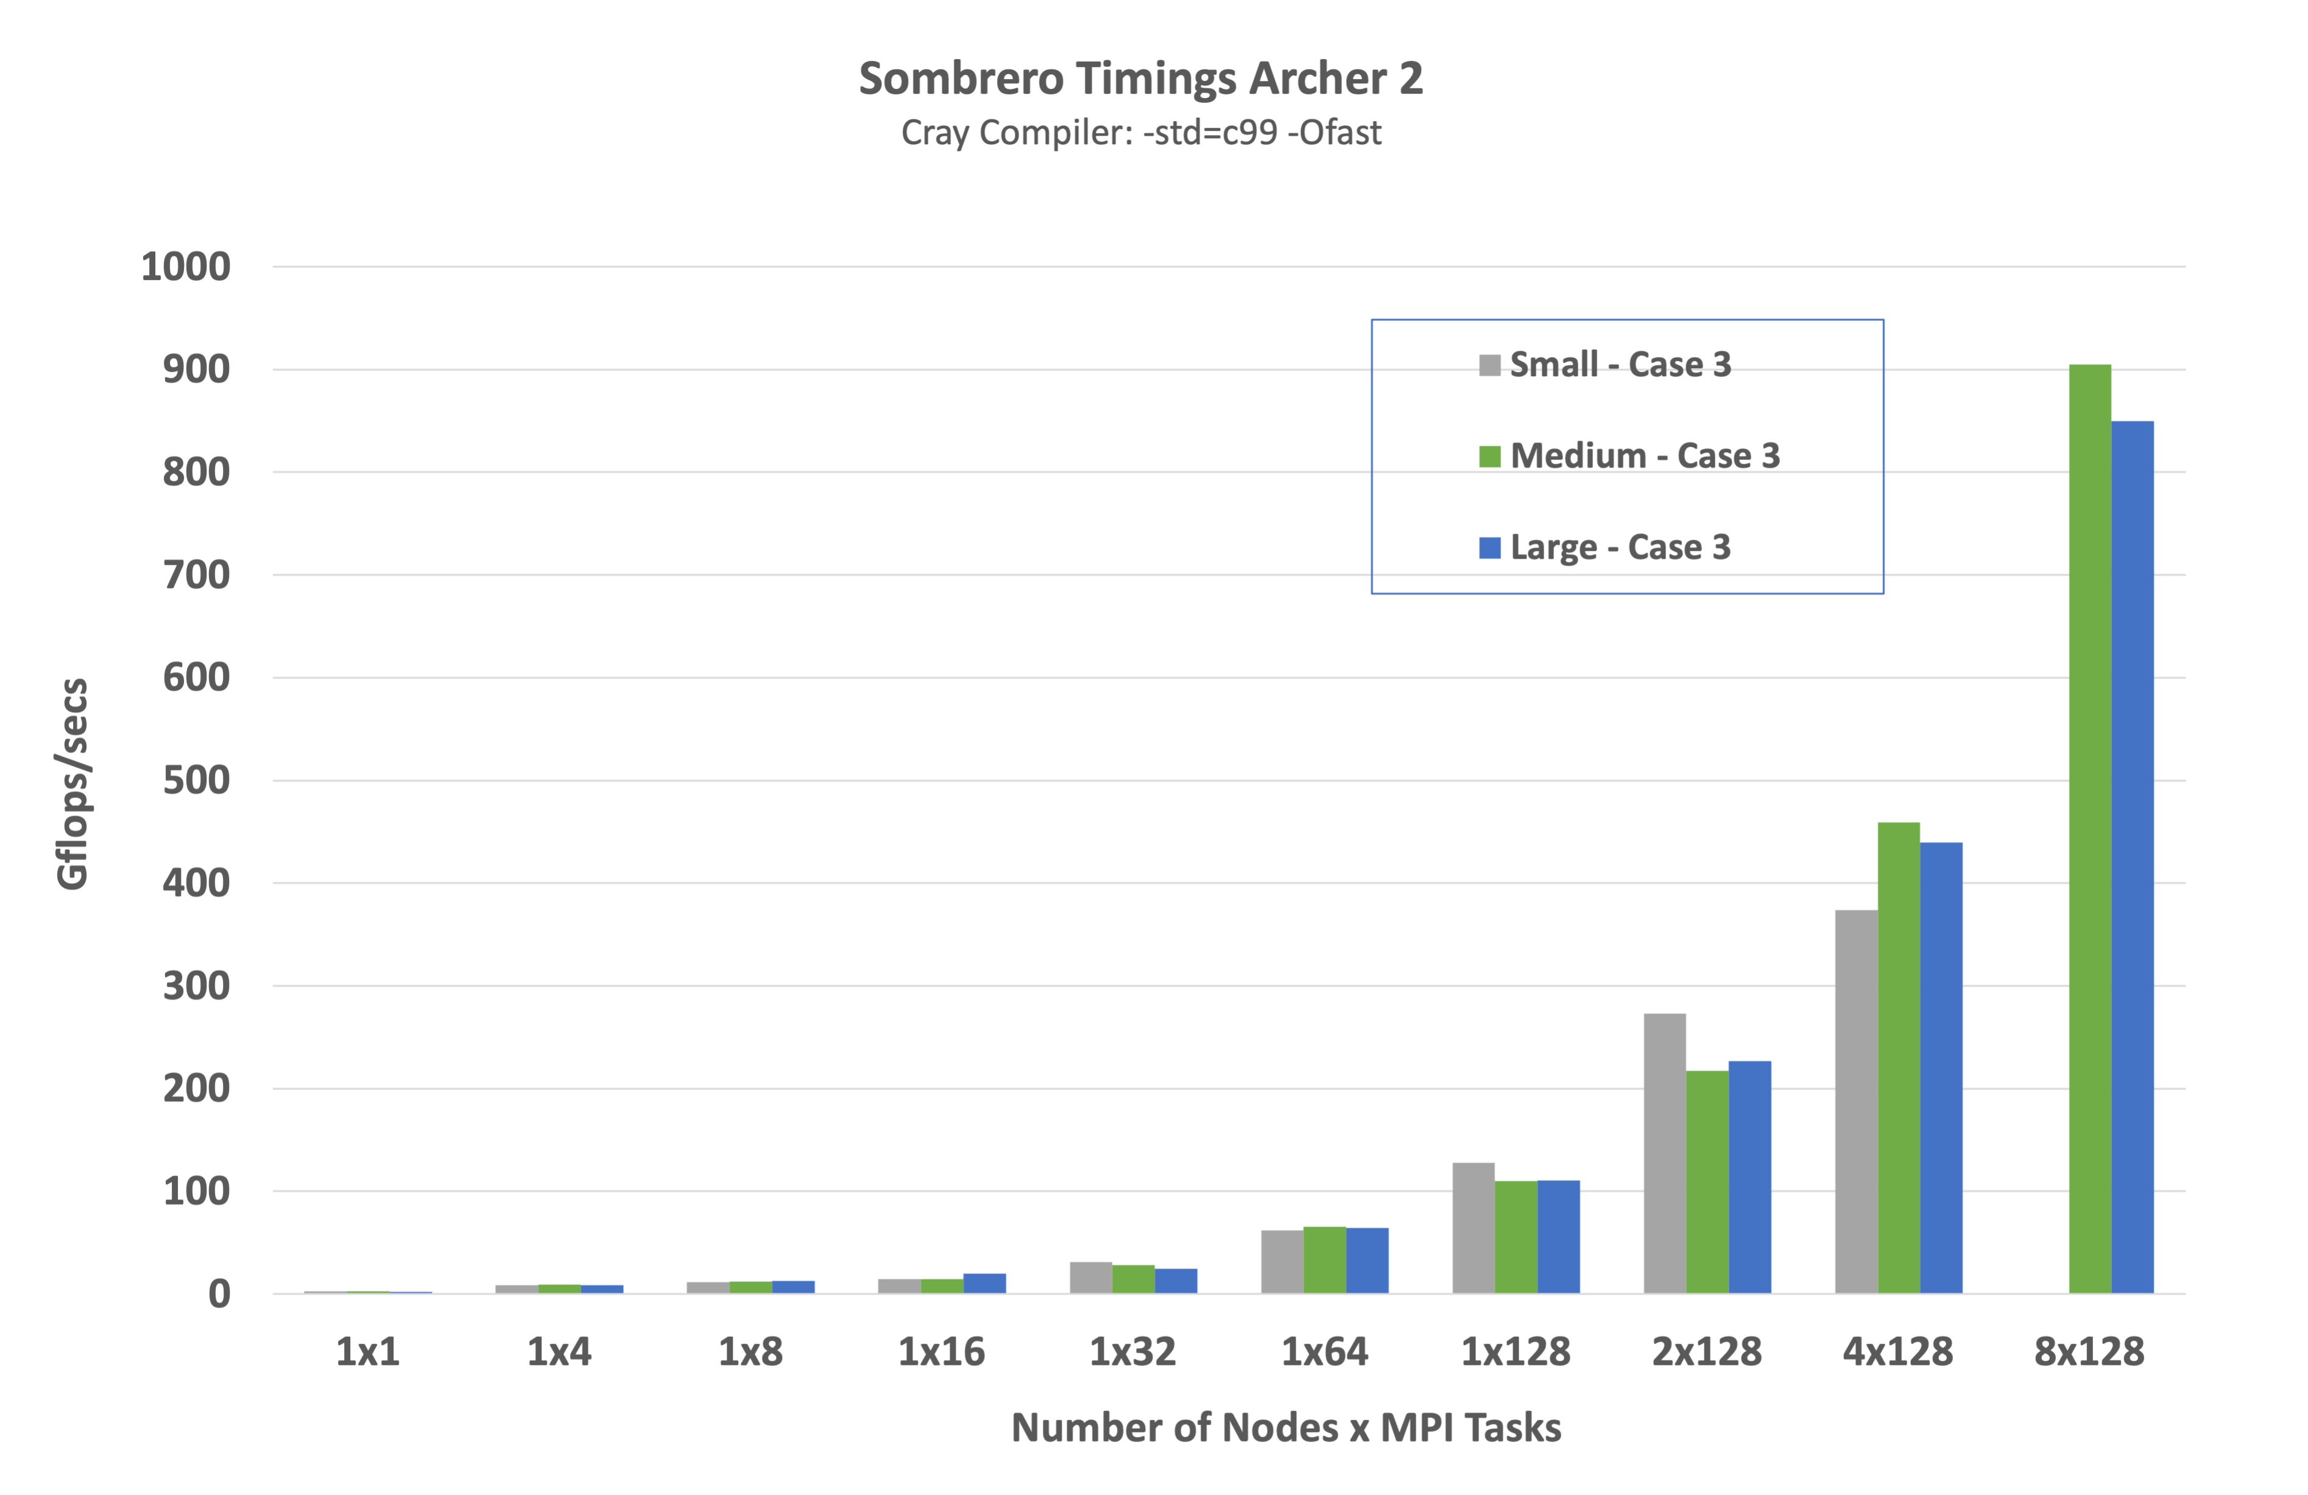
Continuous Benchmark
Andy Sunderland, EXALAT

Slide 15
Other outcomes
Lattice benchmarks (SOMBRERO and predecessors + Grid) have also
  Identified performance issues on new machine setups
  Identified compiler bugs on new architectures
  Contributed to procurement decisions and acceptance tests
  Been used by vendors internally

Slide 16
Tasks for ExaTEPP
HiRep development has moved on
  CUDA branch under active development
  Shoplifter no longer compatible; needs updating
Upcoming DiRAC uplift
  Repeat previous technical commissioning exercise
  Ideally now with SOMBRERO on GPU as well
ExCALIBUR test beds
  Some are compatible with Grid and/or HiRep, so want benchmarking

