Slide 1
SPS Wire Scanner Task Force
Impedance studies
Michael Sullivan

Slide 2
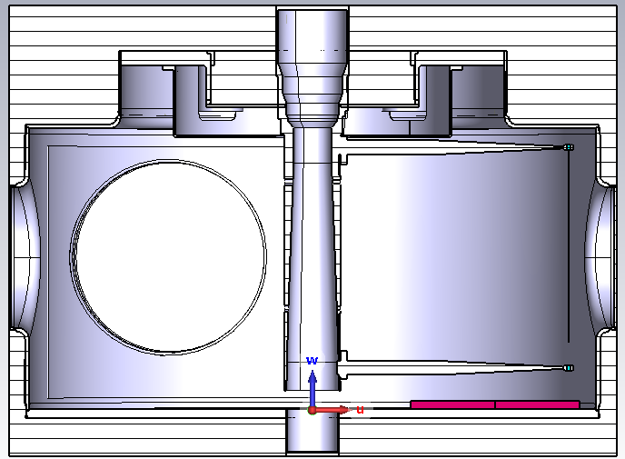
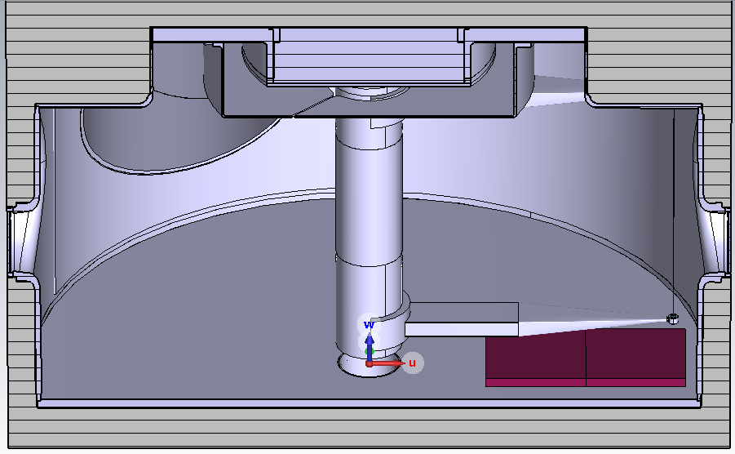
Mitigation option – TT2-111R Ferrite

Slide 3
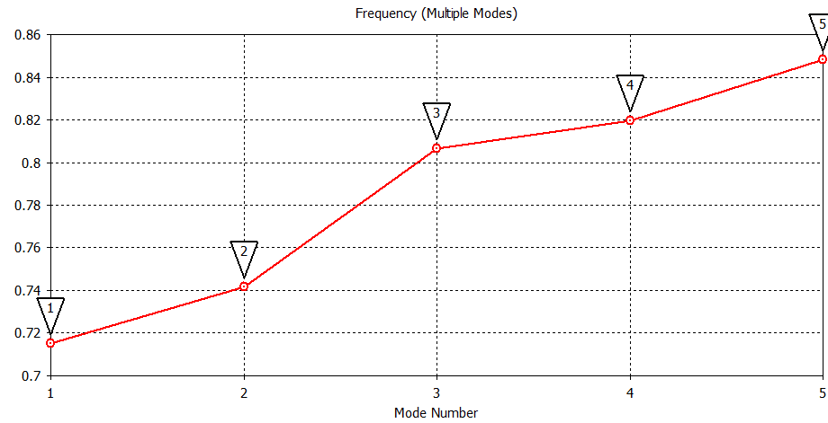
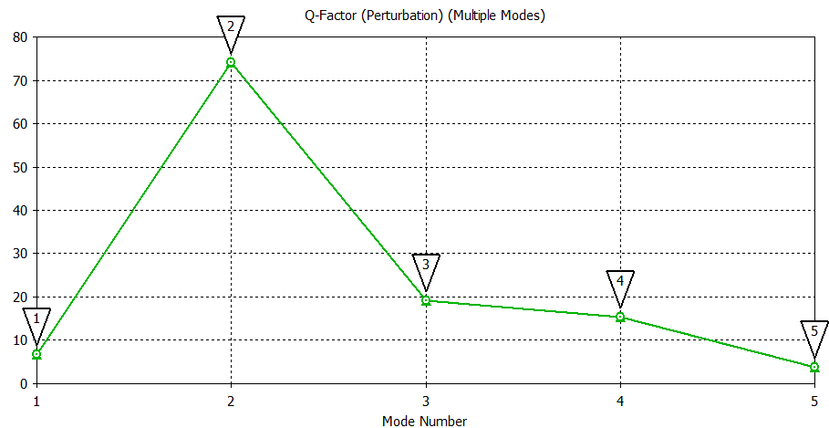
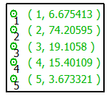
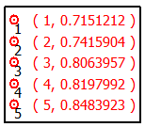
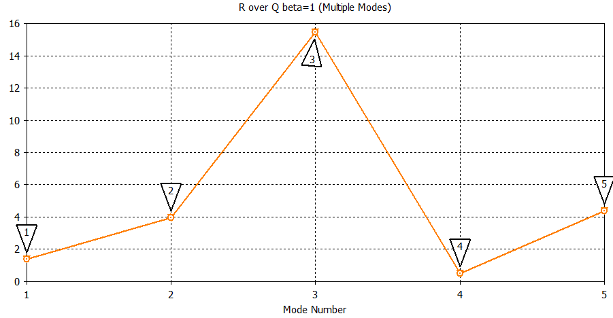
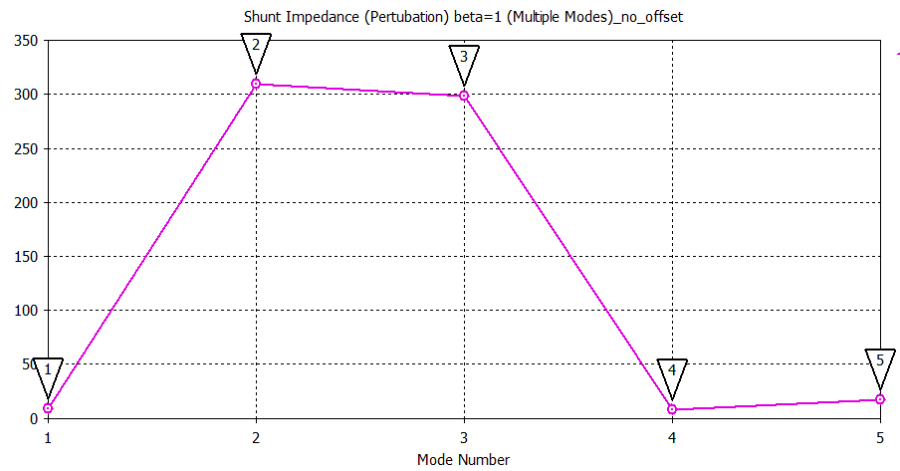
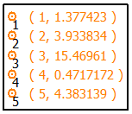
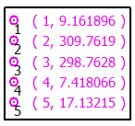
Mitigation option – TT2-111R Ferrite

Slide 4
Mitigation option – TT2-111R Ferrite
Mode | f [GHz] | Zsh [Ω] | Q | R/Q [Ω] | Disp on wire [%]
1 | 0.715 | 4.58 | 6.7 | 0.7 | 43.9
2 | 0.742 | 155 | 74 | 1.97 | 17.2
3 | 0.806 | 149 | 19 | 7.73 | 1.38
4 | 0.820 | 3.71 | 15 | 0.24 | 0.11
5 | 0.848 | 8.57 | 3.7 | 2.19 | 2.5
  For minimal heating we want:
    Frequency not on beam spectrum harmonic
    Lower shunt impedance (Zsh) – higher is ok if not near beam spectrum harmonic
    Higher Q gives sharper peak – Lower Q gives broadband contribution
    R/Q is a measure of the coupling between EM fields and beam
    Disp on wire is the H-field losses on the carbon wire.

Slide 5
Summary
Setup | f [GHz] | Zsh [Ω] | Q | R/Q [Ω] | Disp on wire [%]
No feedthrough | 0.807 | 10381 | 1233 | 8.32 | 34
No feedthrough – filled opening | 0.807 | 10148 | 1180 | 8.50 | 36.5
Connected shaft | 0.812 | 5118.3 | 1343 | 3.79 | 25.4
TT2-111R Ferrite | 0.806 | 149 | 19 | 7.73 | 1.38
  Still to simulate/confirm results:
    Isolated forks in Macor
    Replace Macor by Vespel as isolated material.
    Other arrangements of connecting the shaft to wall
Wire Scanner as in SPS
Impedance mitigation options (feedthrough excluded)

