Slide 1
Beam spectrum, impedance and dissipated power
Niky, Giulia, Alice, Rama, Leo, Elena, Carlo, Christine, Michael and Benoit
for the IWG/ABP/RF teams

Slide 2
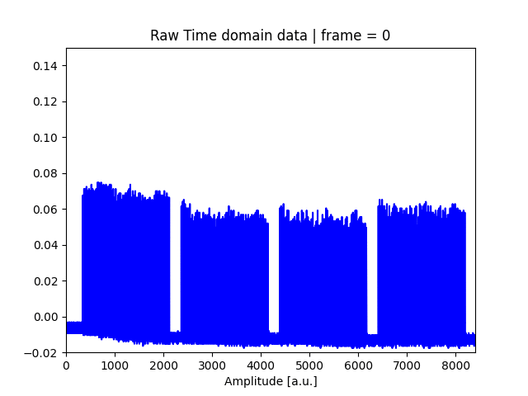
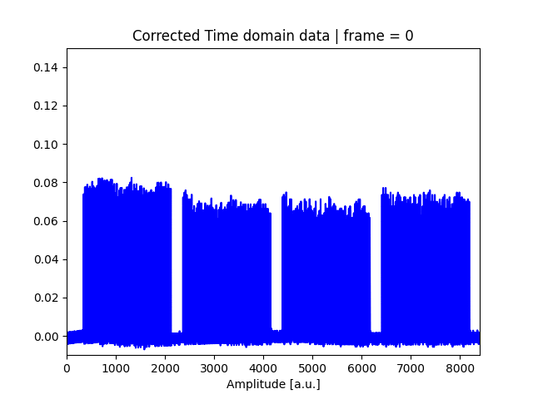
Beam spectrum measured during tests to reproduce the beam that broke the scanner
Same beam parameters, except bunch intensity left at 1.5e11 p/b to avoid disturbing the other users.

Slide 3
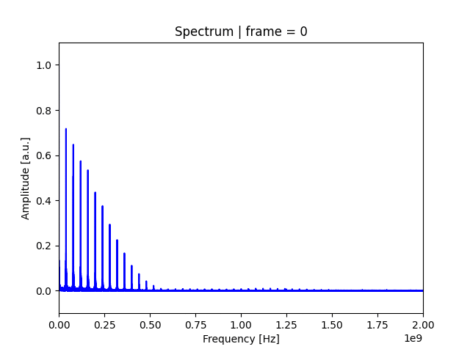
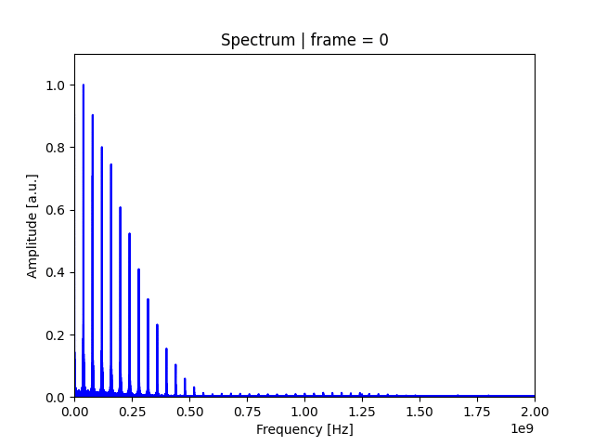
Frequency domain data
uncorrected
corrected

Slide 4
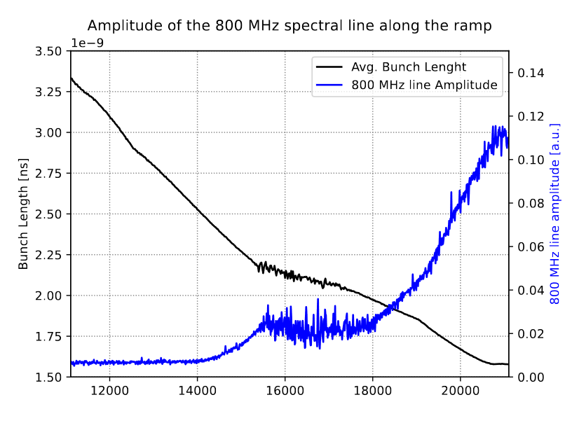
Beam spectrum along the cycle @ 800 MHz
→ Amplitude of 800 MHz line increases by a factor 30 between injection and top energy

Slide 5
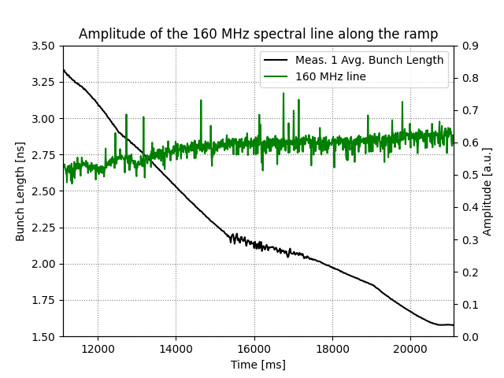
Beam spectrum along the cycle @ 800 MHz and 160 MHz
→ Amplitude of 160 MHz line does not change much when reducing bunch length

Slide 6
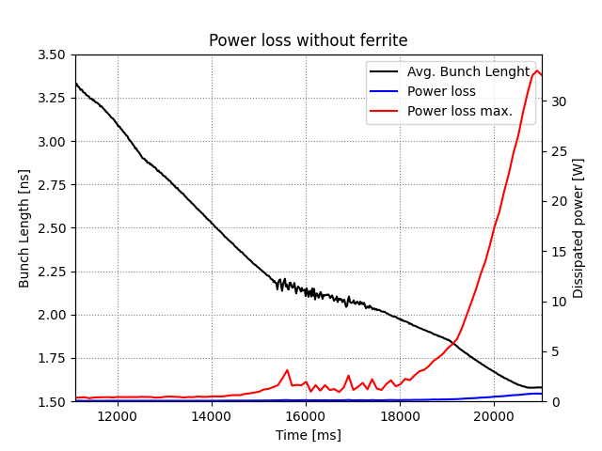
Impedance without ferrite (with feedthrough)
Eigenmode simulation without Ferrite (feedthrough still in)
  f= 786 MHz
  Rs = 1.7 kOhm
  Qr = 250
Measurement of beam spectrum can be affected by
errors and transfer function
Important to also check with Gaussian model and take
the most pessimistic case

Slide 7
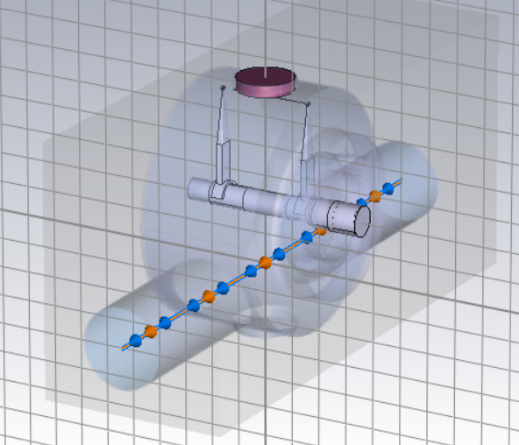
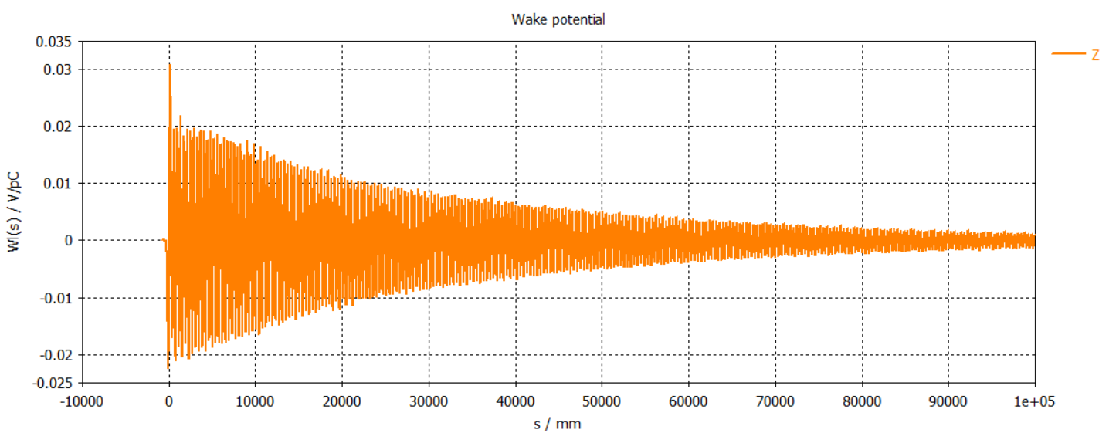
Impedance with ferrite in the viewport
→ Main modes have well decayed

Slide 8
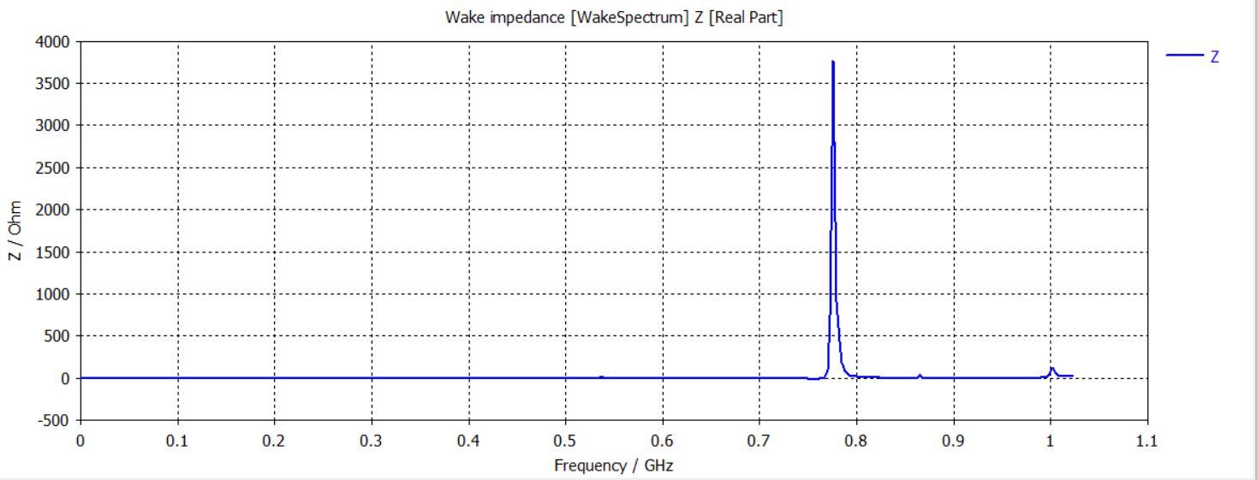
Impedance with ferrite (wakefield simulation)

Slide 9
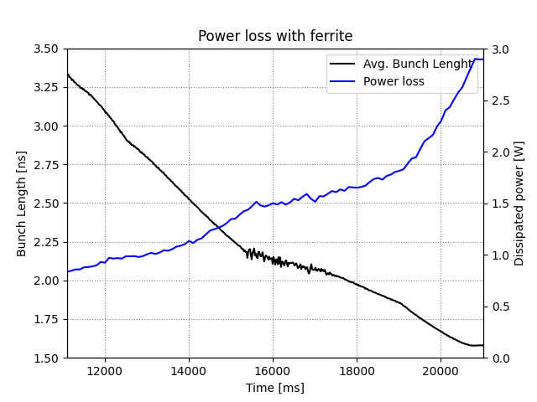
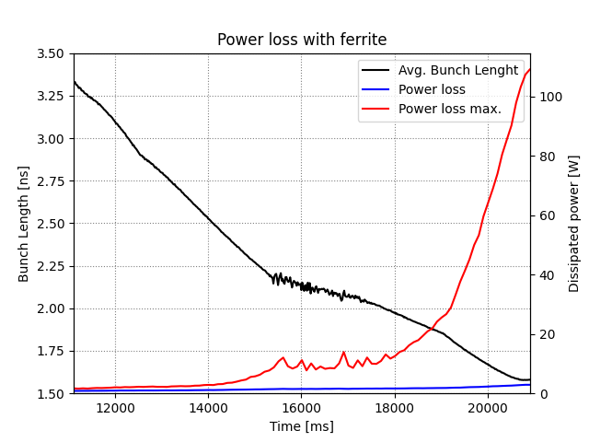
Power loss with ferrite
→ Potentially large power loss on ferrite for some time close to flat top

Slide 10
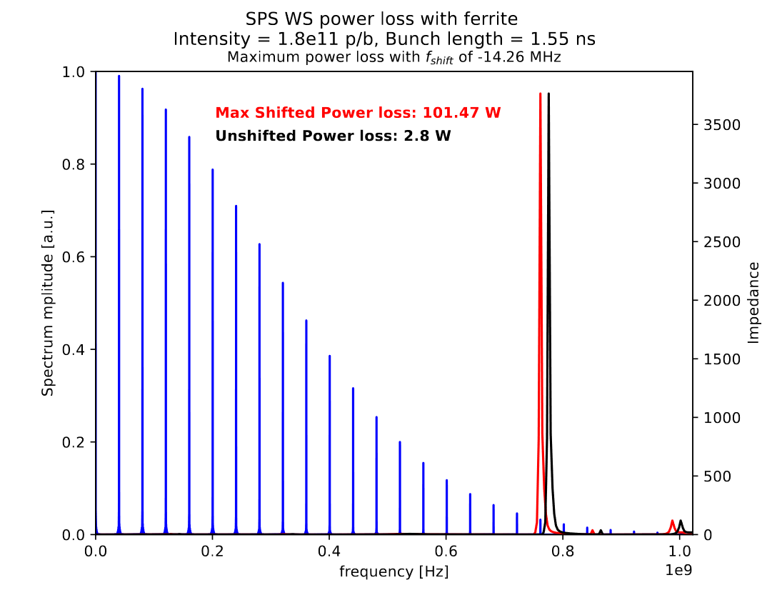
Power distribution

Slide 11
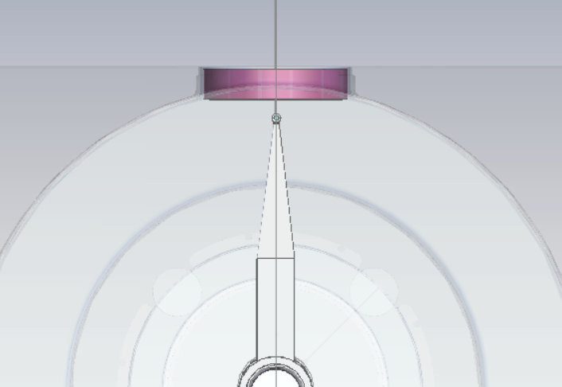
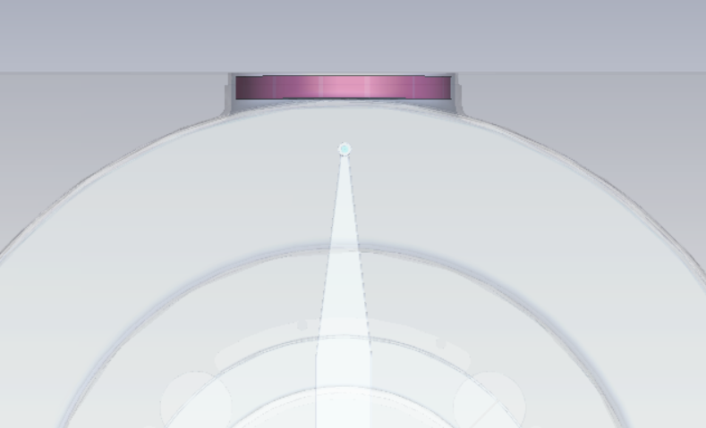
Next steps
Use a smaller ferrite that does not enter in the cylinder volume
Remove the feedthrough in wakefield simulations to see if should be kept or not
Identify the resonant frequency in measurements (for the ferrite or no ferrite case)

