Slide 1
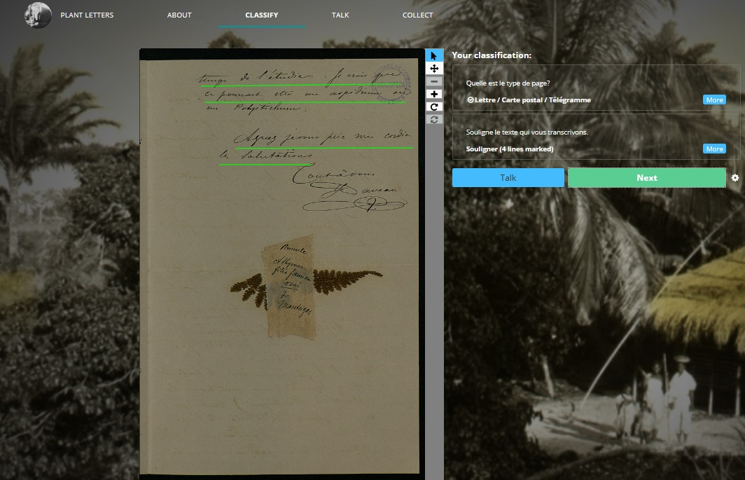
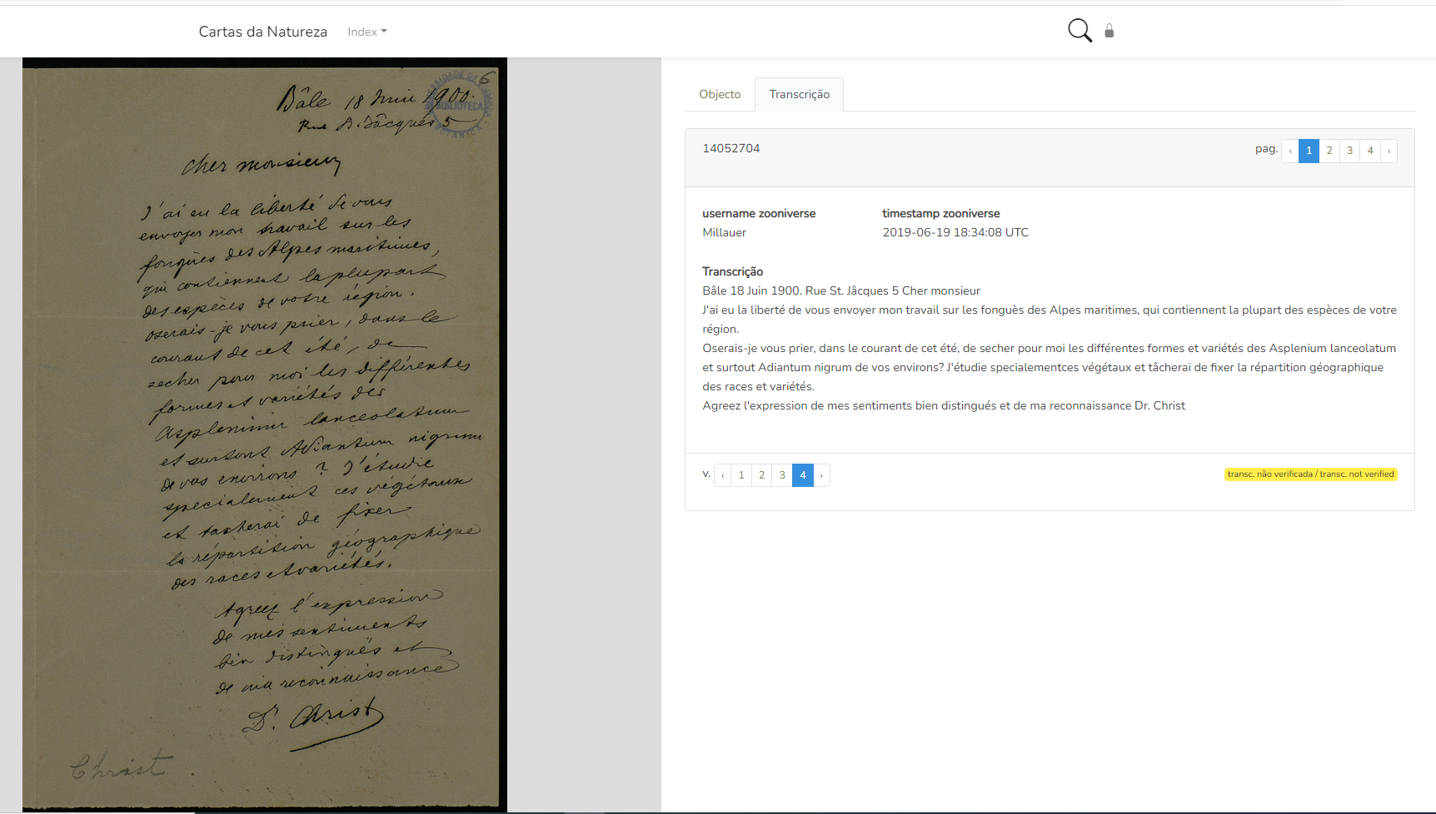
The importance of historical biodiversity data transcribed from botanical garden archives: results from the citizen science project ‘Plant Letters’ on Zooniverse
Symposium on Scientific Archives| June 27-28, 2023
Ana Margarida Silva
anamargarida.silva@uc.pt
Joaquim Santos
António Carmo Gouveia

Slide 2
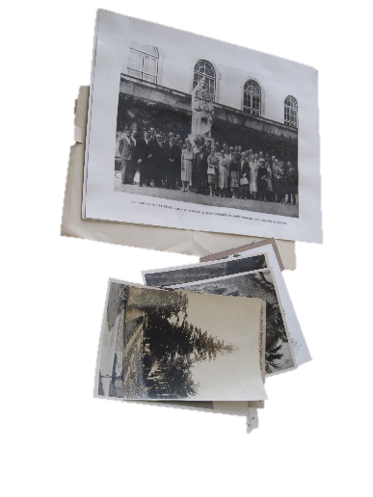
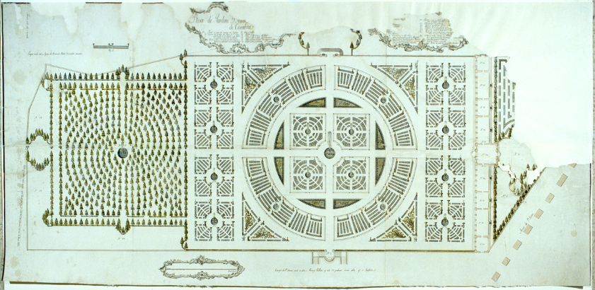
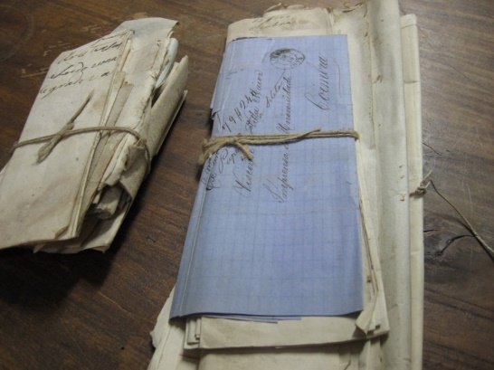
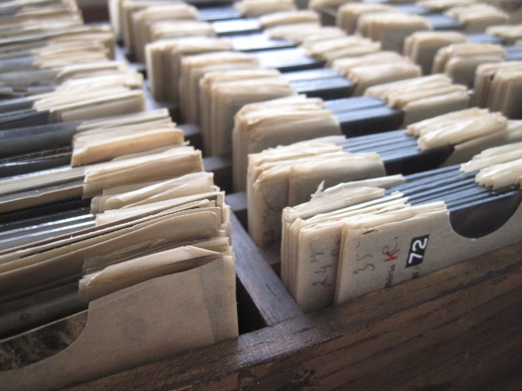
Botany in UC | archive
The Botany Archive was born from the activity of the Faculty of Natural Philosophy and the Botanic Garden of the University of Coimbra, from 1772.
Covering mainly the 19th and 20th centuries, the Botany Archive includes textual, photographic and filmic information from the Botanic Garden (part in the UC Archive), the Botanical Institute (DCV), the Botanical Museum (today in the UC Science Museum) and UC Herbarium.

Slide 3
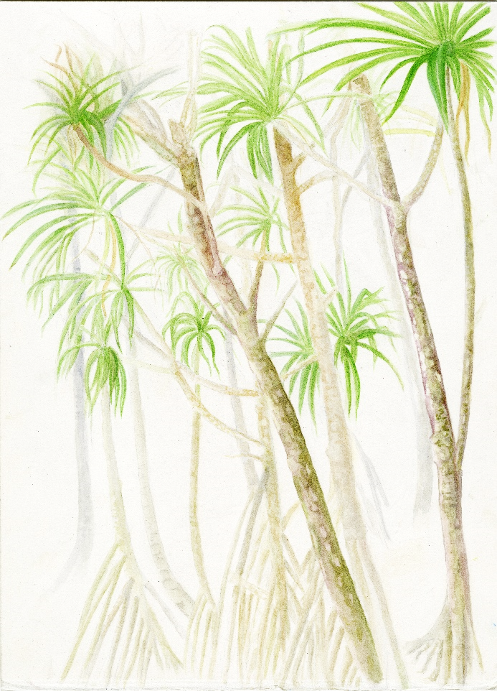
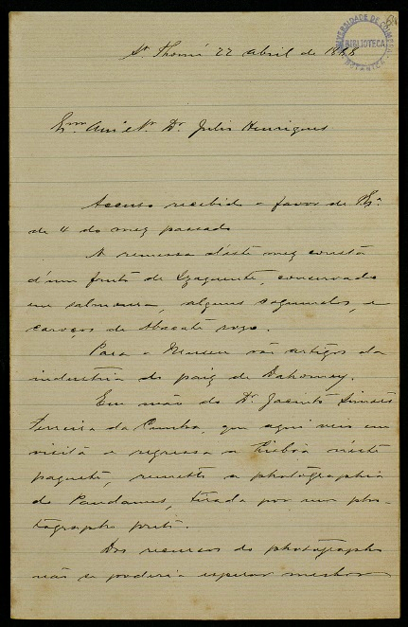
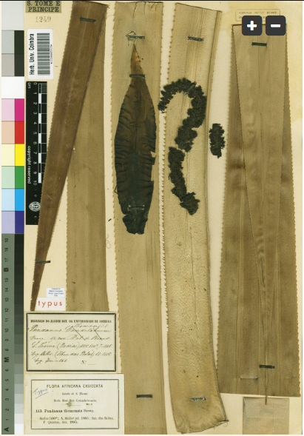
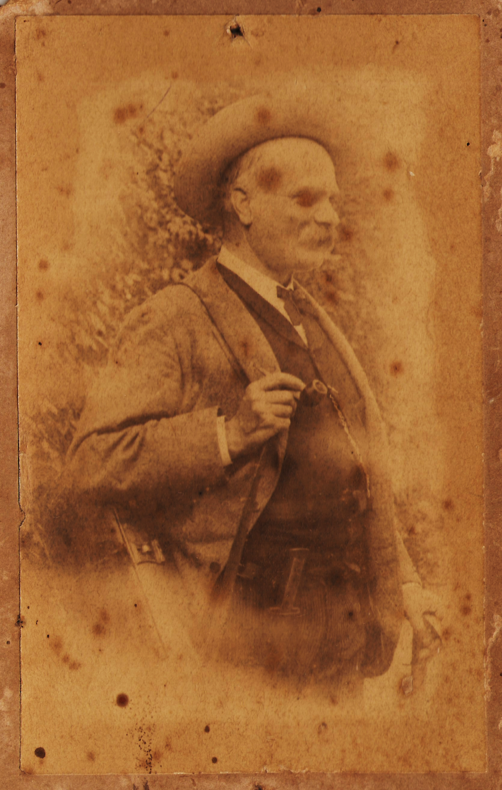
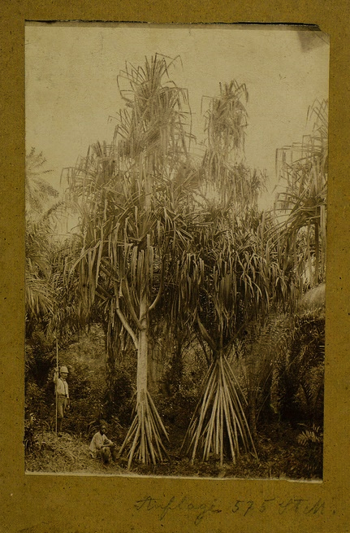
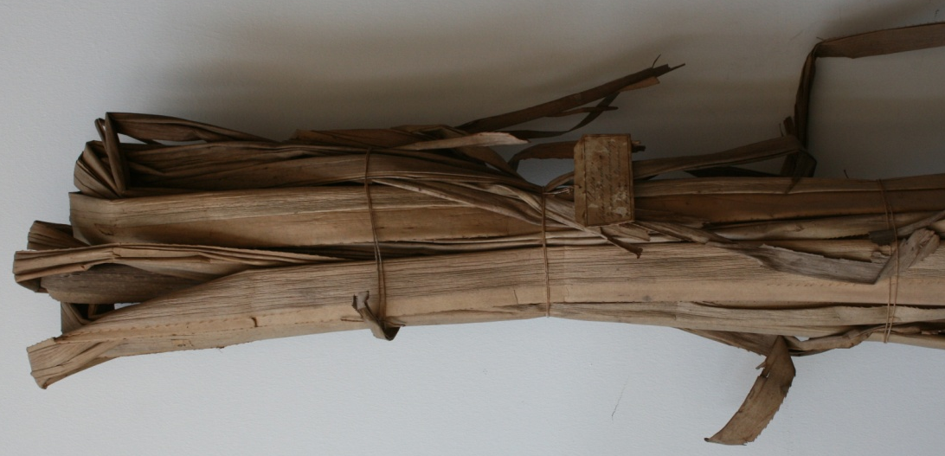
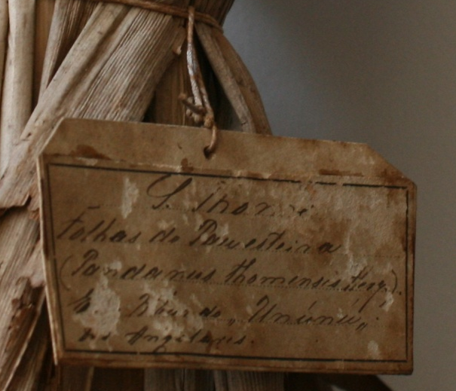
Botanic Archive and Botanic Collections
Pandanus thomensis Henr. (pau-esteira)
Notes:
Este slide mostra a diversidade de informação relacionada com as colecções de história natural que podemos encontrar nos arquivos:
Neste caso a identificação de uma planta desde o colector (fotografia Adolfo Moller) ao botânico que lhe deu o nome (J Henriques), uma carta a pedir amostras para São Tomé e uma fotografia da espécie na ilha de São tomé, onde é endémica. Mostra-se ainda o exemplar-tipo e informação associada na etiqueta

Slide 4
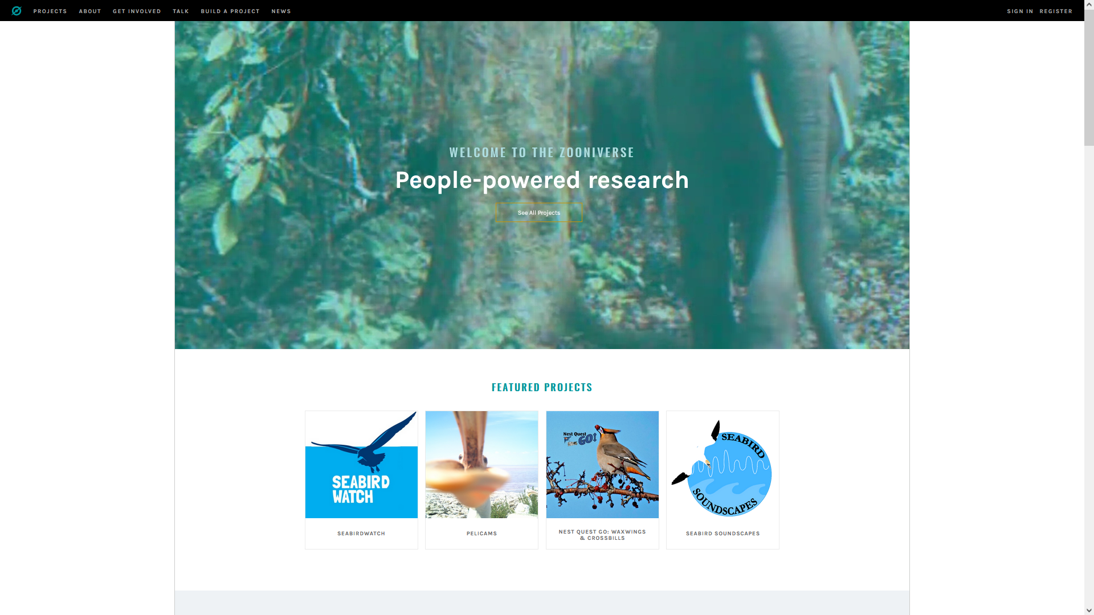


Slide 5
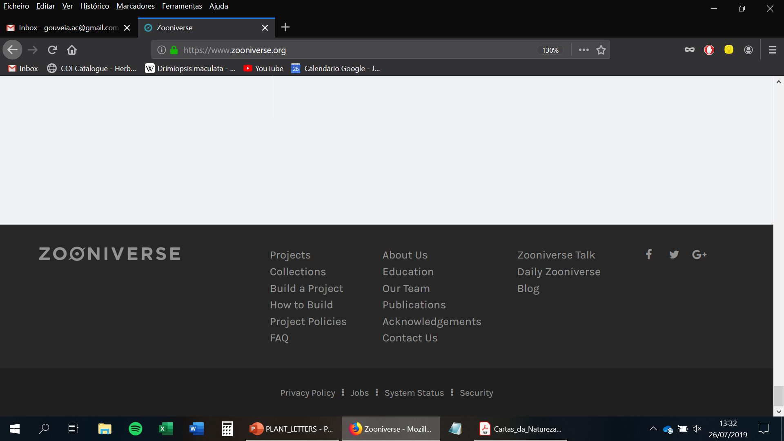
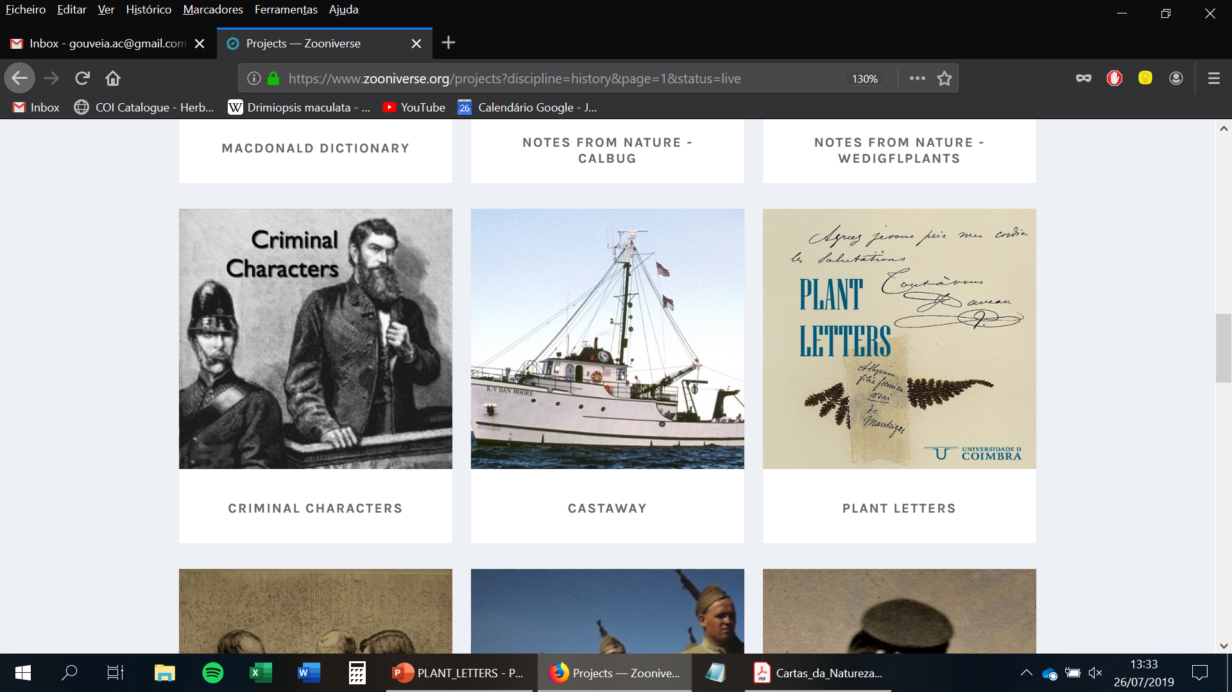
Plant Letters | Zooniverse
DATA TRANSCRIPTION
stages of the scientific processes of collecting, classifying and taxonomy of plants;
historical locations of plants, distribution areas and abundance of species;
records of the circulation of biological material (plant and seed exchanges);
participation of local assistants and indigenous knowledge systems
reconstruct the path of herbarium specimens and museum objects in the UC's natural history collections;
analyze the networks of botanical knowledge production.

Slide 6
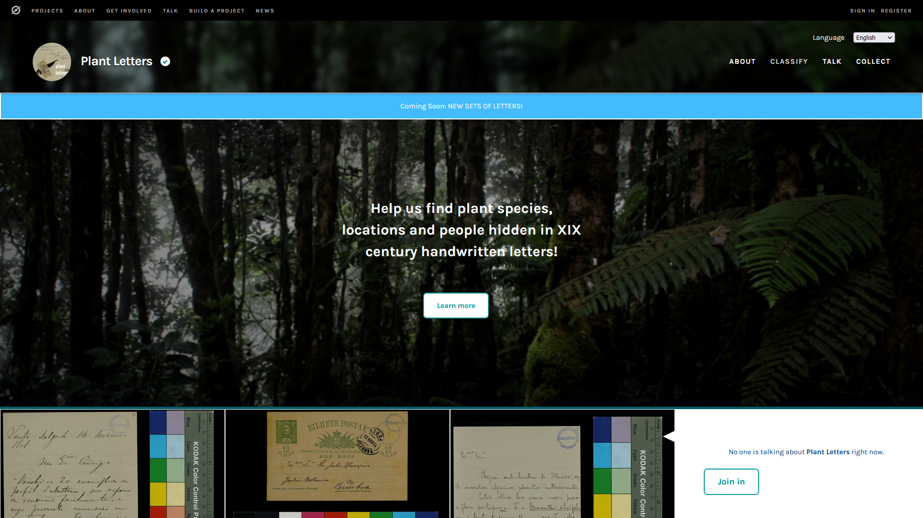

Slide 7
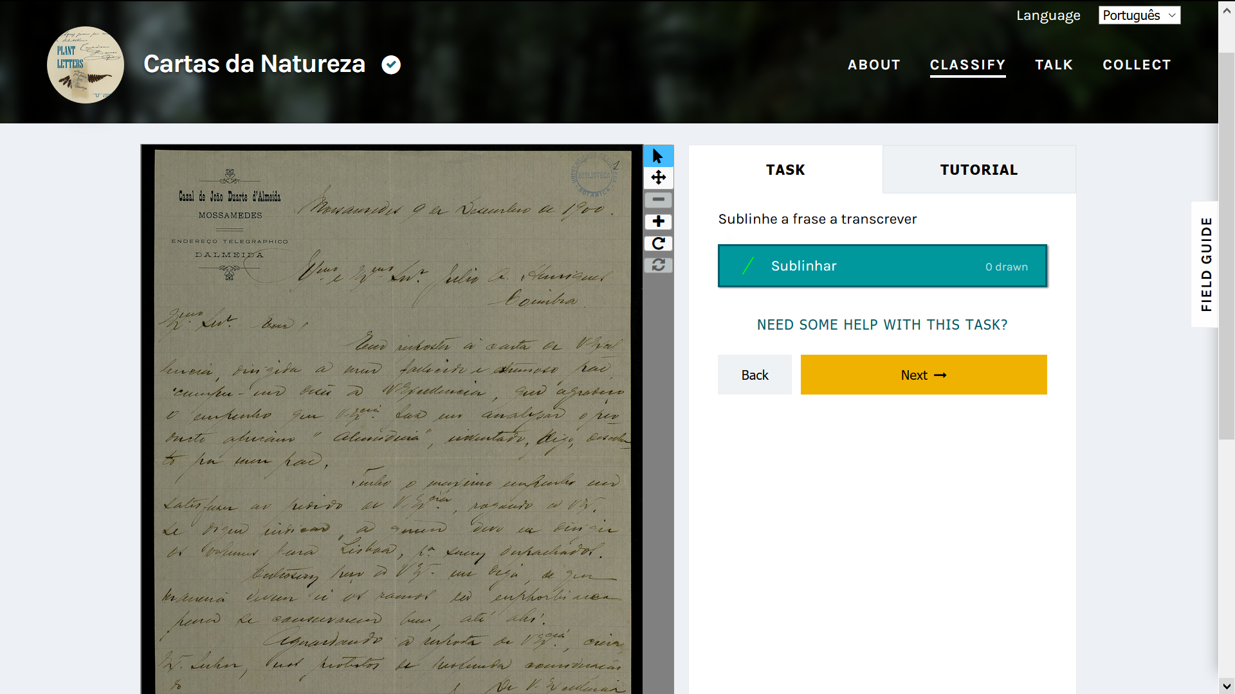

Slide 8
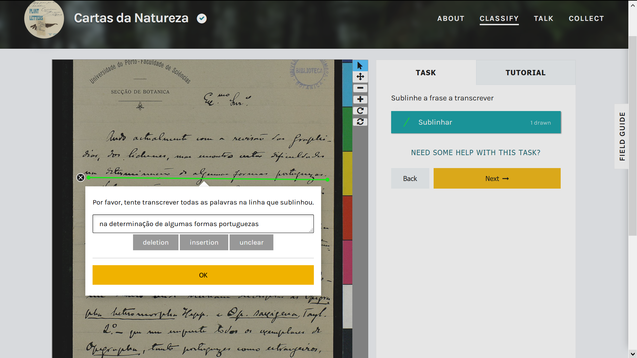

Slide 9
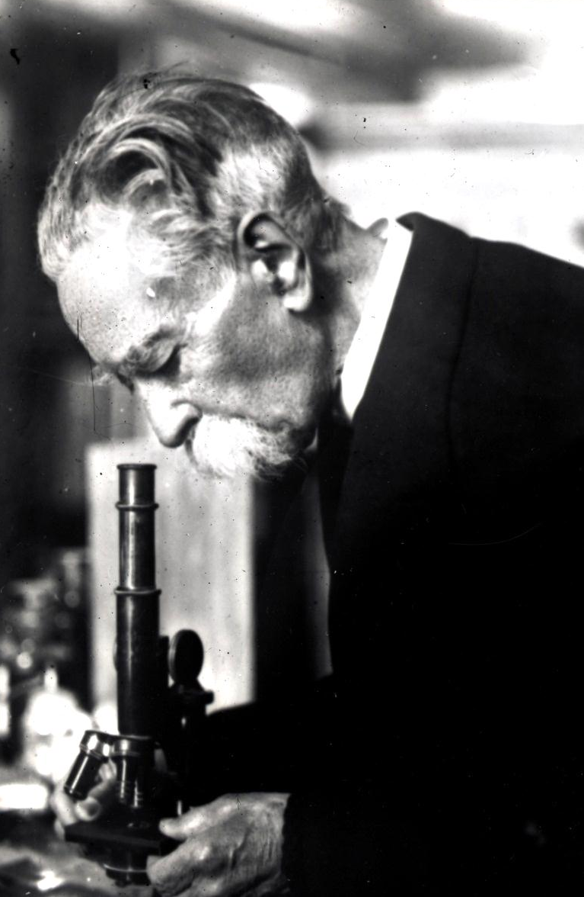
Plant Letters | results
1018 documents [letters, postcards, multiple pages]
17 April 2019 - January 2021
1052 participants
3,809,000 characters transcribed [the King James Bible is ca. 3,116,480]
ca. 641,000 words
32 documents (13%) without any transcribed character

Slide 10
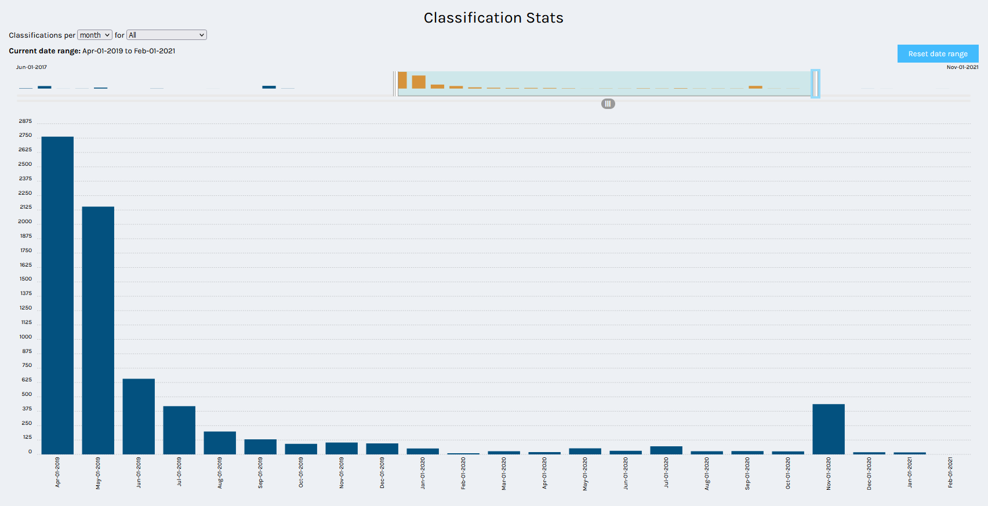
Plant Letters | classifications

Slide 11
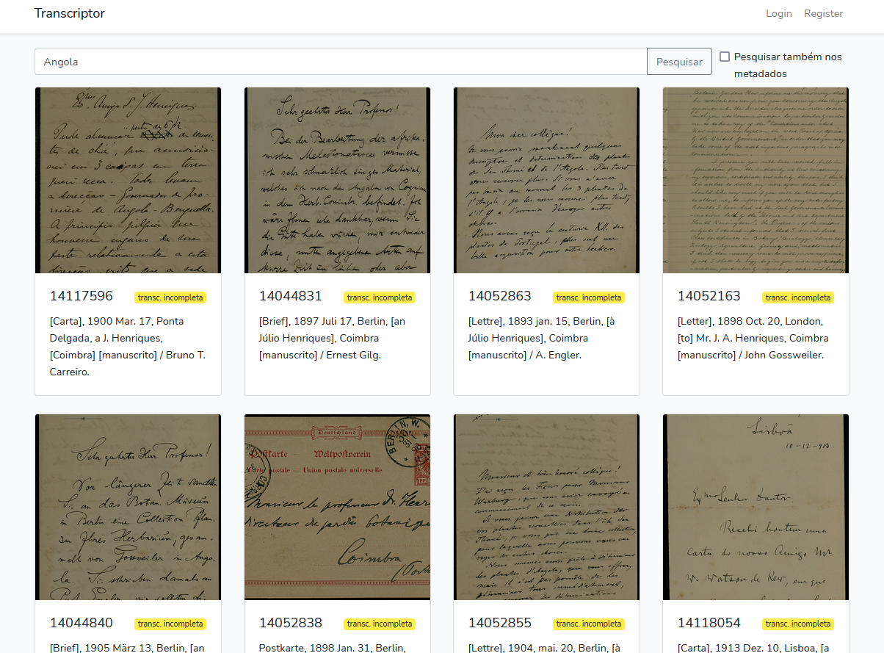
Plant Letters | Open Access
TRANSCRIPTOR
. document image transcription platform;
. allows viewing, searching and browsing the document information;
. analysis and correction of transcripts obtained from Zooniverse;
. expansion potential with other functionalities – research methods that include thesaurus and hierarchical trees (taxonomy, geography).

Slide 12
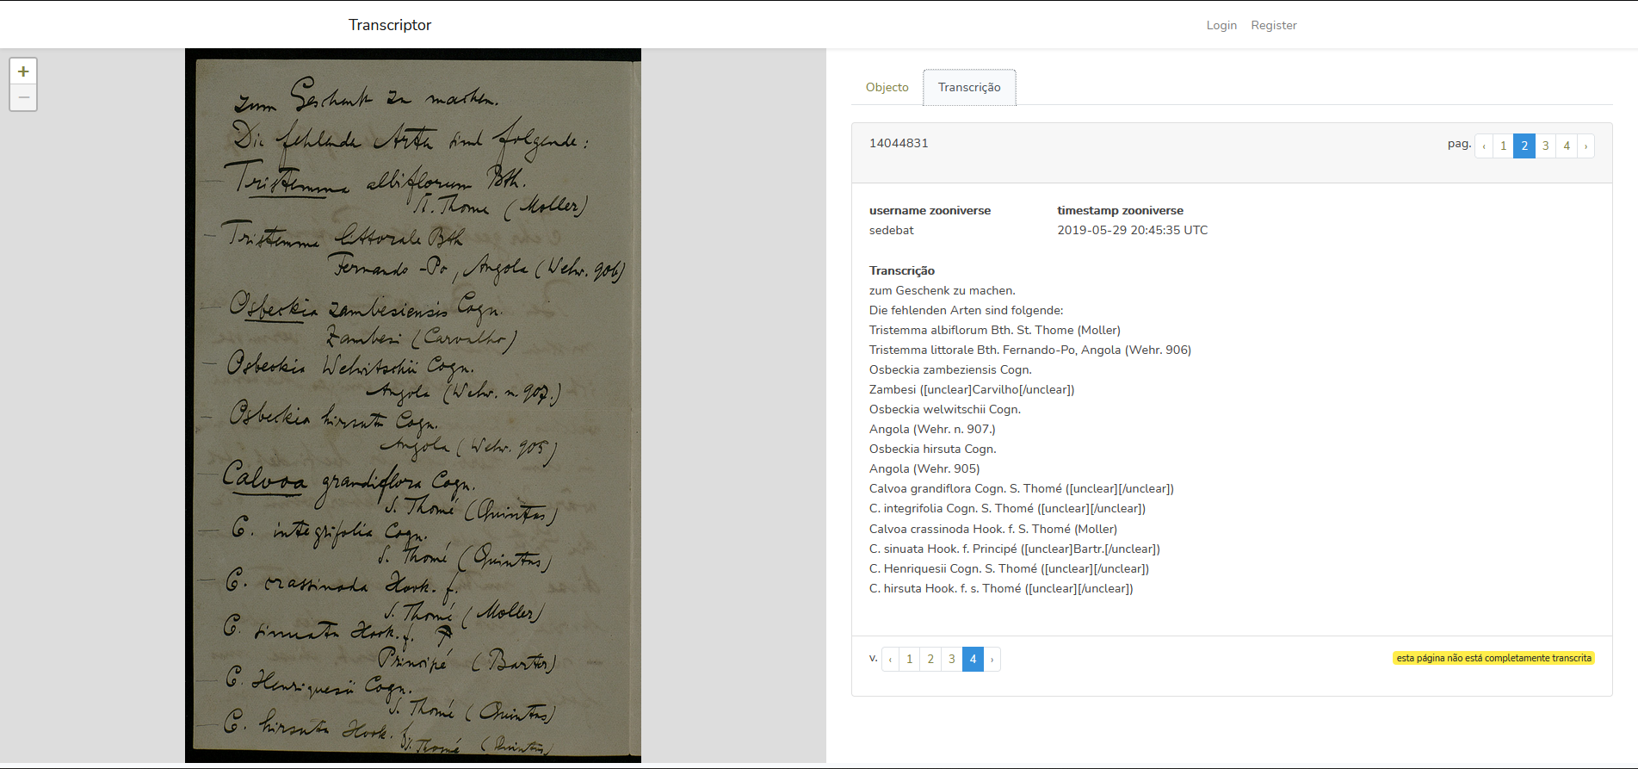

Slide 13
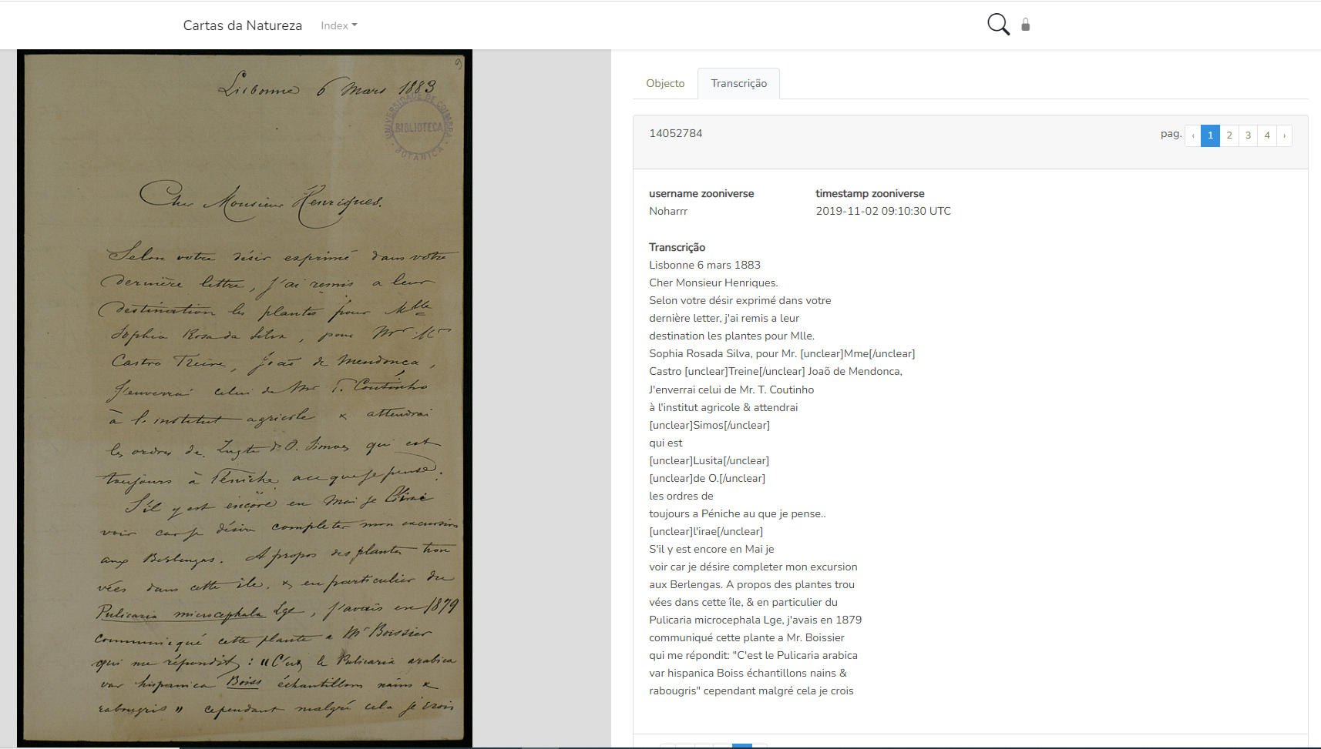
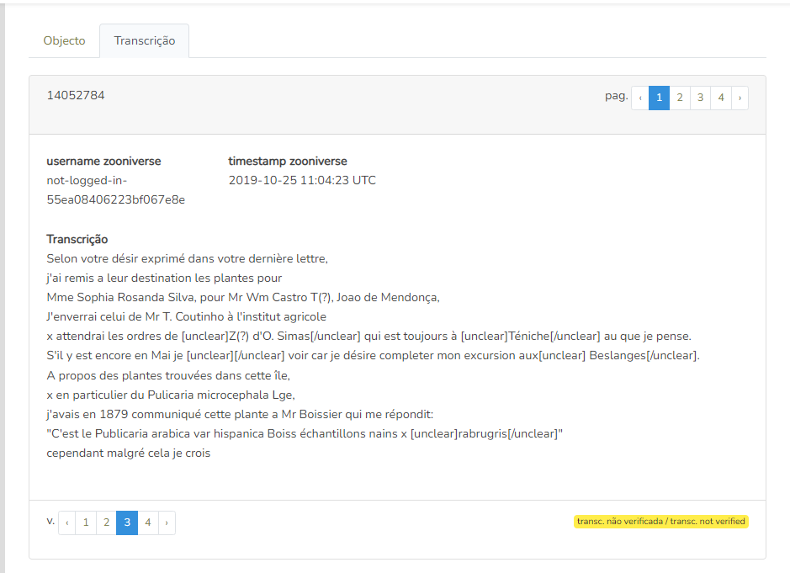

Slide 14
Interesting topics
Sharing archival heritage
Decolonize archives and collections
Participatory science in archives

Slide 15
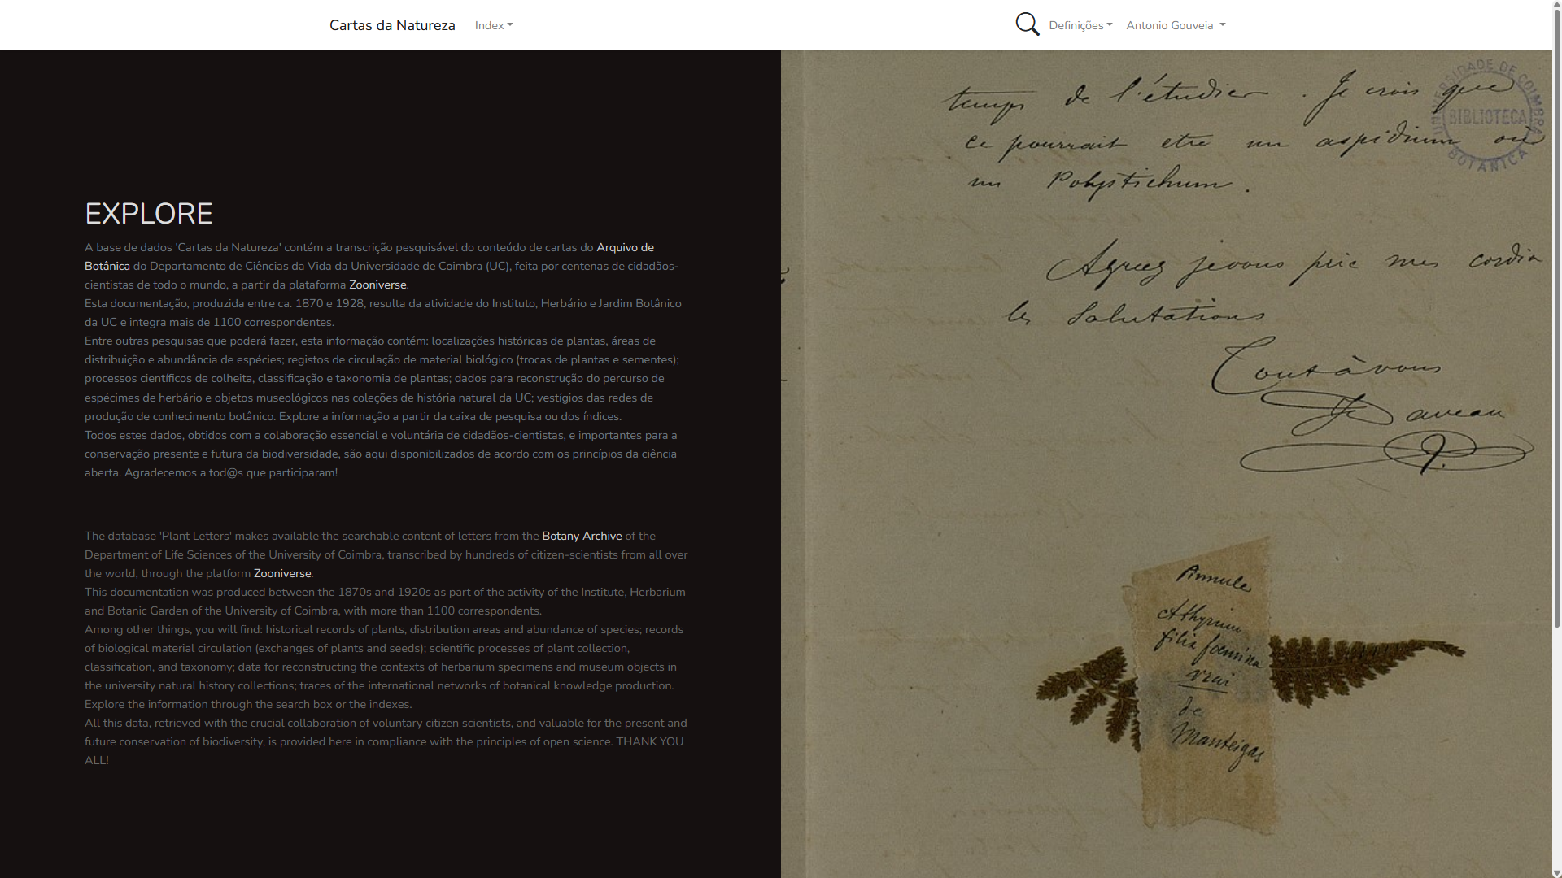
https://cartasdanatureza.uc.pt/

Slide 16
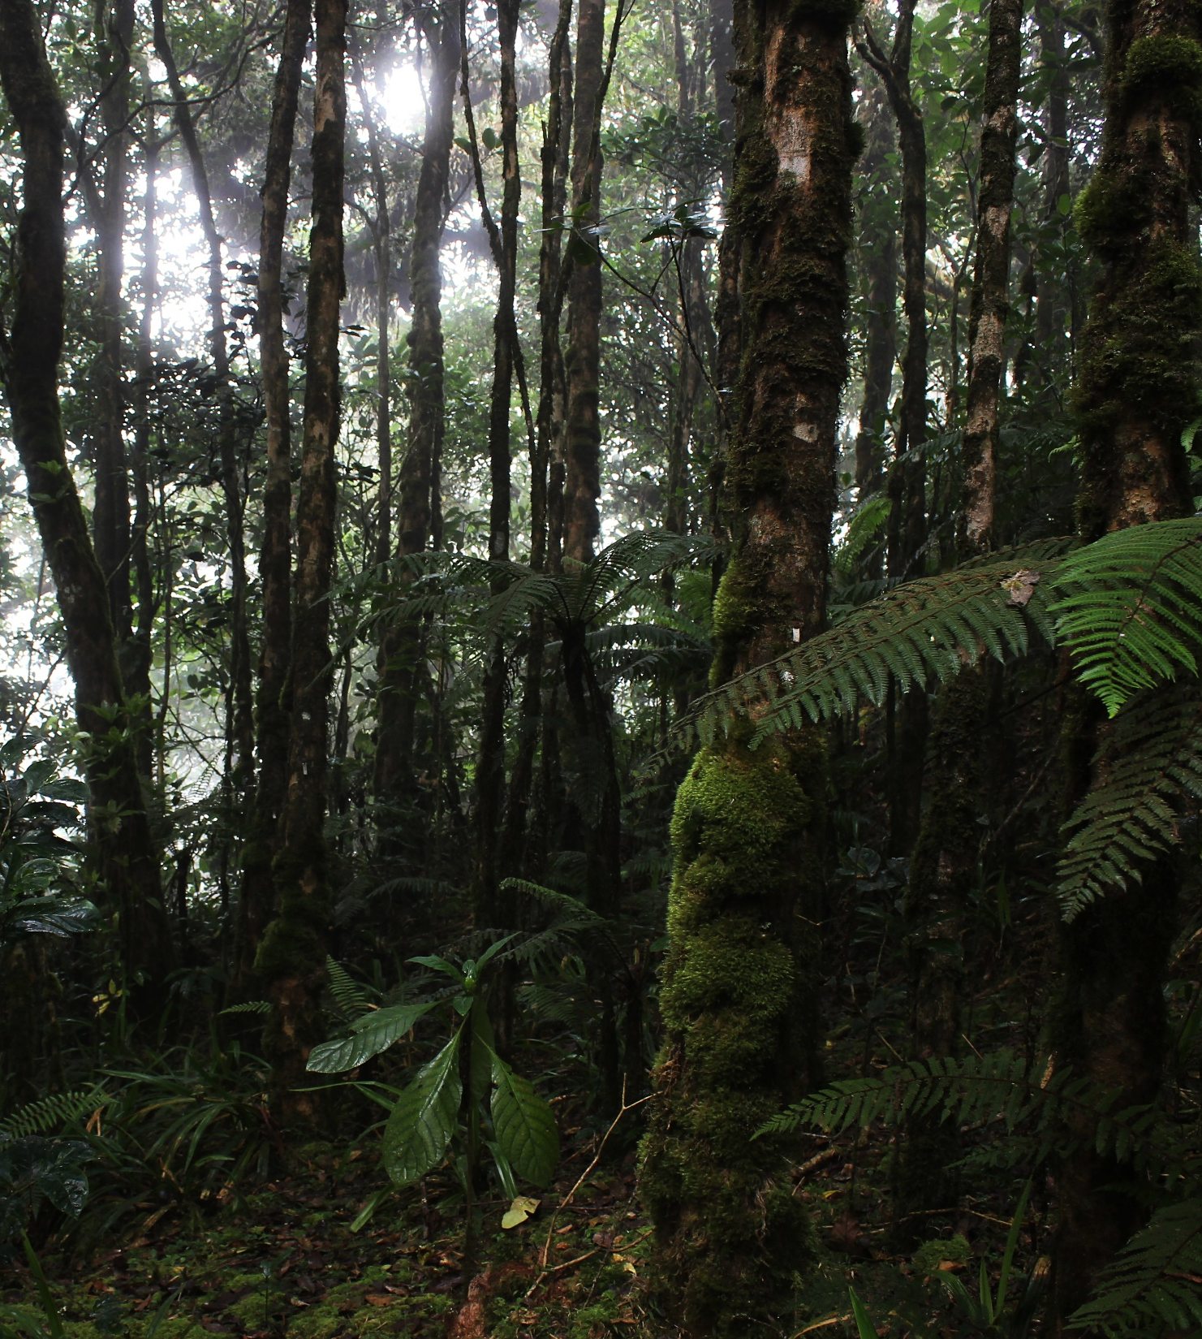





Plant Letters | team
Ana Margarida Dias da Silva anamargarida.silva@uc.pt
António C. Gouveia (coordinator – gouveia.ac@uc.pt)
Joaquim Santos
Joana Cabral Oliveira
Teresa Girão
Helena Freitas
M. Teresa Gonçalves
Thank you!

