Slide 1
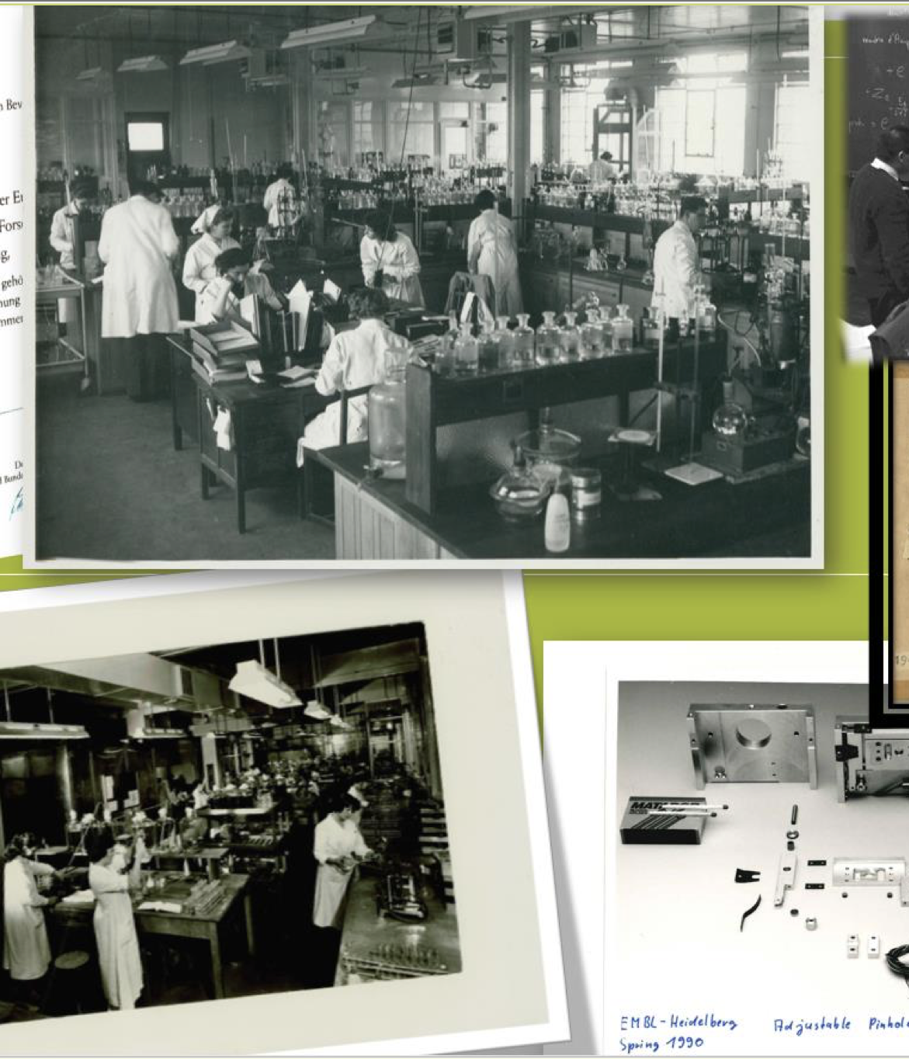
AREA: Advocacy for the archive and archive processes within the organizations
TITLE: Fight and advocacy for the preservation of the archive of the Magnetic Observatory of Tatuoca in the Brazilian Amazon: lessons, restraints, and obstacles.
Symposium
on Scientific Archives

Slide 2
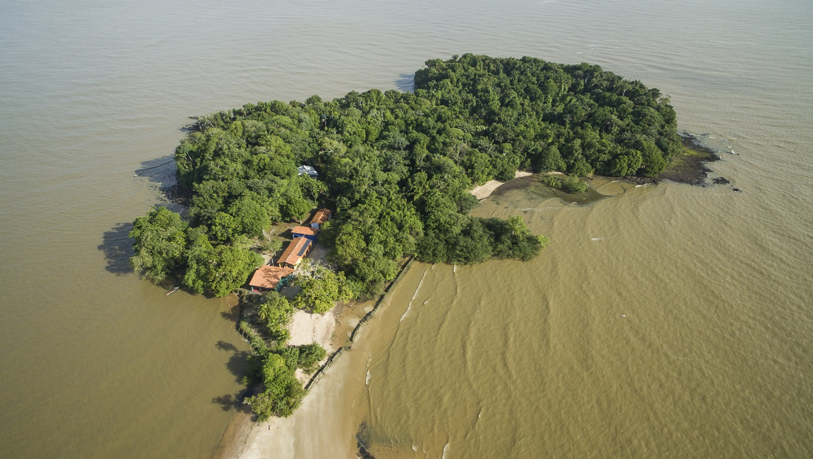
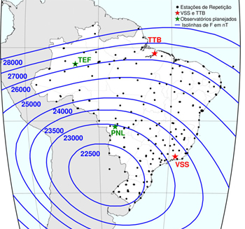
The Magnetic Observatory of Tatuoca (TTB)
Since 1932 has been a privileged spot to observe geomagnetic phenomena.
In 1957 a permanent observatory was built by Brazil, with the aid of the Polar Year Conference.
The National Observatory (ON) from Brazil controls this installations, with the aid of the Institute of Geophysics (IG) of the Federal University of Pará (UFPA).

Slide 3
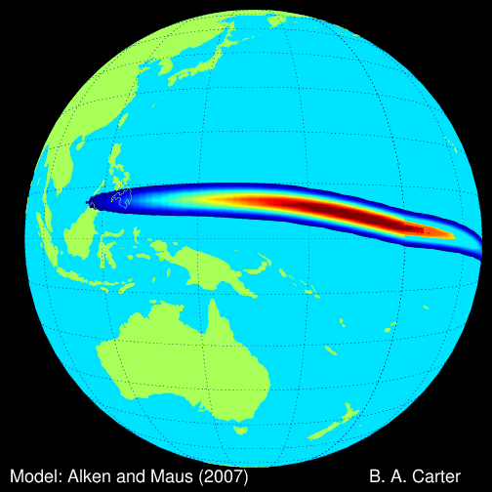
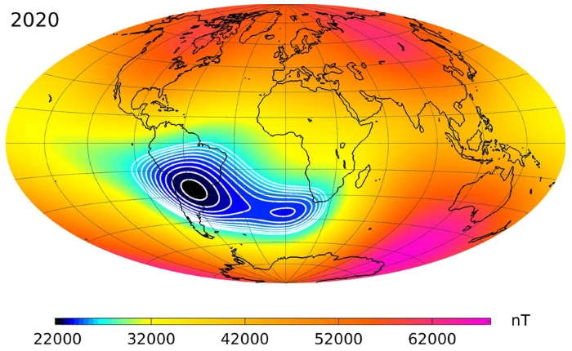
What is special about Tatuoca?
1. Observatories at the equator are scarce due to economic and scientific restrictions of the countries located on that area.
2. The observatory is located under the Equatorial Electrojet.
3. The observatory is on the way od the displacement of the South Atlantic Magnetic Anomaly.

Slide 4
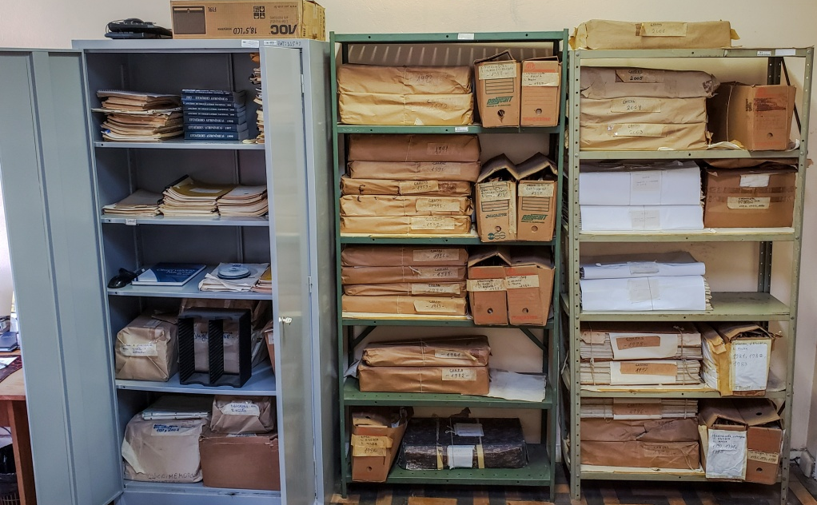
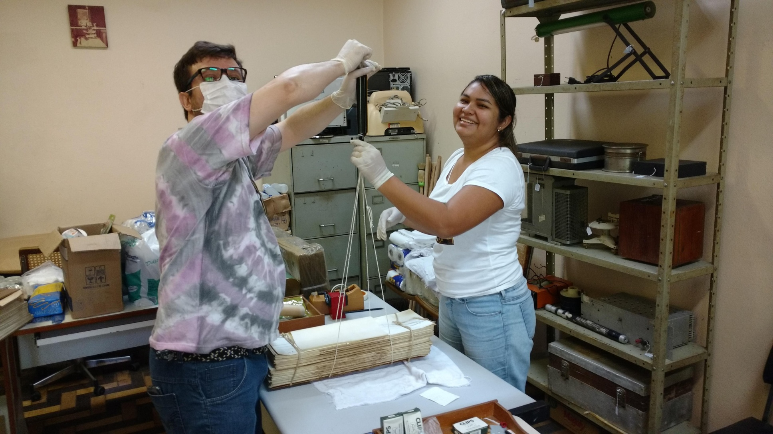
The scientific archive of Tatuoca
Between 1957 and 2007 the Observatory produced approximately 32,000 documents, divides into MAGNETOGRAMS, and ABSOLUTE RECORDS.
In 2017 IG called for help to rescue this material as it was abandoned at Museu Goeldi in Belem City.

Slide 5
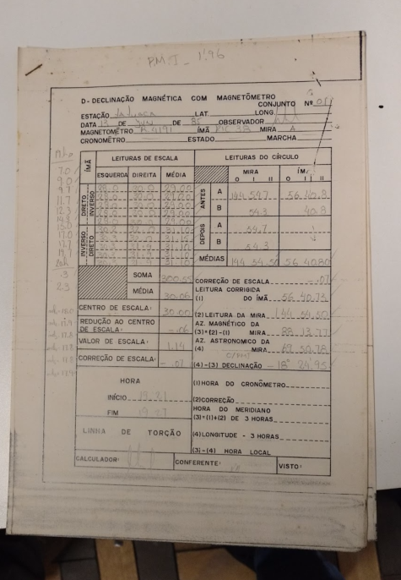
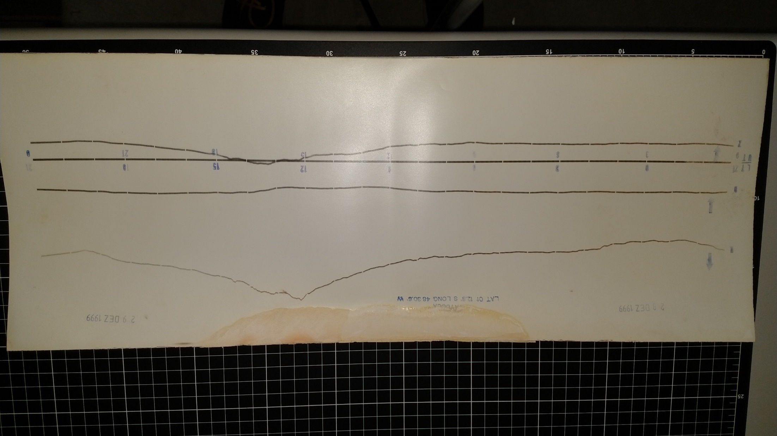
The documents
Main documents are MAGNETOGRAMS 52 x 25 cm (A2) and diaries of ABSOLUTER RECORDS organized in books.

Slide 6
Levels of the project
Physical rescue of the archive and curation
Digitization
Data extraction applying artificial intelligence (InterPARES)
Creation of a museum collection

Slide 7
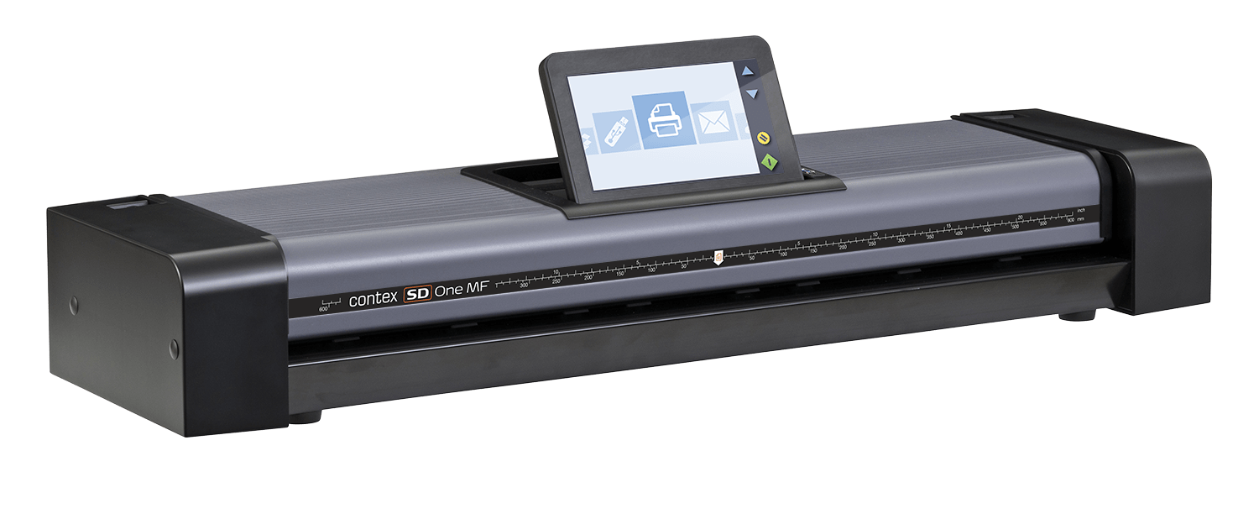


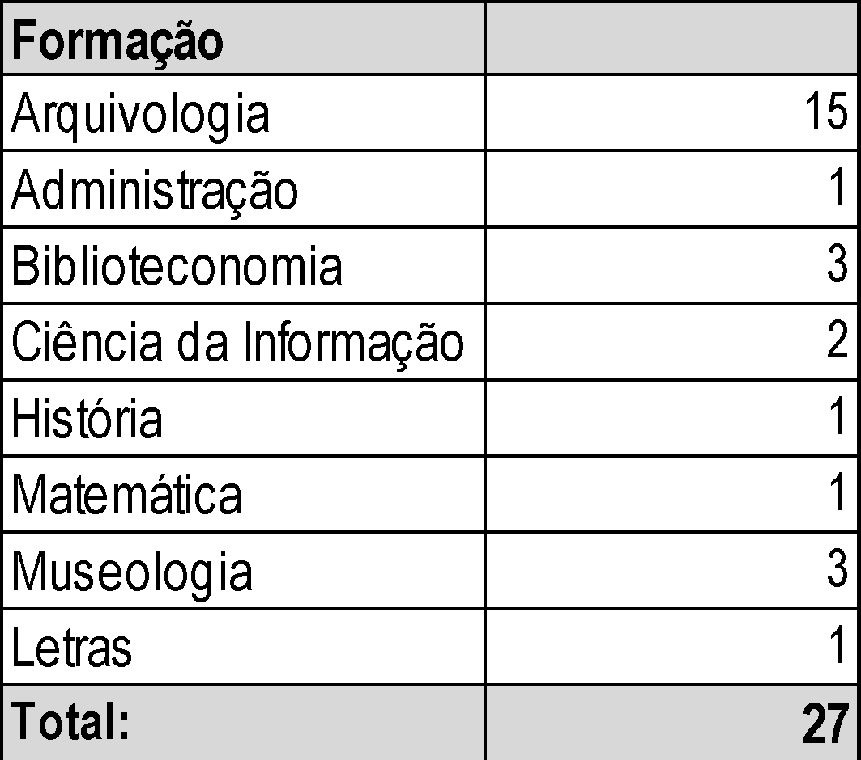
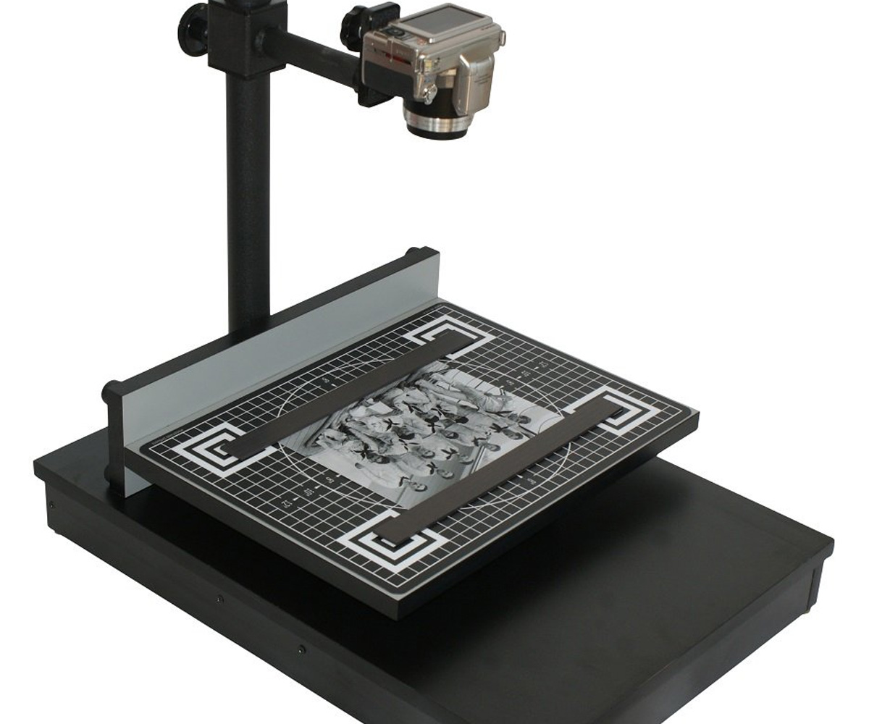
Restraints and obstacles
1. Physical rescue of the archive and curation
  Number of effective collaborators
  Unexpected pandemics
  Box design and materials
2. Digitization
  Technical knowledge and experience
  Resources for equipment acquisition
  Access to reliable suppliers
  Costs of transport and importing
  Access and cost of maintenance

Slide 8

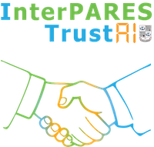

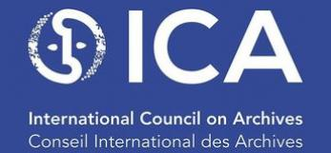
Restraints and obstacles
3. Data extraction applying artificial intelligence (InterPARES)
  Technical knowledge and experience
  Resources for equipment acquisition
4. Creation of a museum collection
  Political support from ON, UFPA & Goeldi
  Securing sponsors
  Technical knowledge and experience
  And ?

Slide 9
Lessons
Archives are a long-term challenges, even the smallest
Keep upgrading your technical, technological and social skills
Look everywhere relentlessly for economic resources
Maintain a permanent local and global networking activity
Look for good partners and wise friends
Be patient and persistent

