Slide 1
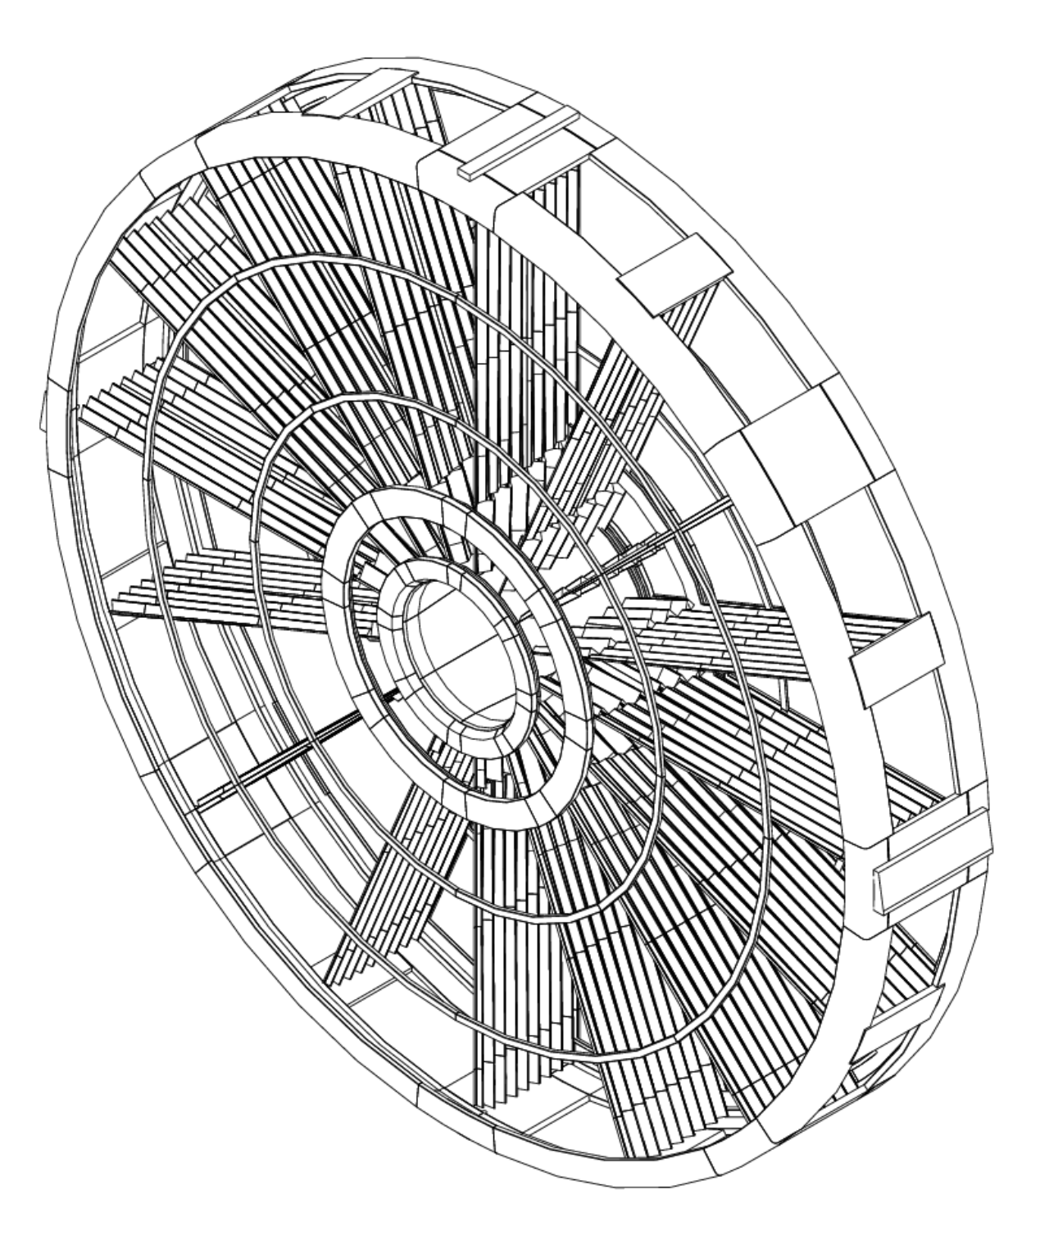
New EMEC description with Geant4 solids
Evgueni Tcherniaev

Slide 2
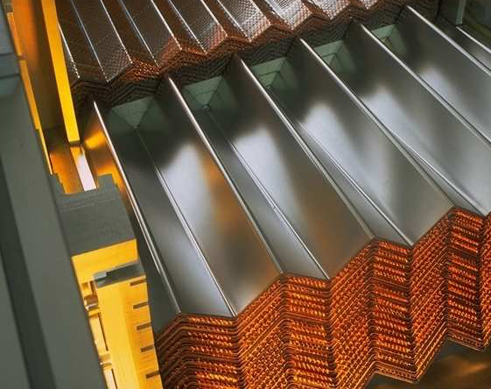
  Prehistory. Geant3
Geometry description of the ATLAS Electromagnetic Endcap calorimeter (EMEC) has a long story. EMEC absorbers and electrodes have a complicated accordion-like shape with twisted surfaces.
In Geant3 there was a solid GTRA (General Trapezoid) with a potentially convenient for EMEC shape, unfortunately its implementation was imperfect:
Users should avoid to use this shape as much as possible, and if they have to do so, they should make sure that the faces are really planes. If this is not the case, the result of the transport is unpredictable.
(GEANT – Detector Description and Simulation tool, p.113)
So, EMEC absorbers and electrodes in the Geant3 version of simulation were described as sets of mini-pieces of ordinary shapes.

Slide 3
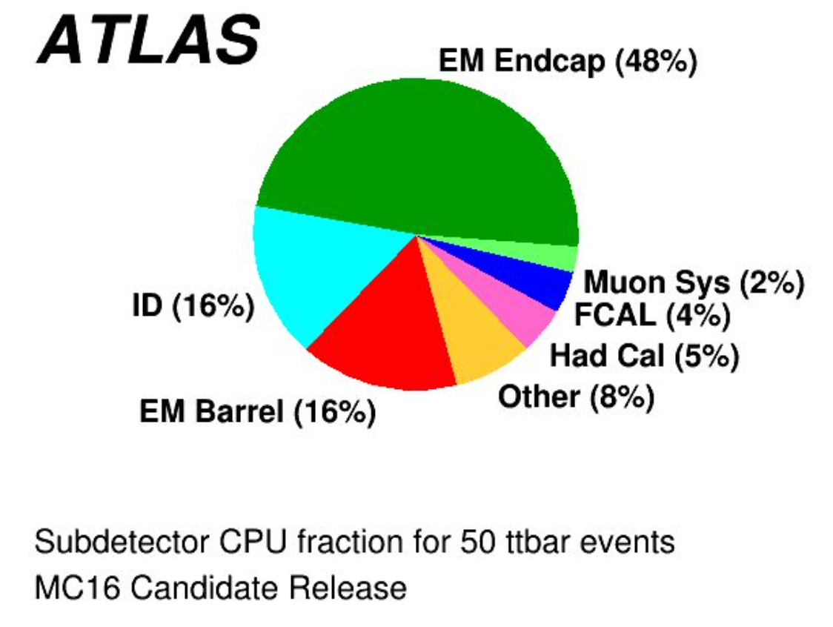
  Prehistory. Geant4
In 2001, it was decided to rely on the Custom solid implemented by for the Geant4 version of the ATLAS simulation. The main reasons for the decision were:
  Absence of “twisted trapezoid” shape in Geant4 at that time
  Non ideal stacking of ”elementary pieces” in Geant3
The Custom solid can very accurately describe the shape of EMEC absorbers and electrodes, but it also has several serious drawbacks.
The main one is the CPU consumption. As it follows from the diagram of CPU fraction in different subdetectors, almost half of CPU time for 50 ttbar events was spent in the EM Endcap calorimeter.
Another disadvantage of the Custom solid is that it can not be dumped into GDML. This does not allow to provide full ATLAS geometry to external teams (Geant4, Adept, Celeritas) for testing their developments.
Therefore, there always been interest in describing the EMEC geometry using Geant4 solids. The current project is not new, it is a continuation of previous efforts.

Slide 4
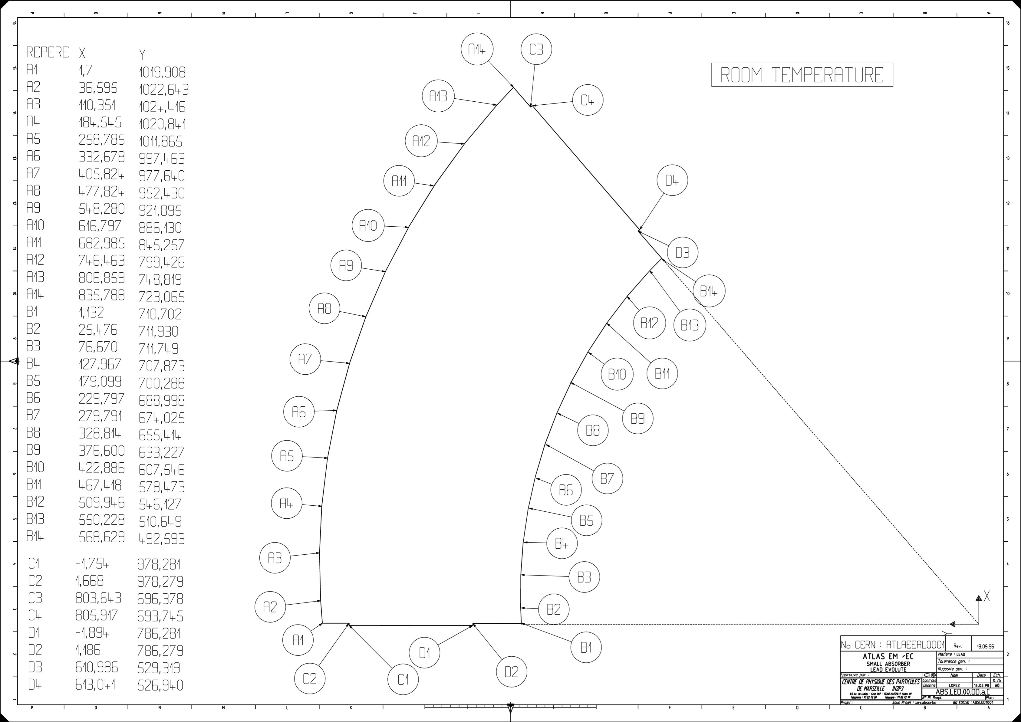
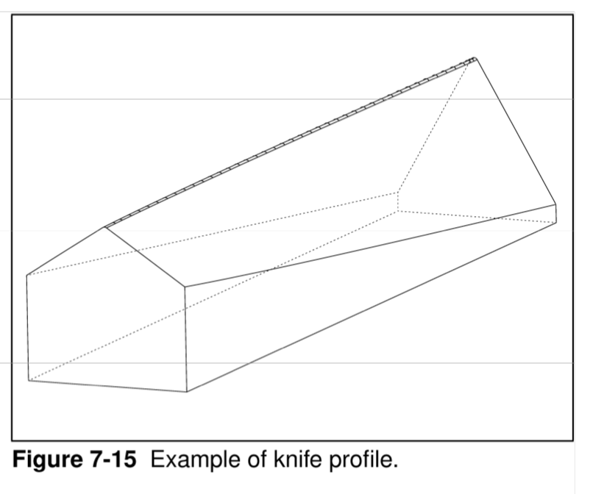
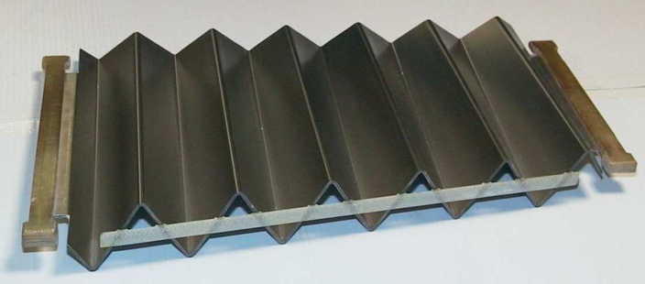
  Selecting solid for describing absorber
In 2005 (Geant4 7.0.0) G4TwistedTrap was added to the Geant4 collection of solids.
Current implementation of G4GenericTrap, adopted from Root TGeoArb8, appeared there in 2010 (Geant4 9.4.0)
To understand which of these two solids is suitable for describing the EMEC Accordion geometry, let’s look at how the absorbers were formed. The absorbers were made from flat plates by deforming them in a press machine using a special knife to obtain the desired profile.
The top part of the knife consists
of two curved surfaces, but all its edges are straight lines.
Similar property has G4GenericTrap, not G4TwistedTrap
Knife
Plate
Absorber

Slide 5
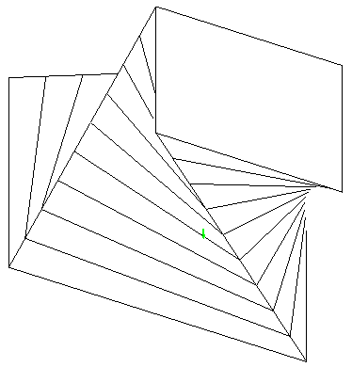
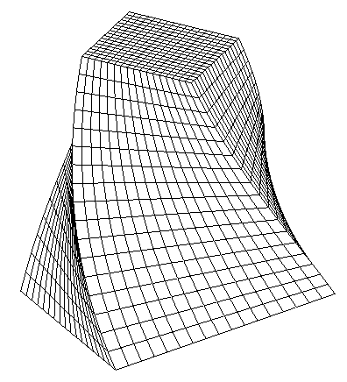
  G4GenericTrap vs G4TwistedTrap
The lateral surfaces of G4GenericTrap are 2nd order surfaces, namely hyperbolic paraboloids. The points of intersection of a line with a hyperbolic paraboloid can be found as the roots of a quadratic equation.
The lateral surfaces of G4TwistedTrap are helicoids. The lateral edges are not straight, and, in addition, there is no analytical solution of the line-helicoid intersection problem, the intersection points are calculated iteratively, which makes G4TwistedTrap much slower than G4GenericTrap.
G4GenericTrap
G4TwistedTrap

Slide 6
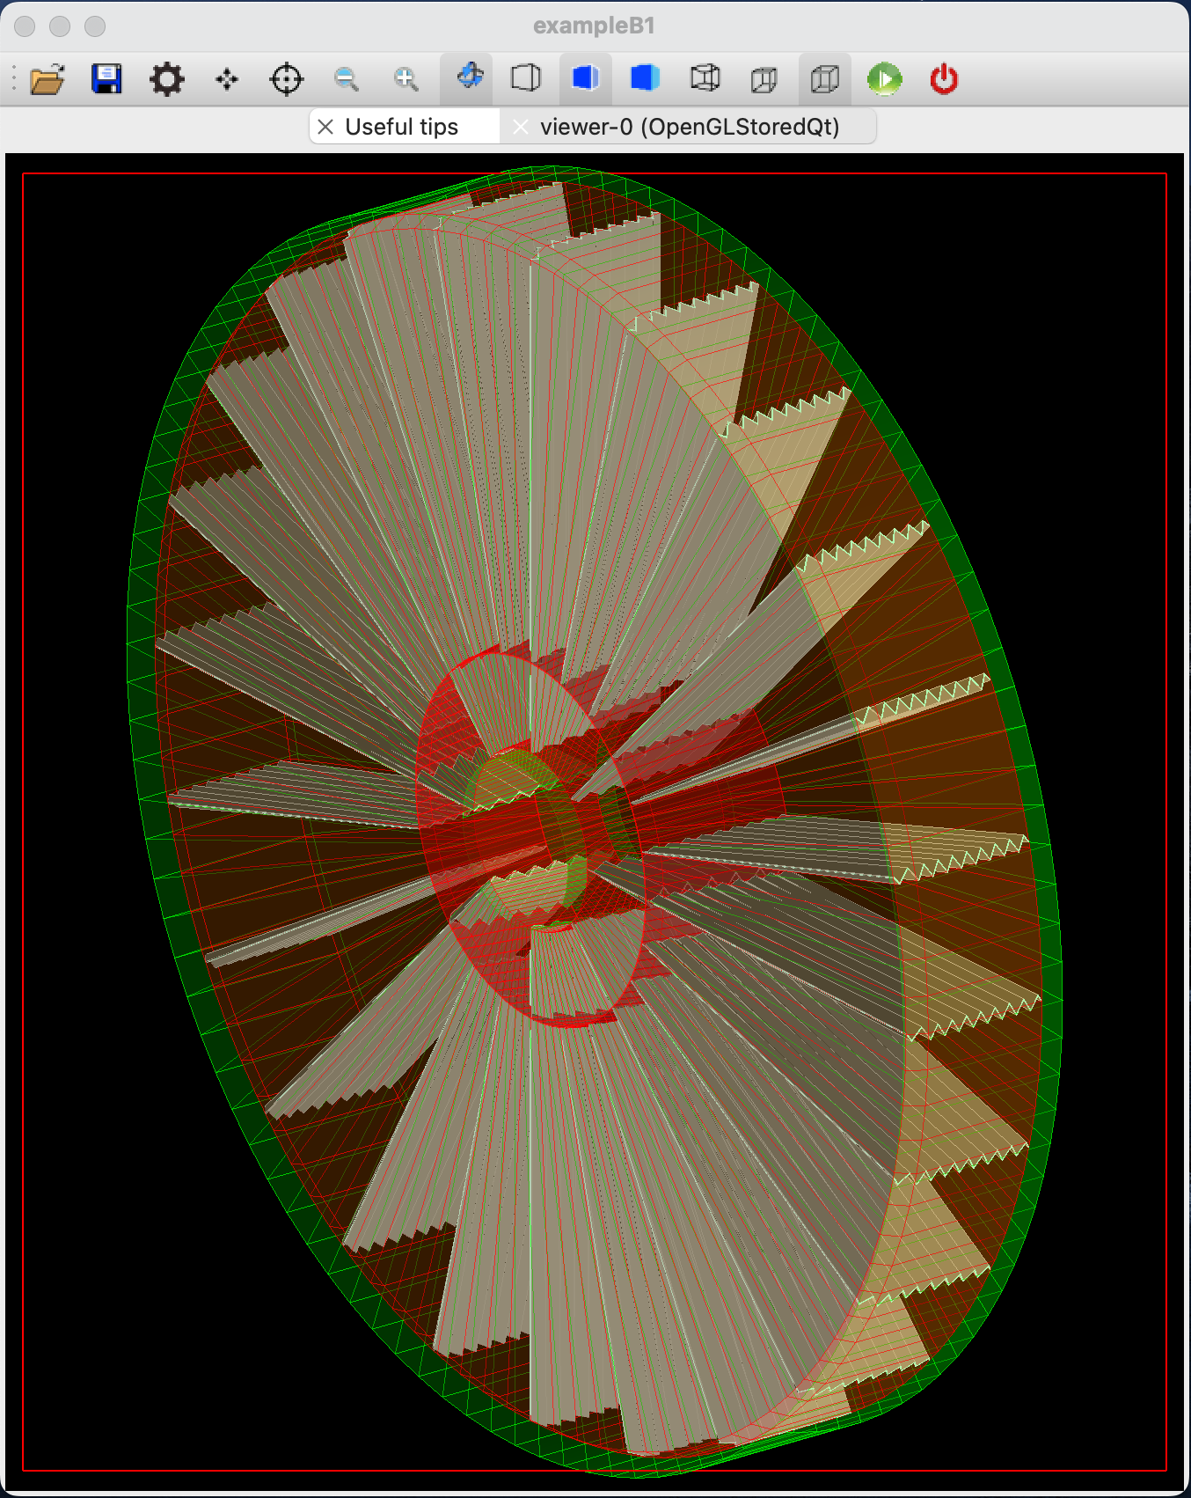
  Current implementation of EMEC Accordion structure
For the construction of absorbers and electrodes inside the Inner and Outer wheels it was implemented a C++ class.
At present time it uses G4GenericTrap, later it will be migrated to GeoGenericTrap
The structures can be built with or without subdivision of the wheels into slices. More options foreseen in the future.
The implementation is based on data taken from the technical drawing of the lead plates for the Inner and Outer wheel absorbers (see next two slides)
Definitions of materials have been taken from C++ code for HEC Test Beam simulation. A possibility to change the materials is provided.
It was checked that the volume of the absorbers corresponds to the volume of original plates.

Slide 7
  Inner Wheel contruction
The Inner Wheel contains 256 Absorbers and 256 Electrodes
The plate can be divided into blades by connecting corresponding points (red lines):
  11 half-wave blades
  2 quarter-wave blades
  2 lips for connection with the longitudinal bars (C-D points)
Profiled blades are described as G4GenericTrap solids
The Inner Wheel can be splitted into 15 slices, each slice contains blades of the same type, in total 512 physical volumes per slice
blade

Slide 8
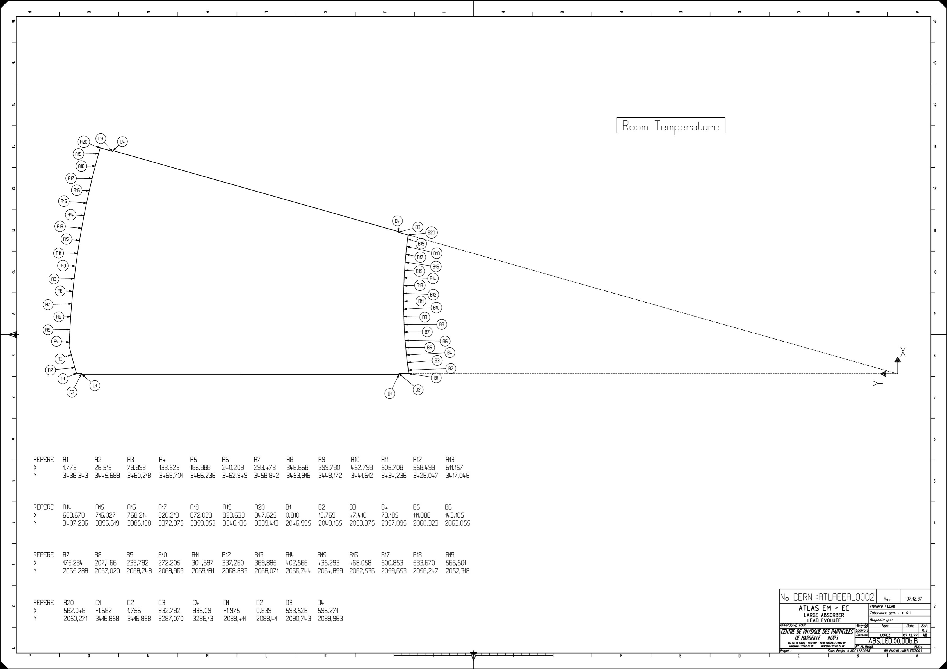
  Outer Wheel construction
The Outer Wheel contains 768 Absorbers and 768 Electrodes
The plate can be divided into the following blades:
  17 half-wave blades
  2 quarter-wave blades
  2 lips for connection with the longitudinal bars
The Outer Wheel can be splitted into
21 slices, in total 1536 physical volumes per slice

Slide 9
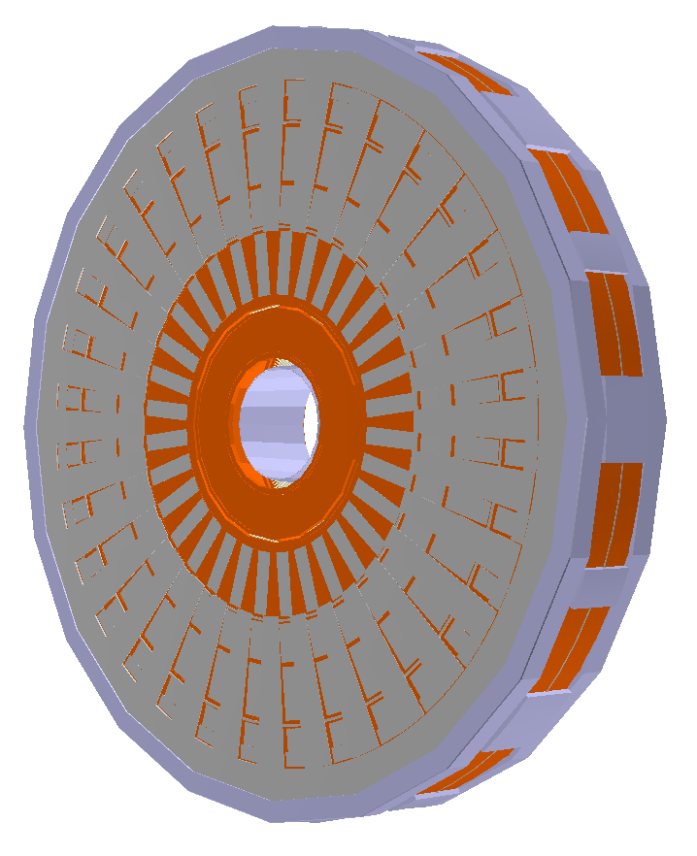
  Performance measurement environment
The CPU consumption of various EMEC implementations was measured using a modified (personal) version of FullSimLight
To have a suitable environment the following features have been added
to FullSimLight:
  Visualization mode for visual control on the setup, the measurements themselves were performed with visualization turned off
  The particle gun that shoots particles within a cone, to ensure that all primary particles cross EMEC
  EMEC_mother.db, containing the Custom solid, was used as the source of geometry with a possibility to replace the Custom solid with the new implementation based on G4GenericTrap
EMEC

Slide 10
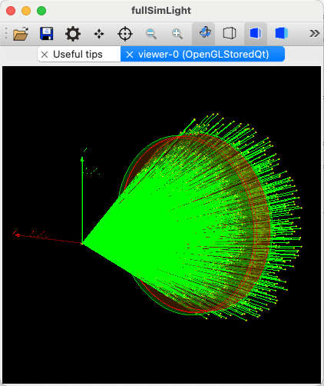
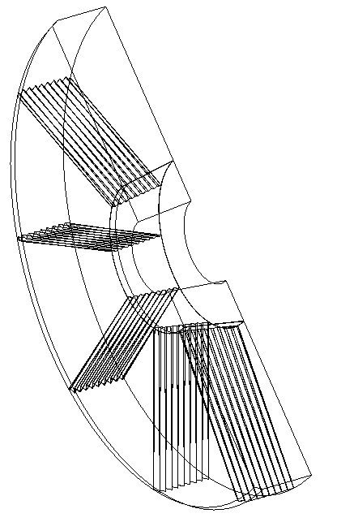
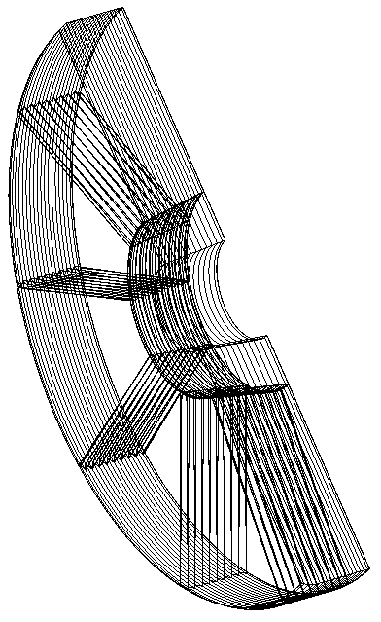
  CPU time, 100K geantino events
The testing was performed for three different geometry settings (Custom solid, G4GenericTrap solids without and with division of the wheels into slices) by shooting a) geantino and b) 10 GeV electrons.
Below is CPU time measured for 100K geantino events. Geantino is a virtual particle which is useful for testing pure transport through geometry. Geantino does not interact with matter, so there is no physics involved.
Custom solid | G4GenericTrap, no slices | G4GenericTrap, slices
107 s | 36 s | 30 s

Slide 11
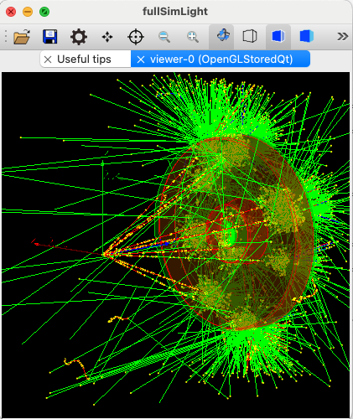
  CPU time, 200 e- 10 GeV events
Benchmark test with 10 GeV electrons has shown very promising performance of the new description, CPU time improved by 2.5 times
There was also observed an unexpected increase in number of secondary electrons by ~6%. A dedicated study has shown that small structural differences between the Custom solid and the description with G4GenericTrap cannot cause extra secondary electrons, and that the source of the issue is most likely in G4GenericTrap itself.
Custom solid | G4GenericTrap, no slices | G4GenericTrap, slices
100 s | 51 s | 42 s
Mean energy deposit per event = 9.938 +- 0.05315 [GeV] Mean track length (charged) per event = 2138 +- 252.1 [cm] Mean track length (neutral) per event = 2.774e+04 +- 6922 [cm] Number of steps (charged) per event = 6.495e+04 +- 3037 Number of steps (neutral) per event = 1.154e+05 +- 5550 Number of secondaries per event : Gammas = 4995 +- 97.5 Electrons = 9138 +- 114.9 Positrons = 504.4 +- 19.83 | Mean energy deposit per event = 9.927 +- 0.09896 [GeV] Mean track length (charged) per event = 2063 +- 299.8 [cm] Mean track length (neutral) per event = 3.197e+04 +- 4966 [cm] Number of steps (charged) per event = 6.867e+04 +- 5078 Number of steps (neutral) per event = 1.066e+05 +- 6838 Number of secondaries per event : Gammas = 4921 +- 106.2 Electrons = 9775 +- 292.9 Positrons = 479.6 +- 17.92 | Mean energy deposit per event = 9.898 +- 0.444 [GeV] Mean track length (charged) per event = 2056 +- 425.3 [cm] Mean track length (neutral) per event = 3.217e+04 +- 7400 [cm] Number of steps (charged) per event = 6.915e+04 +- 6241 Number of steps (neutral) per event = 1.085e+05 +- 1.04e+04 Number of secondaries per event : Gammas = 4907 +- 252.4 Electrons = 9776 +- 529 Positrons = 479.1 +- 31.03

Slide 12
  G4GenericTrap: overestimated safety distance
A special test was implemented to located the problematic code. The test has shown that the safety distance returned by G4GenericTrap::DistanceToIn(p) and G4GenericTrap::DistanceToOut(p) is significantly overestimated in most of cases.
Corresponding bug report was opened in the Geant4 problem report system.
The safety distance of a point relative to a solid is the radius of space around the point, within which the point can move in any direction without crossing the boundaries of the solid. The safety distance may be underestimated, a zero safety distance is a legal return value.
Setting safety distance to zero in G4GenericTrap normalizes the number of secondary electrons but increases the number of steps for charged particles and, consequently, the CPU time.
The bug does not create problems for further development of the project, a revision of G4GenericTrap to improve its performance was a part of this project anyway.
 | G4GenericTrap | DistanceToIn/Out(p) = 0
CPU | 42 s | 72 s
Mean energy deposit per event [GeV] Mean track length (charged) per event [cm] Mean track length (neutral) per event [cm] Number of steps (charged) per event Number of steps (neutral) per event Number of secondaries per event: Gammas Electrons Positrons | 9.898 +- 0.444 2056 +- 425.3 3.217e+04 +- 7400 6.915e+04 +- 6241 1.085e+05 +- 10400 4907 +- 252.4 9776 +- 529 479.1 +- 31.03 | 9.935 +- 0.07721 2138 +- 395.5 2.837e+04 +- 9484 2.58e+05 +- 5172 1.157e+05 +- 5873 5021 +- 95.61 9193 +- 121.8 503.5 +- 19.13

Slide 13
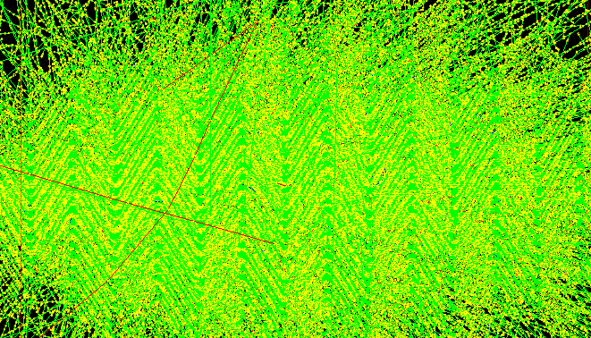
  Further plans
Implement options for additional subdivision of the wheels for further performance improvement
Replace the Custom solid with the new EMEC description in the current LAr plugin
Integrate the new EMEC description into Athena
Revise G4GenericTrap code in Geant4
Shower inside EMEC
E.Tcherniaev, Detector Description session at ATLAS S&C Week
12

Slide 14
  Conclusions
Implemented a new C++ class for describing the EMEC Accordion structure:
  At present time it uses G4GenericTrap, later it will be migrated to GeoGenericTrap
  Geometry data taken from the technical drawings of the lead plates for the Inner and Outer Wheel Absorbers
  A possibility to change the default materials is provided
  Exists a possibility to divide the structure into slices, additional subdivision is under implementation
New geometry description already demonstrates very promising CPU performance. More speed up is expected with further development.

