Slide 1


INTERNATIONAL DUAL CAREER NETWORK
29 June 2023
IDCN Lake Geneva Career Morning with CERN
“CERN. A place like nowhere else on Earth!
Learn about CERN opportunities; tips and tricks on how to build your CV.”

Slide 2
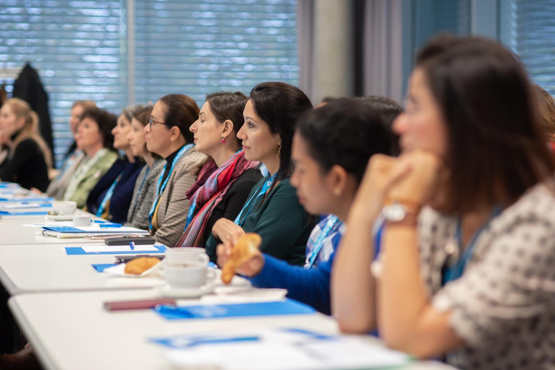
AGENDA
09:00 - 09:30 | Registration
09:30 - 09:40 | Open and welcome - Joanna Książek, Events Team Lead & Vice President, IDCN Lake Geneva, Louise Carvalho, Head of Diversity and Inclusion, CERN
09:40 - 09:50 | IDCN presentation - Pragya Bhatnaga, Partner President, IDCN Lake Geneva
09:50 - 10:30 | Session 1: CERN :an overview of our career opportunity & selection process with Q&A - Barbara Bider, Talent Acquisition Team, Adam Kus,Talent Acquisition Team, CERN
10:30 - 11:00 | Session 2: Testimonials from CERN my journey as an expat with Q&A: Malgorzata Grosbart, PhD - Senior Research Fellow director, Sabrina Holthausen - Intercultural Management & International Communications Expert, CERN
11:30 - 12:15 | Session 3: CV writing presentation - Rocio Alot, Recruitment and Sourcing Specialist, CERN
12:15 - 12:45 | Q & A & closure
12:45 - 13:15 | Light networking lunch and networking
Notes:
Add Q&A to Conclusion and feedback?

Slide 3
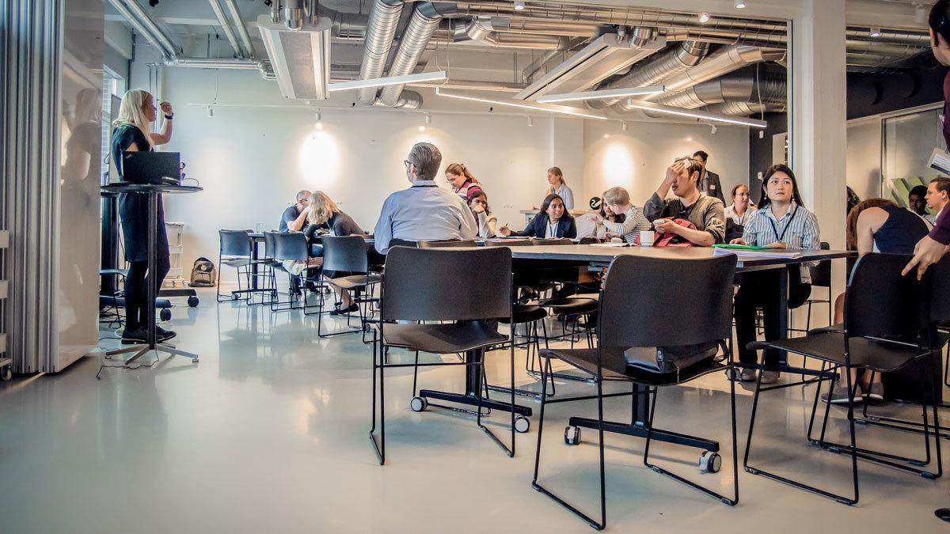
What is IDCN?
An association of international organizations
and corporations facilitating the integration
of mobile employee partners through
awareness, guidance, and professional
networking.

Slide 4
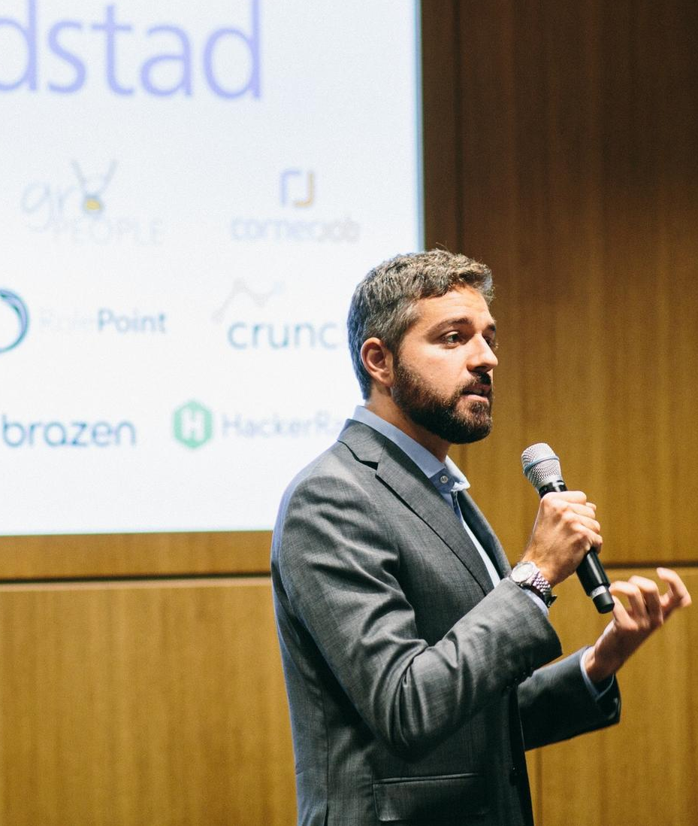
OUR
MISSION
Make relocation more attractive to employee partners
Ensure the long-term success of international mobility
Facilitate professional integration of the dual career partner
Provide a professional network for the dual career partner
IDCN helps to make dual career assignments a success.
HOW ?
By providing:
Corporate Events
Career Mornings, Workshops

Slide 5
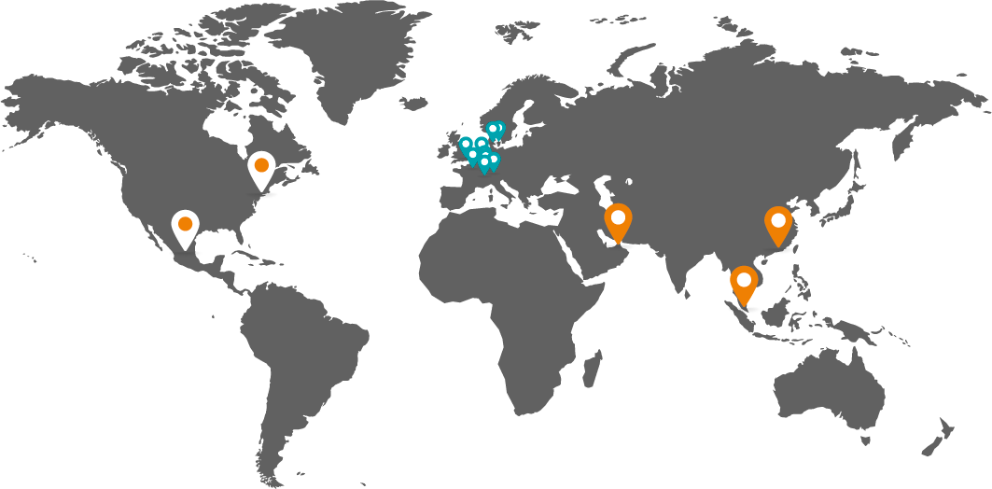














ABOUT IDCN
14 locations worldwide
Americas
Mexico City
New York
Asia
Dubai
Hong Kong
Singapore
Europe
Lake Geneva
Basel-Zurich
Brussels
Copenhagen
Jutland-Funen (DK)
London
Luxembourg
Munich
Paris

Slide 6



Slide 7
IDCN, Lake Geneva Organization Chart
President Office
IDCN LAKE GENEVA PRESIDENT – Pragya Bhatnagar
IDCN LAKE GENEVA VICE-PRESIDENT - Joanna Książek
Ahmet Kaya
MEASUREMENT
Track key performance metrics that drive overall strategy
MEMBERSHIP
Enhance the overall membership experience
EVENTS
Coordinate & Facilitate networking events
COMMUNICATION
Facilitate internal & external communication
TEAM LEAD
Ion Serbusca
TEAM LEAD
Joanna Ksiazek
TEAM LEAD
Ahmet Kaya
TEAM LEAD
Angeliki Sklapani
EVENTS TEAM
NEWSLETTER MANAGER
Akira Takahashi
VOLUNTEER MANAGER
Dipanwita Dash
Giulia Marzari
Jozi Rachman
Joreen Mufwaya
Glenn Borso-Tan
MEASUREMENTS BACKUP
Vacant
VOLUNTEER COORDINATOR
Vacant
LINKEDIN MANAGER
Ahmet Kaya
MEMBERSHIP MANAGER
Ion Serbusca
CREATIVE DESIGNER
Jonas Reker
MEMBERSHIP BACKUP
Sofie Agergaard
PHOTOGRAPHER
Diarmid Farquhar

Slide 8
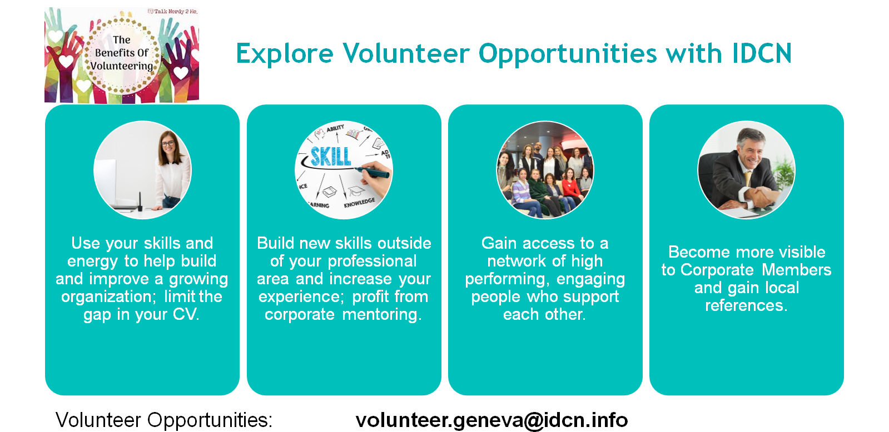

Slide 9
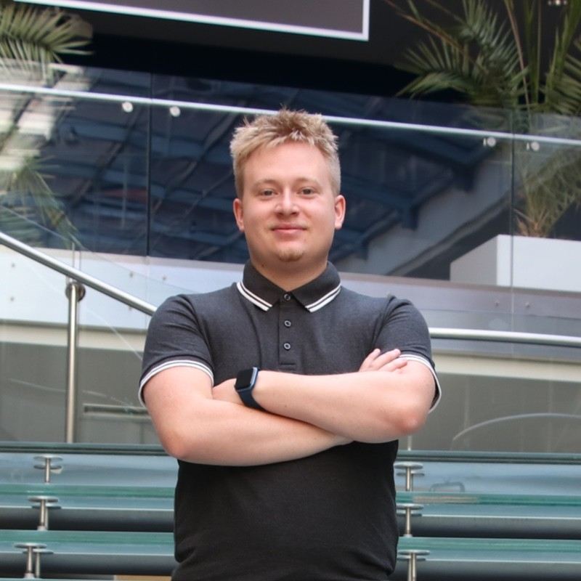
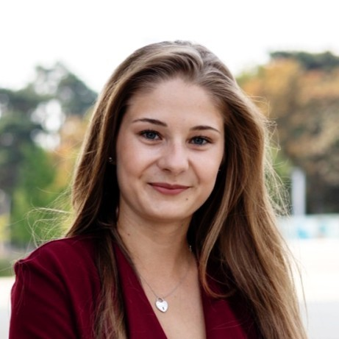
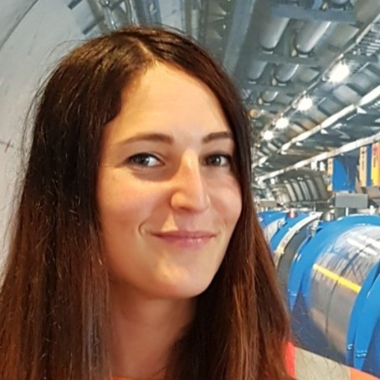
Today’s Speakers
Adam Kus
Talent Acquisition Team, CERN
Barbara Binder
Talent Acquisition Team, CERN
Rocio Alot
Recruitment and Sourcing Specialist, CERN

Slide 10
Q & A

Slide 11

Kindly scan the QR code for feedback.

Slide 12
Thank you!

