Slide 2
Accelerating your CV
Tips and Tricks…
…with a focus on the Swiss job market

Slide 3

https://www.linkedin.com/in/rocioalot/

Slide 4


Slide 5
How to Build Your Resume
Essentials
1. Professional Summary
2. Professional experience
  Responsibilities held
  Achievements
3. Education
4. Your Knowledge Base
  Skill set (technical and/or personal skills)
  Language skills
  Certifications
  Your Digital Trace (portfolio, website, blog, social profiles)
  Associations you are part of or out-of-work activities
Notes:
1. Professional Summary.Too complicated! Will mention it later in a dedicated slide
2. Career History – start with the most recent job and work back to the least recent
3. Education – Grades are not neccessary, however include academic awards and honors if applicable
List any special projects, accomplishments or awards. Employers want to know what professional organizations you are a member of, what publications you have written, what professional awards you have won, etc.

Slide 6
Starting Basics: Format
A recruiter will spend an average of 30 seconds reading your CV.
  Your resume = one page
  Bulleted points
  Legible font, Arial or Times Roman
  Spell/grammar check your resume
  Avoid “lazy” words (such as “etc”, abbreviations)
  Have someone else to proof-read your resume
Use action verbs, such as “performed, executed, awarded”. These will help provide evidence of your experience and skills.
Don't add a job that you were at for less than 3-4 months unless it is relevant to the position you are applying for.
If you are reorienting your career and you lack experience for the job you apply, replace the “career summary” for a “career objective” that describes your search intentions and what type of position you are looking for. Keep it to 2-3 lines.
Notes:
Try to keep your resume to one page. The average resume gets about 30 seconds of attention. So make it count! (cv)
Start with your most current employer and work back. Don't add a job that you were at for less than 3-4 months unless it is relevant to the position you are applying for.
Instead of listing all job responsibilities in a paragraph, make bulleted points to summarize information and make it readable.
Legible font. Don’t detract from what you have to offer by highlighting your name and/or contact information with a special font. Arial or Times Roman
Spelling typos and coherence! Have someone else proof read your resume that will give you constructive feedback. Sometimes job descriptions make sense to you but it may not to other departments/employers that you are applying
Avoid “lazy” words (etc, abbreviations)
Use action verbs, such as “performed, executed, awarded”. These will help provide evidence of your experience and skills.
If your professional summary doesn’t fit the position, opt for adding a career objective that describes your search intentions and what type of position you are looking for. Keep it to 2-3 lines.

Slide 7
Starting Basics: Applying for a job
Start by earching the position/company that you are applying for.
Always tailor your CV. Target the keywords of the job you have.
Be factual. Add some figures of your achievements if you can.
If you are making a career change, stress what skills are transferable to support your new career objectives.
Make sure not to water down or oversimplify your responsibilities and accomplishments.
Avoid using the same words/descriptions over and over again. Avoid slang.
When uploading resume to online websites make sure it imports it correctly before submitting. Use PDF.
Notes:
First research the position that you are applying for. Get to know the department/company. It will help you structure your resume to relevant work experience. (lupa)
Don't assume that your one version of your resume will work for all positions that you will apply for. Adjust your resume to the position you are applying for and you might end up getting better results., make recruiter’s job! Give them the keywords they are looking for
Be factual. Make recruiter’s job! Give them the keywords they are looking for. Did you save the organization time and/or money? Let them know!
If you are making a career change, stress what skills are transferable to support your new career objectives.
Make sure not to water down or oversimplify your responsibilities and accomplishments. Neither to copy-paste the duties of 2 different jobs!
When uploading resume to online websites make sure it imports it correctly before submitting. Use PDF.

Slide 8
Tips and Tricks
Good and Bad Examples
Good
Receptionist XYZ:
  Received incoming calls on three business lines, determined nature of call, and effectively transferred caller to destination with 99% accuracy.
  Maintained log of phone calls, time of call, nature of business, and person called upon.
  Monitored coming and going of staff ensuring callers and walk-in customers were directed to appropriate and available personnel.
  Collected, sorted, and distributed mail and messages to staff members at regular intervals throughout the day.
  Greeted visitors to plant and issued visitor passes when necessary.
  Arranged future appointments for staff upon request.
Bad
Receptionist ABC:
  Answered phone
  Greeted plant visitors
  Made appointments
  Sorted incoming mail, office supplies, postal delivery…etc.

Slide 9
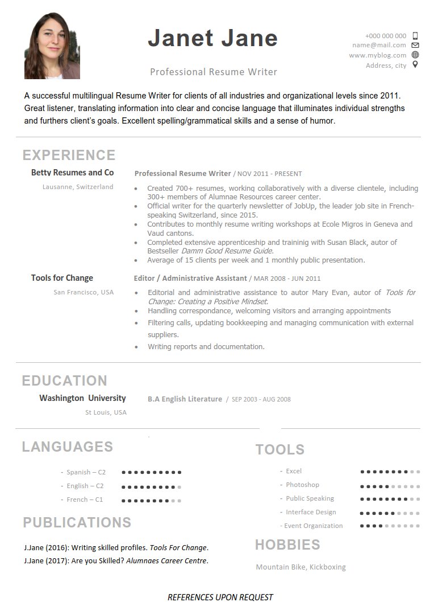
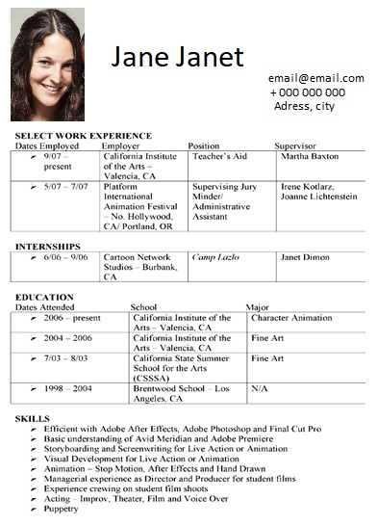
Tips and Tricks
Good and Bad Examples

Slide 10

Swiss Tips & Tricks
Photo. To add or not to add in the CV? In Switzerland they are welcomed but it remains your choice. Whatever it is…Be professional.
Practice proactive networking. Get to know your local expat groups, mingle after work and meet their Swiss friends, and casually inquire as to where other expats might work.
You will be expected to submit a letter of recommendation from your previous employer, so make sure to include it with your initial application.
A majority of jobs requiring English skills will be listed on websites or can be found through job agencies.
Many companies in Switzerland have an English language policy. Make a list, it will help you to know better the local job market and to focus your search.
Swiss employers usually ask for references. Don’t add reference details in your resume, you can underline “references upon request”.
Notes:
Photo or not a photo? What suits to your style? But if you do, please choose a professional one.
Switzerland small country! Network with friends, former colleagues and acquaintances at the department/company you are applying for. They might know of key contact people to get your resume noticed. If available job shadow with someone in that position to see if that would be a good fit for you. proactive networking. Get to know your local expat groups, mingle after work and meet their Swiss friends, and casually inquire as to where other expats might work.
You will be expected to submit a letter of recommendation from your previous employer, so make sure to include it with your initial application.
a majority of jobs requiring English skills will be listed on websites or can be found through job agencies.
You would be surprised at the number of companies in Switzerland with an English language policy. Think insurance companies, hedge funds, banks, non-profit organizations etc.

Slide 11

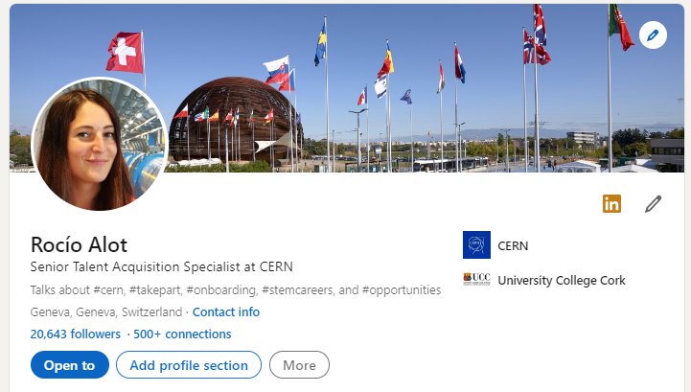
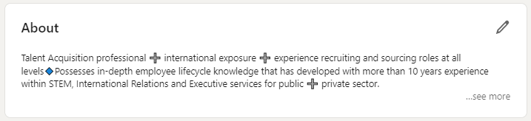
Are you
Linked-In?

Slide 12

Social Media Dos and Don’ts
During a Job Search
It would take 300 views to get a job offer:
Aim for 3-5 views per day
✓ Do create an Online Presence
✓ Do be consistent
✗ Don't forget your Facebook Privacy settings
✓ Do Google your name and check what's online
✓ Do be careful what you Tweet
✓ Do network before you need to
✓ Do give to get
✗ Don't spend time online on your boss's dime

Slide 13

Thank you & good luck!
Any Questions?

Slide 14
Additional Resources
List of powerful action verbs to add in your Resume
Your Job Application Checklist - actions to be done before submitting your application
Unsure of how «professional» your picture is? Check here Picture analyzer - Linkedin

