Slide 1
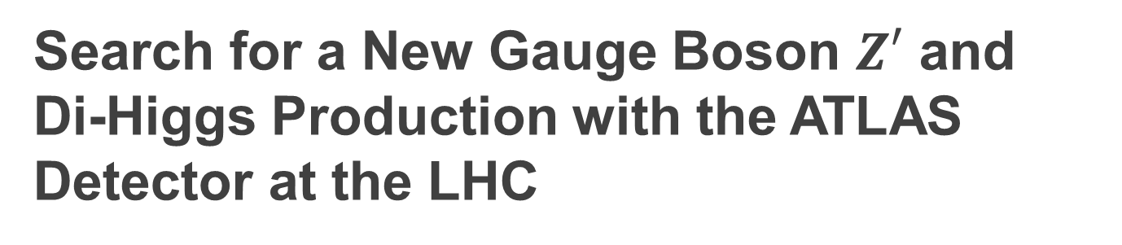
Search for a New Gauge Boson $Z′$ and
Di-Higgs Production with the ATLAS Detector at the LHC
Zhe Yang
PhD thesis defense, May 23, 2023
Supervisors: Prof. Zhengguo Zhao and Prof. Bing Zhou

Slide 2
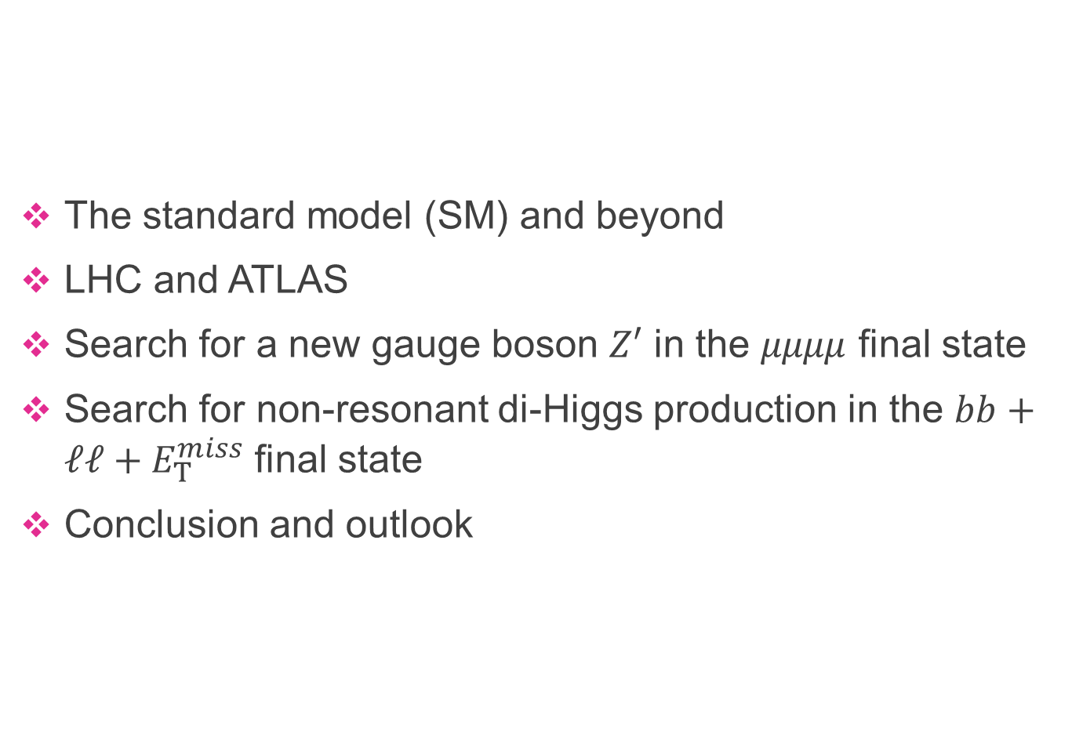
Outline
The standard model (SM) and beyond
LHC and ATLAS
Search for a new gauge boson $Z′$ in the $μμμμ$ final state
Search for non-resonant di-Higgs production in the $bb+ℓℓ+E_{T}^{miss}$ final state
Conclusion and outlook

Slide 3
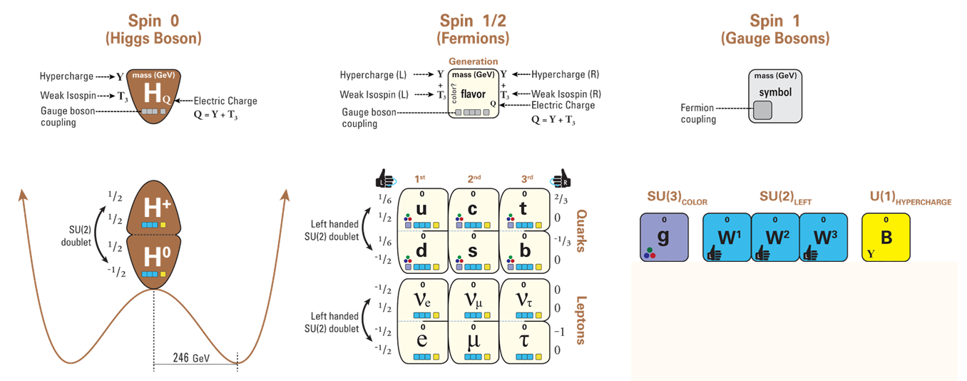


Standard Model of Particle Physics
building blocks
“extend” global sym. to local sym.
Scalar field
$$φ^{+}$$
$$φ^{0}$$

Slide 4
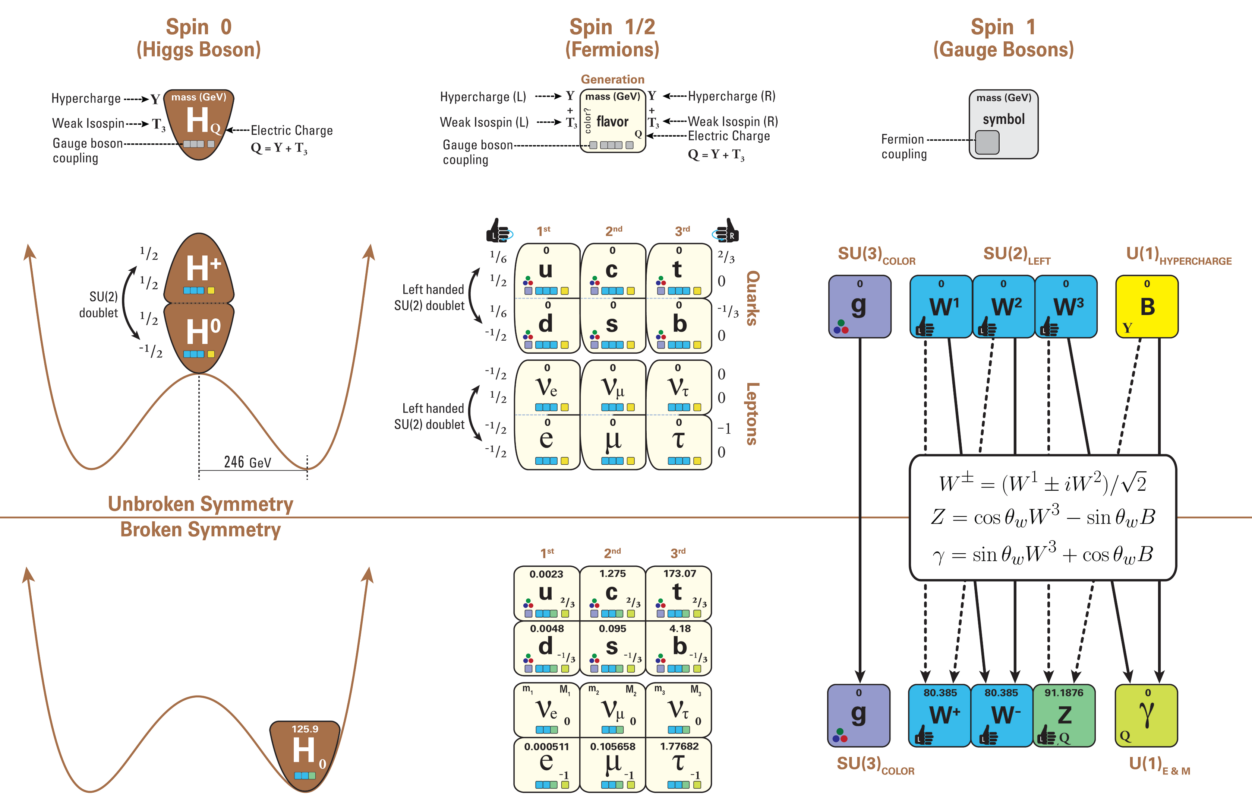
Standard Model of Particle Physics
building blocks
“extend” global sym. to local sym.
Scalar field
$$φ^{+}$$
interaction in vacuum
$$φ^{0}$$
generate masses

Slide 5
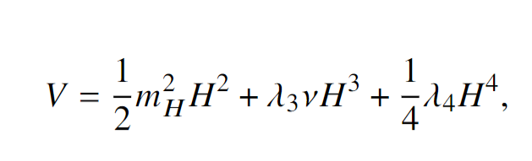
Standard Model of Particle Physics
building blocks
“extend” global sym. to local sym.
Exploration: will there be extra symmetry ? (new gauge boson)
Scalar field
$$φ^{+}$$
interaction in vacuum
$$φ^{0}$$
generate masses
Exploitation: what is the fine structure/coupling ?
Test SM, and search for BSM signature at the LHC

Slide 6
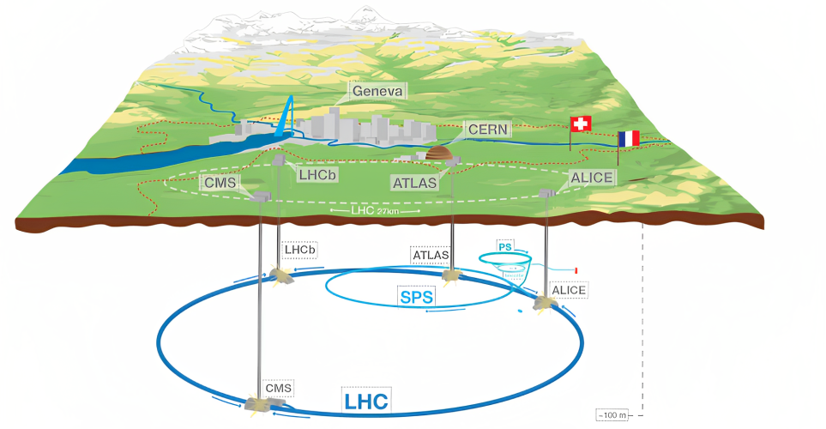


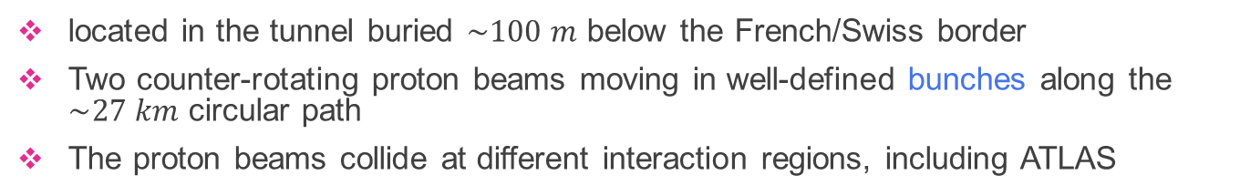
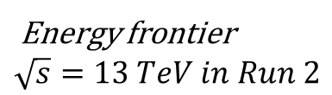
The Large Hadron Collider
Energy frontier
$$\sqrt{s}=13 TeV in Run 2$$
located in the tunnel buried $\sim 100 m$ below the French/Swiss border
Two counter-rotating proton beams moving in well-defined bunches along the $\sim 27 km$ circular path
The proton beams collide at different interaction regions, including ATLAS

Slide 7
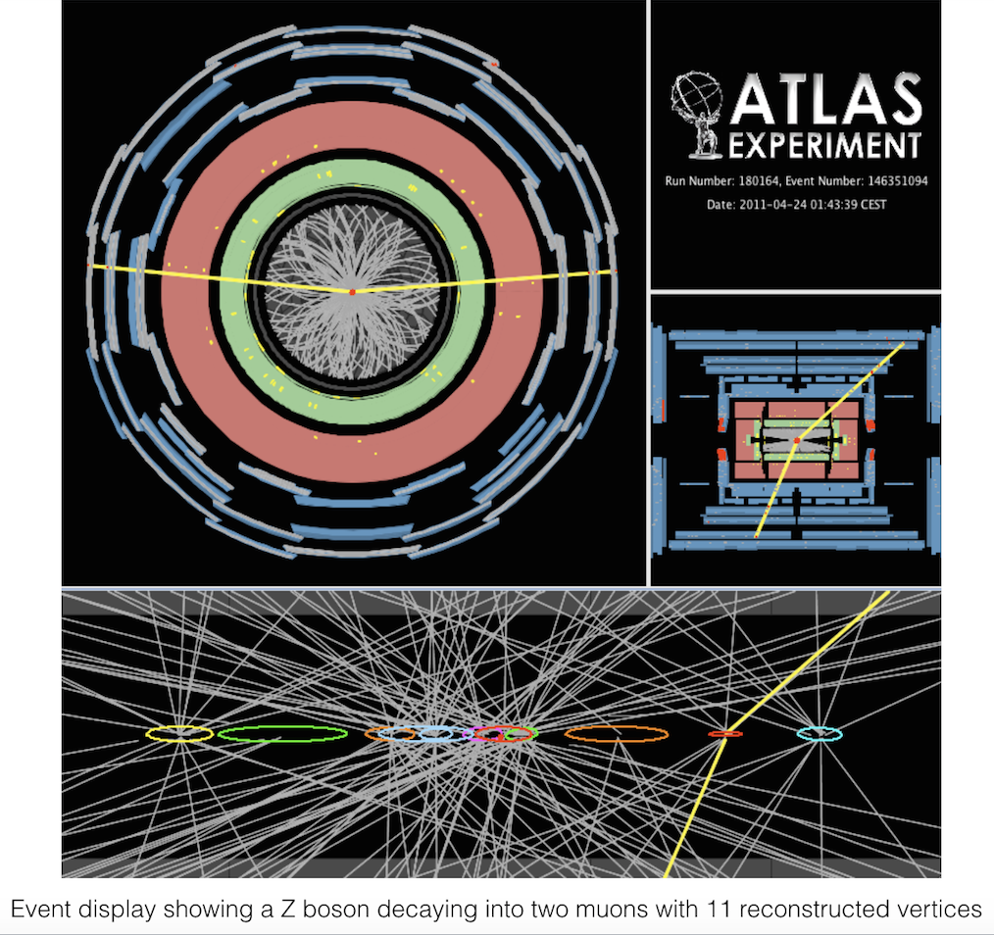
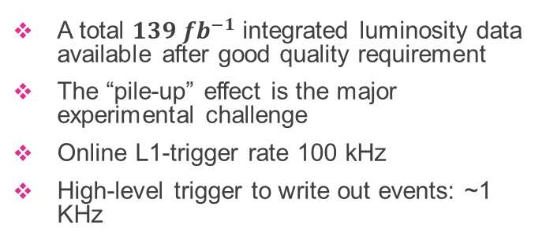
Luminosity delivered to ATLAS in Run2
major experimental challenge: pile-up
A total $139 fb^{−1}$ integrated luminosity data available after good quality requirement
The “pile-up” effect is the major experimental challenge
Online L1-trigger rate 100 kHz
High-level trigger to write out events: ~1 KHz

Slide 8
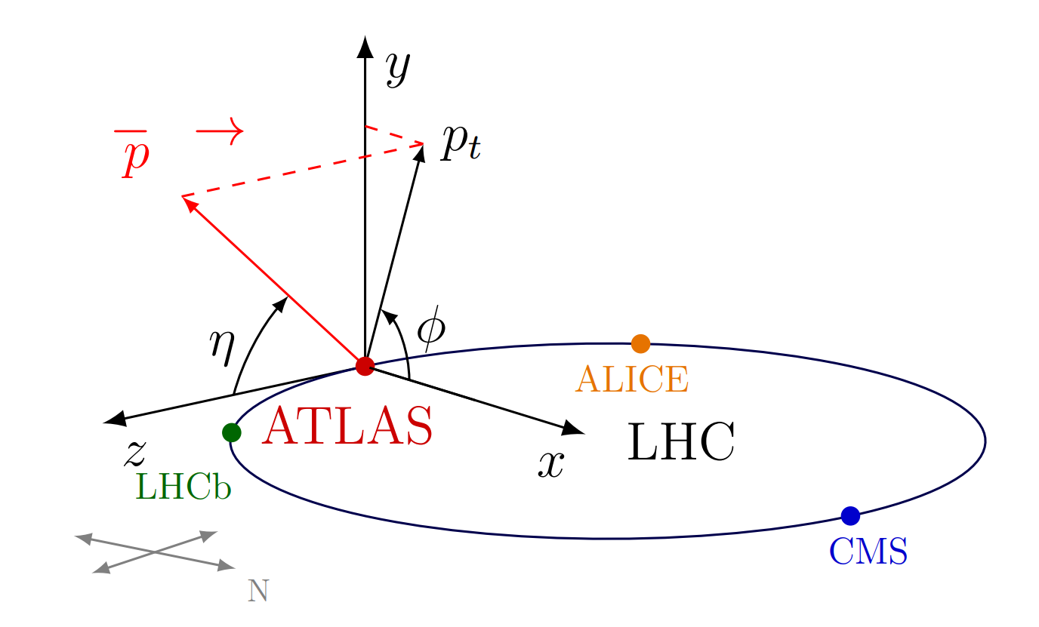
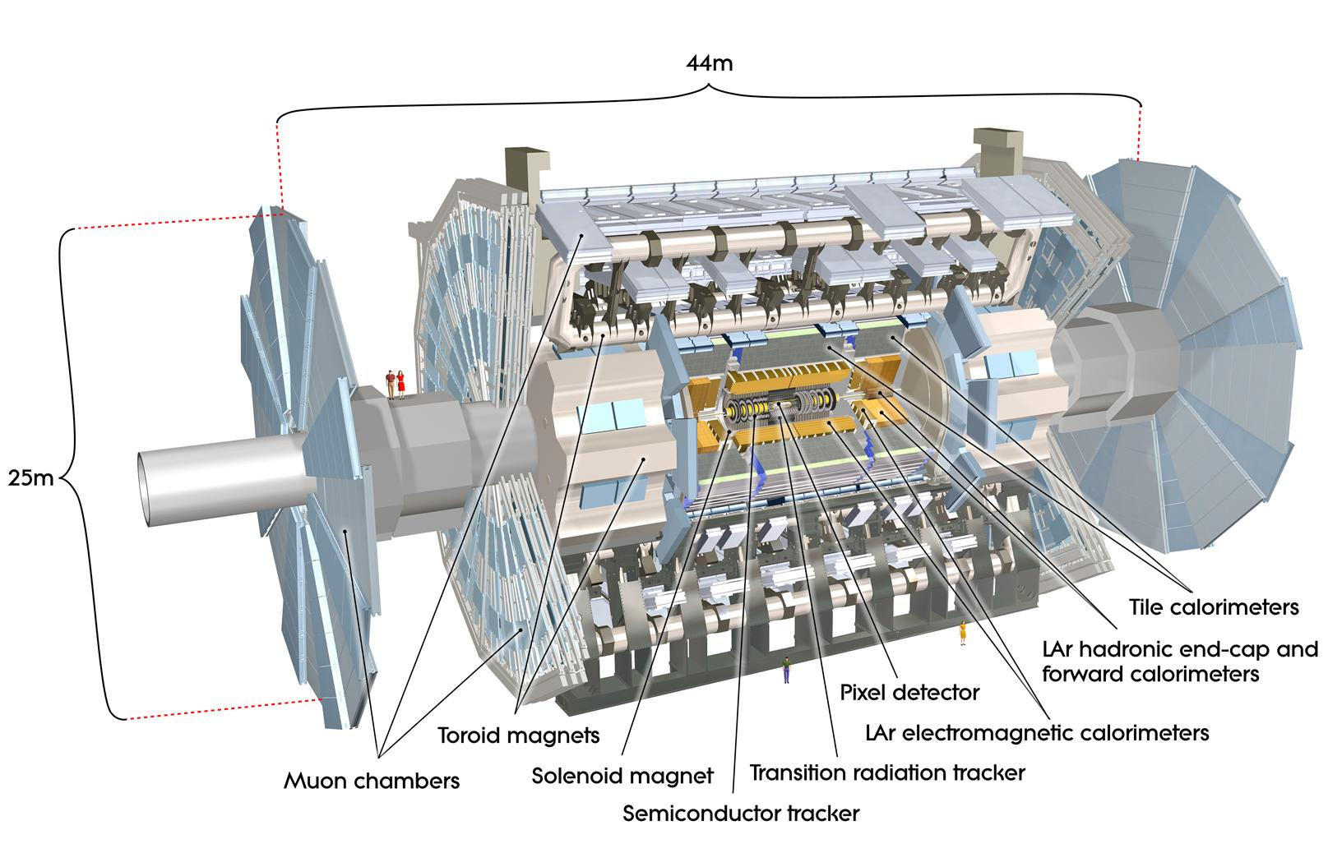

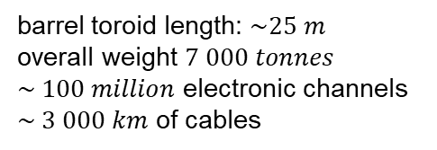
A Toroidal LHC ApparatuS
ATLAS
coordinate systems
barrel toroid length: $\sim 25 m$
overall weight $7 000 tonnes$
$\sim 100 million$ electronic channels
$\sim 3 000 km$ of cables
$$η=−\ln{\tan{(θ/2)}}$$
$$ΔR=\sqrt{(Δ{η)}^{2}+(Δ{φ)}^{2}}$$

Slide 9
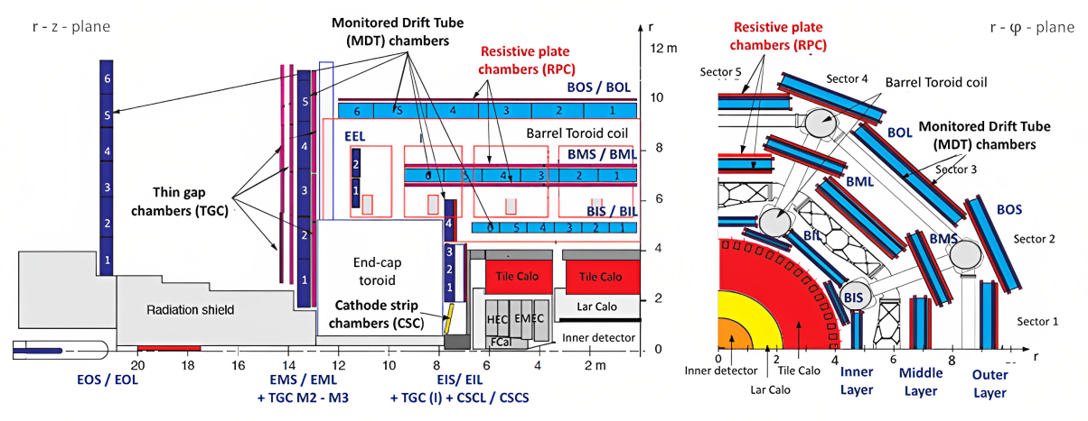
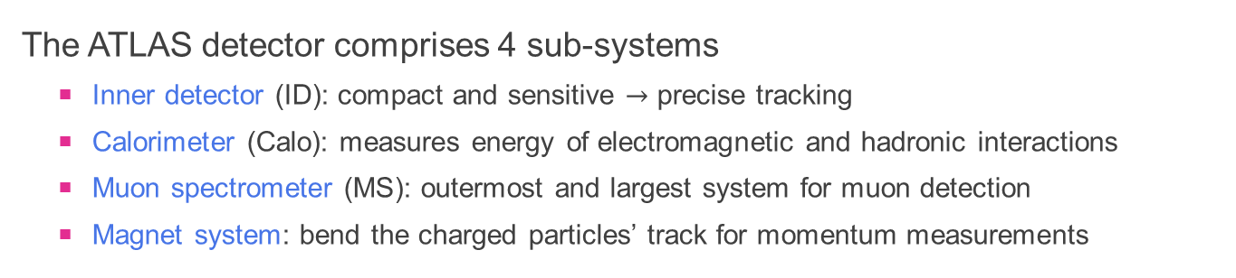
The Cross Section of the ATLAS
The ATLAS detector comprises 4 sub-systems
  Inner detector (ID): compact and sensitive $→$ precise tracking
  Calorimeter (Calo): measures energy of electromagnetic and hadronic interactions
  Muon spectrometer (MS): outermost and largest system for muon detection
  Magnet system: bend the charged particles’ track for momentum measurements

Slide 10
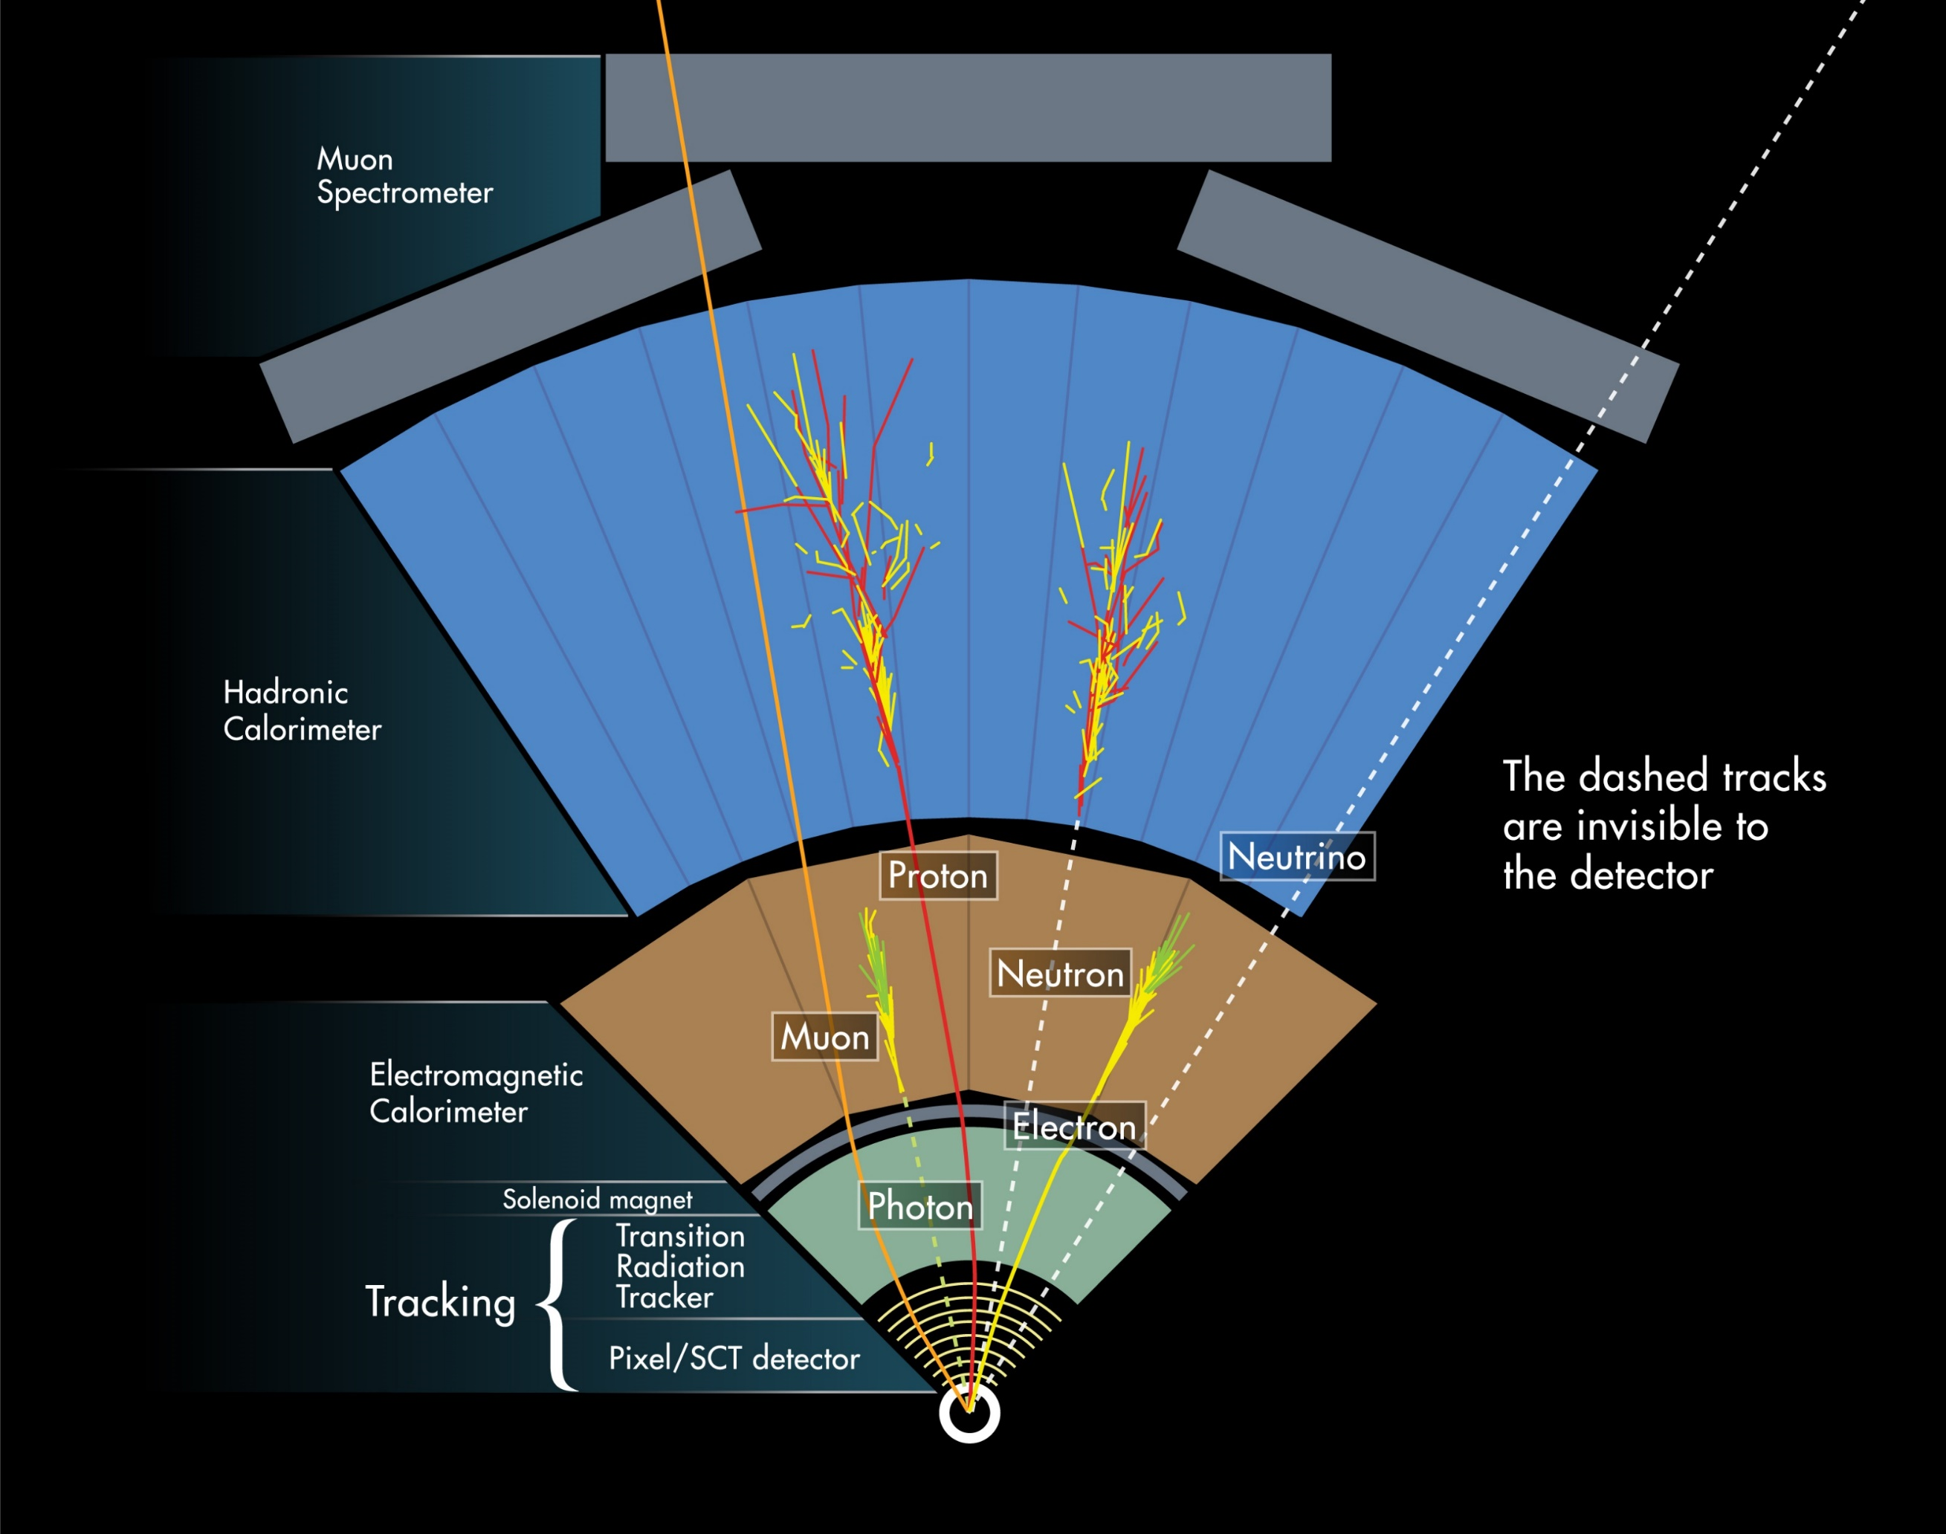
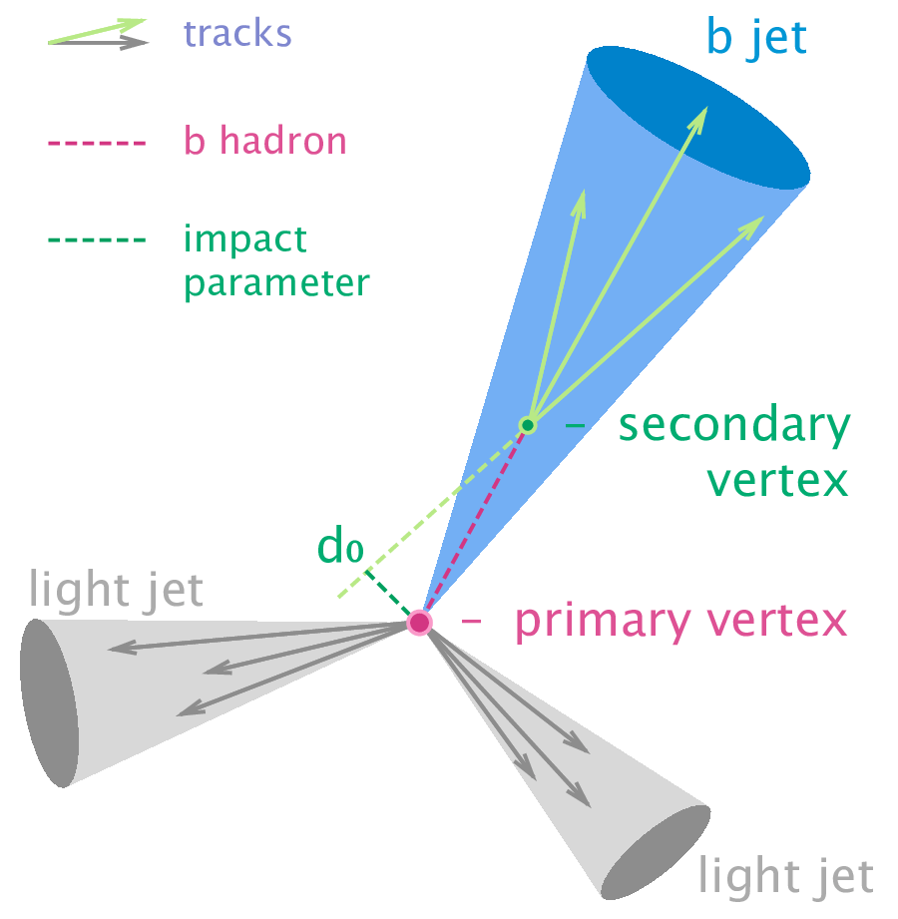
Particle Detection in ATLAS
Objects are reconstructed off-line based on particle identifications

Slide 11

Search for a new gauge boson $Z′$
in the $μμμμ$ final state

Slide 12
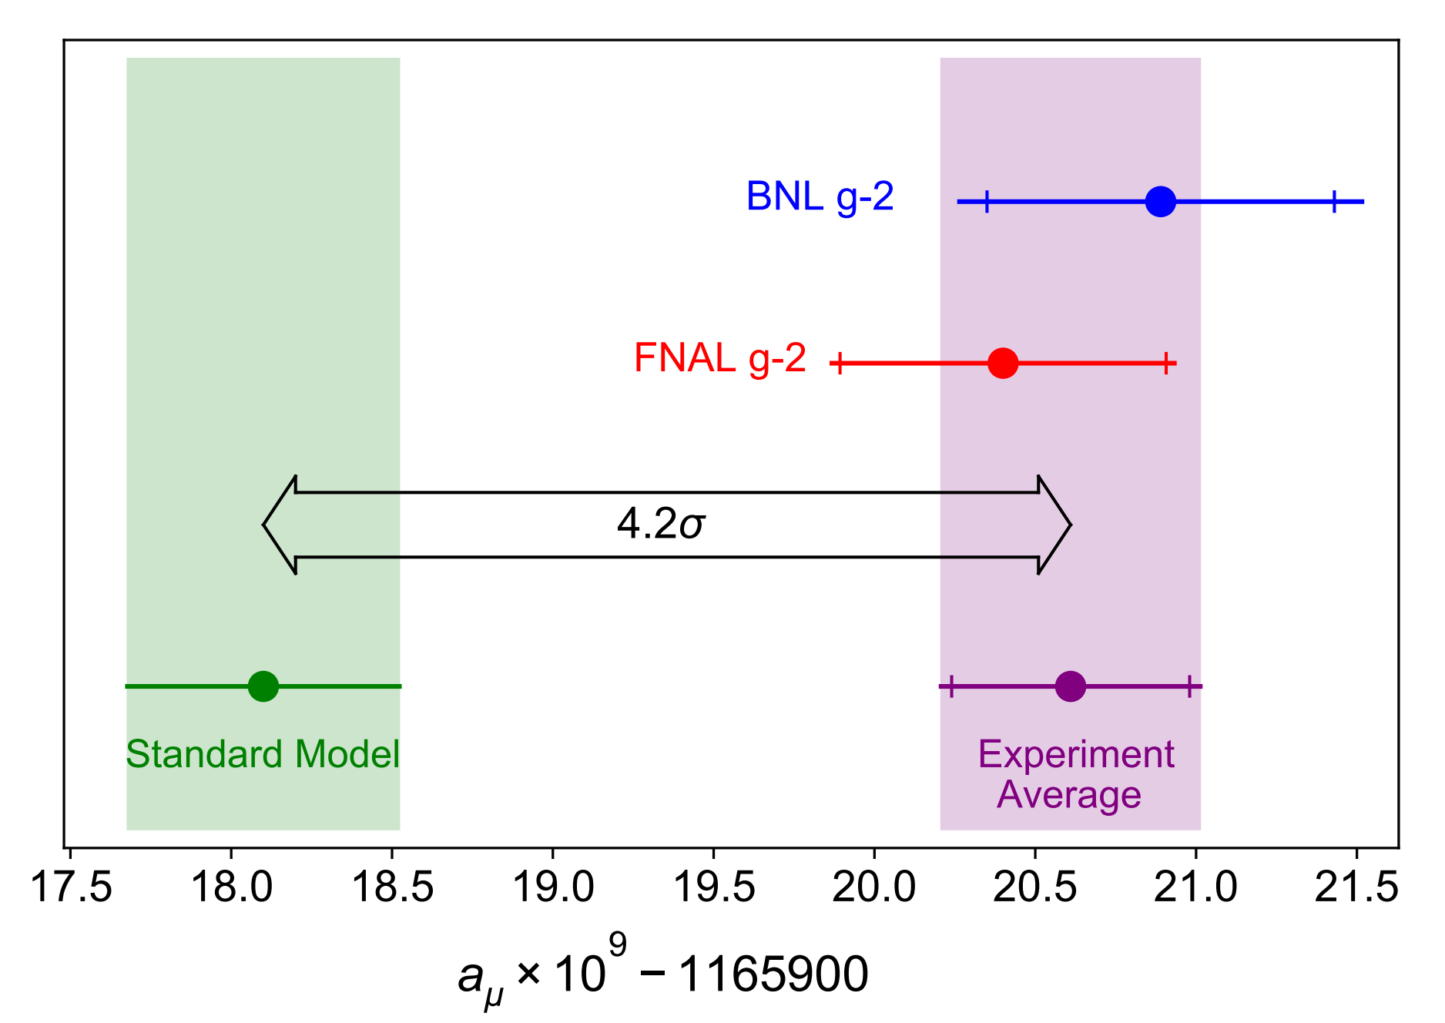
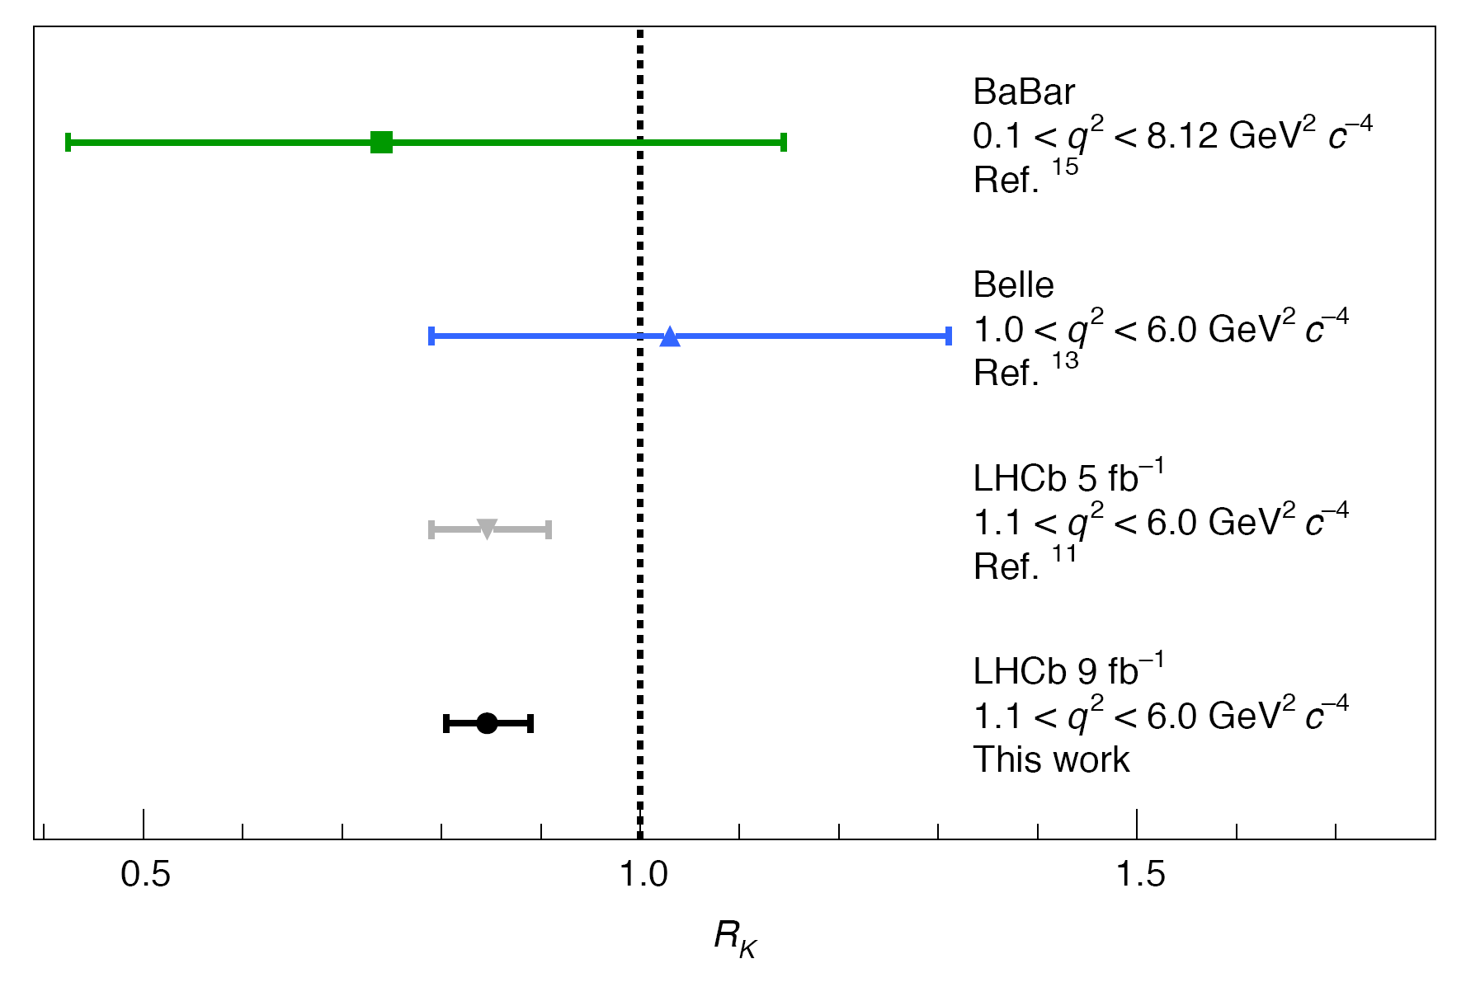
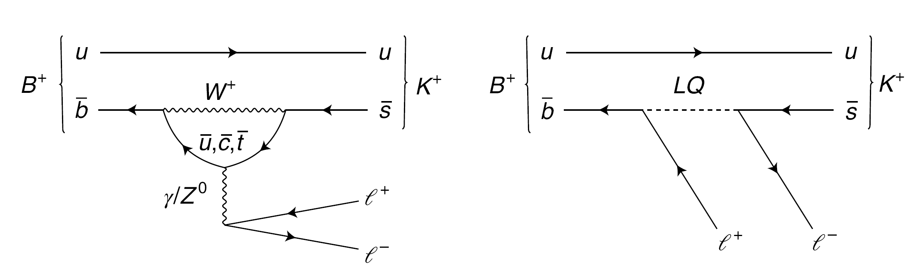

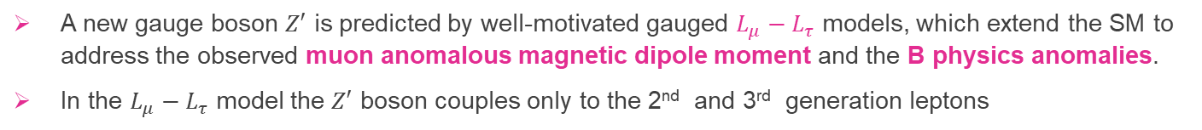


Motivation and New Physics Model
The SM is not the end of theory: gravity, dark matter, neutrino mass…
arXiv:2104.03281
Nature Physics
g-2 anomaly
flavor anomaly
$Z′$ production via Drell-Yan process
$R_{K}=\frac{ℬ\left(B^{+}→K^{+}μ^{+}μ^{−}\right)}{ℬ\left(B^{+}→J/Ψ(→μ^{+}μ^{−})K^{+}\right)}$ / $\frac{ℬ\left(B^{+}→K^{+}e^{+}e^{−}\right)}{ℬ\left(B^{+}→J/Ψ(→e^{+}e^{−})K^{+}\right)}$
Note: new measurement from LHCb shown $R_{k}$ is consistent with SM, but $R_{D}$ is still $3σ$ off
A new gauge boson $Z′$ is predicted by well-motivated gauged $L_{μ}−L_{τ}$ models, which extend the SM to address the observed muon anomalous magnetic dipole moment and the B physics anomalies.
In the $L_{μ}−L_{τ}$ model the $Z′$ boson couples only to the 2nd and 3rd generation leptons

Slide 13
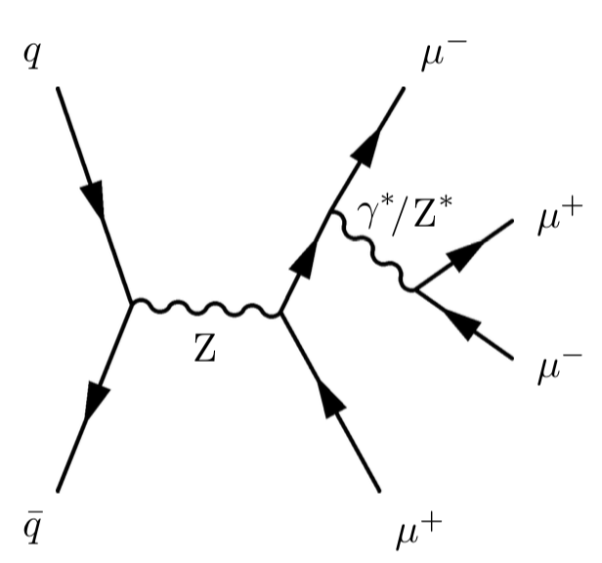
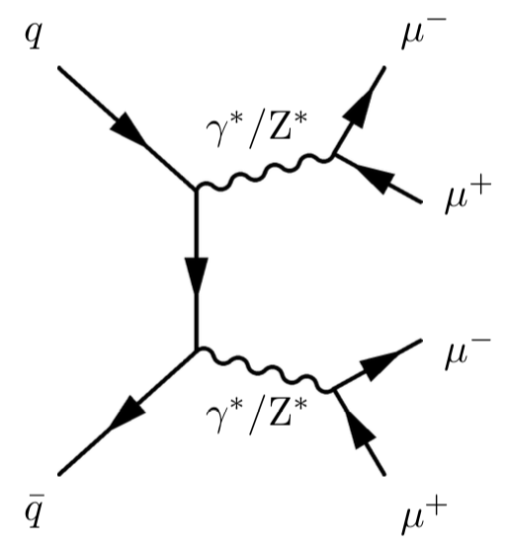
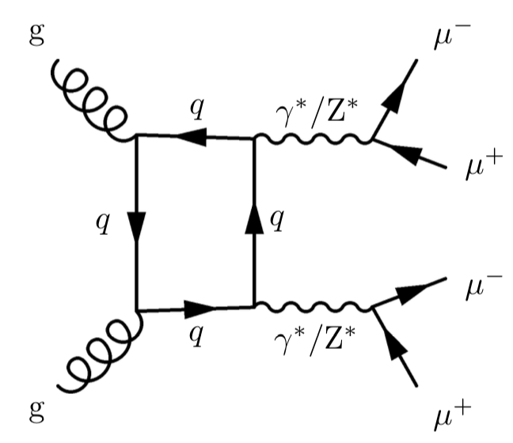
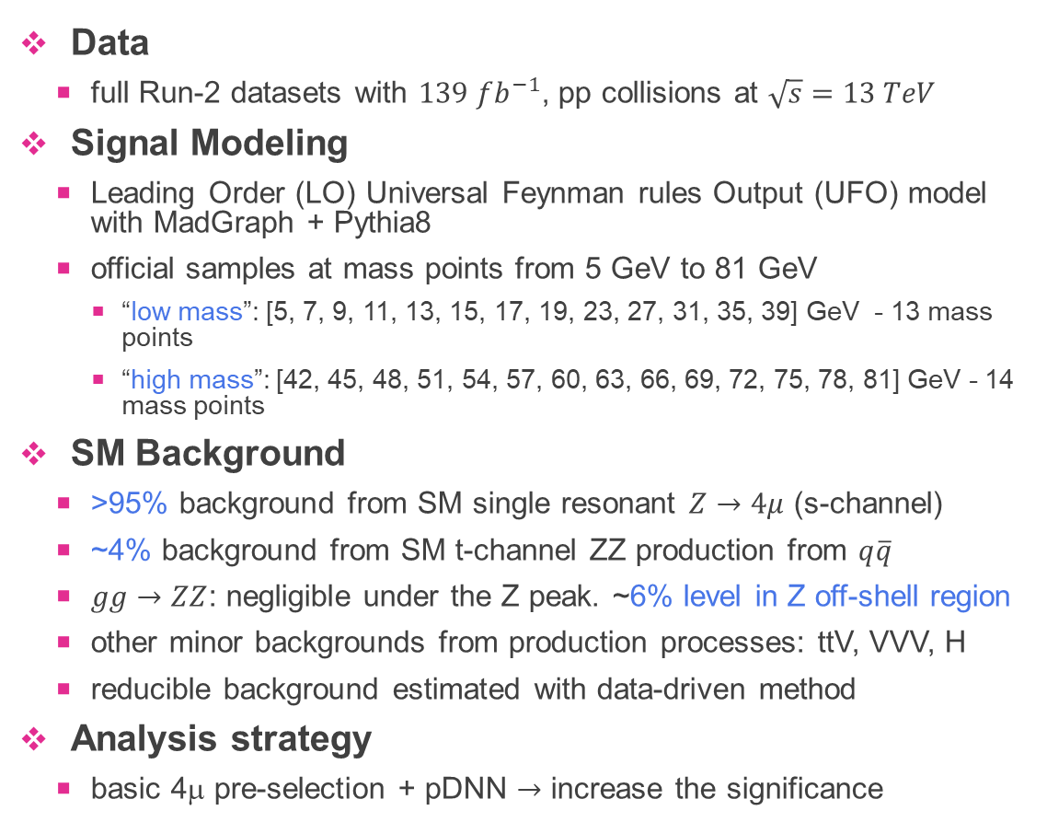
Analysis Overview
Data
  full Run-2 datasets with $139 fb^{−1}$, pp collisions at $\sqrt{s}=13 TeV$
Signal Modeling
  Leading Order (LO) Universal Feynman rules Output (UFO) model with MadGraph + Pythia8
  official samples at mass points from 5 GeV to 81 GeV
    “low mass”: [5, 7, 9, 11, 13, 15, 17, 19, 23, 27, 31, 35, 39] GeV - 13 mass points
    “high mass”: [42, 45, 48, 51, 54, 57, 60, 63, 66, 69, 72, 75, 78, 81] GeV - 14 mass points
SM Background
  >95% background from SM single resonant $Z→4μ$ (s-channel)
  ~4% background from SM t-channel ZZ production from $q\overline{q}$
  $gg→ZZ$: negligible under the Z peak. ~6% level in Z off-shell region
  other minor backgrounds from production processes: ttV, VVV, H
  reducible background estimated with data-driven method
Analysis strategy
  basic 4μ pre-selection + pDNN $→$ increase the significance
SM Background

Slide 14
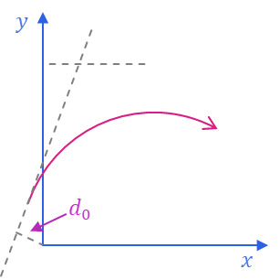
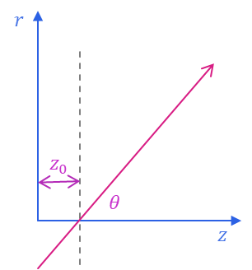
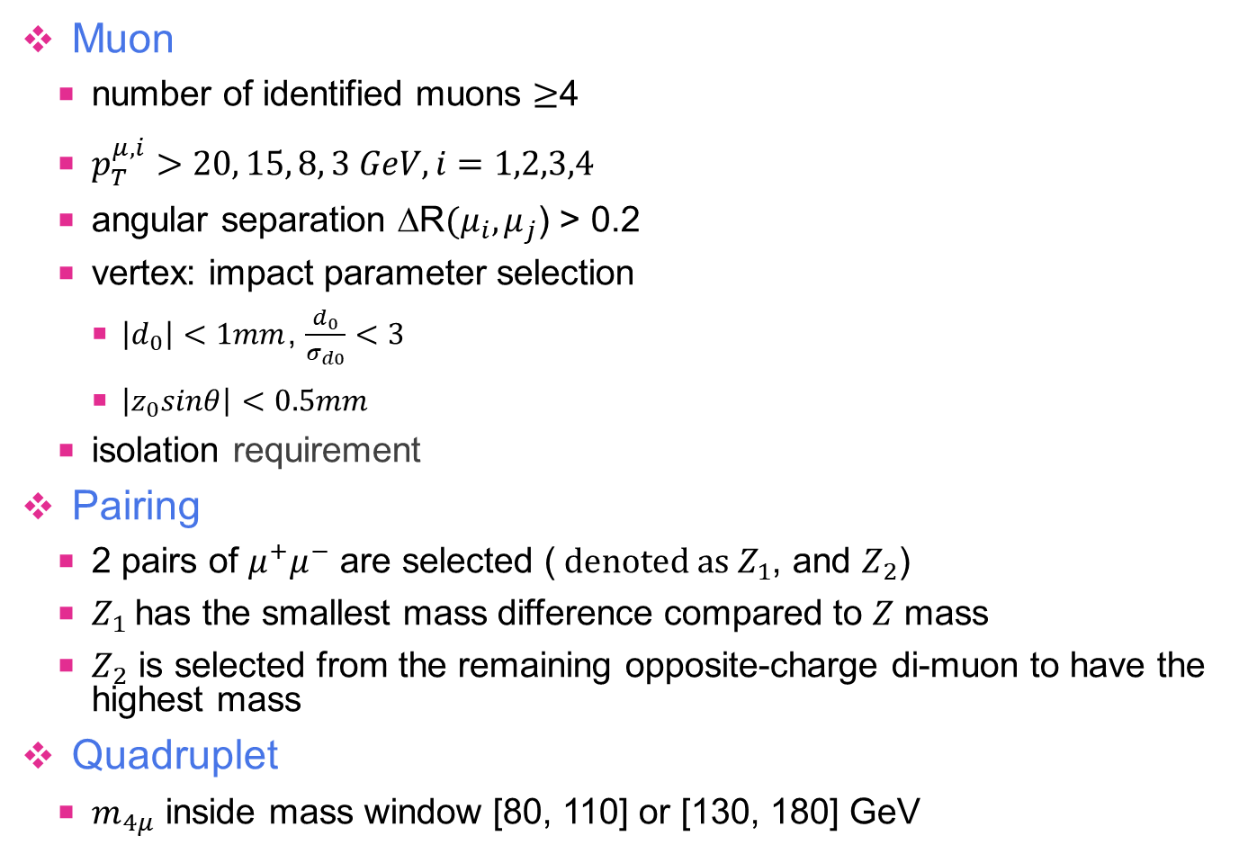



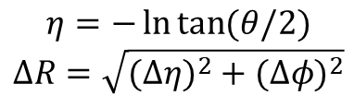


Event selection
$$η=−\ln{\tan{(θ/2)}}$$
$$ΔR=\sqrt{(Δ{η)}^{2}+(Δ{φ)}^{2}}$$
Muon
  number of identified muons $≥$4
  $p_{T}^{μ,i}>20, 15, 8, 3 GeV, i=1,2,3,4$
  angular separation ΔR$(μ_{i},μ_{j}$) > 0.2
  vertex: impact parameter selection
    $\left|d_{0}\right|<1mm$, $\frac{d_{0}}{σ_{d0}}<3$
    $\left|z_{0}sinθ\right|<0.5mm$
  isolation requirement
Pairing
  2 pairs of $μ^{+}μ^{−}$ are selected ($denoted as Z_{1}$, and $Z_{2}$)
  $Z_{1}$has the smallest mass difference compared to $Z$ mass
  $Z_{2}$ is selected from the remaining opposite-charge di-muon to have the highest mass
Quadruplet
  $m_{4μ}$ inside mass window [80, 110] or [130, 180] GeV
well
isolated
$$μ$$
bad
isolated
$$μ$$
$$ΔR$$
$$ΔR$$
enhance for high mass $Z′$ signals

Slide 15
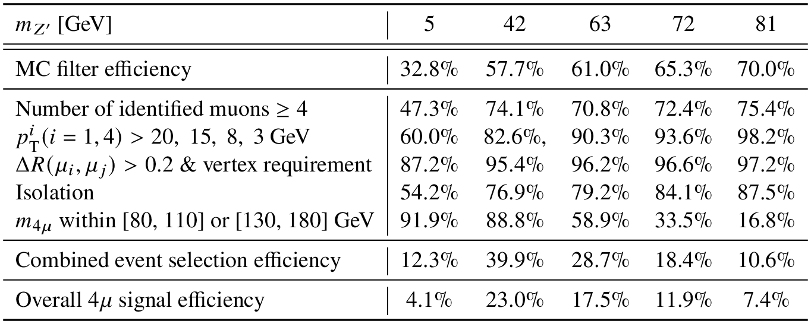
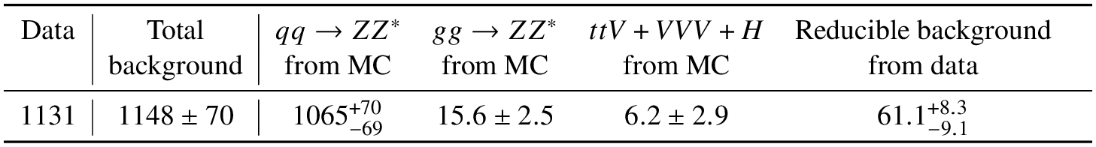
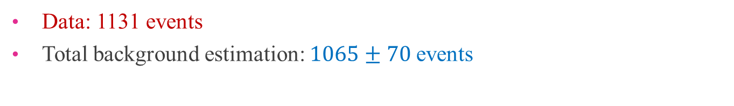
Signal and background selection
relative efficiency compared to previous stage
Data: 1131 events
Total background estimation: $1065±70$events
Will be described in next pages

Slide 16
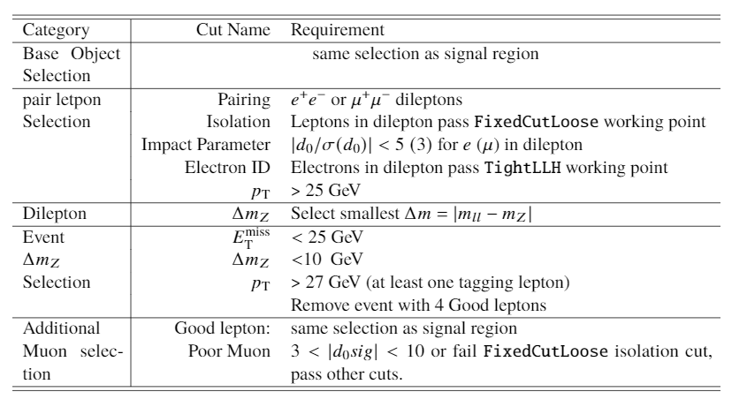
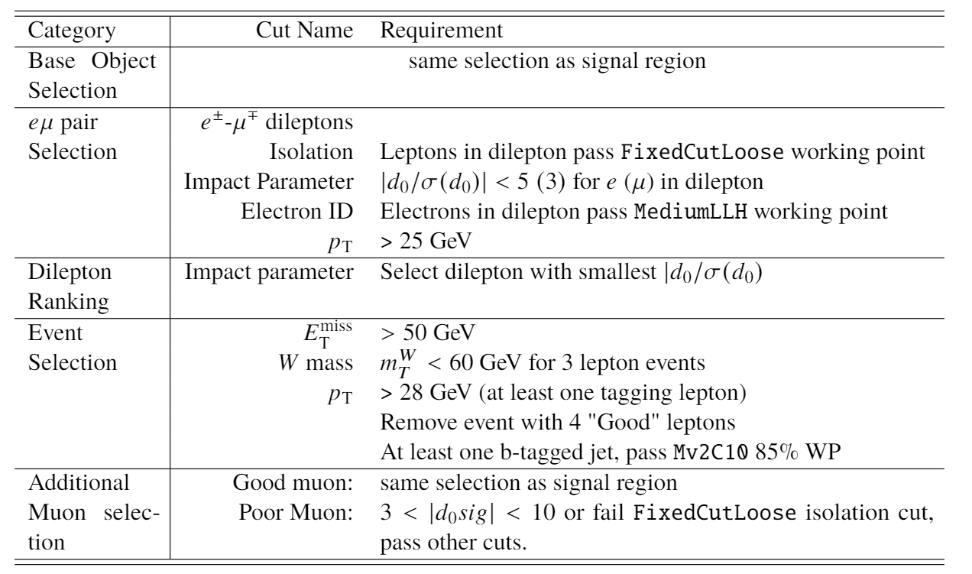
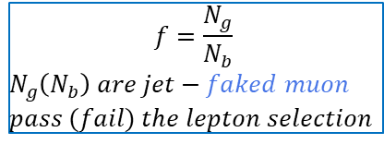


Fake Muon Background Estimation
$$f=\frac{N_{g}}{N_{b}}$$
$$N_{g}\left(N_{b}\right) are jet−faked muon$$
$$pass (fail) the lepton selection$$
Fake lepton backgrounds is estimated using the fake factor method.
We define two CRs to estimate fake factors from ttbar and Z+jets events.
Fake factor is defined as the ratio of “good” ($N_{g}$) and “bad” ($N_{b}$) number of leptons in CRs.
  Bad$“$lepton” is defined as the reconstructed lepton-object failed in isolation, lepton quality or impact parameter cuts.
Estimate the fake-muon events from CRs: with “ggbb” and “gggb” 4μ; then, scaled by FFs
  The 4μ events in the CRs were selected as SR, except 2 or 1 “good” muons were replaced by “bad” muons
Z+jets CR
$t\overline{t}$ CR

Slide 17
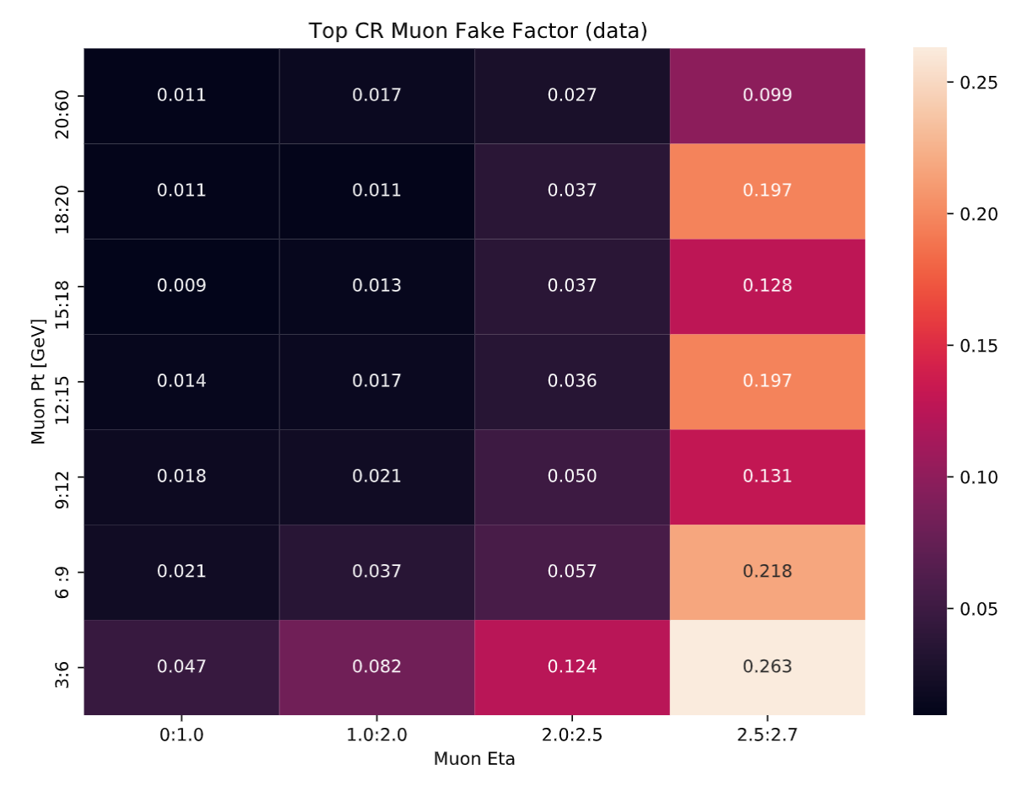
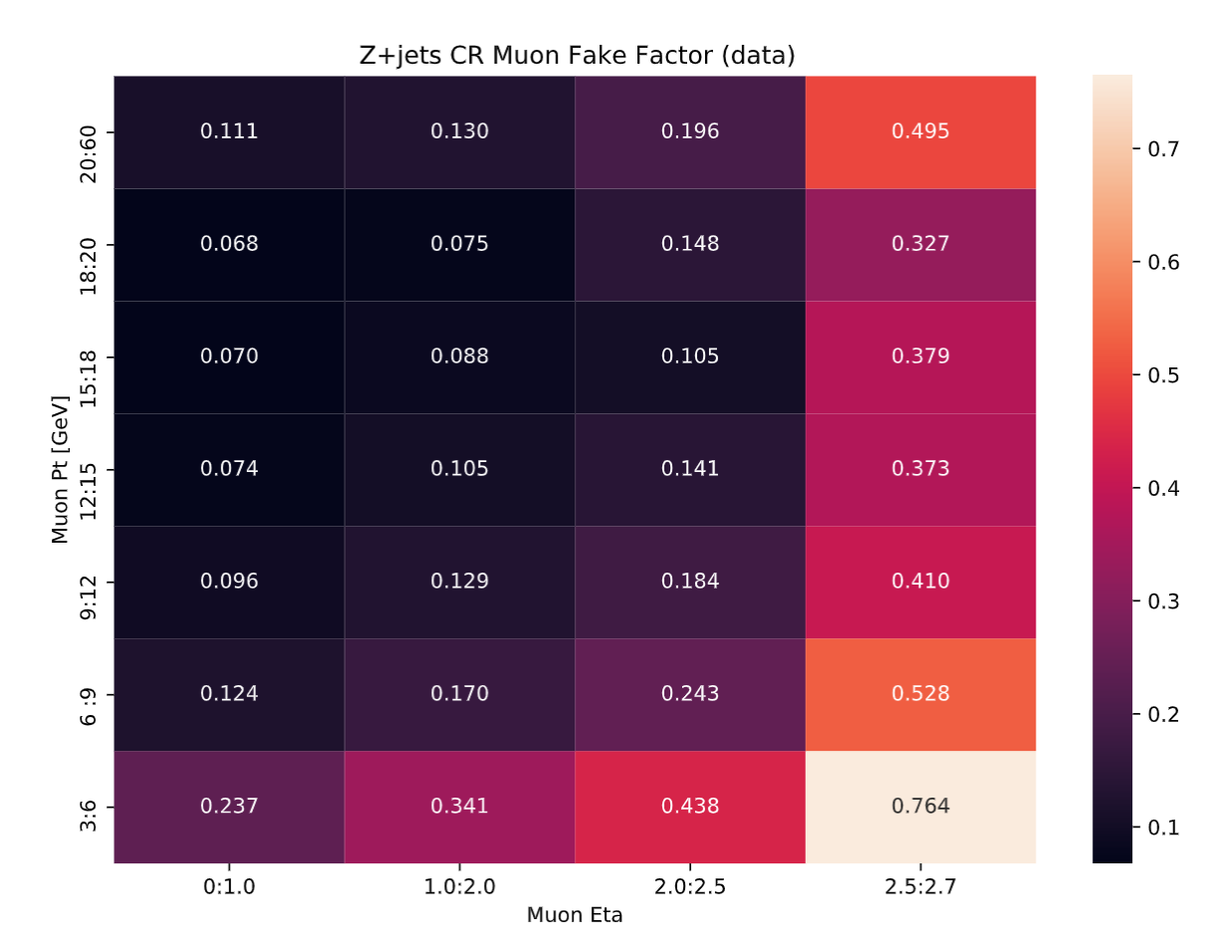
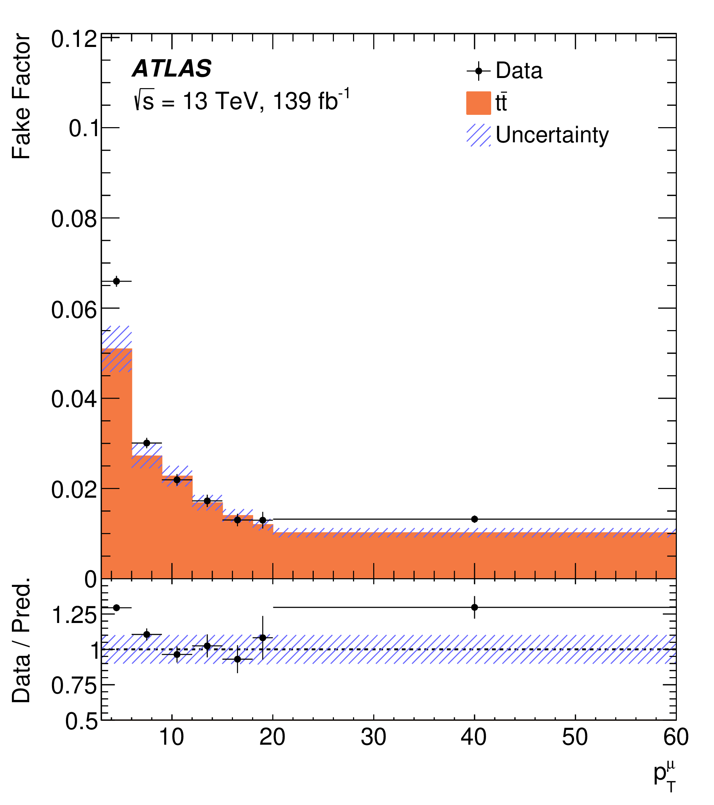
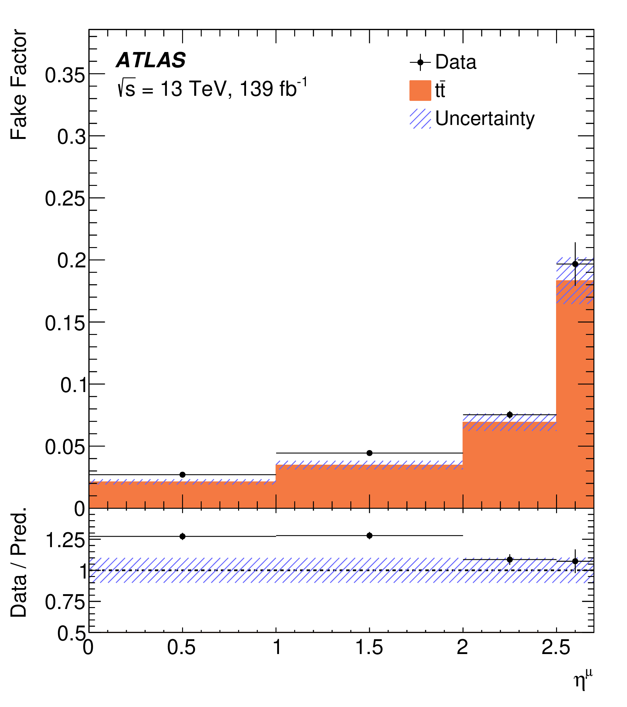
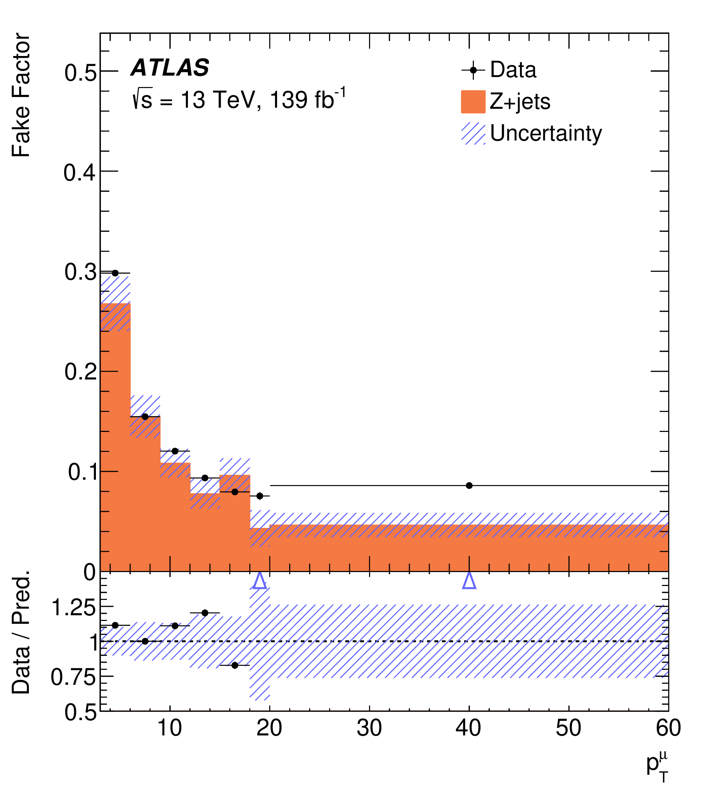
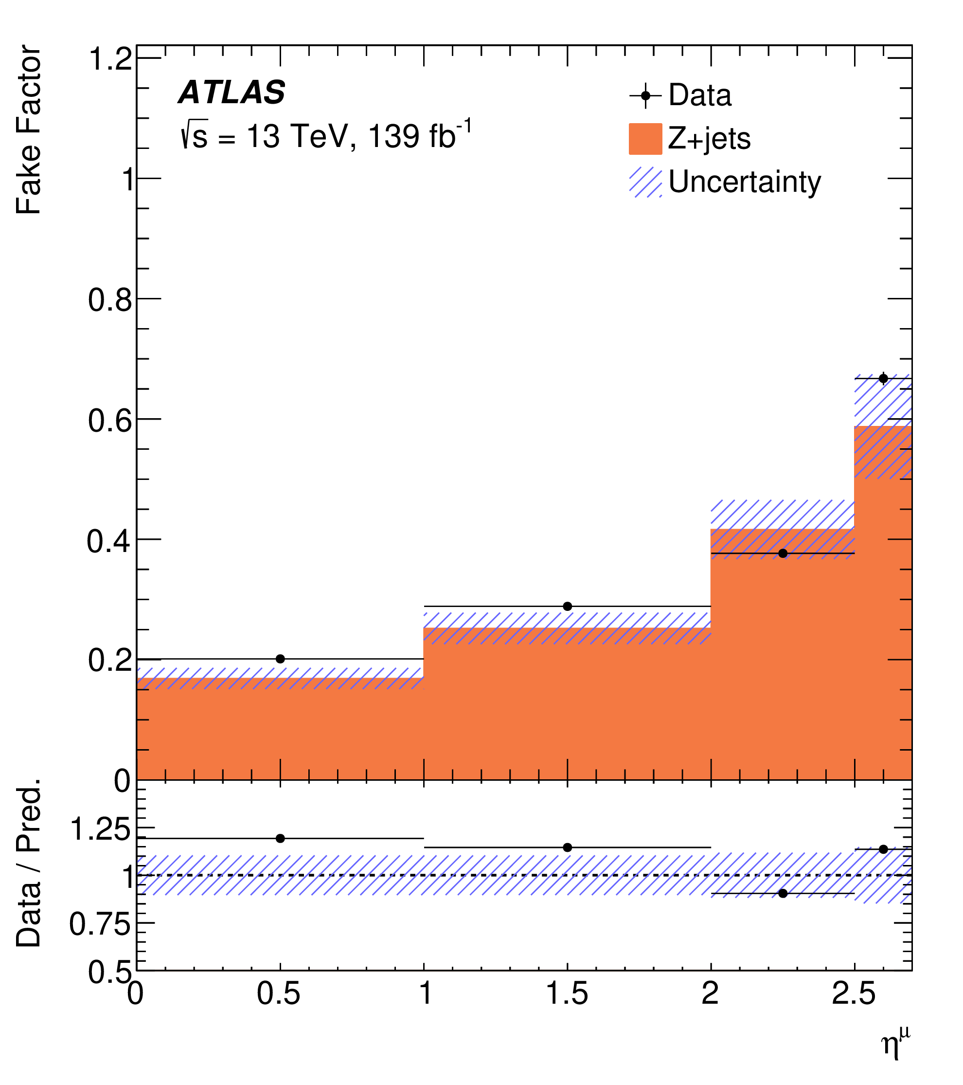

Fake Factors Calculated Using CRs
Fake-factors
Fake-factors
$t\overline{t}$ CR
Z+jets CR

Slide 18
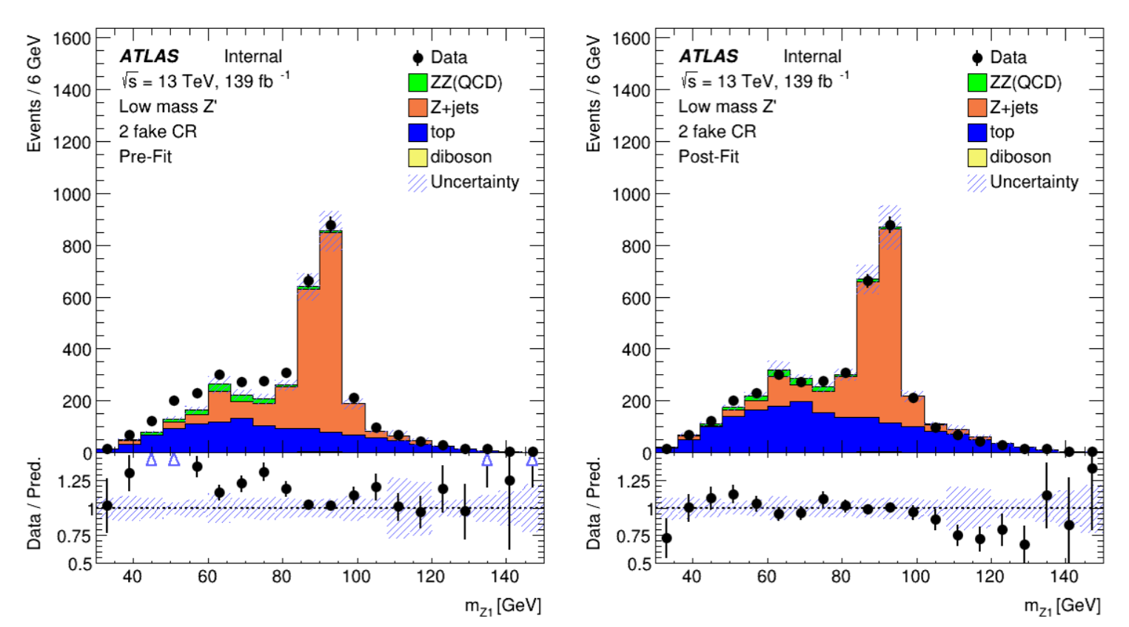
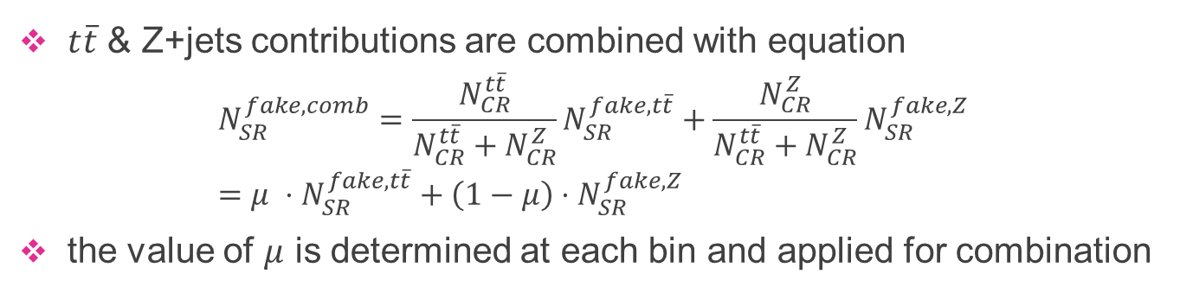
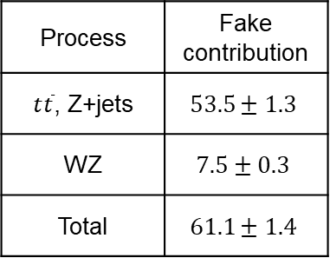
Combination of Fake-Factors
Determine the Z+jets and $t\overline{t}$ event fraction as a function of m_{Z1} in the “ggbb” 4μ CR
Estimated fake background
Process | Fake contribution
$t\overline{t}$, Z+jets | $$53.5±1.3$$
WZ | $$7.5±0.3$$
Total | $$61.1±1.4$$
$t\overline{t}$ & Z+jets contributions are combined with equation
$$N_{SR}^{fake,comb}=\frac{N_{CR}^{t\overline{t}}}{N_{CR}^{t\overline{t}}+N_{CR}^{Z}}N_{SR}^{fake,t\overline{t}}+\frac{N_{CR}^{Z}}{N_{CR}^{t\overline{t}}+N_{CR}^{Z}}N_{SR}^{fake,Z}=μ ⋅N_{SR}^{fake,t\overline{t}}+\left(1−μ\right)⋅N_{SR}^{fake,Z}$$
the value of $μ$ is determined at each bin and applied for combination

Slide 19
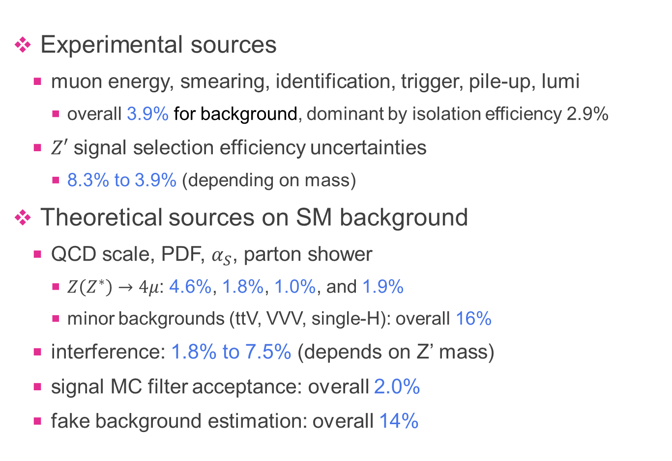
Systematic Uncertainties
Experimental sources
  muon energy, smearing, identification, trigger, pile-up, lumi
    overall 3.9% for background, dominant by isolation efficiency 2.9%
  $Z′$ signal selection efficiency uncertainties
    8.3% to 3.9% (depending on mass)
Theoretical sources on SM background
  QCD scale, PDF, $α_{S}$, parton shower
    $Z\left(Z^{∗}\right)→4μ$: 4.6%, 1.8%, 1.0%, and 1.9%
    minor backgrounds (ttV, VVV, single-H): overall 16%
  interference: 1.8% to 7.5% (depends on Z’ mass)
  signal MC filter acceptance: overall 2.0%
  fake background estimation: overall 14%

Slide 20
Data / MC – Kinematic distributions
Good agreement between data and MC
basics MC kinematic distributions are used for DNN-based classifier training

Slide 21
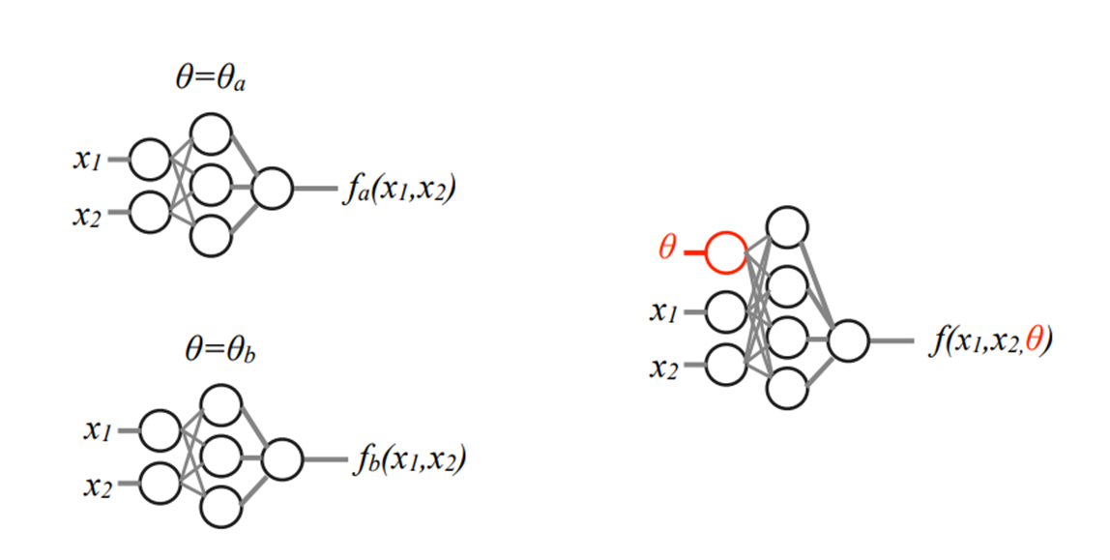
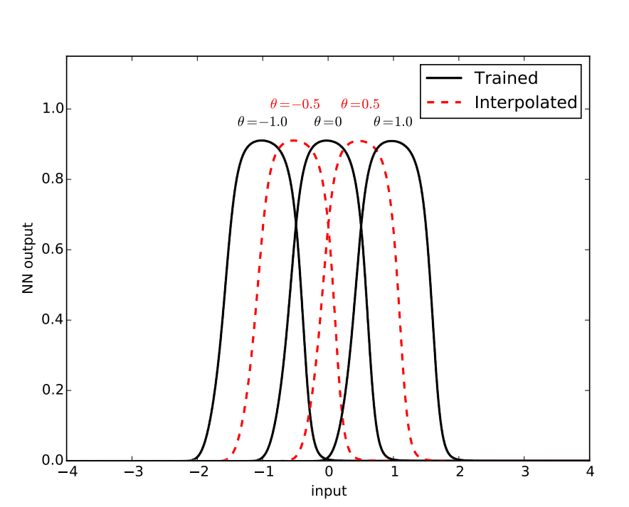
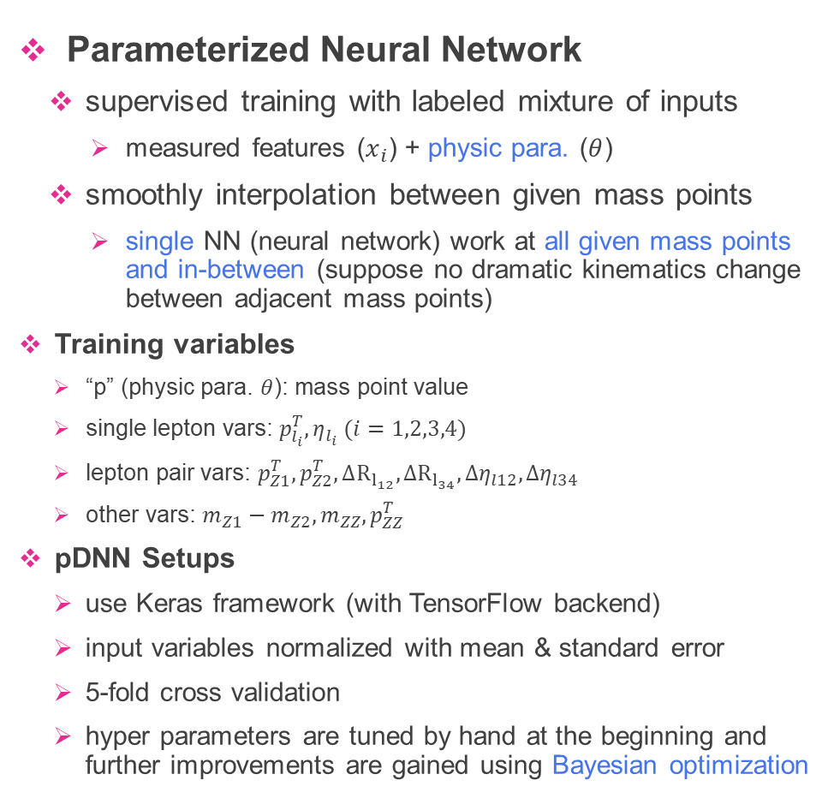
Parameterized Neural Network
Parameterized Neural Network
  supervised training with labeled mixture of inputs
    measured features ($x_{i}$) + physic para. ($θ$)
  smoothly interpolation between given mass points
    single NN (neural network) work at all given mass points and in-between (suppose no dramatic kinematics change between adjacent mass points)
Training variables
  “p” (physic para. $θ$): mass point value
  single lepton vars: $p_{l_{i}}^{T}, η_{l_{i}} (i=1,2,3,4)$
  lepton pair vars: $p_{Z1}^{T}, p_{Z2}^{T}, ΔR_{l_{12}},ΔR_{l_{34}},Δη_{l12},Δη_{l34}$
  other vars: $m_{Z1}−m_{Z2}, m_{ZZ}, p_{ZZ}^{T}$
pDNN Setups
  use Keras framework (with TensorFlow backend)
  input variables normalized with mean & standard error
  5-fold cross validation
  hyper parameters are tuned by hand at the beginning and further improvements are gained using Bayesian optimization
arXiv:1601.07913
arXiv:1601.07913

Slide 22
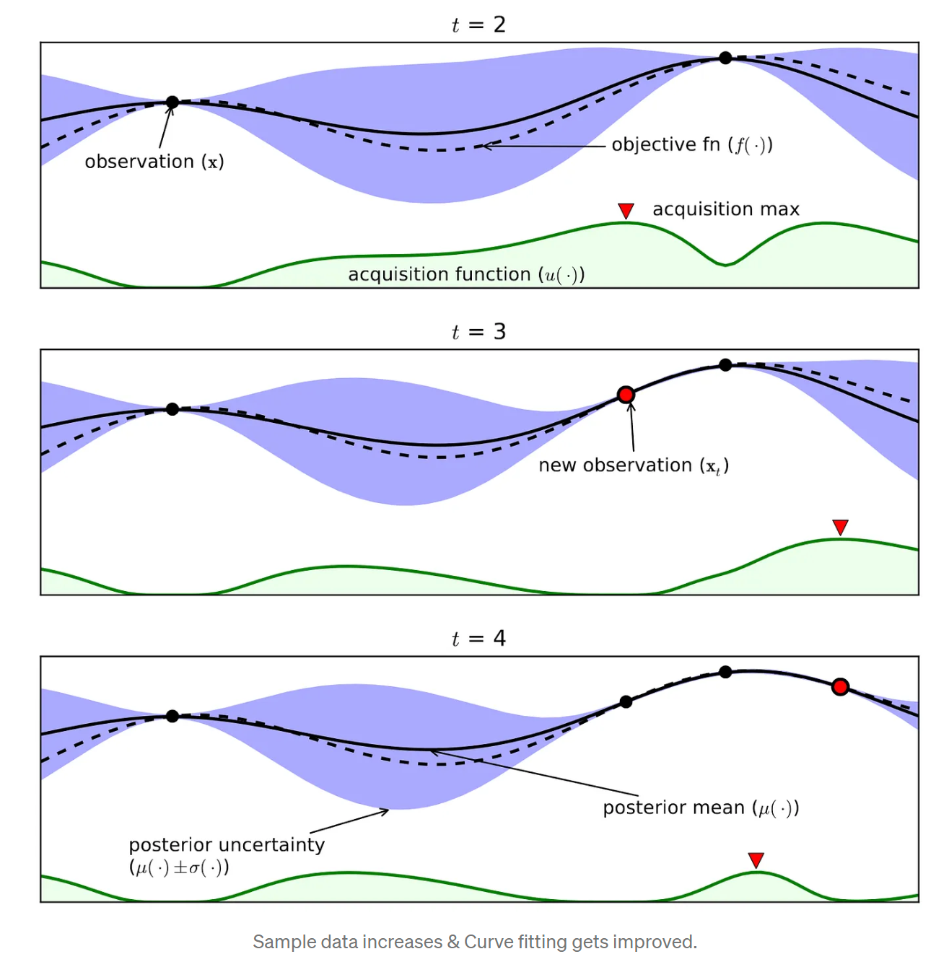


Automatic Hyperparameter Optimization
Optimization algorithms
  task scheduler → ASHA: arXiv:1810.05934 (2018)
  algorithm → HEBO(Bayesian): arXiv:2012.03826 (2020)
    Bayesian based: exploration + exploitation
Search space/dimensions
  structure: layers, nodes (per layer)
  training: learning rate (decay), batch size, class weight
Trials
  ~1000 trials
  2~3 days on a 16-core pc
  a few percent further improvements on coupling limits compared with well hand-tuned model
    ~10% improvement at high mass

Slide 23




Performance and Validations
in general, the performance of pDNN classifier improves as the mass increasing
  higher mass points’ kinematics contains more information
a validation on the pDNN ability to learn between given mass points are done

Slide 24

Mass distributions after the DNN cuts
Z’@51 GeV
Z’@15 GeV
The final limit fitting is on MZ1 and MZ2 distribution after DNN cut
DNN score cut values are different at different mass points
Representative plots (above): MZ1 distribution (for 51 GeV Z’) and MZ2 distribution (for 15 GeV Z’) after DNN cut

Slide 25



Optimization of Z’ Mass Window for fitting
Fitting $σ_{Z^{′}}$ vs $m_{Z^{′}}$
The signal region of the fitting is a symmetric mass window around the investigated mass point
  with the side bands as control regions
Double Gaussian resolution fitting is performed in each mass point
The relation between resolution and mass is determined by polynomial fit
Different fitting window are examined, and the limits are not significantly impacted by the choice with window size

Slide 26



Choice of pDNN Model and Cuts
The application of low/high pDNN models are extended to high/low mass to determine the optimal application border
Grid scans of pDNN cut threshold are performed to determine the optimal values

Slide 27



Statistical Method
Binned likelihood fitting (each bin represented by $i$)
$$L\left(data | μ,θ\right)=Π_{i=1}^{N}Poisson\left(data_{i} | μ⋅s_{i}\left(θ\right)+b_{i}\left(θ\right)\right)×G(\tilde{θ}|θ)$$
Parameter of interest
  the global signal strength $μ$, act as scale factor
Nuisance parameters
  denoted by $θ$
  maximum likelihood estimation $\tilde{θ}$
  Gaussian scaling $G(\tilde{θ}|θ)$
Hypothesis test
  the profile likelihood ratio: $λ(μ)=\frac{L(data|μ,{\hat{\hat{θ}}}_{μ})}{L(data|\hat{μ},{\hat{θ}}_{μ})}$, test statistic: $t_{μ}=−2lnλ(μ$)
    ${\hat{\hat{θ}}}_{μ}$ and ${\hat{θ}}_{μ}$ estimations are fitted with $μ$ fixed and floated
  significance quantified with p-values
CLs method
  test statistic for upper limits: $q_{μ}=\left\{\begin{aligned}−2\ln{λ(μ), \hat{μ}≤μ} \\ 0, \hat{μ}>μ\end{aligned}\right.$
  $CL_{s}\left(μ\right)=\frac{CL_{s+b}}{CL_{b}}=\frac{P(q_{μ}>q_{μ}^{obs})}{P(q_{0}>q_{0}^{obs})}$
  used as no significant excess of data over the expected background

Slide 28



p₀ scan (background only model)
maximum significance observed at 39.6 GeV
  local $2.65σ$
  global $0.52σ$
$→$ No significant excess observed,
set exclusion limits instead
↑ “looks elsewhere” effect

Slide 29


Upper limits on cross-sections & couplings
Upper limits are set on the $Z′$ production cross-section times the decay branching fraction of the $pp→Z^{′}μ^{+}μ^{−}→μ^{+}μ^{−}μ^{+}μ^{−}$ process at 95% CL
  varying from 0.31 to 4.3 fb within $Z^{′}$ mass range [5, 81] GeV
Upper limits are set on the coupling correspondingly at 95% CL
  in the range of 0.003 (for $m_{Z^{′}}=5 GeV$) to 0.2 (for $m_{Z^{′}}=81 GeV$) depending on the $Z^{′}$mass ranging from 5 to 81 GeV

Slide 30



Compared with CMS results
CMS
ATLAS
The parameter space exclusion regions calculated by theorists using data from the Neutrino Trident and the $B_{S}$ mixing measurements
  a large gap in the parameter space not yet excluded
  allowed to explain the LHCb $b→sμ^{+}μ^{−}$ anomalies
This gap is now largely excluded by this analysis.

Slide 31
Search for SM di-Higgs production
in the $bb+ℓℓ+E_{T}^{miss}$ final state

Slide 32




Higgs boson pair production at the LHC
Di-Higgs production processes at the LHC are predicted by the SM
  Gluon-gluon fusion
    $σ_{ggF}^{SM}≃31 fb [13 TeV]$
    the dominant mode
    two diagrams interferes destructively
  Vector-boson fusion
    $σ_{VBF}^{SM}≃1.7 fb \left[13 TeV\right]$
    the second dominant mode
  Associated productions, HHV, HHtt
    with much smaller production cross-sections
Each Higgs boson decays to one of the bb/WW/gg/$ττ$/ZZ/$γγ$ final states
  different channels have different detection opportunities/challenges
  focus on $bbll$ final state, where one Higgs decays to $bb$ and the other decays to $WW$, $ττ$, $ZZ→$ one of the most popular channels to probing Higgs self-coupling
  will not have enough statistics to observe the HH process if SM only $→$ probing BSM at meantime

Slide 33

The Kappa Framework
A simplified model-independent approach to test the SM Higgs boson properties
  coupling of Higgs boson to other particles at LO are dressed with the modifier $κ_{m}$
Assumptions
  signals observed in different channels originates from a single narrow resonance with a mass near 125 GeV
  only modifications of couplings strengths (not tensor structures etc.)
Any significant deviation of a measured $κ_{m}$ from unity would indicate the presence of BSM physics
  for the interpretation of the physical origin of such a discrepancy goes beyond this framework
  $κ_{λ} ≠ 1$modifies the cross-section and kinematical properties of HH events
10.1016/j.physletb.2019.135103
CDS: 2759320
𝜅_{𝜆} =1

Slide 34







$HH→bbll+E_{T}^{miss}$ $Final State$
multiple HH decay channels contribute to $bbll+E_{T}^{miss}$final state ($l=e, μ$)
decay topologies:
$$bbWW$$
$$bbττ$$
$$bbZZ$$
BR=1.62%
BR=0.91%
BR=0.095%

Slide 35

Analysis Overview
Data
  full run-2 datasets with $139 fb^{−1}$ collected in ATLAS detector
Signal
  ggF: Powheg + Pythia8
  VBF: MadGraph5_aMC@NLO + Pythia8
Background
  dominant: top process (>90% in SRs)
  subdominant: Z+jets (~3% in SRs)
  other: W+jets, di-boson, single-H
  reducible: estimated with data-driven method
Analysis strategy
  non-resonant search only
  performs fitting on trained MVA score

Slide 36


Event selection
Standard lepton selection for maximum efficiency
  electron: $p_{T}>9 GeV$, $\left|η\right|<1.37 or 1.52<\left|η\right|<2.47$
  muon: $p_{T}>9 GeV$, $\left|η\right|<2.7$
  regular impact parameter, identification, and isolation requirements
Particle flow jets from anti-$k_{t}$ algorithm
  $R=0.4$, $p_{T}>20 GeV$, $\left|η\right|<2.5$
  b-jet tagger: DL1r tagging @77%WP
  apply bad jet criteria
    noise, hardware issues, etc.
Event selection
  exactly two opposite-charge light leptons
    use both single- and di-lepton triggers
  exactly two b-tagged jets
Regions
  SR: ggF/VBF
  CR: $t\overline{t}$, $Wt$, Z+jets
Orthogonal ggF/VBF categories
  requirements on 2 extra non-b-tagged jets

Slide 37



Multivariable Analysis
ggF classifier
  multi-class deep neural network
  RNN + 2nd b-tagger for jet information encoding
VBF classifier
  boosted decision tree
General
  inputs: low-level kinematics + high-level constructed variables
  cross-validation procedures set to avoid overfitting
  feature selection performed based on permutation method
  hyperparameter tuning with Bayesian method
ggF: multi-node DNN
VBF: BDT

Slide 38




Background estimation
Constrain $t\overline{t}$, $Wt$, $Z+jets$(HF) background in the dedicated CR during the fitting
Reducible (fake) background
  fakes definition: non-prompt
  same-sign (SS) charge fake CR definition:
    SR selection + reverted opposite-sign requirement
  procedures
    fakes contributions in SS CR: $N_{SS}^{fake}=N_{data,SS}−N_{MC,SS}^{prompt}$
    transition factors from SS to OS: $f^{SS→OS}=\frac{N_{MC,OS}^{non−prompt}}{N_{MC,SS}^{non−prompt}}$
    apply the transition factors to SS: $N_{OS}^{fake}=N_{SS}^{fake}×f^{SS→OS}$
other background from MC
normalization factors
MC estimation doesn’t match data-MC discrepancy very well

Slide 39


Systematic Uncertainties
Experimental
  Jet energy scale / resolution
  b-tagging efficiency mismodelling
  $e,μ$ reconstruction, identification efficiency
  $E_{T}^{miss}$ scale and resolution
  pile-up, trigger efficiency and luminosity
Theoretical
  alternative Matrix Element generators, Parton Shower simulators, Parton-Density-Function variations
  different $α_{S}$ choices, QCD scales
  $t\overline{t}$, $Wt$ interference (estimated by comparing DR, DS schemes)

Slide 40



Upper Limits on the SM HH production
ggF
VBF

Slide 41




Confidence Interval for $κ_{λ}$ and $κ_{2V}$
samples for the $κ$ parameter scan are constructed by linear combination of the basis samples
scan is performed with other $κ$ parameters fixed to unit (SM case)

Slide 42

Conclusion & Outlook
New gauge boson $Z′$ search
  upper limit on coupling strength $g_{Z^{′}}$: 0.003 – 0.2 ($m_{Z^{′}}=$5 – 81 GeV)
Search for $HH→bbll+E_{T}^{miss}$
  confidence interval limit on $κ_{λ}$: $[−7.4, 15.8]$
  confidence interval limit on $κ_{2V}$: $[−0.5, 2.6]$
Contributions to muon upgrade project
  sMDT mass production line set up
  good quality of first batch of chambers and pilot commission project
Run 3 and HL-LHC outlook
  Run3 dataset double: sensitivity will improve by 40%
  HL-LHC total dataset at least 3000$fb^{−1}$: ATLAS expected combined HH observation significance will be more than $5σ$
  potential of new physics discovery is great at the LHC

Slide 43





Work on the sMDT Upgrade Project
BIS1-6
(sMDT+RPC)
Participate since the R&D for the prototype chamber
  production: CAD mechanical drawing, glue machine construction, tube assembly & test platform set up
  quality tests: precision measurement, electronic test, cosmic ray test
  software: TDC decoding & analysis software, Labview control / IO software, CV-based tube straightness test code

Slide 44








Service Works at CERN
straightness test ↑→
insulator wrapping for sTGC cables ↑
Wrapping insulator layer on the sTGC cables for installation on NSW
Straightness test for sMDT cables
  measurement system utilizing computer-vison techniques
  semi-automatization for significant increased efficiency
  SQL data management for issue diagnosis
Analyzing software for triggerless data collected from the sMDT chambers to detect issues
  raw data decoding with multi-processing
  track reconstruction & performance analysis
  detected wrong cable connections, mapping, dead tubes record etc.
Serve as on-call expert on a regular basis
sMDT commissioning analysis↑

Slide 45

A Brief Summary of My Research Work
Hardware contributions on Phase 1 and Phase 2 muon detector upgrade
  R&D and production on sMDT construction and test at UM
  Pilot work on Phase 1 BIS78 sMDT commissioning during LS2 at CERN
Physics analyses
  Search for a new gauge boson $Z′$ in the $μμμμ$ final state
    ATLAS paper Contacting co-Editor; major working force (with another student) on all aspects of the analysis, particularly, on the analysis framework, pDNN, and analysis statistical model implication in the analysis
  Search for non-resonant di-Higgs production in the $bb+ℓℓ+E_{T}^{miss}$ final state
    ATLAS paper Contacting co-Editor; major working force on analysis framework, background estimation, systematics, and DNN modeling
  Contributions to combination di-Higgs search with different channels, and search to tri-Higgs interaction coupling by combining H and HH channels
  Contribution to the search of the high mass LFV

Slide 46

Selected Publications and Talks
(JHEP)
(PLB)

Slide 47

Selected Publications and Talks

Slide 48
Thanks！
Thanks to my supervisors, ATLAS collaborators, and committee members!
Supervisors
  Prof. Zhengguo Zhao & Prof. Bing Zhou
Committee members
  USTC: Prof. Lailin Xu, Prof. Yanwen Liu, Prof. Ziping Zhang
  SJTU: Prof. Haijun Yang
  SDU: Prof. Bing Li

Slide 49
Backups

Slide 50





HH combination results (95% CL)
limits on $κ_{λ}$
limits on $σ_{ggF+VBF}^{HH}$
limits on $κ_{2V}$
ATLAS-CONF-2022-050

Slide 51



HH+H: constraints on $κ_{λ}$
Constraints on $κ_{λ}$ via a scan of the negative-logarithm of the profile likelihood, for various fit configurations:
  HH searches only, single-H measurements only, or their combinations
Results
  Profile $κ_{λ}$ only: $−0.4<κ_{λ}<6.3$ (95% CL)
  Profile $κ_{λ}, κ_{t}, κ_{V}, κ_{b}, κ_{τ}$: $−1.3<κ_{λ}<6.1$ (95% CL)
ATLAS-CONF-2022-050

Slide 52










Unifying Electroweak Forces
left-hand doublets
$$L_{i}=\left({ν_{i} \atop ℓ_{i}}\right),Q=\left({u_{i} \atop d_{i}}\right) (i=1,2,3)$$
$$T_{3}$$
$$Y$$
weak isospin
Yukawa
weak
hypercharge
$$SU{\left(2\right)}_{L}$$
$$W^{1}$$
$$W^{2}$$
$$W^{3}$$
$$U{\left(1\right)}_{Y}$$
$$B$$
$$T_{3}$$
Higgs doublets
$$Y$$
Yukawa
$$Y$$
right-hand singlet
$$l_{i},u_{i}, d_{i} \left(i=1,2,3\right)$$
The non-zero VEV gives rise to the sea of Higgs and the particles are “weighted down” traveling/interacting in the fluid
The 3/4 symmetries of 4 freedom complex Higgs doublet generate 3 Goldstone bosons (“eaten” by the $W^{±}$, $Z$) + real scalar Higgs

Slide 53




Signal Simulation: $pp→Z^{′}μμ→μμμμ$
The couplings have been included in a Universal Feynman rules Output (UFO) model
The LO model has been integrated into ATHENA with MG5 aMC@NLO
$Z′$ couples only to $μ$ and $τ$ including their neutrinos. All coupling constants are set to the same.
  Decay BR $\left\{\begin{aligned}\frac{1}{3}→μμ \\ \frac{1}{3}→ττ \\ \frac{1}{6}→μν_{μ} \\ \frac{1}{6}→τν_{τ}\end{aligned}\right.$
  For sample generation, the $Z′$is forced to decay to $μμ$

Slide 54

Generated signal samples

Slide 55

Other MC background samples

Slide 56

Event selection

Slide 57

Mz1 & Mz2 distributions before pDNN

Slide 58

Simulated invariant mass distributions
> 130 GeV region is needed to increase the high mass efficiency

Slide 59



Systematic uncertainties (qq→ZZ)
Experimental sources
  muon energy, smearing, identification, trigger, pile-up, lumi
Theoretical sources
  PDF, $α_{S}$, QCD scale

Slide 60

Ranking plot examples

Slide 61




Comparison of different generators (qq→ZZ)
Sherpa vs Powheg – unfolded m_{Z1} and m_{Z2}.
~10% cross section difference compared with measurement.
~8% yield difference
Generator | Event selection Efficiency | Final Yield
Sherpa | 0.01314 | $$1065±70$$
Powheg | 0.01895 | $$981±65$$
Sherpa gives prediction closer to data

Slide 62


Background estimation
Constrain qqZZ and ggZZ background in the side band CR during the final limit fitting
Reducible background
  estimated with factors derived from data
  ttbar + Z+jets (2 “bad” muon) $\underset{→}{data−driven}53.5±1.3$
  WZ (1 “bad” muon) $\underset{→}{MC}7.5±0.3$
Other background from MC

Slide 63

Sources of the systematics uncertainties of fake-factors

Slide 64

HH invariant mass distribution

Slide 65










Background estimation
ggF $t\overline{t}$ CR
ggF $Wt$ CR
ggF Z+jets CR
VBF $t\overline{t}$ CR
VBF $Wt$ CR
VBF Z+jets CR
plot with scale factors applied

