Slide 1
End of contract
entitlements
Susana PALAZÓN
HR-CBS-B
12.10.2023

Slide 2
Summary
  Travel expenses
  Removal expenses
  Reinstallation indemnity

Slide 3
Legal framework
Staff Rules and Regulations
Administrative Circular no. 30 (Rev. 4 - October 2022)
  Financial benefits on taking up appointment and on termination of contract

Slide 4

1. Travel

Slide 5

Eligibility & Conditions
Home station* :
  > 20 km from CERN or,
  > 70 km if recruited after 01.01.2007 or ex-local staff
New place of residence:
  > 20 km from the previous place of residence or,
  >70 km from CERN if recruited after 01.01.2007 or ex-local staff
  within 2 years of contract termination at the very latest
*Home station : determined at the time of recruitment, specified on staff contract (see also HRT profile)

Slide 6
Benefits
Reimbursement of a single travel journey (cheapest form of public transport) from CERN to the home station or to the new place of residence (provided that the latter cost does not exceed the cost of the journey to the home station).
Travel and luggage expenses for the family members, provided that they take up residence with the member of personnel.
Reimbursement at the end of contract.
Procedure
Contact departmental secretariat (DAO) for the request
Admin e-guide: https://admin-eguide.web.cern.ch/en/procedure/payment-travel-expenses-termination-contract

Slide 7

2. Removal

Slide 8
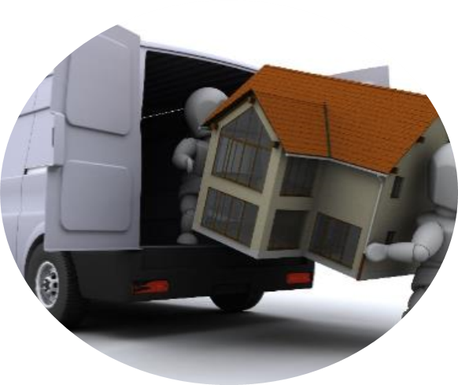
Eligibility & Conditions
Same criteria as travel
Home station* :
  > 20 km from CERN or,
  > 70 km if recruited after 01.01.2007 or ex-local staff
New place of residence:
  > 20 km from the previous place of residence or,
  > 70 km from CERN if recruited after 01.01.2007 or ex-local staff
  within 2 years of contract termination at the very latest

Slide 9
Benefits
Payment of removal expenses for household and personal effects to home station or new place of residence (provided that the latter cost does not exceed the cost of the removal to the home station)
Family situation Category New place of residence | Recipient of the family allowance | Non-recipient of the family allowance
Member State or Associate Member State | 60 m³ | 40 m³
Non-Member State | 25 m³ | 25 m³
Payment of the cost of storing furniture for a maximum period of 12 months while waiting for a fixed address

Slide 10
Procedure
Contact:
  Installation service (SCE department) in advance:
        installation.service@cern.ch
        Location: 73 2-015
        Phone: 7 4407
Admin e-guide procedure:
  https://admin-eguide.web.cern.ch/en/procedure/payment-removal-expenses

Slide 11

3. Reinstallation

Slide 12

Eligibility & Conditions
Same criteria as travel & removal
Home station* :
  > 20 km from CERN or,
  > 70 km if recruited after 01.01.2007 or ex-local staff
New place of residence:
  > 20 km from the previous place of residence or,
  > 70 km from CERN if recruited after 01.01.2007 or ex-local staff
  within 2 years of contract termination, at the very latest
  AND
Neither have been dismissed nor have resigned, except in the case of participation in a pre-retirement program.

Slide 13
Benefits
Calculation of the reinstallation indemnity:
Minimum and maximum basic salaries taken into account:
Years of service as A staff member | Number of months of basic salary
 | Recipient of family allowance | Non-recipient of family allowance
0-2 | 0 | 0
3 | 1 | ½
4 | 2 | 1
5 | 3 | 1 1/2
6 | 4 | 2
7 or more | 5 | 2 1/2
 | Staff Members < 01.01.2007 | Staff Members > 01.01.2007 (including former Local Staff)
minimum | 6 954 CHF
maximum | n/a | 10 284 CHF
      No payment before the last day of contract

Slide 14
Procedure
Complete travel and removal formalities (or formally forgo these rights)
Send the payment request to hr-reinstallation@cern.ch:
  reinstallation form (received with departure formalities)
  departure certificate (if issued) from the former place of residence
  certificate of new residence (tax domicile)
Admin e-guide procedure:
  https://admin-eguide.web.cern.ch/en/procedure/reinstallation-indemnity

Slide 15
QUESTIONS ?
Thank you for your attention!

