Slide 1

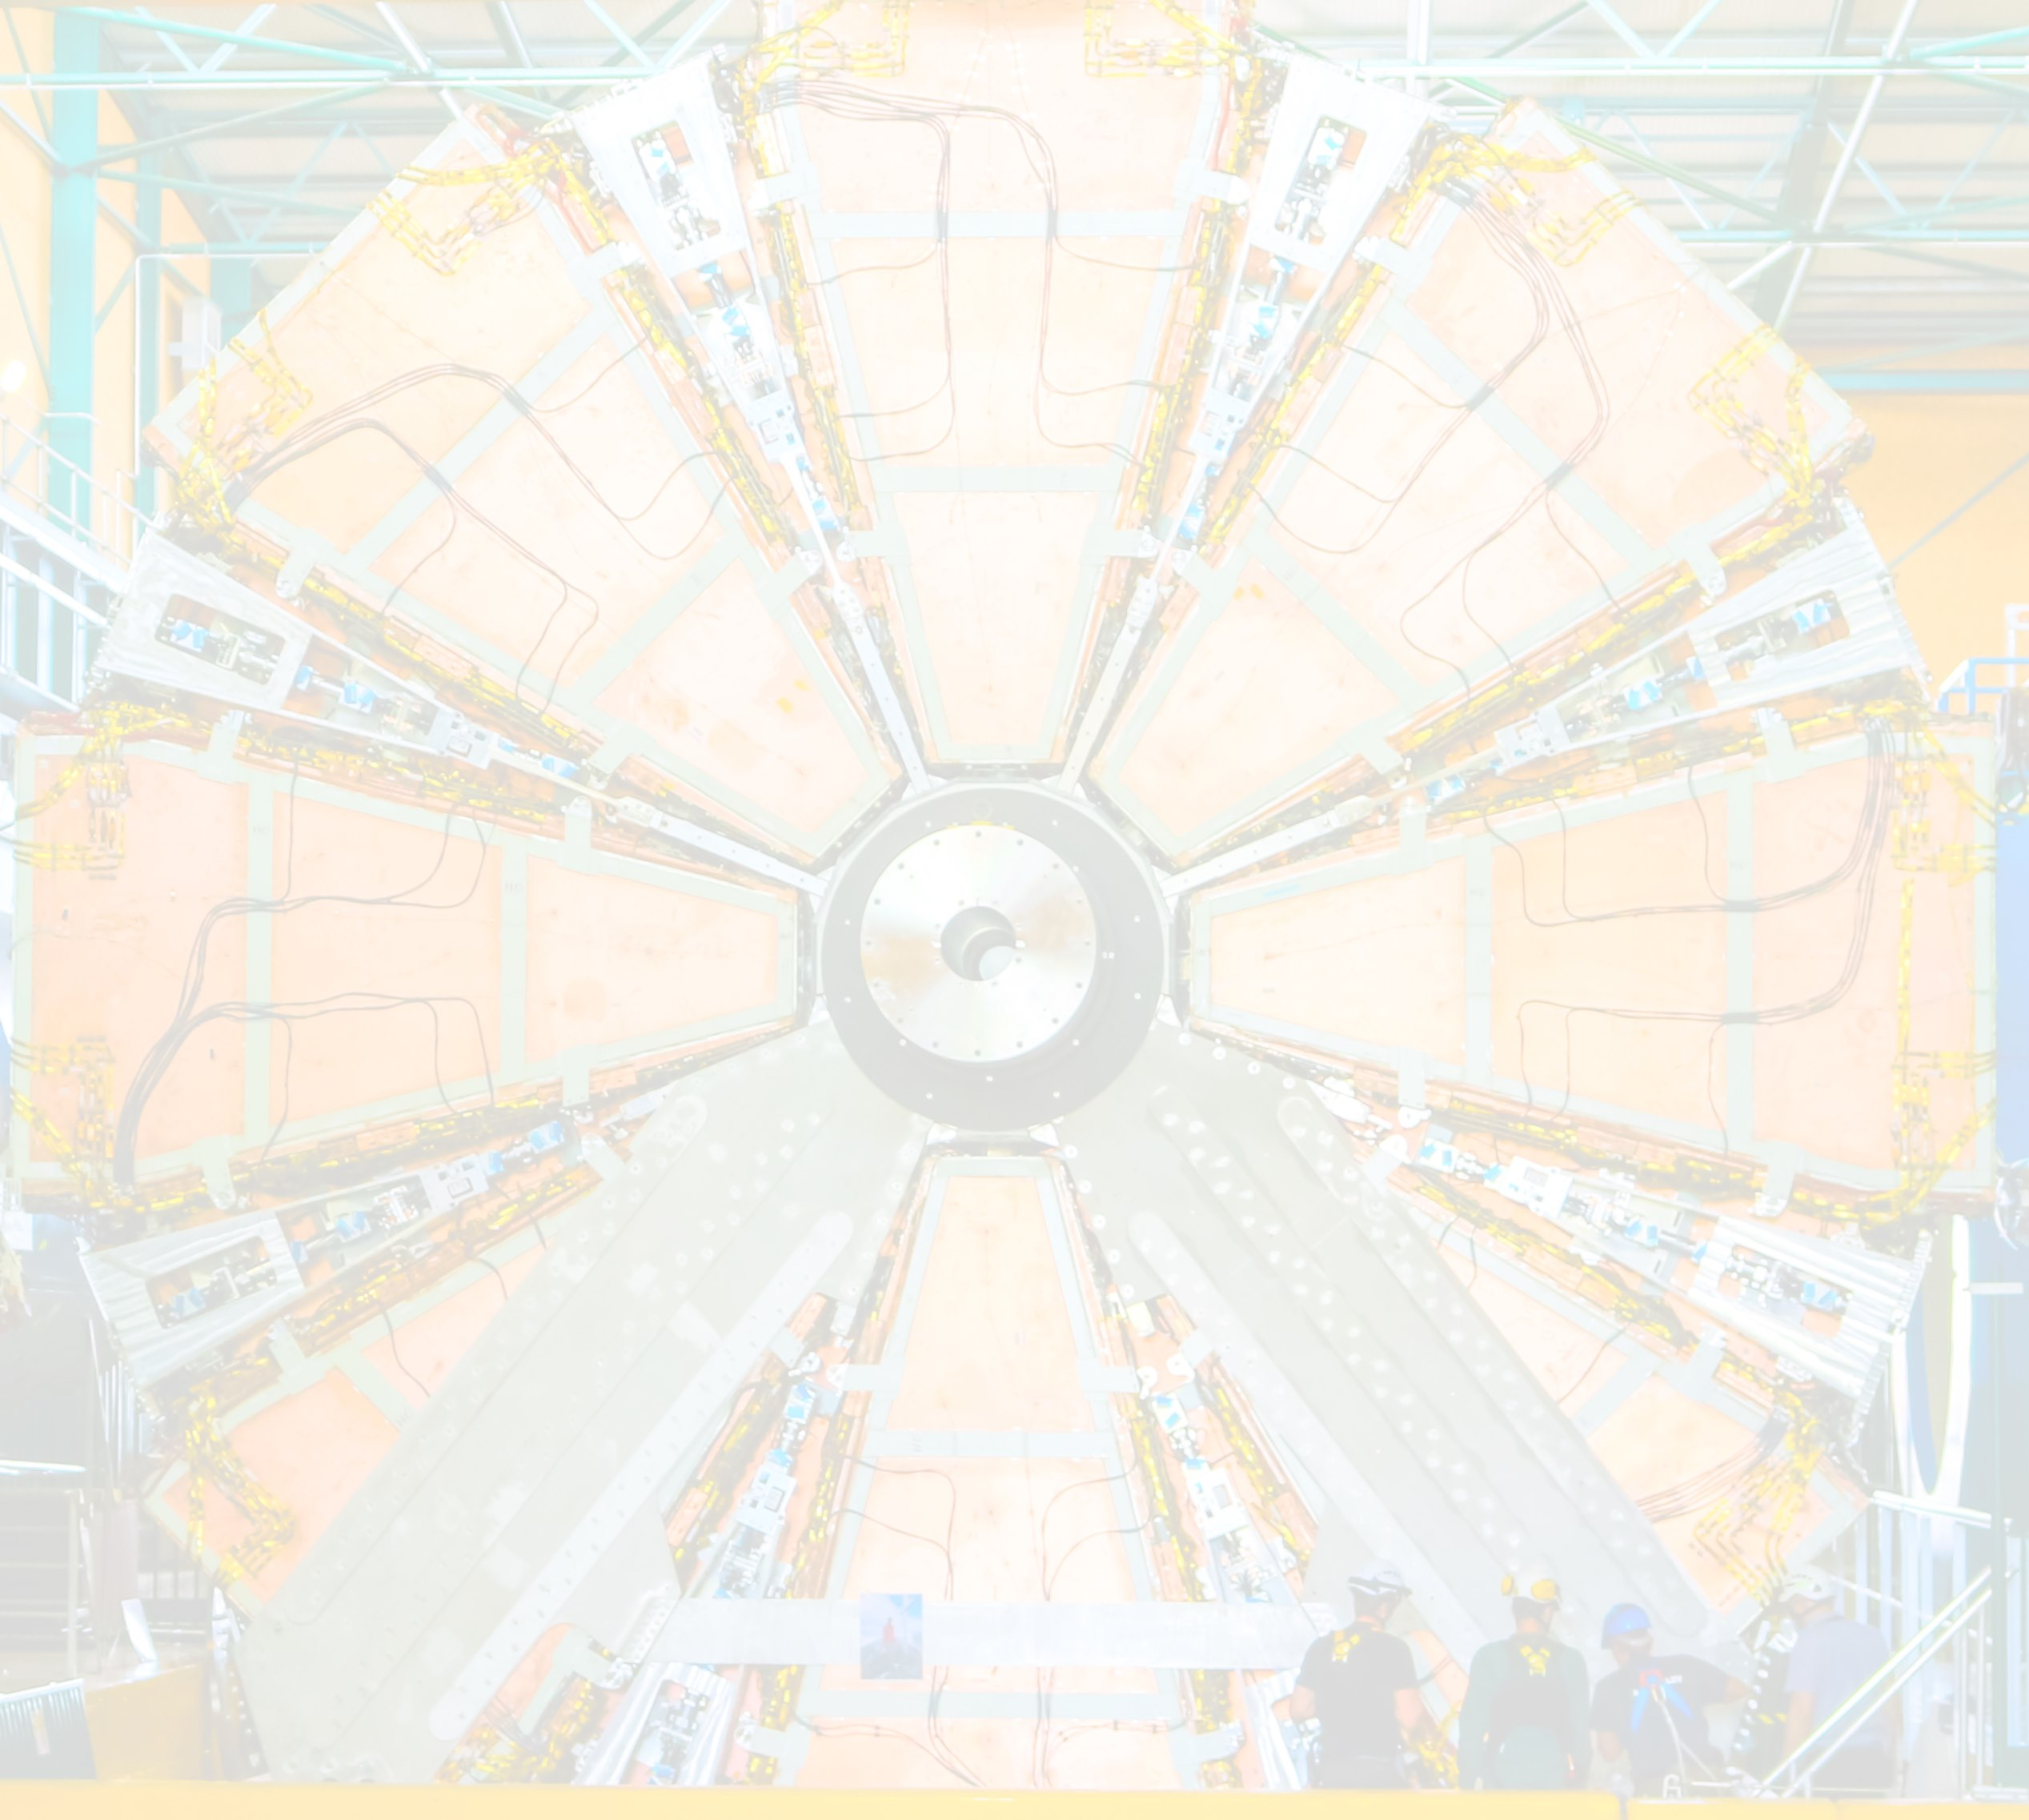
Overview and innovations of the electronics of the New Small Wheel of the ATLAS Muon Spectrometer
Lorne Levinson, Weizmann Institute of Science, Israel
on behalf of the ATLAS Muon Spectrometer system
NTUA, May 2023

Slide 2
This presentation focuses on
features that were innovative, or at least new,
at the time of the design – 2012 to 2015.
Significant parts of the design are, therefore, not included.
Overview paper recently accepted by J.Inst.:
ArXiv ePrint: https://arxiv.org/abs/2303.12571
100+ authors
Dedicated to Stephanie Zimmermann

Slide 3
The NSW electronics’ 23 collaborating institutes
University of Arizona, Tucson AZ, USA
Brookhaven National Laboratory, Upton NY, USA
University of California Irvine, Irvine CA, USA
CERN, Geneva, Switzerland
Chinese University of Hong Kong, Shatin, N.T., Hong Kong, China
Departamento de Física, Universidad Técnica Federico Santa María, Valparaíso, Chile
Harvard University, Cambridge MA, USA
University of Hong Kong, Hong Kong, China
Horia Hulubei National Institute of Physics and Nuclear Engineering, Bucharest, Romania
INFN Sezione di Roma, Sapienza Universita di Roma, Roma, Italy
Institute of Physics, Academia Sinica, Taipei, Taiwan
University of Massachusetts, Amherst MA, USA
University of Michigan, Ann Arbor MI, USA
National Centre for Scientific Research “Demokritos”, Agia Paraskevi, Greece
National Technical University of Athens, Zografou, Greece
Nikhef National Institute for Subatomic Physics and University of Amsterdam, Amsterdam, Netherlands
Physikalisches Institut, Albert-Ludwigs-Universität Freiburg, Freiburg, Germany
University of Science and Technology of China, Hefei, China
Technion, Israel Institute of Technology, Haifa, Israel
Transilvania University of Brasov, Brasov, Romania
University of Victoria, Victoria, Canada
Weizmann Institute of Science, Rehovot, Israel
University of West Attica, Egaleo, Athens, Greece

Slide 4
If you don’t understand something, feel free to interrupt and ask.
If you don’t understand, probably others also don’t.

Slide 5
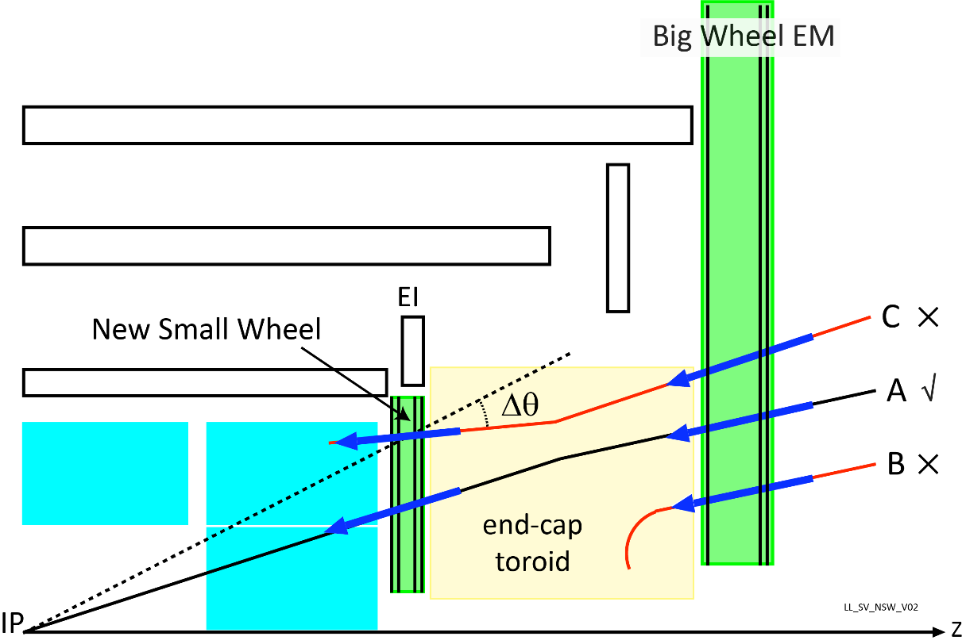
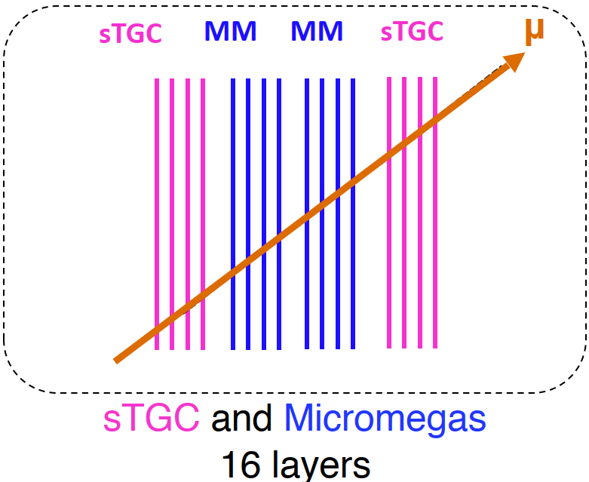
The New Small Wheel
The New Small Wheel is an upgrade of the innermost endcap station of the ATLAS Muon Spectrometer.
Purpose: Reduce the large background of fake triggers from track segments that do not point back to the interaction point (B, C).
It was installed in 2021 and is currently being commissioned
in LHC Run 3.
The NSW employs two gas detector technologies in 16 layers:
sTGC (small strip Thin Gap Chambers) and Micromegas
Both technologies are used for triggering and for track reconstruction.
  The sTGC provides better bunch crossing assignment with high radial resolution and rough φ resolution from pads;
  the Micromegas provides even better offline radial resolution and a good φ coordinate due to its stereo strips.
  But: poorer bunch crossing and radial resolution for triggering.
Micromegas: ≈2.1 million strips
sTGC: ≈282,000 strips, ≈47,000 pads and ≈24,000 wires
  more than doubles the number of muon channels
It is not so “small”: 10-meter diameter, c.f. Big Wheels: 25 m

Slide 6
Demanding requirements
Sophisticated front-end readout required for 2.45 M analog channels with differing characteristics.
Tightly limited latency for the Phase 1 trigger path of ≈ 1.1μs.
Includes 470 ns of time-of-flight, fibre and cable delays.
Need to support two detector technologies with as many shared elements as possible.
Radiation at the inner radius (10-year total dose of 350kRad with safety factors)
Requires radiation and Single Event Upset tolerant ASICs and testing of any commodity electronics used.
FPGAs, even with SEU mitigation, can be used only 5m away from the beam, on the rim of the wheel.
Magnetic fields up to 5 kGauss strongly limit the use of non-air-core inductors in filters and DCDC converters.
Limited space implies dense circuit boards, active cooling
Limited access after installation requires redundancy
Since the on-detector electronics is not able to be replaced for Phase 2,
the Phase 2 requirements, e.g. 1 MHz readout with higher occupancy, must be met with Phase 1 technology.
The ATLAS decision between a low latency single level and a long latency two-level trigger could not be made before freezing the NSW ASIC requirements,
thus requiring the readout ASIC to support both.
Need for state-of-the-art gigabit serial transceivers and interconnecting cables

Slide 7
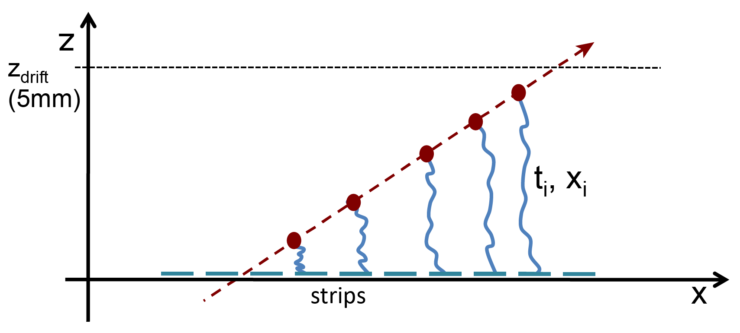
What signals must the electronics process
sTGC, MM: coordinate is the centroid
of the charge distribution
sTGC strips: charge centroids
  Strip width: 3.2mm; avg 1 pC charge per strip, 50ns peaking time,
  Readout: per channel 10-bit ADC,
  Trigger: per channel 6-bit ADC
sTGC pads: charge and time
  3 pC charge per pad (tails to 50 pC!), 25 or 50ns peaking time
  Readout: per channel 10-bit ADC and 8-bit TDC for timing calibration
  Trigger: per channel pulse-at-peak
MM strips
  Strip width: 0.4mm; max 0.25 pC charge/strip, 100ns peaking time,
  10-bit ADC and 8-bit TDC
  Readout: both charge centroid mode and µTPC mode
  Trigger: The hit coord is the channel number of 1st strip hit in a
  bunch crossing.
  This channel is usually the closest to the intercept with the strip plane.
    Requires a window of a few BCs
MM:
µTPC mode: intercept of line fit to time of arrival and the strip #’s, (t_{i}, x_{i})
Trigger: chan of 1st charge to arrive

Slide 8
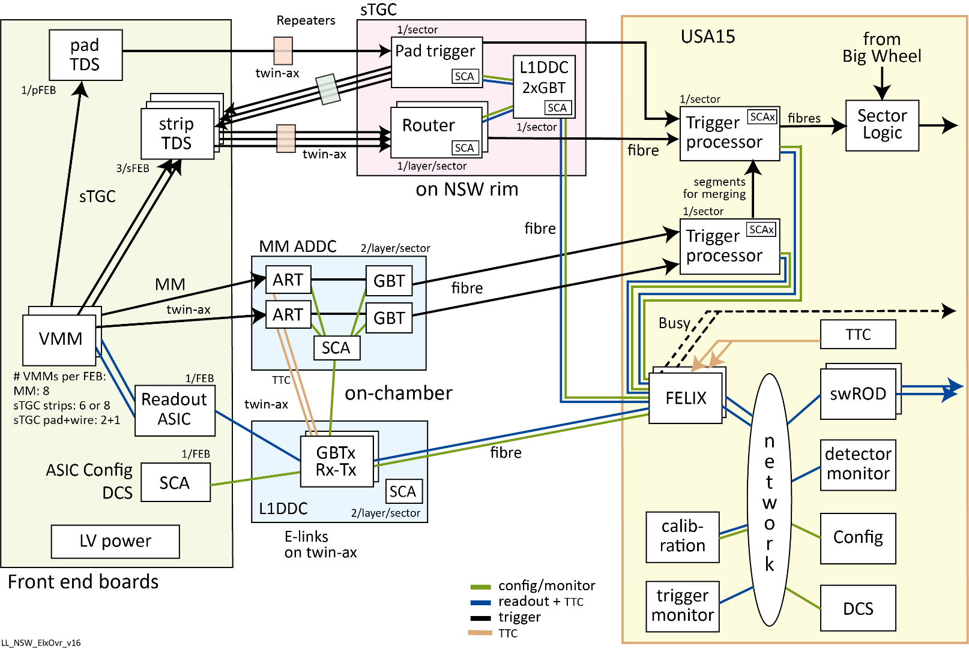
Signal paths
Complex architecture with
2.45 million analog readout channels,
53,000 configurable ASICs.
The architecture is strongly defined by:
  GBTx ASIC: aggregates many slow electrical “E-links” in the collision cavern to/from FELIX in the radiation-protected room via 4.8Gb/s fibre connections.
  FELIX: similar to a network switch, FELIX routes those Front-end links to/from Back-end software processes on an Ethernet network.

Slide 9
Signal paths
Complex architecture with 2.45 million analog readout channels, 53,000 configurable ASICs.
There are five data and signal paths:
Digitized readout data from the detector, including monitoring and calibration
Digitized data from the detector for the trigger path
Synchronization, trigger, test pulse & reset signals and the LHC bunch-crossing clock
Configuration parameters and status indicators
Busy path (- - -)
The architecture is strongly defined by:
  GBTx ASIC: aggregates many slow electrical “E-links” in the collision cavern to/from FELIX in the radiation-protected room via 4.8Gb/s fibre connections.
  FELIX: similar to a network switch, FELIX routes those Front-end links to/from Back-end software processes on an Ethernet network.
The readout, configuration and synchronization paths were implemented with the GBTx and FELIX

Slide 10
Signal paths – read out
Complex architecture with 2.45 million analog readout channels, 53,000 configurable ASICs.
There are five data and signal paths:
Digitized readout data from the detector, including monitoring and calibration
Digitized data from the detector for the trigger path
Synchronization, trigger, test pulse and reset signals and the LHC bunch-crossing clock
Configuration parameters and status indicators
Busy path (- - -)
The architecture is strongly defined by:
  GBTx ASIC: aggregates many slow electrical “E-links” in the collision cavern to/from FELIX in the radiation-protected room via 4.8Gb/s fibre connections.
  FELIX: similar to a network switch, FELIX routes those Front-end links to/from Back-end software processes on an Ethernet network.
The readout, configuration and synchronization paths were implemented with the GBTx and FELIX

Slide 11
Signal paths -- trigger
2
Complex architecture with 2.45 million analog readout channels, 53,000 configurable ASICs.
There are five data and signal paths:
Digitized readout data from the detector including monitoring and calibration
Digitized data from the detector for the trigger path
Synchronization, trigger, test pulse and reset signals and the LHC bunch-crossing clock
Configuration parameters and status indicators
Busy path (- - -)
The architecture is strongly defined by:
  GBTx ASIC: aggregates many slow electrical “E-links” in the collision cavern to/from FELIX in the radiation-protected room via 4.8Gb/s fibre connections.
  FELIX: similar to a network switch, FELIX routes those Front-end links to/from Back-end software processes on an Ethernet network.
The readout, configuration and synchronization paths were implemented with the GBTx and FELIX

Slide 12
Numbers of NSW boards and ASIC’s
Board | Quantity |  | ASIC | Quantity
MM FEB | 4096 |  | VMM | 40,192
Pad FEB | 768 |  | Pad TDS | 768
Strip FEB | 768 |  | Strip TDS | 2304
ADDC | 512 |  | ART | 1024
MM L1DDC | 512 |  | ROC | 5632
sTGC L1DDC | 512 |  | GBTx | 3712
Rim L1DDC | 32 |  | SCA | 7520
Pad Trigger | 32 |  | VTRx | 1920
Router | 256 |  | VTTx | 1056
Direct clock | 2 |  | MTx | 512
FELIX FPGA’s | 60 |  | FEAST DCDC | 5760
Trigger Processor | 16
~7,500 boards
~70,000 ASICs

Slide 13
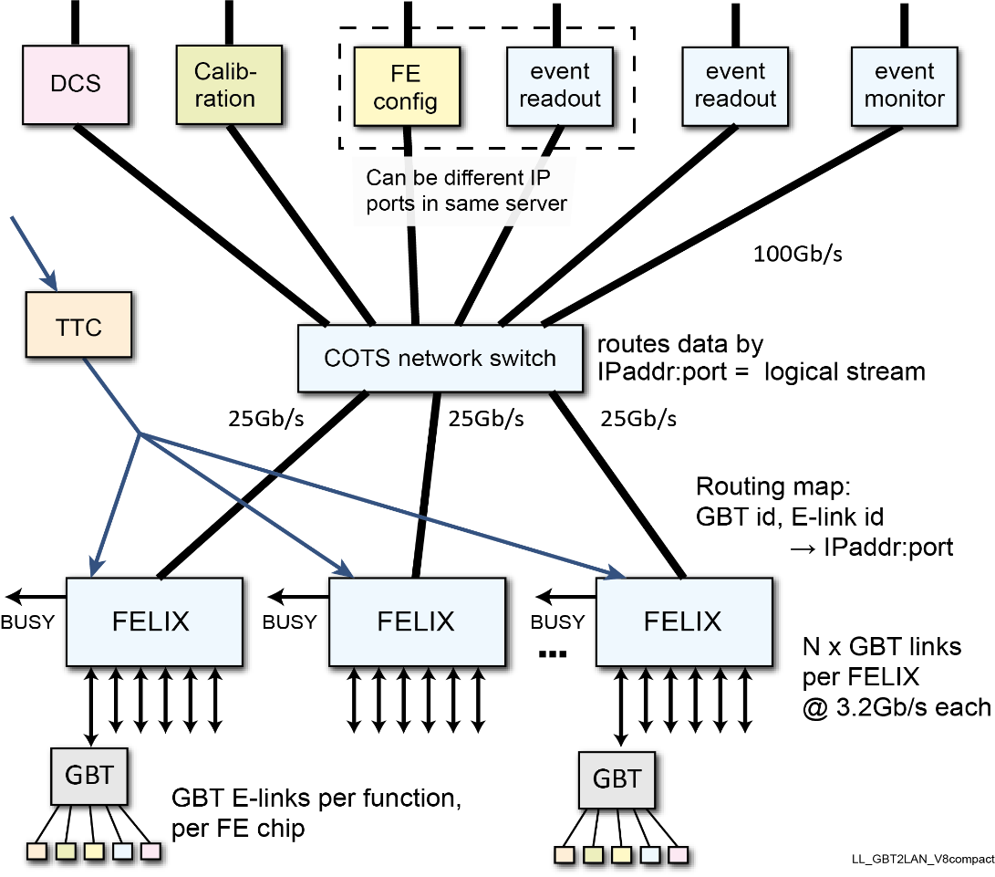
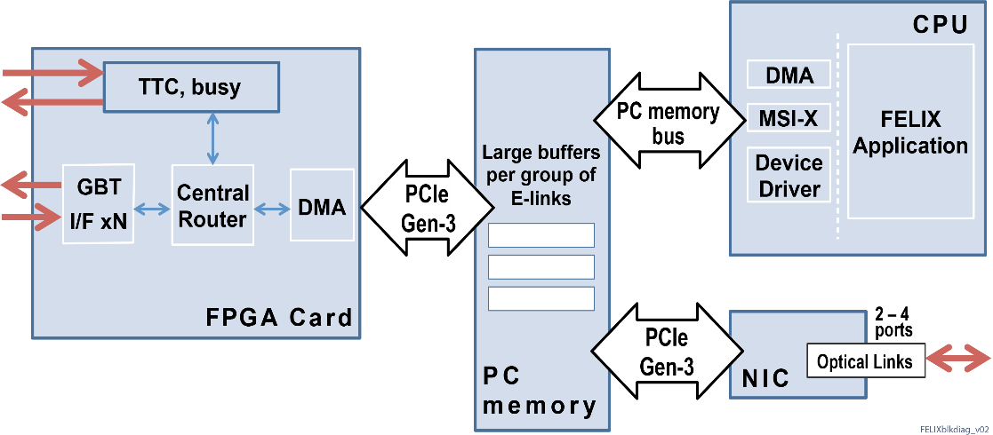
FELIX
Replaces the previous ATLAS front-end readout architecture.
Initially designed for NSW, FELIX provides a common platform
for some ATLAS Run 3 subsystems
and will do so for all ATLAS subsystems in Run 4.
Its proposed deployment was resisted by some sub-detectors.
Separates data transport from data processing:
  Data transport on common custom hardware/firmware -- FELIX
  Data processing by detector-specific software -- swROD
Interfaces custom 4.8 Gb/s optical links from GBTx ASIC’s, which
aggregate several slow serial copper “E-links”,
to an industry-standard Ethernet network.
  These slow links carry front-end readout, configuration,
  calibration and detector monitoring data.
Acting similarly to a network switch, FELIX routes these slow links individually between Front-end electronics and
software processes on the network.
FELIX consists of a custom PCIe FPGA card hosted in a commercial
Linux server with a high-performance Ethernet interface card.
It also distributes the TTC (Timing, Trigger and Control) signals,
including the LHC Bunch Crossing clock.
Developed by the ATLAS
Trigger & DAQ project.

Slide 14
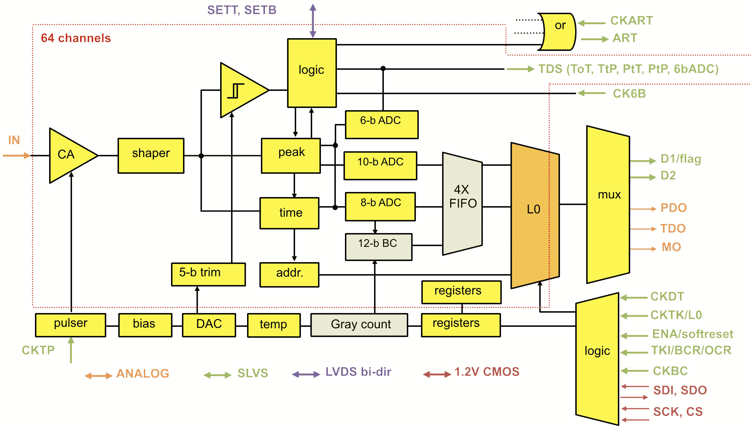
A versatile Front End ASIC – “VMM”
Custom rad hard 130nm 1.2V CMOS, 10 million transistors, large: 130mm² silicon
64 autonomous channels of charge amplifier, shaper, peak detector, 10-bit and 6-bit ADCs, 8-bit TDC, tagged with BCID and stored in an on-chip L0 Latency FIFO for readout on match to an L0 trigger’s BCID via a 2x320Mb/s serial link.
Output options for trigger path:
per chip output of address of 1st strip above threshold (“ART”) in a BC,
per channel Time-over-Threshold signals,
per channel outputs of 6-bit ADC
Configurable input polarity, rise-time, gain,
thresholds and the wide capacitance range
of MM strips, sTGC strips, pads, wires
Output to monitor the shaper output with
‘scope or ADC
Test pulse patterns for testing the chip and
integrating downstream logic
On-chip temperature sensor
Notes:
VMM SOC ASIC with interposers and Zebras to connect to the high-density channels
VMM L0 buffer, avoids Gb/s xfers to ROC

Slide 15
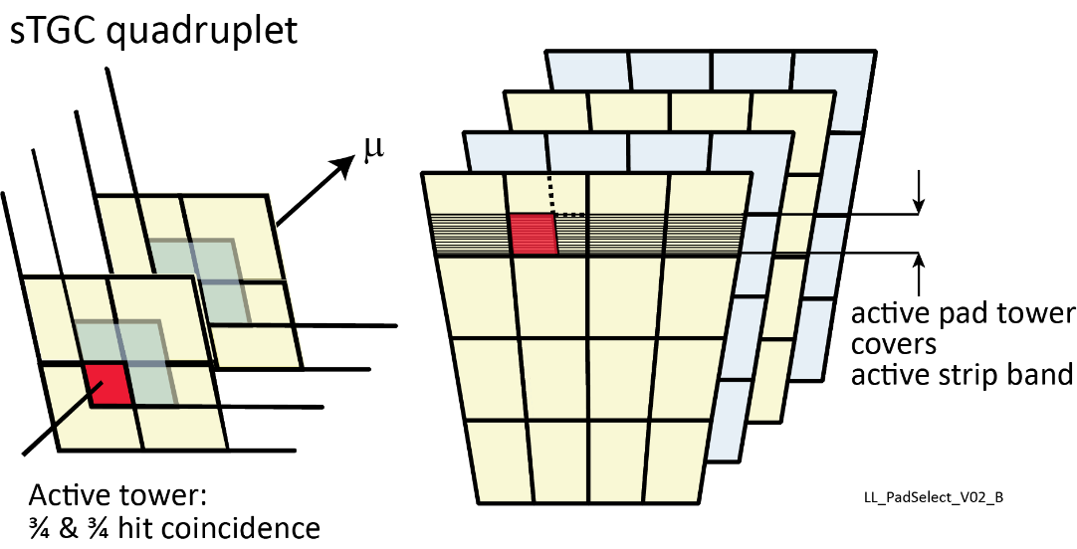
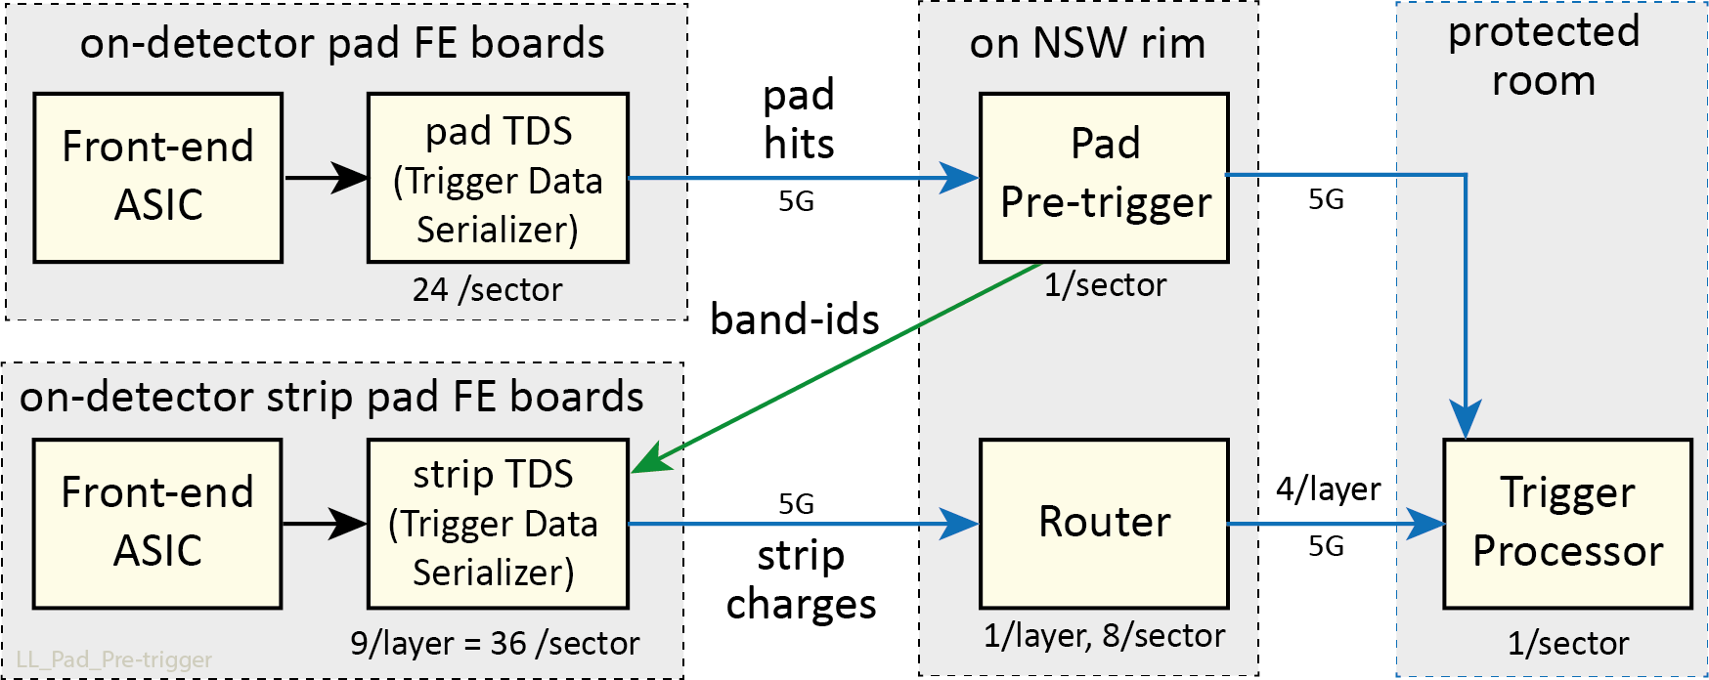
Reducing the sTGC trigger bandwidth with a pad pre-trigger
Ideally, read all the 8 layers of 6-bit strip charges every BC to a
Trigger Processor and compute a track segment. But,
  1050 strips/layer → 2 Tb/s per sector
  2014 state-of-the-art rad tol link: 3.2Gb/s payload
  → 20,160 fibre links for NSW + 35kW cavern power, cooling
  Needed fibres, Tx & Rx electronics, power, cooling is totally prohibitive
Forces the complexity of a pre-trigger to select only strips of interest to transmit to the Trigger Processors.
Strip charges are buffered in the strip-TDS (Trigger Data Serializer)
Pad Trigger receives pad hits from the pad-TDS,
finds up to 4 coincidence towers,
sends a band-id to strip-TDS’s that contain a band.
If a strip-TDS receives a band-id from the Pad Trigger,
it sends out the charges for that band.
Router receives up to 4 charge packets from 9 possible
strip-TDS’s and
routes them to the Trigger Processor via 4 fibres/layer
The “zig-zag” with 2 serializers adds substantial latency.
Notes:
1050 strips/layer x 8 layers x 6-bits/strip x 40MHz = 2.016 Tb/s
2014 state-of-the-art rad tol link: 3.2Gb/s payload (with error correction)
→ 630 fibre links per sector, → 20,160 fibres for NSW
with 1.5W GBTx + 0.25W optical transmitter per link → 35kW
→ GBTx 35CHF+ VTTx 75CHF per fibre → 110CHF x20K = 2.2MCHF + receivers,

Slide 16
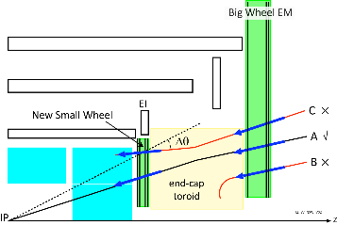
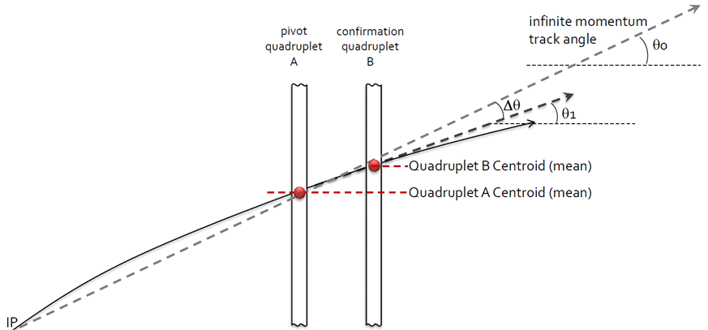
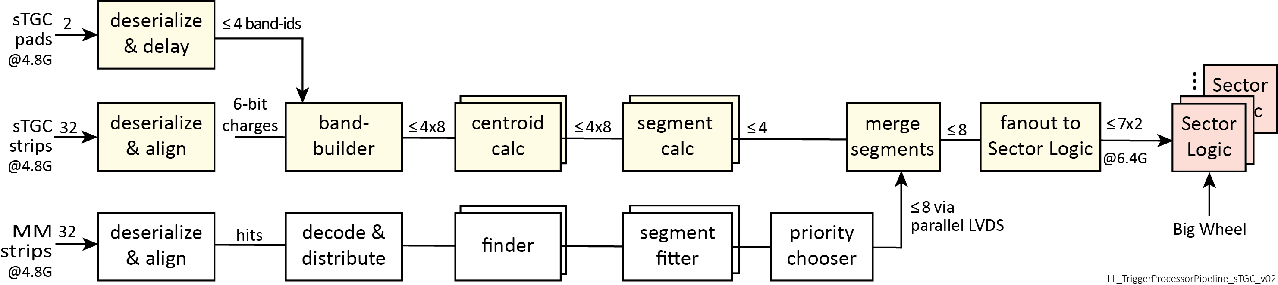
Track segment finding in the ATCA trigger processor -- sTGC
For each of up to 4 bands:
Charge centroids are found in each layer
The 4 upstream and 4 downstream centroids are
separately averaged to form two space points.
The segment’s R and Δθ are calculated.
|Δθ| must be < 15mrad.
φ is provided by the Pad Trigger.
From up to 4 sTGC and up to 8 MM segments,
up to 8 are chosen (after duplicate removal)
and sent to the Sector Logic to confirm BW hits.
Δθ is the segment’s
angle wrt a line to
the IP.

Slide 17
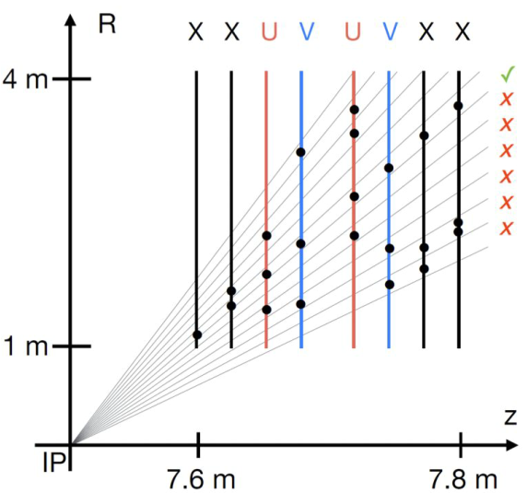
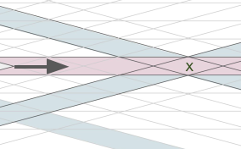
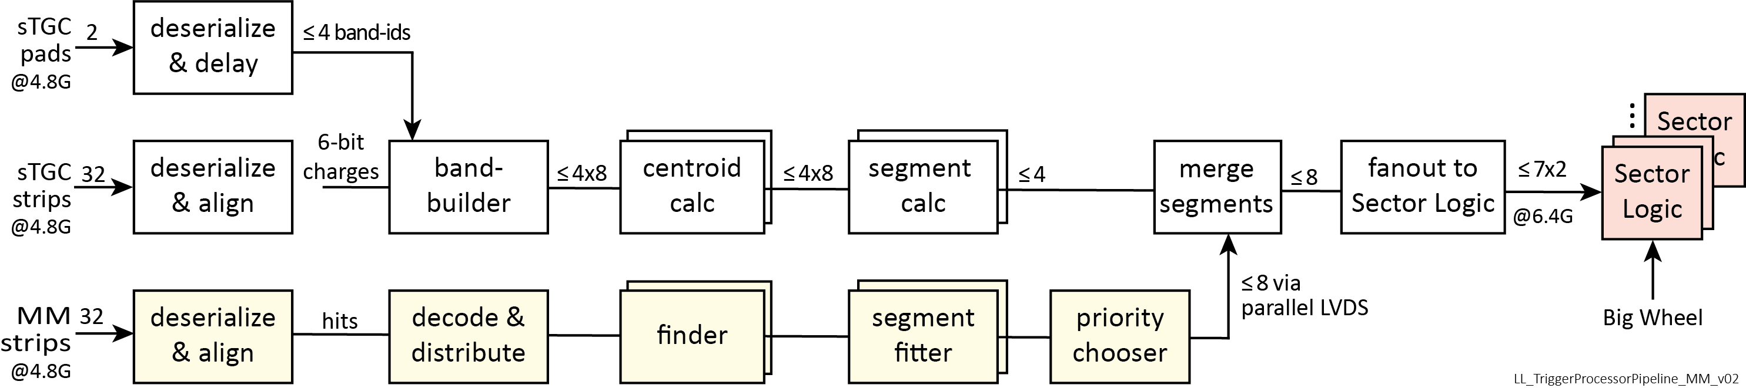
Track segment finding in the ATCA trigger processor -- MM
Recall that a hit in a plane is the 1st hit in a VMM in a BC
Hits are filtered by requiring a match with hits in the
U & V stereo layers.
If sufficient hits are found in a road pointing to the IP,
their coordinates are sent to a track segment fitter.
The fitter calculates the segment’s R, φ and Δθ.
|Δθ| must be < 15mrad.
Finally, up to 8 segments are sent to
be merged with sTGC segments.

Slide 18
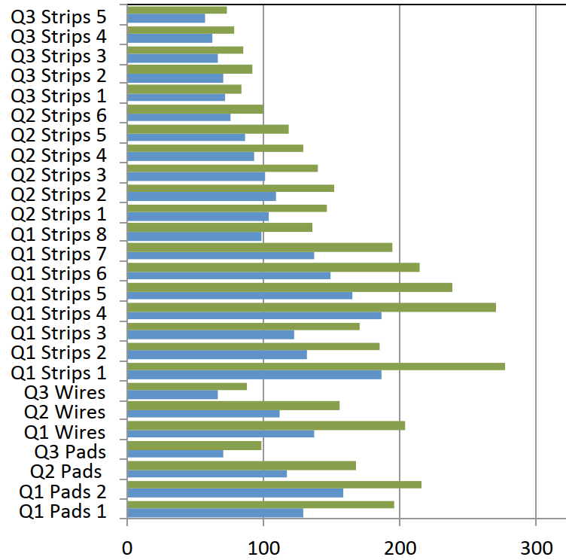
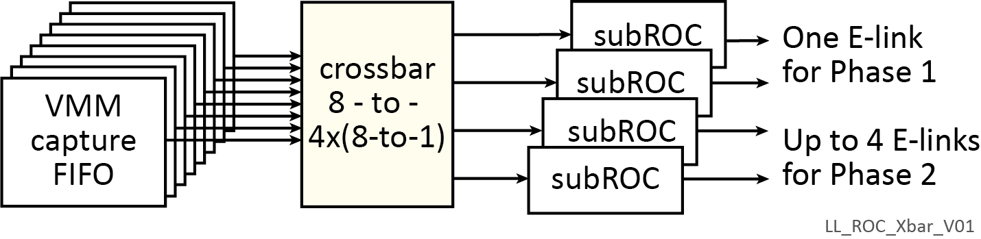
Read-out controller -- ROC ASIC
There is one ROC per Front-end board that handles up to 8 VMM’s
VMM can buffer hits for up to 16 µsec of a single-level, “L0”, trigger latency. (Phase 1: < 2.5µs; Phase 2: 10µs)
L0-triggered data is sent from VMM to ROC, whose buffers support a 2-level trigger with 60µs latency.
  L1 then selects the data in the ROC for transfer on E-links, ultimately to FELIX.
Although expected, only after ASIC production did ATLAS decide on a 1-level trigger.
  Sending L1 also to the VMM as “L0” effectively implements a 1-level trigger.
Configurable Crossbar to select which VMM’s are sent on which E-links
For Phase 1, generally one 320 Mb/s E-link per ROC is sufficient
For Phase 2, more than one E-link is needed, especially at the inner radius.
  VMM occupancy varies strongly with radius.
  Front-end boards at inner and outer radii require different numbers of E-links;
  The crossbar allows routing VMM’s to E-links in order to optimize the
  number of E-links needed.
  For load balancing, a subROC can combine high and
  low occupancy VMM’s on the same E-link.
VMM output
rates (Mb/s)
From Phase 2
Simulation
R
Notes:
For sTGC, a subROC can be configured for a 640 Mb/s E-link

Slide 19

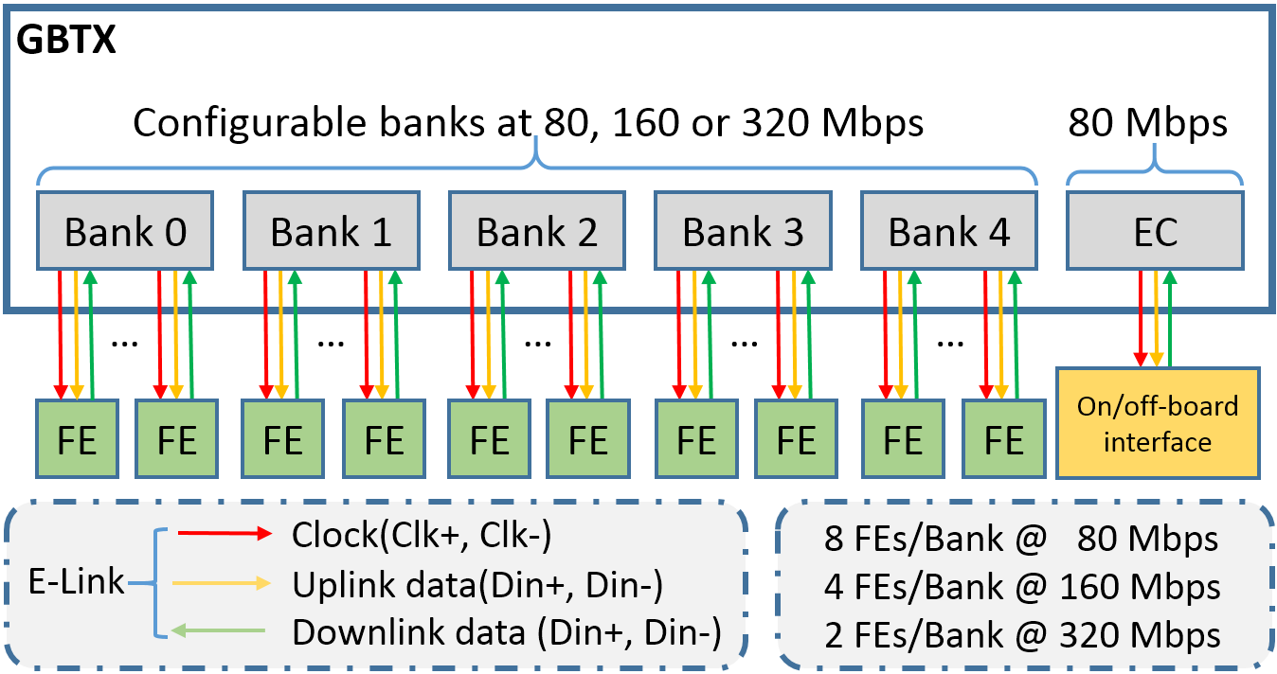
E-link aggregation by the GBTx ASICs on the L1DDC board
L1DDCs are high-bandwidth radiation-tolerant data aggregator boards based on the GBTx ASIC.
  1046 boards
They interface E-links from the Readout Controller on the Front-end boards to FELIX
  E-links: 80, 160 or 320 Mb/s
  Fibre to FELIX: 4.8 Gb/s per GBTx
L1DDC is completely transparent to the data being transmitted or received.
Compatible with HL-LHC (Phase 2):
Number of optical links to FELIX:
  MM: 3 GTBx ASICs: RxTx, TxTx (4 fibres)
  sTGC strips: 2 GBTx ASICs: 2 RxTx (4 fibres)
  sTGC pads: 1 GBTx ASIC: RxTx (2 Fibres)
  Rim: 2 independent, redundant L1DDC’s
two 4.8 Gb/s
Fibres to FELIX

Slide 20
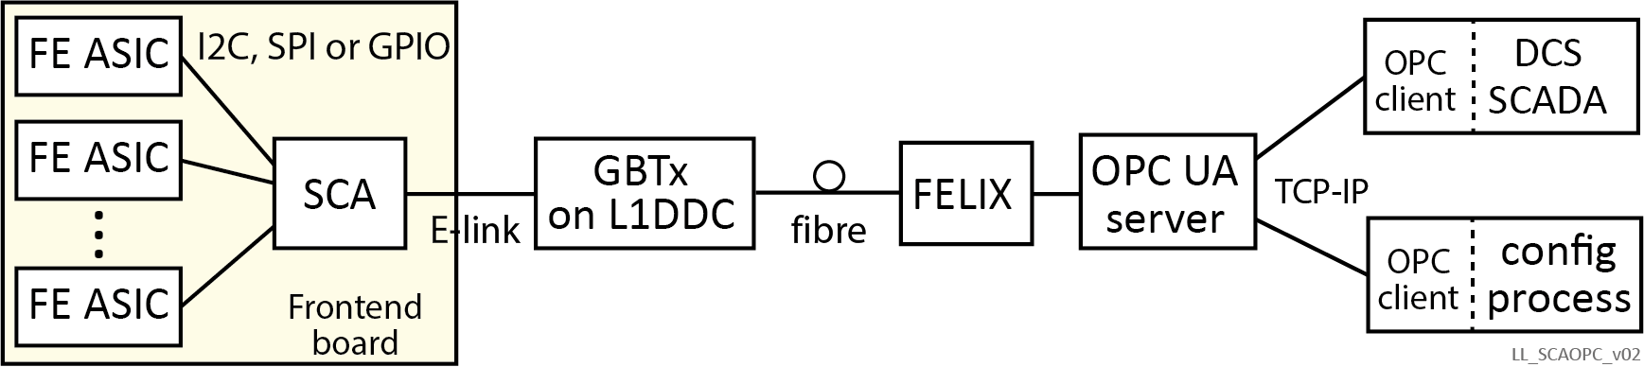
OPC UA for all NSW configuration and calibration
The CERN SCA ASIC
Unique chip ID
32-chan 10-bit ADC
16 I2C masters
1 JTAG master
1 SPI master
32-bit GPIO
4 DACs
Dual E-link interface
(for redundancy)
Radiation hard
Every NSW electronics board has a CERN SCA ASIC (≈ 7500 of them)
An OPC UA server (from ATLAS Central DCS) exists for the SCA.
OPC UA is an industry-standard protocol for slow control (DCS) and process control.
  The commercial system for the ATLAS Detector Control System supports OPC.
  ATLAS DCS monitors NSW board temps and voltages with the onboard SCA ASIC.
  There is an advanced ecosystem of OPC UA tools in industry.
With an SCA on every board and the functionality of the SCA and OPC,
all NSW ASICs are configured and report status to DAQ via the SCA, FELIX and OPC.
  OPC UA allows the DCS & DAQ processes to access the SCA without interfering with each other.
The Trigger Processor FPGA has firmware that emulates needed SCA functionality to access
config & status registers.
  This allows the same backend software to configure all NSW electronics via OPC.
Used to calibrate the VMM pulse heights,
thresholds and channel offsets and
to investigate noise levels.
The Router and Pad Trigger FPGAs on the
Rim can be configured via the SCA’s JTAG.
OPC UA server for the SCA implemented by ATLAS Central DCS

Slide 21
Monitoring the NSW unbiased by the ATLAS Level-1 trigger
If data only from bunch crossings that are accepted by the Level-1 trigger are recorded,
we cannot know if there are missing NSW triggers are due to:
  improper functioning of the NSW trigger (e.g. time or spatial misalignments)
  erroneous downstream decisions.
To address this, the Trigger Processor can:
  choose any bunch crossing with, e.g. a valid NSW segment,
  signal the CTP (via the Sector Logic) that this bunch crossing be an ATLAS global trigger
  this will cause the readout of:
    The NSW full Front-end data (as opposed to just the NSW trigger data seen by the Trigger Processors)
    The Sector Logic and the Muon-to-Central Trigger interface (MUCTPI) data, including their decisions
    All the other ATLAS detectors, especially the endcap calorimeter and trackers.
  Having full information allows a detailed understanding of the NSW trigger
The Central Trigger ensures that the rate of these events does not exceed a few 10’s of Hertz.

Slide 22
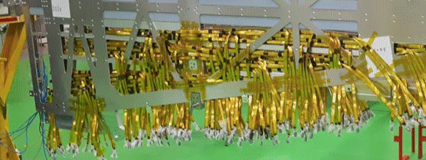

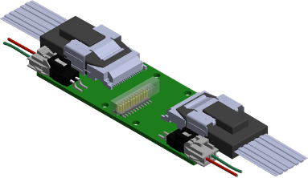
Twin-ax cables and repeaters
Highly congested routing in the Micromegas spacer frame
to connect Frontend boards to L1DDC and ADDC boards
“Highly routable” twin-ax ribbon, 8 pairs per cable.
  Intended for “miniSAS” disk controllers.
  Proved crucial for our ability to connect links
  from Front-end boards
    both 5Gb/s serial and 640 Mb/s LVDS
  < 1mm thick, can be Z-folded 180°
  But thin wires → attenuation & dispersion, especially degrade our 5Gb/s links
    Maximum 4.5m for reliable 5Gb/s
sTGC has links up to 6.5m
→ 5G serial and LVDS repeaters in line with the cable
5G serial: Commercial IC:
Configurable amplification
and shape restoration.
LVDS:
Regenerates standard LVDS when
input threshold crossed.
Highly congested routing on the Micromegas edges
Quad 5Gb/s
repeater
There are 14km of twin-ax cables in the NSW.

Slide 23
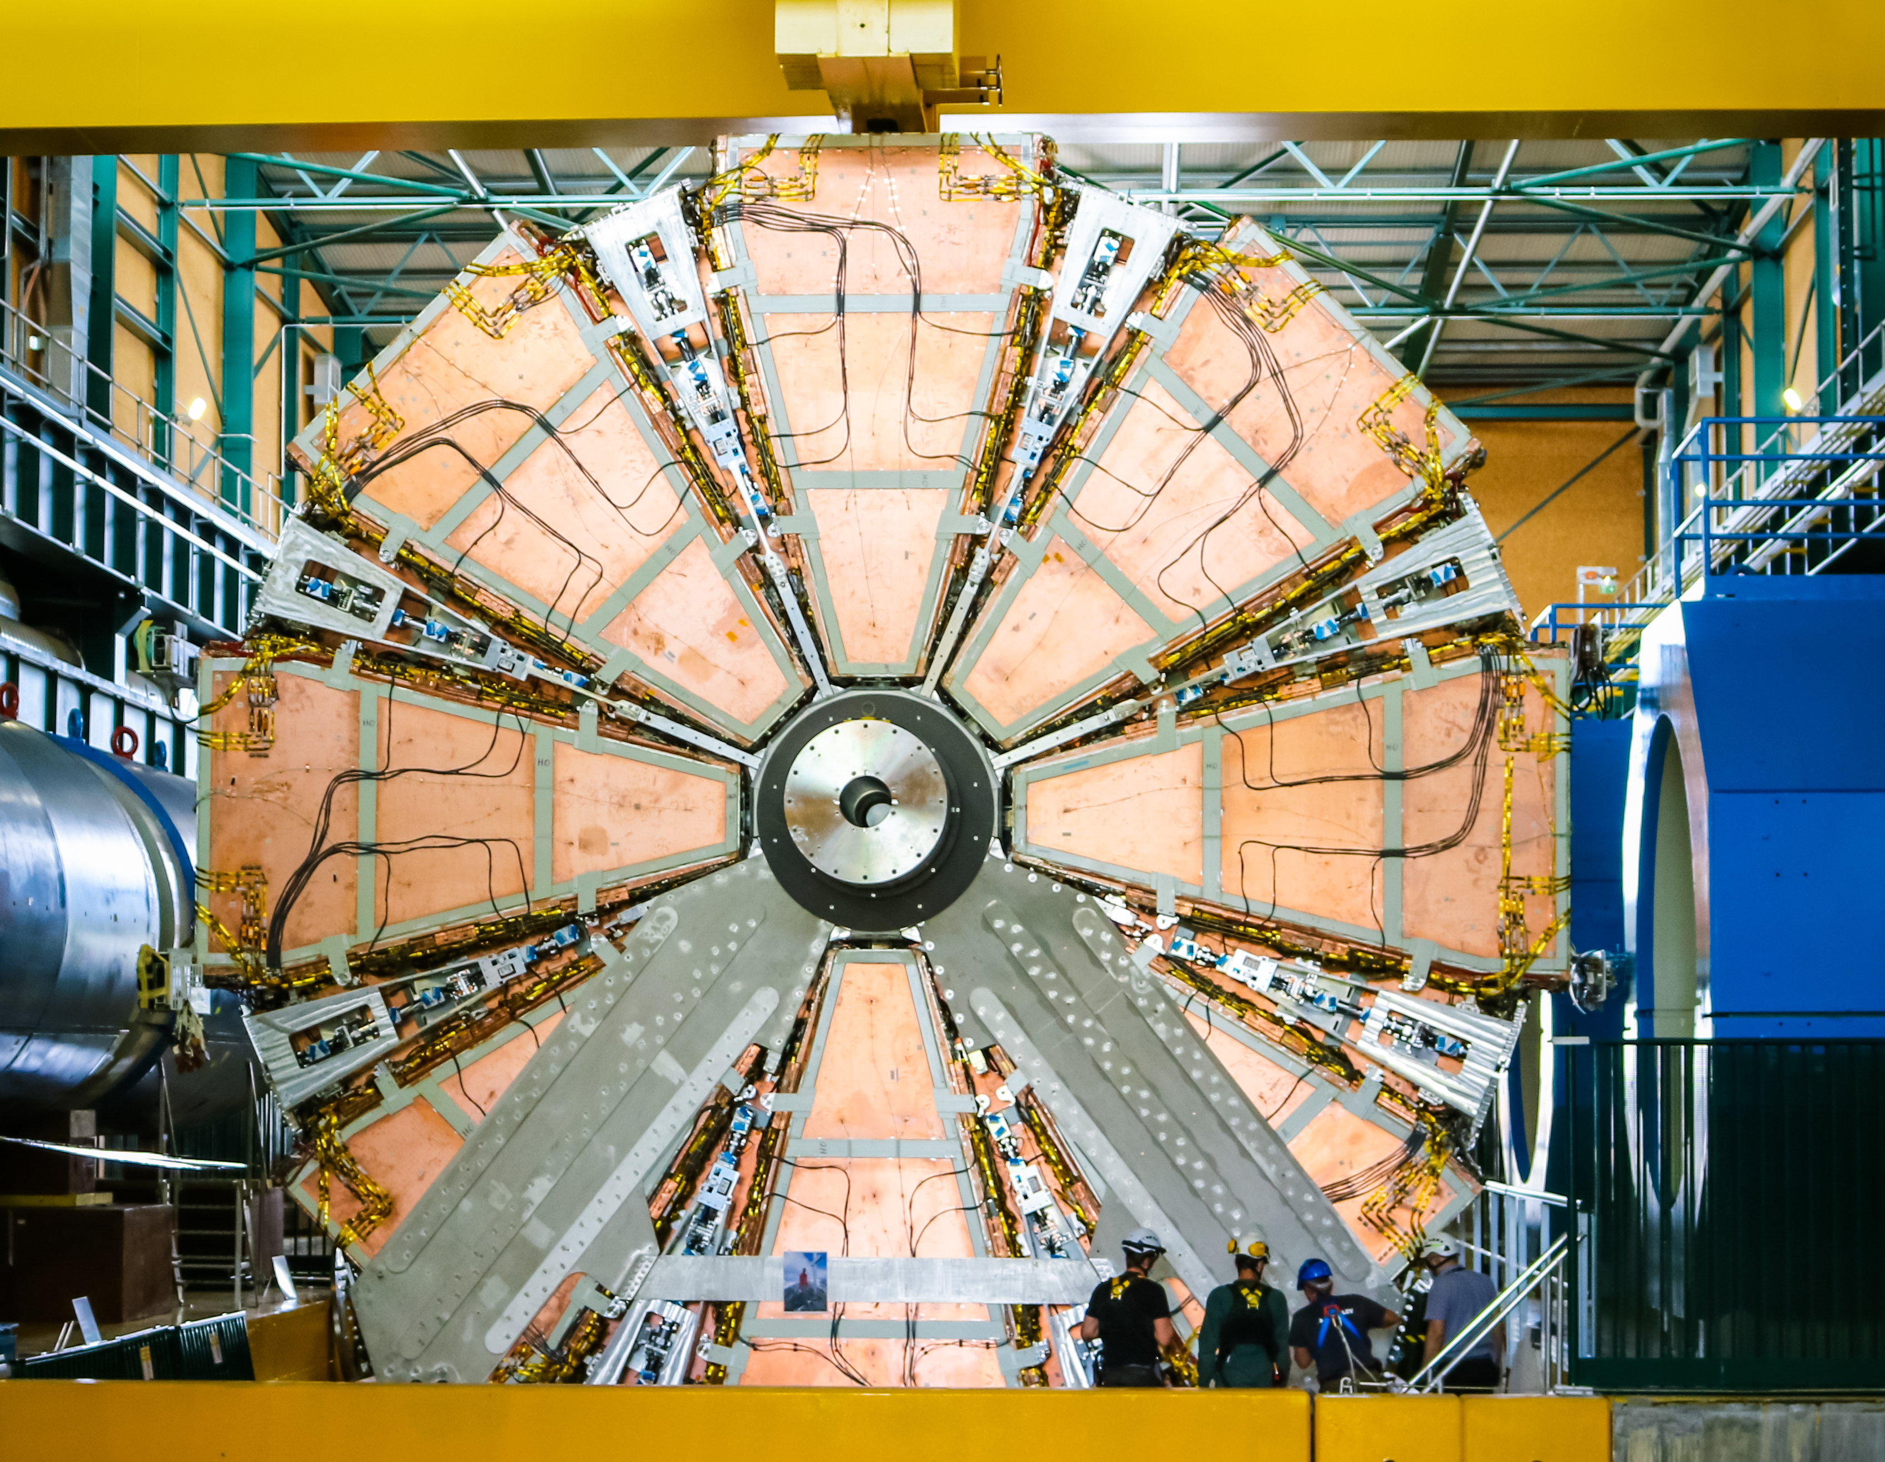
After 10 years…
A New Small Wheel
being lowered into
the ATLAS cavern

Slide 24
Thank you.
extra…

Slide 25
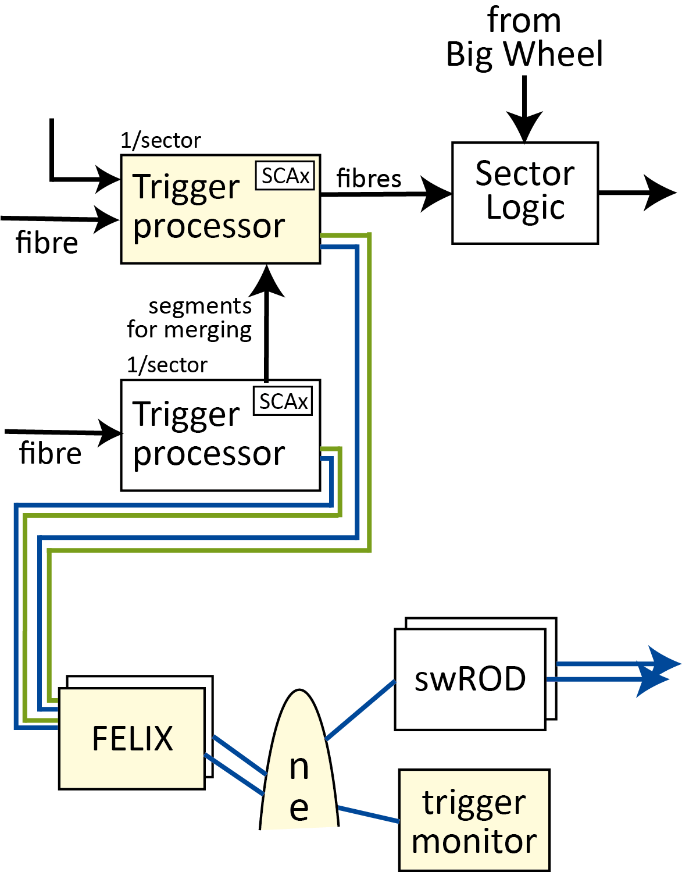
Trigger Processor monitoring
The Pad Trigger and the Trigger Processors are able to send their data for bunch crossings of interest,
e.g. receiving a 3-out-of-4 Pad Trigger coincidence or corner cases and anomalies to a monitoring process.
The monitoring is independent of any Central Trigger decision
The data can include all input, output and intermediate Trigger Processor or Pad Trigger data to allow
both specific studies and general monitoring.
A dedicated monitoring E-link allows FELIX to route the data to a dedicated monitoring process.
The monitoring process is an instance of a swROD that is not connected to the High-Level Trigger.
Notes:
Split to two slides…

Slide 26
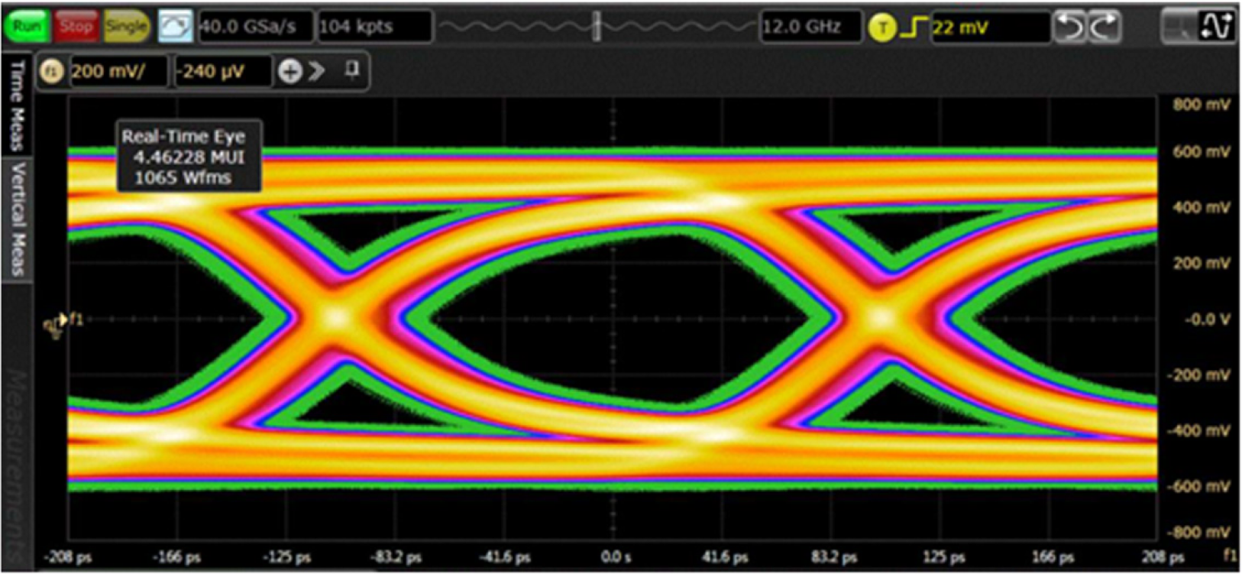
Direct low jitter FPGA transceiver reference clocks
The FPGA 4.8Gb/s transceivers have very strict jitter requirements for their reference clocks.
The 160 MHz clock recovered by the GBTx ASIC has jitter of 4.3 ps,
which is not good enough for the Pad Trigger and Router receivers.
The candidate jitter cleaner to be placed on these boards on the NSW rim was tested and found to suffer from fatal single event upsets in our radiation environment.
→ an additional clock distribution scheme delivers a low jitter clock directly from
the radiation-protected room via fibres direct to the rim of each sector
A clock distributor board per endcap generates a jitter-cleaned 160 MHz reference clock from
the LHC timing, trigger and control (TTC) stream and recovers a 160 MHz clock based on the
LHC bunch crossing clock.
The phase noise jitter of this direct clock was measured to
be from 0.7 ps to 1 ps, well within the FPGA requirement.
IBERT diagram here

