Slide 1
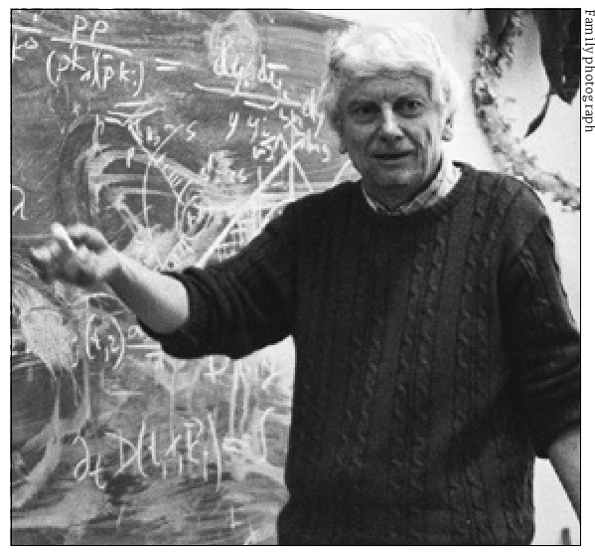
The Discovery of the Standard Model
---
A subjective stroll
From PETRA to the LHC and beyond
Precision matters

Slide 2
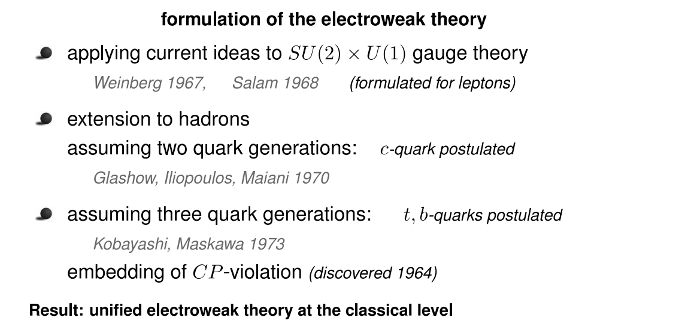

late 60ies, early 70ies

Slide 3
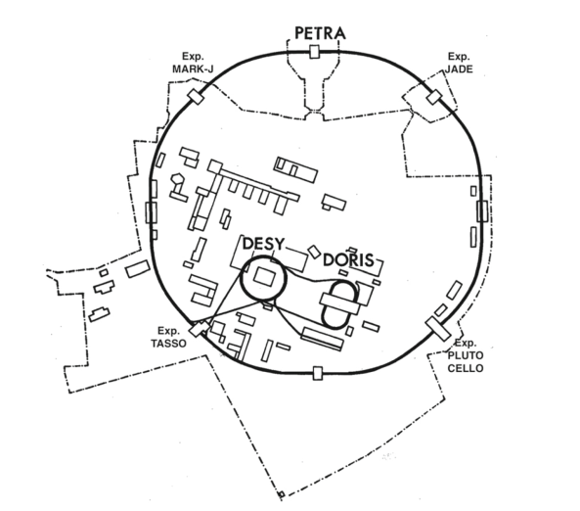
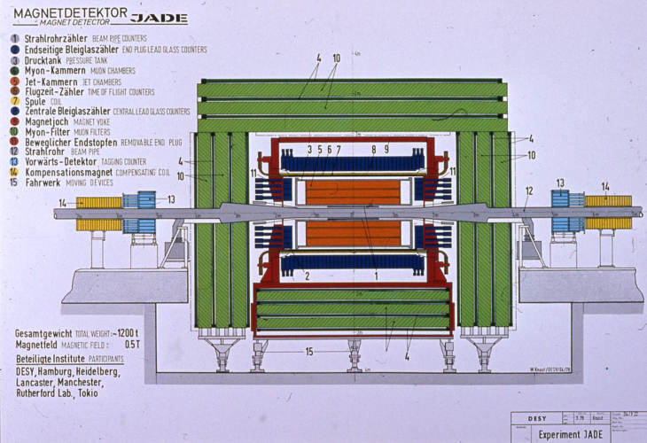
1978 at DESY
First beams were stored in PETRA,
the new e+e- storage ring
4 experiments had been installed
JADE, MARK-J, PLUTO (Cello), TASSO
JADE
Max Energy PETRA: 47 GeV

Slide 4
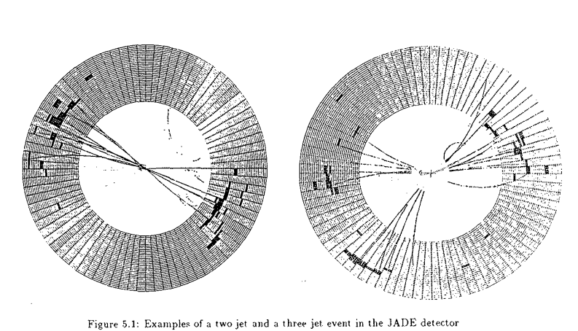
JADE: Carefully selected typical events
Planar events are the signature for gluon radiation
Discovery of the gluon
“nicest” event displays available at that time

Slide 5
A jet is simply a highly collimated bunch of particles (calorimeter cells, tracks, etc.) that can (easily) be found after a visual analysis of events.
But to compare observables based on jet momenta with a theory, one needs an objective and unambiguous jet deﬁnition to be used by experimentalists and theorists on an equal footing.
Most used algorithm for jet definitions at the time
optimal for α_{S} determination studies, setting the standard for a long time

Slide 6
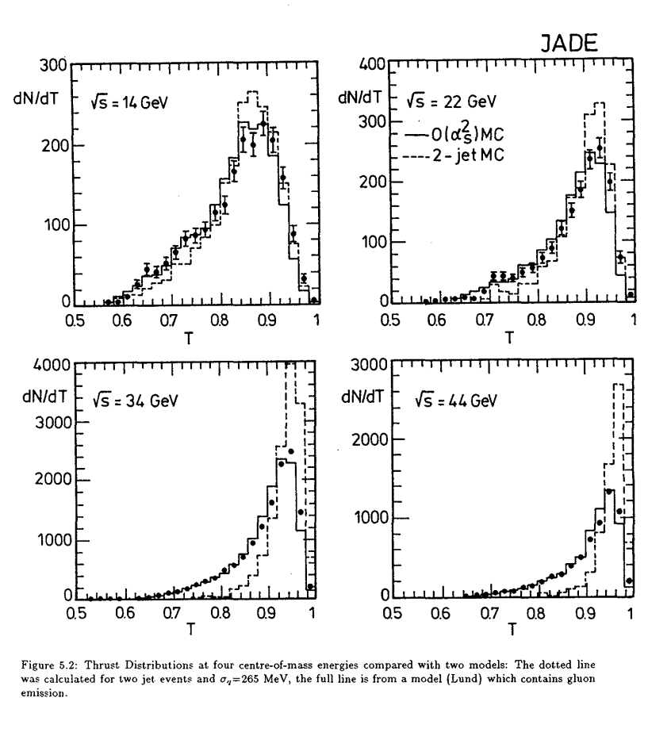
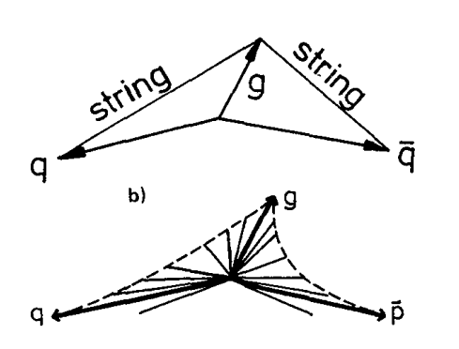
Thrust distributions
for different √s
Excellent agreement with the
Lund Model

Slide 7
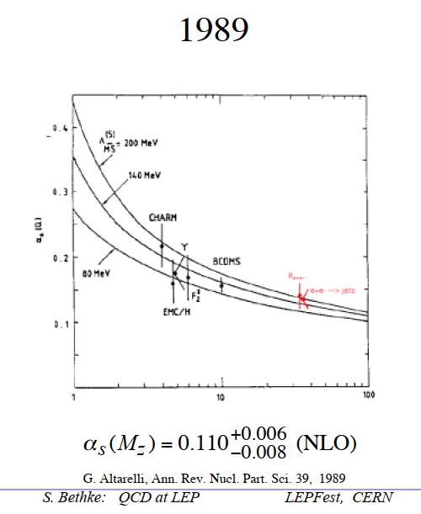

1988
JADE published its studies of jet production rates in the energy range from 22 to 46.7 GeV, and published the ﬁrst
Energy dependence of α_{s}

Slide 8
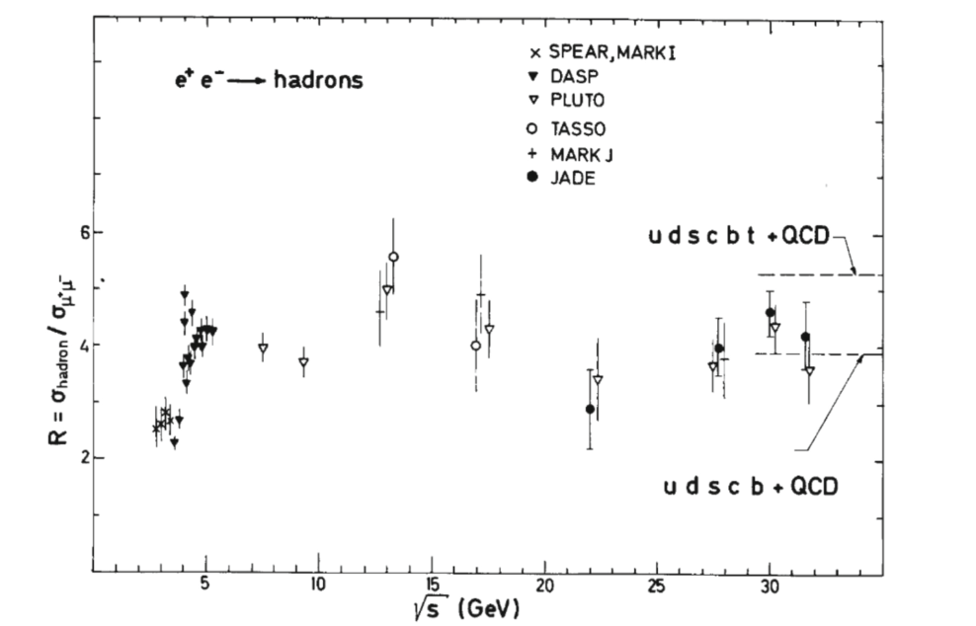
But we expected more:
All experiments at PETRA were searching for the top quark
Theoretical prediction for its mass were rather variable
Energy scan

Slide 9
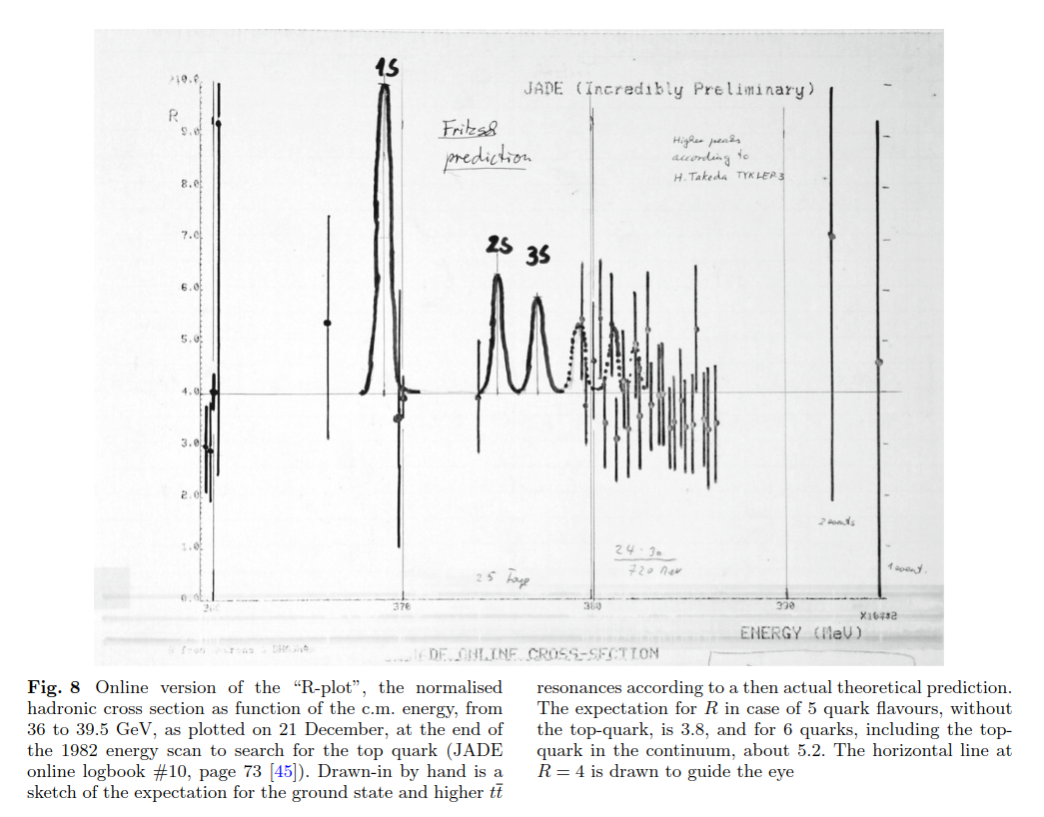
new JADE classification
JADE (of course) had already
an online analysis program
and
a new classification of results
Online version of the R-plot

Slide 10
Beyond the strong interaction:
Study of the electro-weak interference

Slide 11
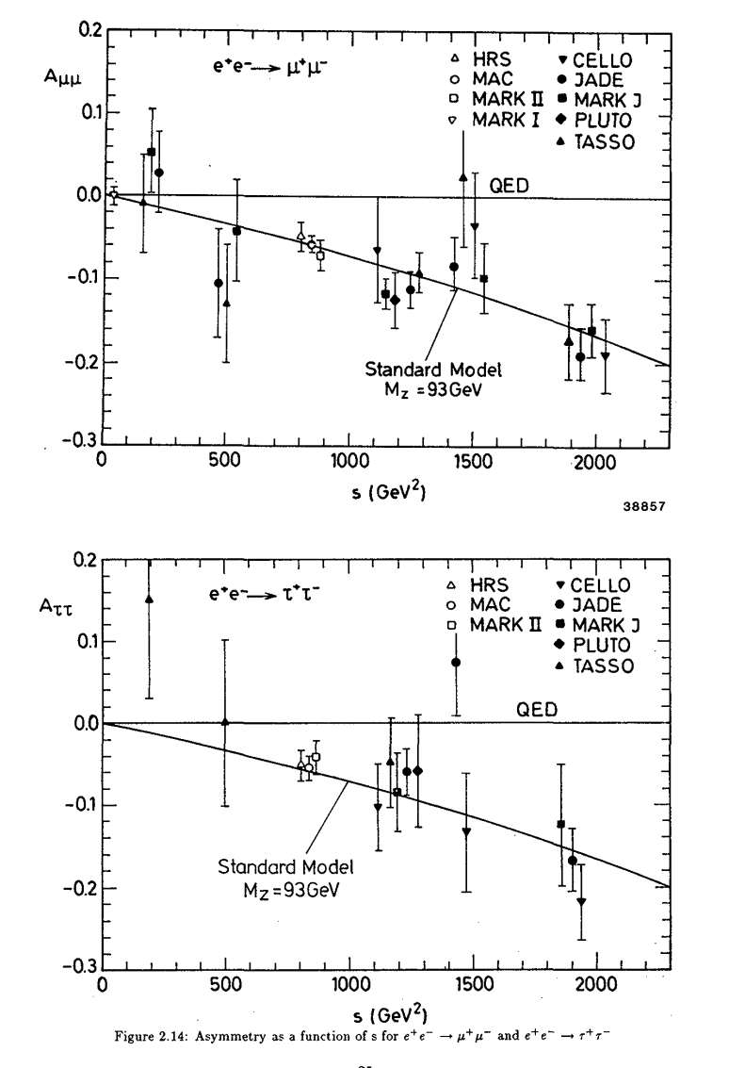
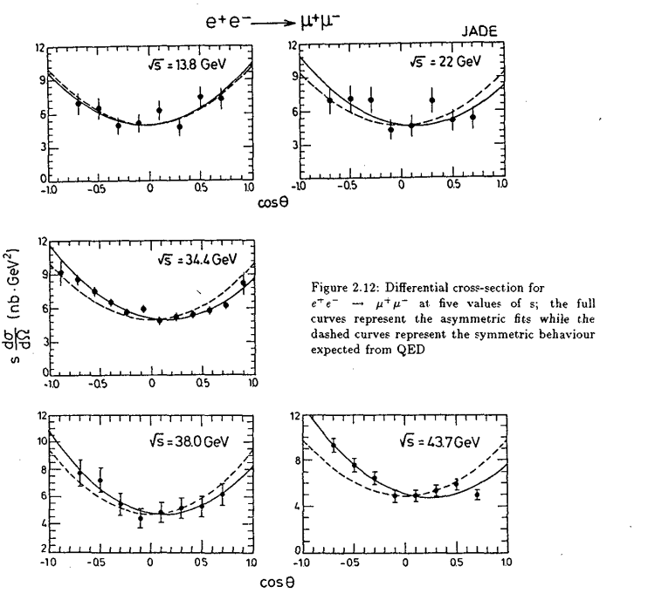
Beate Naroska 1986 Physics Report
SM
Lesson I
Precision measurements indicate the path
to physics beyond present energy reach
SM

Slide 12
Further progress needs progress in experimental techniques as well as in theory

Slide 13
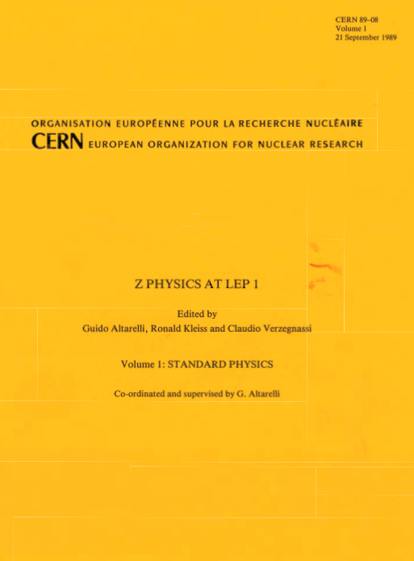
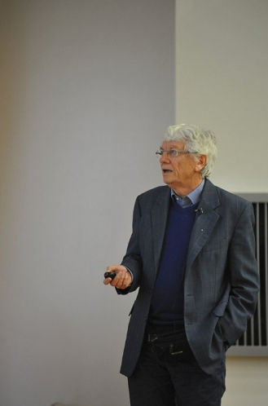
1989
1989 Looking to LEP

Slide 14

2019 Looking forward
to FCC-ee
2019

Slide 15
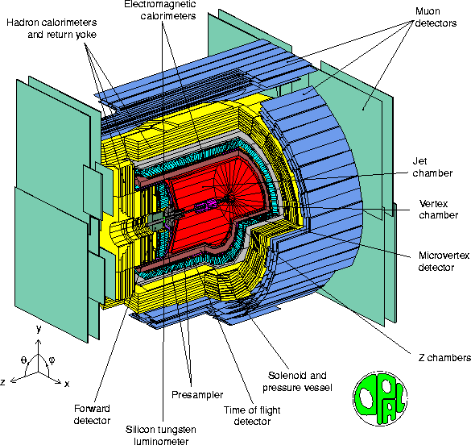
OPAL Detector
(back to)
LEP
Max Energy 209 GeV
Data delivery 1989-2000
ALEPH-DELPHI-L3-OPAL

Slide 16
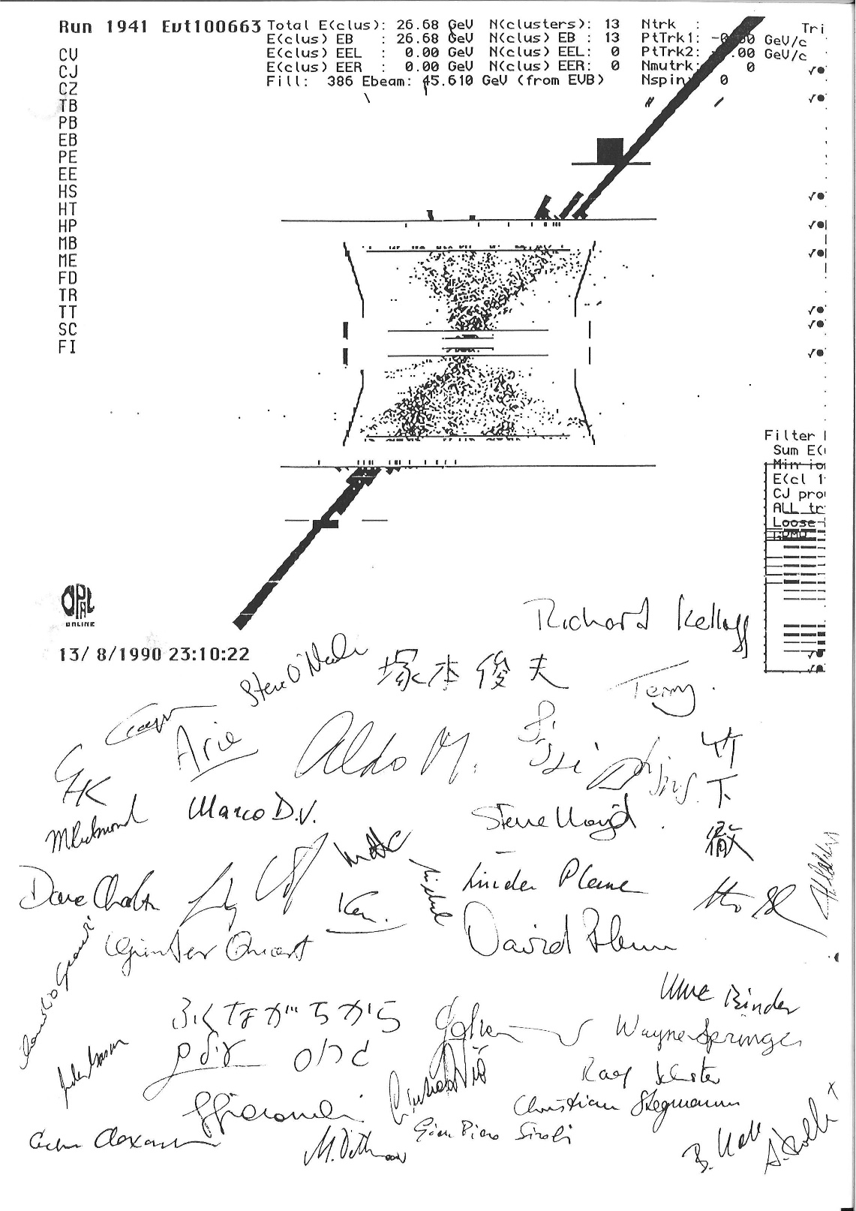
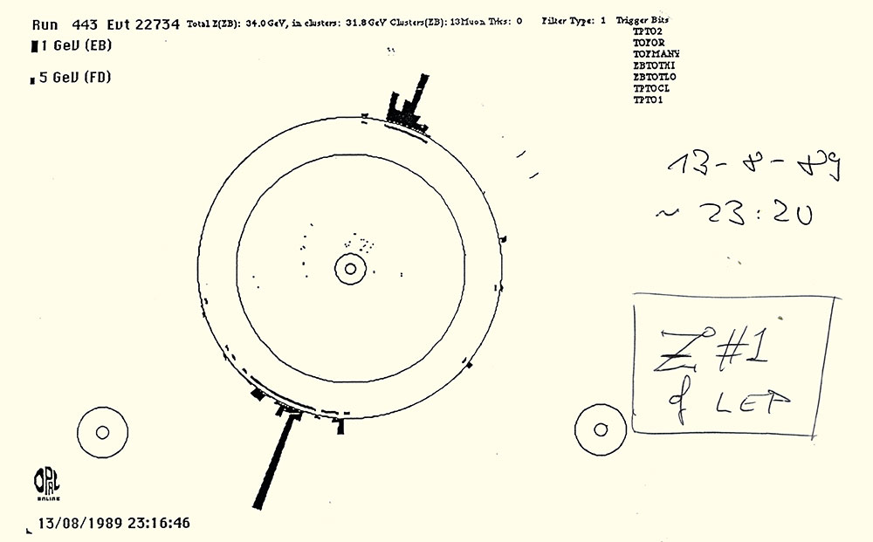
OPAL logbook entries:
first Z seen at LEP
last event seen (at OPAL) 1990

Slide 17
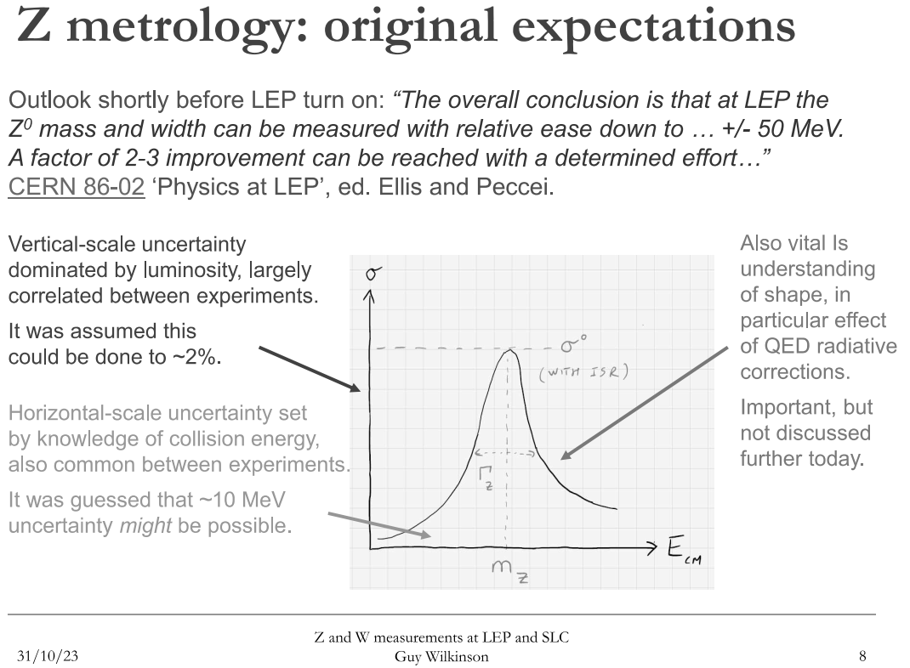

Slide 18
Prior to LEP, all calculations of radiative corrections were based on first- and, later,
partially second-order results. This limited the theoretical precision to the 1% level,
which was unacceptable for experiments. In 1987 S. Jadach solved that problem in a
single-author report, inspired by the classic work of Yennie, Frautschi and Suura,
featuring a new calculational method for any number of photons……
Most of the analysis of LEP data was based exclusively on the novel calculations
provided by Jadach and his colleagues. The most important concerned the LEP
luminosity measurement via Bhabha scattering, the production of lepton and quark
pairs, and the production and decay of W and Z boson pairs……
CERN Courier

Slide 19
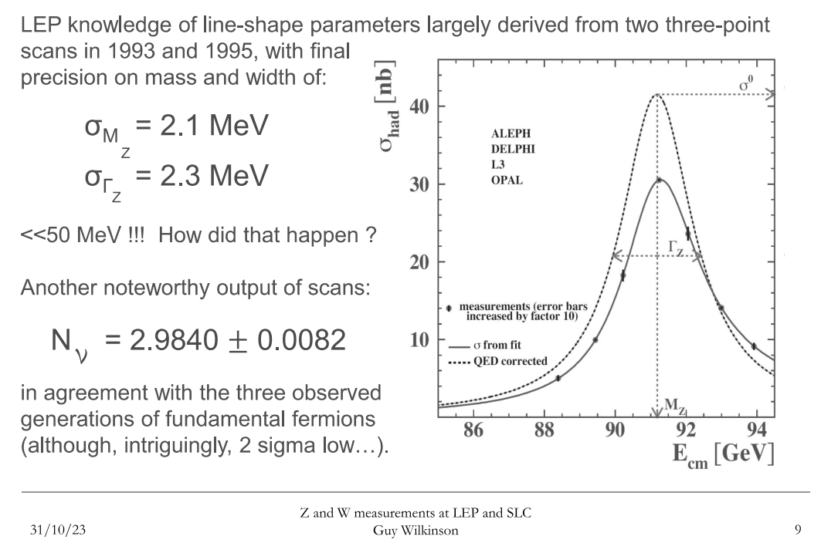
There are only 3 light neutrinos
and therefore 3 generations

Slide 20
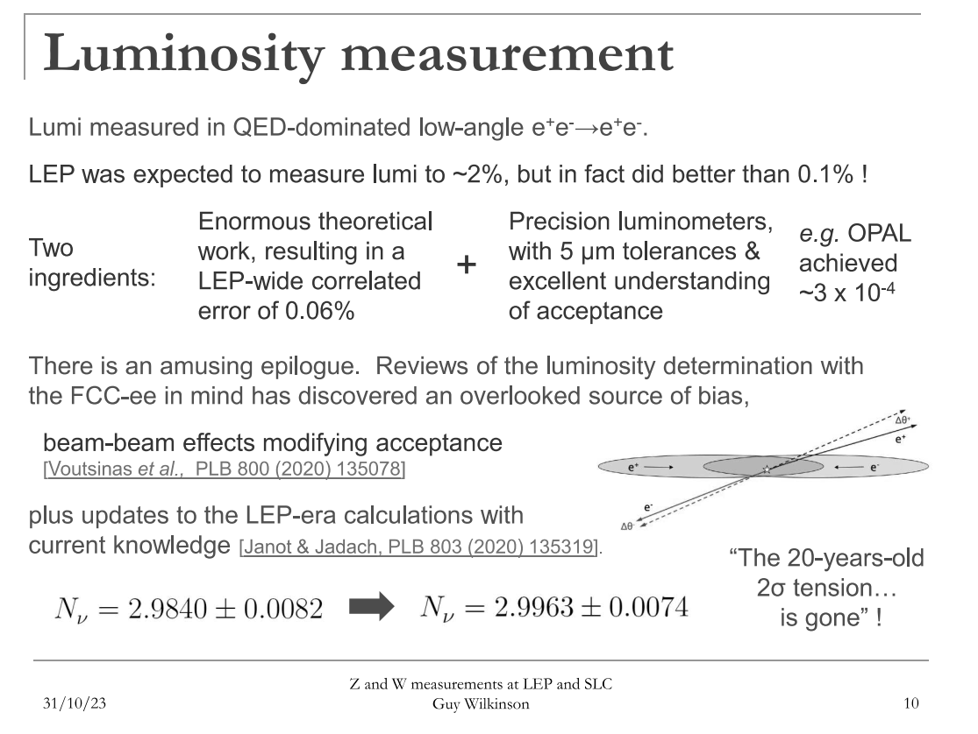
Lesson II
Precision Physics needs progress in
Theory and Experiment

Slide 21
Remember the electro-weak results at PETRA?

Slide 22
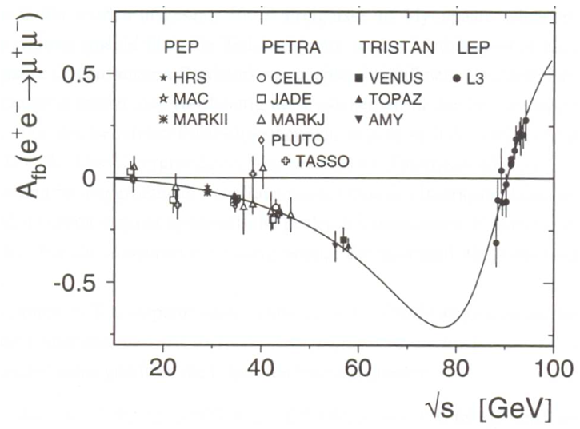
From PETRA to LEP
Lesson I:
Precision measurements
can guide the way to the next discovery

Slide 23
LEP beyond the e-w interaction:
Study of the strong interaction (QCD)

Slide 24
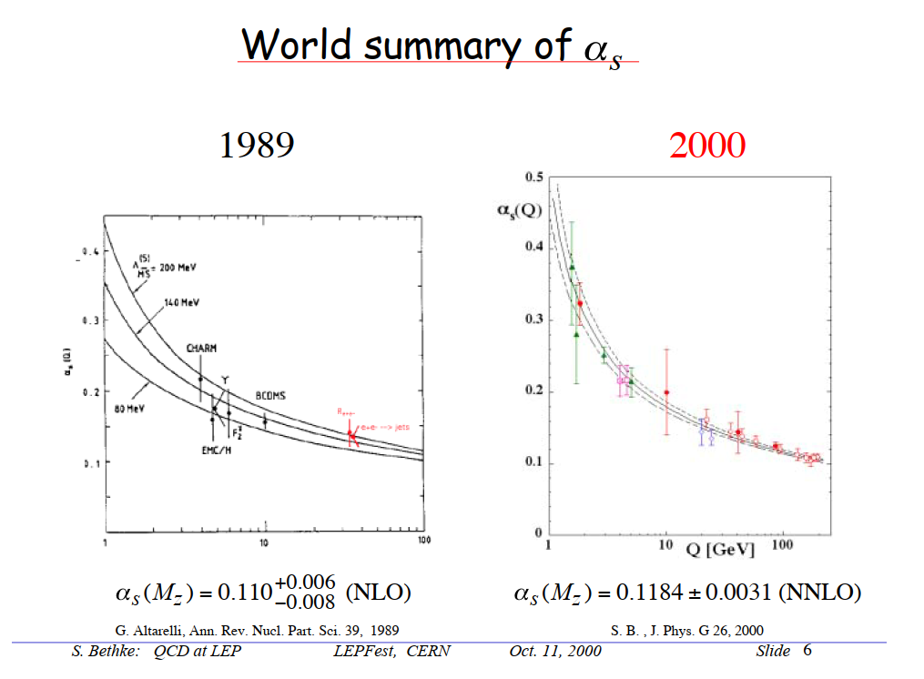
Progress within 10 years

Slide 25
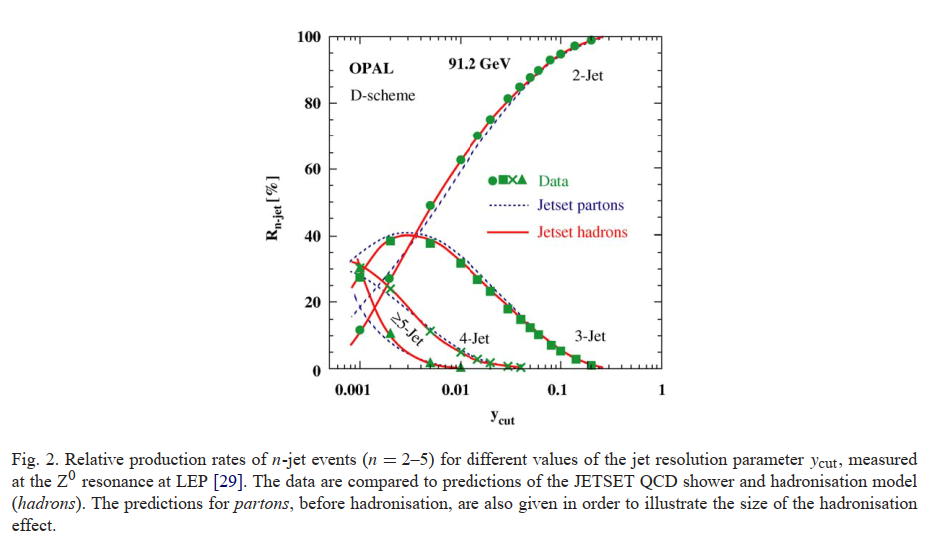
Going beyond three jets

Slide 26
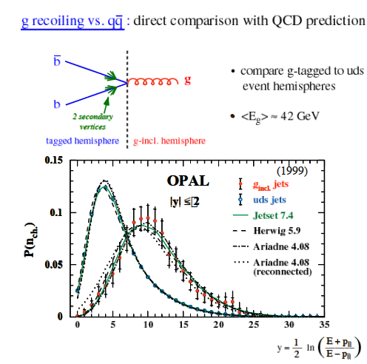
Properties of jets

Slide 27
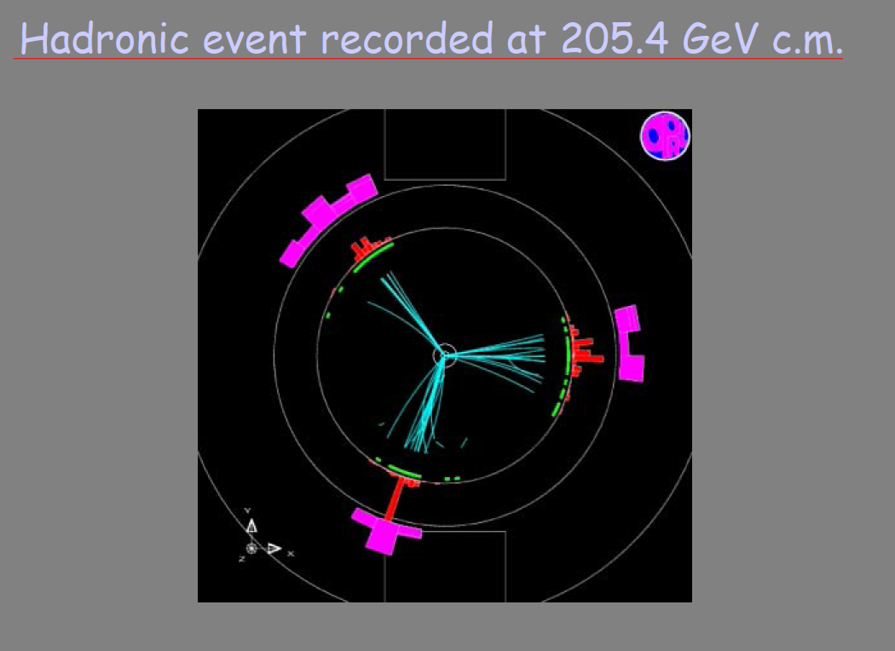
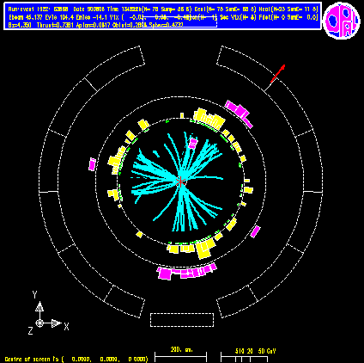
Energy increase
beyond
W-pair production
threshold

Slide 28
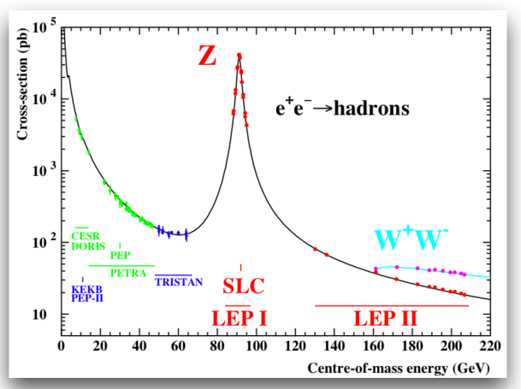
Energy increase beyond W-pair production threshold

Slide 29
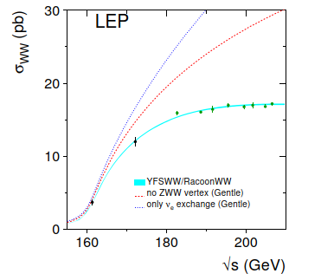
Energy increase beyond
W-pair production threshold
allowed
Confirmation of the
Gauge Boson self-coupling

Slide 30
What should we do with the data once the experiment is switched off?
Very often, data are unique achievements in many respects like energy range, process dynamics and experimental techniques. New, improved and reﬁned scientiﬁc questions may require (re-)analysis of such data sets. Investments necessary to repeat past experiments would exceed the eﬀorts of data preservation by far.
Long-term preservation of data from large-scale high-energy physics (HEP) experiments is imperative to preserve the ability of addressing scientiﬁc questions at times long after the completion of those experiments.
The scientiﬁc motivation for re-using and re-analysing data from past experiments is given by:
• the availability of new theoretical input in terms of increased precision, advanced models or new predictions;
• new and improved analysis techniques;
• the desire to perform cross-checks between diﬀerent experiments.

Slide 31
The JADE collaboration had no plan for further data preservation and future use of their data. Private initiatives for long-term preservation started in 1995/1996 at DESY, when Jan Olsson at DESY organised to copy the JADE data to modern and more eﬃcient data carriers, and to preserve the JADE software libraries.
Driven by the desire to re-analyse JADE data in terms of much advanced QCD calculations and Monte Carlo
models, the resurrection of the JADE software and its usability on modern computer platforms was initiated in 1996/1997, by Siggi Bethke.
Until 2013, the revived software was actively used for new analyses of the JADE data, resulting in 3 further PhD theses, 10 journal publications and several contributions to international conferences and workshops.
The recovery and reusability of JADE data
can be seen as a precursor of today’s FAIR principle

Slide 32
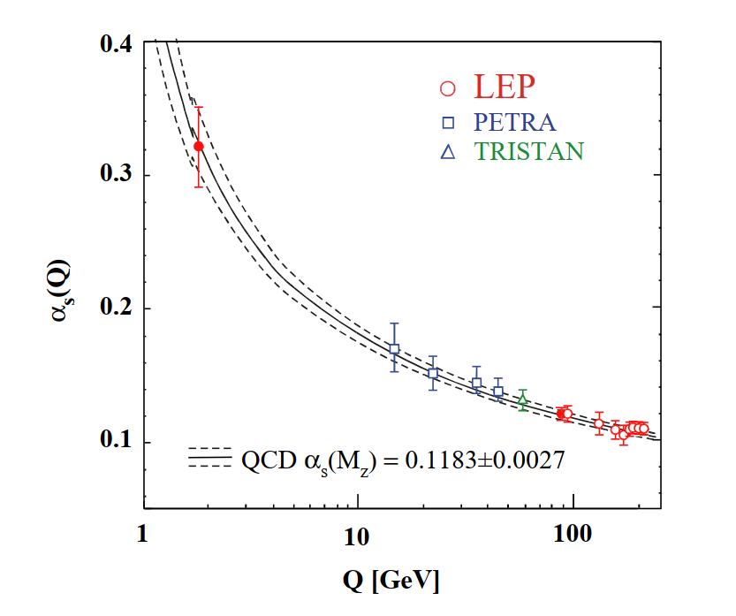
Result of the re-analysis of JADE data
Lesson III
Data preservation and reusability
are important
Data from JADE and OPAL analyzed with the same algorithm and most recent theoretical input

Slide 33
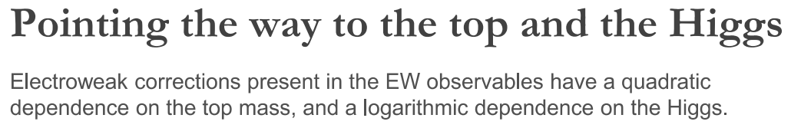
But is there also life beyond all this?
Searches at LEP

Slide 34
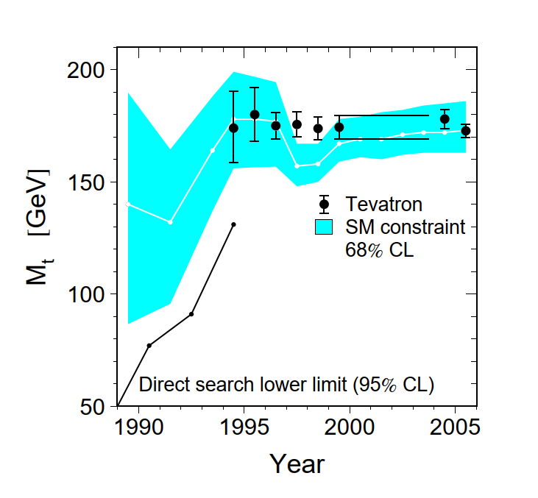
Search for the Top quark
LEP and SLD data indicated
the value of the top mass
well before discovery
Precision measurements (SM constraints)
and direct measurements agree and
complement each other well

Slide 35
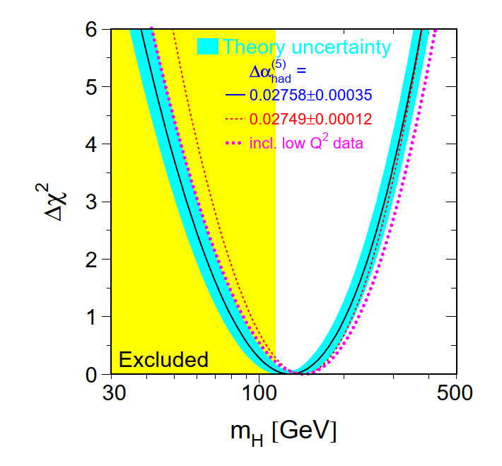
Search for the Higgs-Boson (at that time the last missing ingredient to the SM)
LEP1 data and SM require something Higgs-like and within LHC reach
Lesson 1 repeated:
Precision measurements
can guide the way to the next discovery

Slide 36
After LEP: Towards the LHC

Slide 37
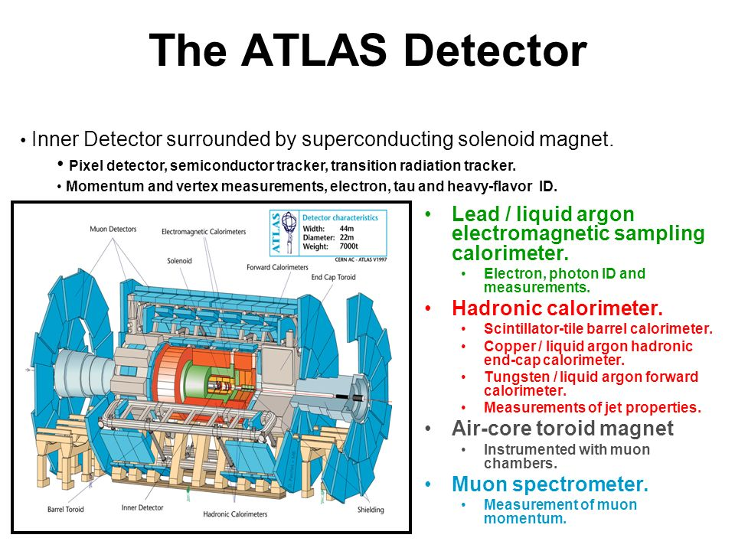
Data taking
since 2009

Slide 38
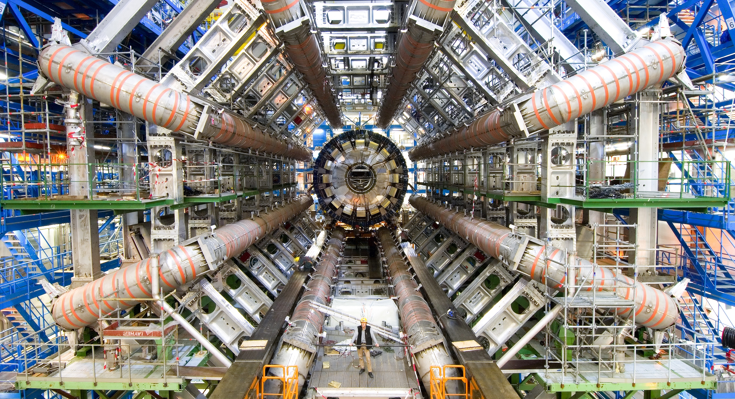
Notes:
This is the title slide for the section on “Research”.
It can be shown for just enough time for viewers to take in the beauty and impact of the image.
(THIS SECTION HAS 13 SLIDES, INCLUDING ONE OPTIONAL SLIDE)

Slide 39
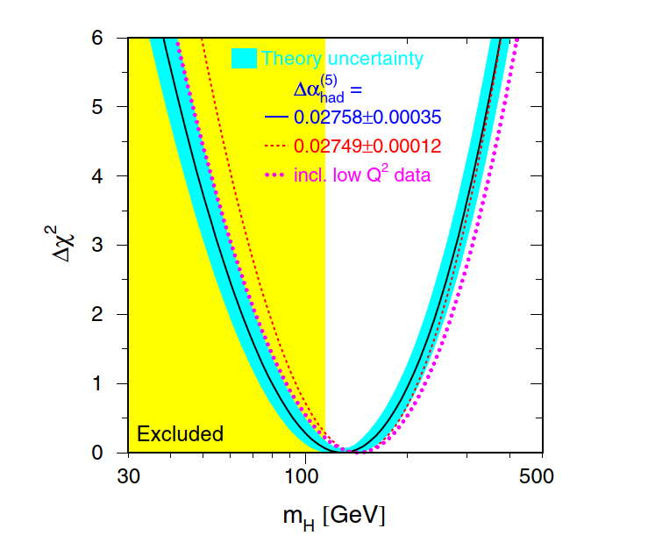
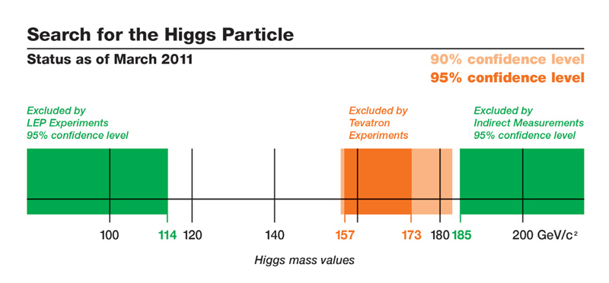
LEP1 1989 - 2000
Precision tests of the
Standard Model
Status of the search for the Higgs-Boson
March 2011
LEP1 + LEP2 and Tevatron

Slide 40
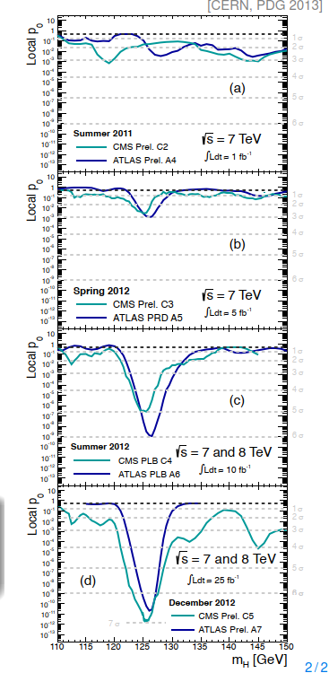
Signal Development
during the 12 months before the announcement
← 3 sigma
← 5 sigma
← 6 sigma

Slide 41
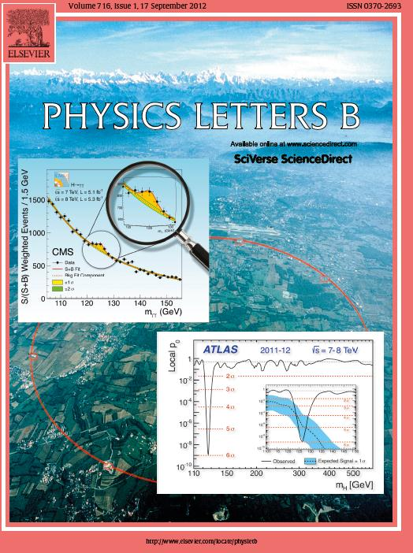

Slide 42
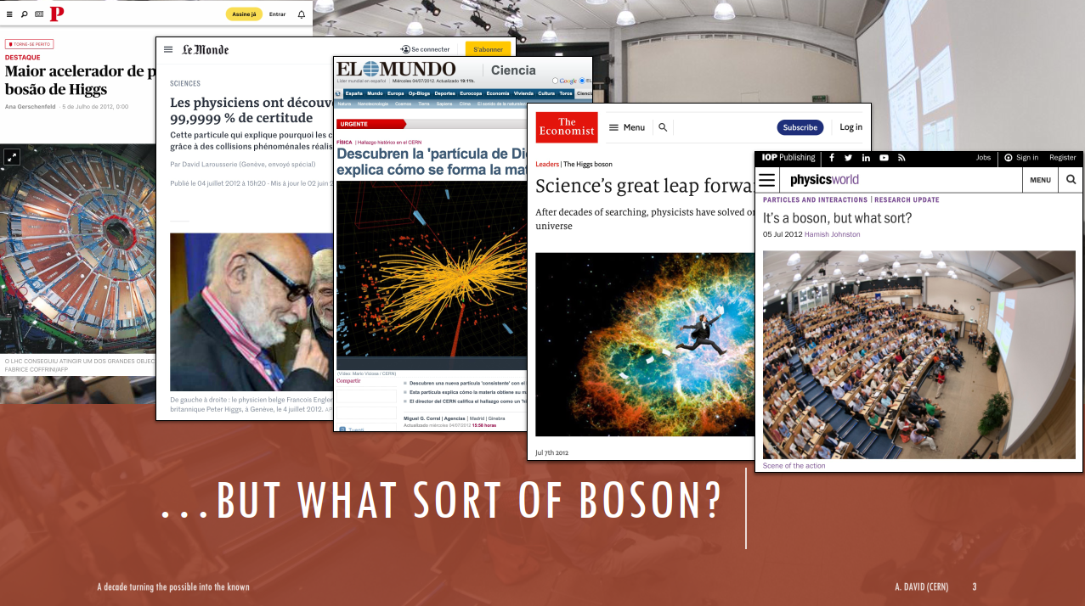
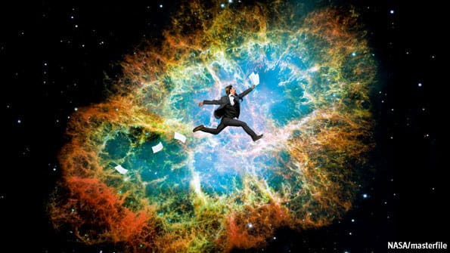
Broadly, particle physics is to the universe what DNA is to life: the hidden principle underlying so much else. Like the uncovering of DNA's structure by Francis Crick and James Watson in 1953, the discovery of the Higgs makes sense of what would otherwise be incomprehensible. Its significance is massive. Literally. Without the Higgs there would be no mass. And without mass, there would be no stars, no planets and no atoms. And certainly no human beings. Indeed, there would be no history.
Science’s great leap forward
After decades of searching, physicists have solved one of the mysteries of the universe
Today it still triggers much interest in society
Lesson IV
Good communication to society is mandatory

Slide 43
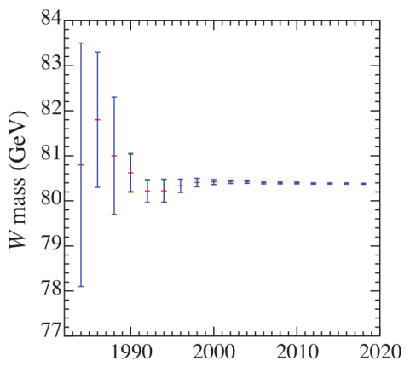
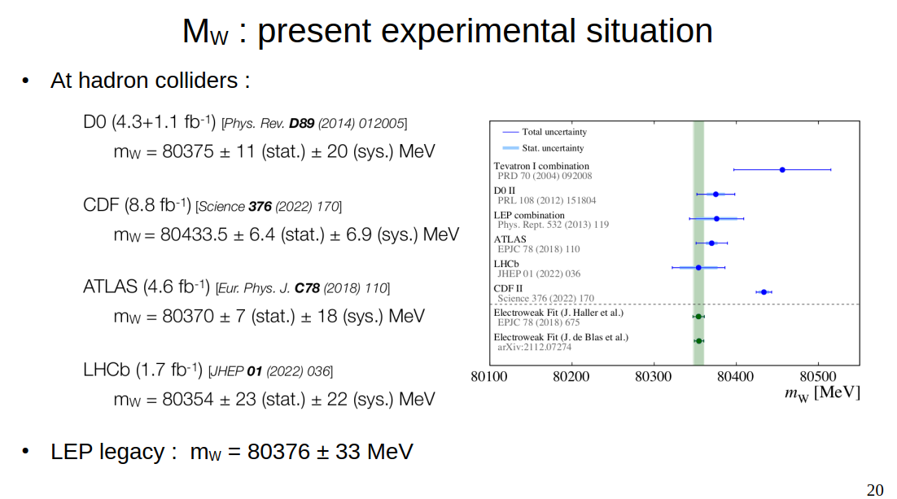

Precision measurements

Slide 44

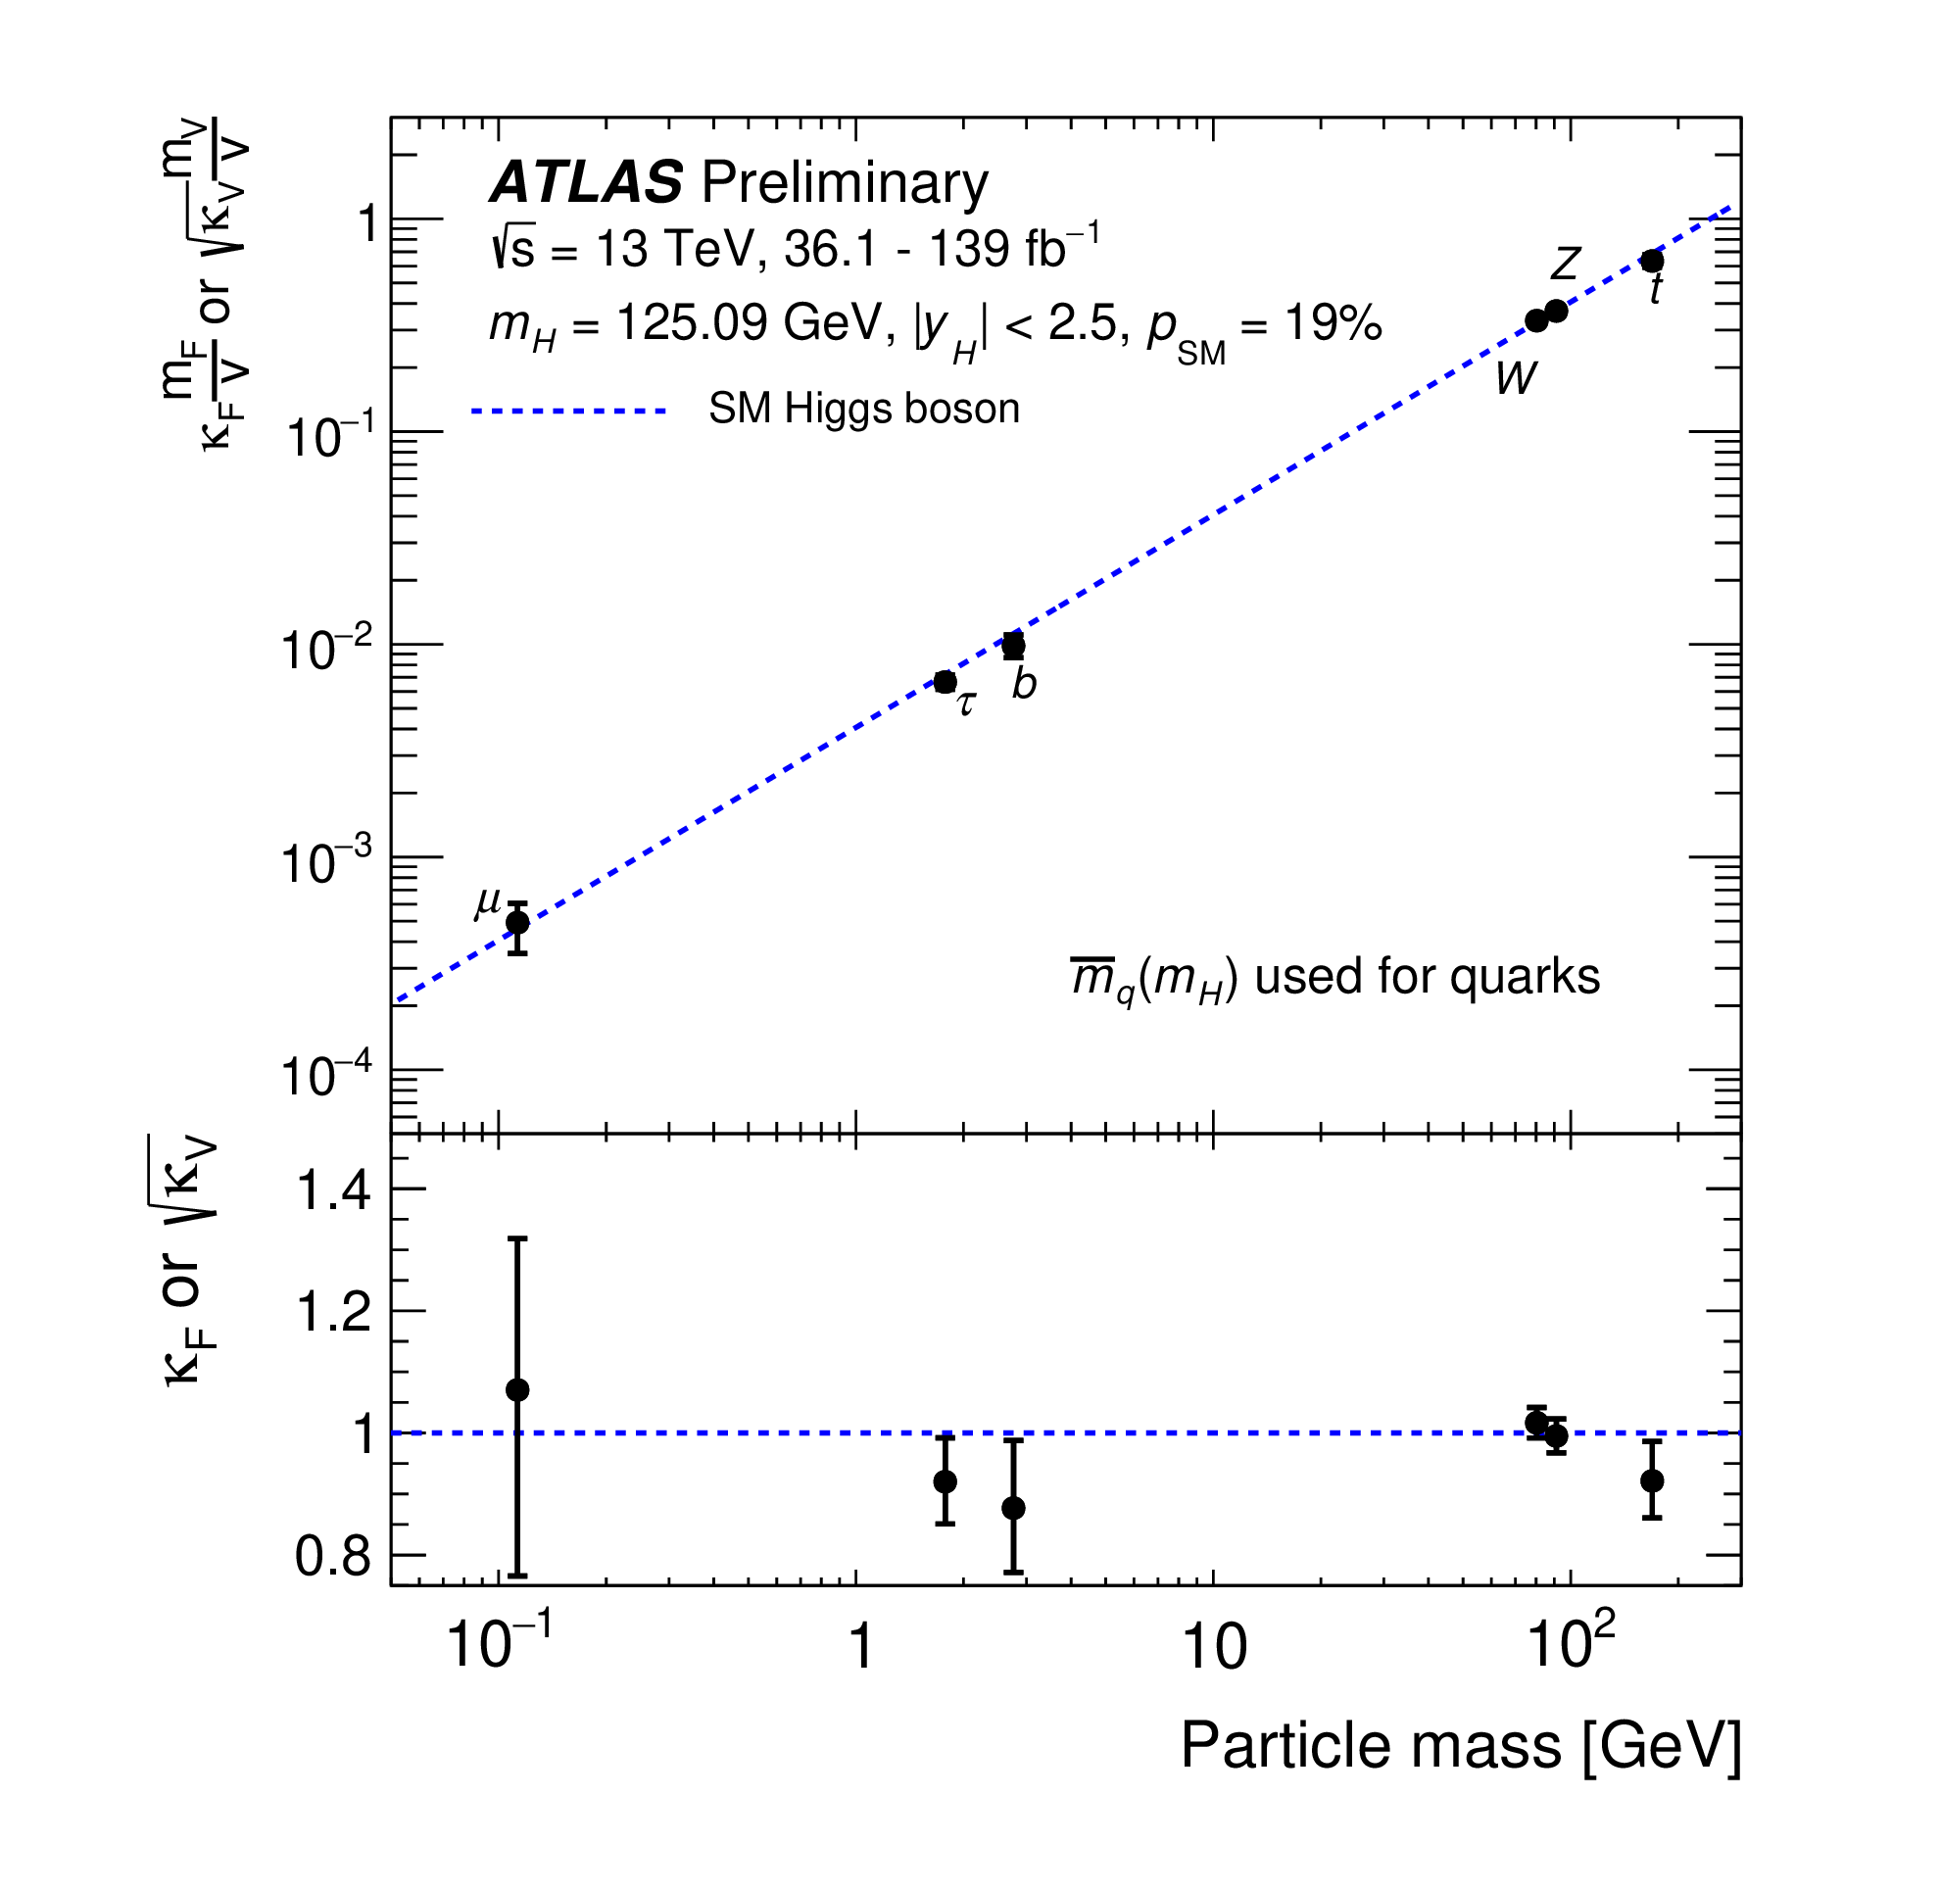
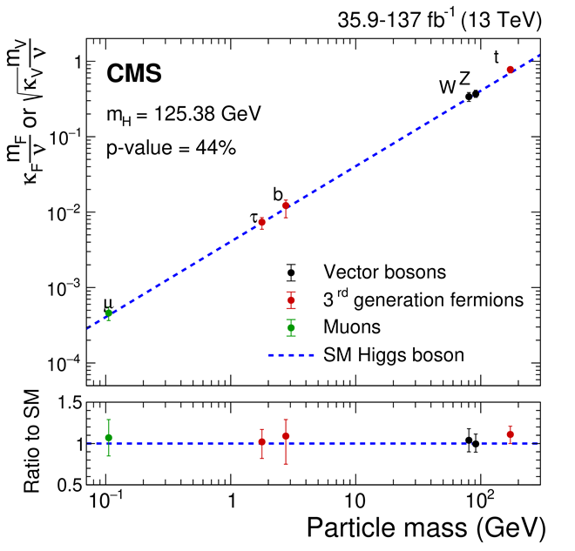
Achievements since the Higgs Boson Discovery
Example: measurement of the Higgs couplings to fundamental particles
ATLAS result based on the full data set (Run 2)
Key prediction of the Standard Model:
Higgs coupling to particles is proportional to their
mass
ATLAS-CONF-2021-053
Precision on couplings reached
Impressive verification with an accuracy often better than 10%
Notes:
B_i and B_u: invisible and undetected Branching fractions

Slide 45
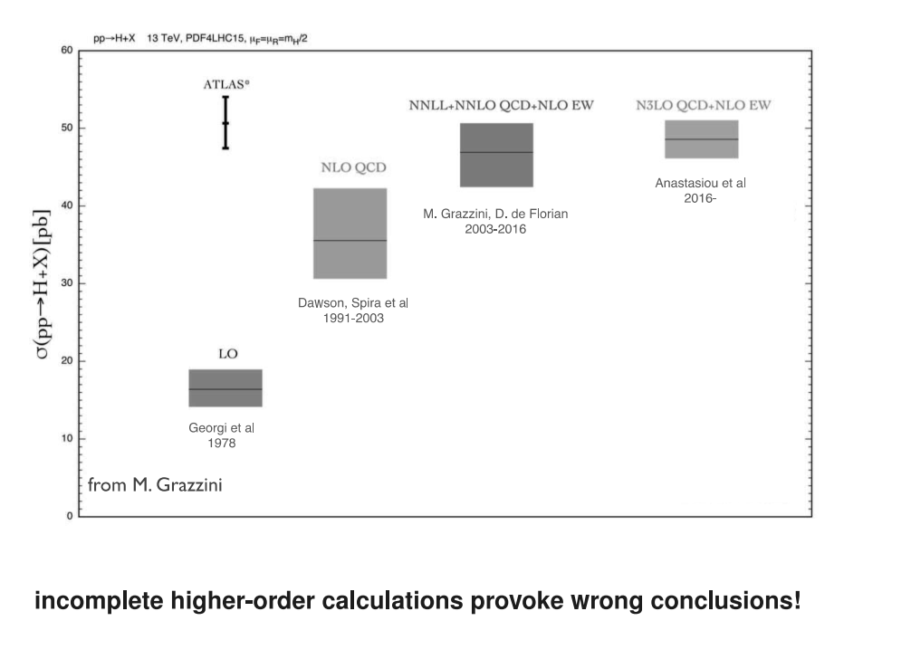
Progress in experiments has to be accompanied by progress in theory
and vice versa

Slide 46
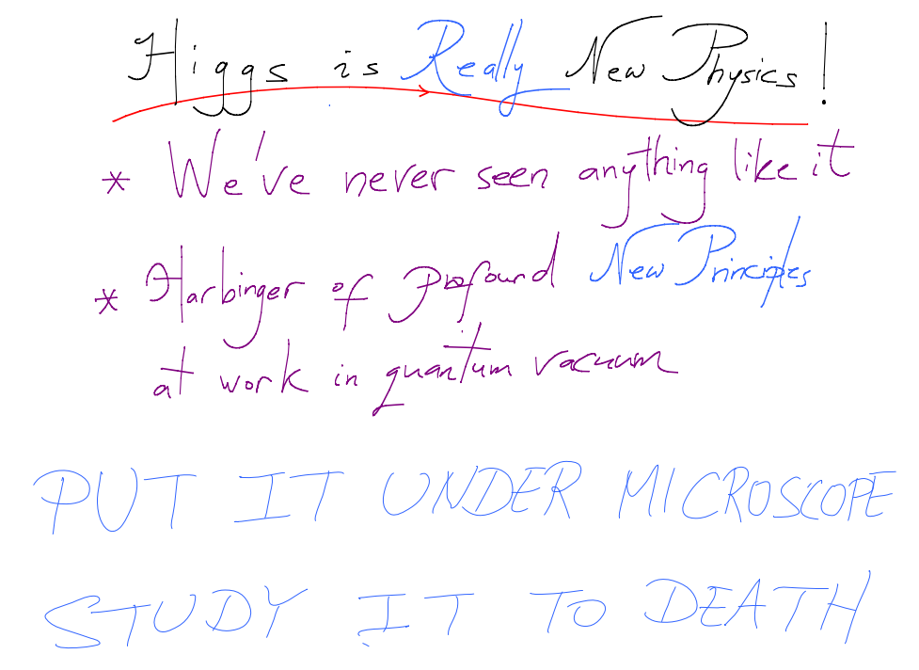

Nima Arkani-Hamed

Slide 47
The path forward:
Update European Strategy for Particle Physics
CERN Council updated the European Strategy for Particle Physics in June 2020
Scientific recommendations
Full exploitation of the LHC and HL-LHC
Highest-priority next collider: e+e- Higgs factory
Increased R&D on accelerator technologies
Investigation of the technical and financial feasibility of a future ≥ 100 TeV hadron collider
Long-baseline neutrino projects in US and Japan
High-impact scientific diversity programme complementary to high-energy colliders
R&D on detector and computing
Theory
Other high priority items:
Exploit synergies with neighboring field, in particular nuclear and astroparticle physics
Mitigate environmental impact of particle physics
Invest in next generation of researchers
Support knowledge and technology transfer
Public engagement, education and communication
Importance of collaboration between CERN and national labs highlighted
ESPPU provides guidelines for the coming years/decades
to the particle physics community in general and to CERN

Slide 48
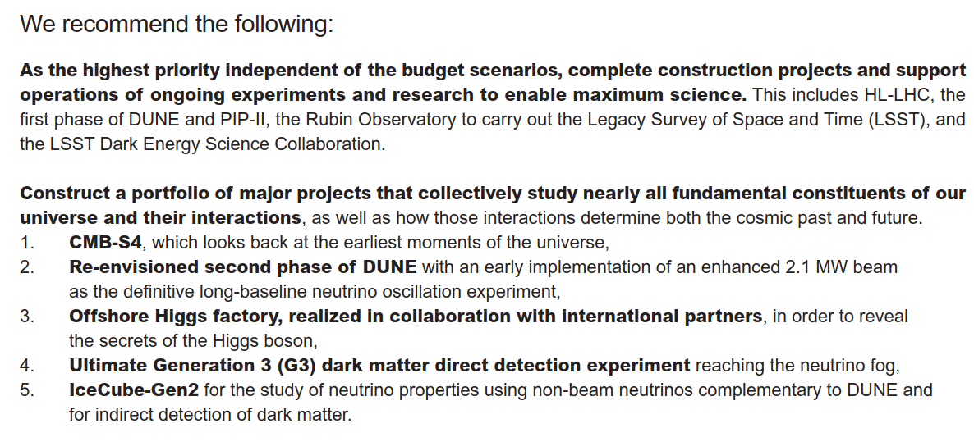
The path forward:
P5 Report

Slide 49
Concluding Remarks
Steady progress in theory and experiment over more than fifty years established the Standard Model
Stanislaw Jadach played a key role during the whole journey

