Slide 1
The Need for Accelerator Physics Outreach
Goal: A larger and more diverse next generation of accelerator physicists to support ambitious future of HEP
Intermediate Steps: “Advertising” -- accelerator physics cannot hope to recruit a more diverse future generation if people don’t know it exists as a degree/career path
How: Outreach and research opportunities for undergraduate students [1]
  We need more students who are well prepared with strong backgrounds applying to gradate programs [2]
  Facility tours/events, guest speakers from facilities
  Expand “advertising” outside of pure physics to adjacent fields
      Engineering, computer/data science, material science, chemistry, etc.
Accelerator Physics is more than bolting together beamlines:
Materials/Cond. Matter research
Beam dynamics/computation
Machine Learning

Slide 2
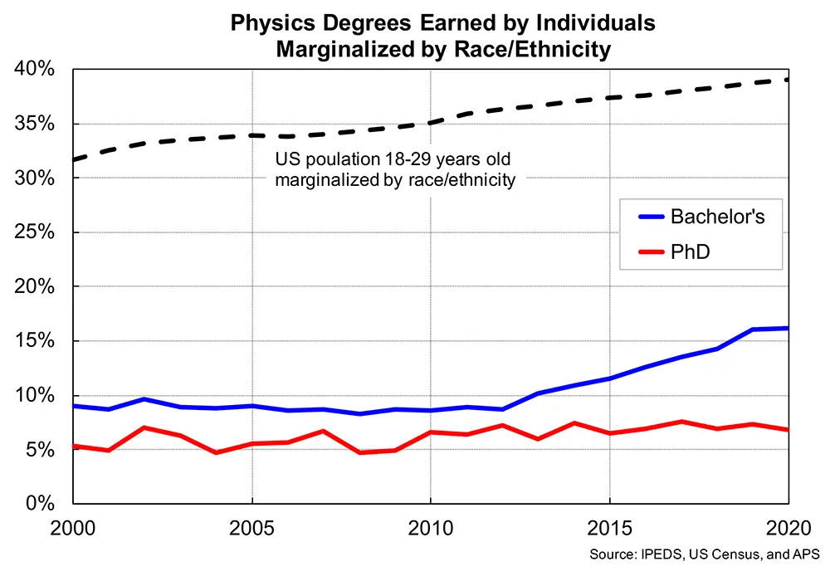
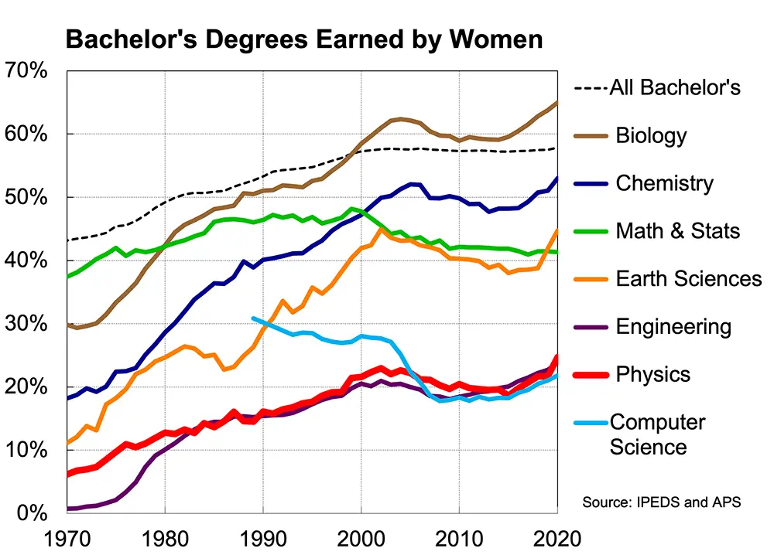
Retention of Current Students
Goal: Maintain current students from underrepresented and marginalized groups
Start from the top down: Keep up with latest research on physics climate, especially those in positions of power [3]
Solidarity amongst URM students increases retention during graduate school [4]
[5]
[6]

Slide 3
The Message
Why P5 Should Care: Particle physics relies on accelerators and accelerator physics. The future of particle physics and the future of accelerator physics are inseparable.
Better advertising: People need to know what accelerator physics is
Recruiting and retaining current URM students
Recruiting well prepared students with strong backgrounds

Slide 4
References, Further Reading
Maxwell Franklin, Eric Brewe, and Annette R. Ponnock. Examining reasons undergraduate women join physics. Phys. Rev. Phys. Educ. Res. 19, 010110 – Published 21 February 2023. https://doi.org/10.1103/PhysRevPhysEducRes.19.010110
Report of the HEPAP Subcommittee for Review of the United States Particle Accelerator School (2015). https://science.osti.gov/-/media/hep/hepap/pdf/Reports/HEPAP_USPAS_Subcommittee_Final_Report.pdf
M. Dancy and A. Hodari, “How well-intentioned white male physicists maintain ignorance of inequity and justify inaction,” arXiv:2210.03522.
Scherr, R. E., Lopez, M. A., & Rosario-Franco, M. (2020). Isolation and connectedness among Black and Latinx physics graduate students. Physical Review Physics Education Research, 16(2), 020132. https://doi.org/10.1103/PhysRevPhysEducRes.16.020132
Physics degrees earned by underrepresented minorities, AIP: Education and DiversityCollege Park, MD). from https://www.aps.org/programs/education/statistics/phdpopulation.cfm.
Bachelor’s degrees earned by women, by major, AIP: Education and DiversityCollege Park, MD). from https://www.aps.org/programs/education/statistics/womenmajors.cfm.
Special thanks to Ritchie Patterson and Matthias Liepe for their advice and discussions

