Slide 1

Closing remarks
https://indico.cern.ch/event/1288731/
Assoc. Prof. Dr. Brigita ABAKEVIČIENĖ
Deputy Chair of the CERN Baltic Group

Slide 2

The main objectives of the CERN Baltic Group (CBC) 2023 are to bring together the scientific community of the Baltic states and to provide updates on the most recent scientific achievements of the members of this research community working on CERN-related fields of research.
The scientific topics include, but are not limited to:
Particle physics: experiment;
Particle physics: theory;
Accelerator physics;
Accelerator and particle detector technologies;
Medical physics.

Slide 3
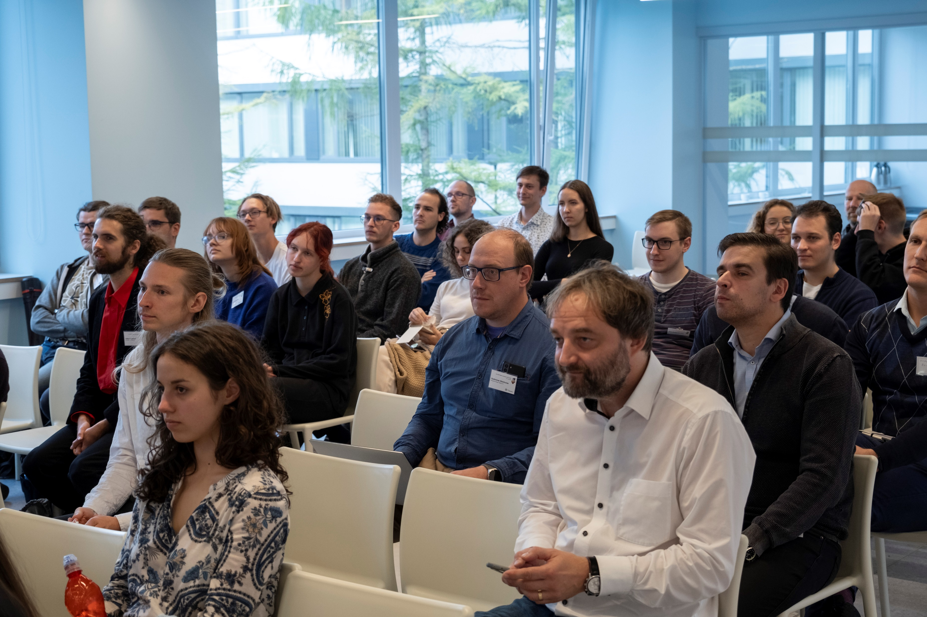
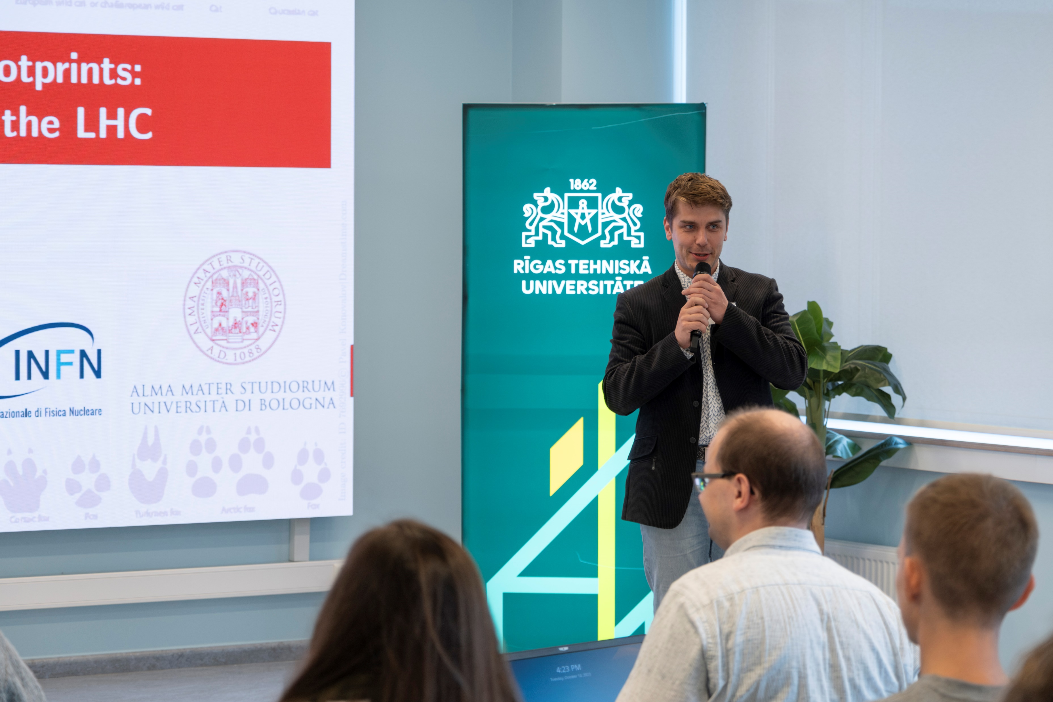
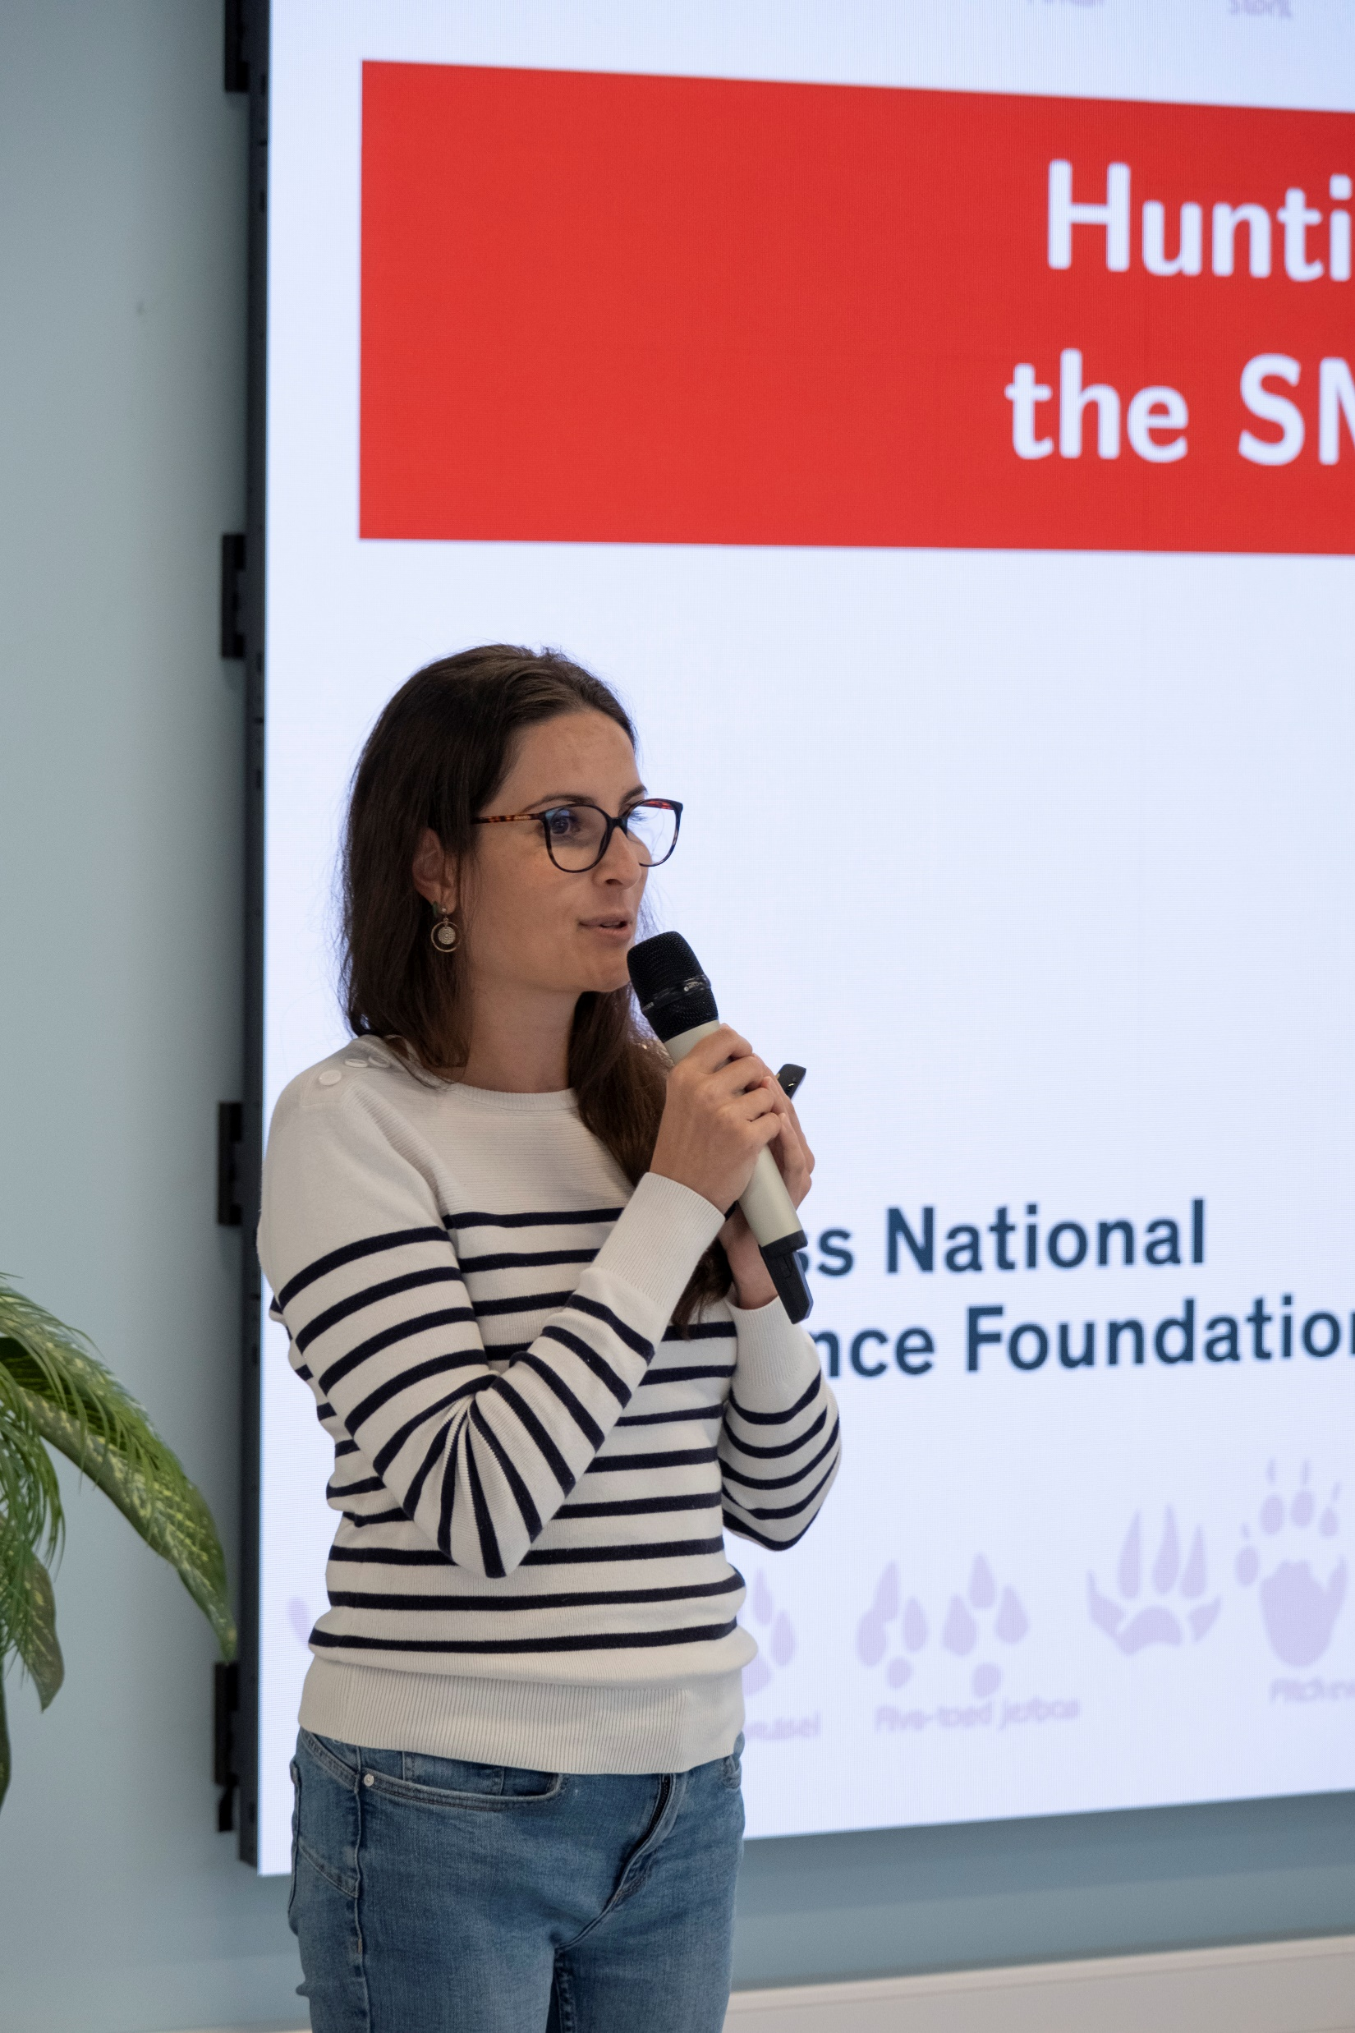
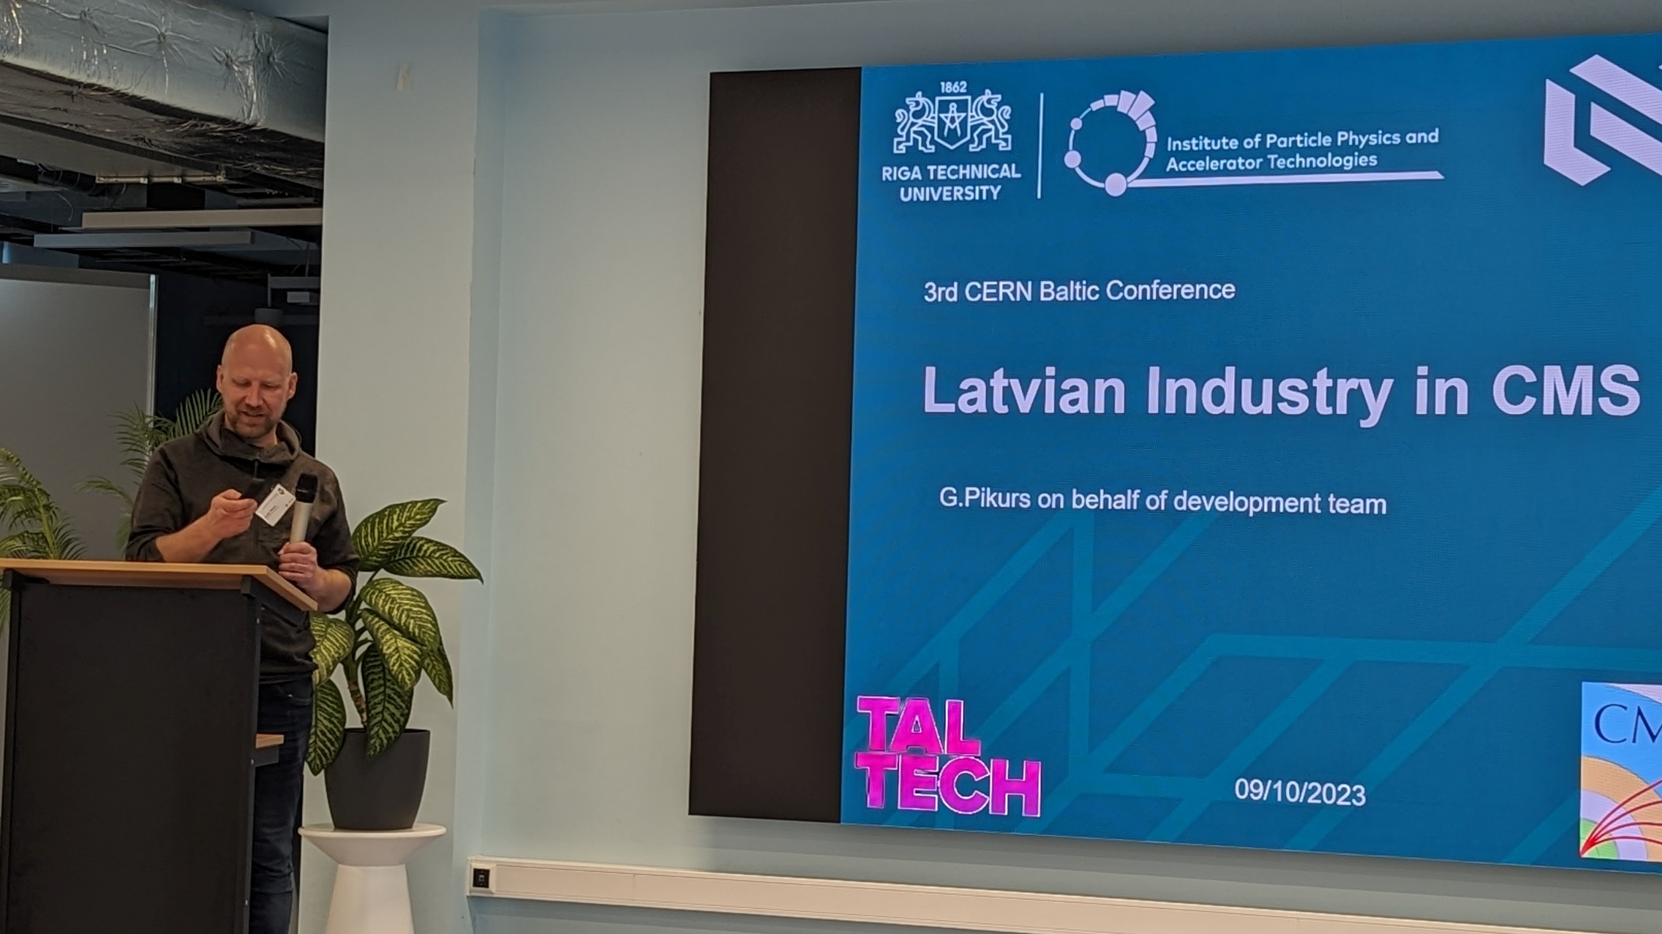
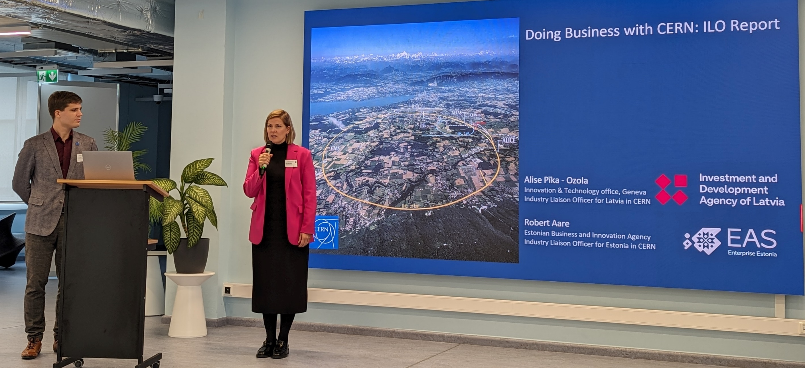

Slide 4
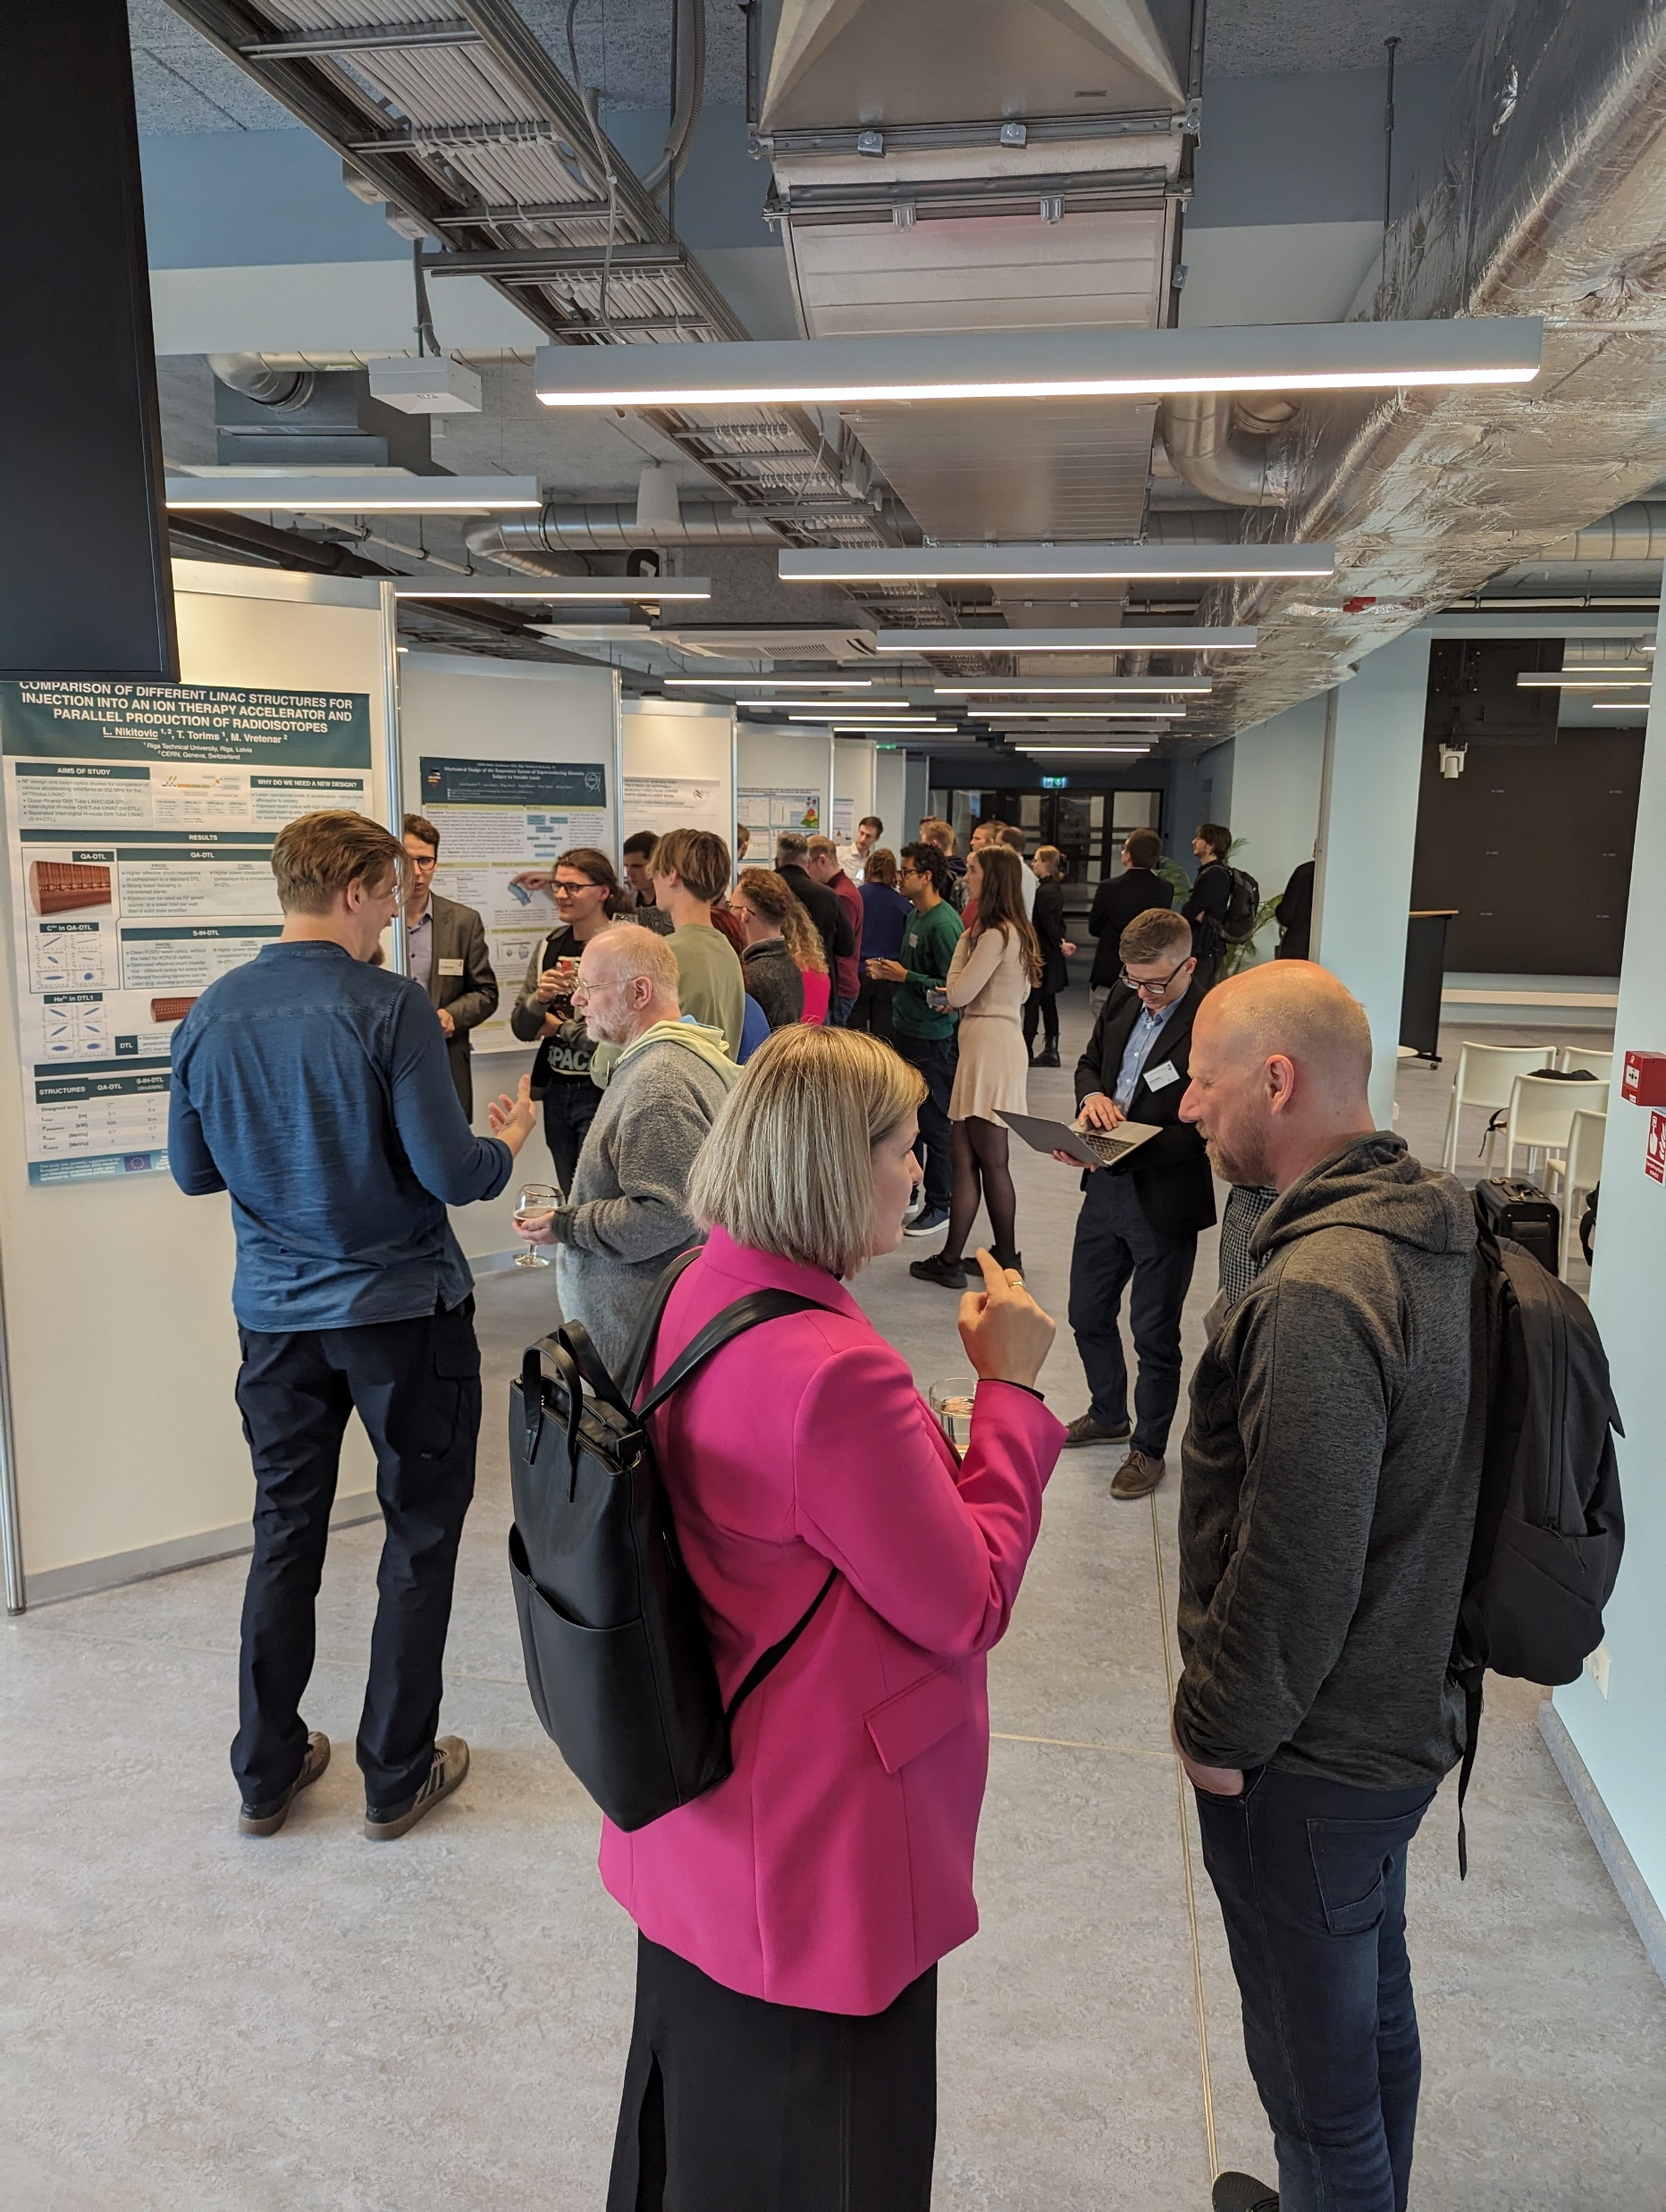
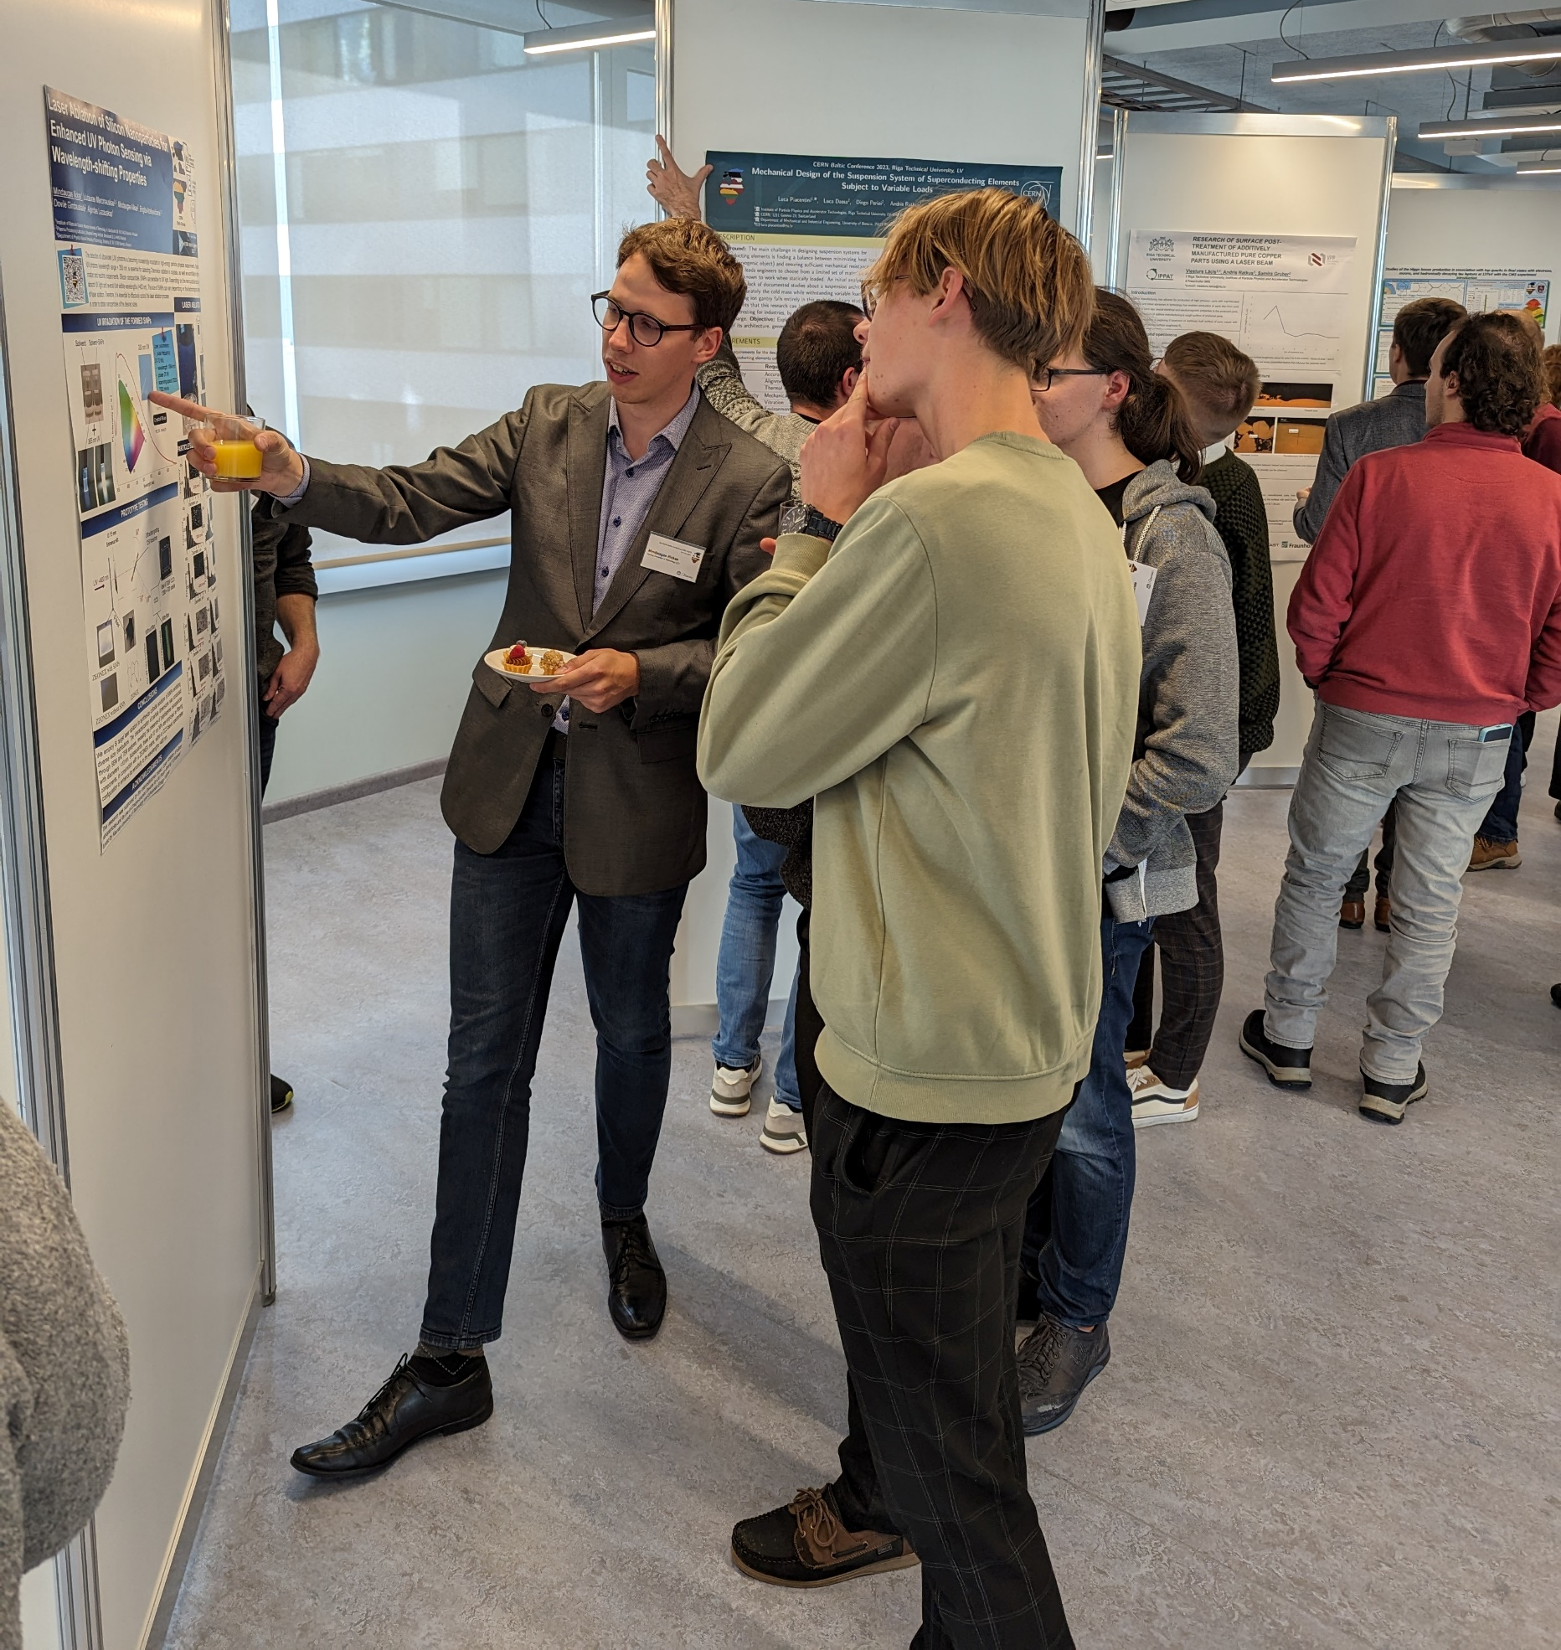
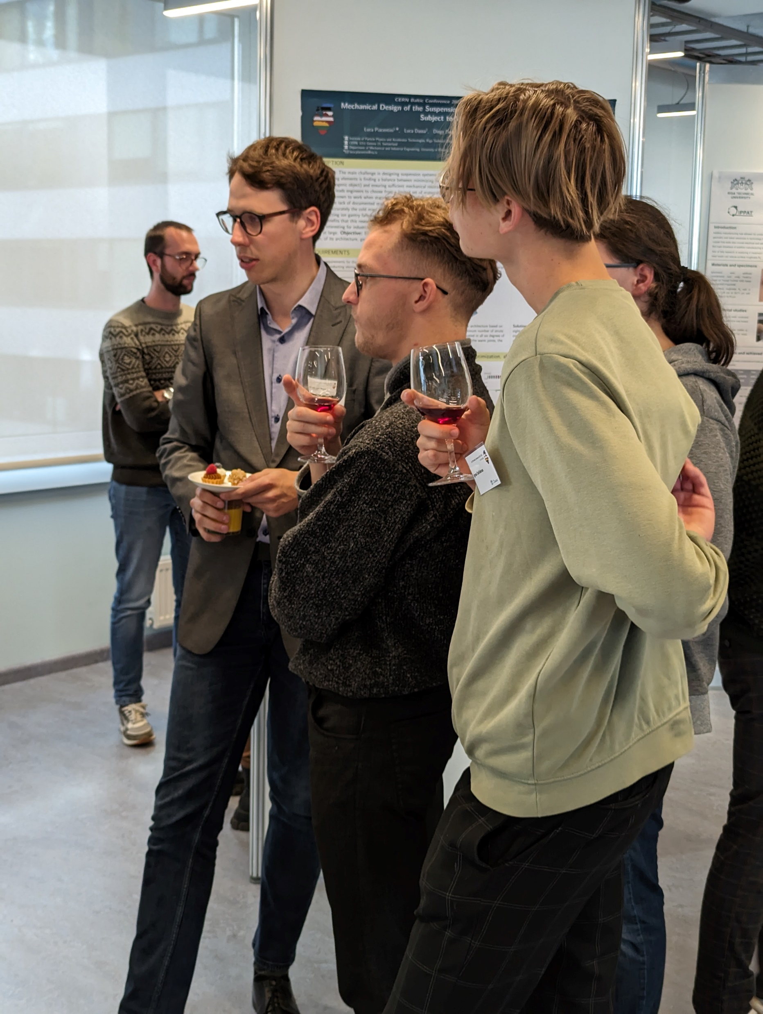
Poster Session

Slide 5
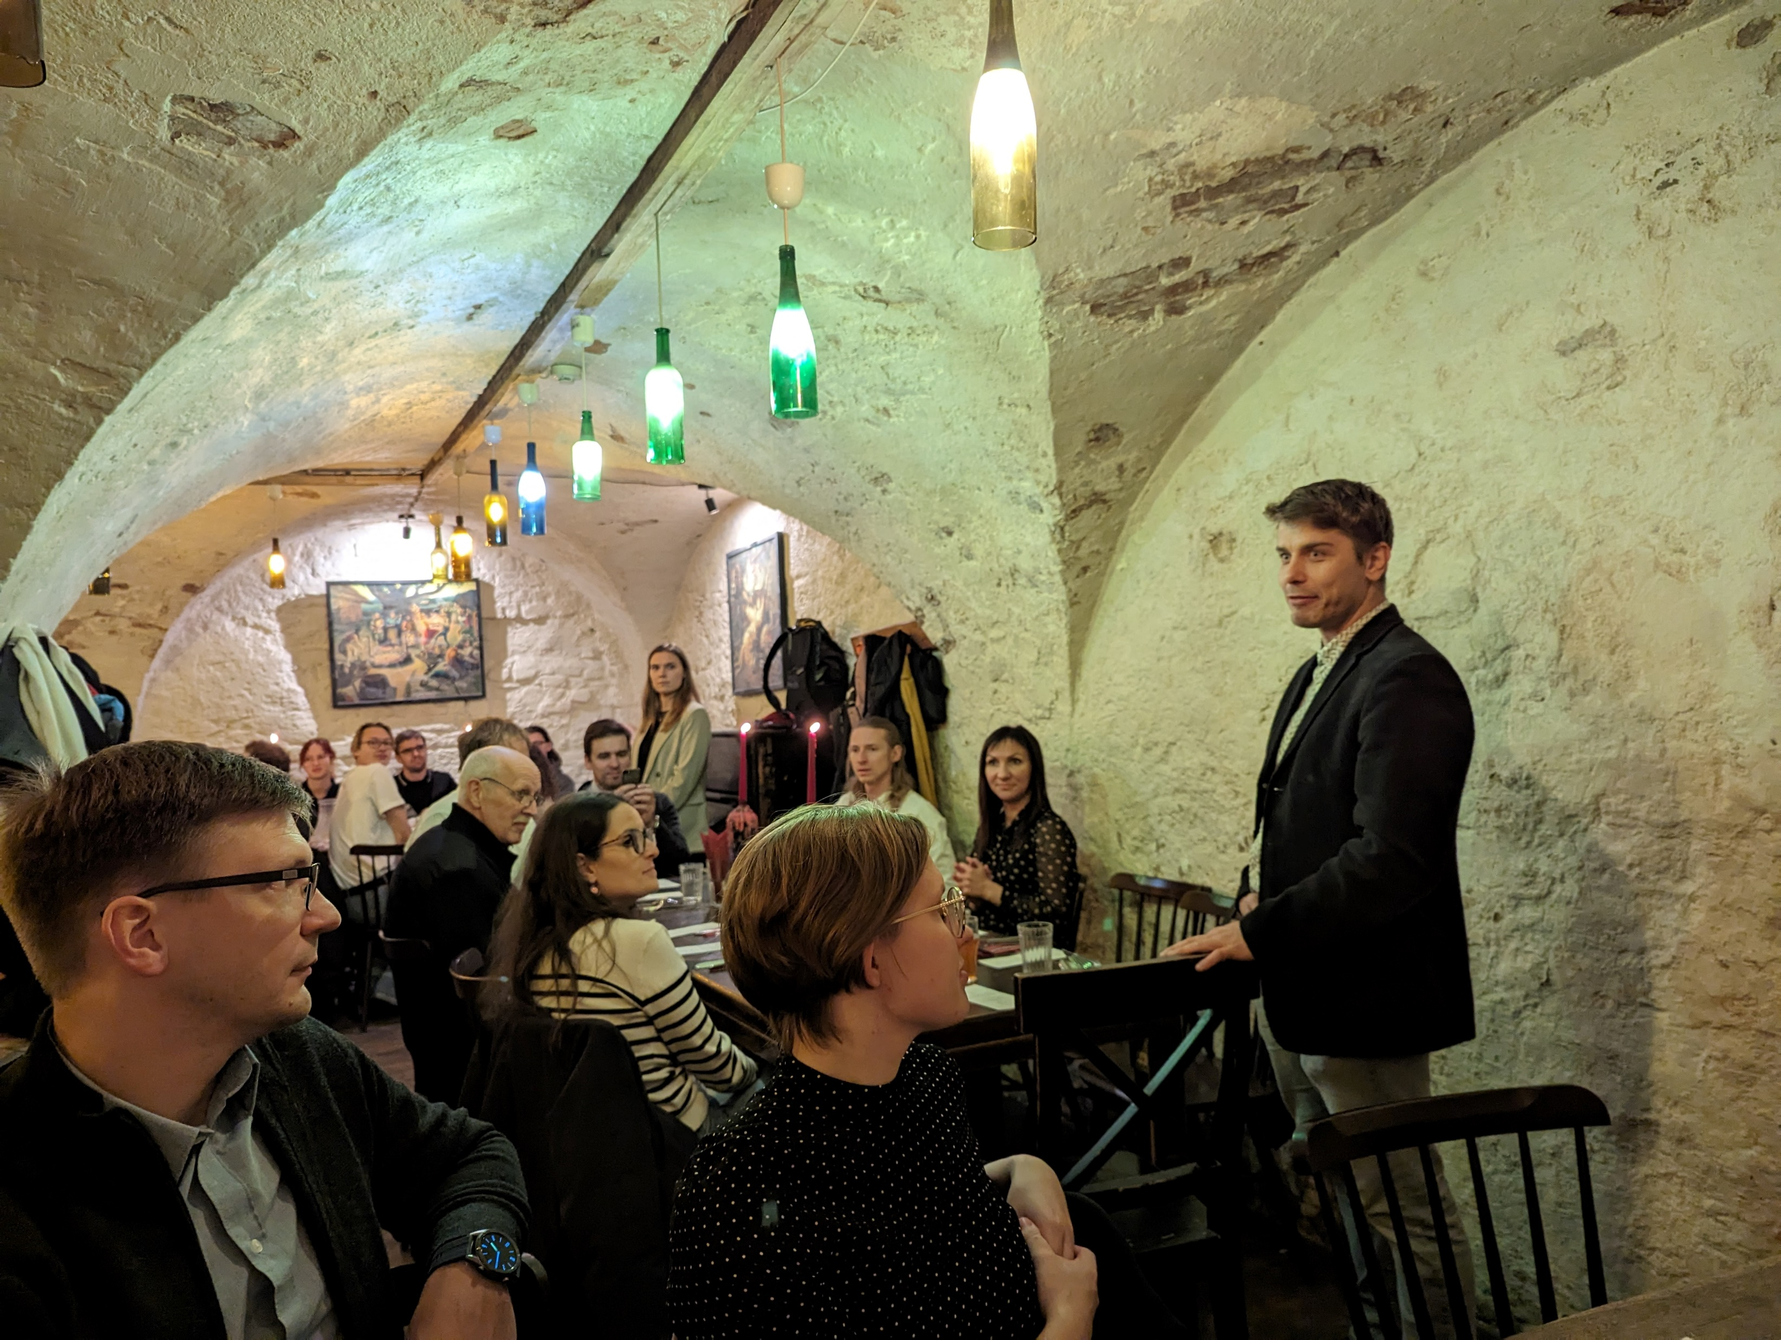
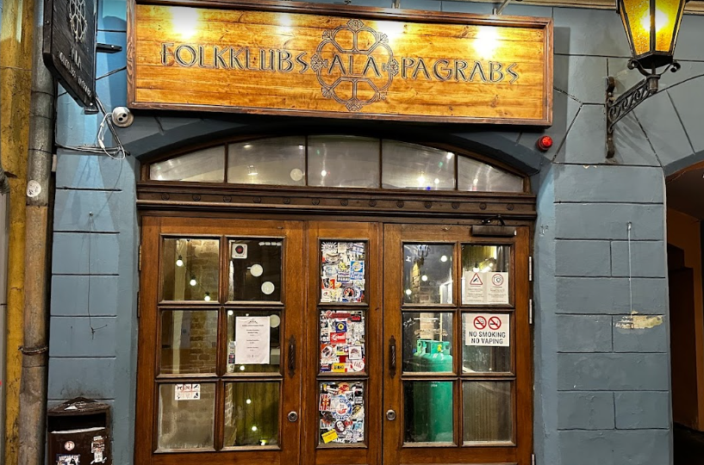
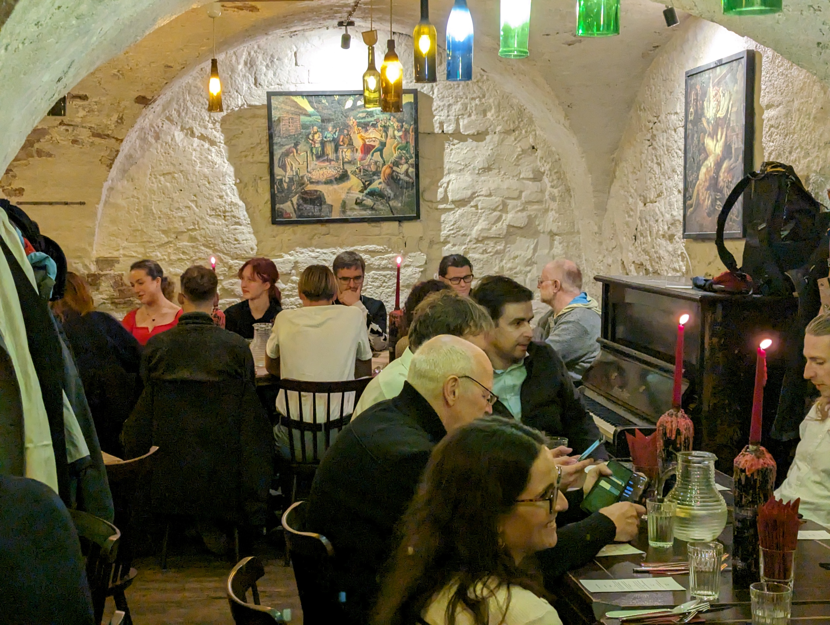
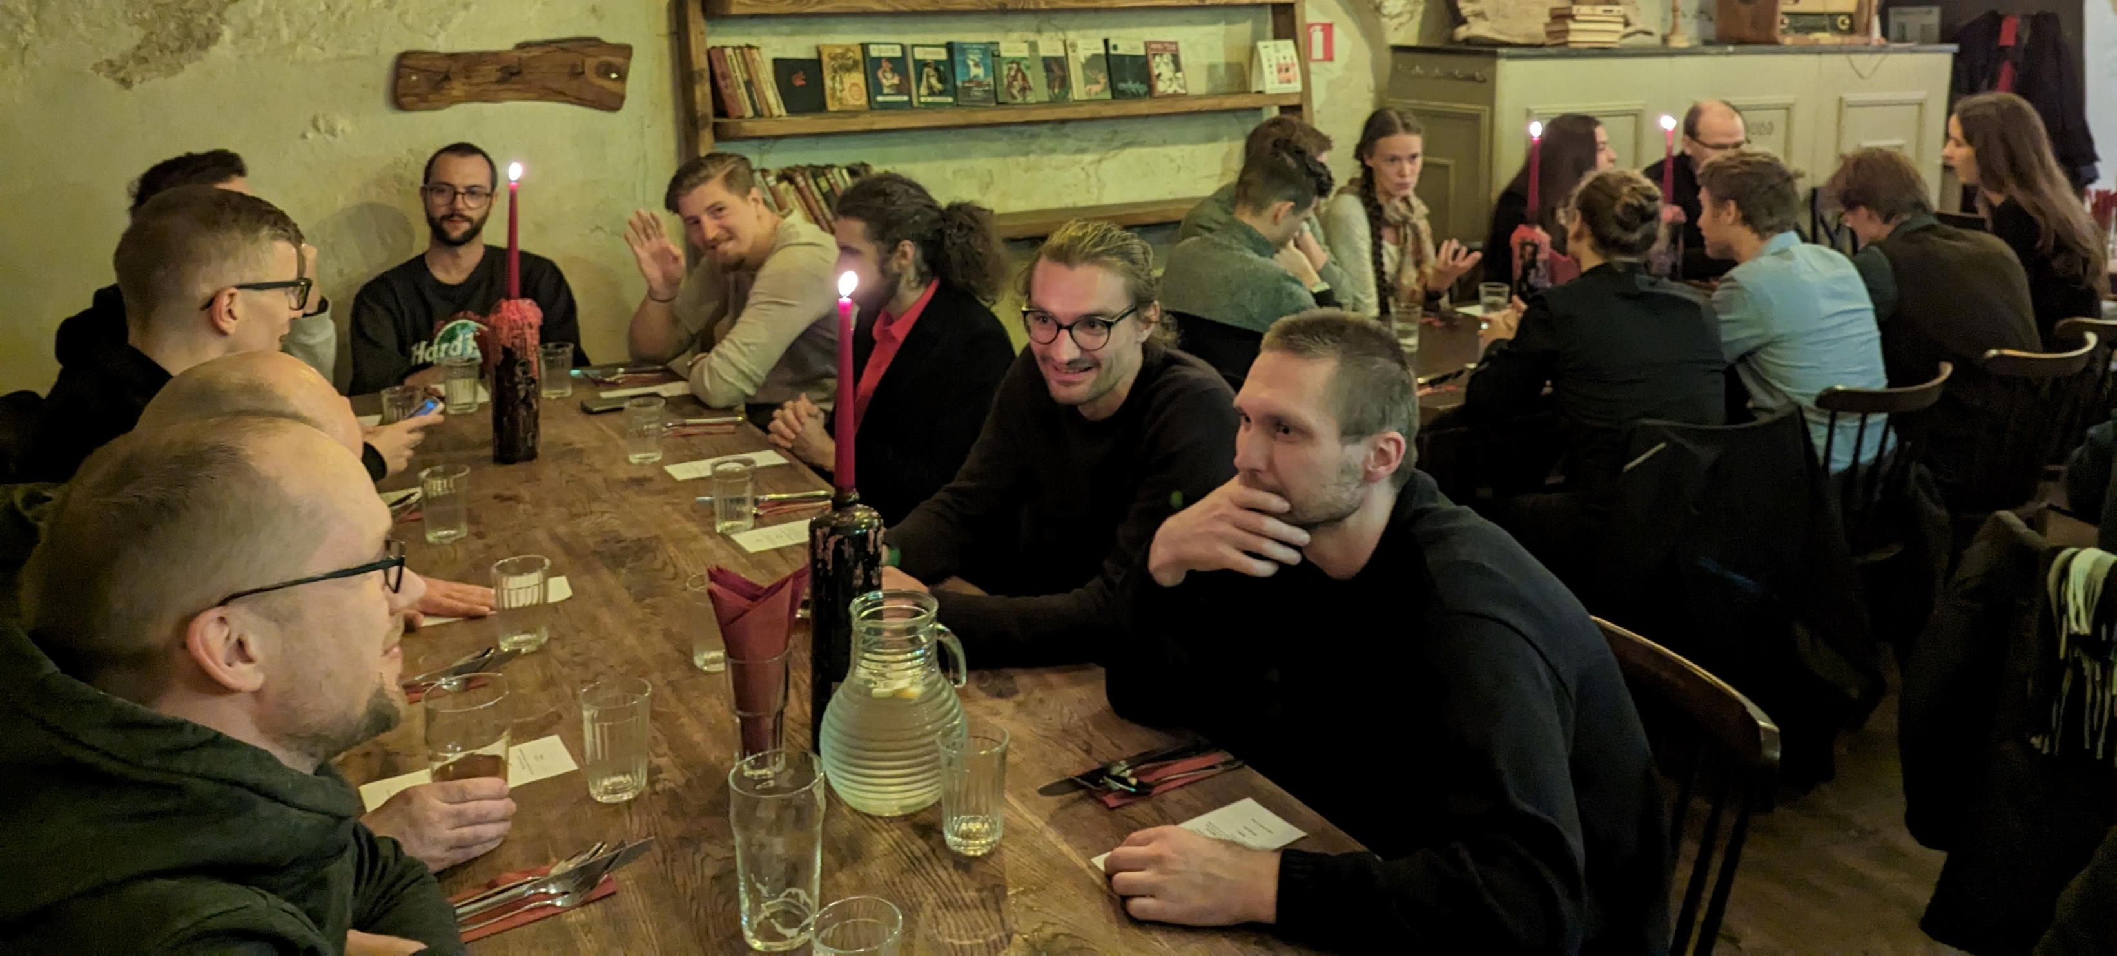
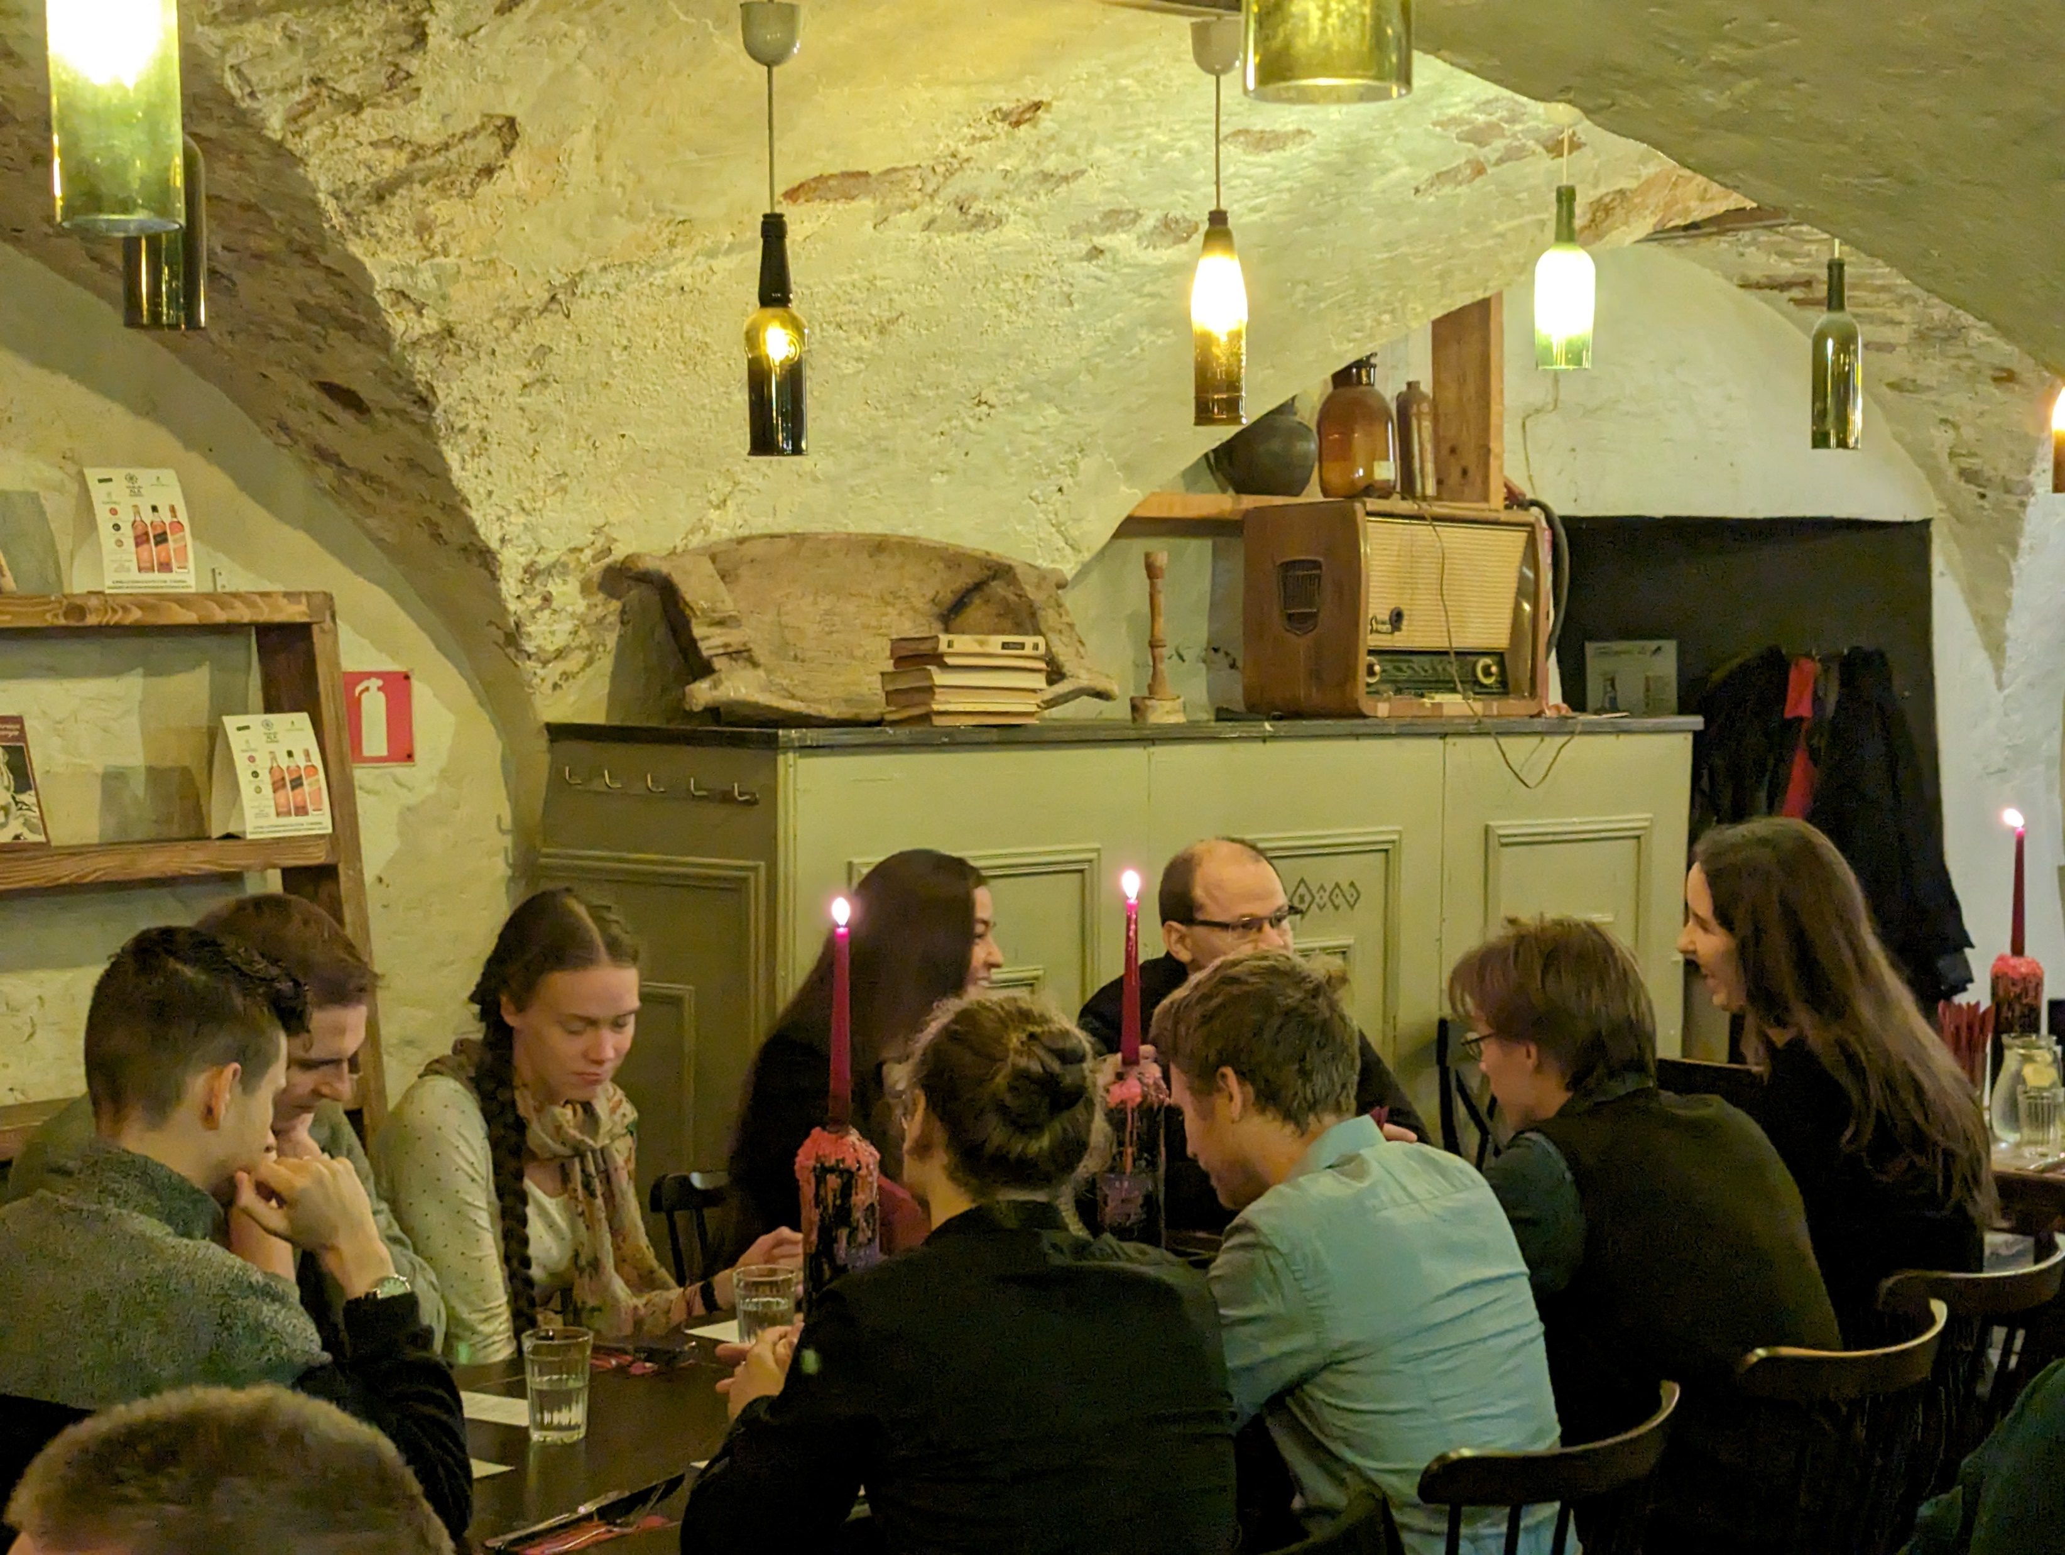
Social Dinner
Folkklubs ALA Pagrabs (Peldu iela 19, Riga)

Slide 6
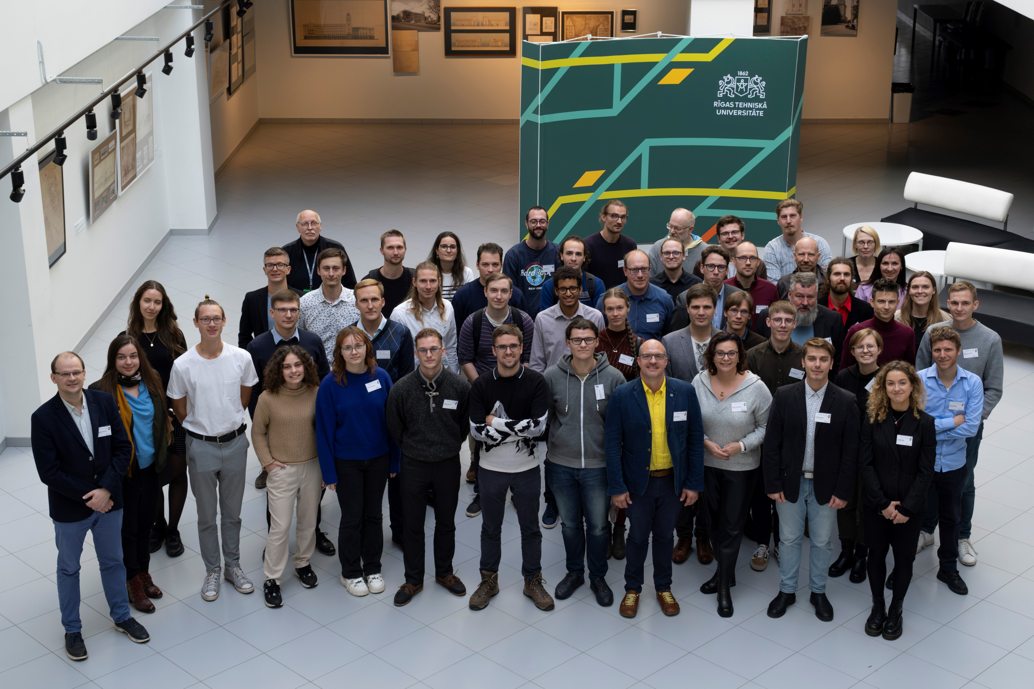
Participants
60+
26 talks
20 posters

Slide 7

Organizers
https://indico.cern.ch/category/10023/

Slide 8
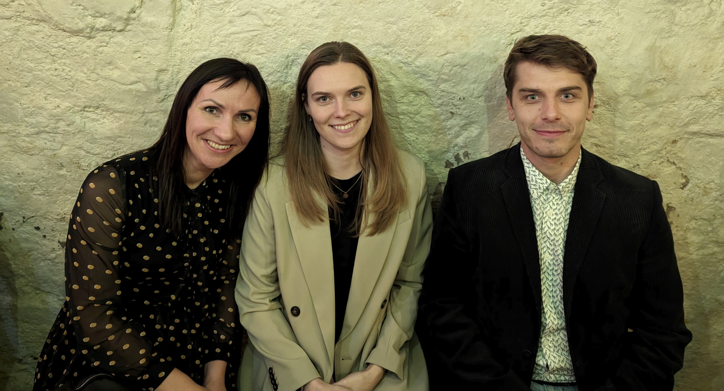
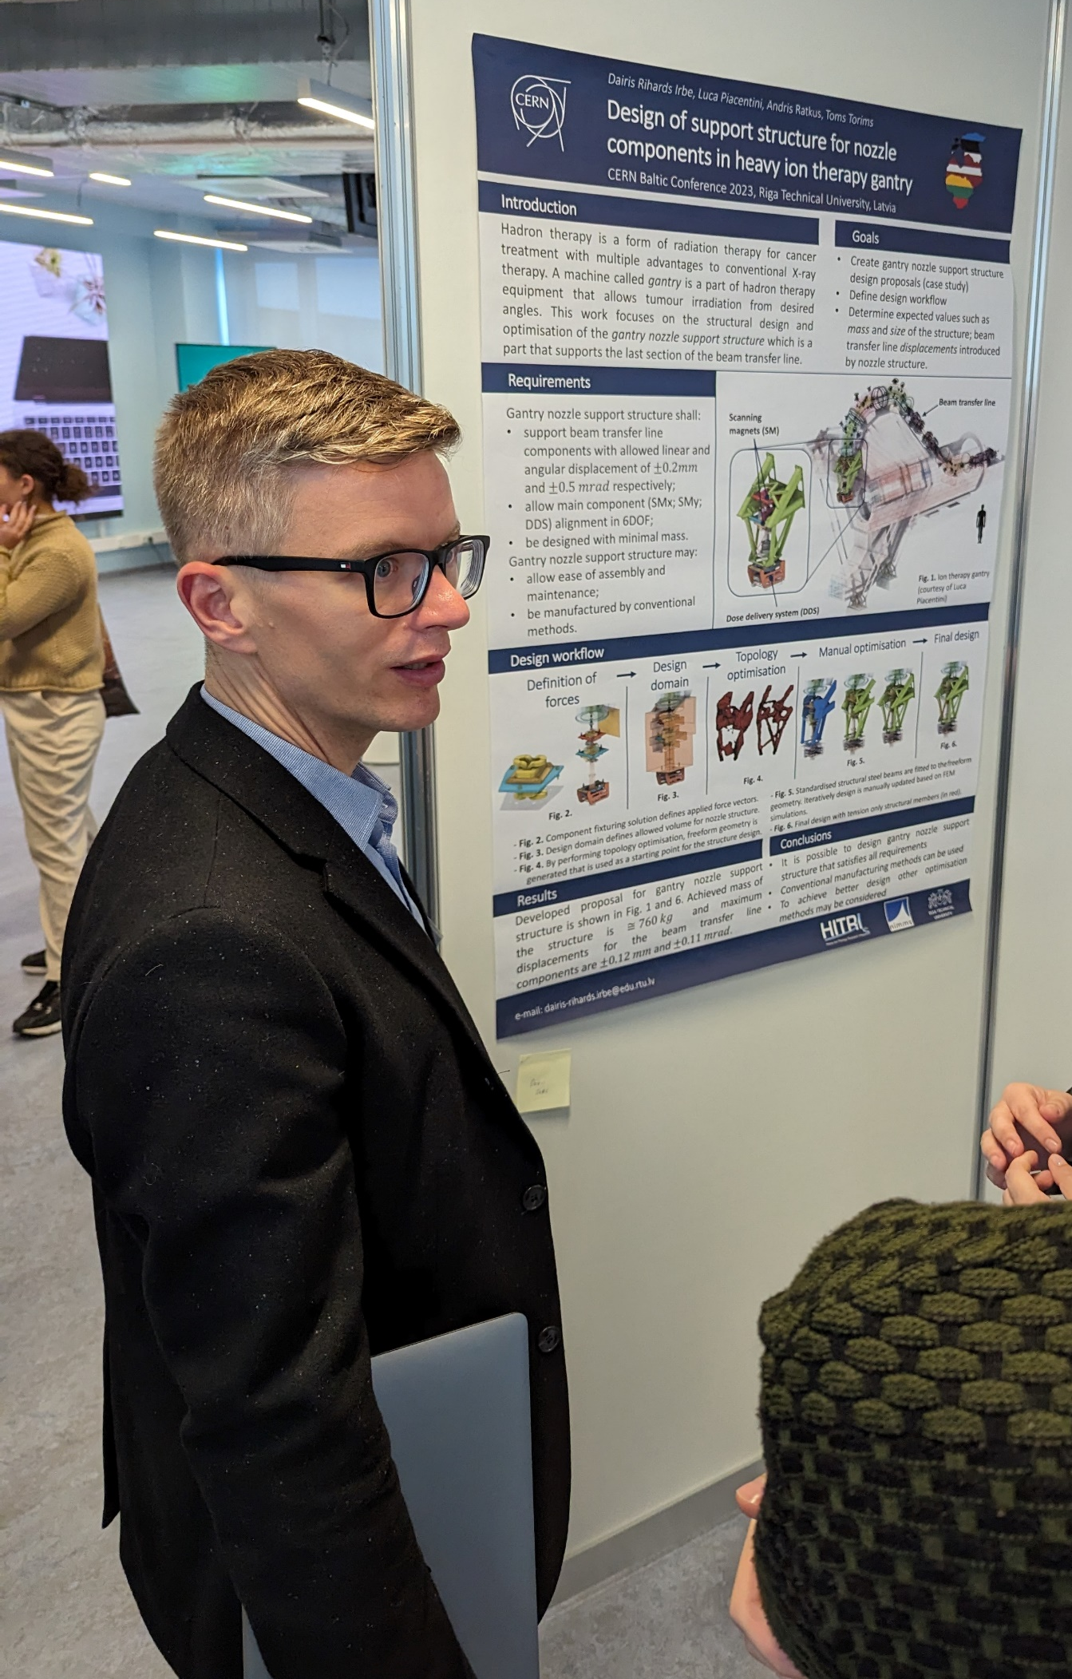
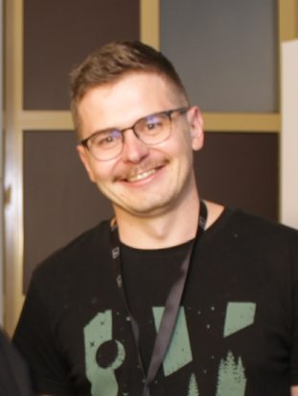
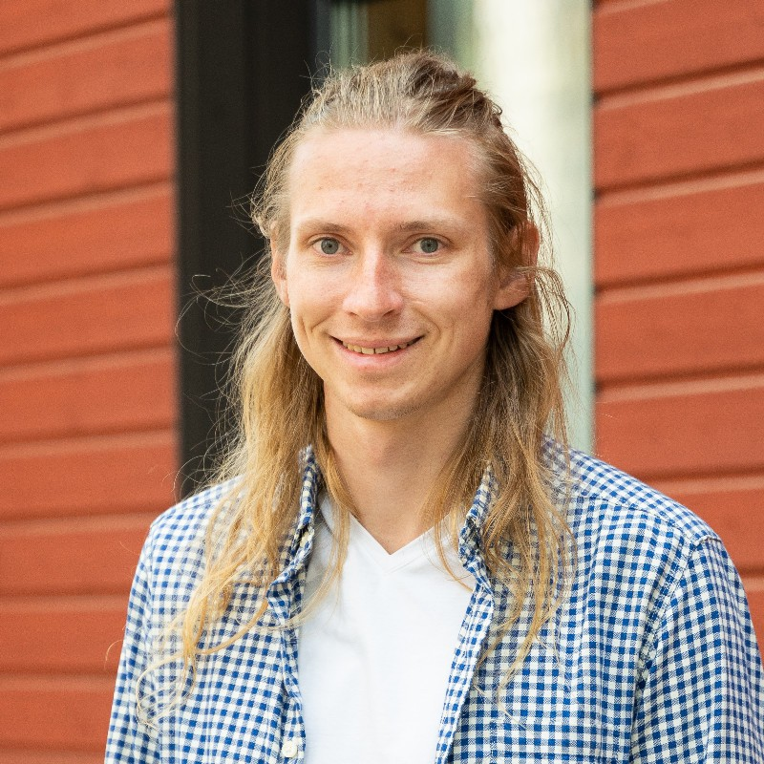

Local Organizing Committee
Dr. Karlis Dreimanis
Dr. Andris Ratkus
Ms Gundega Selga Horste
Ms Silva Vitola
Mr Andris Potrebko
Mr Kristaps Palskis
The conference is financed by RTU Institute of Particle Physics and Accelerator Technologies and CERN National Contact Point of Latvia.

Slide 9
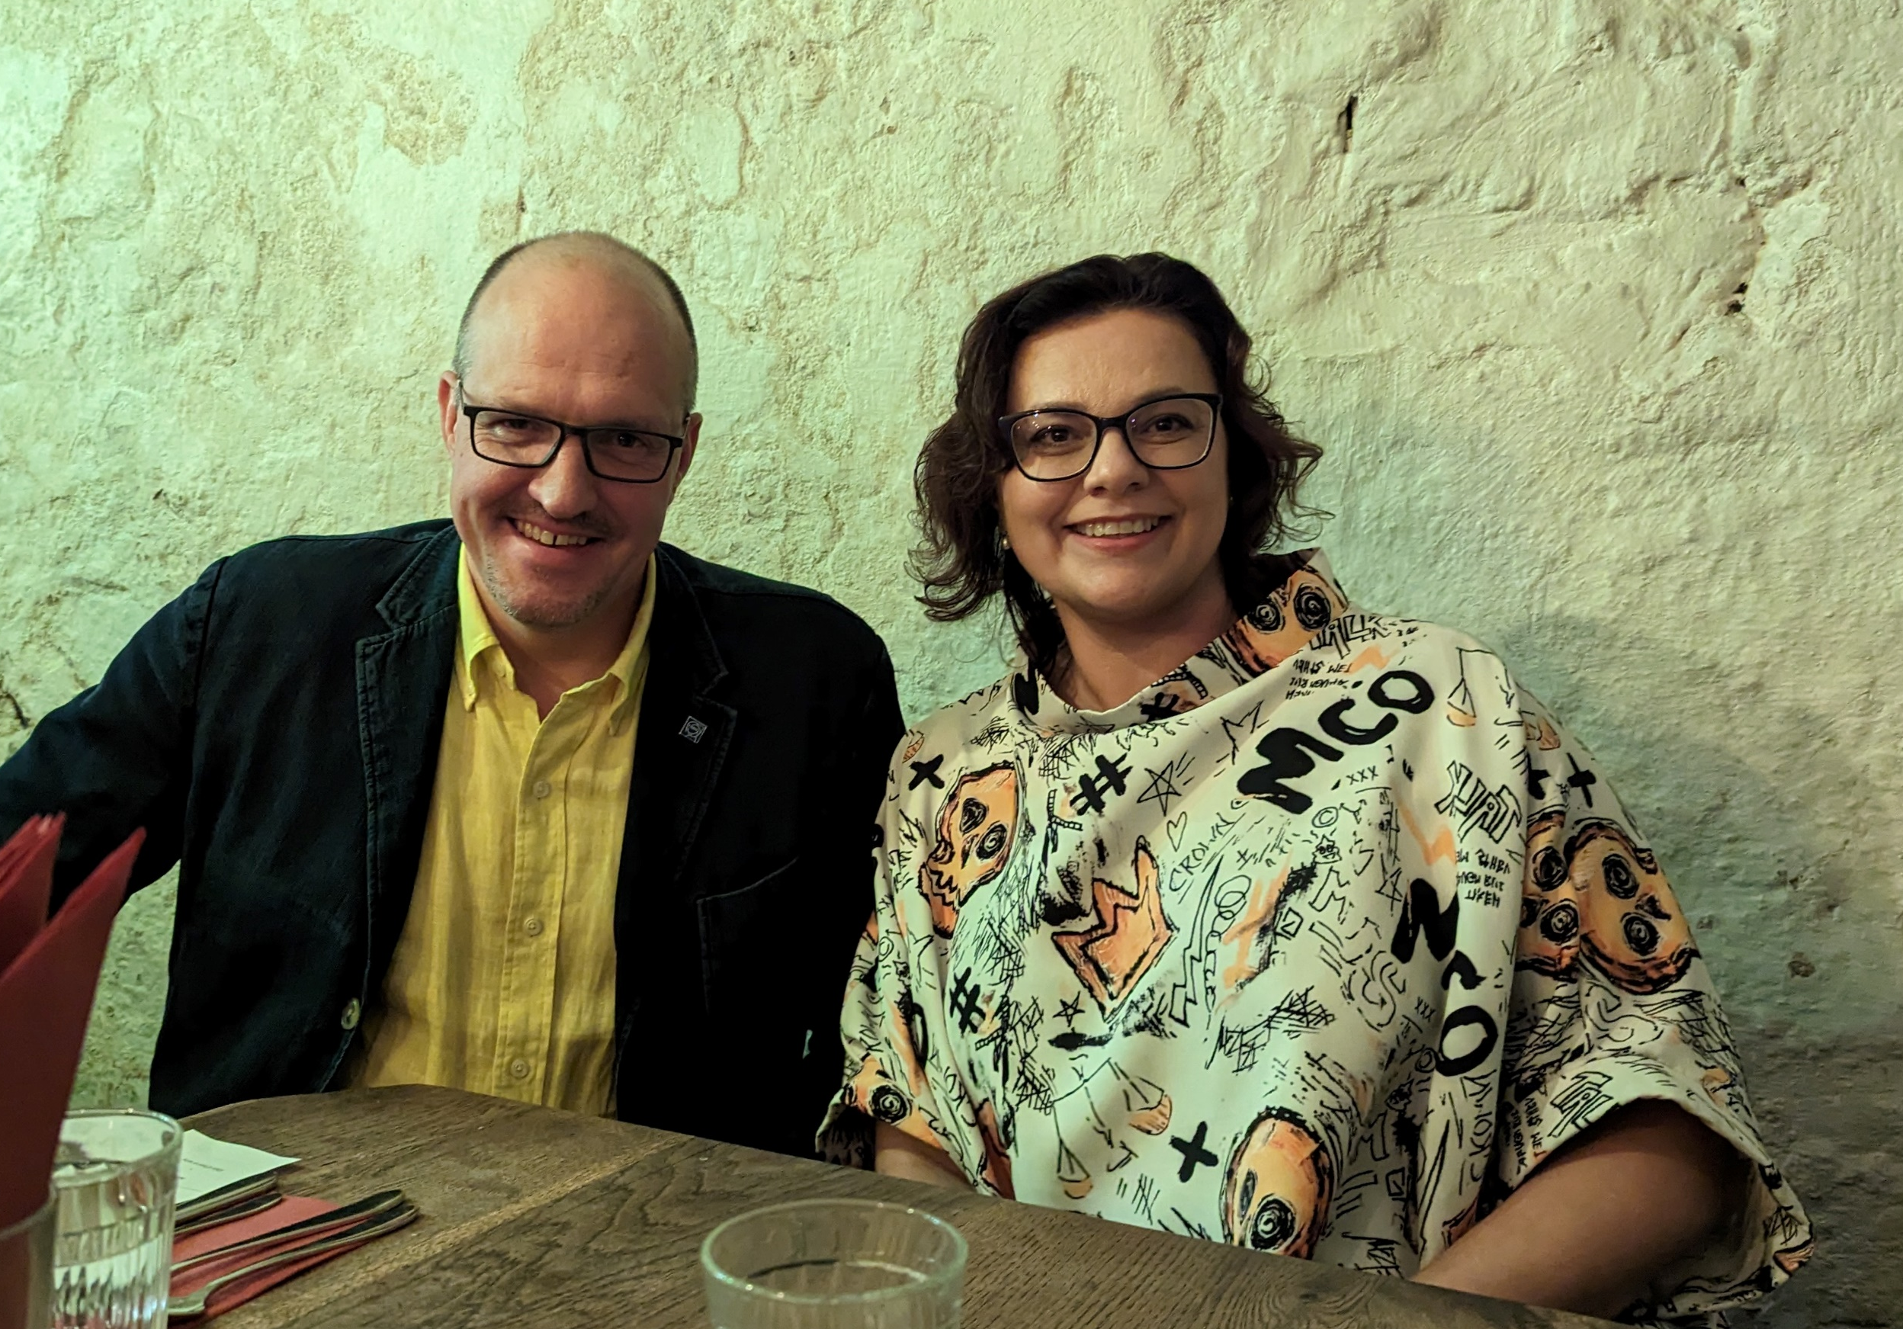

Special thanks goes to
Prof. Toms Torims
Riga Technical University, CERN

Slide 10

Special thanks go to Scientific Committee
Prof. Toms Torims (RTU, LV)
Prof. Mārcis Auziņš (UL, LV)
Dr. Maurizio Vretenar (CERN)
Dr. Martijn Mulders (CERN)
Dr. Karlis Dreimanis (RTU, LV)
Dr. Jevgenijs Proskurins (RSU, LV)
Dr. Aleksejs Klokovs (VIRAC, LV)
Dr. Uldis Valainis (DU, LV)
Prof. Fjodor Sergejev (TalTech, EE)
Prof. Veronika Zadin (UT, EE)
Prof. Mario Kadastik (NICPB, EE)
Dr. Brigita Abakevičienė (KTU, LT)
Dr. Aurelijus Rinkevičius (VU, LT)
Dr. Erika Korobeinikova (LSMU, LT)
Dr. Augustinas Stepšys (VDU, LT)
Dr. Gediminas Stankūnas (LEI, LT)
CERN
Baltic Group

Slide 11
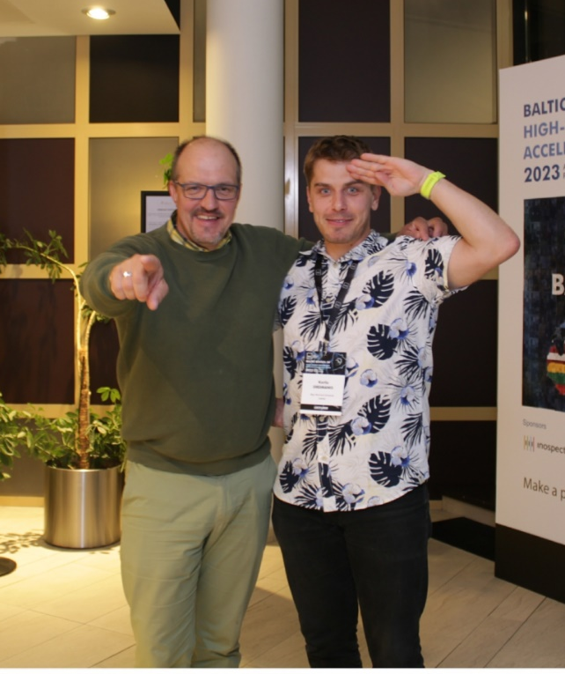

4th CERN Baltic Group School 2024
See you in Latvia!

Slide 12

4th CERN Baltic Group Conference 2024
See you in Estonia!

Slide 13

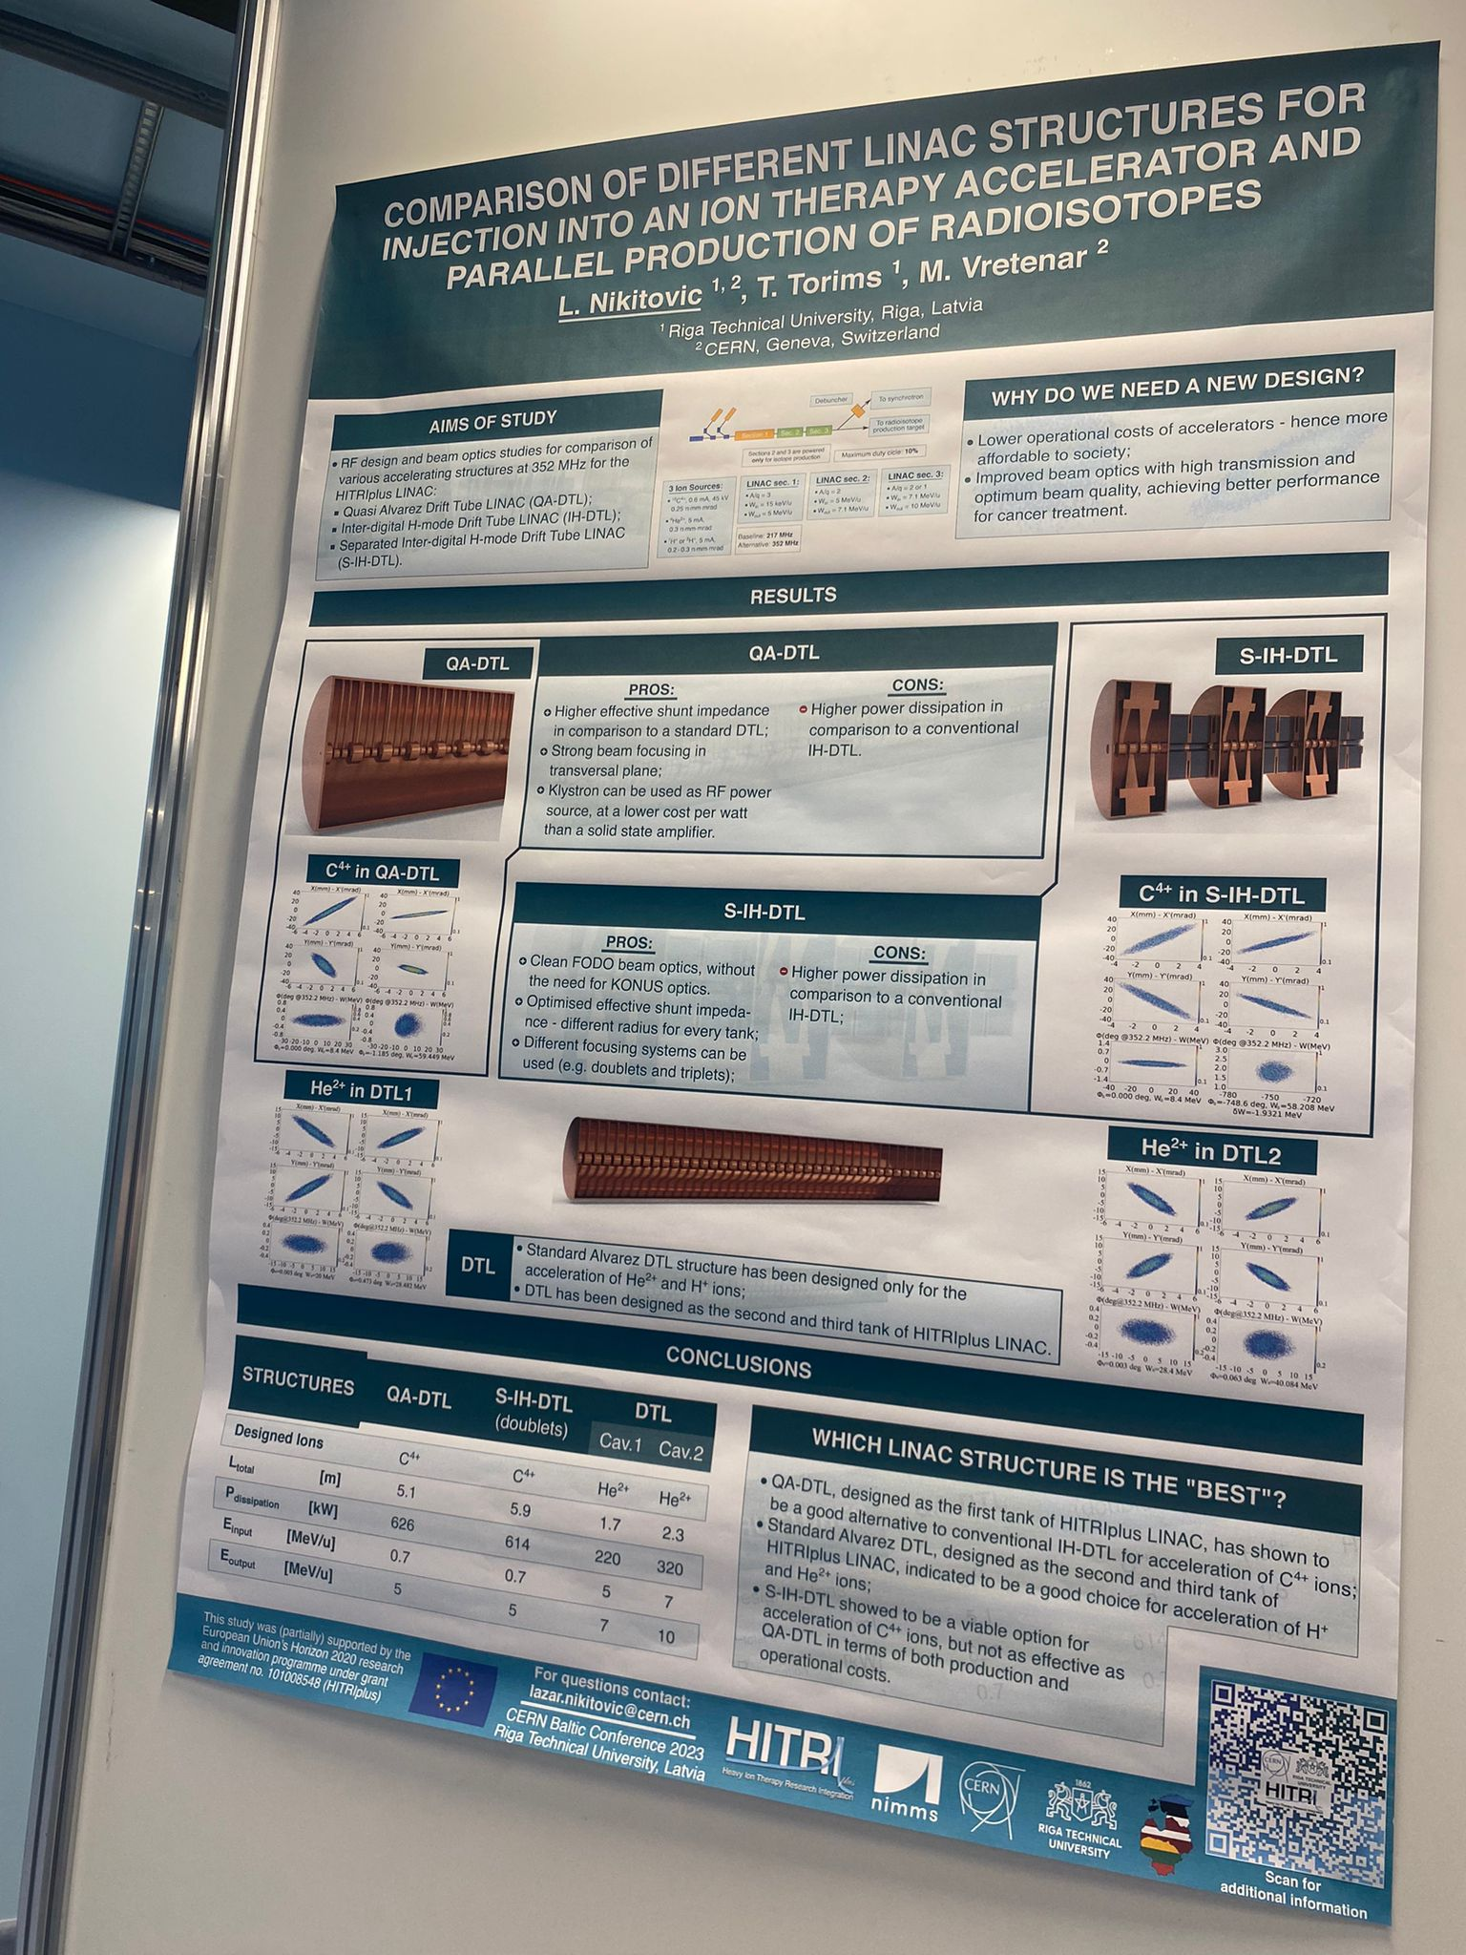
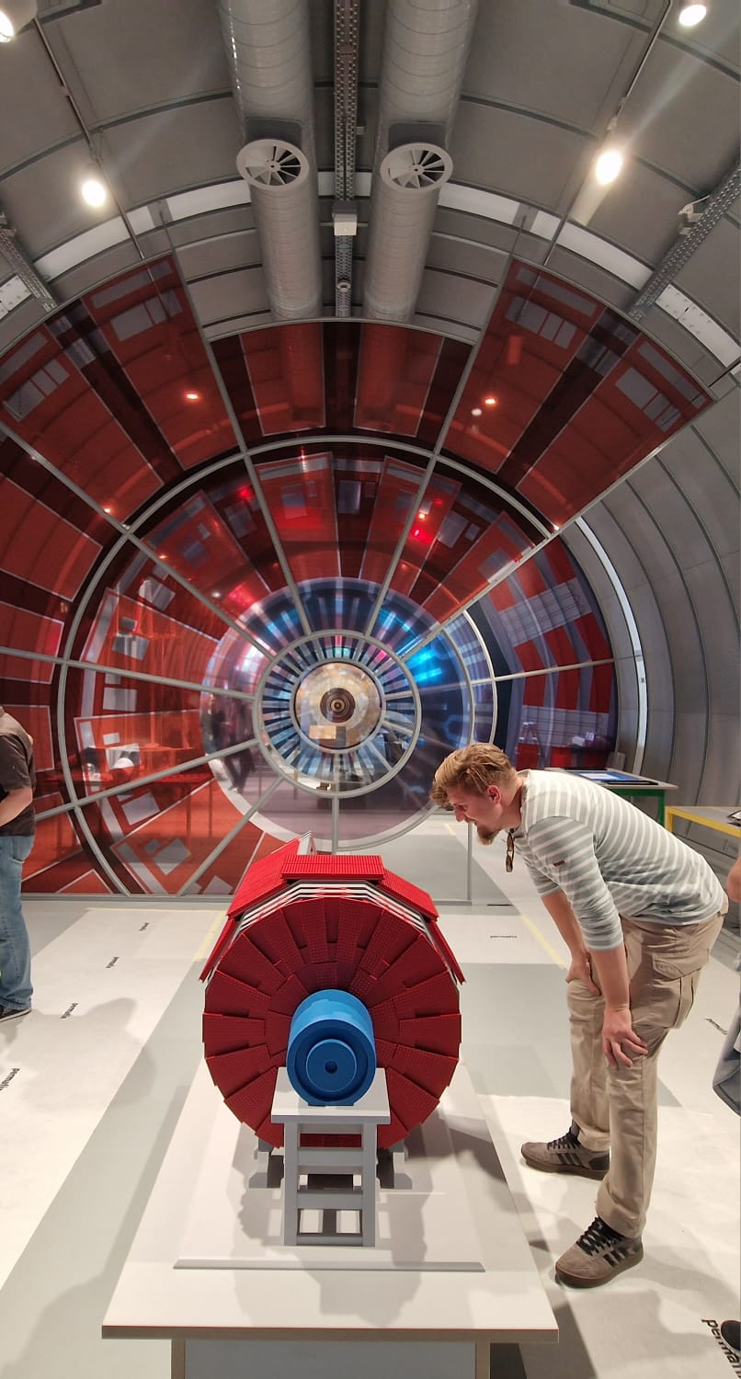

Best poster award 2023
Lazar Nikitovic
«Comparison of different LINAC structures for injection into an ion therapy accelerator and parallel production of radioisotopes»

