Slide 1

Comparison of Two Lattices for Z with 4 IPs
D. Shatilov
Acknowledgments: K. Oide, P. Raimondi, M. Hofer
168th FCC-ee Optics Design Meeting
CERN, 01 Jun 2023

Slide 2
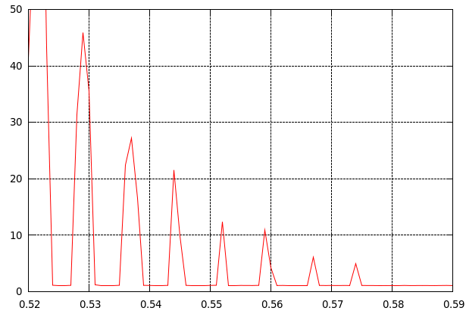
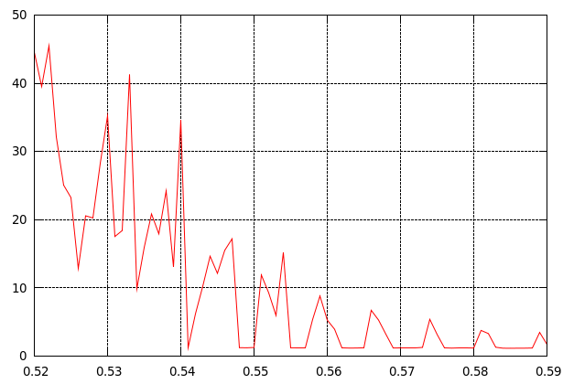
Parameters
Coherent beam-beam instability
 | Baseline (K. Oide, 25.04) | Alt. lattice (P. Raimondi)
Perimeter [m] | 90658.8 | 91474.9
Momentum comp. [10⁻⁵] | 2.86 | 2.37
Damping partitions | 1 / 1 / 2 | 1.54 / 1 / 1.46
Energy loss / turn [MeV] | 39.4 | 33.1
Bunch population [10¹¹] | 1.5
RF voltage, 400 MHz [MV] | 79.2 | 80
Hor. emittance [nm] | 0.71 | 0.34
Ver. emittance [pm] | 1.4 | 1
Energy spread (SR/BS) [%] | 0.039 / 0.092 | 0.043 / 0.120
Bunch length (SR/BS) [mm] | 5.6 / 13.3 | 5.5 / 15.4
β *_{x} /β *_{y} [mm] | 110 / 0.7 | 150 / 0.8
β *_{x} /β *_{y} dynamic [mm] | 107 / 0.52 | 146 / 0.56
Length of int. area [mm] | 0.58 | 0.47
Synchrotron tune | 0.0288 | 0.0272
Betatron tunes (full ring) | 0.1584 / 0.2
Δν_{x} / Δν_{y} (full footprint size) | 0.0082 / 0.293 | 0.0084 / 0.291
ε_{x} / ε_{x0}
ν_{x}
ε_{x} / ε_{x0}
ν_{x}
D. Shatilov 168th FCC-ee Optics Design Meeting, CERN 2

Slide 3
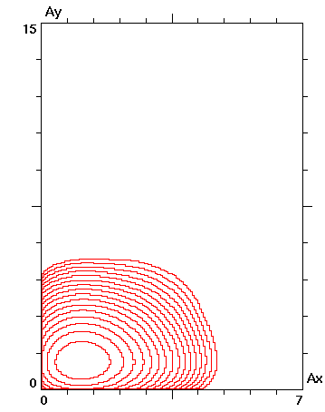
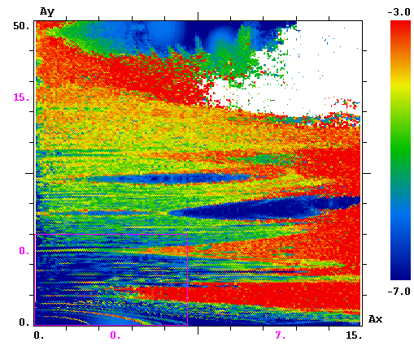
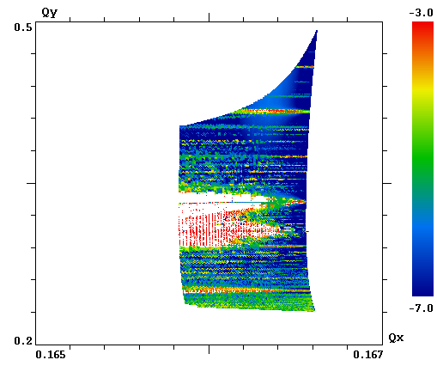
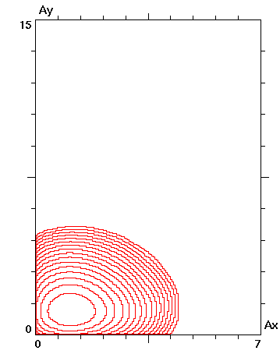
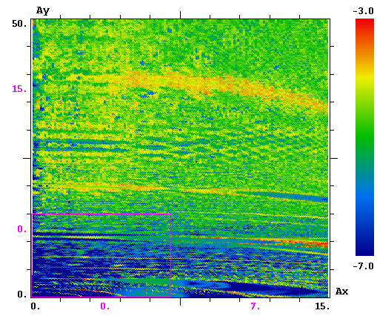
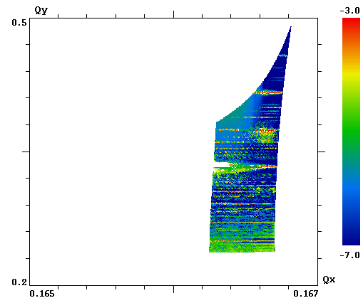
Ideal Case w/o Errors
Equilibr. Density FMA for on-momentum particles
ε_{y} /ε_{y0} = 1.2
Baseline
ε_{y} /ε_{y0} = 1.1
Alternative
D. Shatilov 168th FCC-ee Optics Design Meeting, CERN 3

Slide 4
Misalignments of Arc Sextupoles
It was found that the main effect comes from the vertical misalignments (explicit betatron coupling).
Horizontal misalignments which result in ∼1% beta-beating add very little to this. Therefore, in what follows, we will consider only vertical misalignments.
Baseline: sigma = 15 mkm => ε_{y} = 0.5 pm, κ = 0.07 %
No other vertical excitation was applied. The nominal emittance “at collision” is 1.4 pm.
Alternative: sigma = 30 mkm => ε_{y} = 0.6 pm, κ = 0.18 %
Additional vertical noise has been applied, which adds 0.4 pm. Thus we have the nominal emittance of 1 pm without collision.
Weak-strong simulations, where the opposite (strong) bunch has the “nominal” emittance: 1.4 pm for the baseline and 1 pm for the alternative lattice.
D. Shatilov 168th FCC-ee Optics Design Meeting, CERN 4

Slide 5
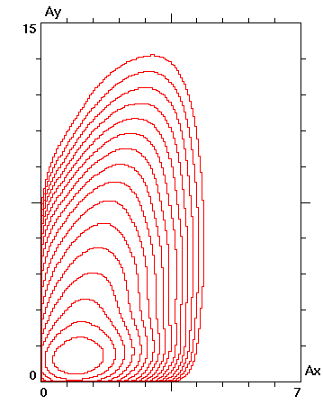
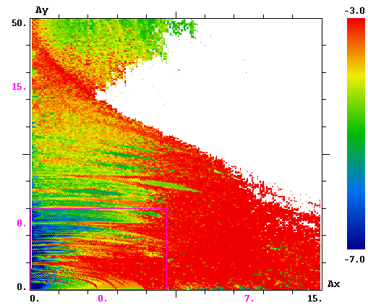
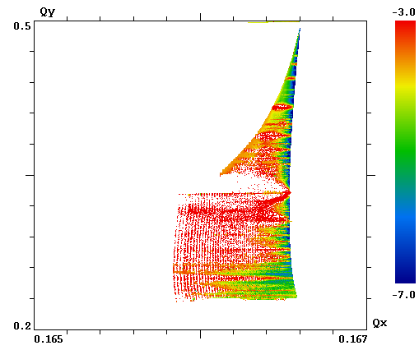
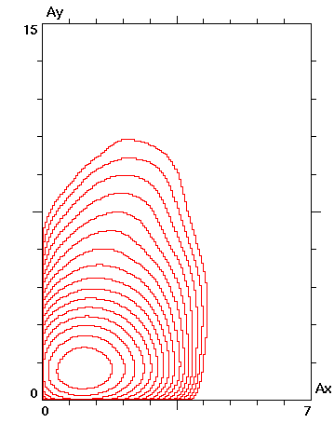
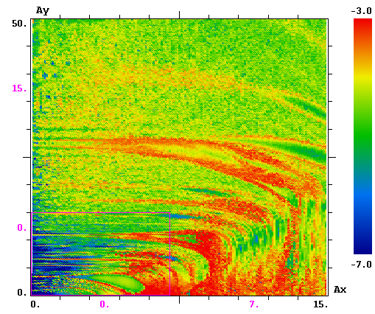
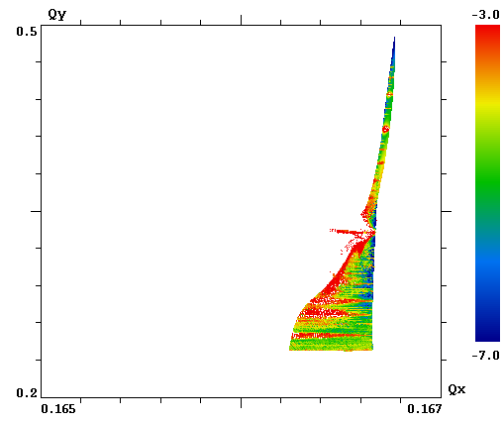
Beam-beam with Misalignments
Equilibr. Density FMA for on-momentum particles
ε_{y} /ε_{y0} = 1.7
Baseline
ε_{y} /ε_{y0} = 1.4
Alternative
D. Shatilov 168th FCC-ee Optics Design Meeting, CERN 5

