Slide 1
Update on Task 3.2
Concept of a SC solenoid
Michal Duda (PSI)
1/06/2023

Slide 2
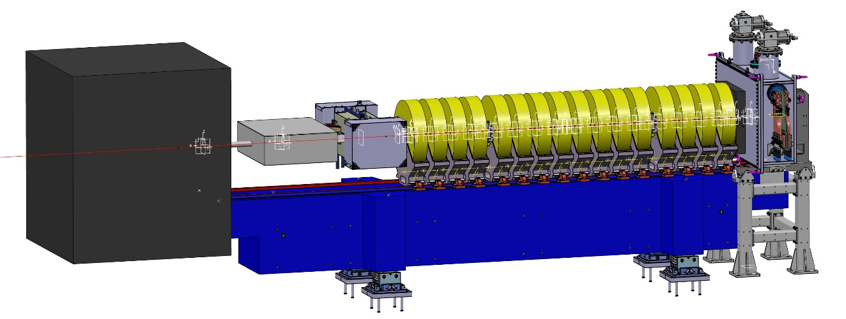
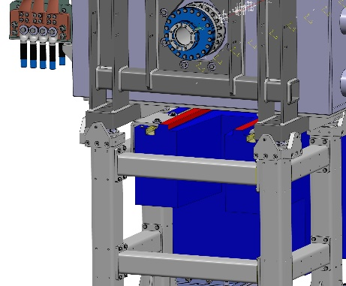
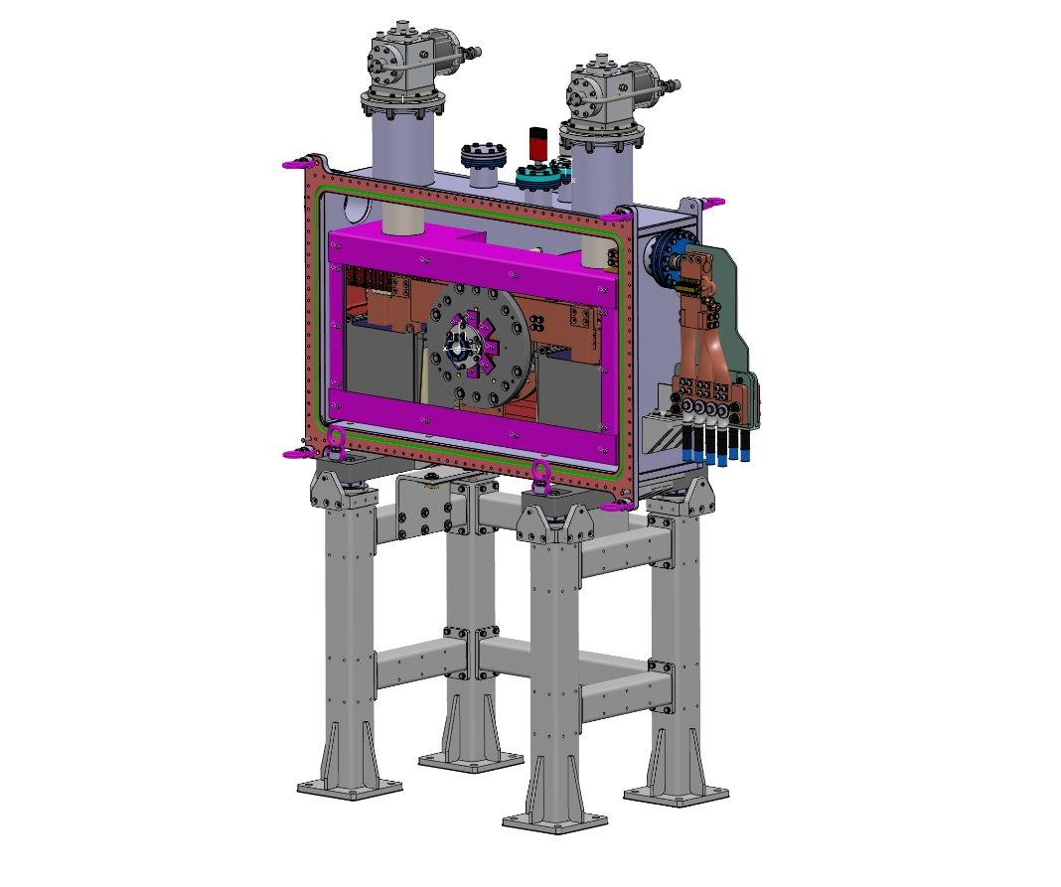
HTS solenoid for P³ experiment
Lead shield
and gate valve
DN63CF wide bore flange
DN160CF bellow
Mineral girder
Experimental setup
HTS solenoid assembly
Warm wide bore through tube
Vacuum chamber
Thermal shielding
Cryo coolers
Electrical and thermal Leads
Thermal lead buffers
Support structure
Ground support frame
Backbone frame for vacuum chamber

Slide 3
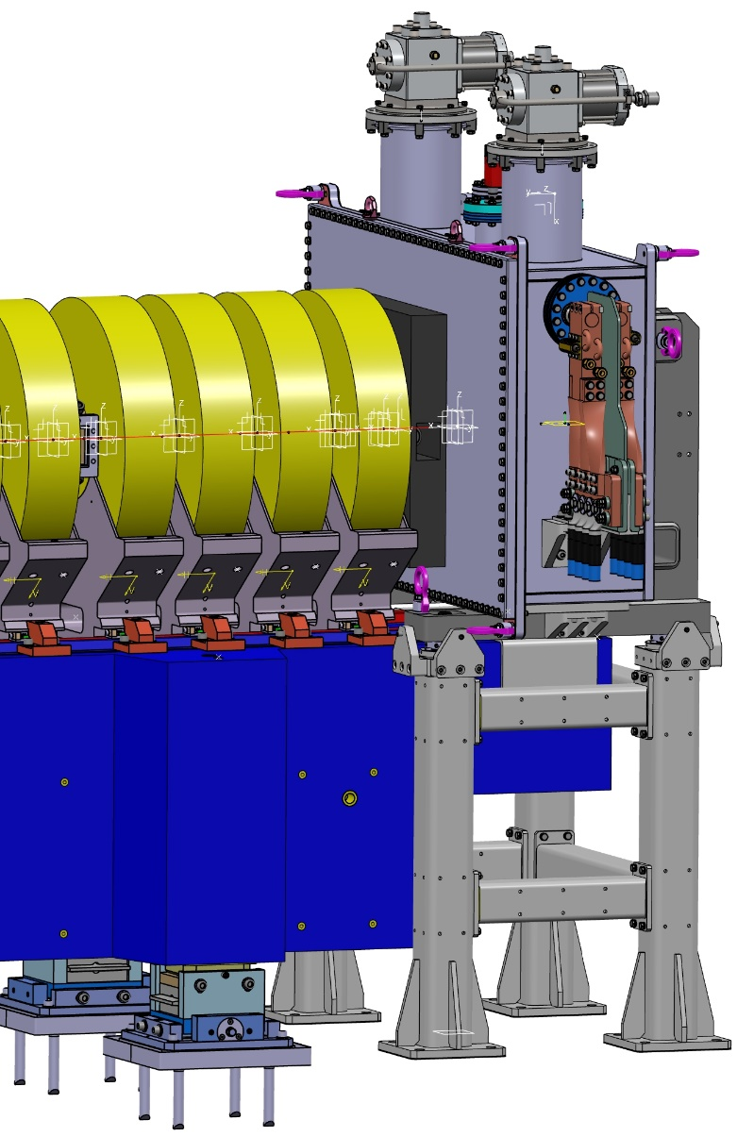
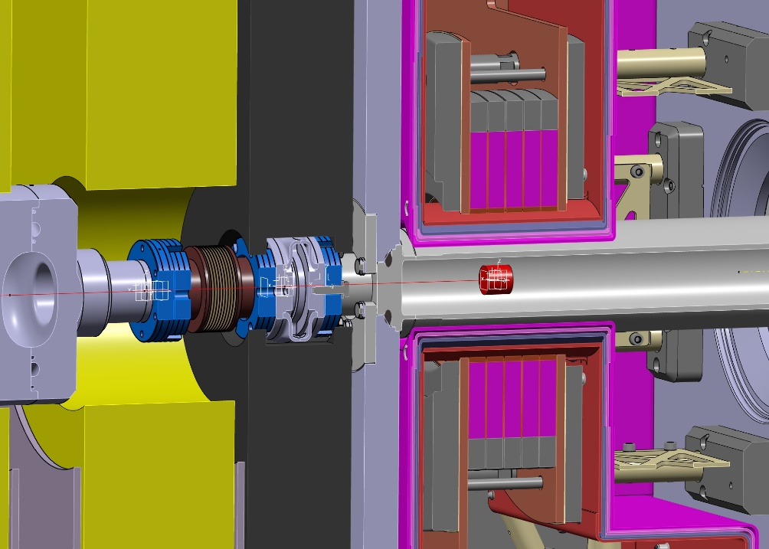
Specification Requirements
Needs of fine adjustment
of vacuum chamber
DN40CF gate valve
Lead shield
DN40CF bellow
Shielding
Chamber
144 mm

Slide 4
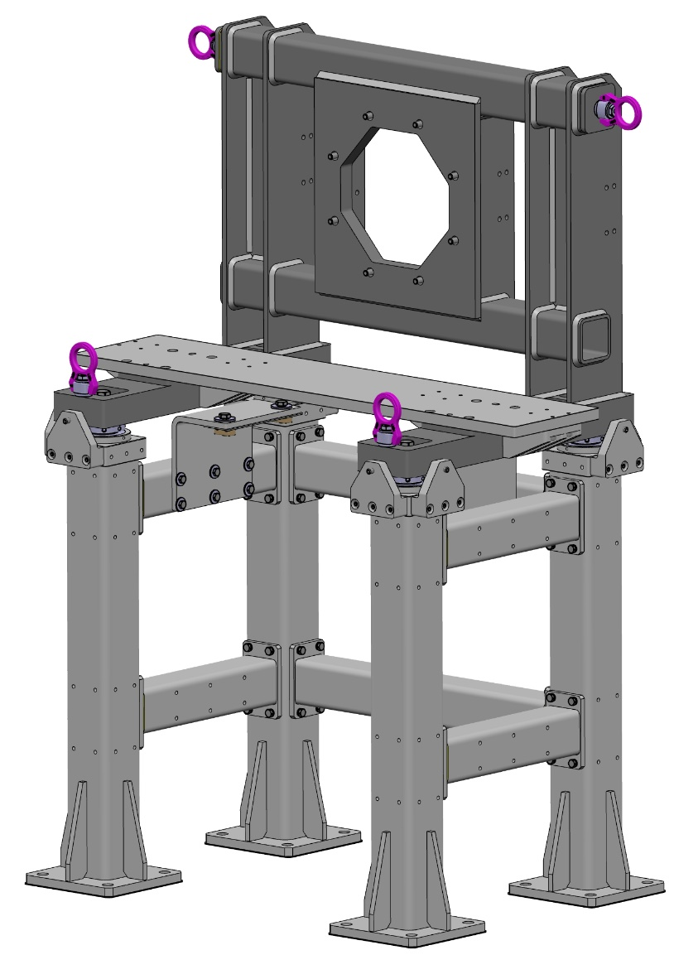

Support Structures
Crane
hooks
Weight of chamber assembly ~ 1 Ton
Force between NC and SC solenoids 30 kN
Welded frames from ▢80 / D6 and
▢100 / D8 stainless steel tubes
Solenoid support directly in contact
with backbone plate
Earthquake and deviation analysis
Sub mm adjustment
Vertical /
horizontal
Tilt
Remachined
support plates
for precise
repositioning
1200 mm
Girder
brackets
(D10)

Slide 5
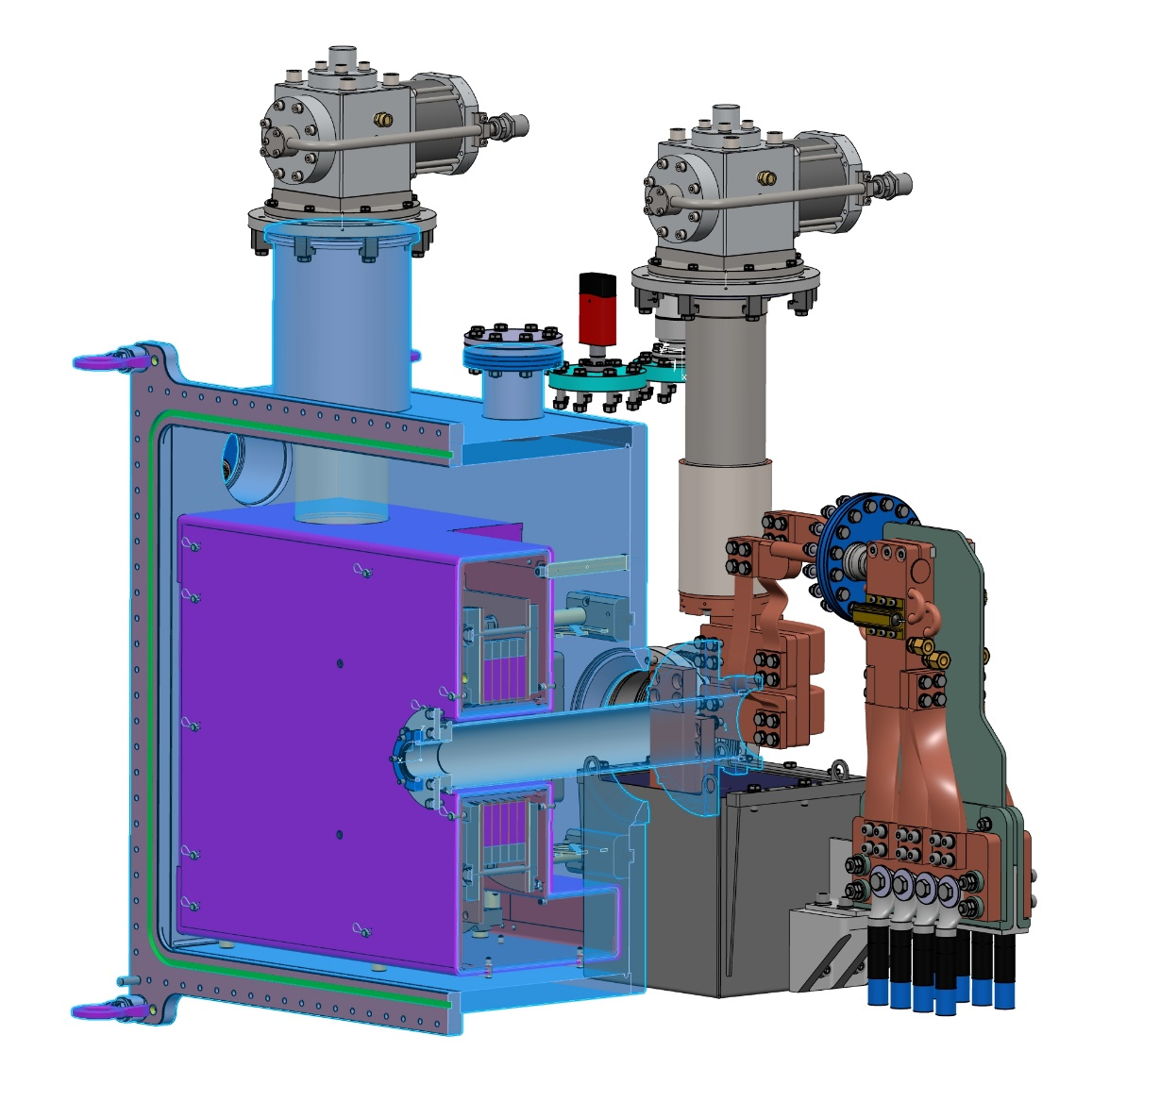
P3 Main Assembly
Cryo cooler 2
Coil assembly
Right buffer
Cryo cooler 1
Leads
Thermal shield
Thermal shielding
case EN AW-1050
and 3 x 10 layer MLI
7 G10 support
pillars
Supports only
Al shield D2
and MLI (7kg)
Air side cabling
and leads
Water cooler
with 50W heater
A = 3 * 300mm²
J = 1.3A/mm²
@ I = 1.17kA
G10 separator
Remachined
vacuum chamber
Warm wide bore
through pipe
Thermal lead buffers

Slide 6
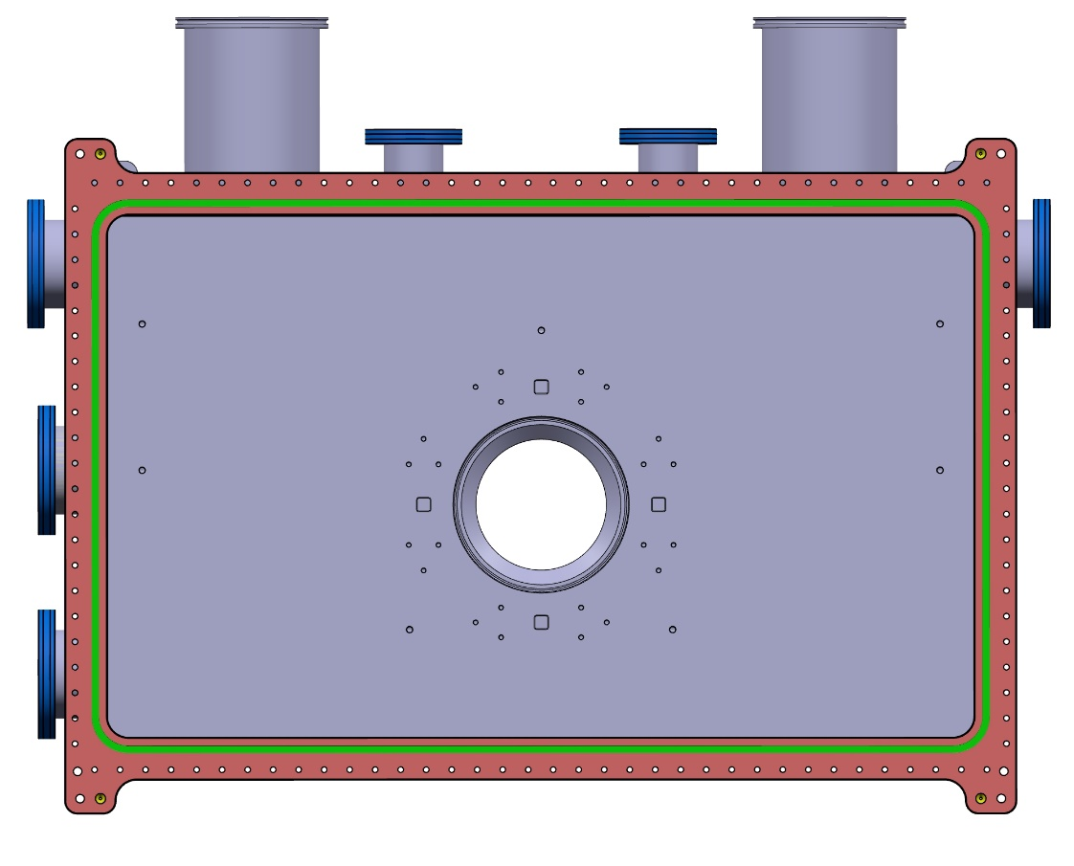
Vacuum Chamber Remachined
DN160ISO-K
ports for
cryo cooler 2
Spare
DN63CF port
Two DN63CF
Ports for
vacuum
gauges
DN160ISO-K
ports for
cryo cooler 1
4 benchmarks
for metrology
DN100CF port
for electrical
feedthrough
instrumentation
DN100CF port
for leads
Remachined
vacuum chamber
D25 welded stainless
steel chamber
Front rim remachined
after welding
O-ring sealed
Spare
DN100CF port
DN100CF port
for vacuum
pumps
7x M8 holes
for thermal Al
Shield mount
24x M6 holes
for coil support pillars
with alignment pockets
DN160CF
upstream
port

Slide 7
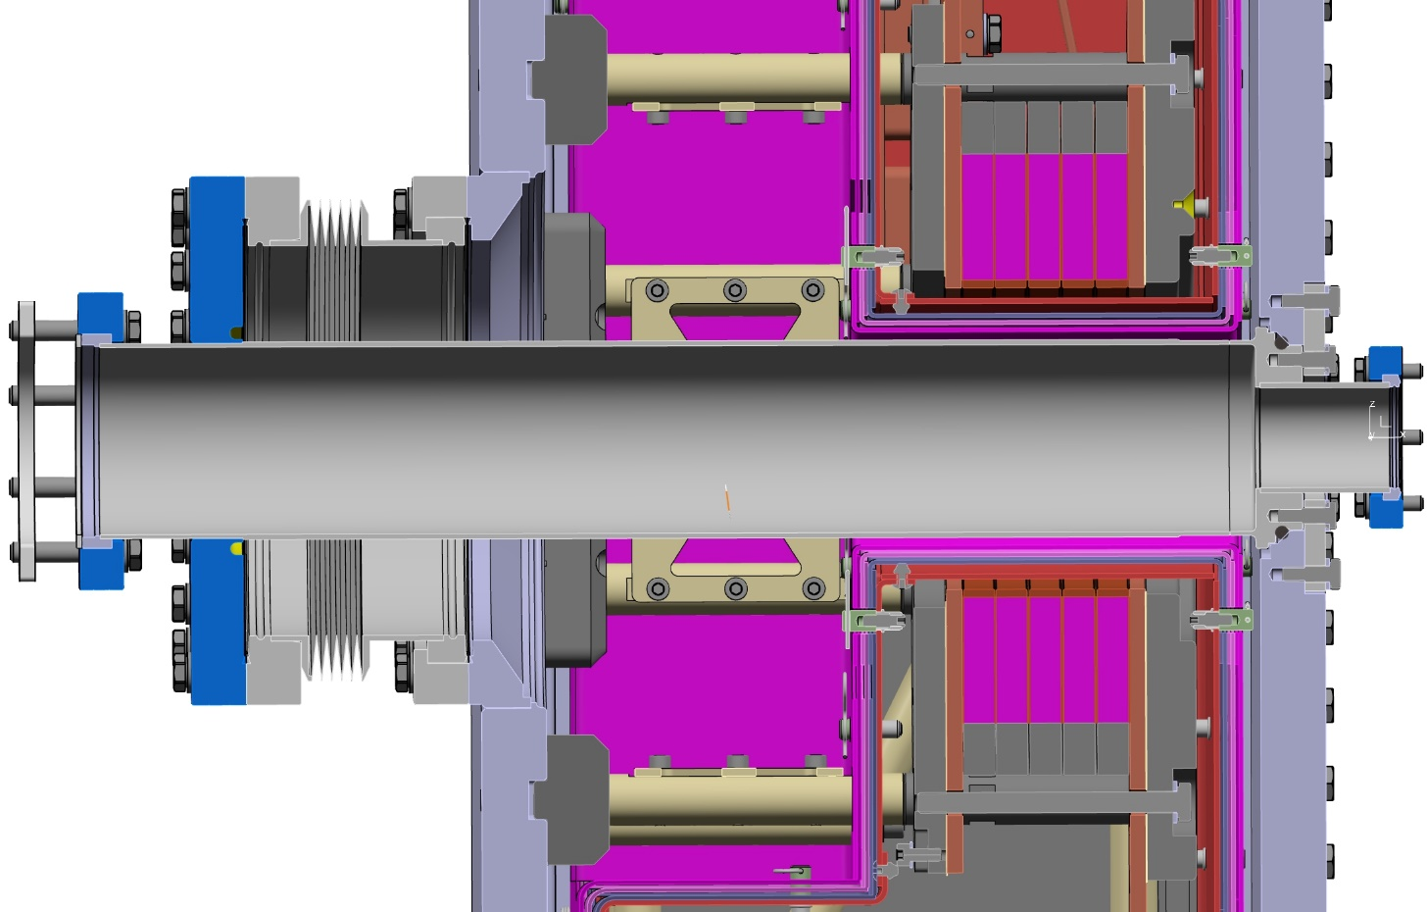
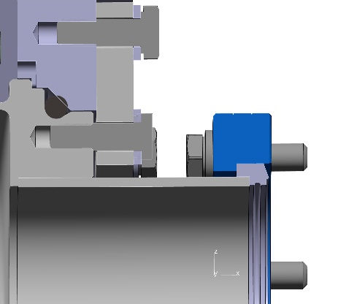
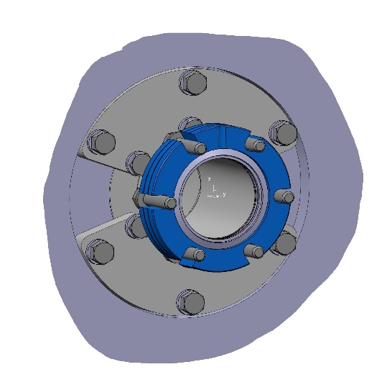
Solenoid Access Bore
DN160CF
Bellow
one side
rotatable
DN40CF-R
wide bore
downstream
flange
O-ring sealed
retention
groove
DN63CF-R
wide bore
upstream
flange
W target insertion
upstream side

Slide 8
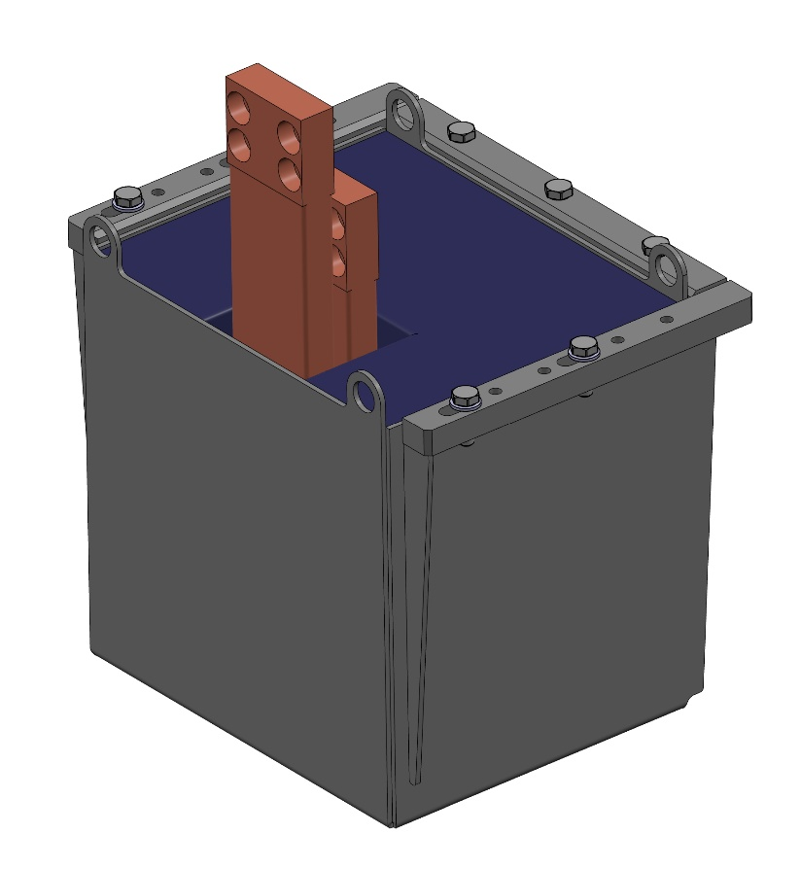
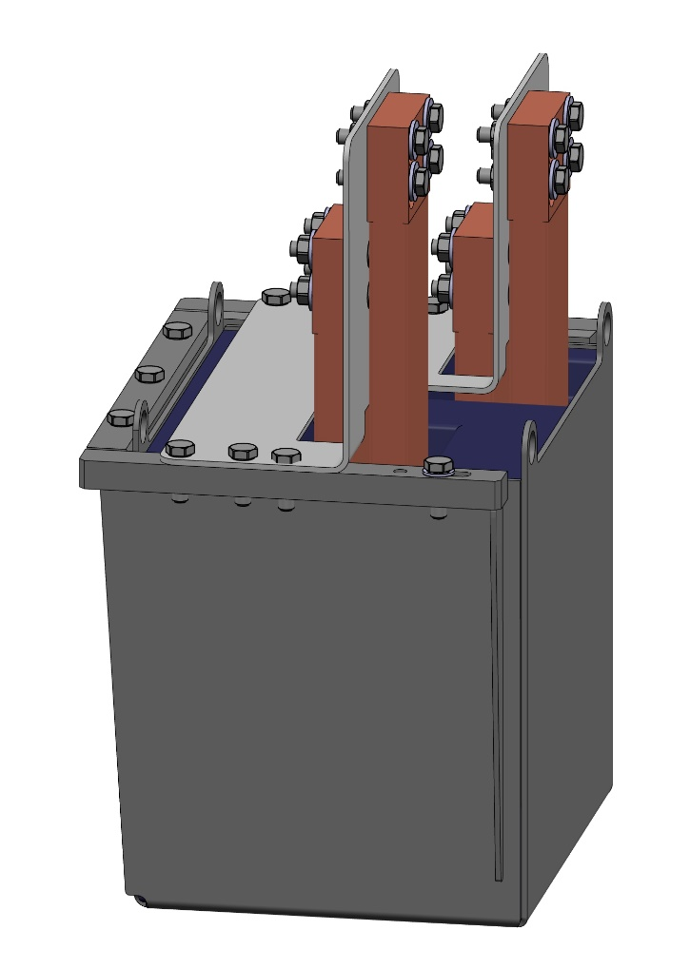
Thermal Lead Buffers: Casting
Melting Pb (119kg) directly in SS cage
Support structure for Cu braids
(allow for some excess length)
Cu braids with solder stop
Submerge Cu braids
Pits (H25) around braids
for better flexibility
4 integrated
crane hooks
To cryo cooler
cold head
To coil pack
terminal
Left thermal
lead buffer
Right thermal
lead buffer

Slide 9
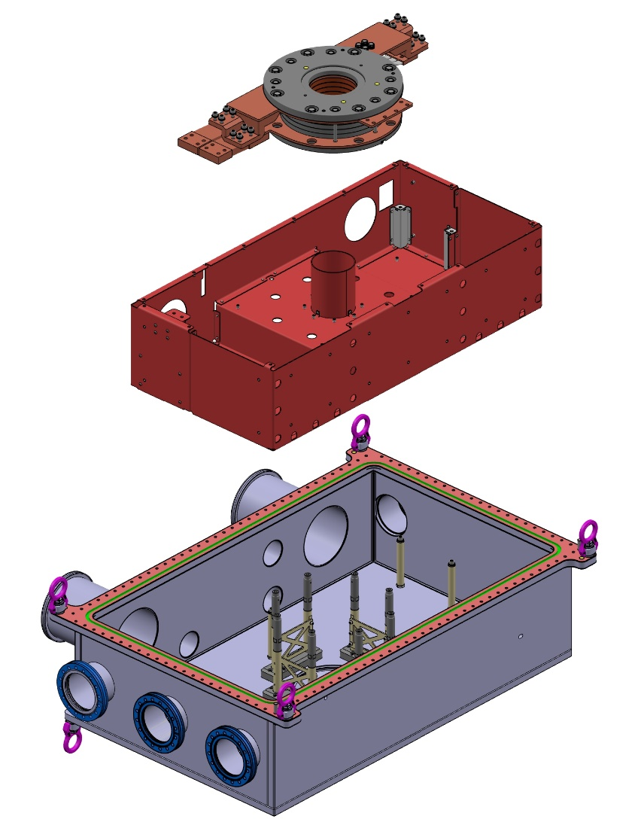
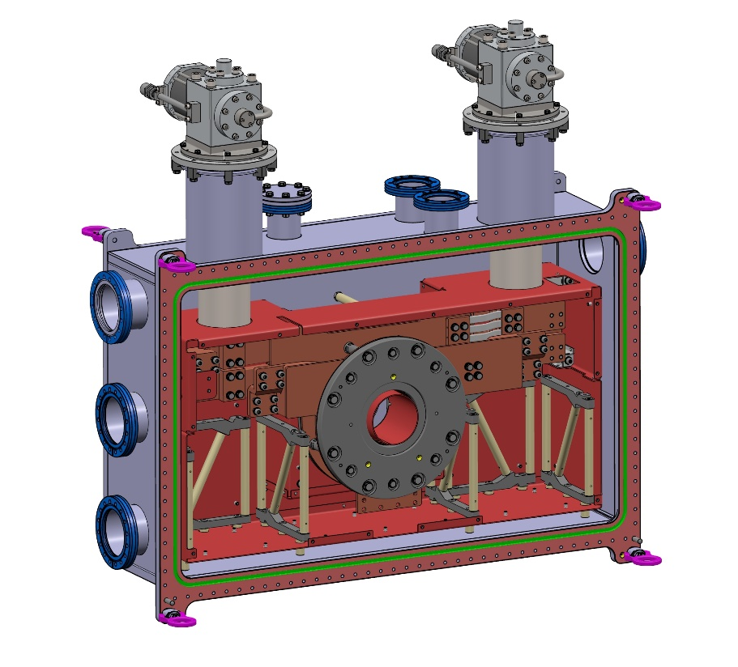
Assembly
Assembly of
Cryo coolers
Flex cables, HTS leads
Supports for lead buffers
Coil pack
in vertical position.
Assembly of
Coil pack supports
Shield supports
Thermal shield
(with MLI, not shown)
Coil pack
in horizontal position.

