Slide 1
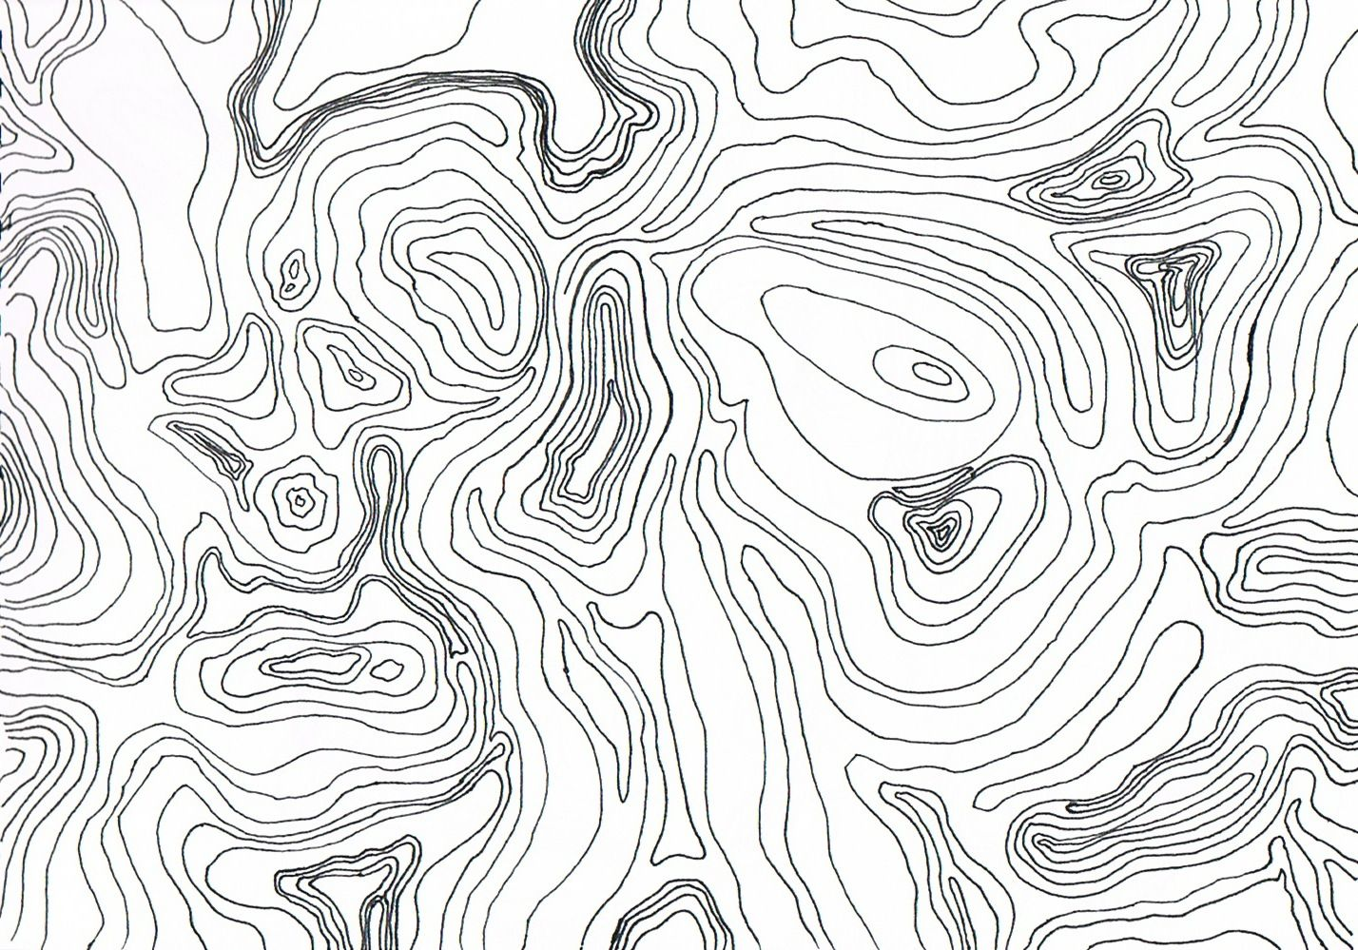
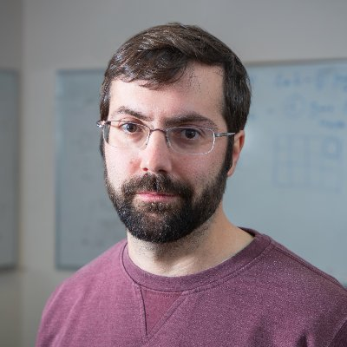


Diego Garcia-Martin^{1,2}@ QTML23
The landscape of QAOA Max-Cut Lie algebras:
Diego Garcia-Martin
I am not Diego.
If you came to see Diego, you are right to be pissed off. I apologize.
1. Theoretical Division, Los Alamos National Laboratory
2. Center for Nonlinear Studies, Los Alamos National Laboratory
Notes:
Thanks for having me and giving me the chance to share with you our recent work on ‘the geometric qml programme’.
As we will see, certain phenomena that are critical for the performance and scalability of QNNs, like barren plateaus and overparametrization, can be linked to the size of the set of unitaries that are reachable by the QNN, the breadth of ‘expressible’ unitares.

Slide 2
gello im diego garxia martin ans today i want to talk about qaoa maxcut.
no, ictually im not siego diego is this awesome and very good looking guy here depicted.

Slide 3
Martin Larocca^{1,2}@ QTML23
The landscape of QAOA Max-Cut Lie algebras
if you go deep, dont forget your initialization!
1. Theoretical Division, Los Alamos National Laboratory
2. Center for Nonlinear Studies, Los Alamos National Laboratory
Notes:
Thanks for having me and giving me the chance to share with you our recent work on ‘the geometric qml programme’.
As we will see, certain phenomena that are critical for the performance and scalability of QNNs, like barren plateaus and overparametrization, can be linked to the size of the set of unitaries that are reachable by the QNN, the breadth of ‘expressible’ unitares.

Slide 4
what is this talk about?

Slide 5
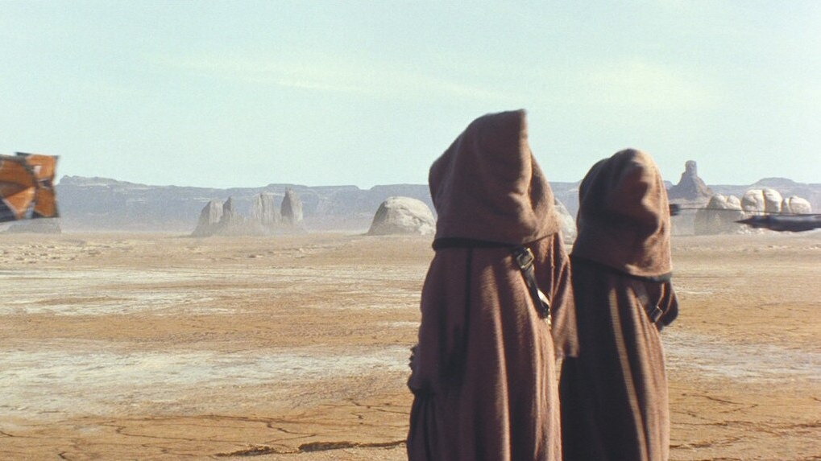
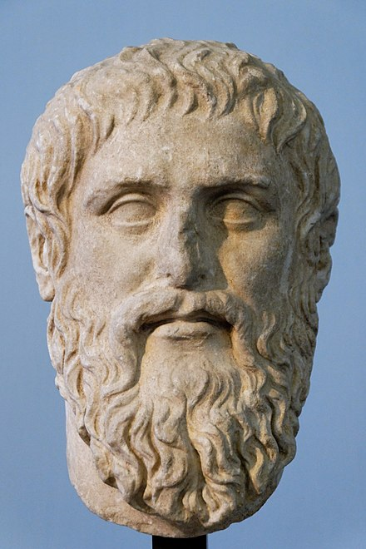
Barren Platos

Slide 6
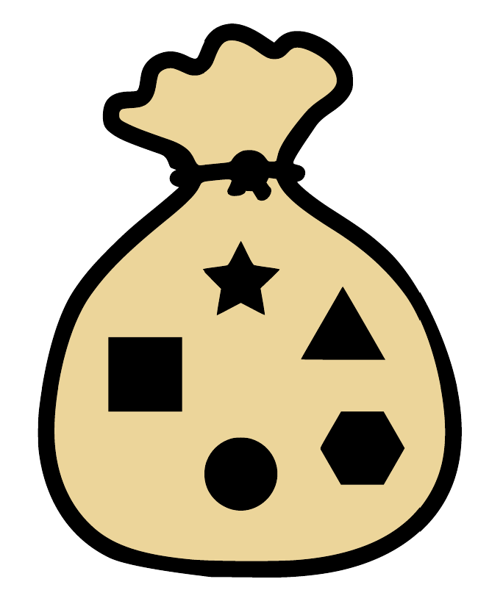
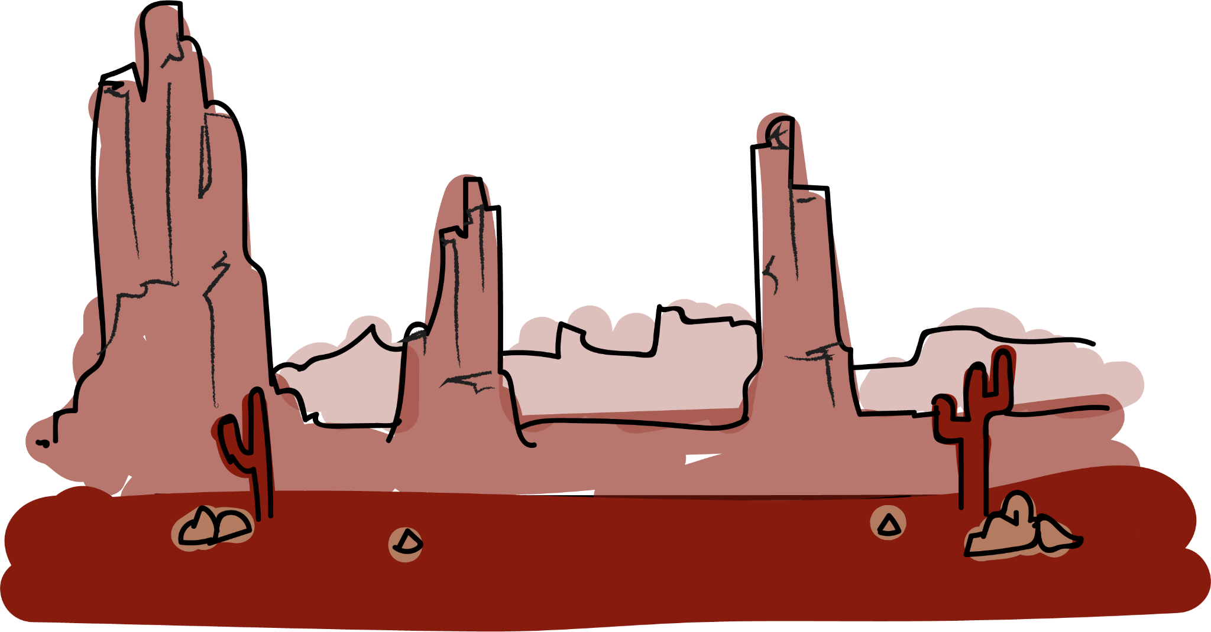
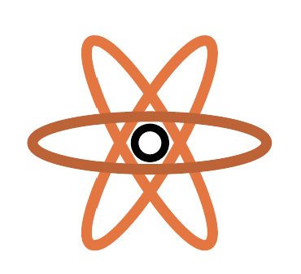
barren plateau
Deep (= poly depth) QAOA ansatz
random init

Slide 7
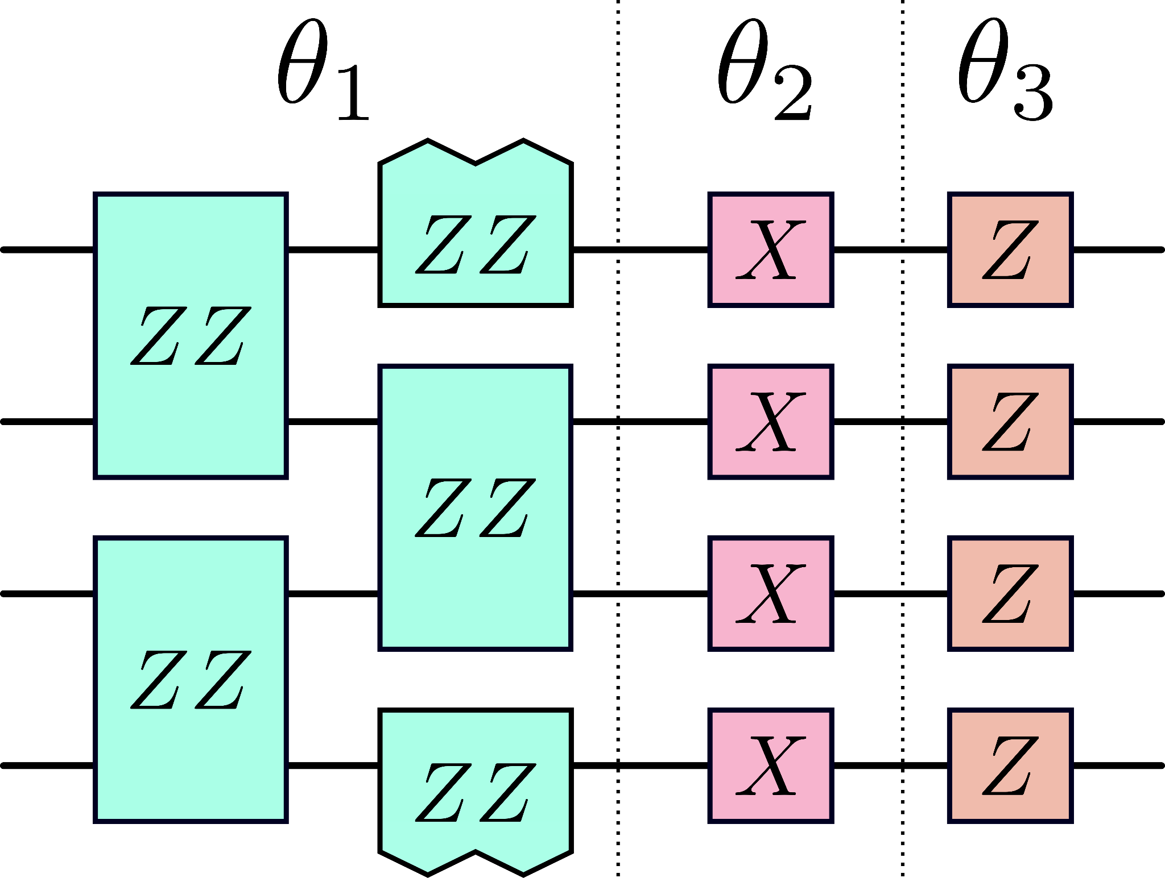
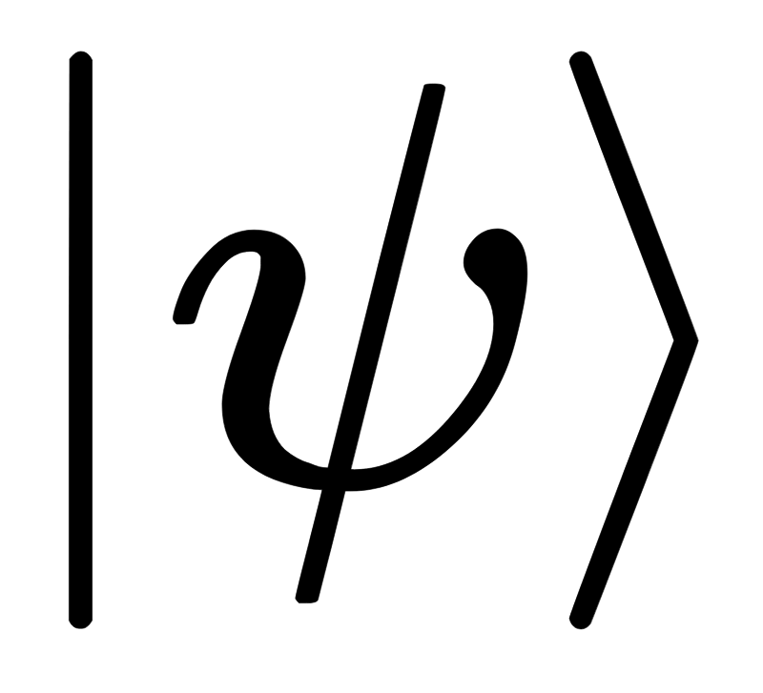
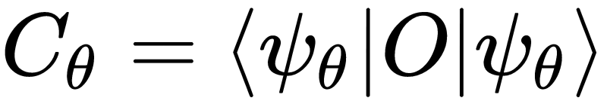
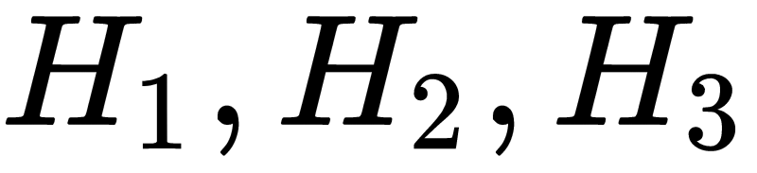
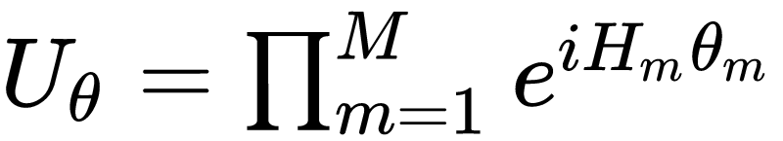
Variational Quantum Algorithms
Update parameters to minimize

Slide 8
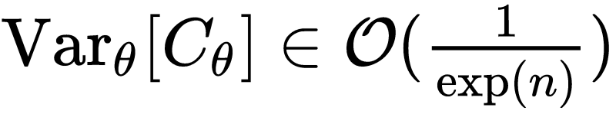

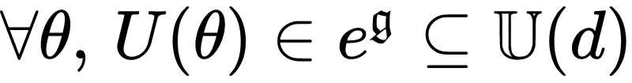
The Barren Plateau problem:
Expectation values concentrate (over landscape): if I sample points with vhp I will not be able to see a difference from the mean → cannot determine descent direction with poly shots
why do BPs happen?
Dynamical Lie algebra (DLA) [*]
‘The DNA of PQCs’
Intuition: the DLA constitutes the fingerprint of a PQC
since it characterizes its (potential) expressiveness
Conjecture ML21’: Var ~ 1/dimg (more expressive = more concentrating)
[*] ML21’: ML et al., Diagnosing barren plateaus with tools from quantum optimal control, Quantum 6, 824 (2022).
Notes:
circuit expressiveness: deep (>log) problem-agnostic (universal) ansatzes show BP (McClean)
initial state: entanglement-induced BPs
observable: cost-function-globality-induced BPs
lie-algebraic perspective: allows for a unified framing of these.
in particular, can capture expressiveness of PQCs beyond universal gatests → QAOA
google: deep random HEA
LANL: cost function globality dep
entanglement-induced: if initial state is entangled / entanglement is generated
diagnosing:

Slide 9
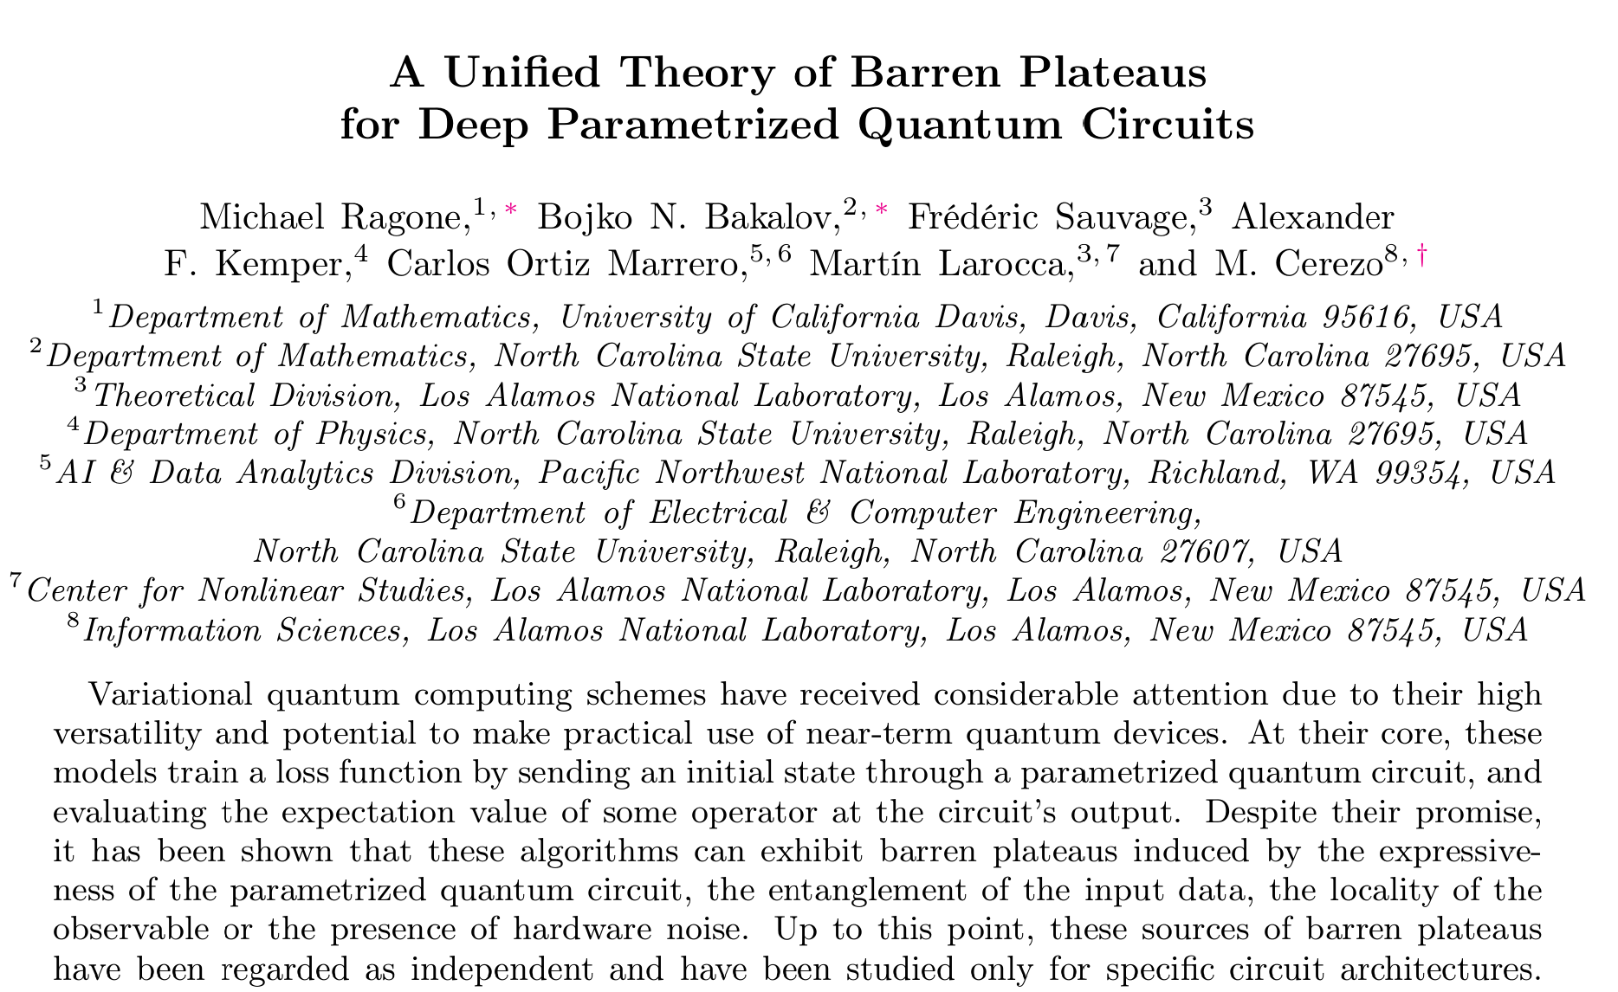
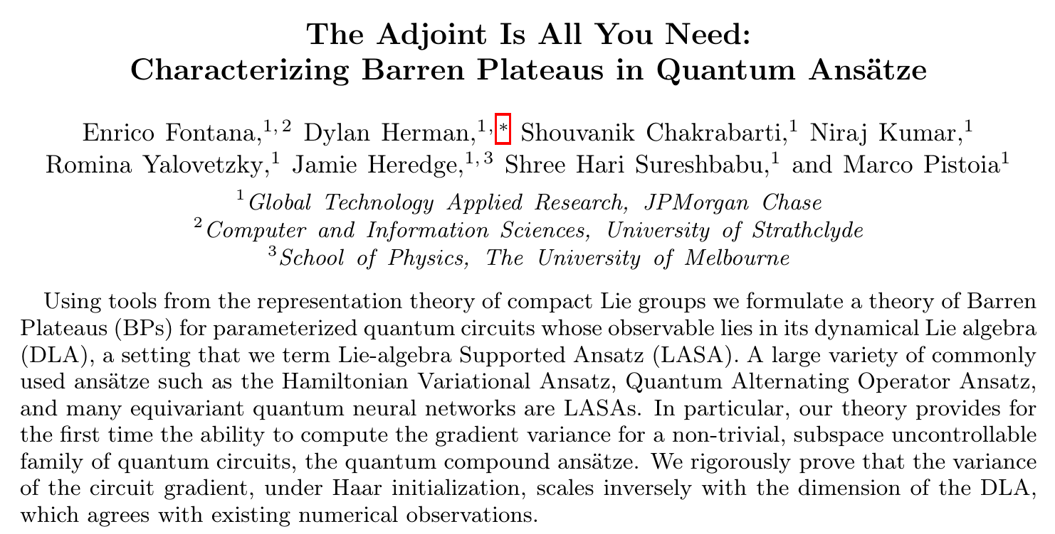
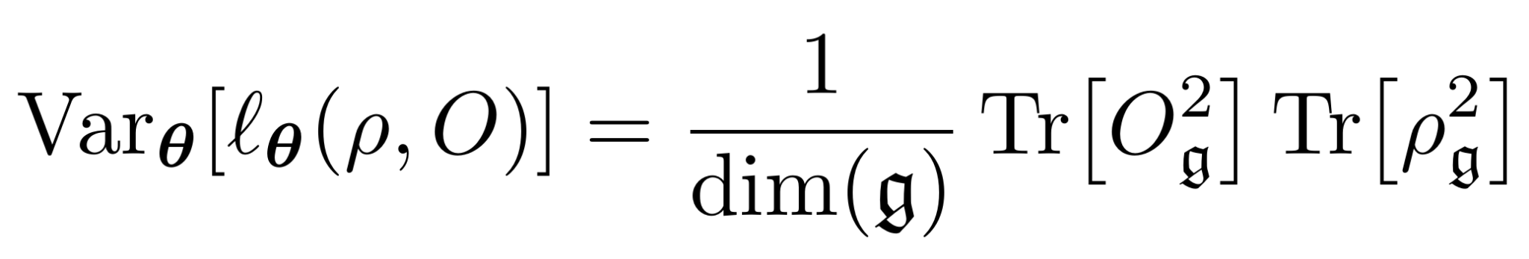
RESOLVED RECENTLY (SEPT23)!
just the typical QIP deadline situation… two proofs for the conjecture came out simultanously!
Conjecture ML21’: Var ~ 1/dimg (more expressive = more concentrating)
new result:
locality
“new physics”: (besides the conjectured dependence on expressiveness) the exact expression provides unforeseen connection between DLA and two other reported causes of BP: entanglement and locality.
it is official: symmetry = less concentration = less QPU time for a given task
expressiveness
entanglement
Remark: the theory assumes O in g. Luckily, this is the case of QAOA (and other popular VQAs).
For a theory beyond this constraint see:
Diaz et al., Showcasing a Barren Plateau Theory Beyond the Dynamical Lie Algebra, arXiv:2310.11505 (2023).

Slide 10
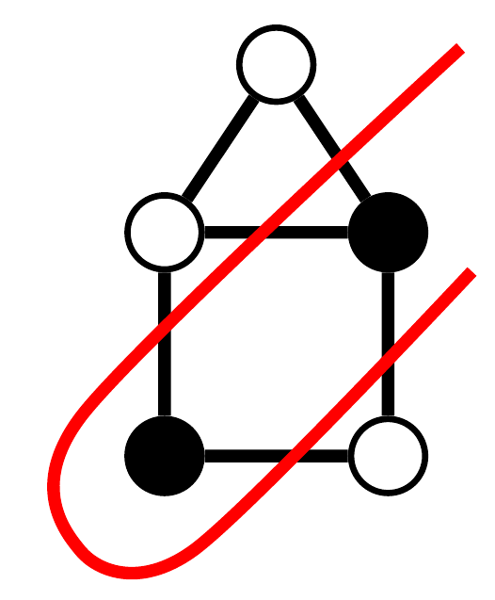
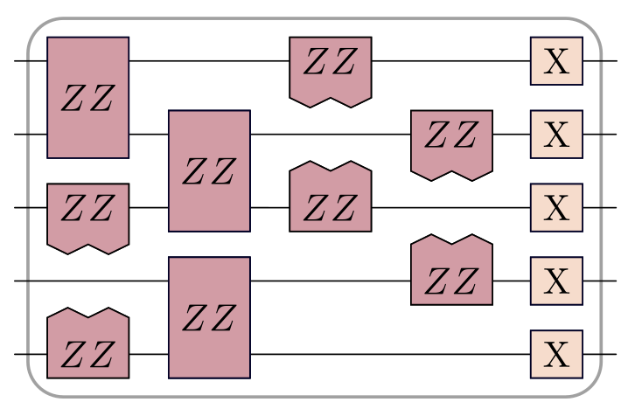
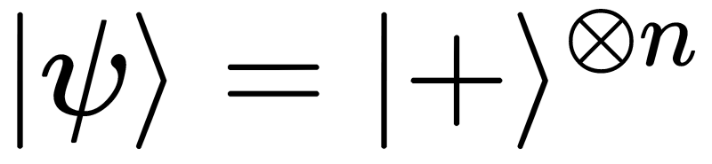
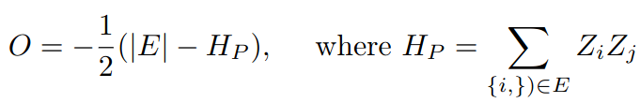

MAXCUT and QAOA
QAOA: variational quantum algorithm with
and

Slide 11
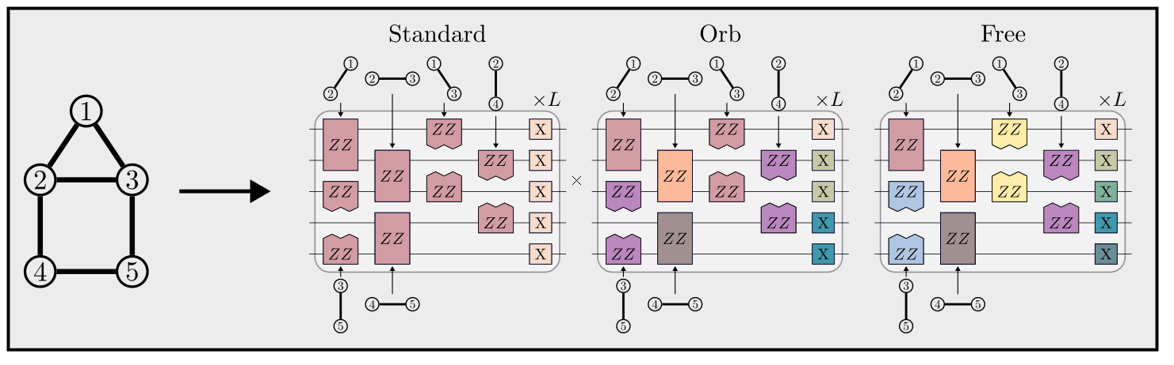
MAXCUT and QAOA: various ansatzes
Sn, symmetric group. Its action on graphs generates new (isomorphic) graphs.
Automorphism group (graph): graph-dependent subgroup of Sn that leaves a given graph invariant.
Aut(complete graph ) = Sn
Aut(random graph n>>) = trivial → in this regime (the relevant for maxcut) orb = free!

Slide 12
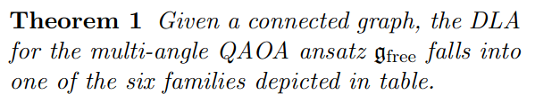
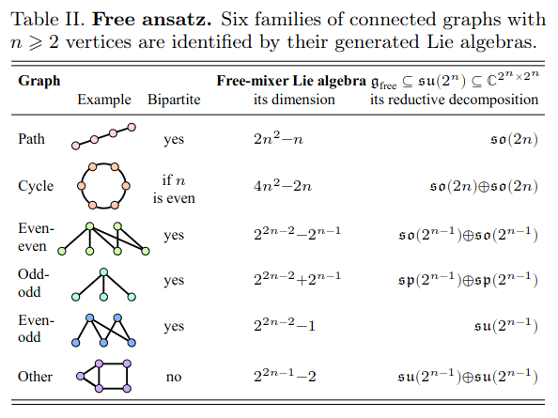
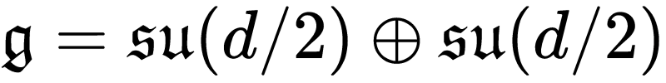
FREE/MA ANSATZ: Dynamical Lie Algebra
We can completely characterize and classify the MA-QAOA DLAs for any graph.
relevant case:

Slide 13
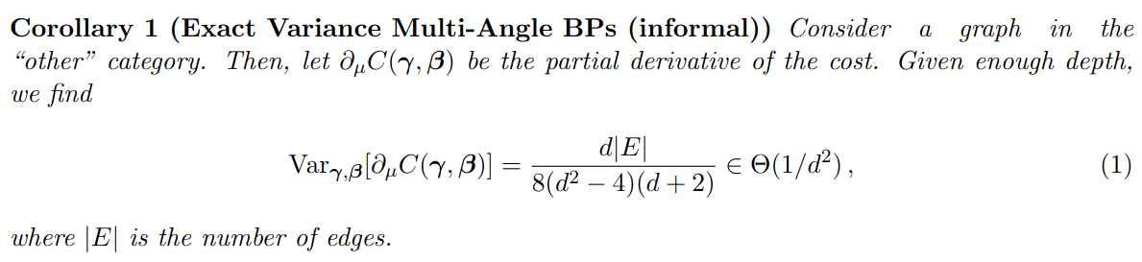
FREE ANSATZ: Exact Variance
For all relevant graphs, MA-QAOA exhibits BP.
Trivially, same holds for ORB.

Slide 14
STD ANSATZ:
slightly more nuanced but:
consequence: standard QAOA follows same fate… almost universal DLA that combined with deep ansatz + random initialization means a no go.

Slide 15
DISCUSSION:
QAOA doesnt seem to be much of a “problem-inspired” ansatz after all.
EXACTLY same DLA for different graphs!
In the deep regime the graph-dependent information –except automorphisms– gets washed out. We did maxcut but expect same to happen in other combinatorial opt problems.
“Loopholes” and opportunities:
  shallow regime: specific graph topology not washed out.
We don't have a theory for BP here but would guess this regime is trainable. It's not obvious to me how powerful this regime is / how truly quantum (at least expectation values). Work is needed!
  Deep Initializations: if you are going deep don't forget to bring them.
For some reason you are able to initialize in the narrow gorge and use QAOA to do a final tweaking.

Slide 16
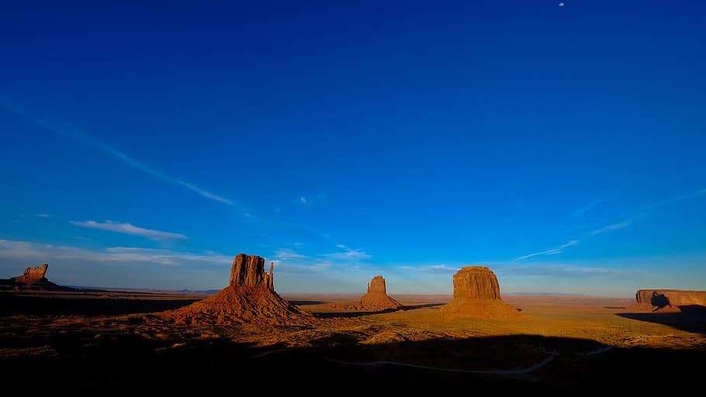
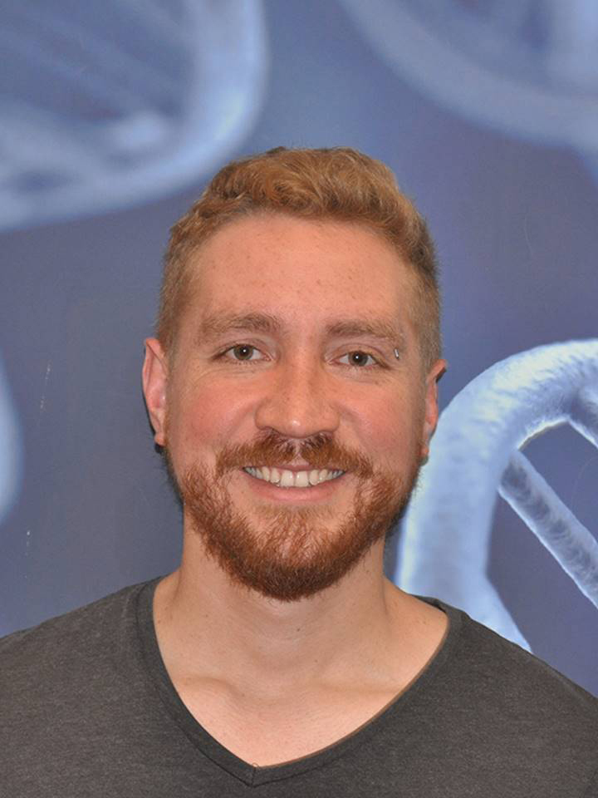
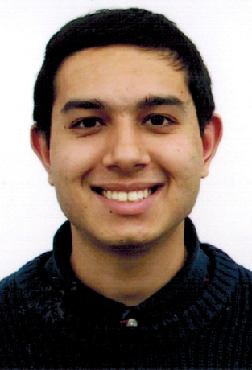
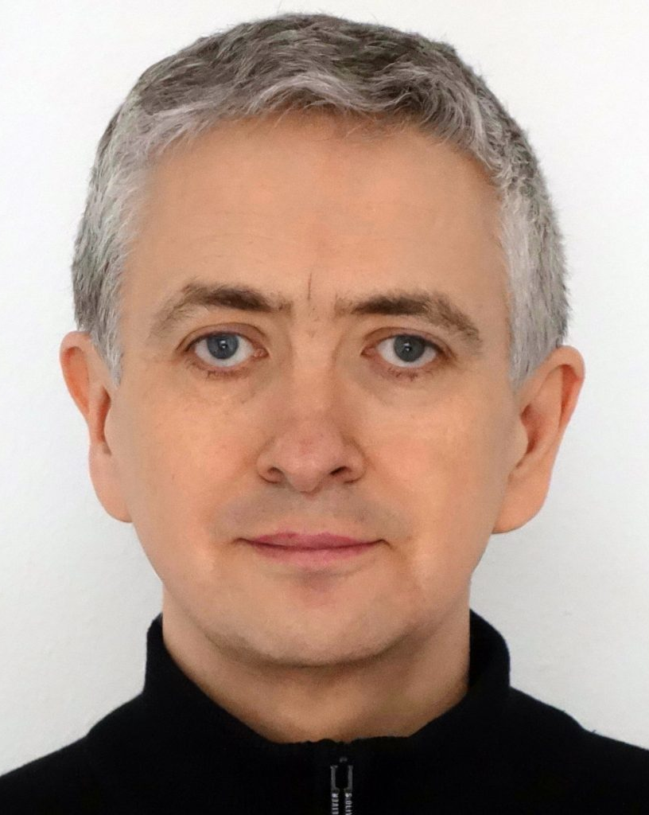
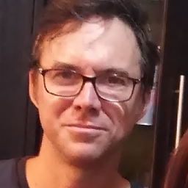
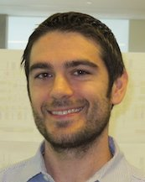
Thanks for your attention! Questions?
LANL
DUKE
UBA (Buenos Aires)
Normal Comp.
Julich

Slide 17
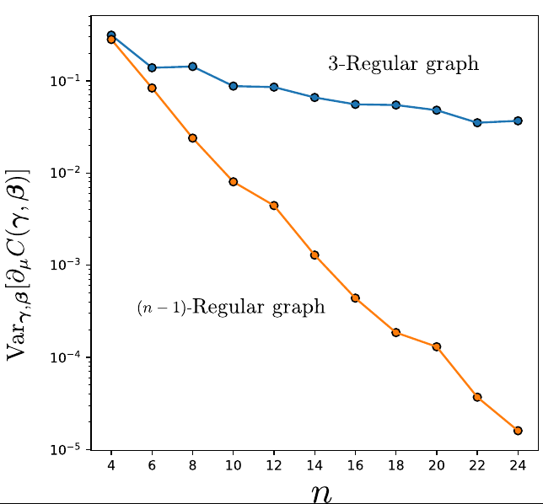
FREE ANSATZ: Barren Plateau with a single layer!
When the graph has O(n) edges → even a single layer of MA-QAOA exhibits a BP.

