Slide 1


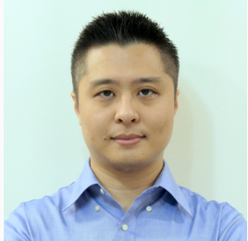


Homogeneous space expressibility of parametric quantum circuits
Rahul Arvind, Kishor Bharti, Khoo Jun Yong, Koh Enshan Dax, and Kong Jian Feng
A*STAR Quantum Innovation Centre (Q.InC), Institute of High Performance Computing (IHPC), Agency for Science,
Technology and Research (A*STAR).
arXiv:2309.05253

Slide 2







Symmetries in tasks
Task: I give you a globe and ask you to throw darts at it. I want a uniform sample of longitudes.
$$(Lat_{2},Long_{2})$$
$$(Lat_{1},Long_{1})$$
We are sampling points up to a symmetry!
$$(Lat_{2},Long_{2})$$
$$(Lat_{1},Long_{1})$$
$$(Lat_{1},Long_{2})$$
$$(Lat_{3},Long_{3})$$
$$(Lat_{4},Long_{4})$$
Throw darts across the globe.
Fix the equator, and only throw darts here!

Slide 3
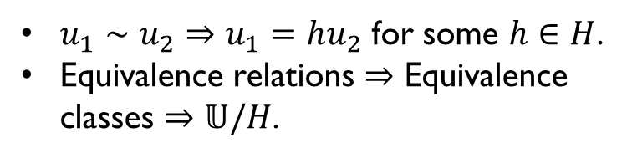
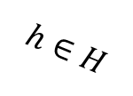







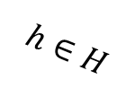




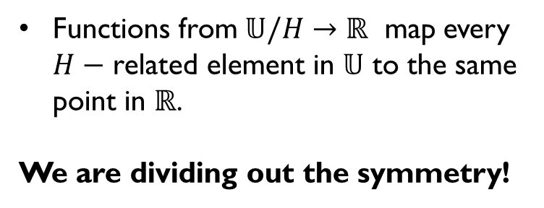

Homogeneous Spaces of the unitary group
G
$$𝕌/H$$
$$𝕌$$
$$𝕌$$
$$H$$
$$π\left(h\right)∈ 𝕌/H$$
$$H$$
$$h∈H$$
$$h∈H$$
$$u∈𝕌$$
$$u∈𝕌$$
$$hu∈𝕌$$
$$hu∈𝕌$$
$$f(𝕌/H)$$
$u_{1}∼u_{2}⇒u_{1}=hu_{2}$ for some $h∈H$.
Equivalence relations $⇒$ Equivalence classes $⇒𝕌/H$.
$$ℝ$$
Functions from $𝕌/H→ℝ$ map every $H−$ related element in $𝕌$ to the same point in $ℝ$.
We are dividing out the symmetry!

Slide 4
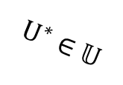







Sampling $𝕌$ up to a symmetry $H$: Sampling on $𝕌/H$
$$𝕌/H$$
$$𝕌$$
$$π$$
$$U^{∗}∈𝕌$$
$$U_{1}⊂𝕌$$
Haar measure
Haar measure
$$U_{2}=U^{∗}U⊂𝕌$$
$$ℝ$$
Haar measure
$$ℝ$$
Where does this map to?
$$P\left(X⊂𝕌/H\right)=P\left(π^{−1}\left(X\right)⊂𝕌\right).$$
Sampling on $𝕌/H$: just sample on $𝕌$, send to equivalence class.
Notes:
It turns out the Haar sampling on $𝕌/H$(luckily) follows the most obvious thing you could do!
The probability of sampling a subset $X$ of $𝕌/H$ is the same as the probability of sampling the set $π^{−1}(X)$ in $𝕌$!

Slide 5
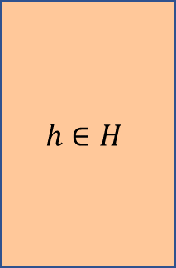
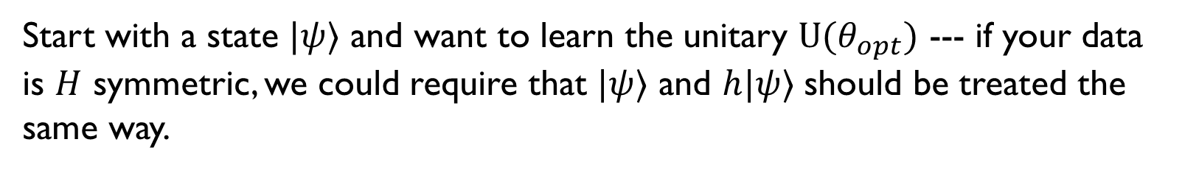
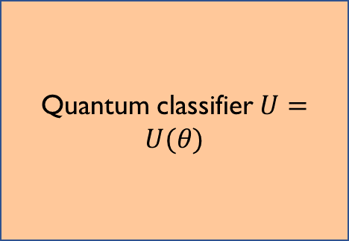

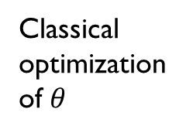
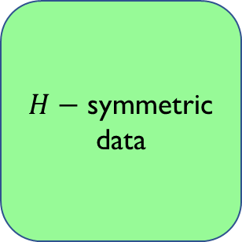
Quantum machine learning up to a symmetry
$H−$ symmetric data
$$h∈H$$
Quantum classifier $U=U(θ)$
No point!
Classical optimization of $θ$
Update $θ$
Key Idea
Start with a state $|ψ⟩$ and want to learn the unitary $U{(θ}_{opt})$ --- if your data is $H$ symmetric, we could require that $|ψ⟩$ and $h|ψ⟩$ should be treated the same way.

Slide 6
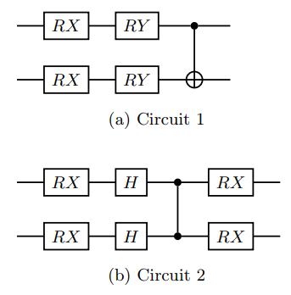
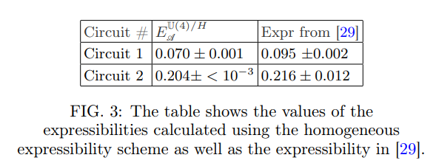

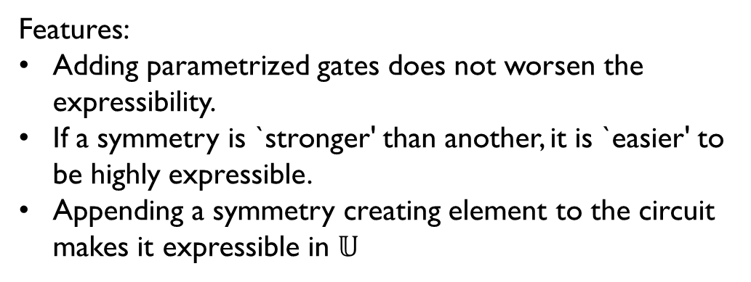
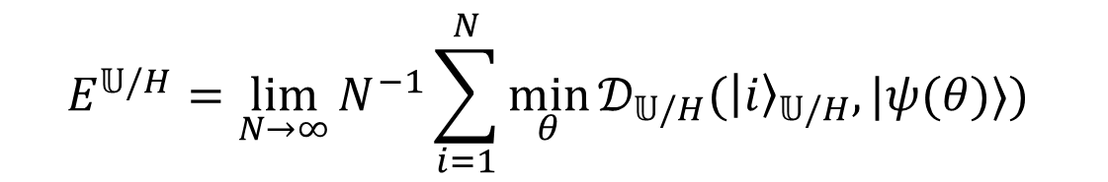
arXiv:1905.10876
Expressibility, up to a symmetry
$$H=\{I, SWAP\}$$
$$E^{𝕌/H}=\lim_{N→∞}⁡N^{−1}\sum_{i=1}^{N}{\min_{θ}{𝒟_{𝕌/H}({\left|i\right\rangle }_{𝕌/H},|ψ(θ)⟩) }}$$
Features:
Adding parametrized gates does not worsen the expressibility.
If a symmetry is `stronger' than another, it is `easier' to be highly expressible.
Appending a symmetry creating element to the circuit makes it expressible in $𝕌$
29: arXiv:1905.10876, Expressibility and Entangling Capability of Parameterized Quantum Circuits for Hybrid Quantum‐Classical Algorithms, Sim, Sukin
and Johnson, Peter D. and Aspuru‐Guzik, Alán
Notes:
${\left|i\right\rangle }_{𝕌/H}$ : sampling from $𝕌/H$, applying it to a state.

Slide 7
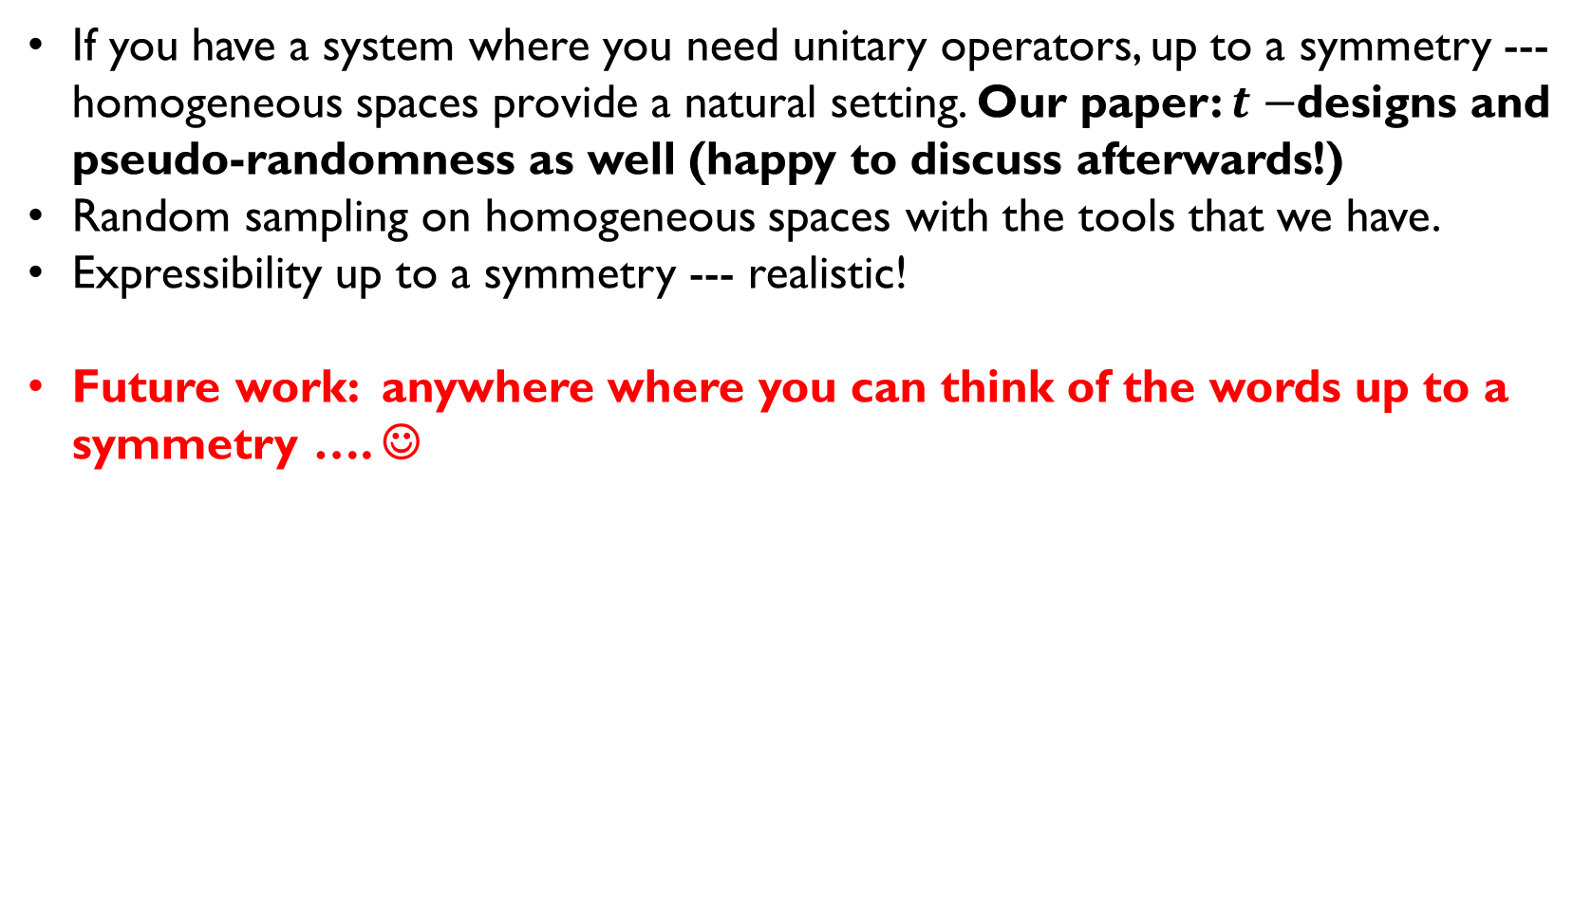
Outlook (up to a symmetry)
If you have a system where you need unitary operators, up to a symmetry --- homogeneous spaces provide a natural setting. Our paper: $t−$designs and pseudo-randomness as well (happy to discuss afterwards!)
Random sampling on homogeneous spaces with the tools that we have.
Expressibility up to a symmetry --- realistic!
Future work: anywhere where you can think of the words up to a symmetry …. ☺

