Slide 1
A Unified Theory of Barren Plateaus for Deep Parametrized Quantum Circuits
Marco Cerezo
CCS-3
“A Unified Theory of Barren Plateaus for Deep Parametrized Quantum Circuits” arxiv 2309.09342 (2023)
Michael Ragone, Bojko N. Bakalov, Frédéric Sauvage, Alexander F. Kemper, Carlos Ortiz Marrero, Martin Larocca, MC
“Showcasing a Barren Plateau Theory Beyond the Dynamical Lie Algebra” arXiv:2310.11505 (2023).
N. L. Diaz, Diego García-Martín, Sujay Kazi, Martin Larocca, and MC
11/21/2023 @QTML, CERN
LA-UR-23-31823

Slide 2
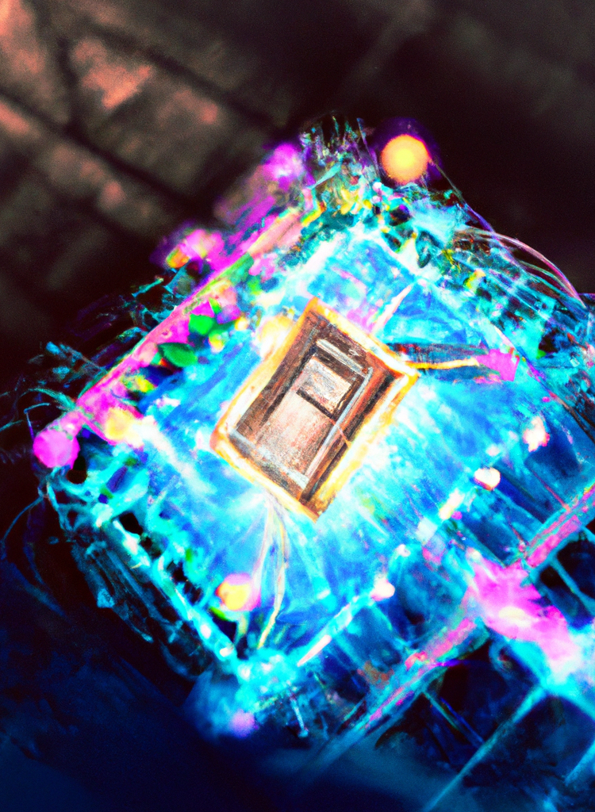
Outline
(Very brief) Introduction to variational quantum computing
A casual stroll through the history of Barren Plateaus (BPs)
A unified Dynamical Lie algebraic perspective to BPs
Beyond the Dynamical Lie algebra BP Theory
Outlook
Image credits: Our AI overlord Dall-E 2

Slide 3

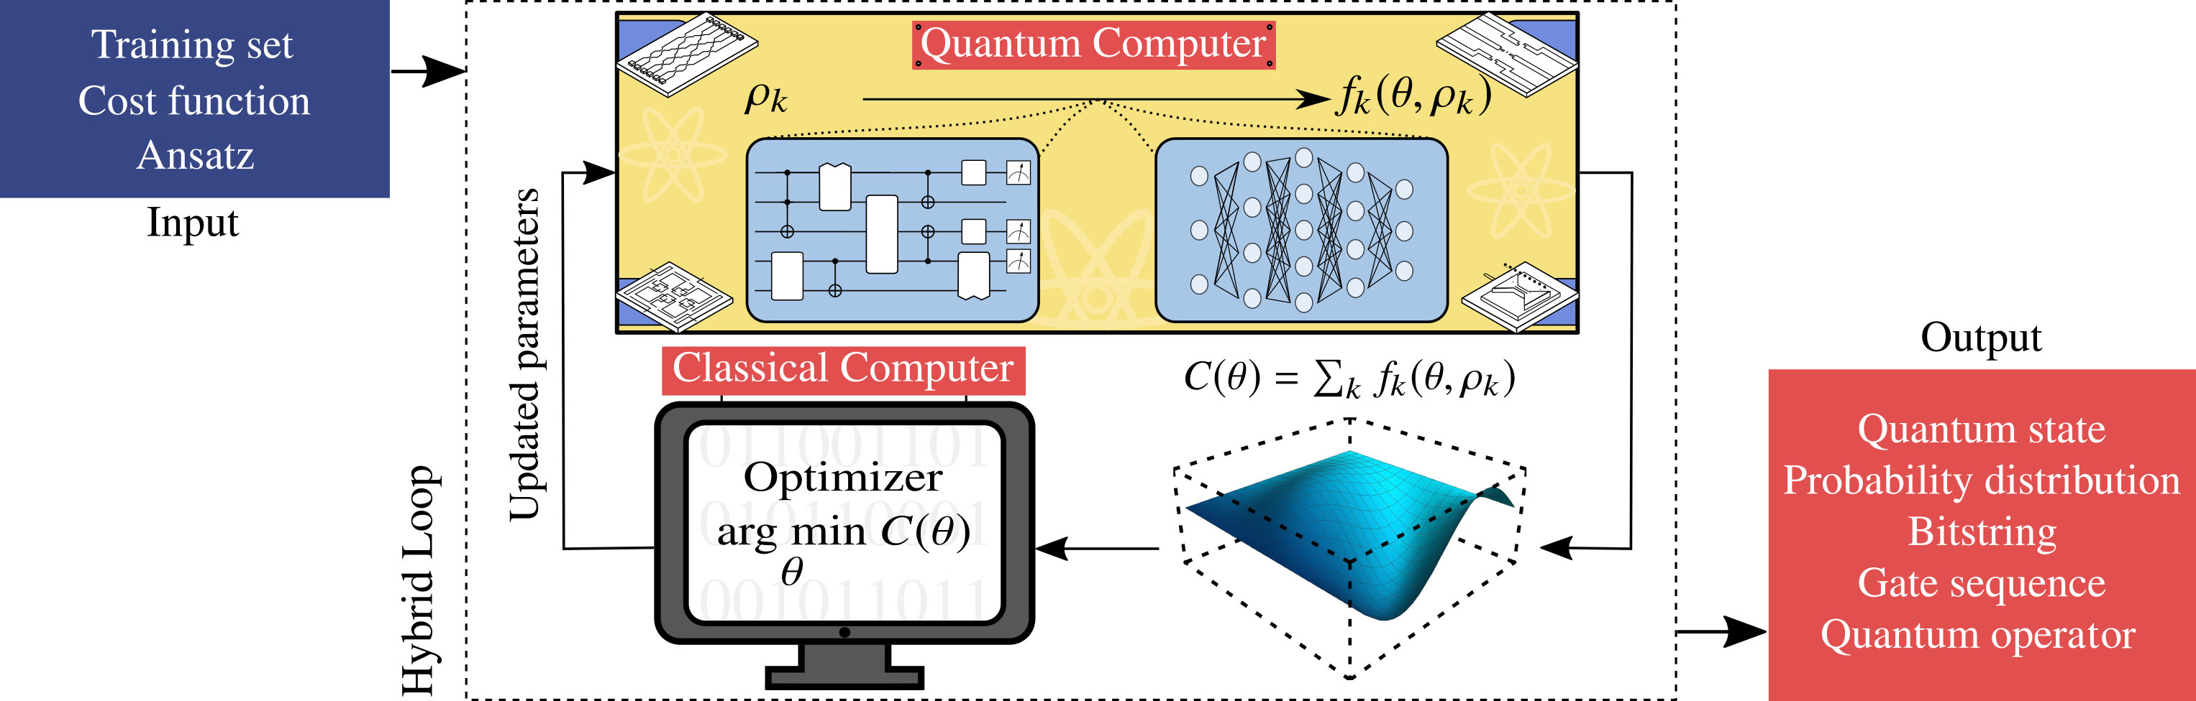

Variational Quantum Computing
Solve a problem of interest by encoding it as an optimization task.
These include Variational Quantum Algorithms (VQE, QAOA, etc), but also Quantum Machine Learning schemes. We will consider models passed on Parametrized Quantum Circuits, or, Quantum Neural Networks.
The loss function will take the form:
We will assume (standard)
${\left|O\right|}_{2}^{2}≤2^{n}$
$$ℓ_{θ}\left(ρ, O\right)=Tr[U\left(θ\right)ρU^{†}\left(θ\right)O]$$
Review: Variational Quantum Algorithms, MC et al, Nature Reviews Physics 3, 625-644 (2021)
Review: Noisy intermediate-scale quantum algorithms, K. Bharti et al, Rev. Mod. Phys. 94, 015004 (2022)

Slide 4

How and when can this computational approach fail?
While NN are widely used today, their historical development saw periods of great stagnation (or winters).
Variational Quantum Computing holds tremendous the tremendous promise to achieve a quantum advantage – a computational speedup – we need to guarantee that our architectures will work when scaled up and applied to large, realistic problems.
Challenges and opportunities in quantum machine learning, MC et al, Nature Computational Science 2, 567–576 (2022)

Slide 5
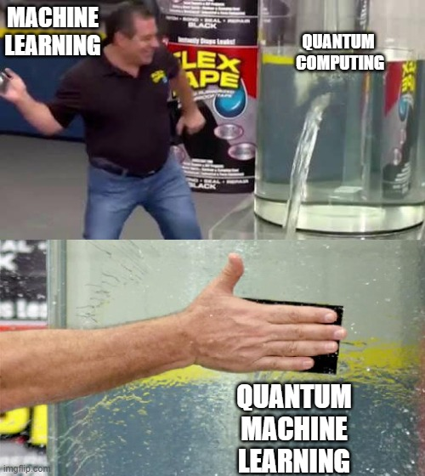
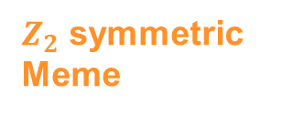
Two memes in a row? Oh, the humanity!
$Z_{2}$ symmetric Meme

Slide 6
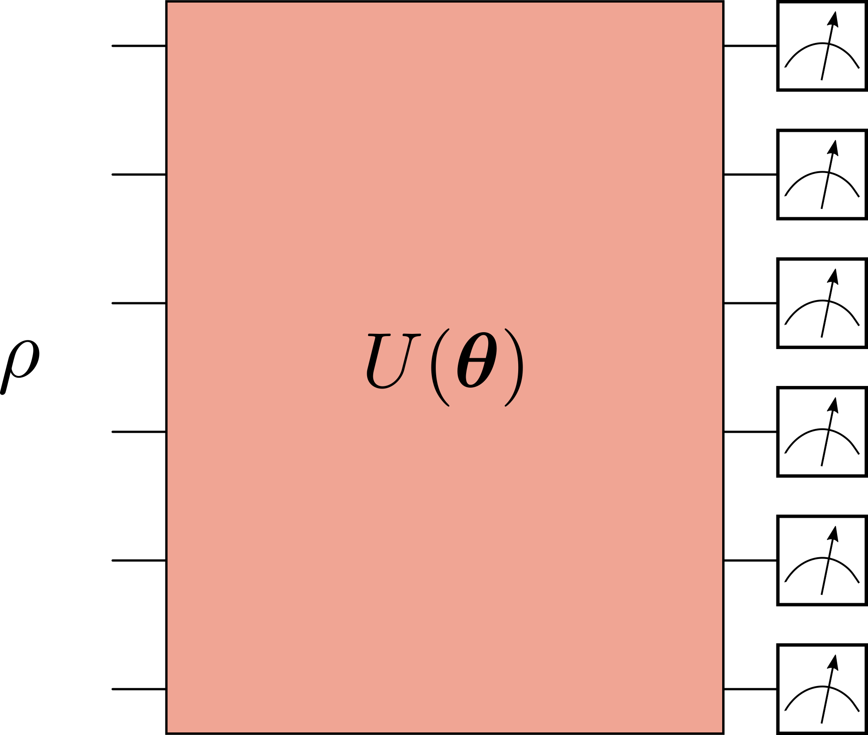

A review of Barren Plateaus and their sources
Good practices that we have come to learn and love <3:
Global observables (acting non-trivially on all qubits) are untrainable
Too much entanglement leads to BPs.
Deep circuits are have BPs.
We will study loss concentration, not partial derivative concentration.
They can be shown to be equivalent.
Equivalence of quantum barren plateaus to cost concentration and narrow gorges, A. Arrasmith, et al, Quantum Sci. Technol. (2021)

Slide 7


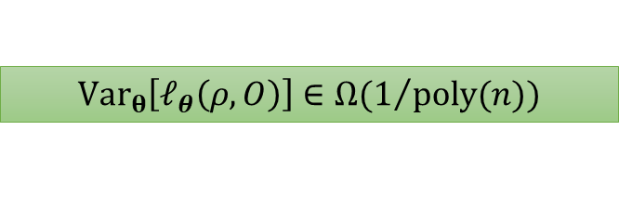
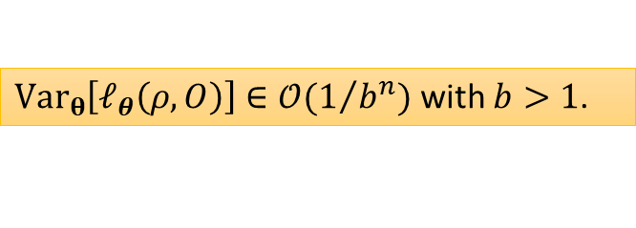
Barren Plateaus
No Barren Plateau
Barren Plateau
Image Credits: Samson Wang
$Var_{θ}\left[ℓ_{θ}\left(ρ, O\right)\right]∈Ω(1/{poly(n)})$
$Var_{θ}\left[ℓ_{θ}\left(ρ, O\right)\right]∈𝒪(1/{b^{n}})$ with $b>1$.

Slide 8
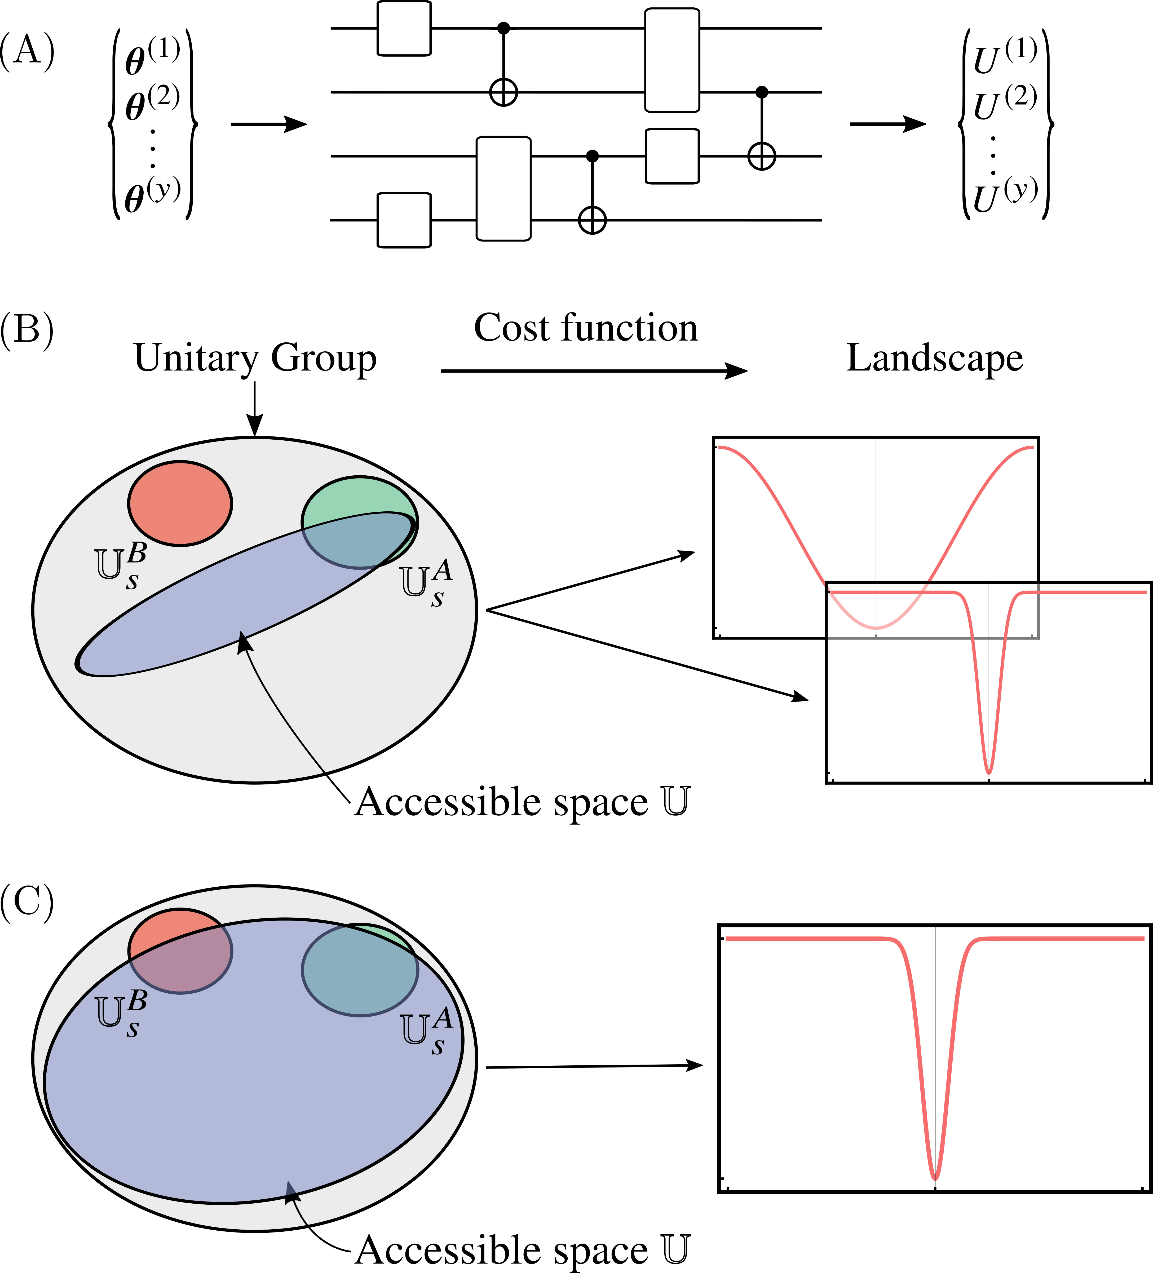
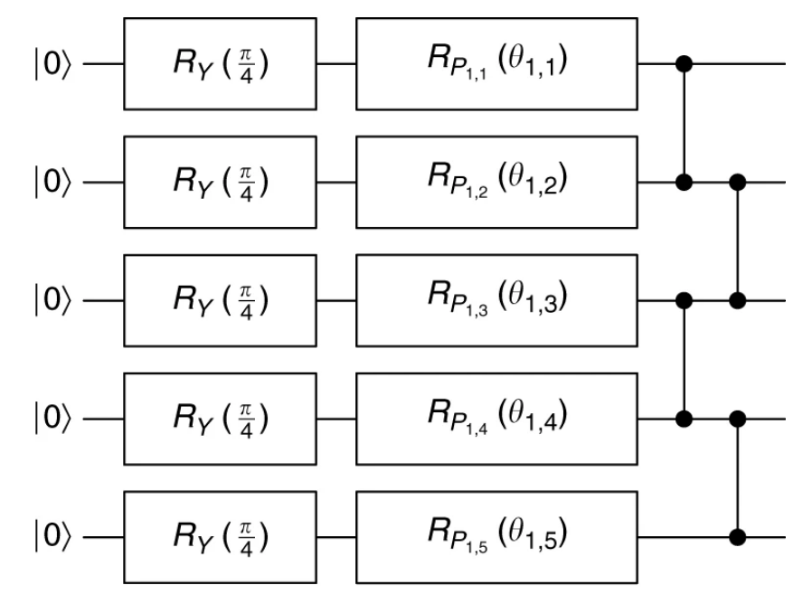

Expressiveness in the circuit,
or, a general form of No-Free-Lunch theorem
The first, and perhaps, most studied source of BPs:
Seminal Google paper: $U\left(θ\right)$ forms a 2-design
$$Var_{θ}\left[ℓ_{θ}\left(ρ, O\right)\right]=\frac{1}{4^{n}−1}(Tr\left[ρ^{2}\right]−1/{2^{n}})(Tr\left[O^{2}\right]−{Tr{\left[O\right]}^{2}}/{2^{n}})$$
We have a BP for any $ρ$, and $O$.
Barren Plateaus in Quantum Neural Networks, McClean et al, Nat. Commun. (2018)
Connecting ansatz expressibility to gradient magnitudes and barren plateaus, Z. Holmes, et al,PRX Quantum (2022).

Slide 9
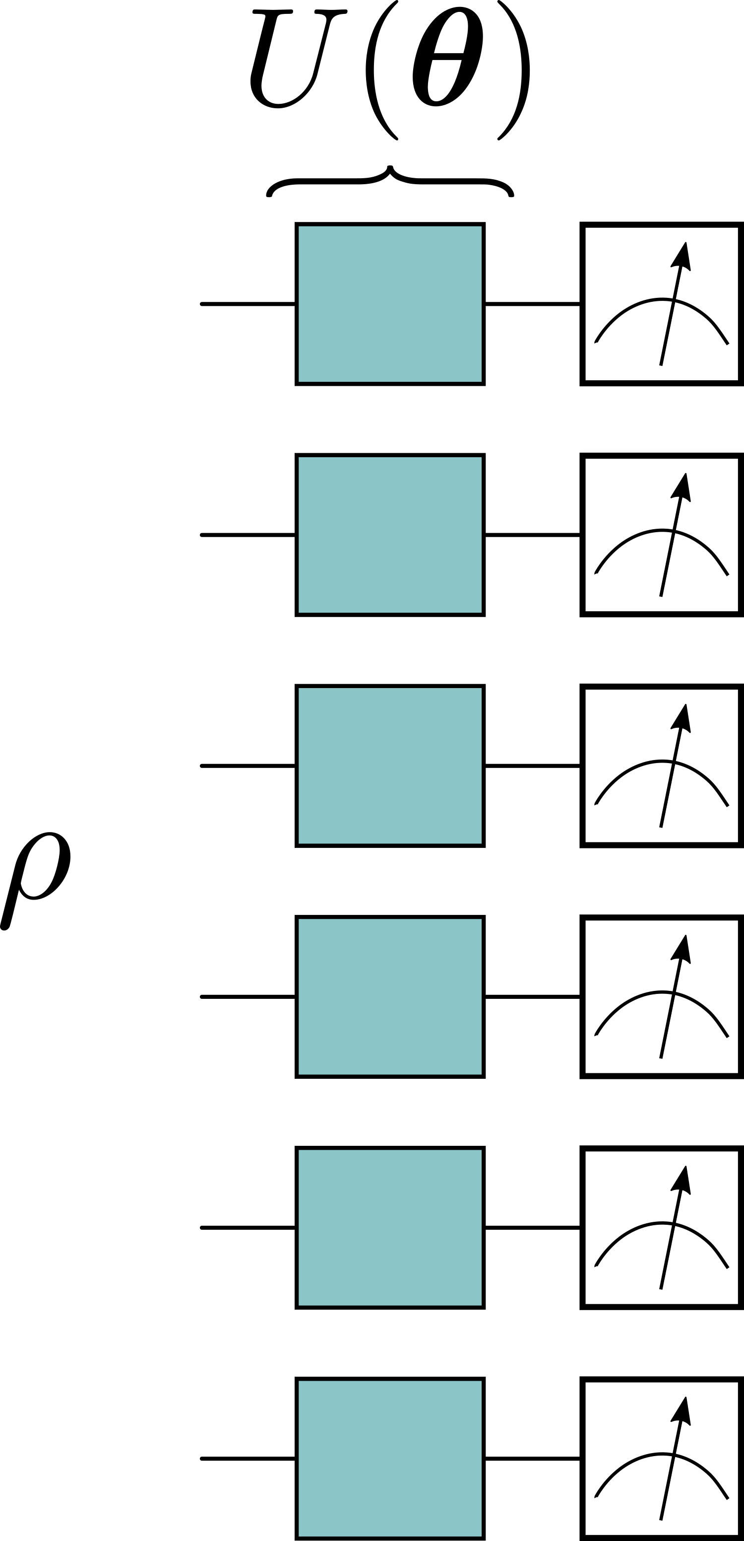
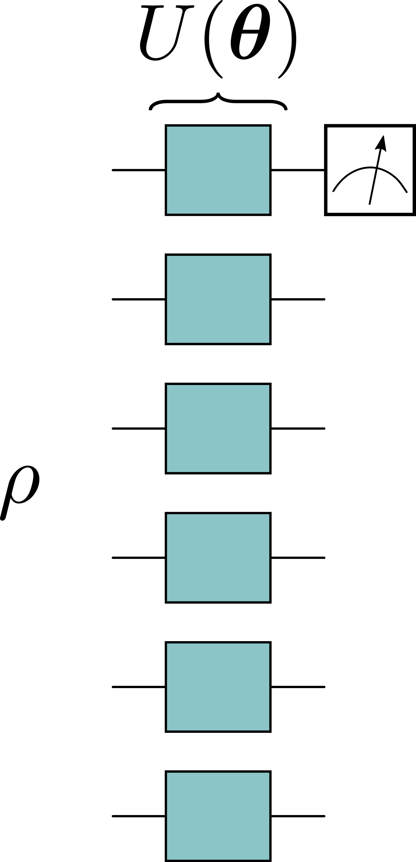
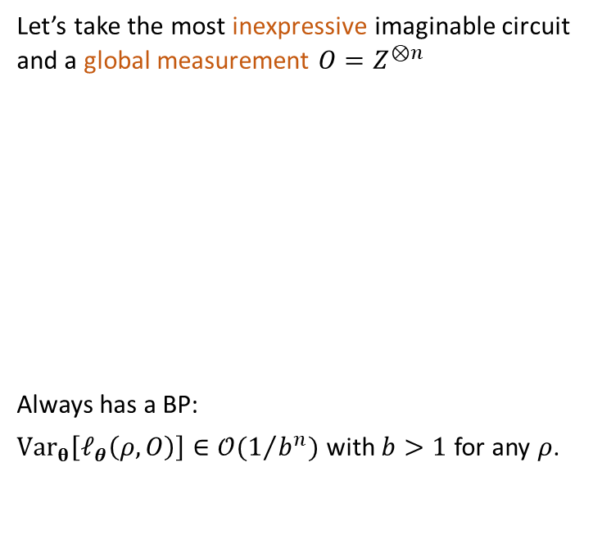
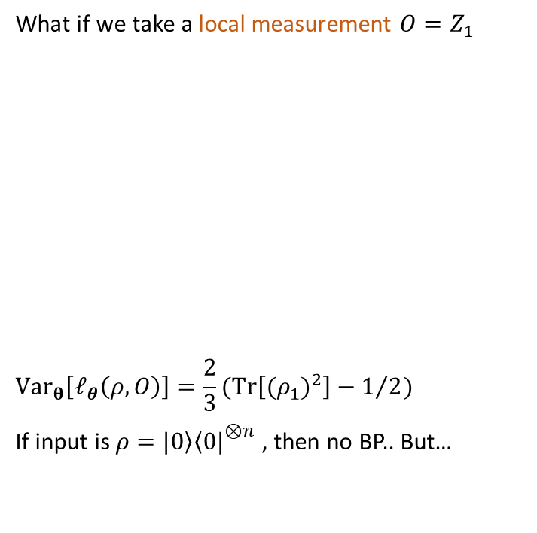
Locality of measurement operator
or, why comparing exponentially large objects is bound to fail
Let’s take the most inexpressive imaginable circuit and a global measurement $O=Z^{⊗n}$
Always has a BP:
$Var_{θ}\left[ℓ_{θ}\left(ρ, O\right)\right]∈𝒪(1/{b^{n}})$ with $b>1$ for any $ρ$.
What if we take a local measurement $O=Z_{1}$
$$Var_{θ}\left[ℓ_{θ}\left(ρ, O\right)\right]=\frac{2}{3}(Tr\left[{(ρ_{1})}^{2}\right]−1/2)$$
If input is $ρ=\left.|0\right\rangle {\left\langle 0|\right.}^{⊗n}$, then no BP.. But…
Cost Function Dependent Barren Plateaus in Shallow Parametrized Quantum Circuits, MC et al, Nat. Commun. (2020)

Slide 10
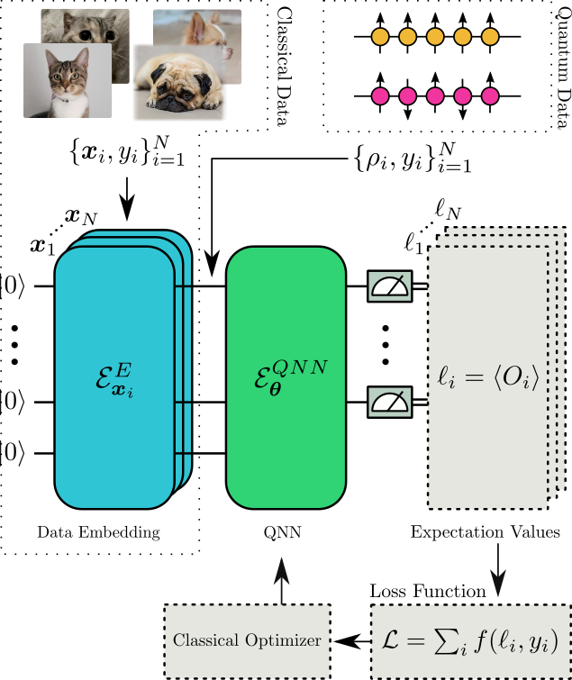
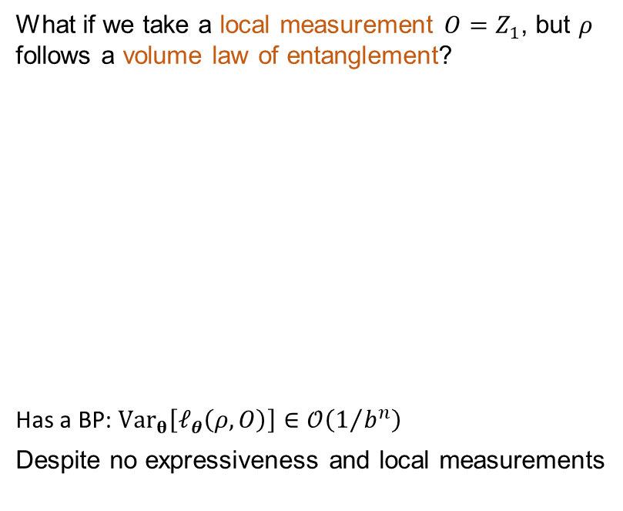
Entanglement in the initial state
or, why untamed entanglement can be bad
What if we take a local measurement $O=Z_{1}$, but $ρ$ follows a volume law of entanglement?
Has a BP: $Var_{θ}\left[ℓ_{θ}\left(ρ, O\right)\right]∈𝒪\left(1/{b^{n}}\right)$
Despite no expressiveness and local measurements
Subtleties in the trainability of quantum machine learning models, S. Thanasilp et al, arxiv (2021).

Slide 11
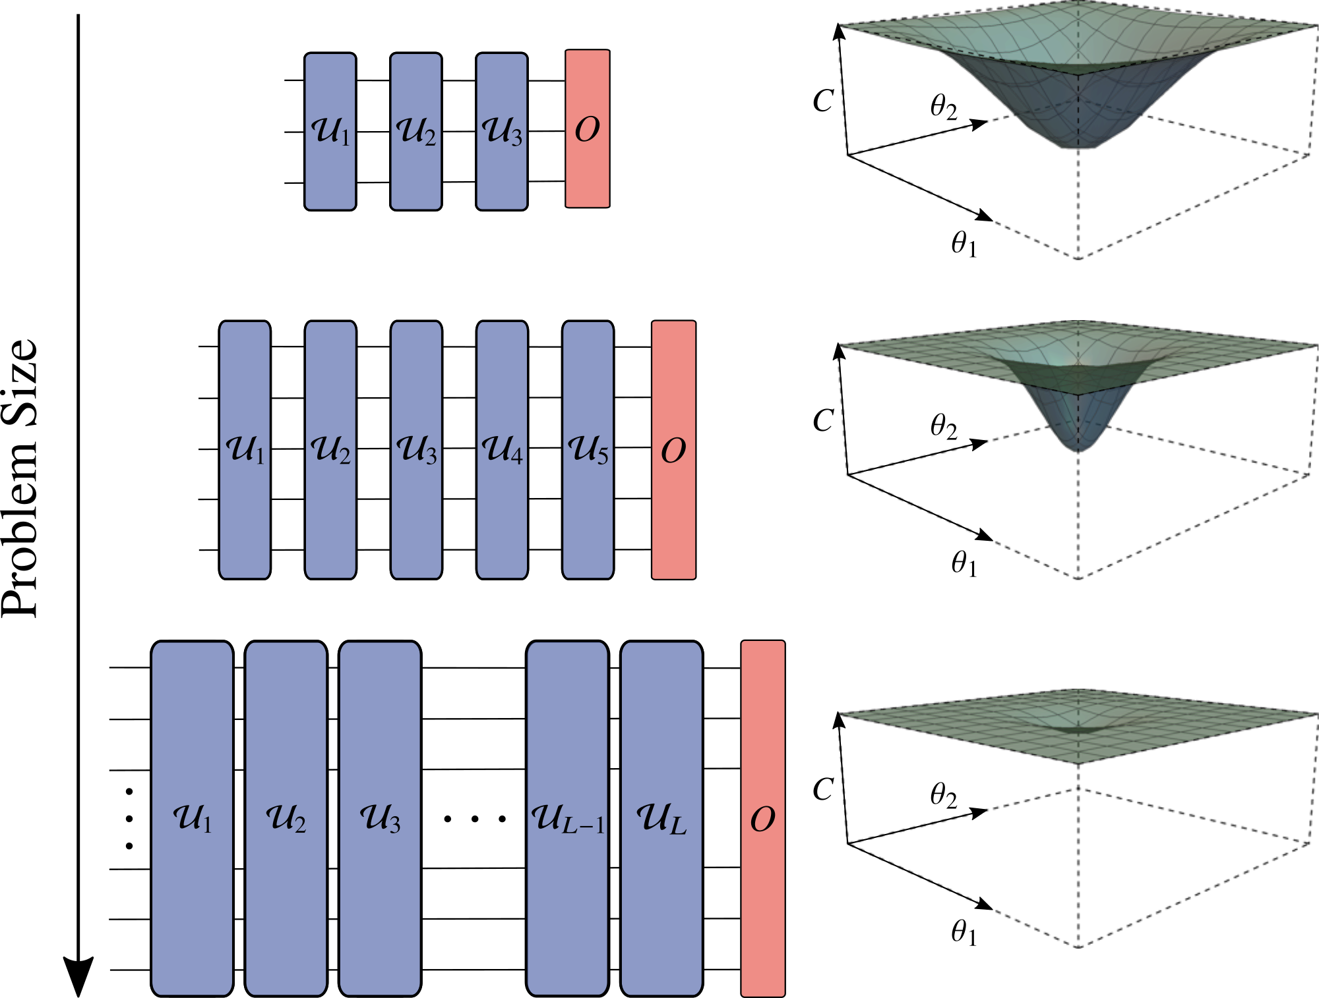
And of course, Noise
or, why existence is pain
Noise Induced-barren plateaus, S. Wang et al, Nat. Commun. (2021).

Slide 12
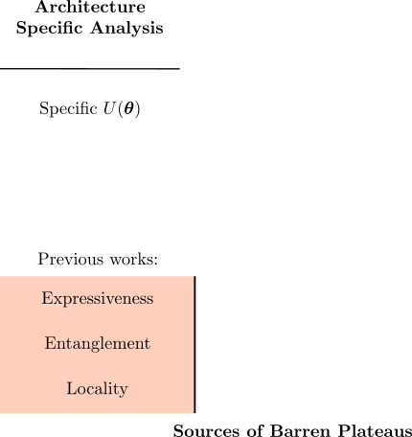
Previous understanding of BPs
or, yes this slide looks ugly, but it will get better soon.

Slide 13
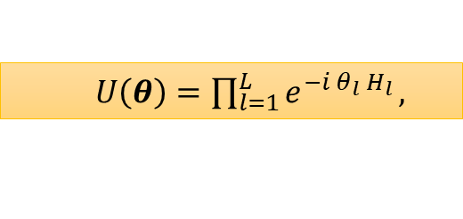



Can we understand and unify all these sources of BPs?
Yes! We need to take a Lie algebraic perspective. Assume
Where $H_{l}∈𝒢$ (set of generators).
Then we need to construct the circuit’s Dynamical Lie algebra (DLA):
DLA = subspace spanned by the nested commutators of the generators
The DLA is important for 2 reasons:
$U\left(θ\right)∈e^{g}$ for any $θ$, $L$.
Quantifies the ultimate expressiveness $U\left(θ\right)$.
  $U\left(θ\right)=\prod_{l=1}^{L}{e^{−i θ_{l} H_{l}}},$
$$\text{𝔤}={\left\langle i𝒢\right\rangle }_{Lie}⊆su\left(d\right)$$
BCH Formula $e^{A}e^{B}=e^{C}$ with
$C=A+B+\frac{1}{2}\left[A,B\right]+\frac{1}{12}\left[A,\left[A,B\right]\right]−\frac{1}{12}[B,[A,B]]$)+…

Slide 14
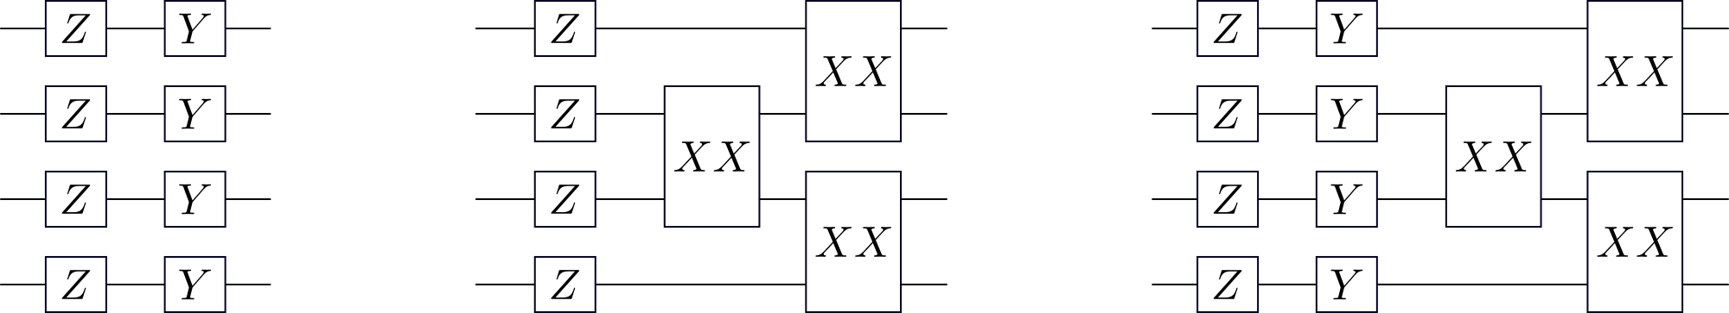

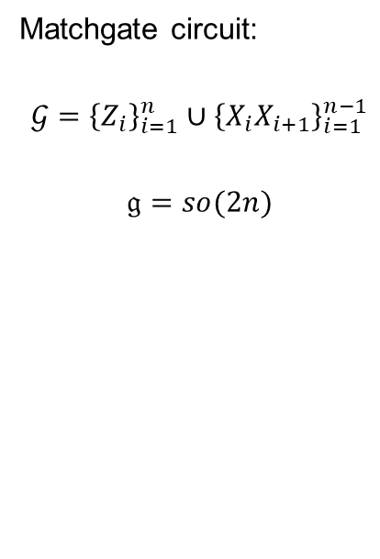
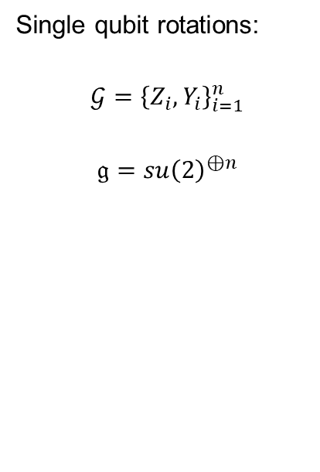
Examples of DLA
Single qubit rotations:
$$𝒢={\left\{Z_{i},Y_{i}\right\}}_{i=1}^{n}$$
$$\text{𝔤}=su{\left(2\right)}^{⊕n}$$
Matchgate circuit:
$$𝒢={\left\{Z_{i}\right\}}_{i=1}^{n}∪{\left\{X_{i}X_{i+1}\right\}}_{i=1}^{n−1}$$
$$\text{𝔤}=so(2n)$$
Universal circuit:
$$𝒢={\left\{Z_{i},Y_{i}\right\}}_{i=1}^{n}∪{\left\{X_{i}X_{i+1}\right\}}_{i=1}^{n−1}$$
$$\text{𝔤}=su(2^{n})$$

Slide 15

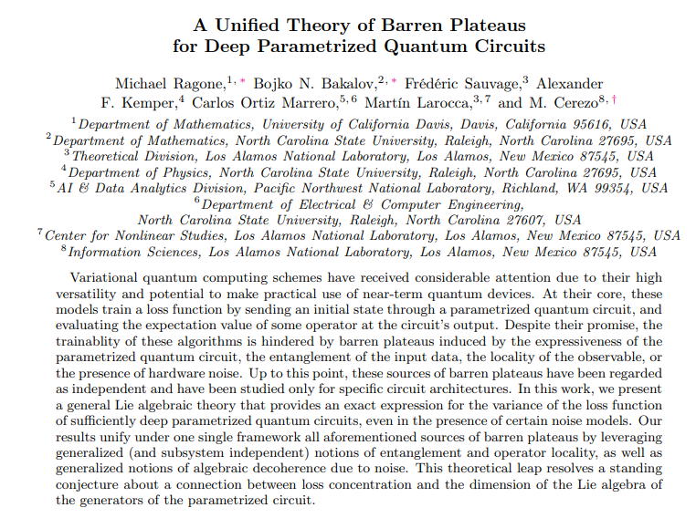
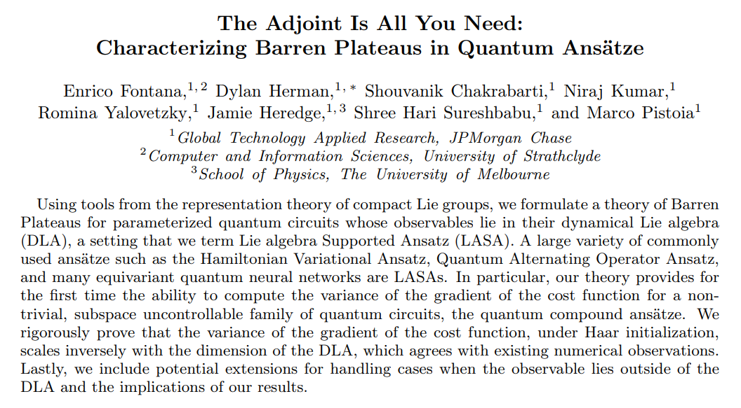
Enough math. Why is the DLA important?
The importance of the DLA was conjectured in our work [1], and recently proven to be central in the BP study. A classic QIP deadline induced rush:
Image Credits: Stan Lee.
ABC’s Spiderman Cartoon: “Double Identity” Season 1, Episode 19 (1968). Yeah, I googled it.
arXiv:2309.07902
arXiv:2309.09342
[1] Diagnosing Barren Plateaus with tools from quantum optimal control, M. Larocca, et al, Quantum. (2022).

Slide 16
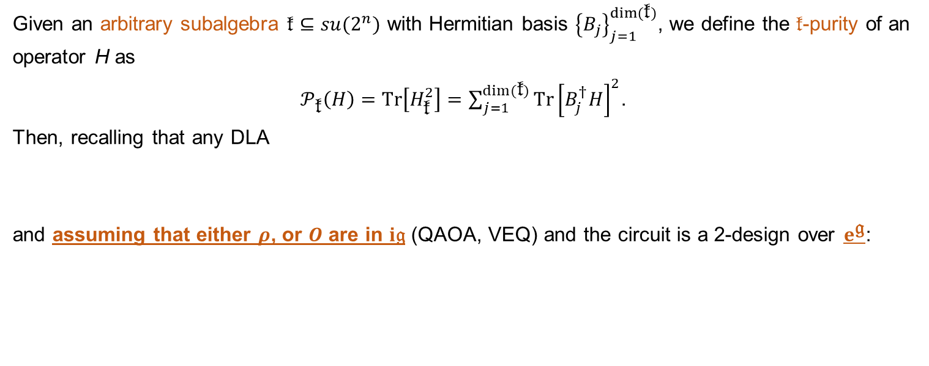
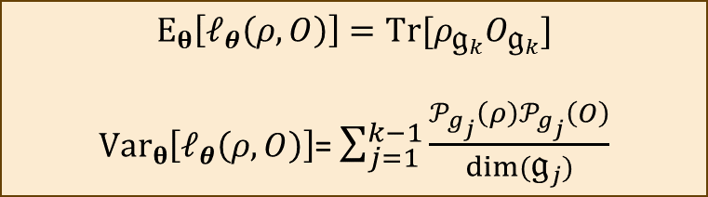

Exact variance formula for states or observables in the DLA
Given an arbitrary subalgebra $\text{𝔨}⊆su(2^{n})$ with Hermitian basis ${\left\{B_{j}\right\}}_{j=1}^{dim⁡(\text{𝔨})}$, we define the 𝔨-purity of an operator $\text{H}$ as
$𝒫_{\text{𝔨}}\left(H\right)=Tr\left[H_{\text{𝔨}}^{2}\right]=\sum_{j=1}^{dim⁡(\text{𝔨})}{Tr{\left[B_{j}^{†}H\right]}^{2}}$.
Then, recalling that any DLA
and assuming that either $ρ$, or $O$ are in $i\text{𝔤}$ (QAOA, VEQ) and the circuit is a 2-design over $e^{\text{𝔤}}$:
$$\text{𝔤}\text{=}{\text{𝔤}}_{1}⊕{\text{𝔤}}_{2}⊕⋯⊕{\text{𝔤}}_{k}$$
simple abelian
We have bounds for circuit depth
$$E_{θ}\left[ℓ_{θ}\left(ρ, O\right)\right]=Tr[ρ_{{\text{𝔤}}_{k}}O_{{\text{𝔤}}_{k}}]$$
$Var_{θ}\left[ℓ_{θ}\left(ρ, O\right)\right]$= $\sum_{j=1}^{k−1}{\frac{𝒫_{g_{j}}\left(ρ\right)𝒫_{g_{j}}\left(O\right)}{dim⁡({\text{𝔤}}_{j})}}$
EXACT Formulae
A Unified Theory of Barren Plateaus for Deep Parametrized Quantum Circuits, M. Ragone et al, arxiv (2023)

Slide 17













What can we learn from here?
Assume $\text{𝔤}$ is simple
If either $\dim\left(\text{𝔤}\right),1/{𝒫_{g}\left(ρ\right)},1/{𝒫_{g}\left(O\right)}∈Ω\left(b^{n}\right)$ with $b>2$, one has a BP!
There are 3 sources of BPs here!
1. The circuit expressiveness, measured through $\dim\left(\text{𝔤}\right)$.
2. The generalized entanglement in $ρ$, measured through $𝒫_{g}\left(ρ\right)$.
3. The generalized locality of $O$, measured through $𝒫_{g}\left(O\right)$.
$$E_{θ}\left[ℓ_{θ}\left(ρ, O\right)\right]=0$$
$Var_{θ}\left[ℓ_{θ}\left(ρ, O\right)\right]$= $\frac{𝒫_{g}\left(ρ\right)𝒫_{g}\left(O\right)}{dim⁡(\text{𝔤})}$
$$su(2^{n})$$
$$I$$
$$Y_{1}$$
$$Z_{1}$$
$$X_{1}$$
$$Z_{2}$$
$$⋯$$
$$X_{1}X_{2}$$
Proves a conjecture in [1]!
$$I$$
$$Y_{1}$$
$$Z_{1}$$
$$X_{1}$$
$$Z_{2}$$
$$⋯$$
$$X_{1}X_{2}$$
Maximized for a HWS.
Maximized for O in DLA
$$su(2^{n})$$
[1] Diagnosing Barren Plateaus with tools from quantum optimal control, M. Larocca, et al, Quantum (2022)
Generalizations of entanglement based on coherent states and convex sets, H. Barnum et al, Phys. Rev. A (2003)
A subsystem-independent generalization of entanglement, H. Barnum et al, Phys. Rev. Lett. (2004)

Slide 18

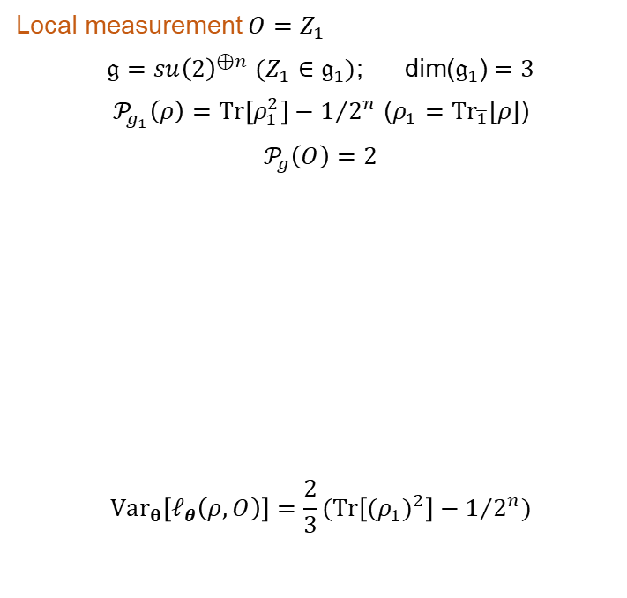
Revisiting previous examples
Google’s result:
$\text{𝔤}=su\left(2^{n}\right)$; $\text{dim}\text{(}\text{𝔤}\text{)}=4^{n}−1$
$𝒫_{g}\left(ρ\right)=Tr\left[ρ^{2}\right]−1/{2^{n}}$ ($ρ=ρ_{\text{𝔤}}−I/{2^{n}}$)
$𝒫_{g}\left(O\right)=Tr\left[O^{2}\right]$ ($O=O_{\text{𝔤}}−Tr[O]I/{2^{n}}$)
$$Var_{θ}\left[ℓ_{θ}\left(ρ, O\right)\right]=\frac{1}{4^{n}−1}(Tr\left[ρ^{2}\right]−1/{2^{n}})(Tr\left[O^{2}\right]−{Tr{\left[O\right]}^{2}}/{2^{n}})$$
Local measurement $O=Z_{1}$
$\text{𝔤}=su{\left(2\right)}^{⊕n}$ $(Z_{1}∈{\text{𝔤}}_{1})$; $\text{dim}\text{(}{\text{𝔤}}_{1}\text{)}=3$
$𝒫_{g_{1}}\left(ρ\right)=Tr\left[ρ_{1}^{2}\right]−1/{2^{n}}$ ($ρ_{1}=Tr_{\overline{1}}[ρ]$)
$𝒫_{g}\left(O\right)=2$
$$Var_{θ}\left[ℓ_{θ}\left(ρ, O\right)\right]=\frac{2}{3}(Tr\left[{(ρ_{1})}^{2}\right]−1/{2^{n}})$$
Generalized entanglement = standard entanglement
Algebra IS local
A Unified Theory of Barren Plateaus for Deep Parametrized Quantum Circuits, M. Ragone et al, arxiv (2023)

Slide 19

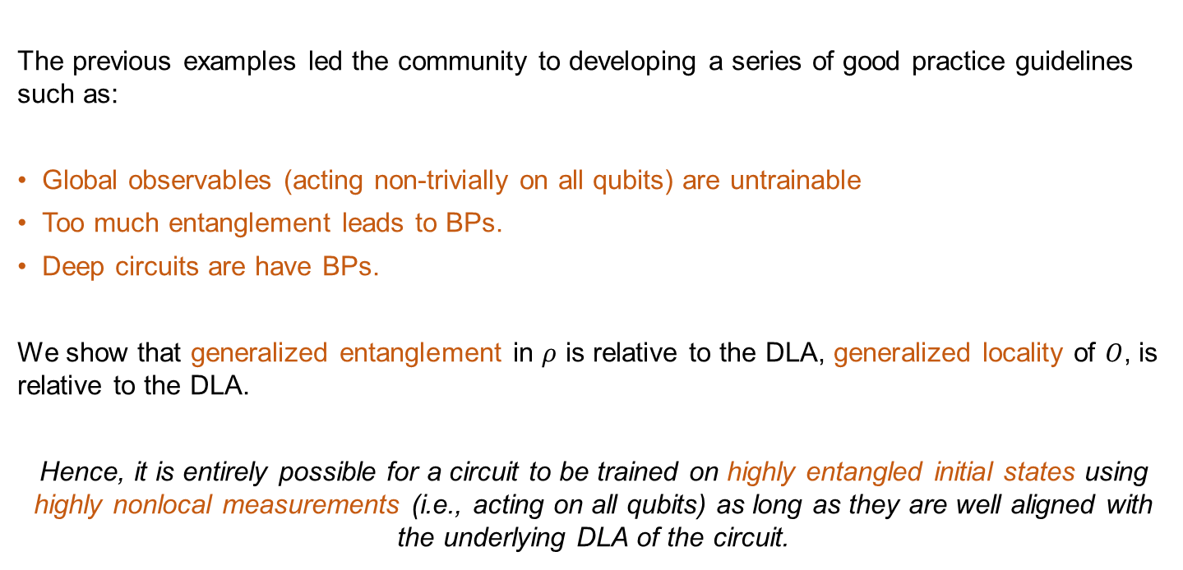
An important lesson learnt
The previous examples led the community to developing a series of good practice guidelines such as:
Global observables (acting non-trivially on all qubits) are untrainable
Too much entanglement leads to BPs.
Deep circuits are have BPs.
We show that generalized entanglement in $ρ$ is relative to the DLA, generalized locality of $O$, is relative to the DLA.
Hence, it is entirely possible for a circuit to be trained on highly entangled initial states using highly nonlocal measurements (i.e., acting on all qubits) as long as they are well aligned with the underlying DLA of the circuit.
A Unified Theory of Barren Plateaus for Deep Parametrized Quantum Circuits, M. Ragone et al, arxiv (2023)

Slide 20
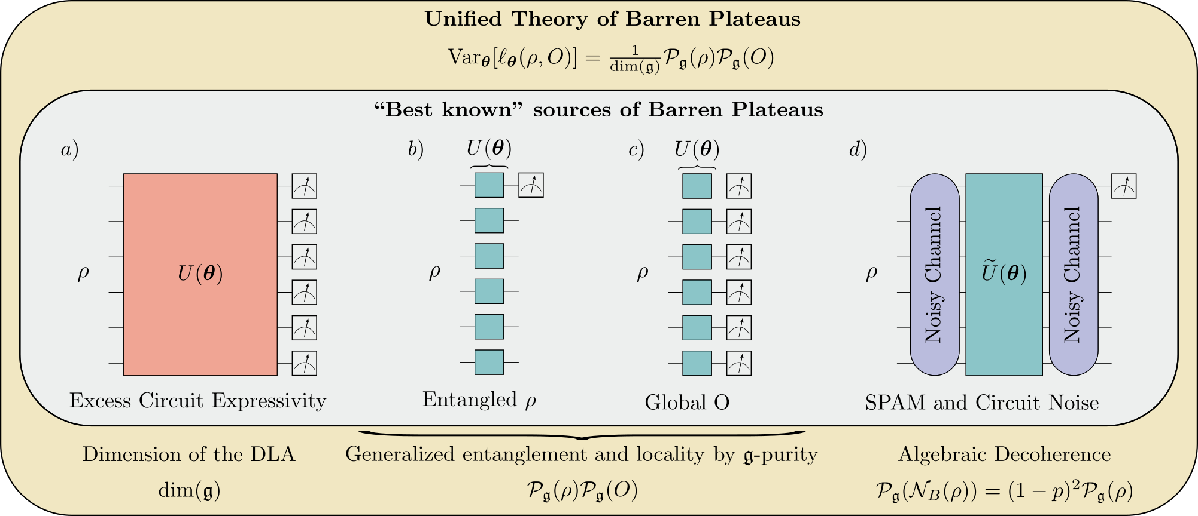
Summary
A Unified Theory of Barren Plateaus for Deep Parametrized Quantum Circuits, M. Ragone et al, arxiv (2023)

Slide 21

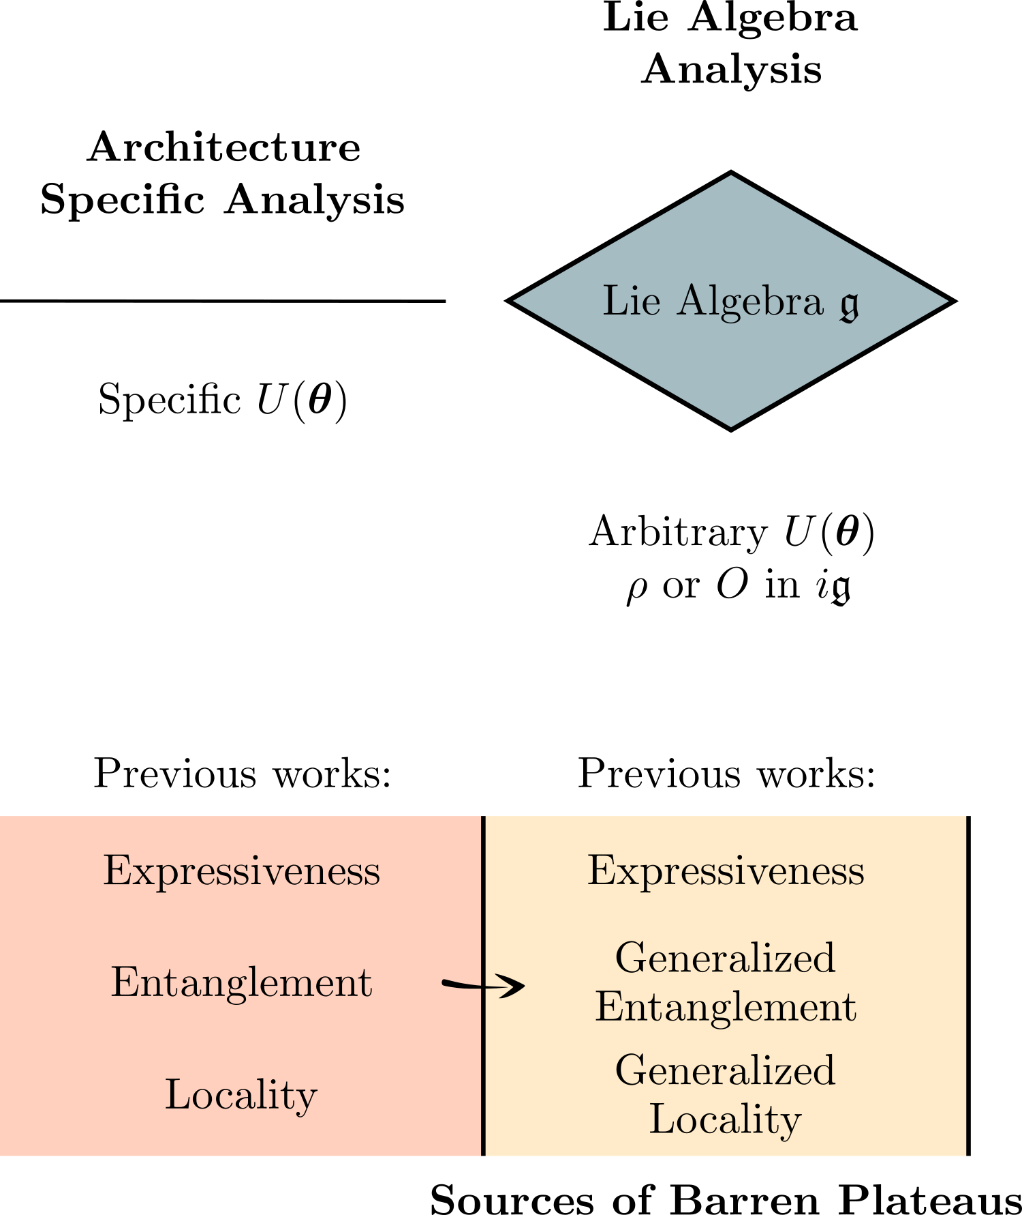

Slide 22
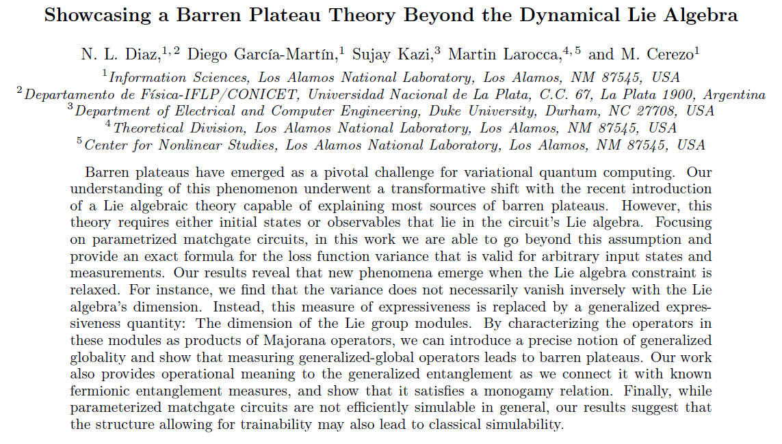
“Showcasing a Barren Plateau Theory Beyond the Dynamical Lie Algebra” arXiv:2310.11505 (2023). N. L. Diaz, et al

Slide 23
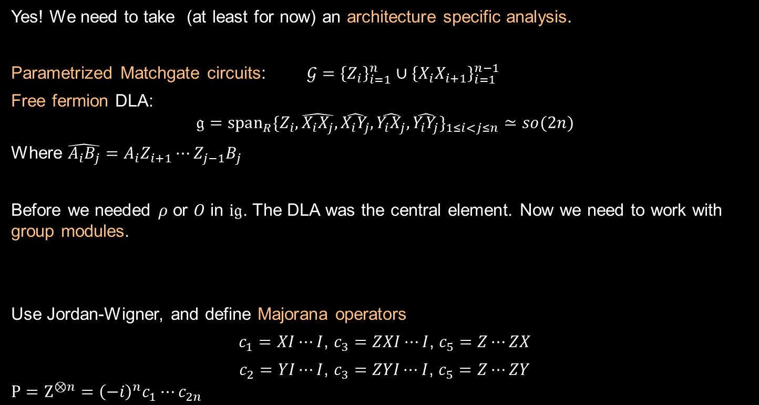


Can we go beyond the DLA?
Yes! We need to take (at least for now) an architecture specific analysis.
Parametrized Matchgate circuits: $𝒢={\left\{Z_{i}\right\}}_{i=1}^{n}∪{\left\{X_{i}X_{i+1}\right\}}_{i=1}^{n−1}$
Free fermion DLA:
$$\text{𝔤}=span_{R}\{Z_{i},\hat{X_{i}X_{j}},\hat{X_{i}Y_{j}},\hat{Y_{i}X_{j}},\hat{Y_{i}Y_{j}}\}_{1≤i<j≤n}≃so(2n)$$
Where $\hat{A_{i}B_{j}}=A_{i}Z_{i+1}⋯Z_{j−1}B_{j}$
Before we needed $ρ$ or $O$ in $i\text{𝔤}$. The DLA was the central element. Now we need to work with group modules.
Use Jordan-Wigner, and define Majorana operators
$c_{1}=XI⋯I$, $c_{3}=ZXI⋯I$, $c_{5}=Z⋯ZX$
$c_{2}=YI⋯I$, $c_{3}=ZYI⋯I$, $c_{5}=Z⋯ZY$
$$P=Z^{⊗n}={\left(−i\right)}^{n}c_{1}⋯c_{2n}$$
$ℬ=⊕_{κ=0}^{2n}ℬ_{κ}$; $\dim\left(ℬ_{κ}\right)=\left(\begin{matrix}2n \\ κ\end{matrix}\right)$
$∀M_{κ}∈ℬ_{κ}$, then $UM_{κ}U^{†}∈ℬ_{κ}$ for any $U∈e^{\text{𝔤}}$

Slide 24
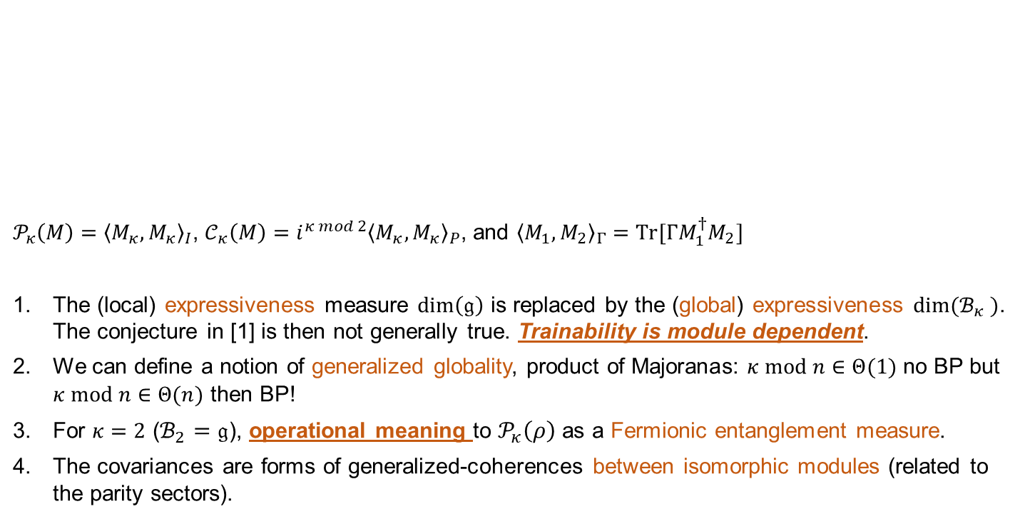
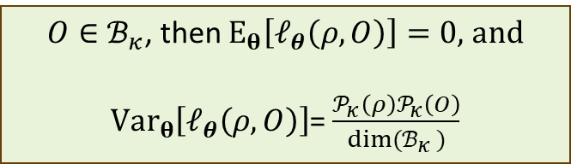
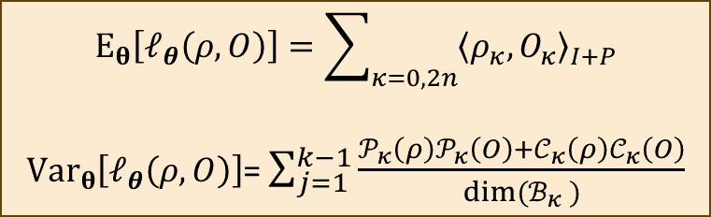
Moar exact variance formulae,
/môar/ - adj - A way of asking for more of something you want very badly
$𝒫_{κ}\left(M\right)={\left\langle M_{κ},M_{κ}\right\rangle }_{I}$, $𝒞_{κ}\left(M\right)=i^{κ mod 2}{\left\langle M_{κ},M_{κ}\right\rangle }_{P}$, and ${\left\langle M_{1},M_{2}\right\rangle }_{Γ}=Tr[ΓM_{1}^{†}M_{2}]$
The (local) expressiveness measure $\dim\left(\text{𝔤}\right)$ is replaced by the (global) expressiveness $dim⁡(ℬ_{κ} )$. The conjecture in [1] is then not generally true. Trainability is module dependent.
We can define a notion of generalized globality, product of Majoranas: $κ mod n∈Θ(1)$ no BP but $κ mod n∈Θ(n)$ then BP!
For $κ=2$ ($ℬ_{2}=\text{𝔤}$), operational meaning to $𝒫_{κ}\left(ρ\right)$ as a Fermionic entanglement measure.
The covariances are forms of generalized-coherences between isomorphic modules (related to the parity sectors).
$$E_{θ}\left[ℓ_{θ}\left(ρ, O\right)\right]=\sum_{κ=0,2n}{{\left\langle ρ_{κ},O_{κ}\right\rangle }_{I+P}}$$
$Var_{θ}\left[ℓ_{θ}\left(ρ, O\right)\right]$= $\sum_{j=1}^{k−1}{\frac{𝒫_{κ}\left(ρ\right)𝒫_{κ}\left(O\right)+𝒞_{κ}\left(ρ\right)𝒞_{κ}\left(O\right)}{dim⁡(ℬ_{κ} )}}$
$O∈ℬ_{κ}$, then $E_{θ}\left[ℓ_{θ}\left(ρ, O\right)\right]=0$, and
$Var_{θ}\left[ℓ_{θ}\left(ρ, O\right)\right]$= $\frac{𝒫_{κ}\left(ρ\right)𝒫_{κ}\left(O\right)}{dim⁡(ℬ_{κ} )}$
Remember, we have qubits!
Showcasing a Barren Plateau Theory Beyond the Dynamical Lie Algebra, NL Diaz et al,.
Entanglement in fermion systems, N. Gigena et al, Physical Review A (2015).

Slide 25
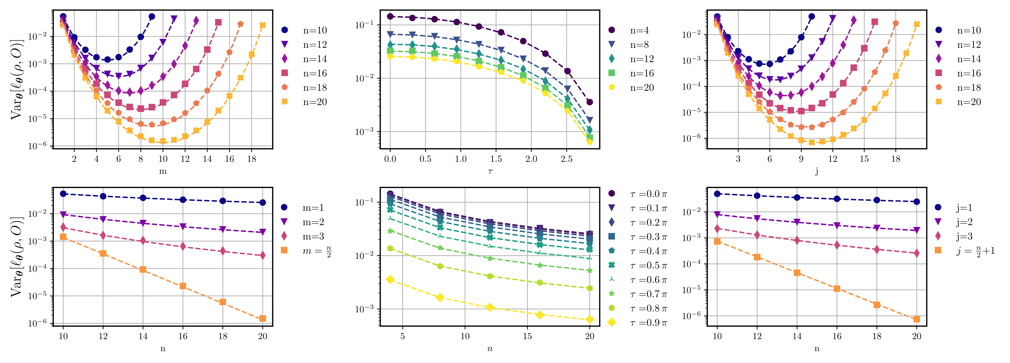
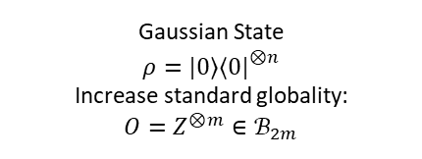
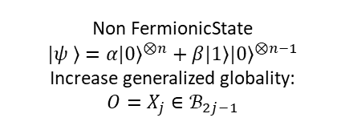
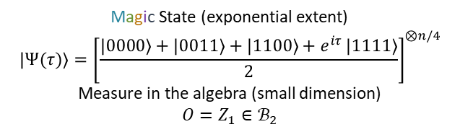
I do theory, but… here are some cool numerics:
Gaussian State
$$ρ=\left.|0\right\rangle {\left\langle 0|\right.}^{⊗n}$$
Increase standard globality:
$$O=Z^{⊗m}∈ℬ_{2m}$$
Magic State (exponential extent)
$$\left.|Ψ(τ)\right\rangle ={\left[\frac{\left.|0000\right\rangle +\left.|0011\right\rangle +\left.|1100\right\rangle +e^{iτ }\left.|1111\right\rangle }{2}\right]}^{⊗n/4}$$
Measure in the algebra (small dimension)
$$O=Z_{1}∈ℬ_{2}$$
Non FermionicState
$$\left.|ψ \right\rangle ={\left.α|0\right\rangle }^{⊗n}+{\left.β|1\right\rangle \left.|0\right\rangle }^{⊗n−1}$$
Increase generalized globality:
$$O=X_{j}∈ℬ_{2j−1}$$
Showcasing a Barren Plateau Theory Beyond the Dynamical Lie Algebra, NL Diaz et al.
Classical simulation of non-gaussian fermionic circuits, B. Dias arXiv (2023).

Slide 26
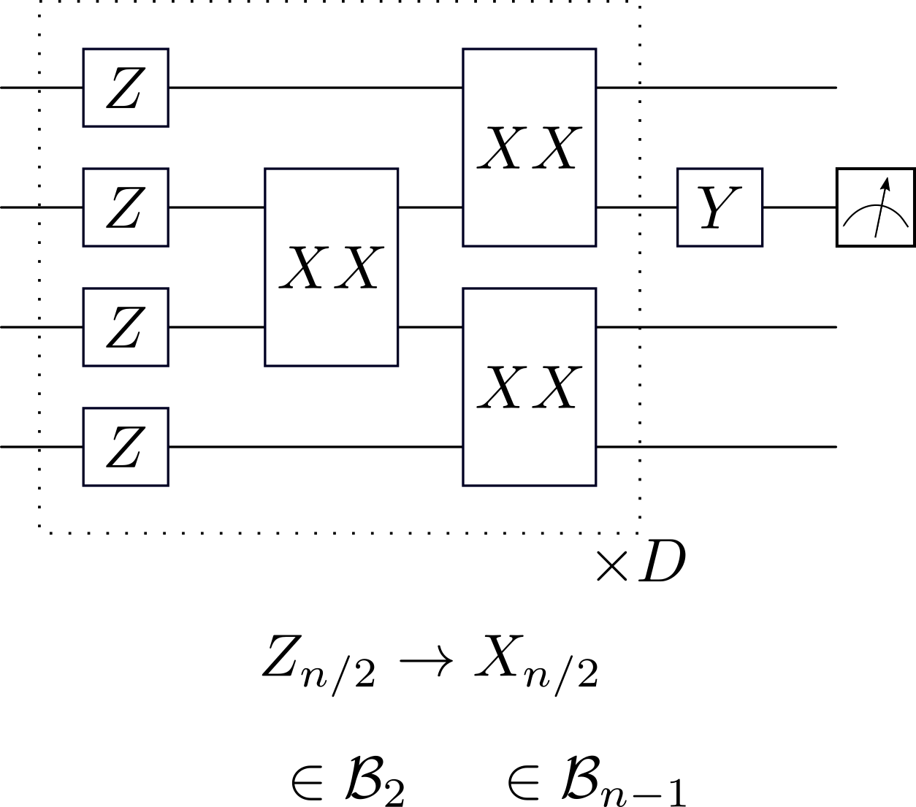
Enough is enough Marco! Ok, just one more cool result
Showcasing a Barren Plateau Theory Beyond the Dynamical Lie Algebra, NL Diaz et al.
Classical simulation of non-gaussian fermionic circuits, B. Dias arXiv (2023).

Slide 27
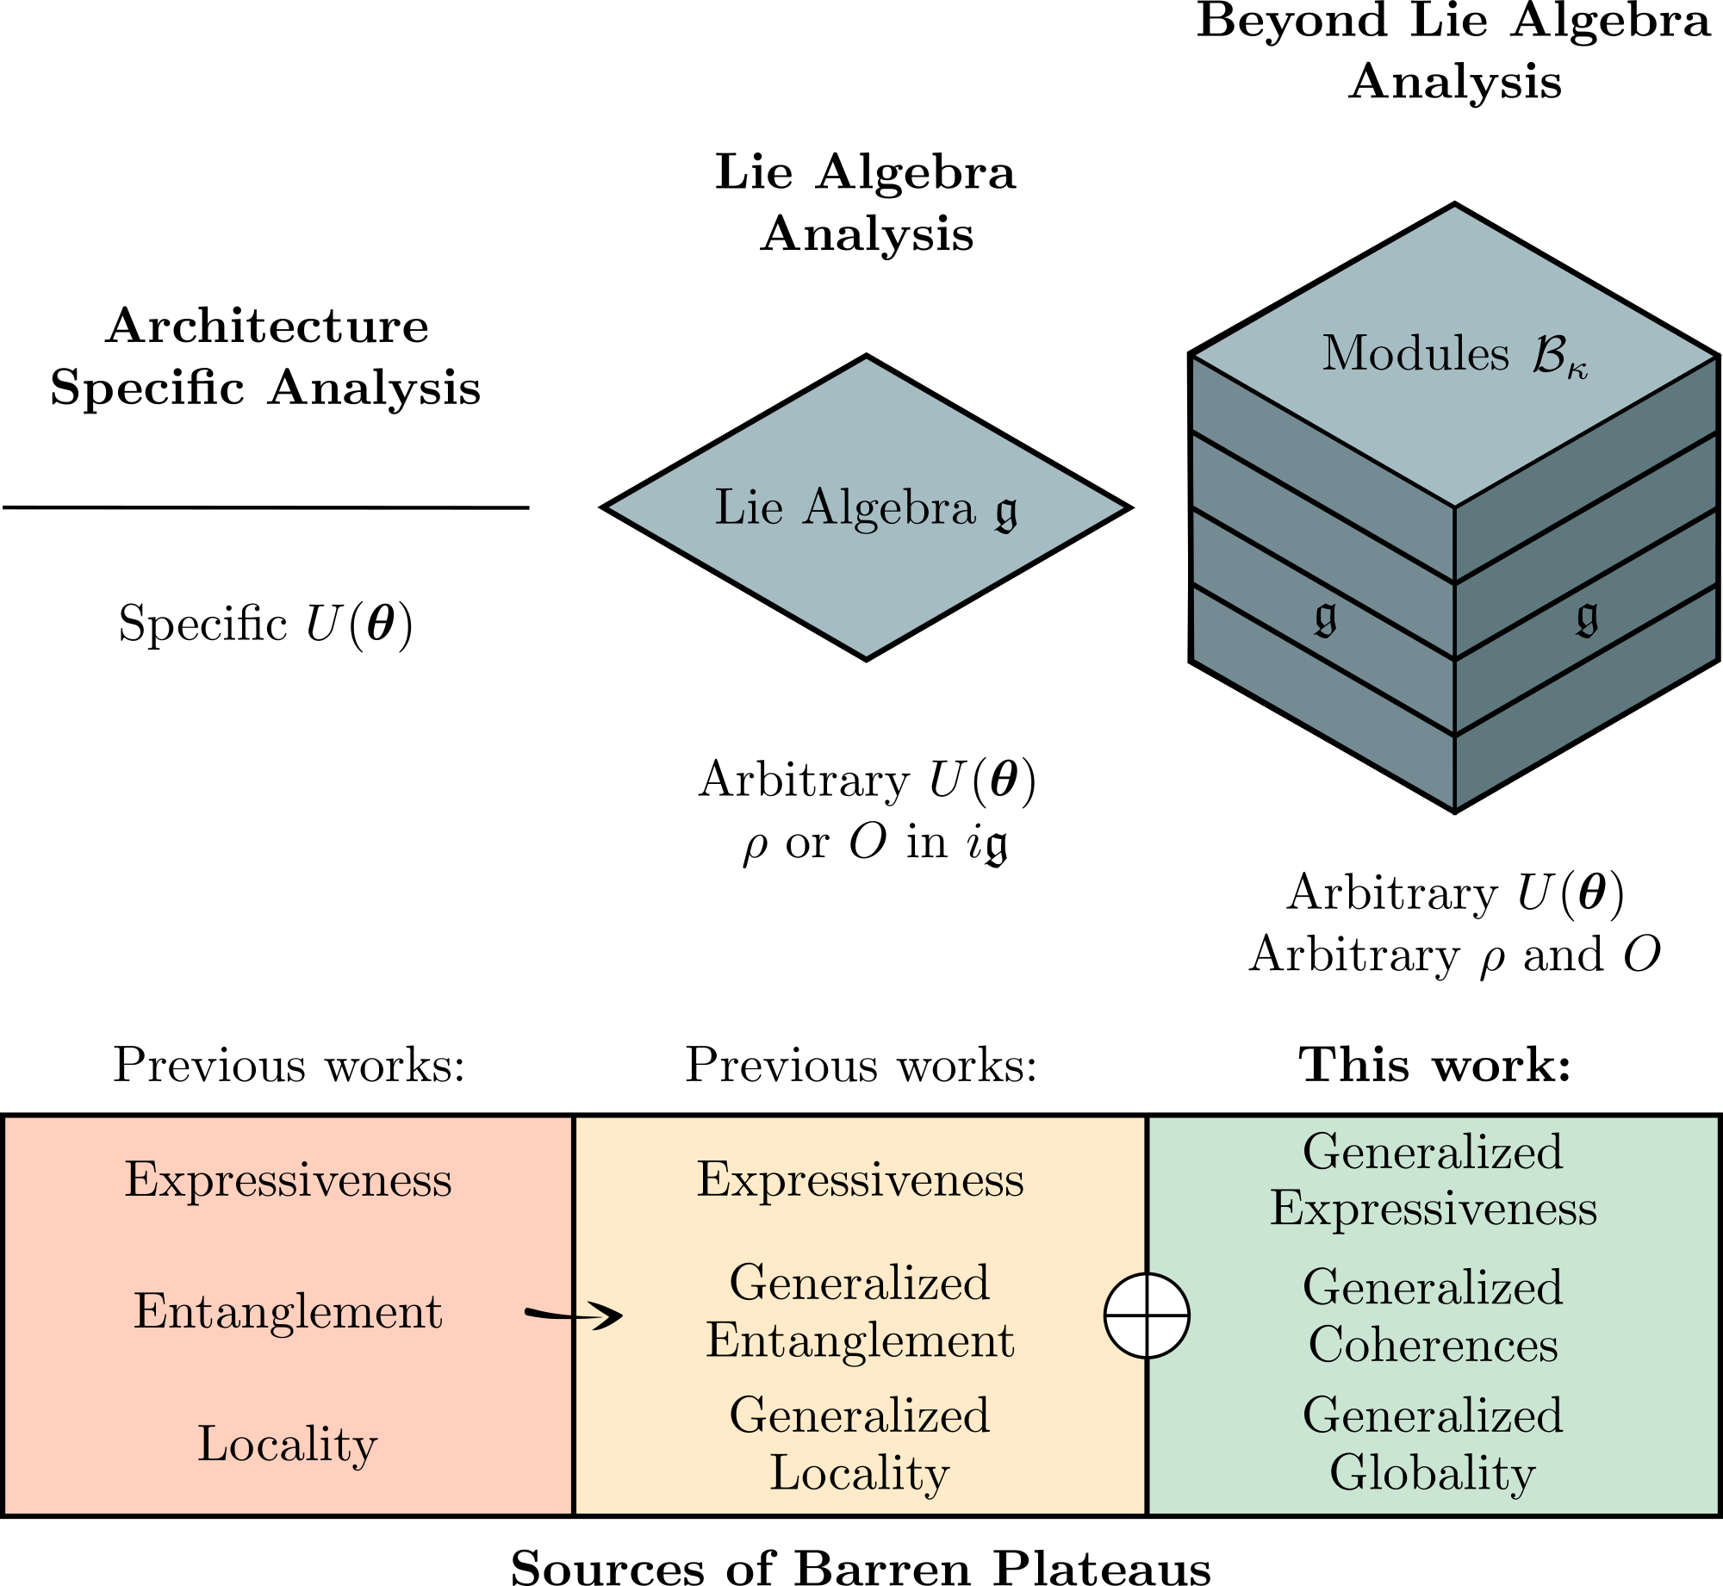
Towards a super duper, unified mega complete BP theory
Showcasing a Barren Plateau Theory Beyond the Dynamical Lie Algebra, NL Diaz et al.

Slide 28
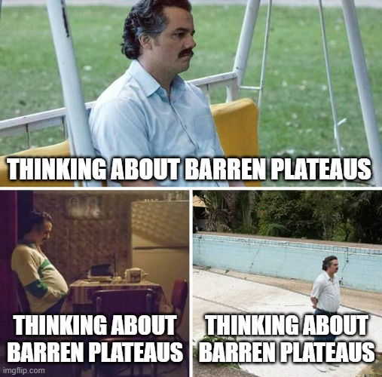

Slide 29
Phew.. That was a lot… What did we learn?
IMHO: Our understanding of BPs underwent a recent transformative shift. We can use these results to guide our model’s design.
Here are some open questions:
In the Matchgate case, we can relate trainability to fermionic entanglement (a computational resource that can promote matchgates to universal circuits). We see that e-v-e-r-y trainable model, is also (somehow*) classically simulable.
We even propose a simulation method for exponential magic states that are non-simulable via Wick theorem simulation-based techniques!)
What about noise?
What about shallow depth?
Non-expectation value-based models (generative)?
Is this connection more general?

Slide 30

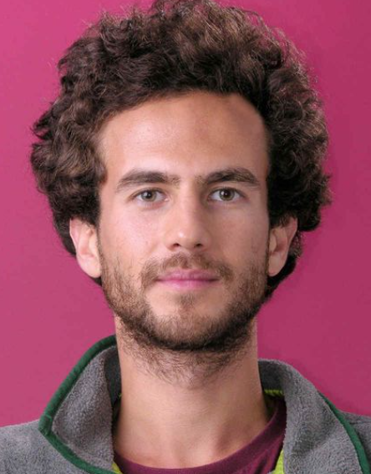

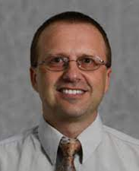








Thanks for your attention!
Michael Ragone
UC Davis
Frederic Sauvage
Ex-LANL (Quantinuum)
Martin Larocca LANL
Bojko Bakalov
NCU
Sujay Kazi
Duke
Lex Kemper
NCU
Carlos Ortiz Marrero
PNNL
Diego Garcia Martin
LANL
Nahuel Diaz
LANL
LANL’s 2024 Quantum Computing Summer School
Applications now open!
cerezo@lanl.gov

