Slide 1
Efficient information recovery from Pauli noise via classical shadow
Yifei Chen¹, Zhan Yu^{1,2}, Chenghong Zhu^{1,3}, and Xin Wang^{1,3}
1:Baidu Research
2:National University of Singapore
3:HKUST (Guangzhou)
arXiv: 2305.04148

Slide 2
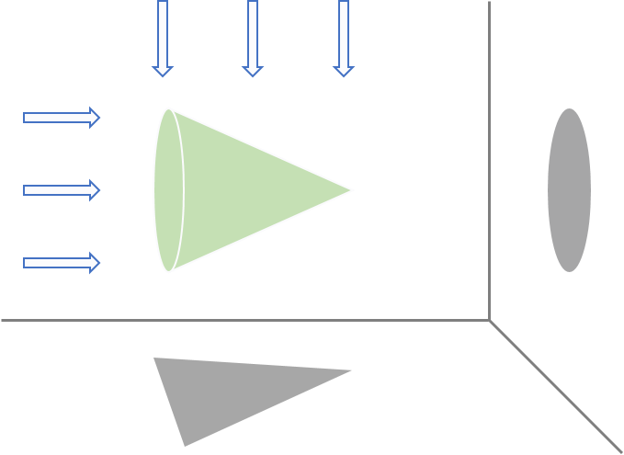





Shadow Information
Results we usually want from quantum computing are still classical information
Shadow information is the expectation value of some chosen observable: $Tr[Oσ]$
Shadow information is the target of many quantum algorithms
Estimation of the information $Tr[Oσ]$is obtained via making measurements with the corresponding observable O and post-processing.
$$O_{1}$$
$$O_{2}$$
$$Tr\left[O_{2}σ\right]$$
$$Tr\left[O_{1}σ\right]$$

Slide 3



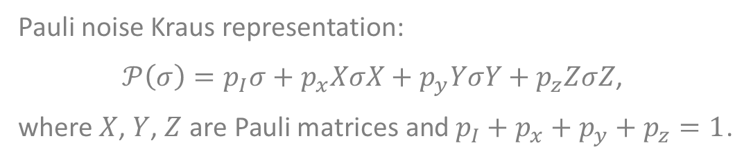






Pauli noise
One of the most standard theoretical models for quantum noise in the study of quantum error correction and mitigation is Pauli noise.
$$p_{I}$$
$$σ$$
$$p_{x}$$
$$XσX$$
Pauli noise Kraus representation:
$𝒫\left(σ\right)=p_{I}σ+p_{x}XσX+p_{y}YσY+p_{z}ZσZ$,
where $X$, $Y$, $Z$ are Pauli matrices and $p_{I}+p_{x}+p_{y}+p_{z}=1$.
$$σ$$
$$𝒫$$
$$p_{y}$$
$$YσY$$
$$p_{z}$$
$$ZσZ$$
Pauli twirling can be applied to converts any noise channel to a Pauli channel

Slide 4
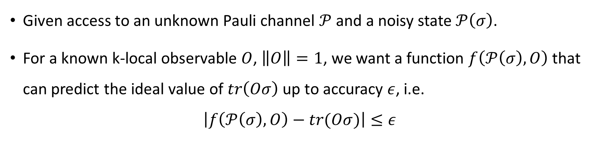
Problem of recovering from Pauli noise
Given access to an unknown Pauli channel $𝒫$ and a noisy state $𝒫\left(σ\right)$.
For a known k-local observable $O$, $\left\|O\right\|=1$, we want a function $f\left(𝒫\left(σ\right),O\right)$ that can predict the ideal value of $tr\left(Oσ\right)$ up to accuracy $ε$, i.e.
$$\left|f\left(𝒫\left(σ\right),O\right)−tr(Oσ)\right|≤ε$$

Slide 5








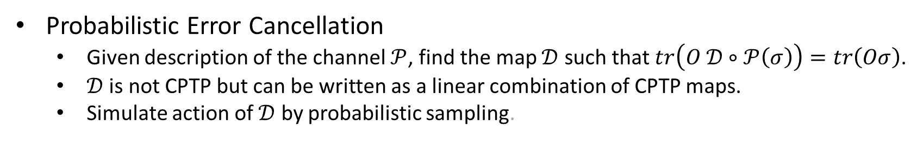



Known method
Probabilistic Error Cancellation
  Given description of the channel $𝒫$, find the map $𝒟$ such that $tr\left(O 𝒟∘𝒫\left(σ\right)\right)=tr\left(Oσ\right)$.
  $𝒟$ is not CPTP but can be written as a linear combination of CPTP maps.
  Simulate action of $𝒟$ by probabilistic sampling.
Description of the channel required
  Tomography – computational inefficient and still an approximation
  Typically requires number of copies exponentially in number of qubits
$$𝒩(σ)$$
$$𝒟^{\left(1\right)}$$
$$scti$$
Post
Processing
$$scti$$
$$𝒩(σ)$$
$$𝒟^{\left(2\right)}$$
$$scti$$
$$scti$$
Implementation of arbitrary CPTP map required
$$Tr[Oσ]$$
$$𝒩(σ)$$
$$𝒟^{\left(3\right)}$$
$$scti$$
$$scti$$
$$⋮$$
$$⋮$$
$$⋮$$
$$𝒩(σ)$$
$$𝒟^{\left(S\right)}$$
$$scti$$
$$scti$$
Zhao, Xuanqiang, et al. "Information recoverability of noisy quantum states." Quantum 7 (2023): 978.

Slide 6
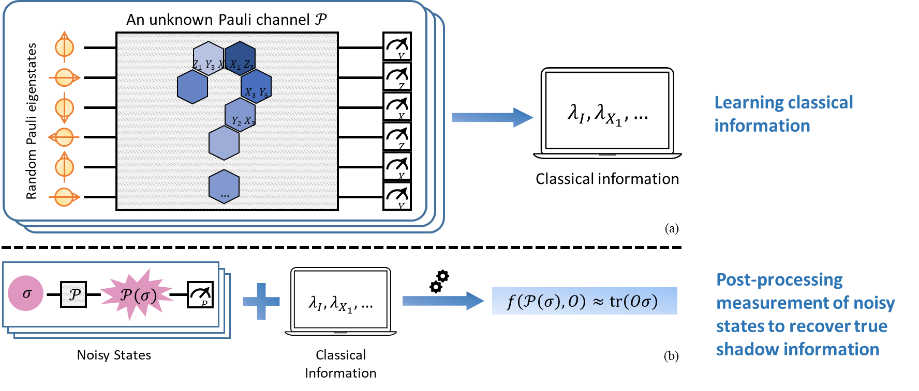
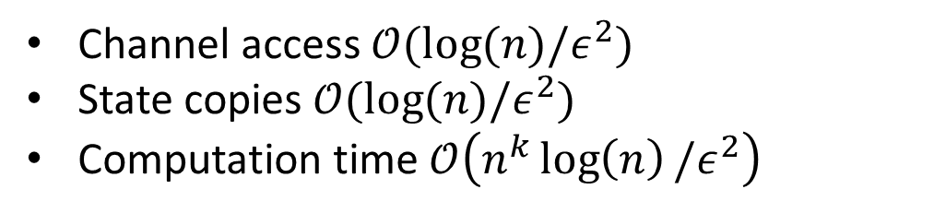
Main result
Efficient algorithm for information recovery from Pauli noise for local observable
Channel access $𝒪(\log{(n)/ε^{2}) }$
State copies $𝒪(\log{(n)/ε^{2}) }$
Computation time $𝒪\left(n^{k}\log\left(n\right)/ε^{2}\right)$

Slide 7
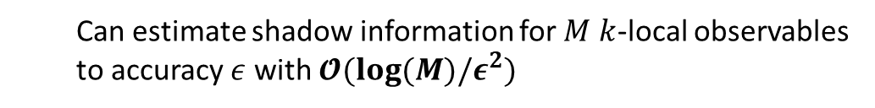

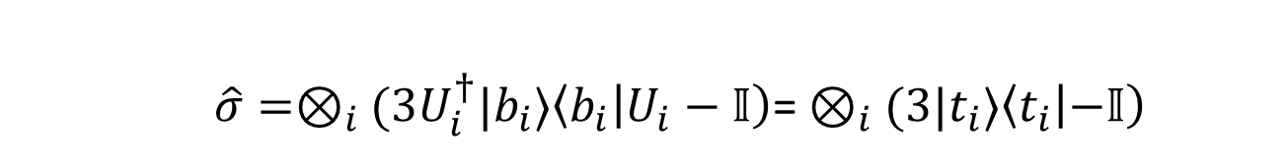


Classical shadow
Used to predict $tr(Oσ)$ for a set of $O$ simultaneously
Random
Unitary
$$\hat{σ}$$
$$σ$$
Unknown
State
Estimate of state
using measurement data
Repeated for a few times
  $\hat{σ}=⊗_{i}(3U_{i}^{†}|b_{i}⟩\left\langle b_{i} | U_{i}−𝕀\right)$= $⊗_{i}$ $(3|t_{i}⟩\left\langle t_{i} | −𝕀\right)$
  Can estimate shadow information for $M$ $k$-local observables to accuracy $ε$ with $𝓞(log⁡(M)/ε^{2})$
Huang, Hsin-Yuan, Richard Kueng, and John Preskill. "Predicting many properties of a quantum system from very few measurements." Nature Physics 16.10 (2020): 1050-1057.

Slide 8
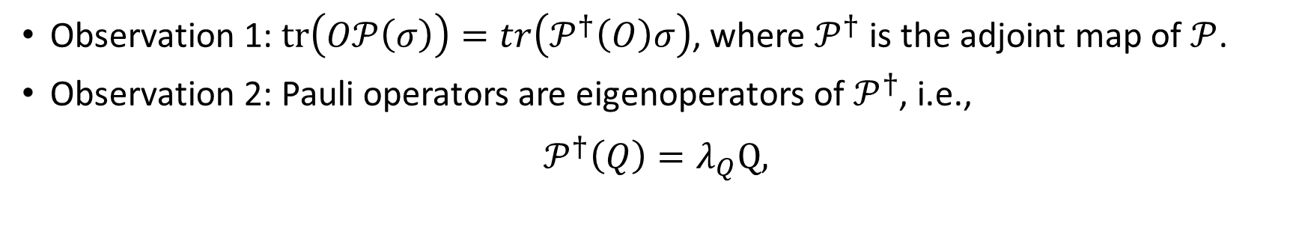
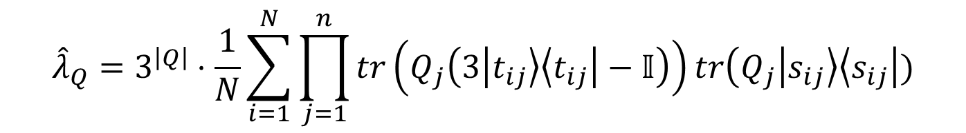
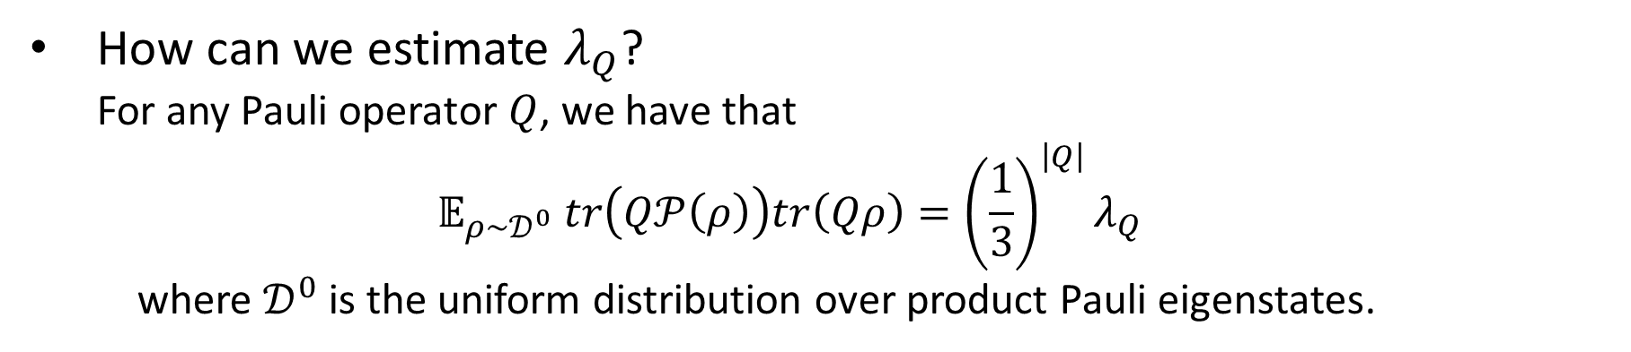
Learning the Pauli channel
Observation 1: $tr\left(O𝒫\left(σ\right)\right)=tr\left(𝒫^{†}\left(O\right)σ\right)$, where $𝒫^{†}$ is the adjoint map of $𝒫$.
Observation 2: Pauli operators are eigenoperators of $𝒫^{†}$, i.e.,
$$𝒫^{†}\left(Q\right)=λ_{Q}Q,$$
How can we estimate $λ_{Q}$?
  For any Pauli operator $Q$, we have that
  $$𝔼_{ρ∼𝒟^{0}} tr\left(Q𝒫\left(ρ\right)\right)tr\left(Qρ\right)={\left(\frac{1}{3}\right)}^{\left|Q\right|}λ_{Q}$$
  where $𝒟^{0}$ is the uniform distribution over product Pauli eigenstates.
$${\hat{λ}}_{Q}=3^{\left|Q\right|}⋅\frac{1}{N}\sum_{i=1}^{N}{\prod_{j=1}^{n}{tr\left(Q_{j}\left(3\left|t_{ij}\right\rangle \left\langle t_{ij}\right|−𝕀\right)\right)tr\left(Q_{j} | s_{ij}\right\rangle \left\langle s_{ij}\right|)}}$$

Slide 9


Recover shadow information
For any $\overset{⃖}{O}=\sum_{Q}{{\overset{⃖}{α}}_{Q}Q}$,
$$tr\left(\overset{⃖}{O}𝒫\left(σ\right)\right)=\sum_{Q}{{\overset{⃖}{α}}_{Q}λ_{Q}tr\left(Qσ\right)}$$
Compare with $tr\left(Oσ\right)=\sum_{Q}{α_{Q}tr(Qσ})$, simply set ${\overset{⃖}{α}}_{Q}=\frac{α_{Q}}{λ_{Q}}$.
  $$\sum_{Q:\left|Q\right|≤k}{\frac{α_{Q}}{λ_{Q}}tr\left(Q𝒫\left(σ\right)\right)}=tr(Oσ)$$
$$\sum_{Q:\left|Q\right|≤k}{\frac{α_{Q}}{{\hat{λ}}_{Q}}\hat{tr}\left(Q𝒫\left(σ\right)\right)}$$

Slide 10
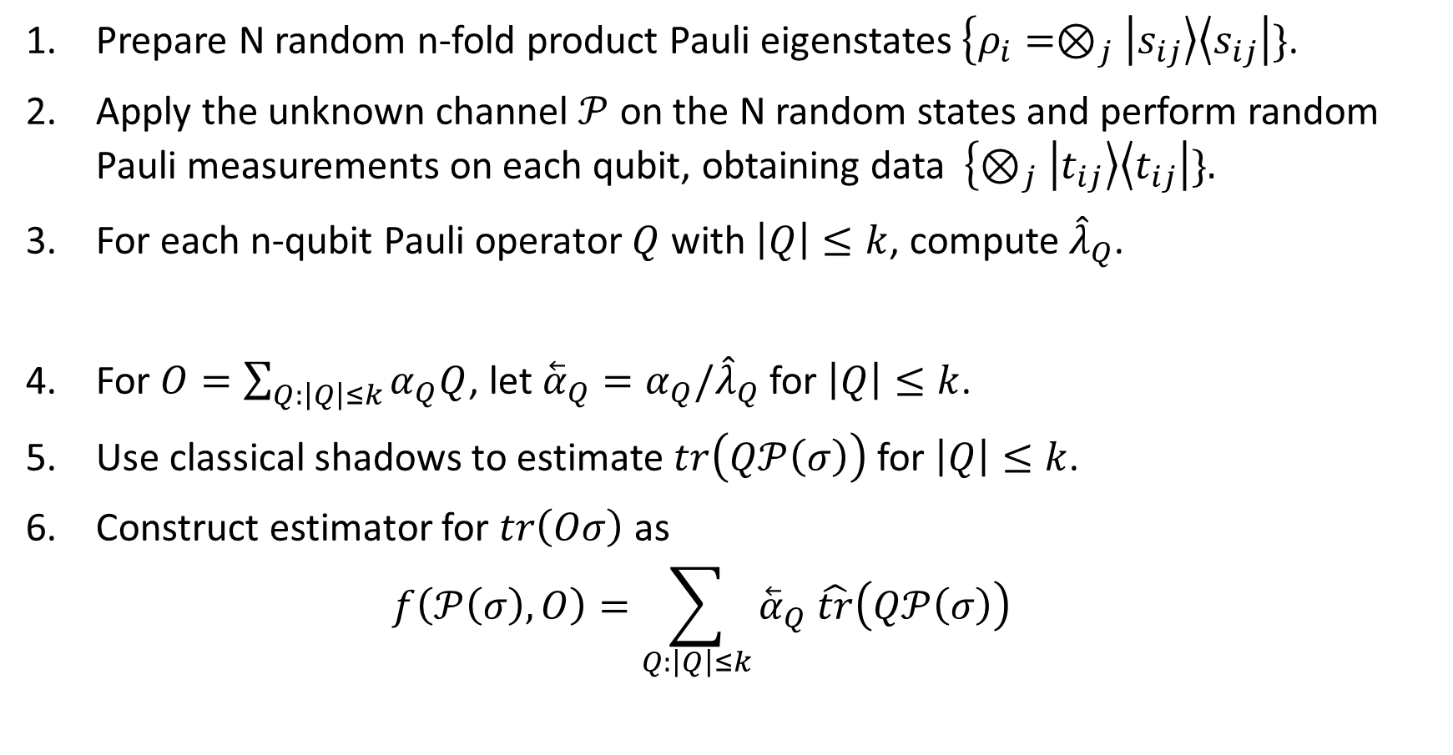
Algorithm for information recovery
Prepare N random n-fold product Pauli eigenstates $\left\{ρ_{i}=⊗_{j} | s_{ij}\right\rangle \left\langle s_{ij}\right|\}$.
Apply the unknown channel $𝒫$ on the N random states and perform random Pauli measurements on each qubit, obtaining data $\left\{⊗_{j} | t_{ij}\right\rangle \left\langle t_{ij}\right|\}.$
For each n-qubit Pauli operator $Q$ with $\left|Q\right|≤k$, compute ${\hat{λ}}_{Q}$.
For $O=\sum_{Q:\left|Q\right|≤k}{α_{Q}Q}$, let ${\overset{⃖}{α}}_{Q}=α_{Q}/{\hat{λ}}_{Q}$ for $\left|Q\right|≤k$.
Use classical shadows to estimate $tr\left(Q𝒫\left(σ\right)\right)$ for $\left|Q\right|≤k$.
Construct estimator for $tr\left(Oσ\right)$ as
  $$f\left(𝒫\left(σ\right),O\right)=\sum_{Q:\left|Q\right|≤k}{{\overset{⃖}{α}}_{Q} \hat{tr}\left(Q𝒫\left(σ\right)\right)}$$
Learning
Post-processing

Slide 11

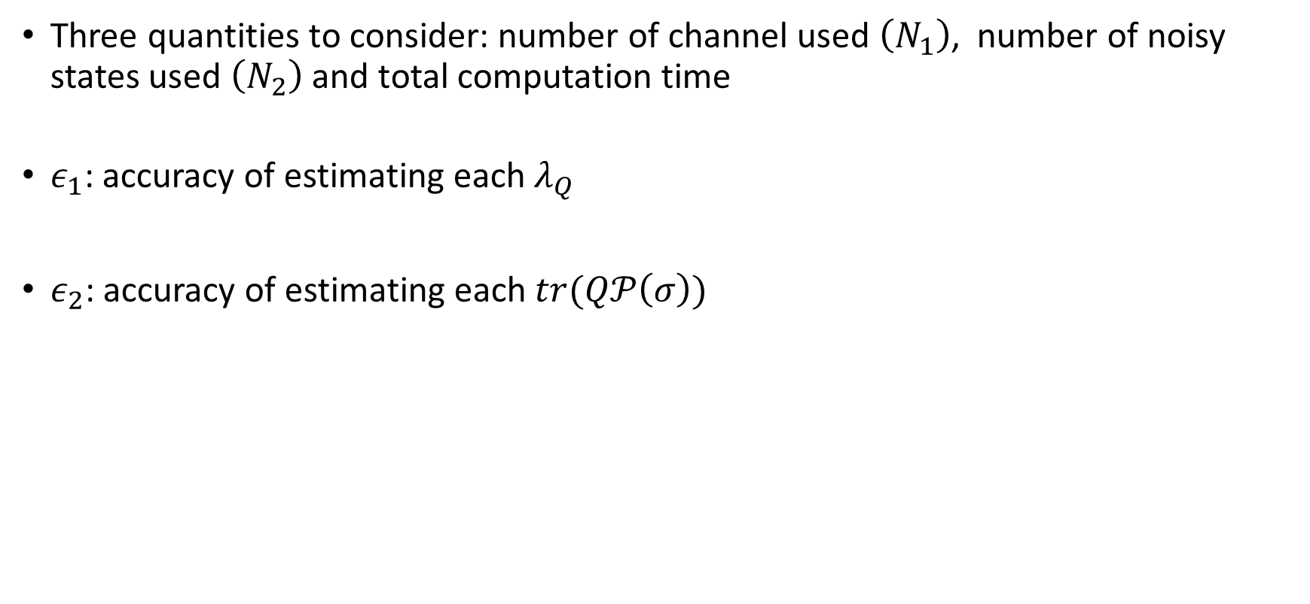




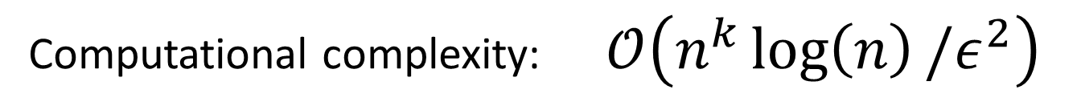
Complexity of the algorithm
Three quantities to consider: number of channel used $\left(N_{1}\right)$, number of noisy states used $\left(N_{2}\right)$ and total computation time
$ε_{1}$: accuracy of estimating each $λ_{Q}$
$ε_{2}$: accuracy of estimating each $tr(Q𝒫\left(σ\right))$
$$N_{1}=𝒪(\log\left(n^{k}\right)/ε_{1}^{2})$$
$$ε_{1}=Cλ_{min}^{\left(k\right)}ε$$
$$𝒪(\log\left(n\right)/ε^{2})$$
$$N_{2}=𝒪(\log\left(n^{k}\right)/ε_{2}^{2})$$
$$ε_{2}=𝒪(ε\left(1−ε\right))$$
Computational complexity: $𝒪\left(n^{k}\log\left(n\right)/ε^{2}\right)$

Slide 12
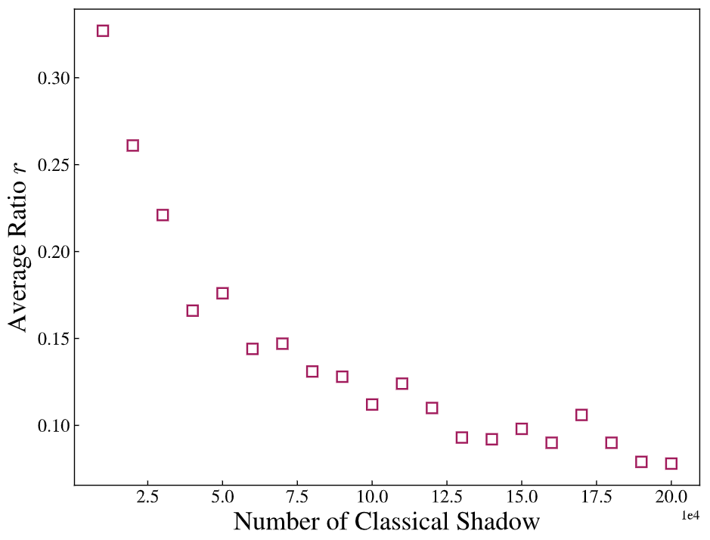

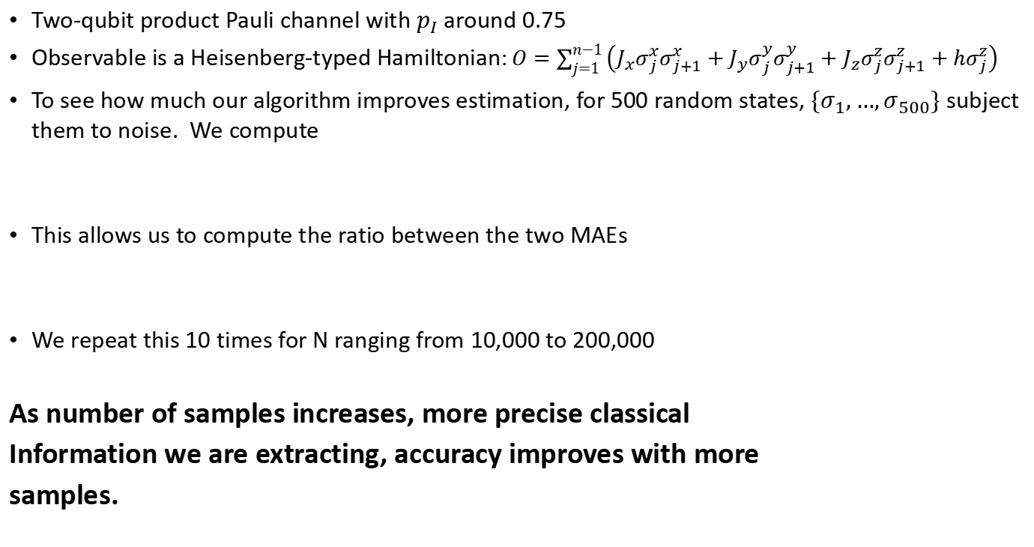


Numerical experiments
Two-qubit product Pauli channel with $p_{I}$ around 0.75
Observable is a Heisenberg-typed Hamiltonian: $O=\sum_{j=1}^{n−1}{\left(J_{x}σ_{j}^{x}σ_{j+1}^{x}+J_{y}σ_{j}^{y}σ_{j+1}^{y}+J_{z}σ_{j}^{z}σ_{j+1}^{z}+hσ_{j}^{z}\right)}$
To see how much our algorithm improves estimation, for 500 random states, $\{σ_{1},…,σ_{500}\}$ subject them to noise. We compute
This allows us to compute the ratio between the two MAEs
We repeat this 10 times for N ranging from 10,000 to 200,000
As number of samples increases, more precise classical
Information we are extracting, accuracy improves with more
samples.
MAE with no
post-processing
$$=\frac{1}{500}\sum_{i=1}^{500}{|tr\left(O𝒫\left(σ_{i}\right)\right)−tr\left(Oσ_{i}\right)|}$$
MAE with
post-processing
$$=\frac{1}{500}\sum_{i=1}^{500}{|f\left(𝒫\left(σ_{i}\right),O\right)−tr\left(Oσ_{i}\right)|}$$
$$r=\frac{\text{MAE} \text{with} \text{post}\text{−}\text{processing}}{\text{MAE} \text{with} \text{no} \text{post}\text{−}\text{processing}}$$

Slide 13
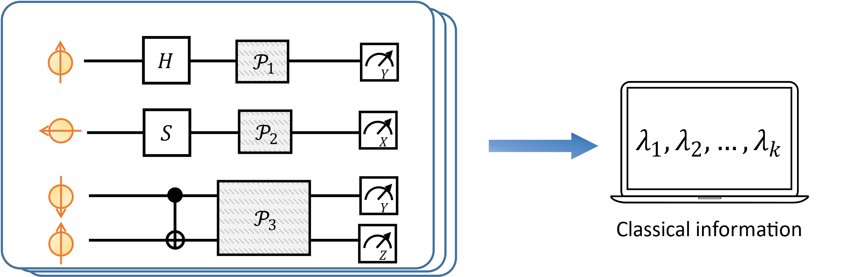
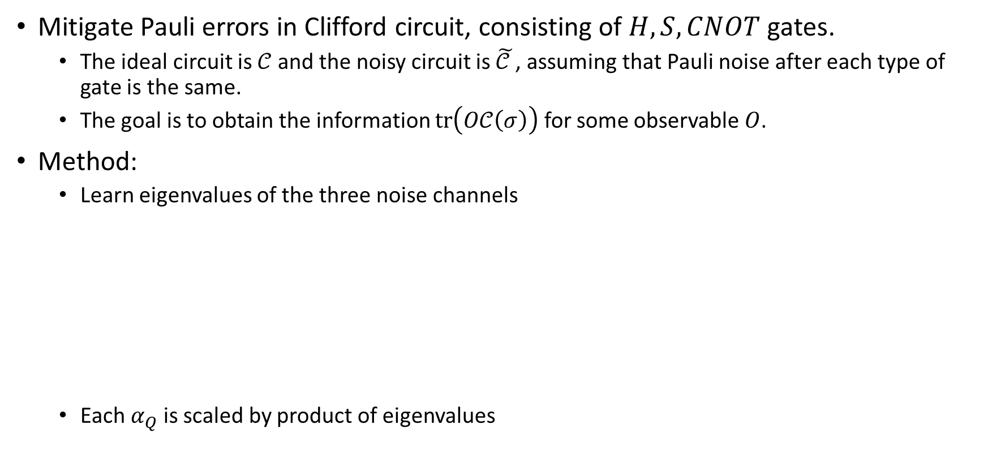
Application in mitigating Pauli errors in Clifford circuits
Mitigate Pauli errors in Clifford circuit, consisting of $H, S, CNOT$ gates.
  The ideal circuit is $𝒞$ and the noisy circuit is $\tilde{𝒞 }$, assuming that Pauli noise after each type of gate is the same.
  The goal is to obtain the information $tr\left(O𝒞\left(σ\right)\right)$ for some observable $O$.
Method:
  Learn eigenvalues of the three noise channels
  Each$α_{Q}$ is scaled by product of eigenvalues

Slide 14
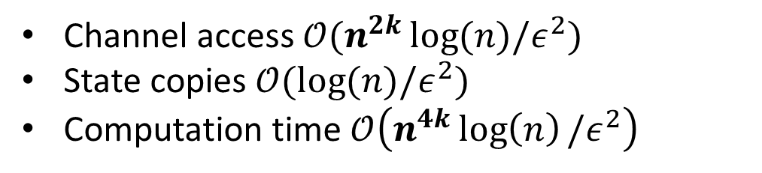
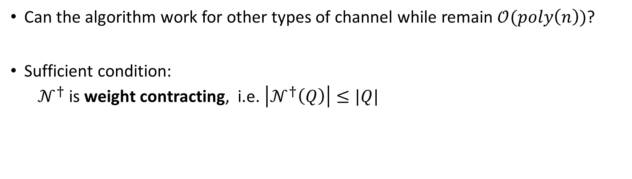
Extensions of the algorithm
Can the algorithm work for other types of channel while remain $𝒪(poly\left(n\right))$?
Sufficient condition:
  $𝒩^{†}$ is weight contracting, i.e. $\left|𝒩^{†}\left(Q\right)\right|≤|Q|$
Updated algorithm for weight contracting channel
Channel access $𝒪(n^{2k}\log{(n)/ε^{2}) }$
State copies $𝒪(\log{(n)/ε^{2}) }$
Computation time $𝒪\left(n^{4k}\log\left(n\right)/ε^{2}\right)$

Slide 15
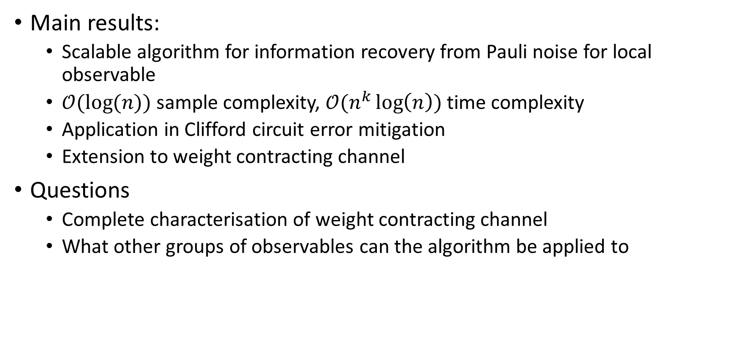
Conclusion
Main results:
  Scalable algorithm for information recovery from Pauli noise for local observable
  $𝒪(\log{(n))}$ sample complexity, $𝒪(n^{k}\log\left(n\right))$ time complexity
  Application in Clifford circuit error mitigation
  Extension to weight contracting channel
Questions
  Complete characterisation of weight contracting channel
  What other groups of observables can the algorithm be applied to
Thank you for listening
arXiv: 2305.04148

