Slide 1
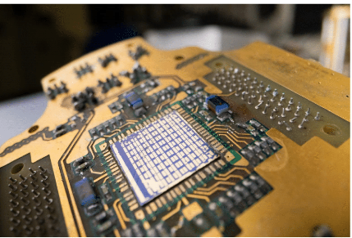

Machine learning for tackling quantum device variability
Natalia Ares
University of Oxford

Slide 2
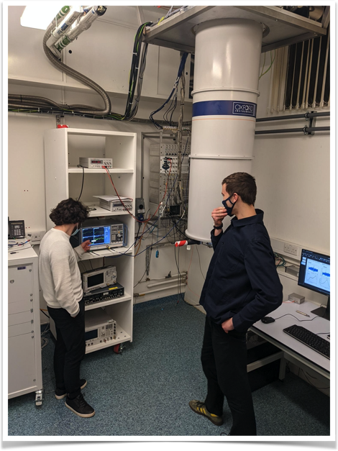
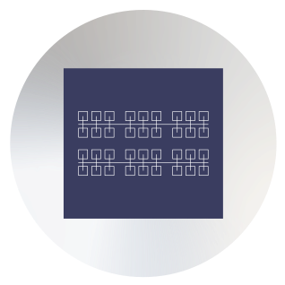
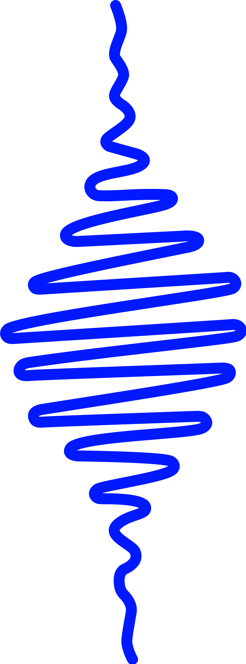
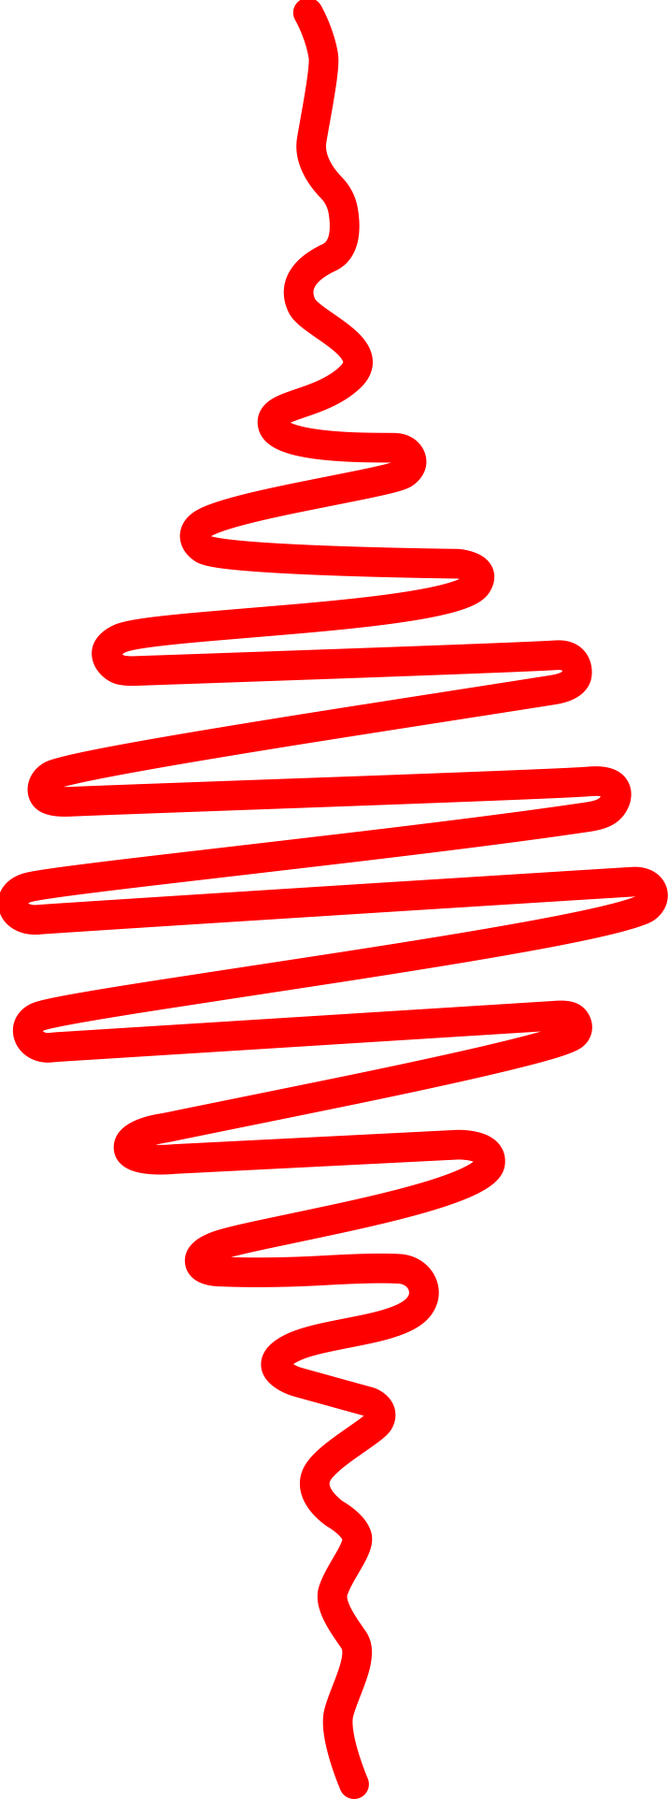
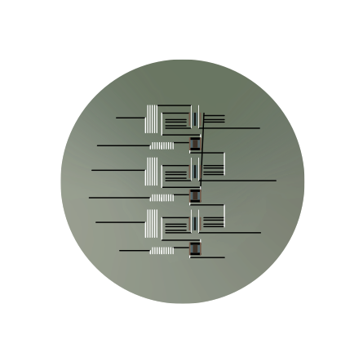
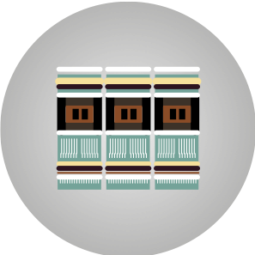
A quantum device lab
Human’s loop
Quantum hardware
while human not satisfied with the result
fix parameters
measure
evaluate measurement
else:
go for coffee
Human
Human
Semiconductor
chips
Ion traps
Superconducting
chips
Big parameter space
Big variability between devices
Error thresholds >99%
Small data sets
Big variability between devices
Flat optimisation landscapes
Noisy data and (in some cases) hysteretic

Slide 3
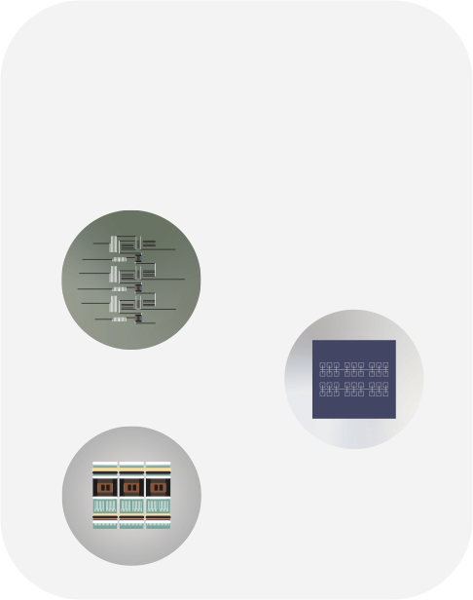
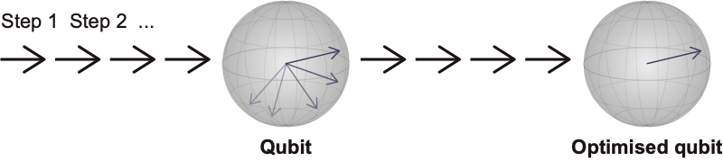
From quantum chip to qubit
Quantum devices
Superconducting
devices
Semiconductor
devices
Ion traps
Machine
Learning
Machine
Learning
N. Ares, Nature Reviews Materials 6,870 (2021)

Slide 4
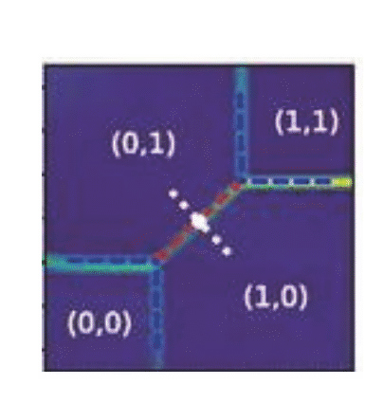

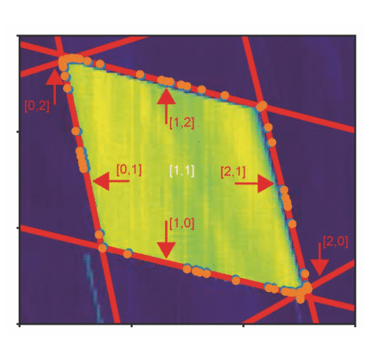
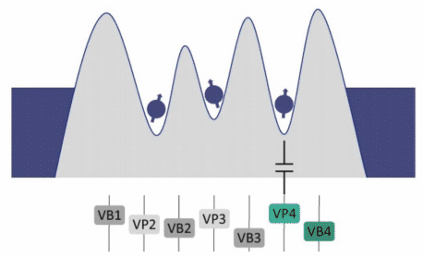
Van Diepen, C . J . et al . Appl . Phys .
Lett . 113 , 033101 (2018)
Botzem, T. et al. Phys. Rev. Appl. 10 ,
054026 (2018)
Teske, J . D . et al . Appl . Phys .
Lett . 114 , 133102 (2019)
Machine learning for spin qubit tuning
Baart, T. A. et al. Appl. Phys. Lett. 108 ,
213104 (2016)
Darulová, J. et al. Phys. Rev. Appl. 13 ,
054005 (2020)
Kalantre, S . S . et al . npj QI 5 , 6 (2019)
Zwolak, J. P. et al. Phys. Rev. Appl. 13 , 034075
(2020)
Durrer, R., et al. Phys. Rev. Appl. 13 , 054019 (2020)
Chatterjee et al. arXiv:2108.10656
Krause et al. arXiv:2205.01443
Krause et al. Electronics 15, 2327 (2022)
Gate Voltage 2
Gate Voltage 2
Gate Voltage 1
Gate Voltage 2
Mills, A. R. et al. Appl. Phys. Lett. 115 ,
113501 (2019)
Volk, C . et al . npj QI . 5 , 29 (2019)
Gate Voltage 1
Gate Voltage 1

Slide 5
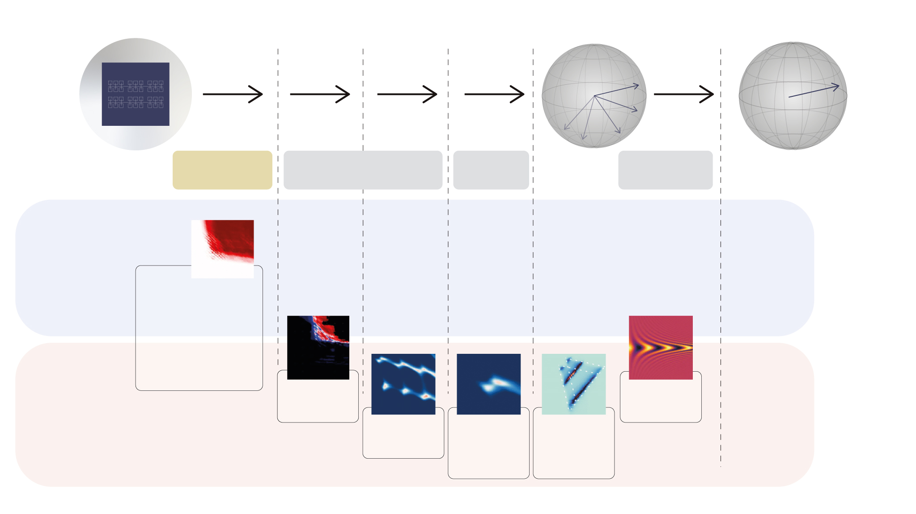
Automating quantum device tuning
https://github.com/oxquantum-repo/
Semiconductor
chip
Qubit
Optimised
qubit
Step 1:
Tune
Step 2 and 3:
Characterise
Step 4:
Refine
Step 5:
Find optimal
No Deep
learning
- van Straaten et al. arXiv:2211.04504
- Severin et al. arXiv:2107.12975
- Craig et al. arXiv:2111.11285
- Moon et al. Nat. Commun. (2020)
Lennon et al.
npj QI (2019)
soon…
Deep
learning
Nguyen et al.
npj QI (2021)
van Esbroeck
et al. NJP
(2020)
Schuff et al.
Quantum 7,
1077 (2023)
N. Ares, Nature Reviews Materials 6,870 (2021)

Slide 6
Automating quantum device tuning
https://github.com/oxquantum-repo/
Semiconductor
chip
Qubit
Optimised
qubit
Step 1:
Tune
Step 2 and 3:
Characterise
Step 4:
Refine
Step 5:
Find optimal
No Deep
learning
- van Straaten et al. arXiv:2211.04504
- Severin et al. arXiv:2107.12975
- Craig et al. arXiv:2111.11285
- Moon et al. Nat. Commun. (2020)
Lennon et al.
npj QI (2019)
soon…
Deep
learning
Nguyen et al.
npj QI (2021)
van Esbroeck
et al. NJP
(2020)
Schuff et al.
Quantum 7,
1077 (2023)
N. Ares, Nature Reviews Materials 6,870 (2021)

Slide 7
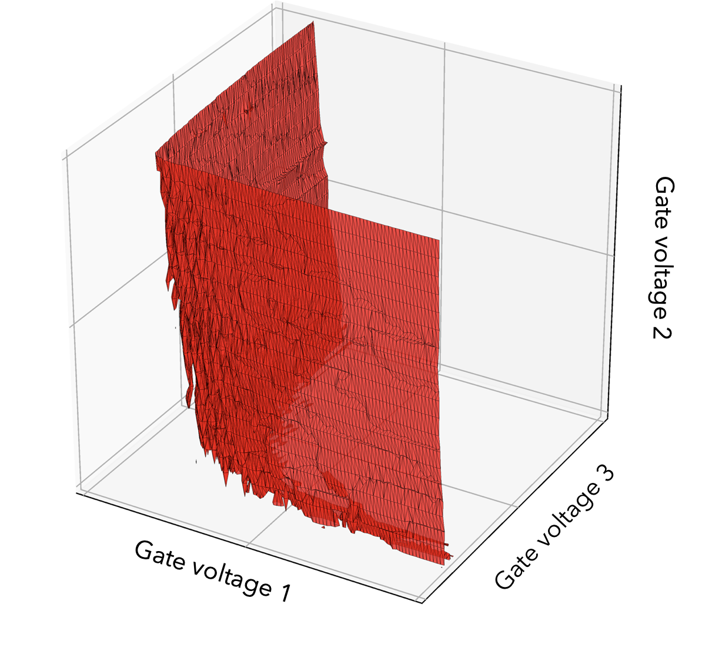
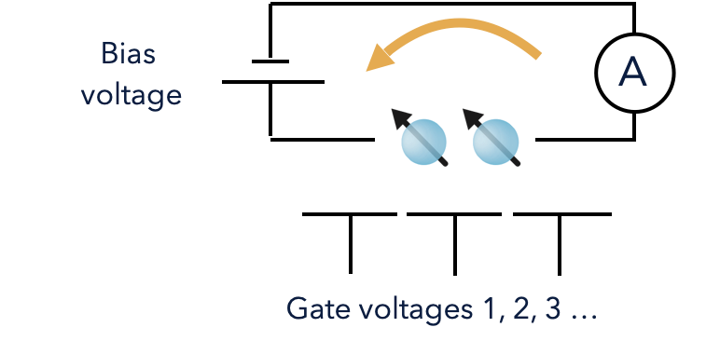

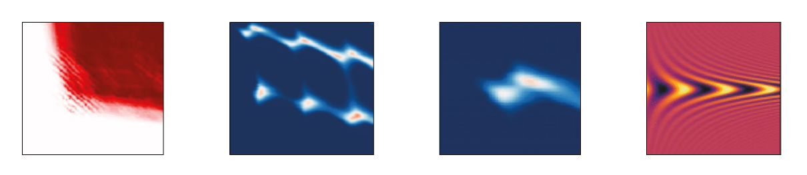
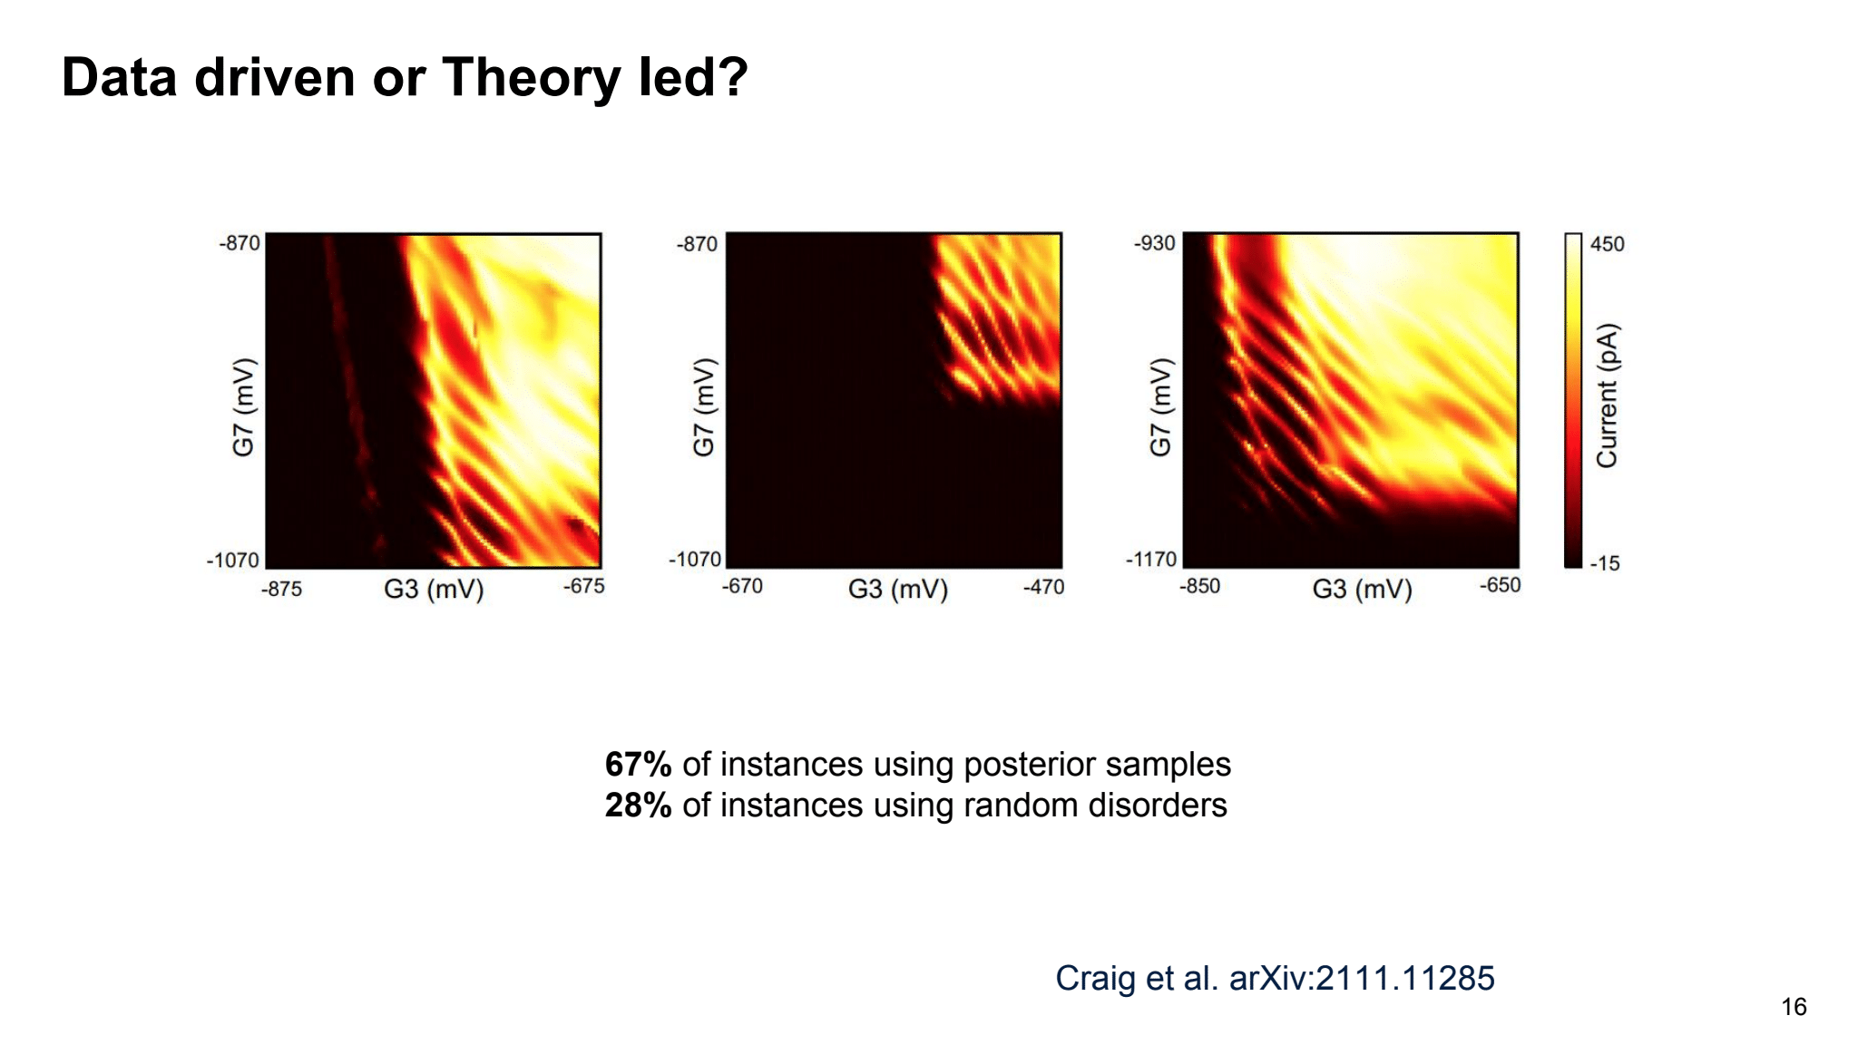
Step 1: Super coarse tuning
ON
OFF
current
Gate Voltage 2
Gate Voltage 1

Slide 8
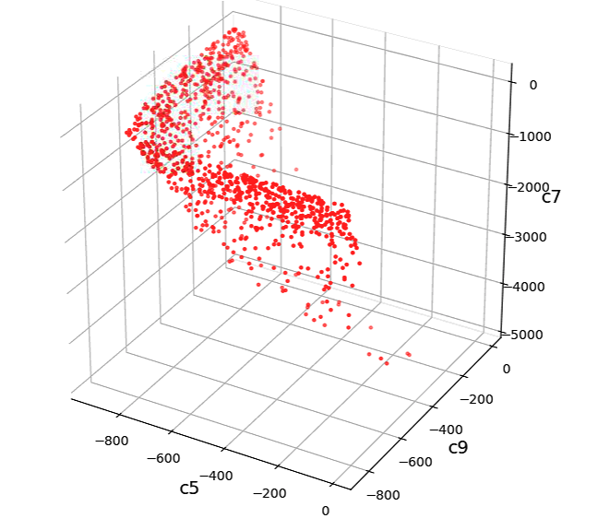
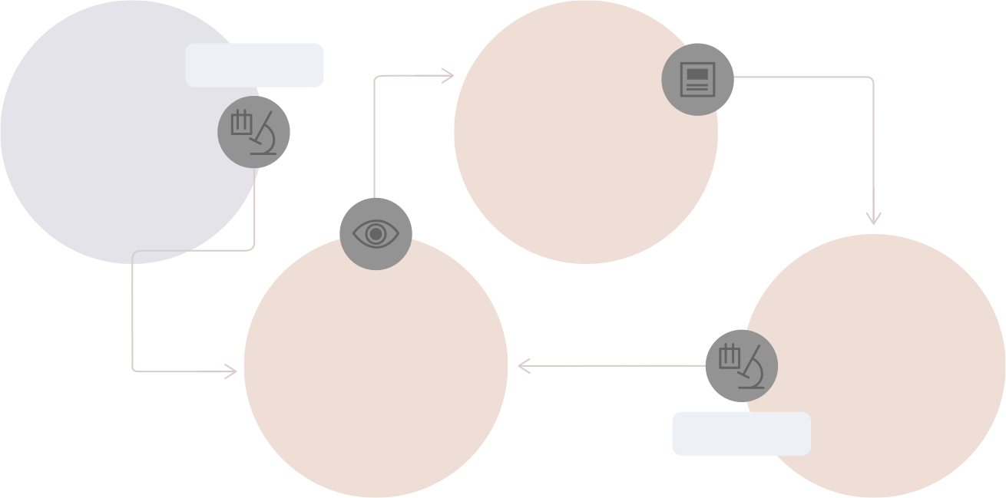
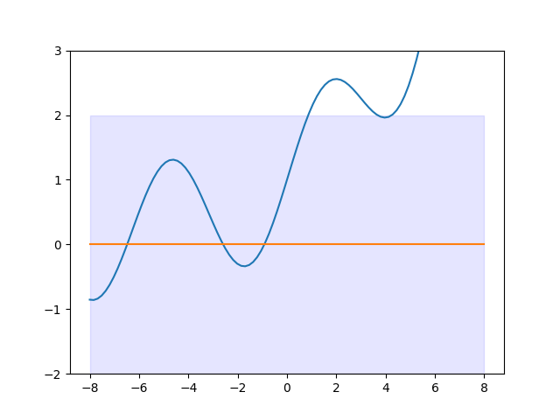
Step 1: Super coarse tuning
i
iii
REAL TIME
Initial
observations
Choose promising locations
Gate voltage 2
ii
iv
Model
Investigate candidate locations
Gate voltage 3
REAL TIME
Gate voltage 1
Hypersurface
Hypersurface evaluation
Prediction (with uncertainty)
Real hypersurface
Gate voltage

Slide 9
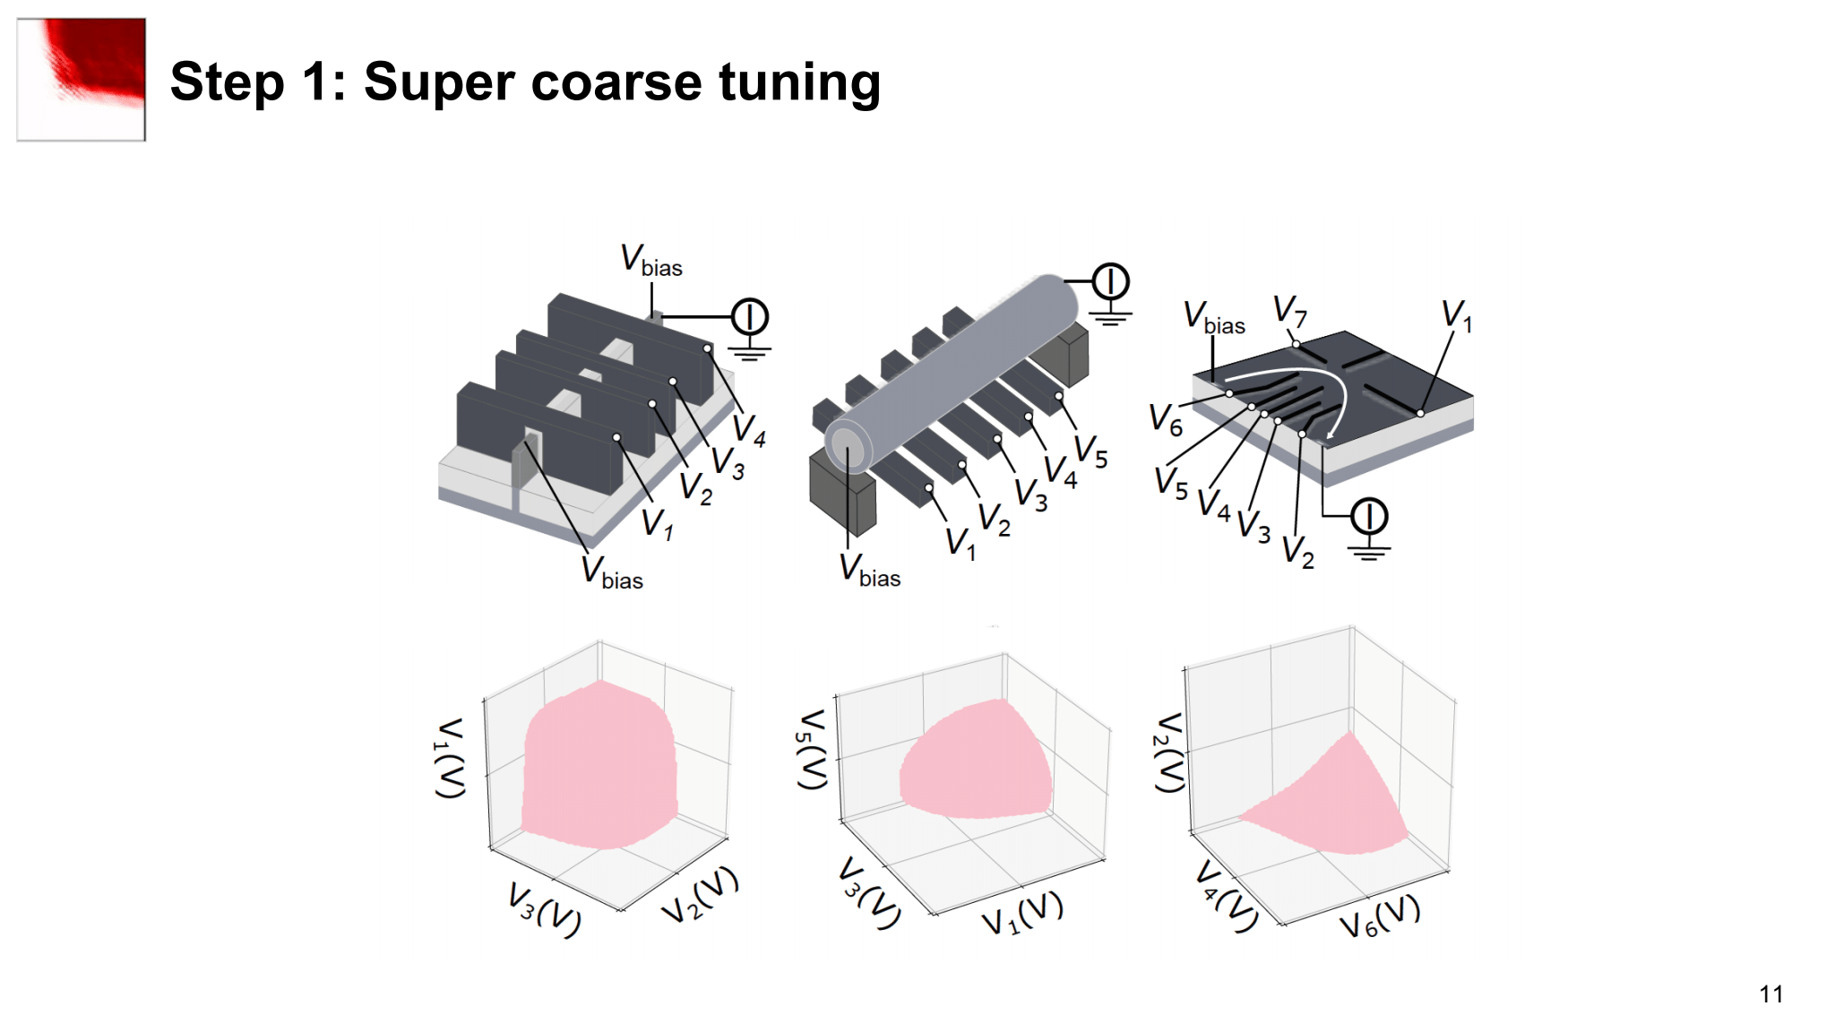
Step 1: Super coarse tuning
Silicon FinFET
Ge/Si core/shell Nanowire
Ge/SiGe Heterostructure
Holes, Accumulation
Holes, Depletion
Holes, Depletion

Slide 10
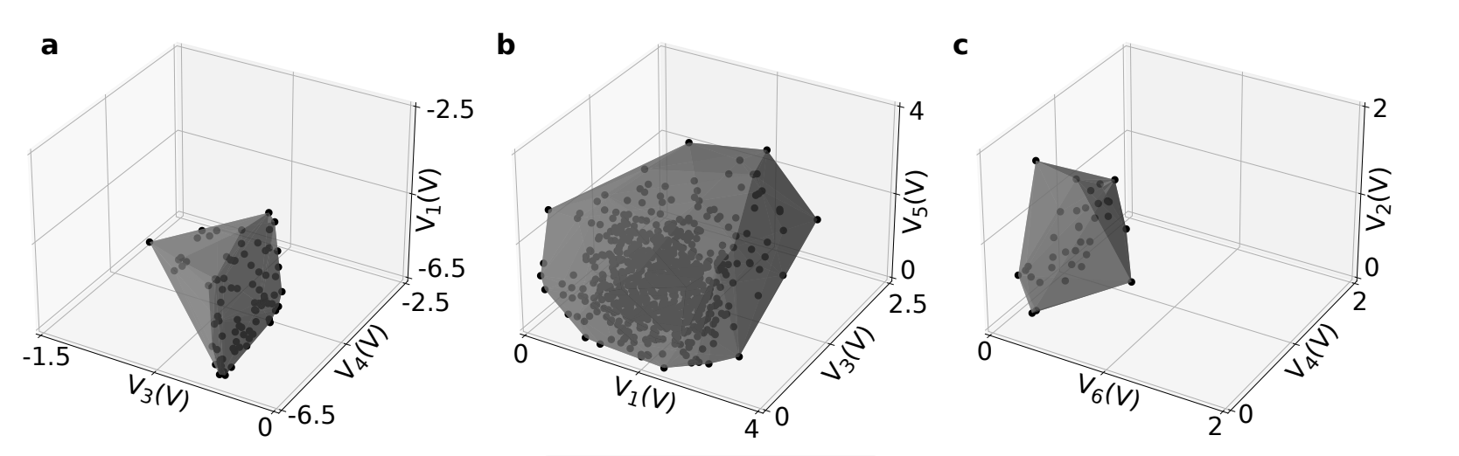
Step 1: Super coarse tuning
Silicon FinFET
Ge/Si core/shell Nanowire
Ge/SiGe Heterostructure
Holes, Accumulation
Holes, Depletion
Holes, Depletion
Severin et al. arXiv:2107.12975

Slide 11
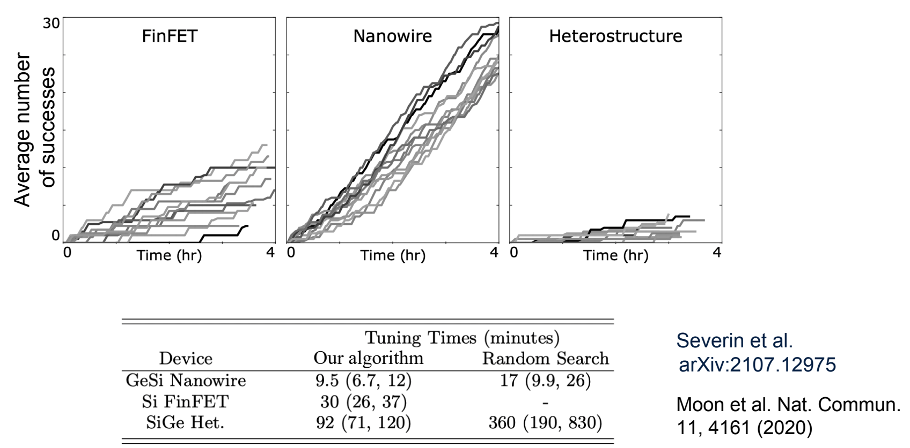
Step 1: Super coarse tuning
How does success look like?
current
Gate Voltage 2
Gate Voltage 1

Slide 12
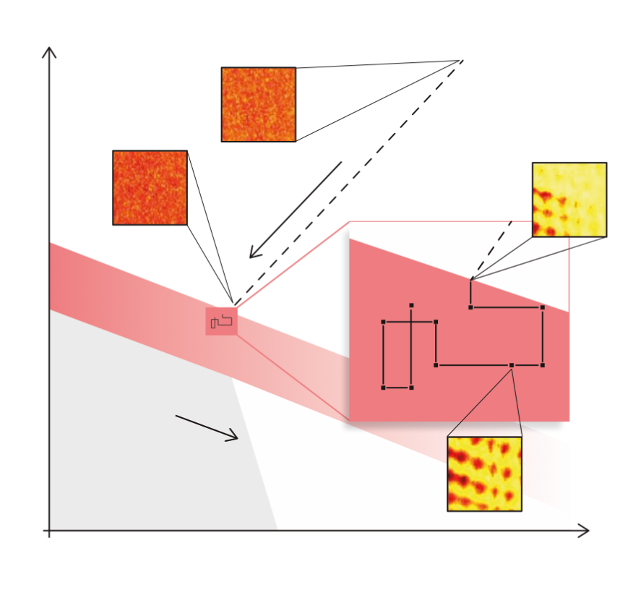
Step 1: Super coarse tuning with RF reflectometry
Exploratory Ramp
Random Walk
Gate voltage 2
RF Hypervolume
Current
Hypersurface
Gate voltage 1
van Straaten et al. arXiv:2211.04504
Notes:
10 ms no averae, AWG 4, 5 frames per seconds

Slide 13

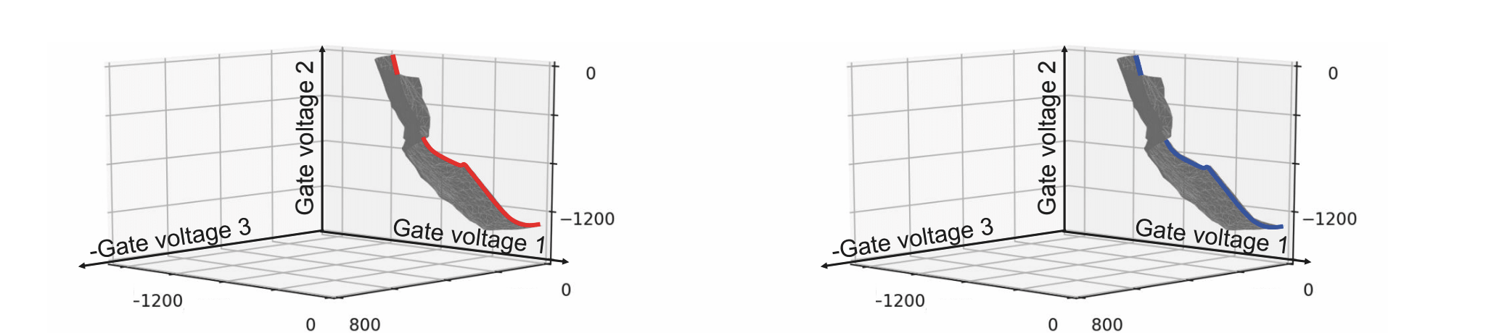
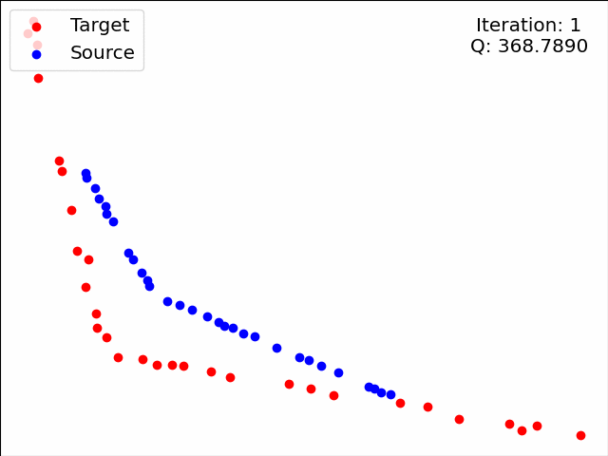
Quantifying device variability
Device 1
Device 2
Gate voltage 2
Gate voltage 1

Slide 14
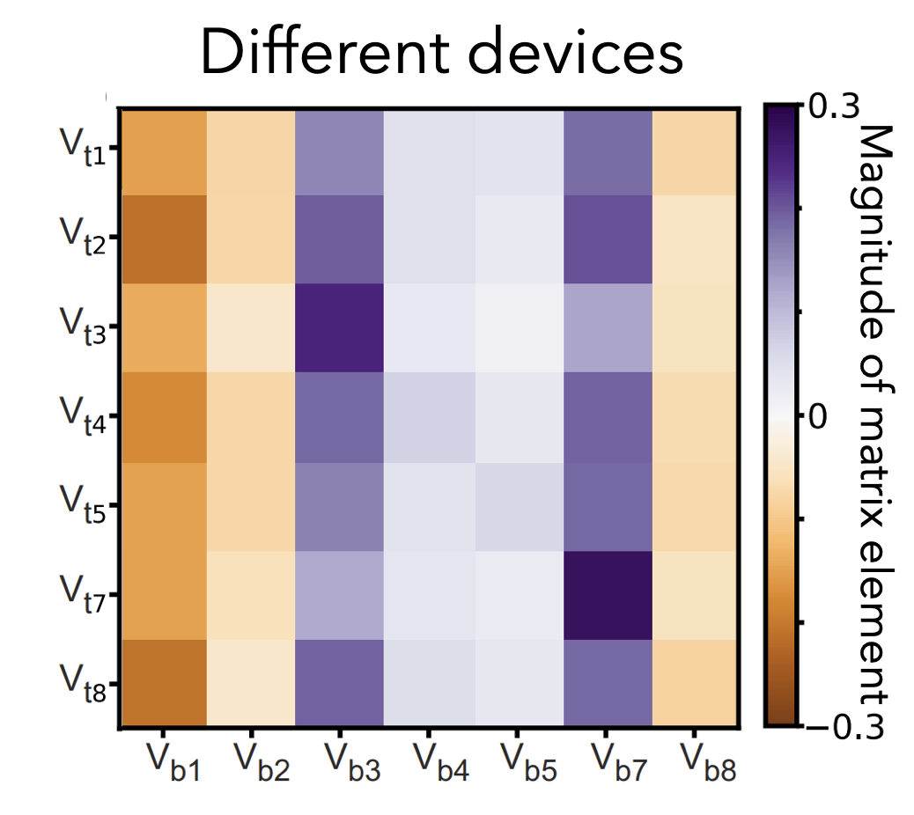
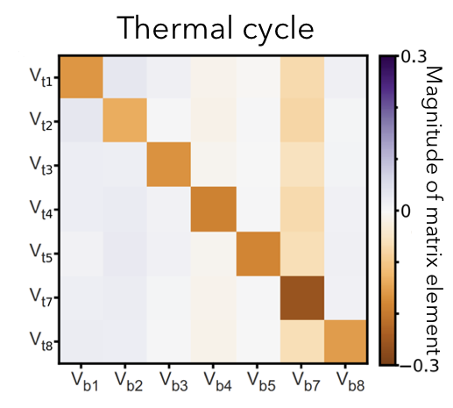
Quantifying device variability
(University
of Basel)
Moon et al. Nat. Commun. (2020)

Slide 15
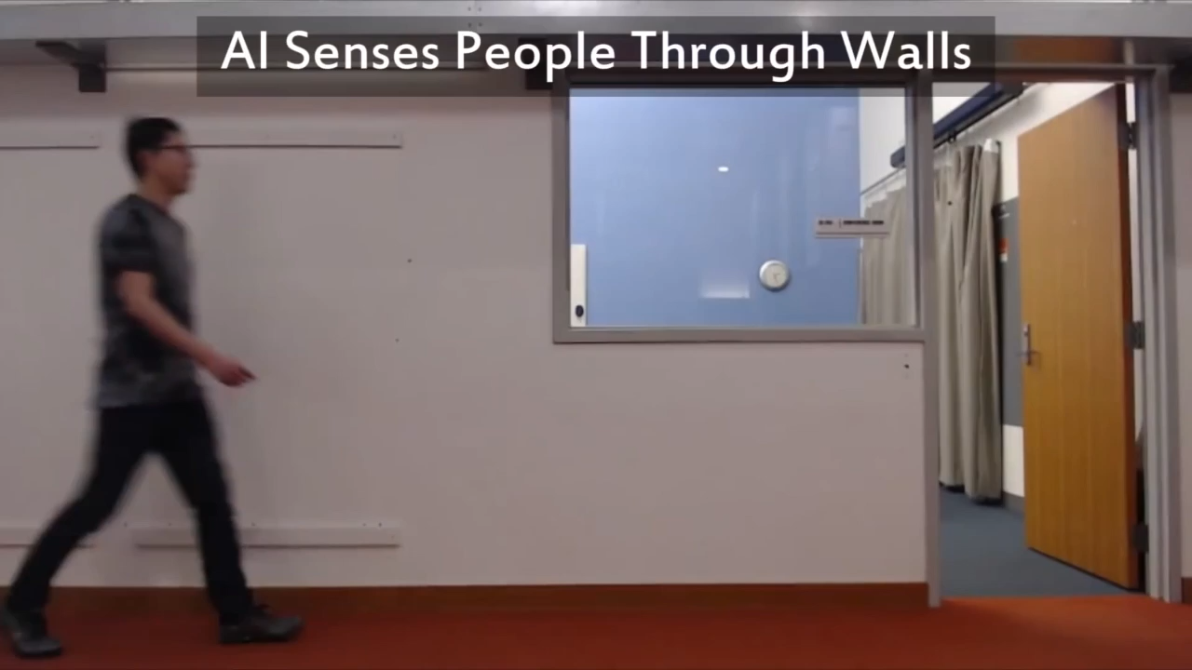
MIT’s Computer Science and Artificial Intelligence Laboratory (CSAIL)

Slide 16
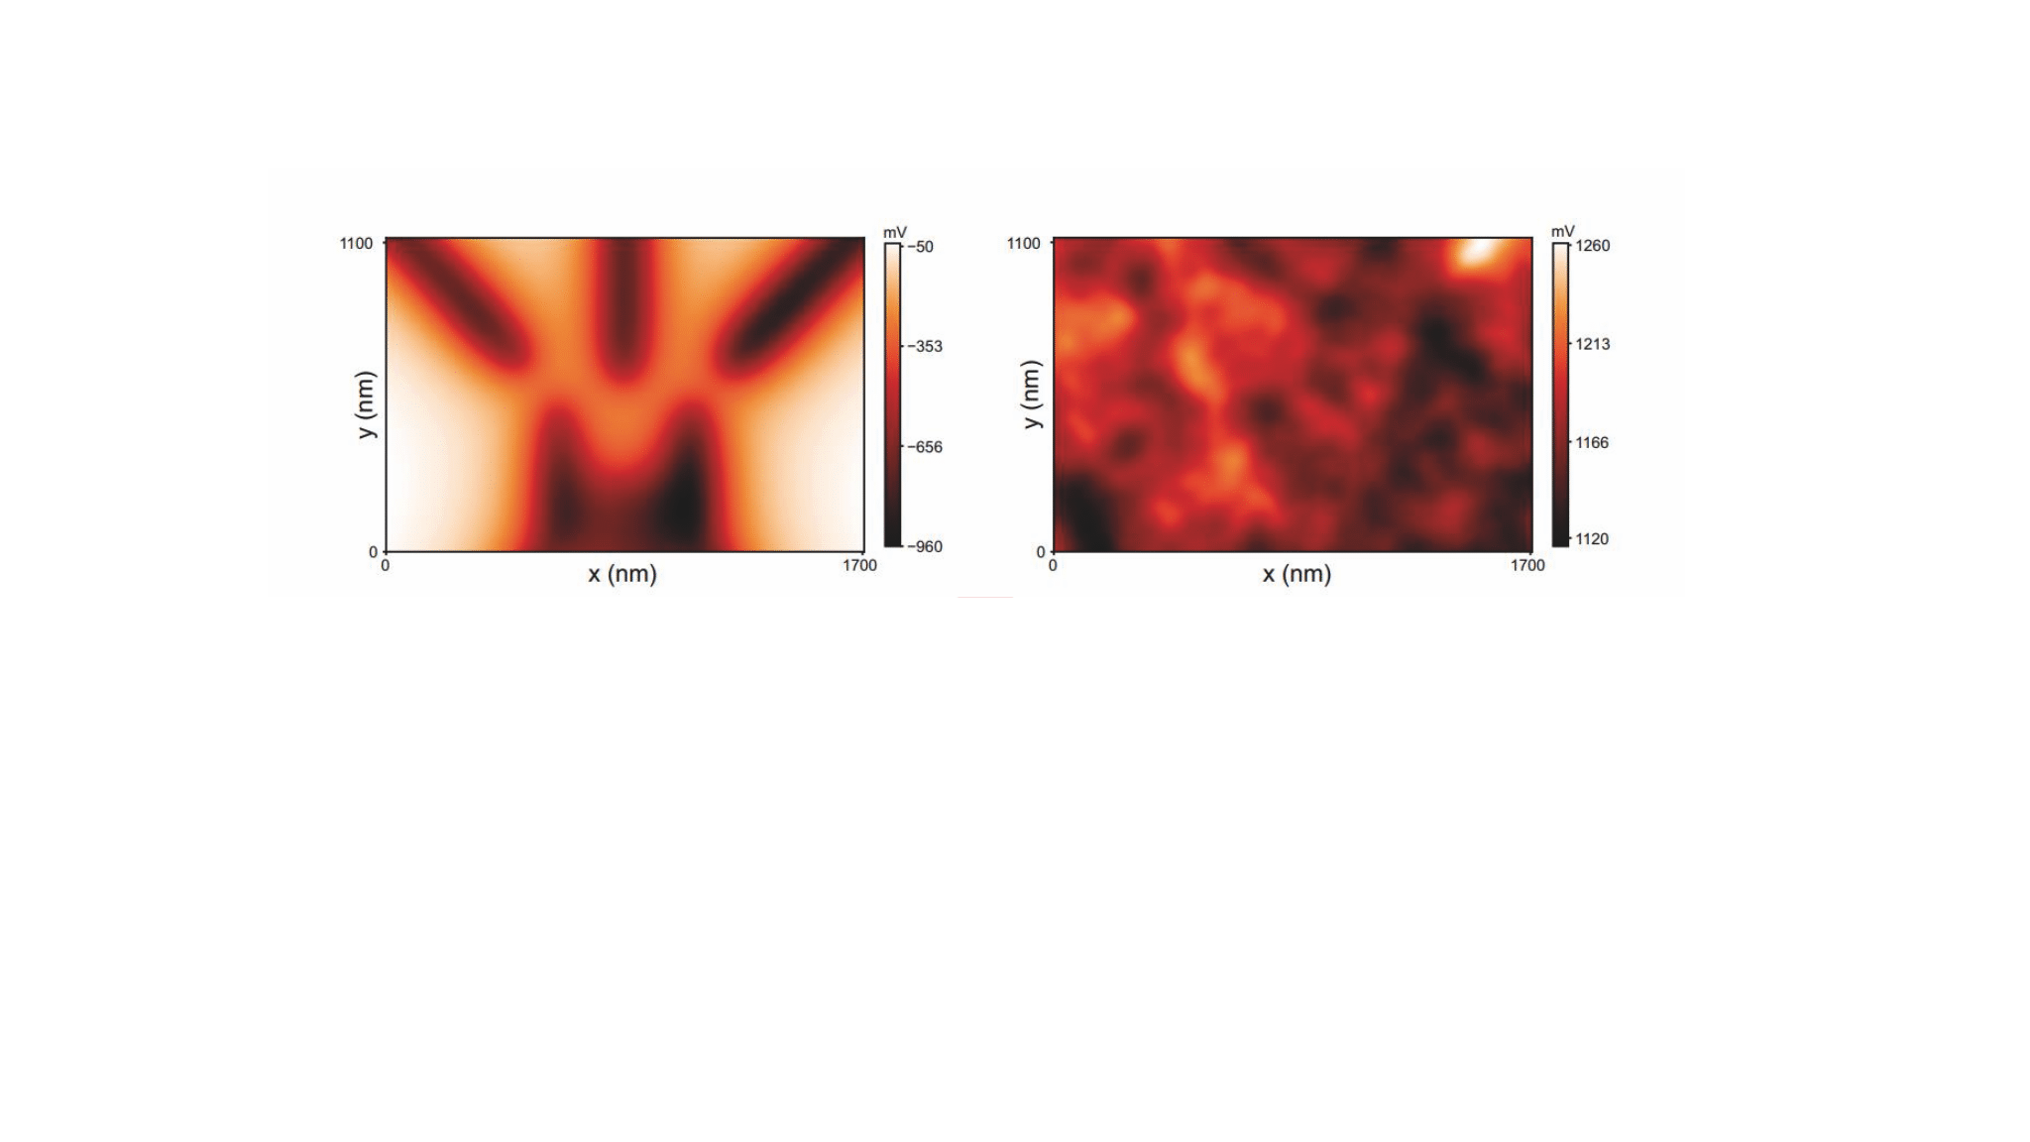
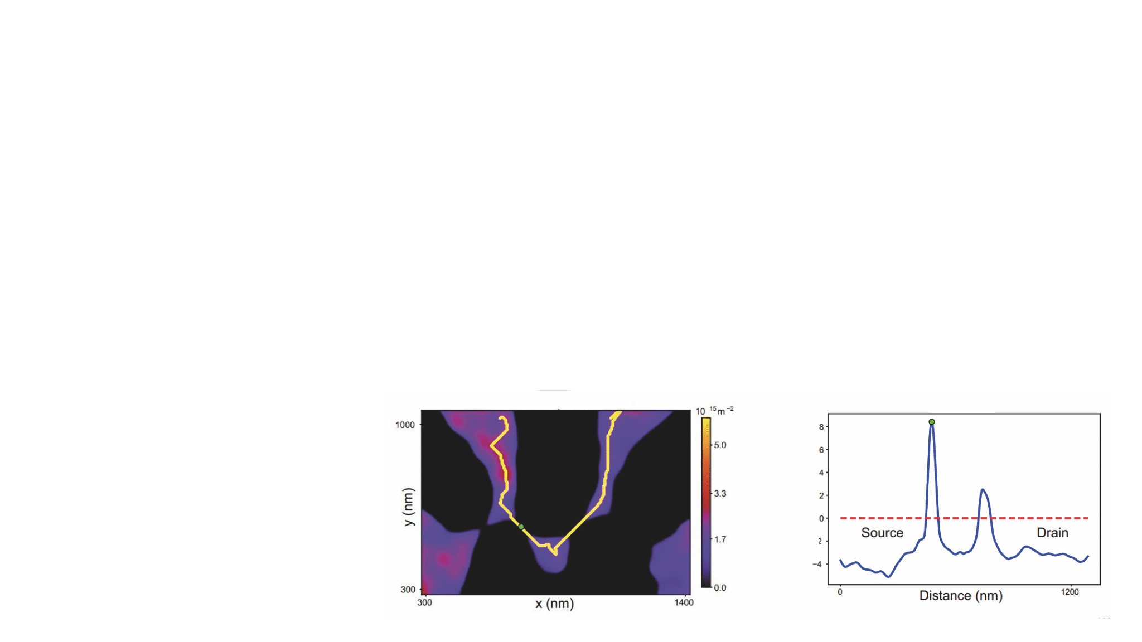
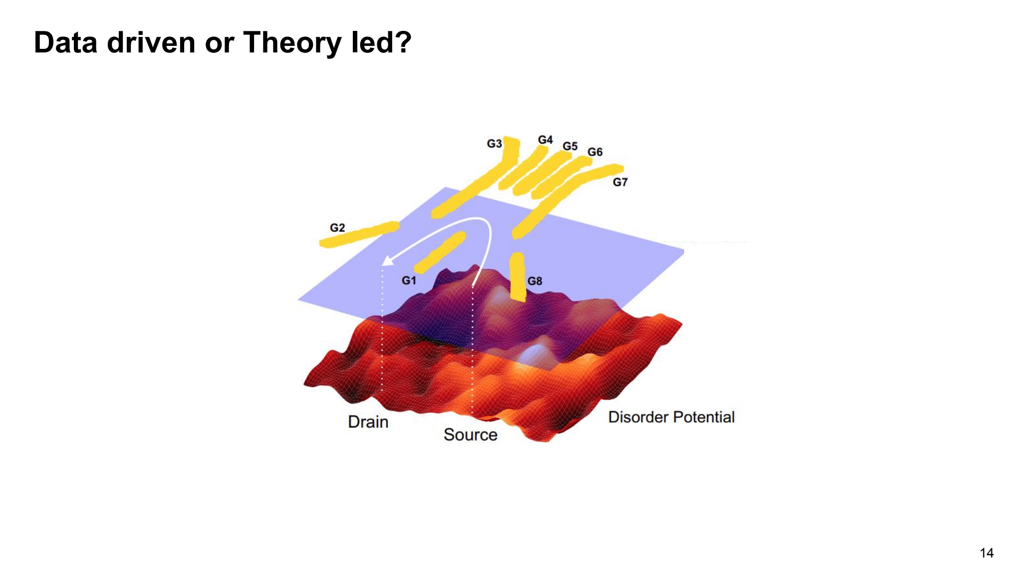
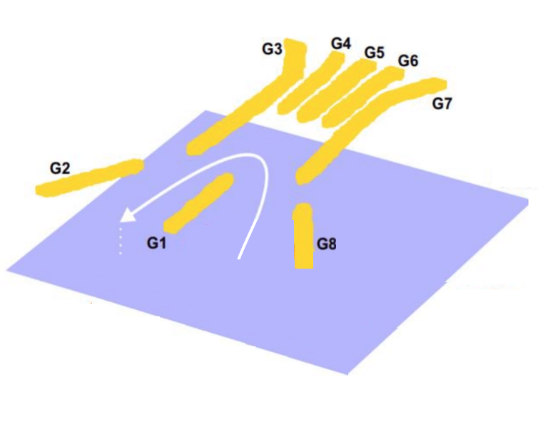
Learning disorder
y (nm)
y (nm)
Electron density
Potential
x (nm)
current
+
x (nm)
Gate Voltage 2
Gate Voltage 1
y (nm)
Potential energy (au)
Potential
x (nm)
Distance (nm)

Slide 17
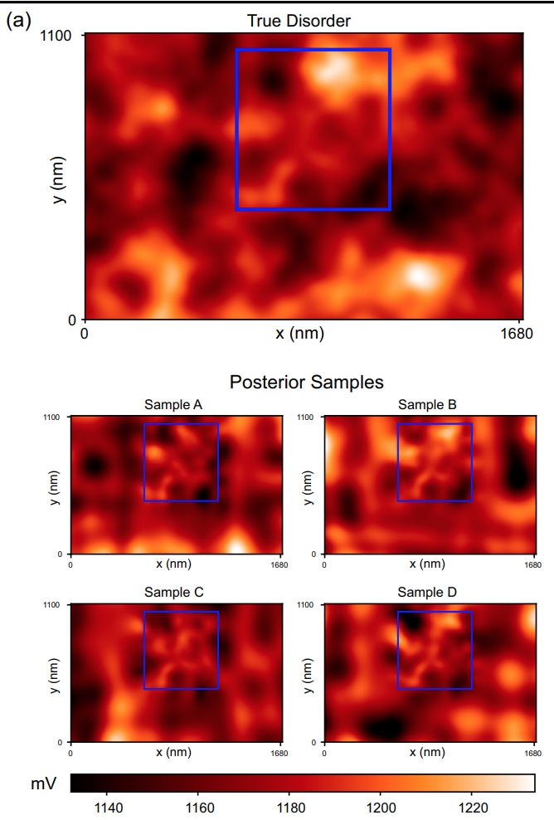
Learning disorder
Posterior samples
True disorder

Slide 18
Learning disorder
67% of instances using posterior samples
28% of instances using random disorders
Craig et al. arXiv:2111.11285

Slide 19
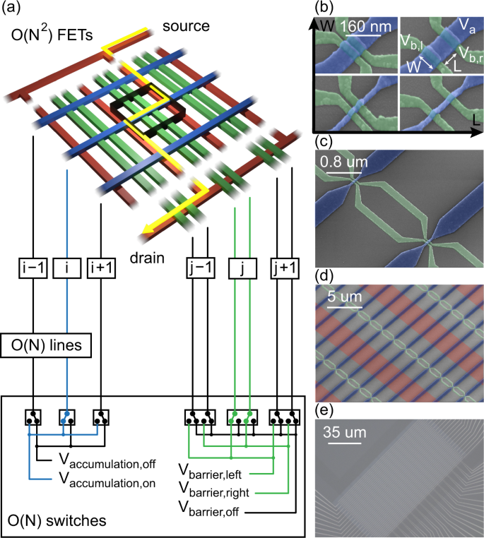
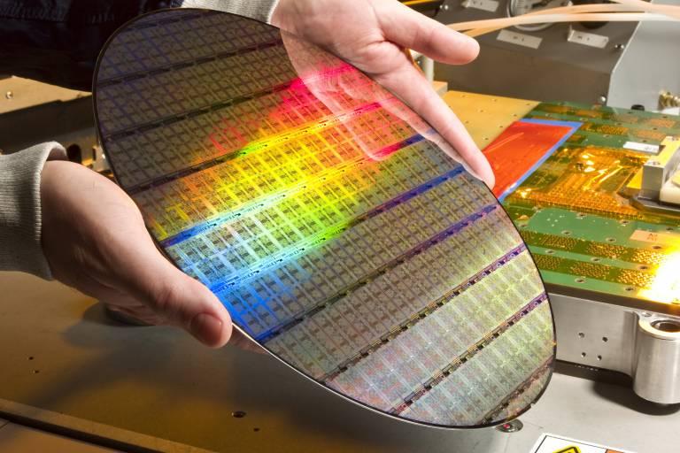
Quantifying device variability at wafer scales
CEA LETI
y (nm)
Potential
x (nm)
Bavdaz et al. npj QI 8, 86 (2022)
Bavdaz et al. npj QI 8, 86 (2022)
Rojas-Arias et al, arXiv:2302.11717

Slide 20
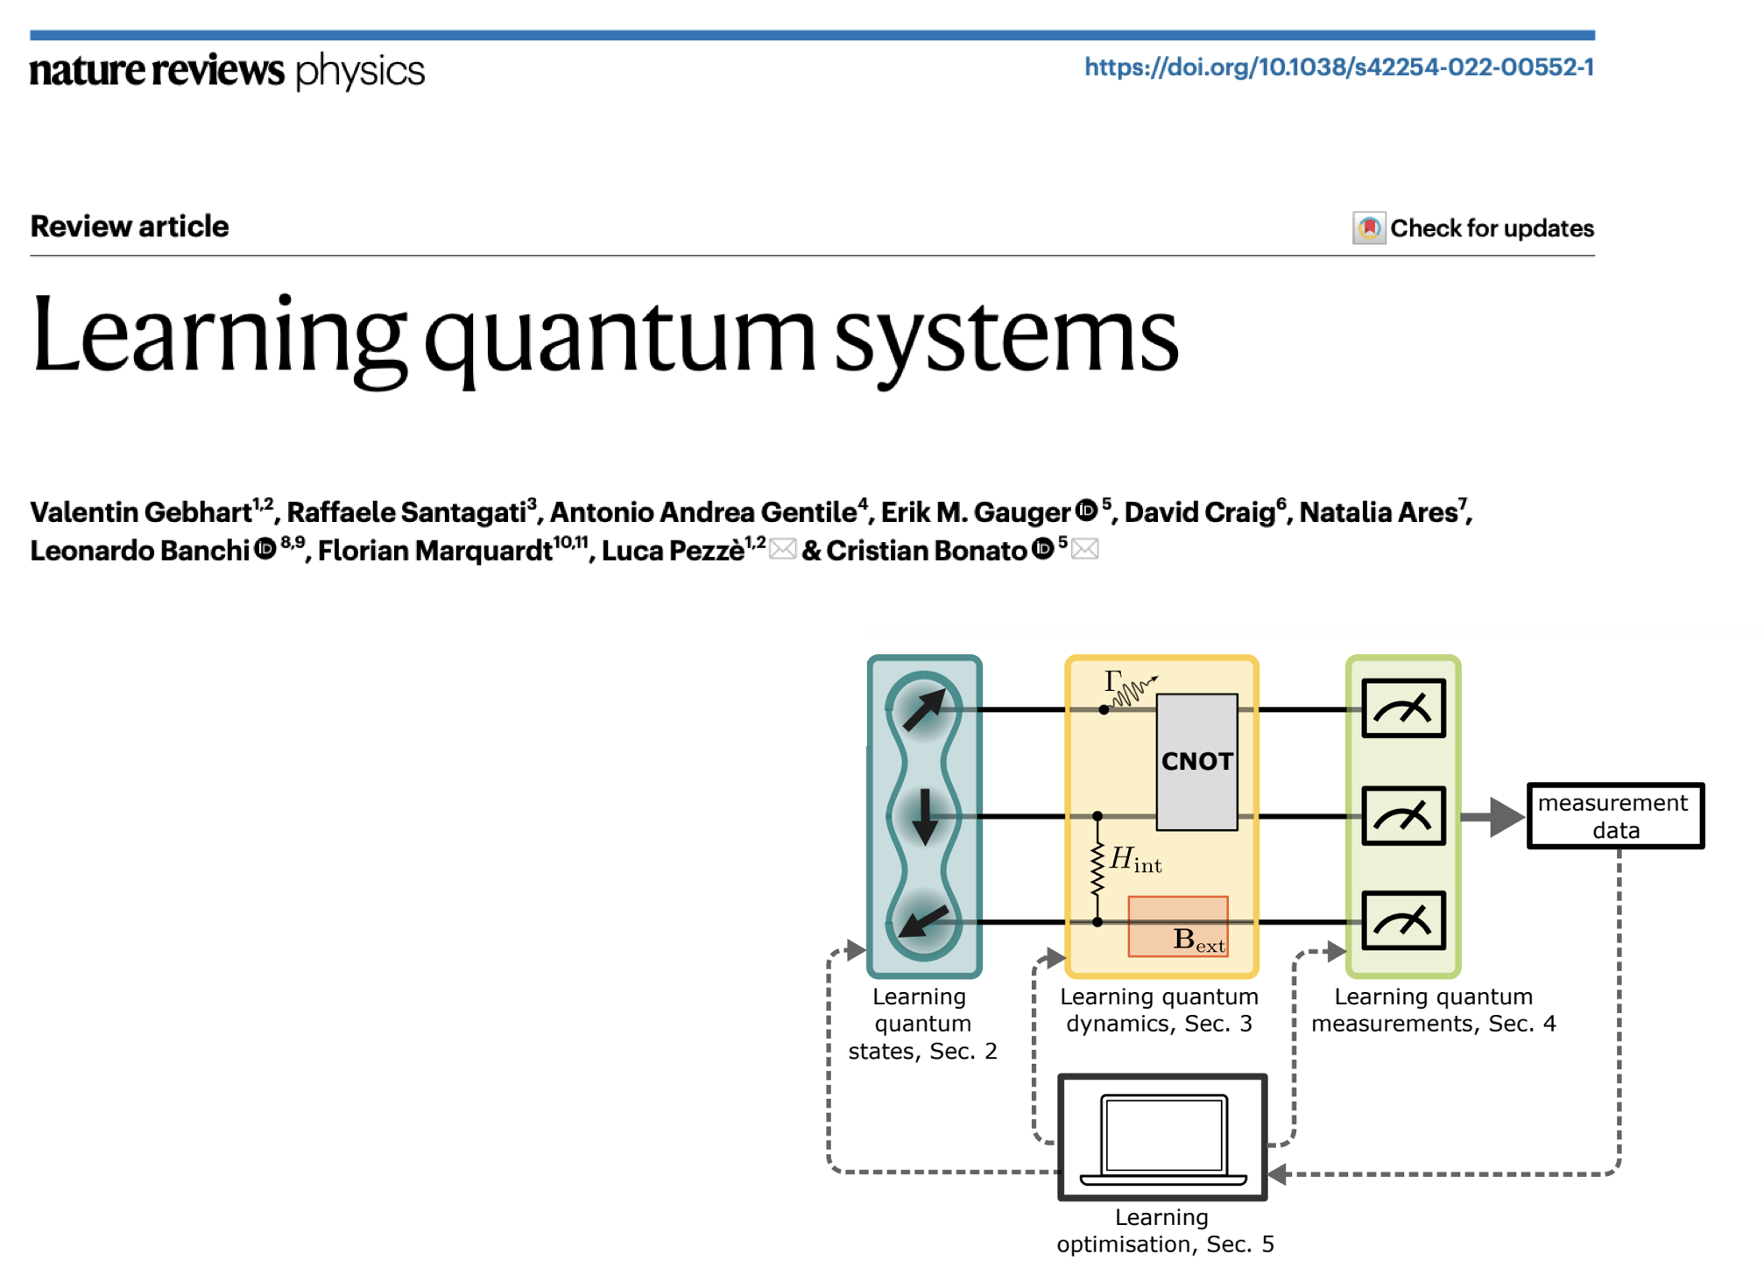

Slide 21
Automating quantum device tuning
https://github.com/oxquantum-repo/
Semiconductor
chip
Qubit
Optimised
qubit
Step 1:
Tune
Step 2 and 3:
Characterise
Step 4:
Refine
Step 5:
Find optimal
No Deep
learning
- van Straaten et al. arXiv:2211.04504
- Severin et al. arXiv:2107.12975
- Craig et al. arXiv:2111.11285
- Moon et al. Nat. Commun. (2020)
Lennon et al.
npj QI (2019)
soon…
Deep
learning
Nguyen et al.
npj QI (2021)
van Esbroeck
et al. NJP
(2020)
Schuff et al.
Quantum 7,
1077 (2023)
N. Ares, Nature Reviews Materials 6,870 (2021)

Slide 22
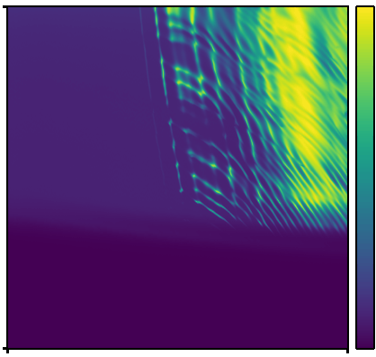
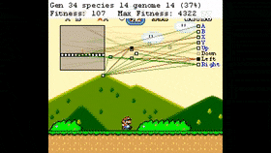
Step 2 and 3: Characterise
Current
Deep Reinforcement Learning
Gate voltage 2
Gate voltage 1
Notes:
breakout (Atari) Human-level control through deep reinforcement learning
Nature volume 518, pages 529–533 (26 February 2015

Slide 23
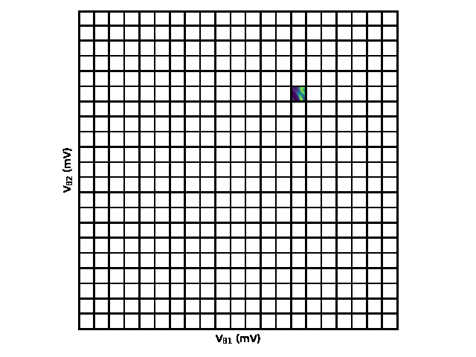
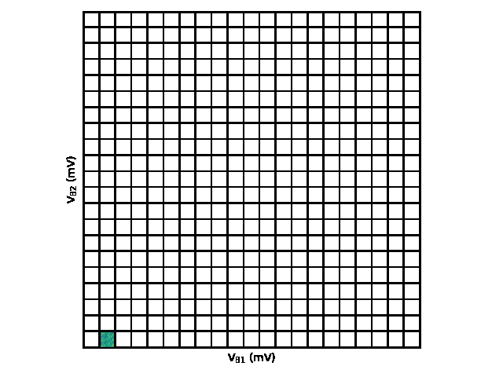

Step 2 and 3: Characterise
Current
Gate voltage 2
Gate voltage 1
Nguyen et al. npj QI 7,100 (2021)

Slide 24
Automating quantum device tuning
https://github.com/oxquantum-repo/
Semiconductor
chip
Qubit
Optimised
qubit
Step 1:
Tune
Step 2 and 3:
Characterise
Step 4:
Refine
Step 5:
Find optimal
No Deep
learning
- van Straaten et al. arXiv:2211.04504
- Severin et al. arXiv:2107.12975
- Craig et al. arXiv:2111.11285
- Moon et al. Nat. Commun. (2020)
Lennon et al.
npj QI (2019)
soon…
Deep
learning
Nguyen et al.
npj QI (2021)
van Esbroeck
et al. NJP
(2020)
Schuff et al.
Quantum 7,
1077 (2023)
N. Ares, Nature Reviews Materials 6,870 (2021)

Slide 25
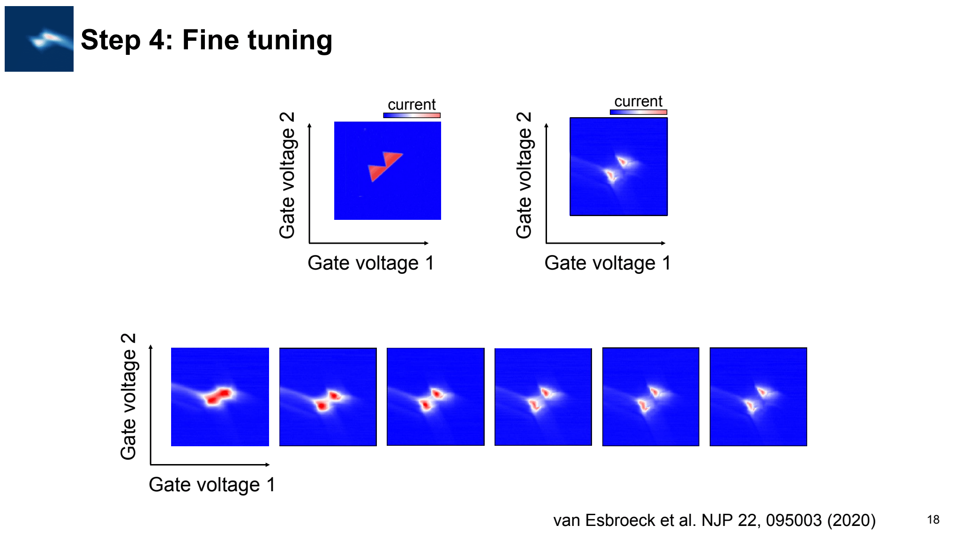
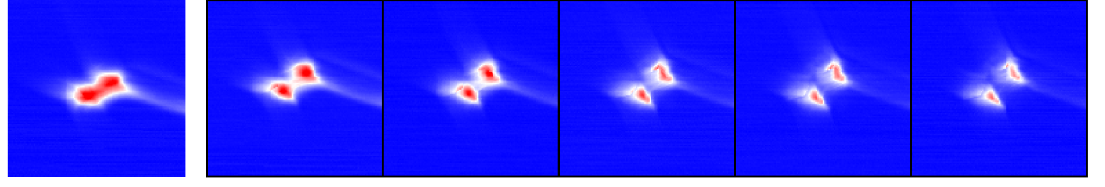
Step 4: Fine tuning
van Esbroeck et al. NJP 22, 095003 (2020)

Slide 26
Automating quantum device tuning
https://github.com/oxquantum-repo/
Semiconductor
chip
Qubit
Optimised
qubit
Step 1:
Tune
Step 2 and 3:
Characterise
Step 4:
Refine
Step 5:
Find optimal
No Deep
learning
- van Straaten et al. arXiv:2211.04504
- Severin et al. arXiv:2107.12975
- Craig et al. arXiv:2111.11285
- Moon et al. Nat. Commun. (2020)
Lennon et al.
npj QI (2019)
soon…
Deep
learning
Nguyen et al.
npj QI (2021)
van Esbroeck
et al. NJP
(2020)
Schuff et al.
Quantum 7,
1077 (2023)
N. Ares, Nature Reviews Materials 6,870 (2021)

Slide 27
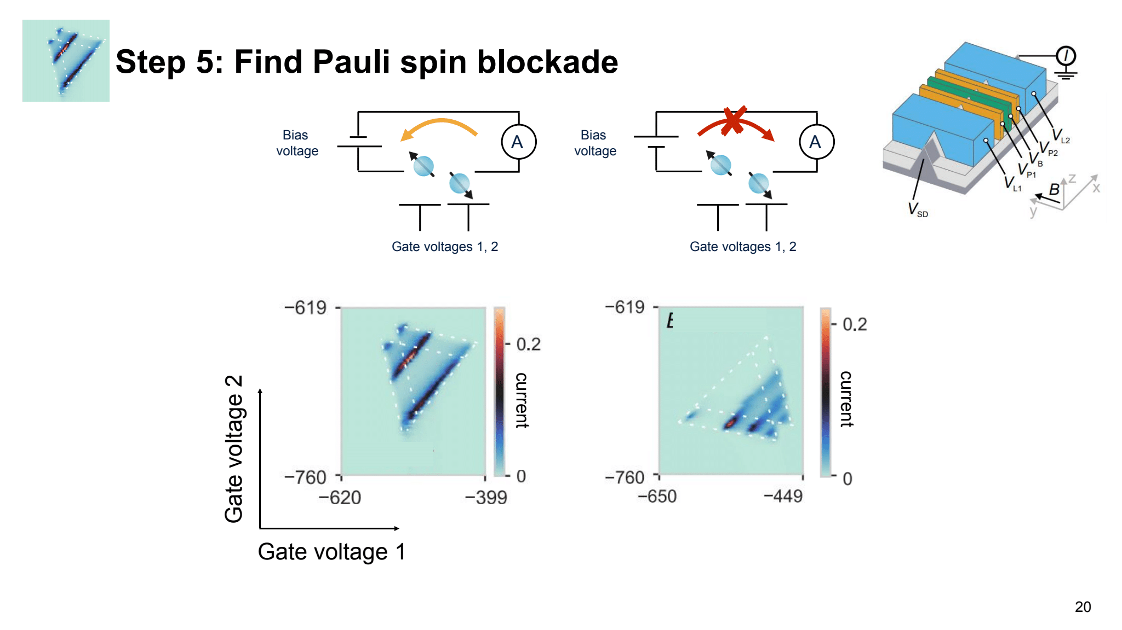

Step 5: Find Pauli spin blockade

Slide 28
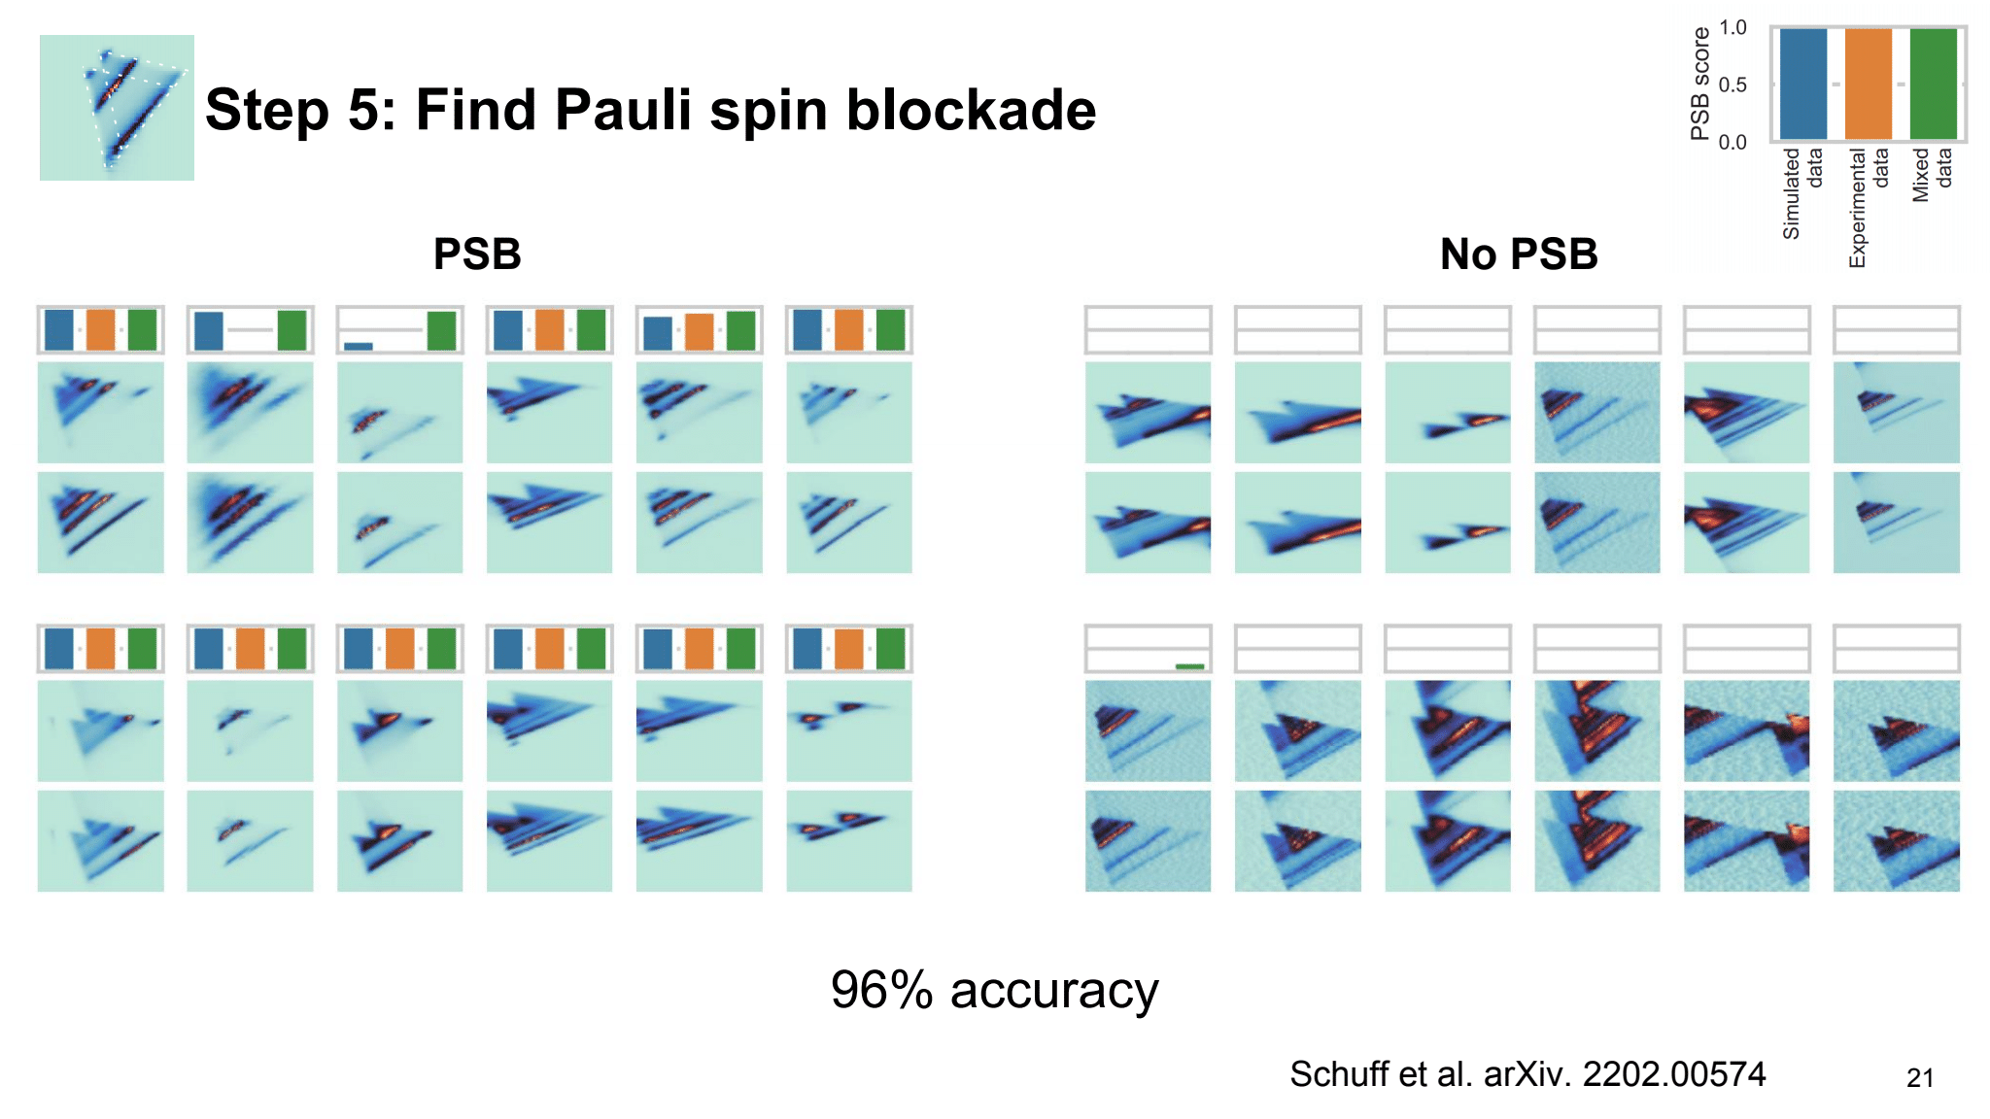
Step 5: Find Pauli spin blockade
PSB
No PSB
96% accuracy
Schuff et al. Quantum 7, 1077 (2023)

Slide 29
Automating quantum device tuning
https://github.com/oxquantum-repo/
Semiconductor
chip
Qubit
Optimised
qubit
Step 1:
Tune
Step 2 and 3:
Characterise
Step 4:
Refine
Step 5:
Find optimal
No Deep
learning
- van Straaten et al. arXiv:2211.04504
- Severin et al. arXiv:2107.12975
- Craig et al. arXiv:2111.11285
- Moon et al. Nat. Commun. (2020)
Lennon et al.
npj QI (2019)
soon…
Deep
learning
Nguyen et al.
npj QI (2021)
van Esbroeck
et al. NJP
(2020)
Schuff et al.
Quantum 7,
1077 (2023)
N. Ares, Nature Reviews Materials 6,870 (2021)

Slide 30
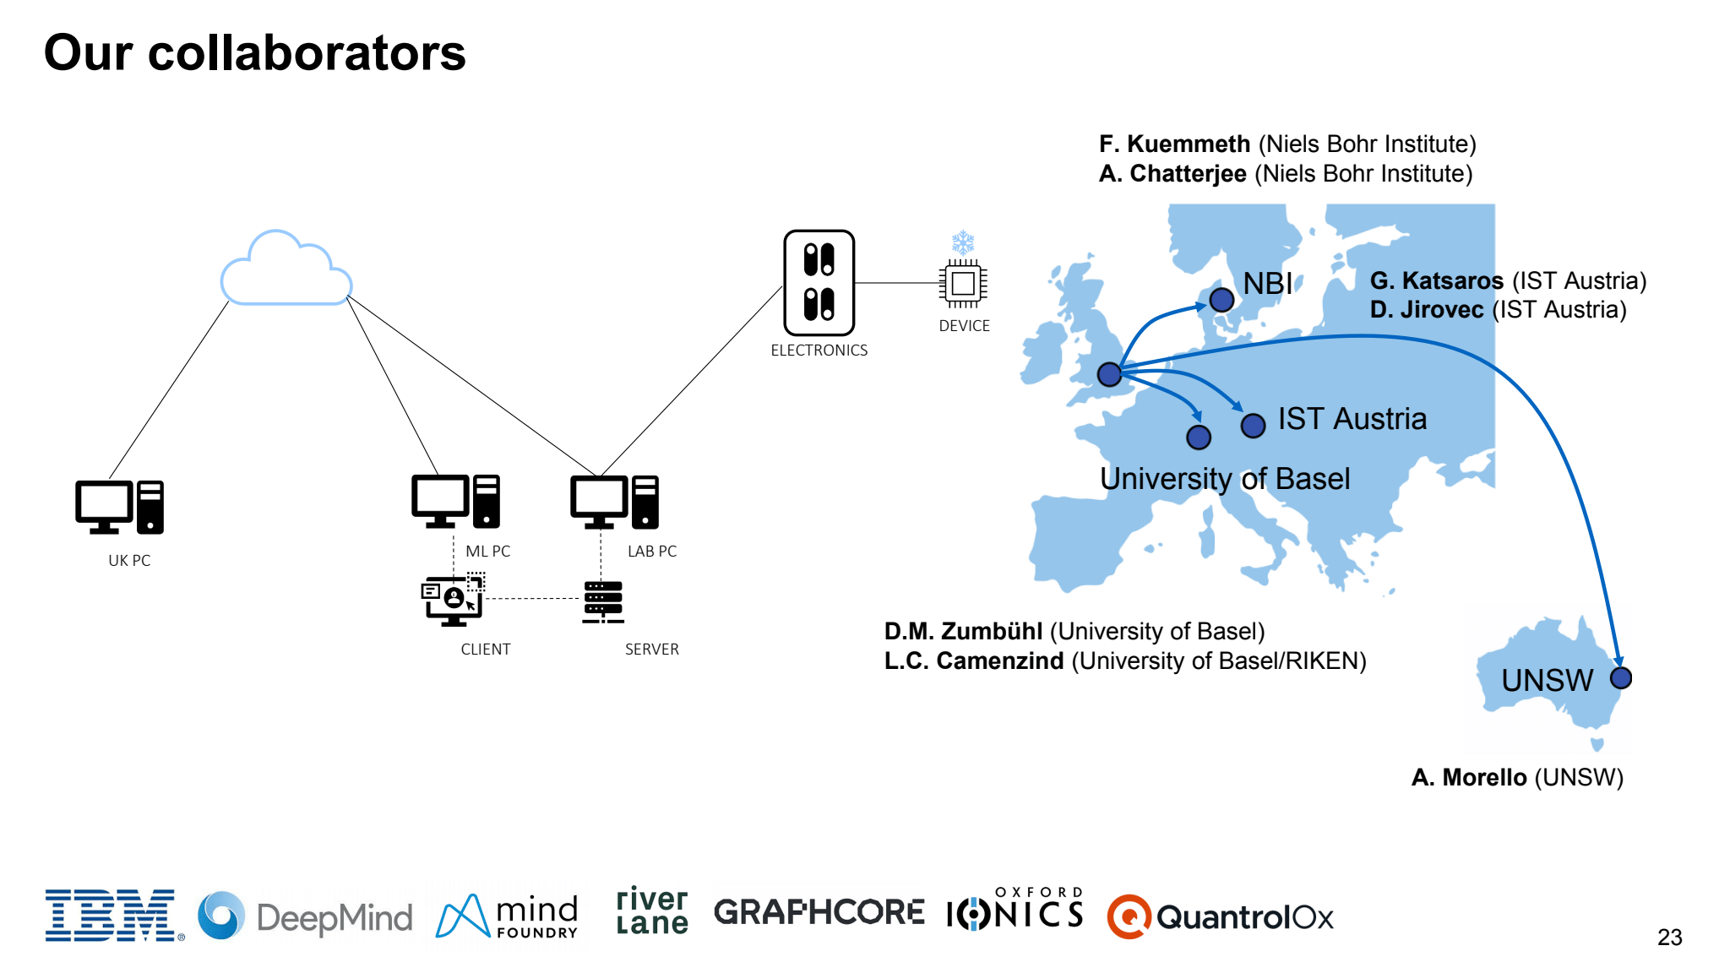
Our network
Prof Michael Osborne and Prof Jakob Foerster (University of Oxford)
Prof Dino Sejdinovic (University of Adelaide)

Slide 31
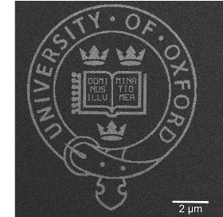
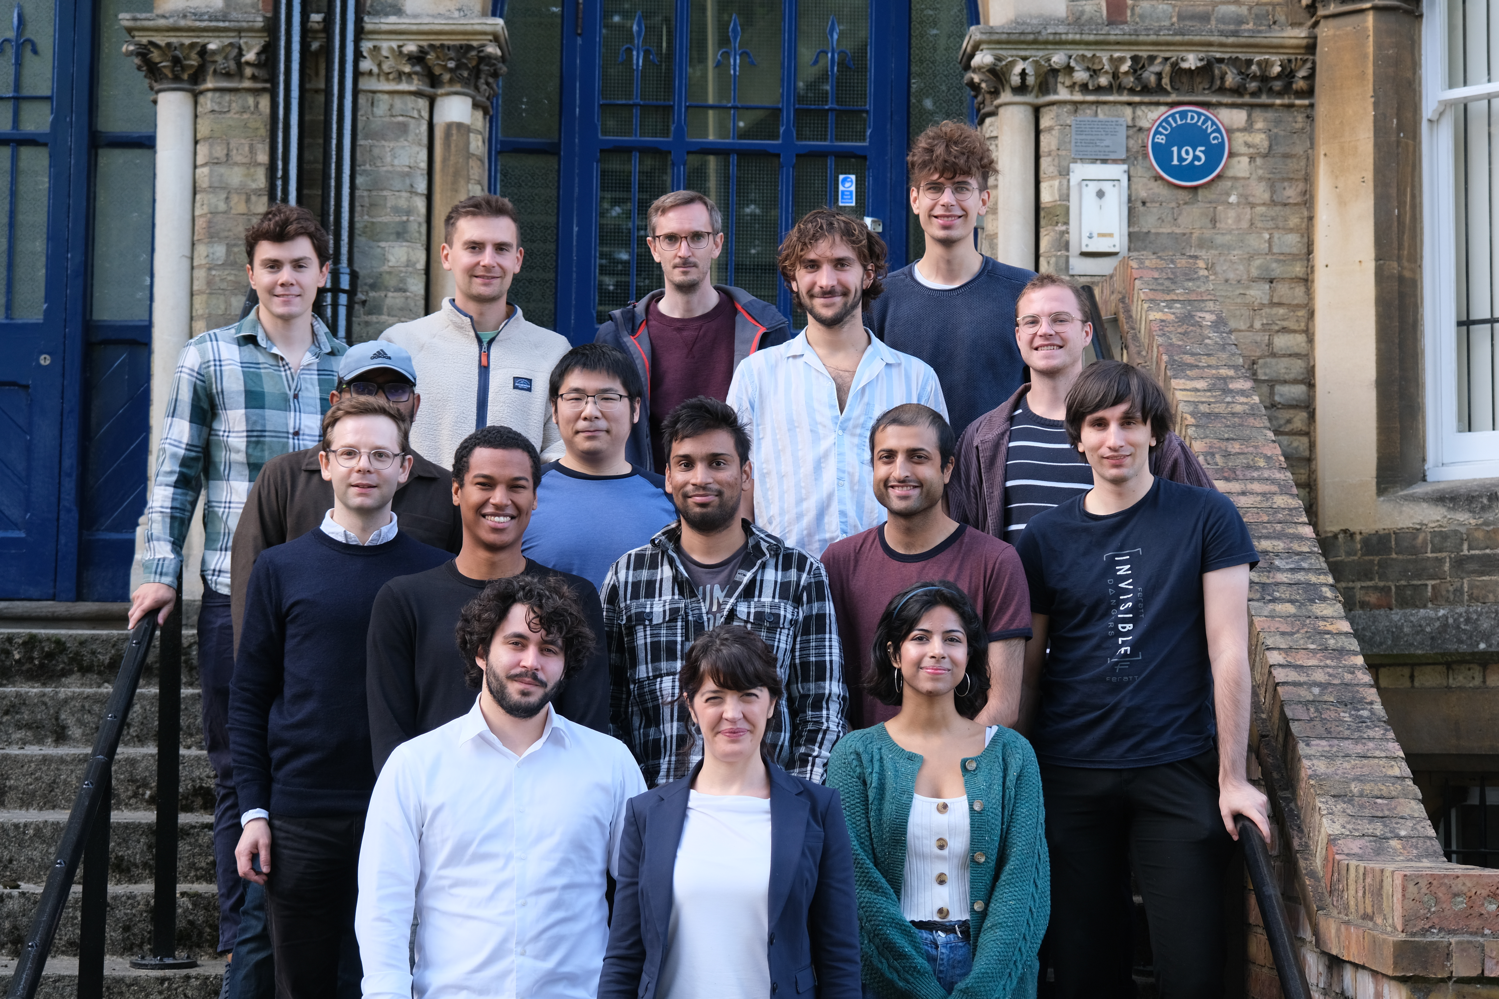

The group and our collaborators
A. Auffèves (Insitute Néel)
J. Parrondo (UCM)
J. Anders (University of Exeter)
P. Erker (IQOQI)
Y. Guryanova (IQOQI)
M. Huber (IQOQI)
E. A. Laird (Lancaster University)
D.M. Zumbühl (University of Basel)
L.C. Camenzind (University of Basel)
G. Katsaros (IST Austria)
D. Jirovec (IST Austria)
J. Kirkpatrick (DeepMind)
M. Osborne (Oxford)
D. Sejdinovic (Oxford)
A. Chatterjee (NBI)
F. Kuemmeth (NBI)
N. Korda (Mind Foundry)
Join us!
Notes:
But first let me thank my students and colleagues at Oxford and my collaborators and funding agencies.

Slide 32
Thank you

Slide 33
Quantifying device variability at wafer scales
CEA LETI
Current
Current
Bavdaz et al. npj QI 8, 86 (2022)
Gate voltage
Gate voltage

Slide 34
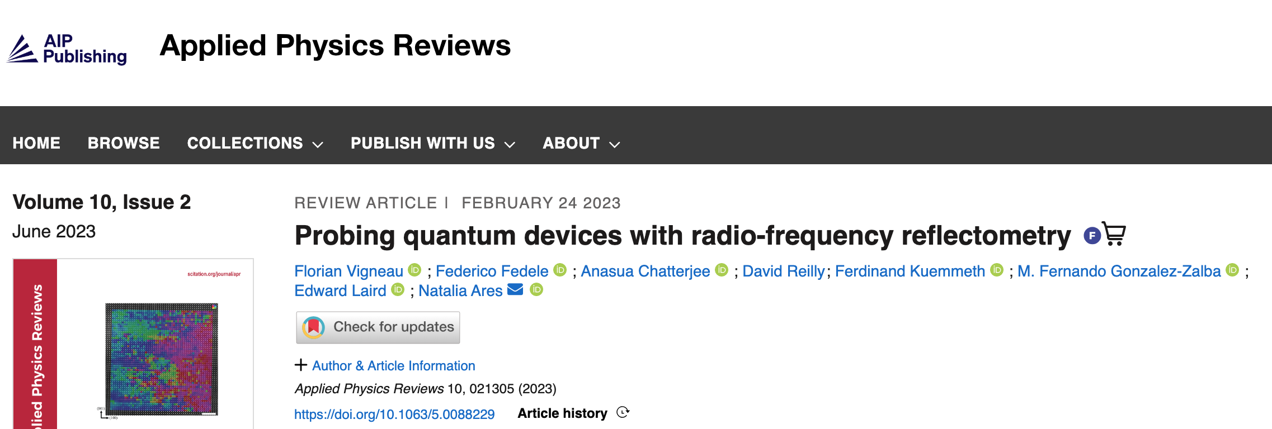
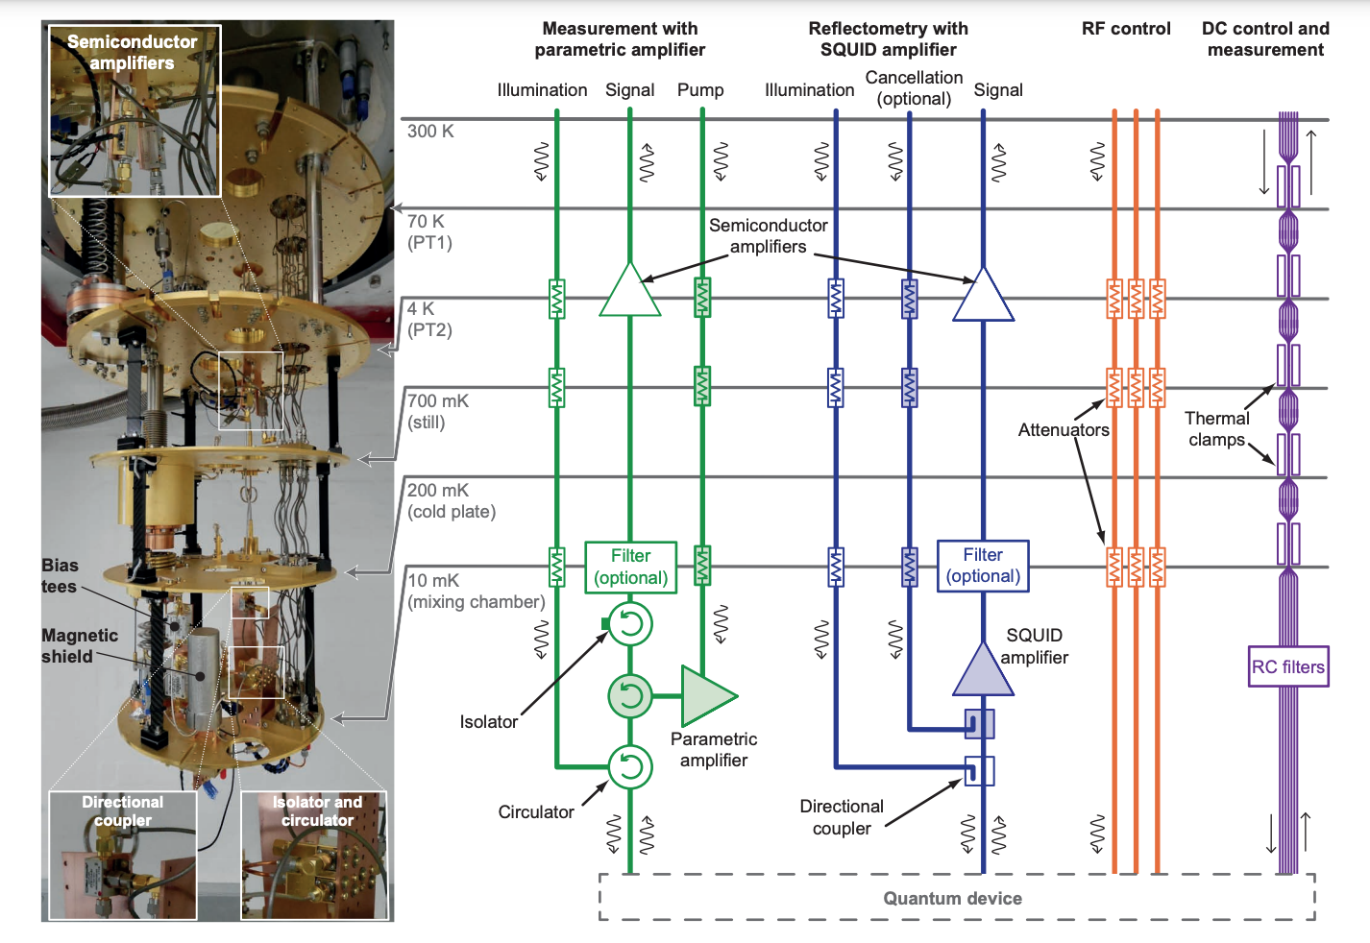


Slide 35
Gate voltage 2
Quantifying device variability
Gate voltage 1
Device 1
Device 2
ON
OFF
Moon et al. Nat. Commun. (2020)

Slide 36
Where are we at?
https://github.com/oxquantum-repo/
Semiconductor
chip
Qubit
Optimised
qubit
Step 1:
Tune
Step 2 and 3:
Characterise
Step 4:
Refine
Step 5:
Find optimal
No Deep
learning
- van Straaten et al. arXiv:2211.04504
- Severin et al. arXiv:2107.12975
- Craig et al. arXiv:2111.11285
- Moon et al. Nat. Commun. (2020)
Lennon et al.
npj QI (2019)
soon…
Deep
learning
Nguyen et al.
npj QI (2021)
van Esbroeck
et al. NJP
(2020)
Schuff et al.
Quantum 7,
1077 (2023)
N. Ares, Nature Reviews Materials 6,870 (2021)

Slide 37

Quantifying device variability at wafer scales
y (nm)
Potential
x (nm)
CEA LETI
y (nm)
Potential
x (nm)

Slide 38
A quantum device lab
Human’s loop
while human not satisfied with the result
fix parameters
measure
evaluate measurement
else:
go for coffee
Quantum hardware
Human
Human
Semiconductor
chips
Ion traps
Superconducting
chips
Big parameter space
Big variability between devices
Error thresholds >99%
Small data sets
Big variability between devices
Flat optimisation landscapes
Noisy data and (in some cases) hysteretic

Slide 39
From quantum chip to qubit
Quantum devices
Superconducting
devices
Semiconductor
devices
Ion traps
Machine
Learning
Machine
Learning
N. Ares, Nature Reviews Materials 6,870 (2021)

Slide 40


Slide 41

Notes:
8 ms no averae, AWG 4, 5 frames per seconds

Slide 42
Step 1: Super coarse tuning, model led
67% of instances using posterior samples
28% of instances using random disorders

Slide 43




Step 1: Super coarse tuning
A
Bias
voltage
i
iii
REAL TIME
Initial
observations
Choose promising locations
Gate voltages 1, 2, 3
ON
ii
iv
Model
Investigate candidate locations
Gate voltage 2
REAL TIME
OFF
Gate voltage 3
Hypersurface
Hypersurface evaluation
Real hypersurface
Prediction (with uncertainty)
Gate voltage 1
Gate voltage

Slide 44

Spin qubit tuning
Semiconductor device
A
SET
features
Charge
transition
PSB
found
Rabi
Freq
tuned
ON/OFF
Bias
voltage
Step 1
Step 2 and 3
Step 4
Step 5
Gate voltages 1 and 2
current
current
current
current
Gate Voltage 2
Gate Voltage 2
Gate Voltage 2
Frequency
Gate Voltage 1
Gate Voltage 1
Gate Voltage 1
Time

Slide 45
Van Diepen, C . J . et al . Appl . Phys .
Lett . 113 , 033101 (2018)
Botzem, T. et al. Phys. Rev. Appl. 10 ,
054026 (2018)
Teske, J . D . et al . Appl . Phys .
Lett . 114 , 133102 (2019)
Machine learning for spin qubit tuning
Baart, T. A. et al. Appl. Phys. Lett. 108 ,
213104 (2016)
Darulová, J. et al. Phys. Rev. Appl. 13 ,
054005 (2020)
Kalantre, S . S . et al . npj QI 5 , 6 (2019)
Zwolak, J. P. et al. Phys. Rev. Appl. 13 , 034075
(2020)
Durrer, R., et al. Phys. Rev. Appl. 13 , 054019 (2020)
Chatterjee et al. arXiv:2108.10656
Krause et al. arXiv:2205.01443
Krause et al. Electronics 15, 2327 (2022)
Gate Voltage 2
Gate Voltage 2
Gate Voltage 1
Gate Voltage 2
Mills, A. R. et al. Appl. Phys. Lett. 115 ,
113501 (2019)
Volk, C . et al . npj QI . 5 , 29 (2019)
Gate Voltage 1
Gate Voltage 1

Slide 46



Unlocking quantum technologies
with machine learning
Machine Learning
Quantum Technologies

Slide 47
Where are we at?
https://github.com/oxquantum-repo/
Semiconductor
chip
Qubit
Optimised
qubit
Step 1:
Tune
Step 2 and 3:
Characterise
Step 4:
Refine
Step 5:
Find optimal
No Deep
learning
- Severin et al. arXiv:2107.12975
- Craig et al. arXiv:2111.11285
- Moon et al. Nat. Commun. (2020)
Lennon et al.
npj QI (2019)
…
Deep
learning
Nguyen et al.
npj QI (2021)
van Esbroeck
et al. NJP
(2020)
Schuff et al.
arXiv.
2202.00574

Slide 48
Step 1: Super coarse tuning
current
Gate Voltage 2
Gate Voltage 1

Slide 49
Step 1: Super coarse tuning with RF reflectometry
Exploratory Ramp
Random Walk
Gate voltage 2
RF Hypervolume
Current
Hypersurface
van Straaten et al. arXiv:2211.04504
Gate voltage 1
Notes:
10 ms no averae, AWG 4, 5 frames per seconds

Slide 50

Where are we at?
https://github.com/oxquantum-repo/
Semiconductor
chip
Qubit
Optimised
qubit
Step 1:
Tune
Step 2 and 3:
Characterise
Step 4:
Refine
Step 5:
Find optimal
No Deep
learning
- Severin et al. arXiv:2107.12975
- Craig et al. arXiv:2111.11285
- Moon et al. Nat. Commun. (2020)
Lennon et al.
npj QI (2019)
…
Deep
learning
Nguyen et al.
npj QI (2021)
van Esbroeck
et al. NJP
(2020)
Schuff et al.
arXiv.
2202.00574

Slide 51
Step 4: Fine tuning
van Esbroeck et al. NJP 22, 095003 (2020)

Slide 52

Where are we at?
https://github.com/oxquantum-repo/
Semiconductor
chip
Qubit
Optimised
qubit
Step 1:
Tune
Step 2 and 3:
Characterise
Step 4:
Refine
Step 5:
Find optimal
No Deep
learning
- Severin et al. arXiv:2107.12975
- Craig et al. arXiv:2111.11285
- Moon et al. Nat. Commun. (2020)
Lennon et al.
npj QI (2019)
…
Deep
learning
Nguyen et al.
npj QI (2021)
van Esbroeck
et al. NJP
(2020)
Schuff et al.
arXiv.
2202.00574

Slide 53

Where are we at?
https://github.com/oxquantum-repo/
Semiconductor
chip
Qubit
Optimised
qubit
Step 1:
Tune
Step 2 and 3:
Characterise
Step 4:
Refine
Step 5:
Find optimal
No Deep
learning
- Severin et al. arXiv:2107.12975
- Craig et al. arXiv:2111.11285
- Moon et al. Nat. Commun. (2020)
Lennon et al.
npj QI (2019)
…
Deep
learning
Nguyen et al.
npj QI (2021)
van Esbroeck
et al. NJP
(2020)
Schuff et al.
arXiv.
2202.00574

Slide 54
Where are we at?
https://github.com/oxquantum-repo/
Semiconductor
chip
Qubit
Optimised
qubit
Step 1:
Tune
Step 2 and 3:
Characterise
Step 4:
Refine
Step 5:
Find optimal
No Deep
learning
- Severin et al. arXiv:2107.12975
- Craig et al. arXiv:2111.11285
- Moon et al. Nat. Commun. (2020)
Lennon et al.
npj QI (2019)
…
Deep
learning
Nguyen et al.
npj QI (2021)
van Esbroeck
et al. NJP
(2020)
Schuff et al.
arXiv.
2202.00574

Slide 55




Step 5: Rabi tuning

Slide 56


Step 5: Rabi tuning
Score
Optimal Frequency (MHz)
Vp2 (mV)
Iterations
Vp1 (mV)
Orbell et al. soon!

Slide 57


Quantum thermodynamics
Alexia Aufféves
Janet Anders
Juan Parrondo
Marcus Huber
Andras Payli
Pearson et al. Phys. Rev. X 11, 021029 (2021)

Slide 58


AI to the rescue?
Eliza (psychotherapist) 1970
Kuki now

Slide 59



Optimisation objective
High Rabi frequency
-> high score
Low Rabi frequency
-> low score
Noise
-> score = 0

Slide 60


Slide 61


Slide 62

Machine learning for spin qubit scalability
F. Kuemmeth, Niels Bohr Institute,
Copenhagen

Slide 63



Step 1: Super coarse tuning
Model
Choose
Hypersurface
Hypersurface evaluation
Real hypersurface
Prediction (with uncertainty)
Gate voltage
Notes:
This is what we call BO. Our score function in the parameter space where we are looking for features has a functional form we don’t know. For a given iteration n we have a prediction of how this score function looks like, and we aim to find the max or a minimum of this score function. This prediction has some uncertainty that I represent here with a light blue shade. Each measurement, we evaluate the score function and reduce this uncertainty. The acquisition map is going to tell us, according to the model, where is more informative to evaluate the score function according to the model. As you can see, the acquisition functions has minimums where the score function has already been evaluated and a maximum where the model predicts a minimum of the score function. Evaluating the score function at the most informative point in the next iteration, our model is updated and so our acquisition function. Now our model is more accurate and we are guided towards the max or min of the score function.
gaussian process (uncertainty information) (one of stochastic process) + acquisition function (information theoretic)
CVAE+ acquisition function
target function is the score function
in our case CVAE gives the target function
Mutual information is an information theoretic model

Slide 64
Step 1: Super coarse tuning, data driven or model led?
y (nm)
Electron density
y (nm)
Potential
x (nm)
current
+
x (nm)
Gate Voltage 2
Gate Voltage 1
y (nm)
Potential energy (au)
Potential
x (nm)
Distance (nm)

