Slide 1

Dimension Reduction for Quantum Stochastic Modelling
Speaker: Chengran Yang,
Collaborators: Mile Gu, Jayne Thompson, Thomas Elliot, Andrew Garner, Kangda Wu, Guoyong Xiang, Oscar Dahlsten, Feiyang Liu, Nora Tischlerm, …
📅: Nov 22nd , 2023
📍: Main Auditorium, CERN

Slide 2



A small game
What will the main character?
Will the main character like quantum machine learning?

Slide 3



Memory cost and distortion
Distortion
Classical
Quantum
$$\overline{d}$$
$$d_{q}$$
$$d_{c}$$
Memory Resource

Slide 4

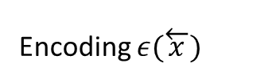






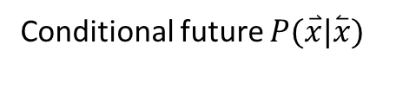

Predictive Models
Encoding $ε(\overset{←}{x})$
Predictive model
Past $\overset{⃐}{x}≔⋯x_{−2}x_{−1 }$
Future $\overset{⃑}{x}≔x_{0}x_{1}⋯$
$x_{−2}$
$x_{1}$
$$⋯$$
$x_{−1}$
$x_{0}$
$$⋯$$
Conditional future $P(\overset{⃑}{x}|\overset{⃐}{x})$

Slide 5






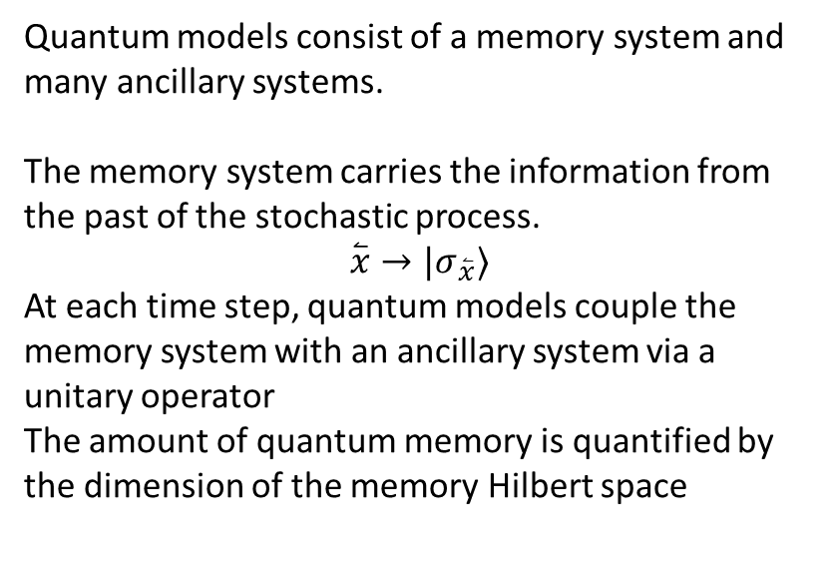
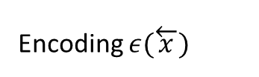









Quantum models
Quantum Model
Encoding $ε(\overset{←}{x})$
Memory
$${|σ}_{\overset{←}{x}}⟩$$
U
U
U
$$d_{q}=𝓗(\left|σ_{\overset{⃐}{x}}\right\rangle )$$
$$|0⟩$$
$$|0⟩$$
$$|0⟩$$
Past $\overset{⃐}{x}$
Future $\overset{⃑}{x}$
$$⋯$$
${|x}_{0}⟩$
${|x}_{1}⟩$
${|x}_{2}⟩$
$x_{−1}$
$$⋯$$
Q-Samples
$$x_{0}$$
$$x_{1}$$
$$x_{2}$$
Quantum models consist of a memory system and many ancillary systems.
The memory system carries the information from the past of the stochastic process.
$$\overset{⃐}{x}→|σ_{\overset{⃐}{x}}⟩$$
At each time step, quantum models couple the memory system with an ancillary system via a unitary operator
The amount of quantum memory is quantified by the dimension of the memory Hilbert space

Slide 6

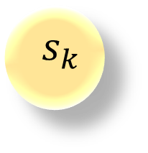
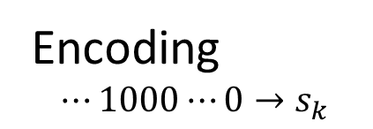


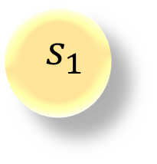
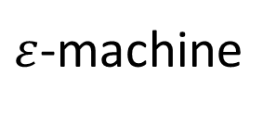
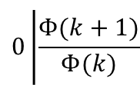
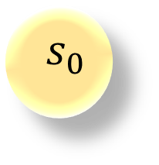

Dual Poisson processes
Encoding
$$⋯1000⋯0→s_{k}$$
$ε$-machine
$$0\left|\frac{Φ(k+1)}{Φ(k)}\right.$$
k
$$s_{0}$$
$$s_{1}$$
$$s_{k}$$
$$⋯$$
$$⋯$$
$$1\left|1 − \frac{Φ(k+1)}{Φ(k)}\right.$$
$$Φ\left(n\right)=pΓ_{1}^{n}+\left(1−p\right)Γ_{2}^{n}$$

Slide 7
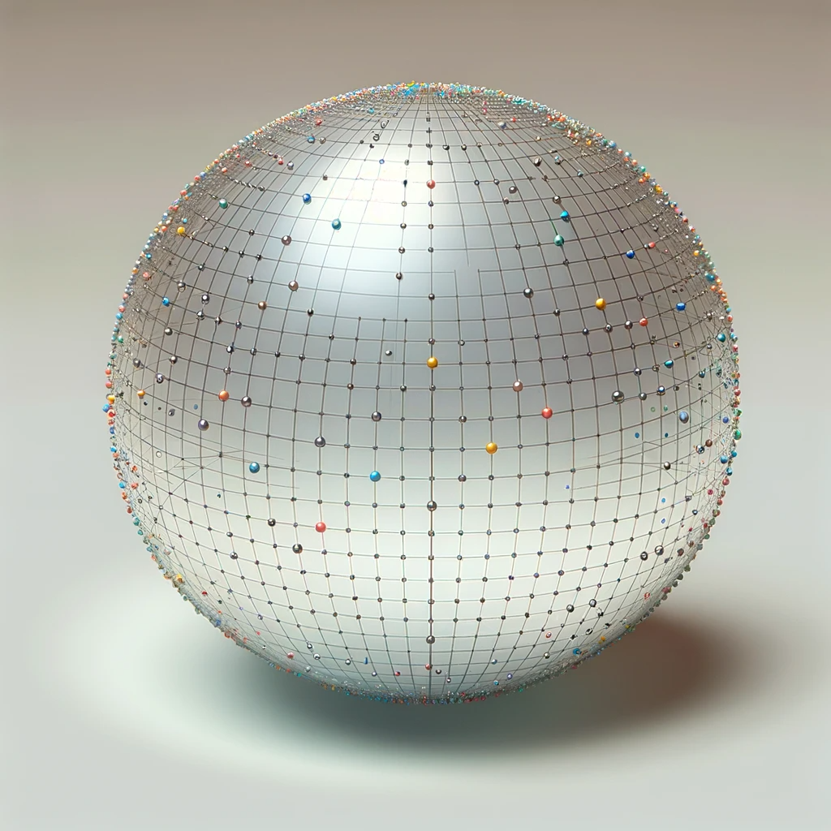
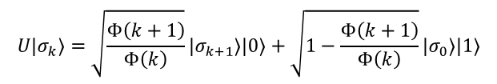
Single Qubit Model
Unitary operator
$$U\left|σ_{k}\right\rangle =\sqrt{\frac{Φ\left(k+1\right)}{Φ\left(k\right)}}\left|σ_{k+1}\right\rangle \left|0\right\rangle +\sqrt{1−\frac{Φ\left(k+1\right)}{Φ\left(k\right)}}\left|σ_{0}\right\rangle |1⟩$$

Slide 8
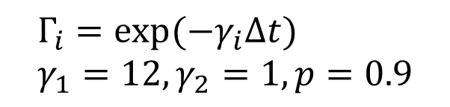
The amount of quantum memory
$$Γ_{i}=\exp{(−γ_{i}Δt)} \\ γ_{1}=12, γ_{2}=1, p=0.9$$

Slide 9
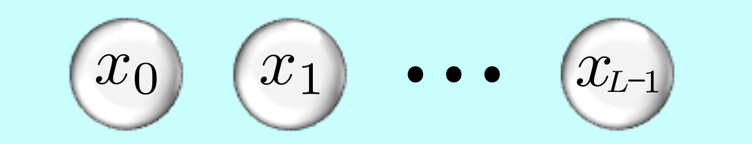
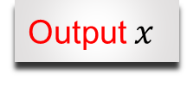


Learn a model from data
Memory
Learning Algorithm
U
$$|0⟩$$
Dimension $d_{q}$
Output $x$

Slide 10

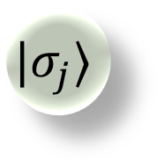
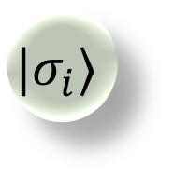


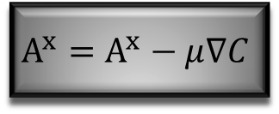


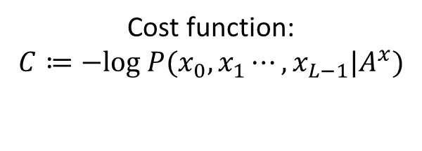

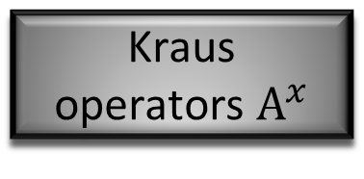
Learning Quantum Model
$$|σ_{i}⟩$$
U
$$|σ_{j}⟩$$
0
1
1
0
1
1
0
$$A^{x}≔⟨x|U|0⟩$$
Recover $\sum_{x}{A^{x}{A^{x}}^{†}=𝕀}$
$$|0⟩$$
$$x$$
Cost function:
    $$C≔−log P(x_{0},x_{1}⋯,x_{L−1}|A^{x})$$
Kraus operators $A^{x}$
$$A^{x}=A^{x}−μ∇C$$
Evaluate the gradient $∇C$
Update $A^{x}$

Slide 11
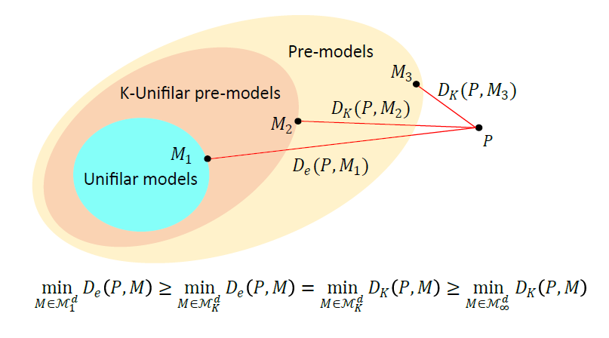
Classical Distortion Bound

Slide 12
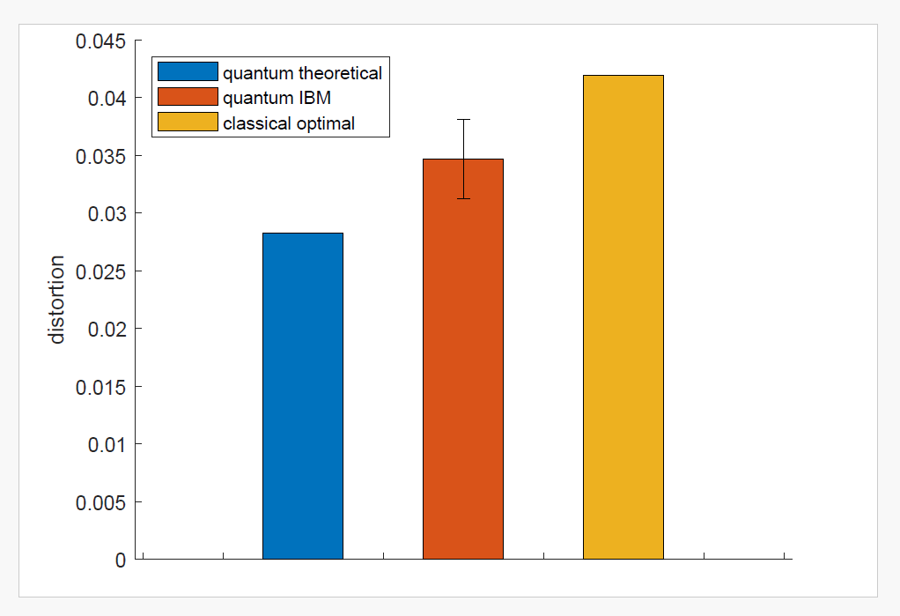
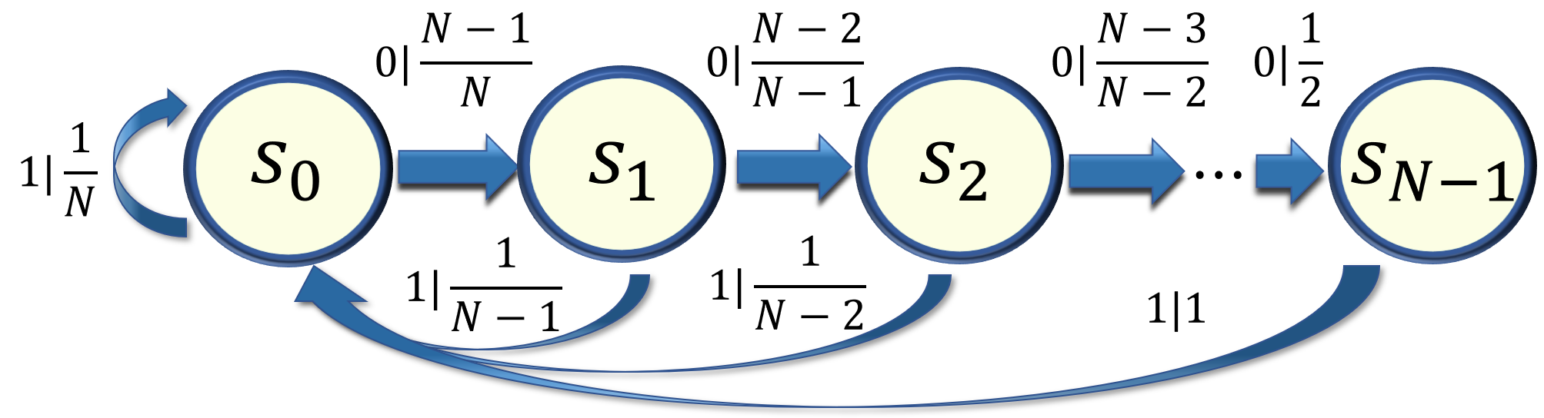

Training result and IBM Implementation
$$d_{C}=d_{q}=2, N=3$$

Slide 13
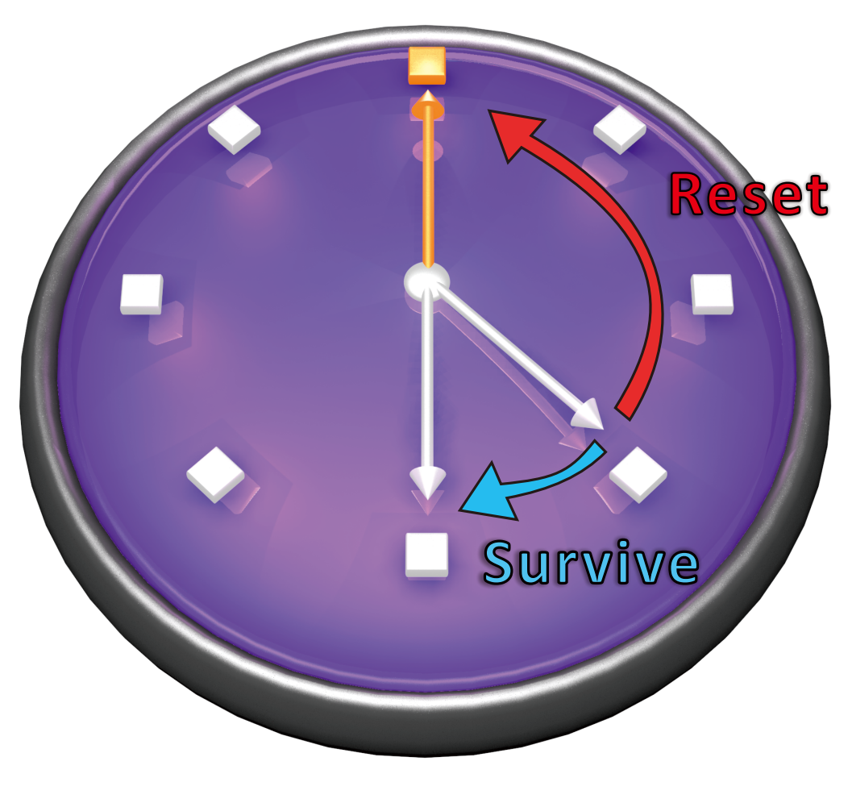

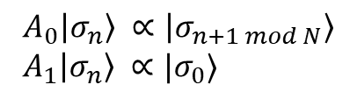
A Clock process
$$Φ\left(n\right)=Γ^{n}(1−V\sin^{2}{nθ})$$
$$A_{0}\left|σ_{n}\right\rangle ∝\left|σ_{n+1 mod N}\right\rangle \\ A_{1}\left|σ_{n}\right\rangle ∝|σ_{0}⟩$$

Slide 14
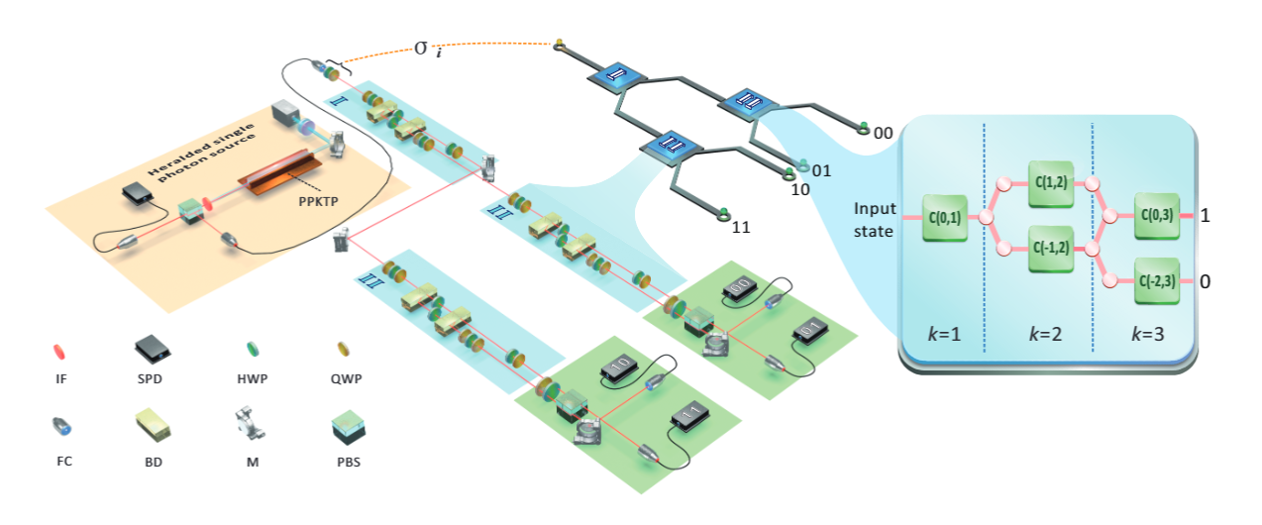
Experimental Details

Slide 15
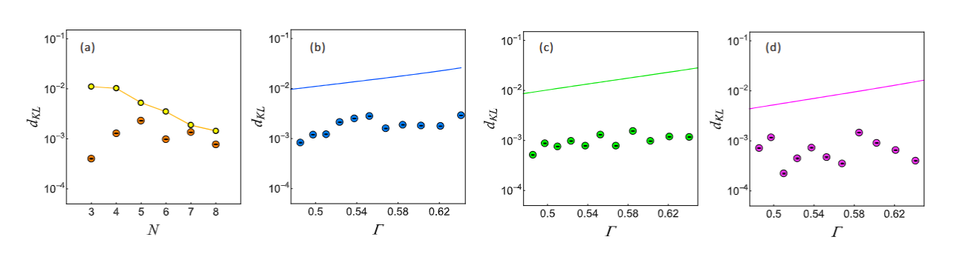
Experimental Results

Slide 16
Conclusion
There exists quantum models that present unbounded memory advantages over classical models
We develop a discovery algorithm to find accurate quantum models with reduced dimension
We experimentally implement quantum models that outperform the best classical model in terms of memory.

