Slide 1
Closing remarks on
QTML 2023
J.K. Kevin Rhee
On behalf of
Steering Committee

Slide 2
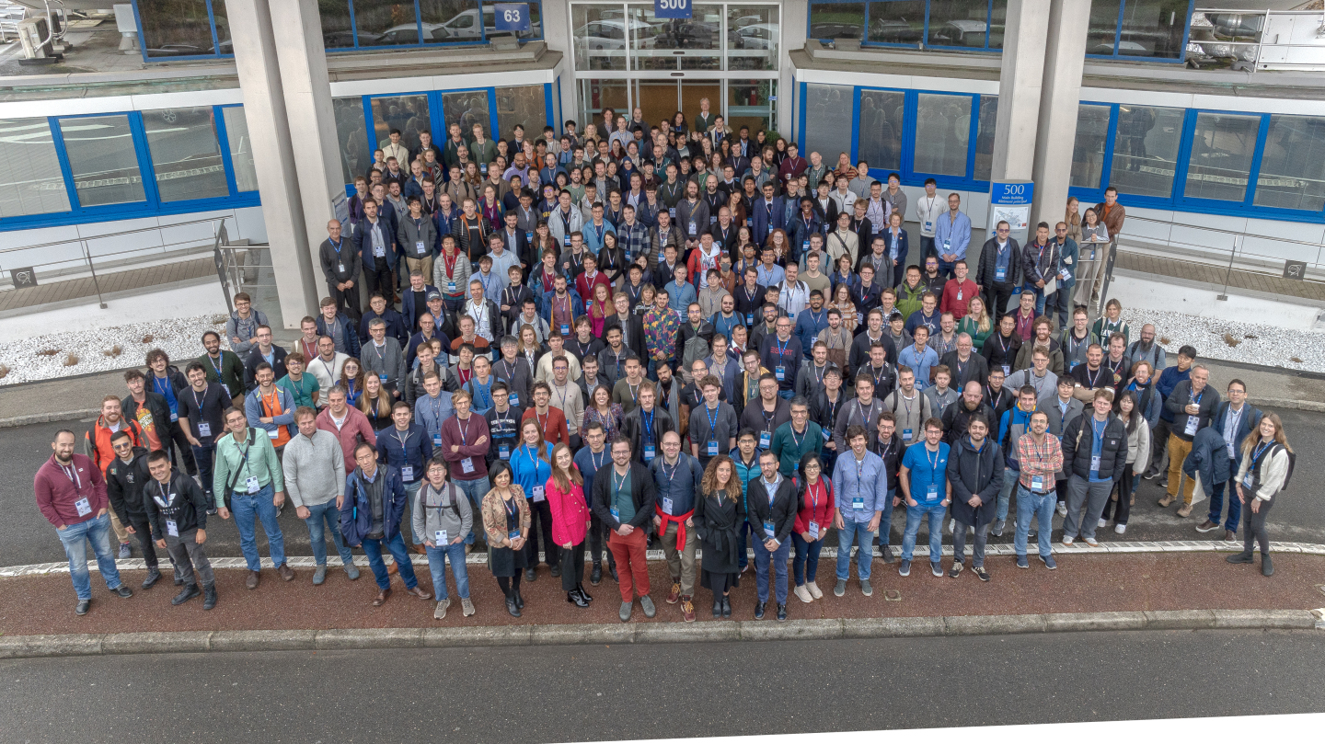
QTML 2023 in the Memory

Slide 3
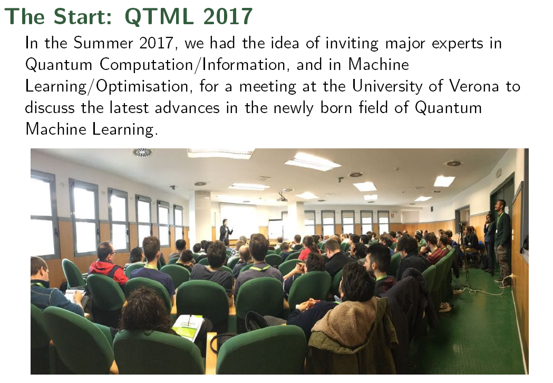

Slide 4
QTML 2023 at a glance
333
100
8
78
Attendees
Paper Submissions
and Oral Presentation
15
53
24
~35
13
33
12
23
~30
12
21
180
Quantum Speed Up !!
113
80
65
2017
2018
2019
2020
2021
2022
2023
2017
2018
2019
2020
2021
2022
2023

Slide 5

Special Issue of QUMI
Topical Collection dedicated to QTML 2023.
Collecting the extended versions of the best original results on recent
advances in the development of quantum techniques in machine
learning presented at QTML 2023.
6 /

Slide 6
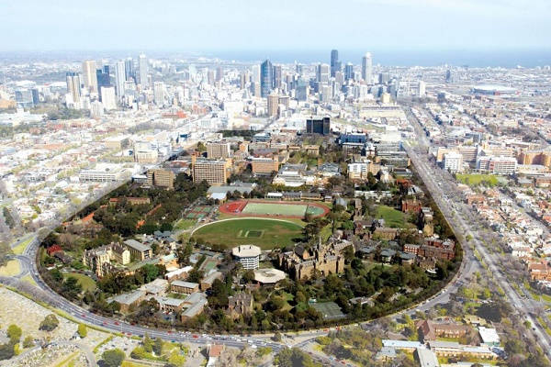
Au Revoir, QTML 2023
See all at QTML 2024 in
MELBOURNE
See you all (down) here!!

