Slide 1

Tl run COLLAPS 2023
IS718, High-resolution laser spectroscopy of thallium isotopes
9-15.05.2023
Physics case completed!

Slide 2
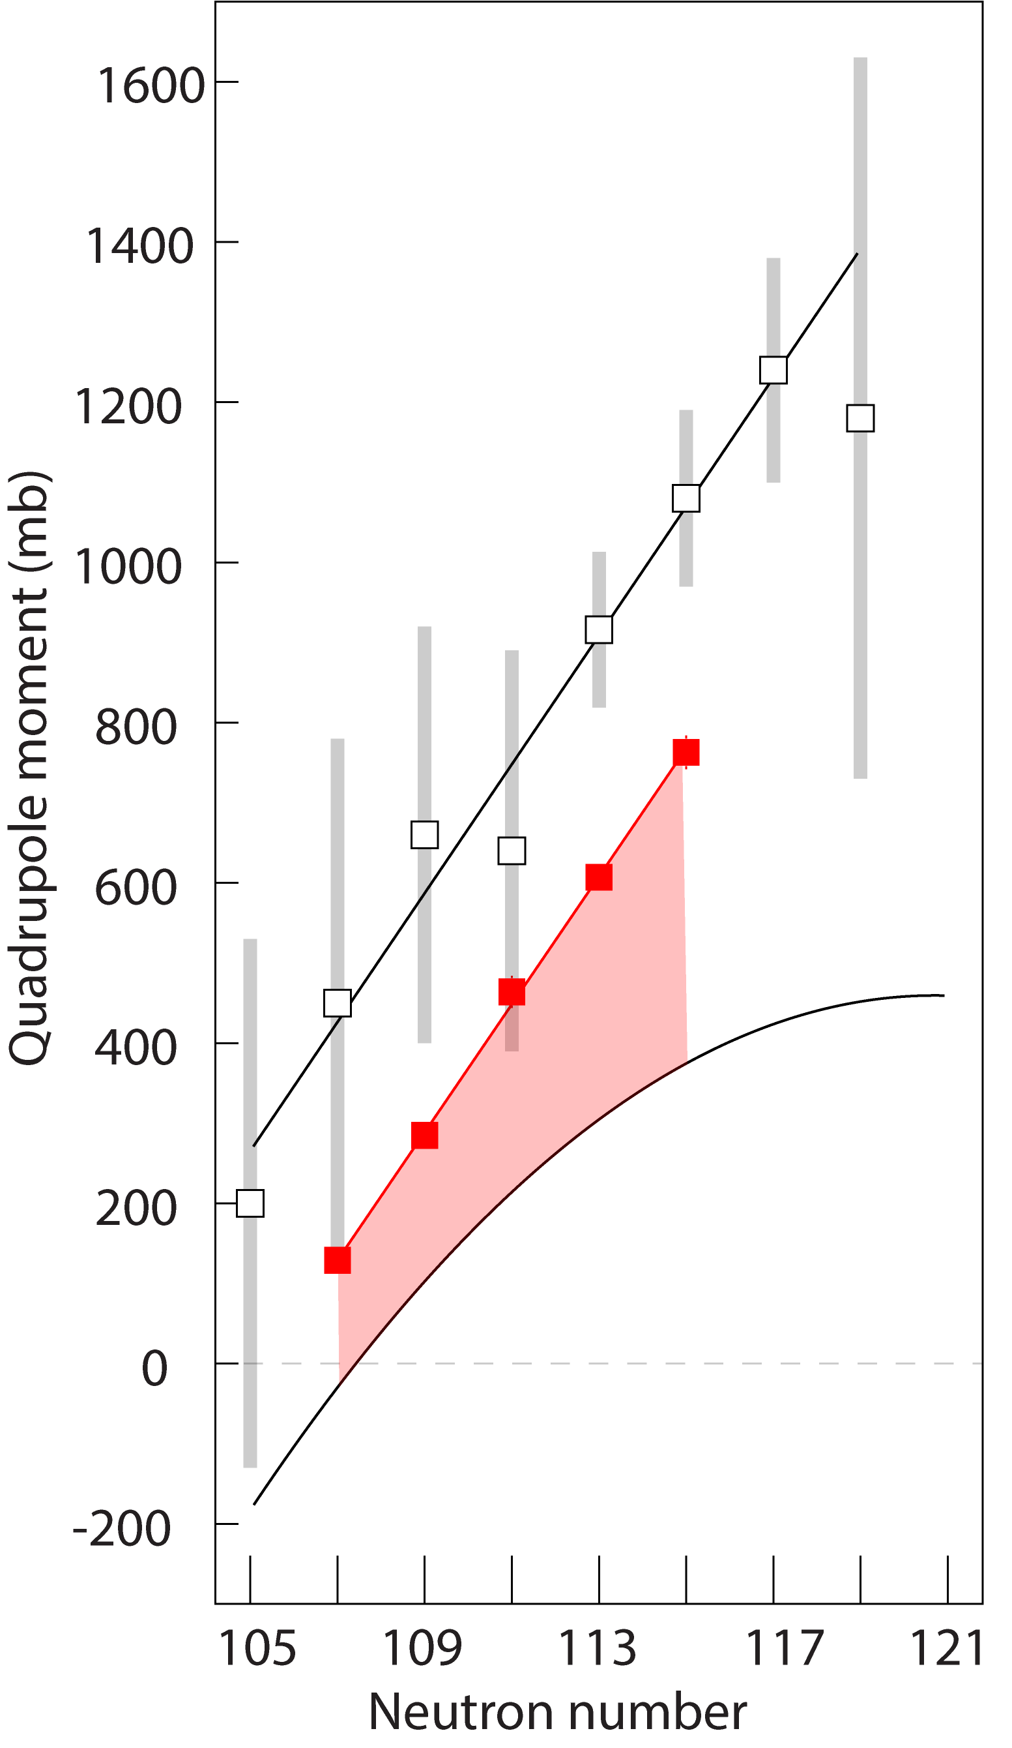

Physics case
Odd-odd isotopes
Quadrupole moments
Isomer shifts in Pb and Tl
Thallium
Proton orbits
Neutron orbits
N=126
3p_{1/2}
_{Hg (Z=80, 13/2+)}
2f_{5/2}
3p_{3/2}
1i_{13/2}
1h_{9/2}
_{Tl (Z=81)}
1h_{9/2}
2f_{7/2}
_{Tl (Z=81), 7+}
_{Tl: (7+) – (2-)}
Z=82
3s_{1/2}
1p-hole
Additivity rule
7+ : s_{1/2} proton and i_{13/2} neutron
_{Pb* (Z=82), 13/2+}
1
_{Pb (Z=82)}
0
_{Pb: (13/2+) – (3/2-)}
Q(7+)=[ ]× Qsp + [ ]× Qsn
Q(7+) = Qsn = Q(i_{13/2})

Slide 3
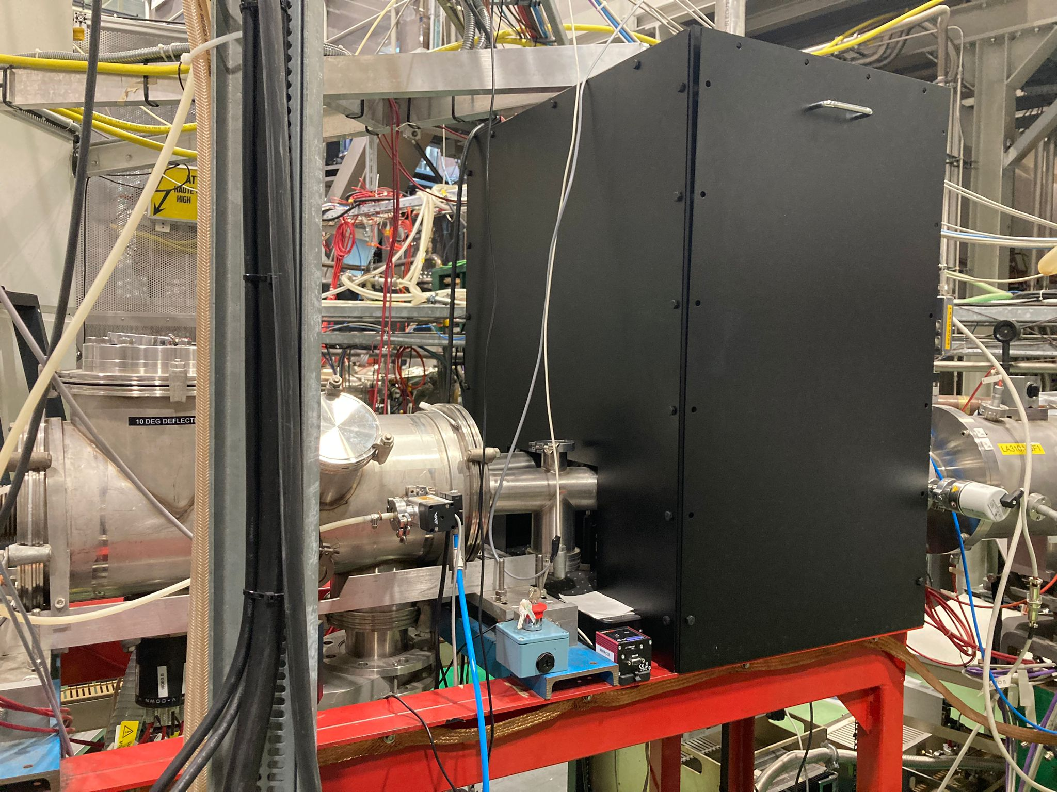
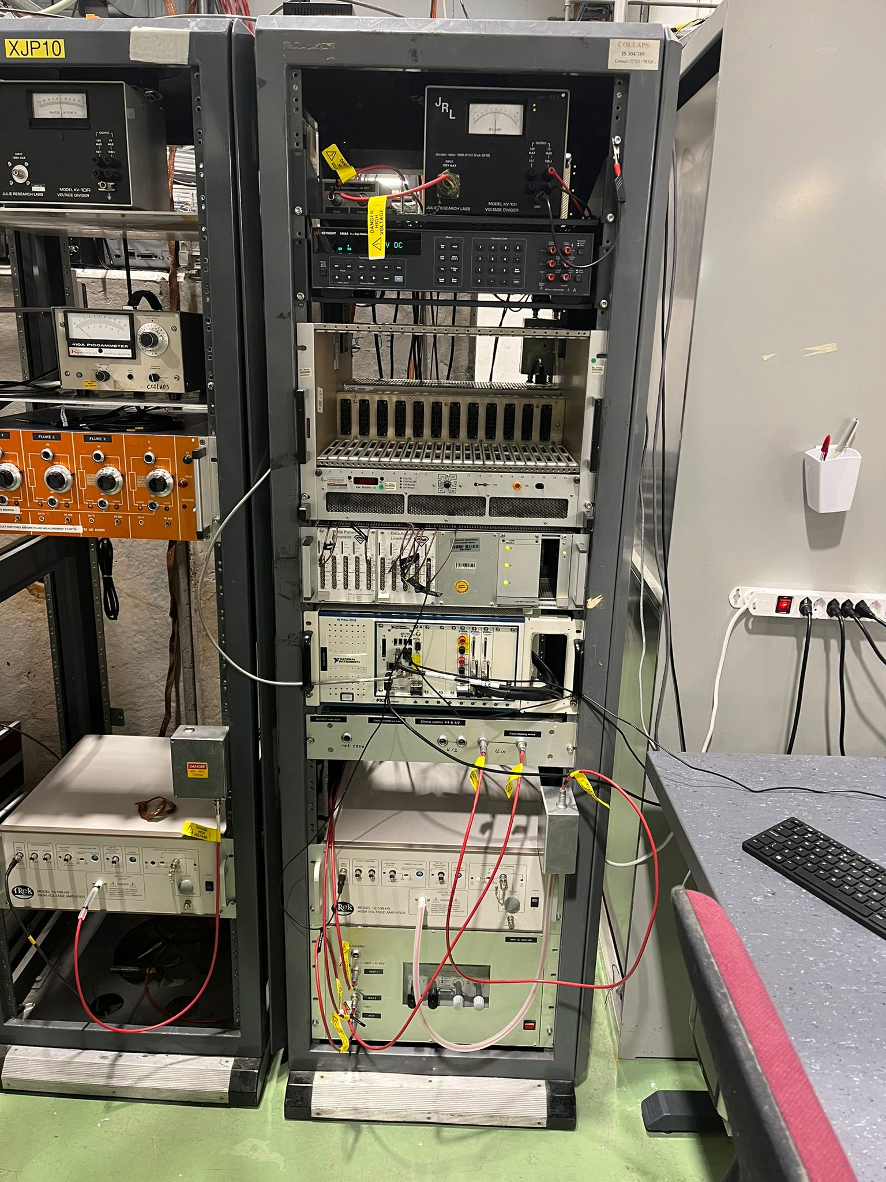
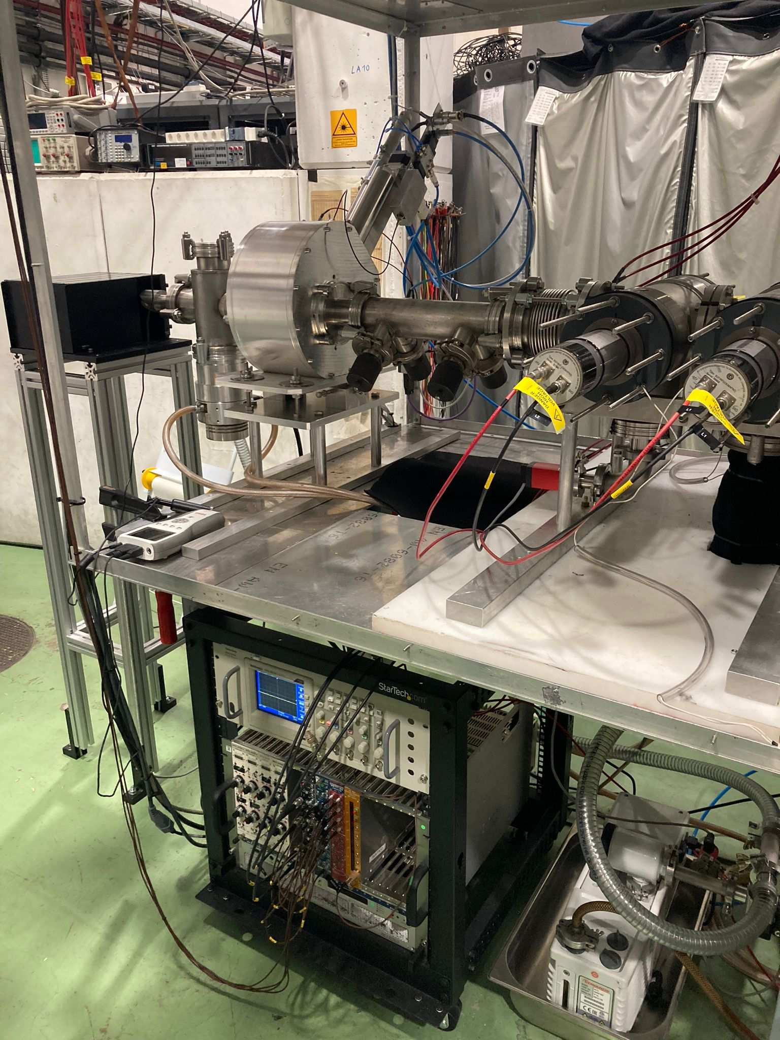
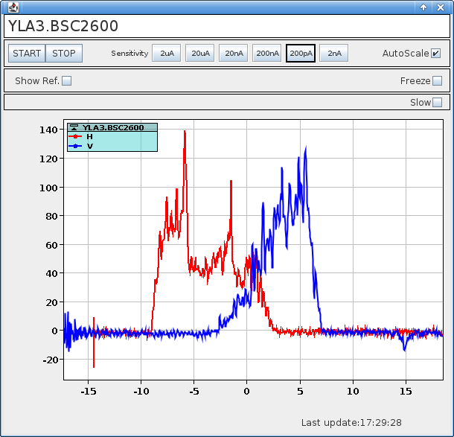
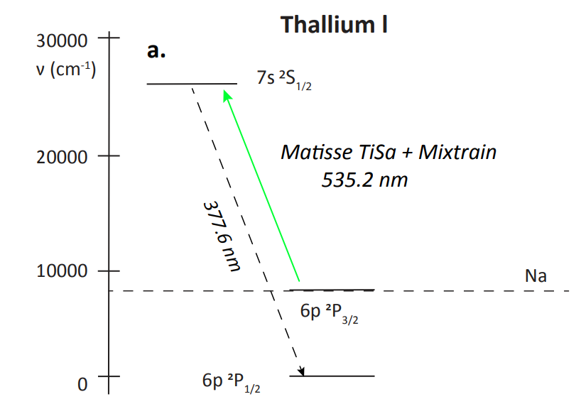
What was new?
New heating power supply
New laser enclosure and completely new laser beam path
Two transitions to be used, and no “easy cases”
New wire scanner and FC at the end of the beamline

Slide 4
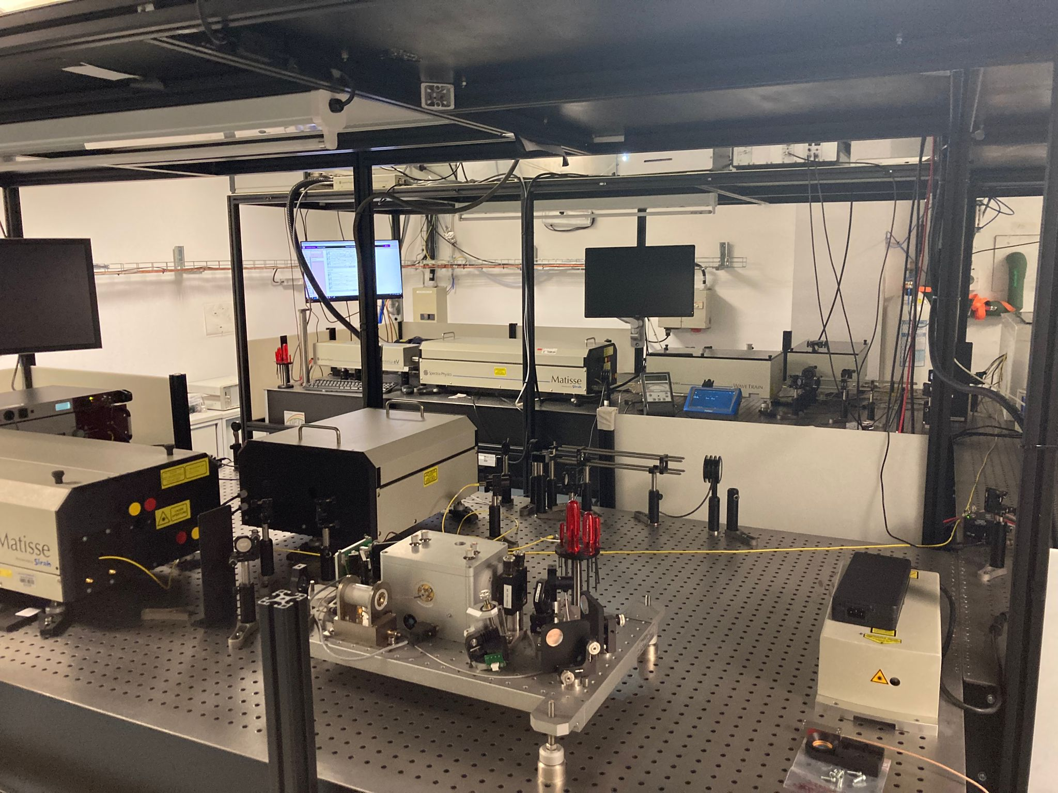
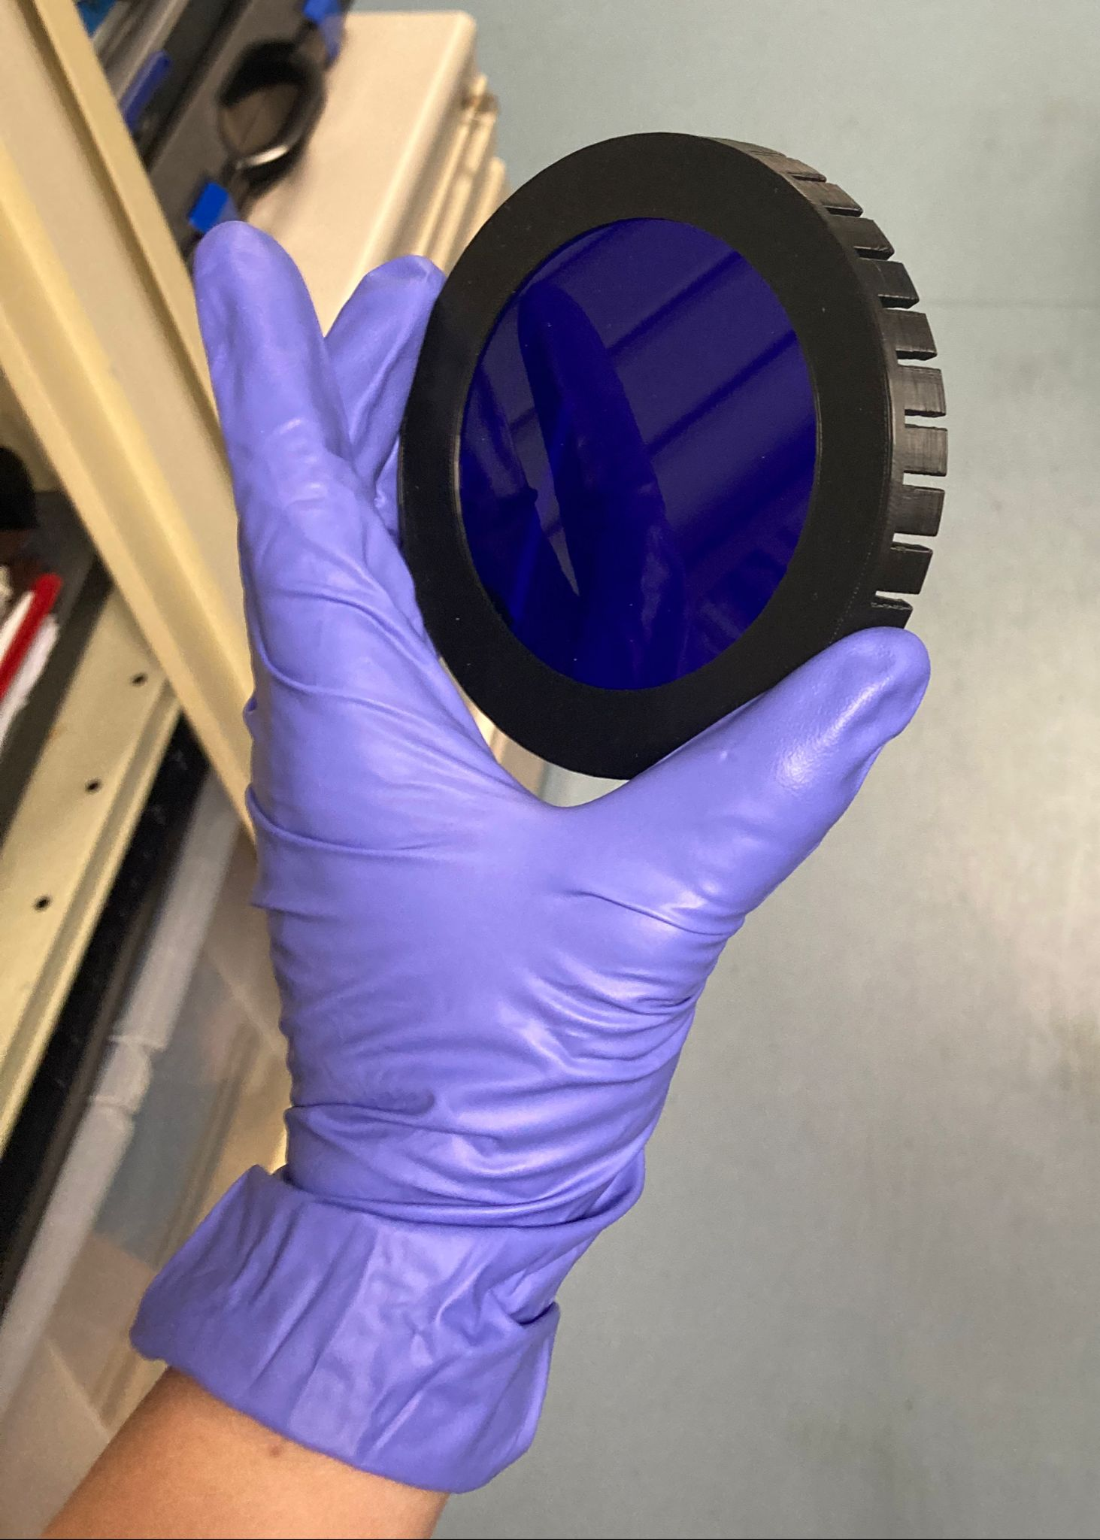
Laser lab
377 nm, hfa transition
535 nm, main transition

Slide 5
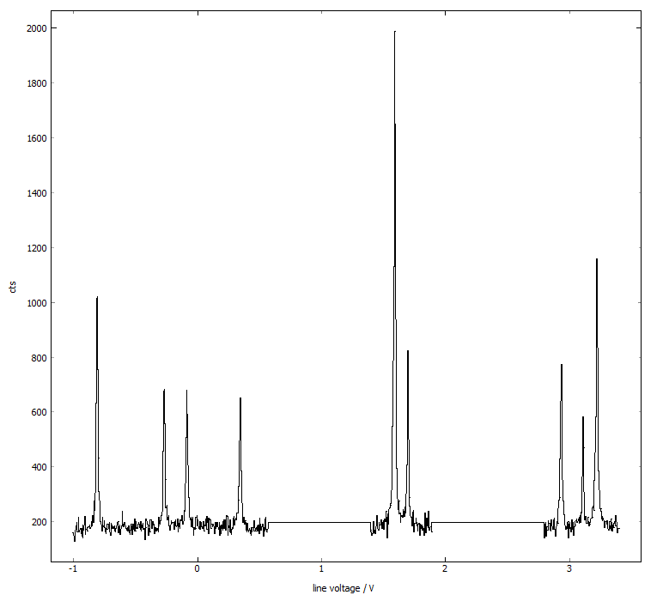
Results
¹⁸⁵Tl
535 nm transition
Odd-even example

Slide 6
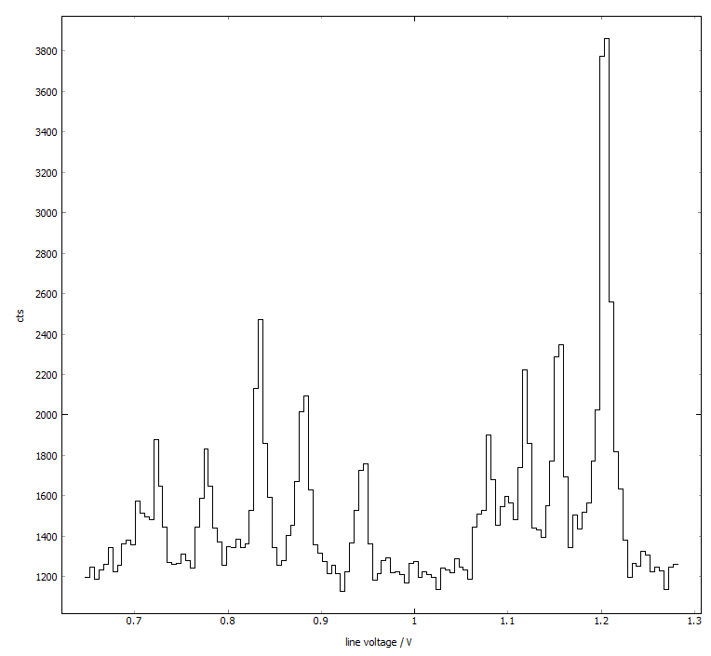
Results
?
¹⁸⁴Tl
535 nm transition
Odd-odd example
?
?

Slide 7
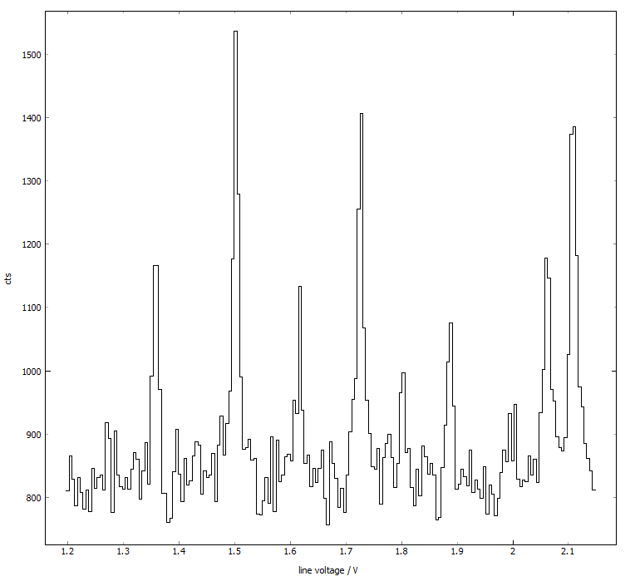
Results
¹⁸⁴Tl
535 nm transition
Odd-odd example

