Slide 1
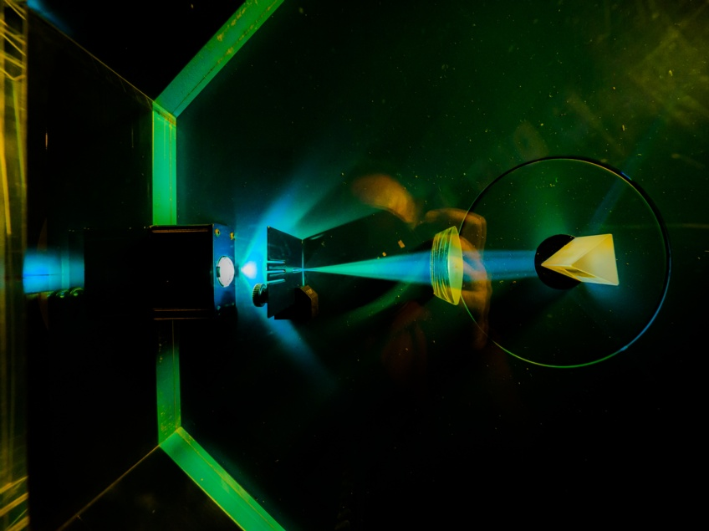


Securing the RAL Site
Image © STFC Alan Ford
Notes:
To edit the background image, select ‘Format’ from the PowerPoint menu and ‘Slide Background’ from the drop-down menu. Within the new list of options that appears on the right of the screen, select the ‘File’ button under ‘Insert picture from’ and select your image from your file browser. Remember to delete the image credit if using your own image.

Slide 2
Outline
Landsape
Motivations for RAL
WLCG SOC WG
Applying the model to RAL
Positives/Challenges
Next Steps
Image © STFC Alan Ford
Notes:
To replace photo with one of your own. 1) Send the geometric shape overlay to the back – Right-Click > Send to Back > Send to Back. 2) Replace image – use the guides provided to correctly position it. 3) Send your image to the back so that the geometric overlay re-appears over the image. Remember to delete the image credit if using your own image.

Slide 3
Landscape
The current threats for research communities include sophisticated, motivated and well funded actors
A SOC is a powerful tool for monitoring and alerting threats
SOC augments security capabilities
Important to share intelligence within the community
Notes:
To replace photo with one of your own. 1) Send the geometric shape overlay to the back – Right-Click > Send to Back > Send to Back. 2) Replace image – use the guides provided to correctly position it. 3) Send your image to the back so that the geometric overlay re-appears over the image. Remember to delete the image credit if using your own image.

Slide 4
Implementation at RAL
General motivation
  Increase in priority of cybersecurity projects within STFC over last few years
  Coupled to modern landscape and clear understanding of potential impact
Specific motivation
  Work already planned to deploy SOC capabilities for RAL Tier1 following original SOC WG design
  Opportunity with modest increase in funding to cover entire campus due to network topology
  Intention both to improve cybersecurity posture for Harwell campus (RAL) and act as pilot for other STFC sites
    Alongside other SOC development work in the broader UK Research and Innovation context
Image © STFC Alan Ford
Notes:
To replace photo with one of your own. 1) Send the geometric shape overlay to the back – Right-Click > Send to Back > Send to Back. 2) Replace image – use the guides provided to correctly position it. 3) Send your image to the back so that the geometric overlay re-appears over the image. Remember to delete the image credit if using your own image.

Slide 5
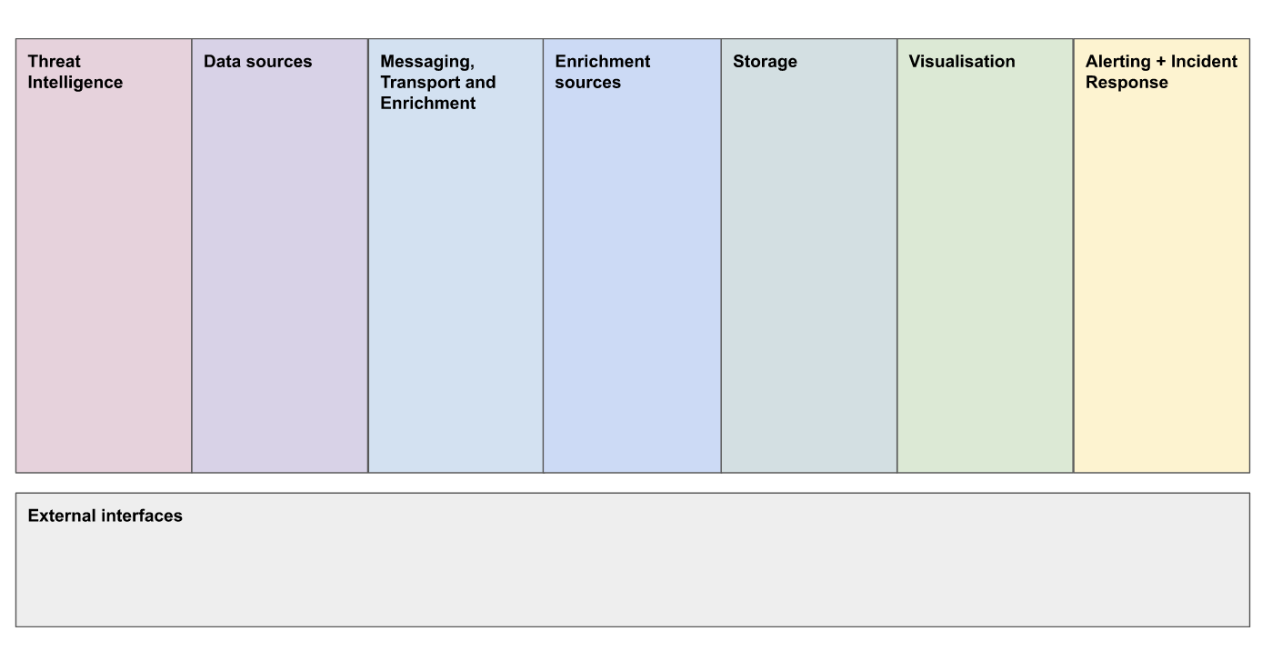
WLCG SOC WG
Workshop 14th – 18th August
Participants from UKRI, University of Durham, CERN, University of Chicago and University of Michigan, JISC
Docker deployed Misp
Zeek RPM’s for Rocky9/el9
Documentation
Image © STFC Alan Ford
Notes:
To replace photo with one of your own. 1) Send the geometric shape overlay to the back – Right-Click > Send to Back > Send to Back. 2) Replace image – use the guides provided to correctly position it. 3) Send your image to the back so that the geometric overlay re-appears over the image. Remember to delete the image credit if using your own image.

Slide 6
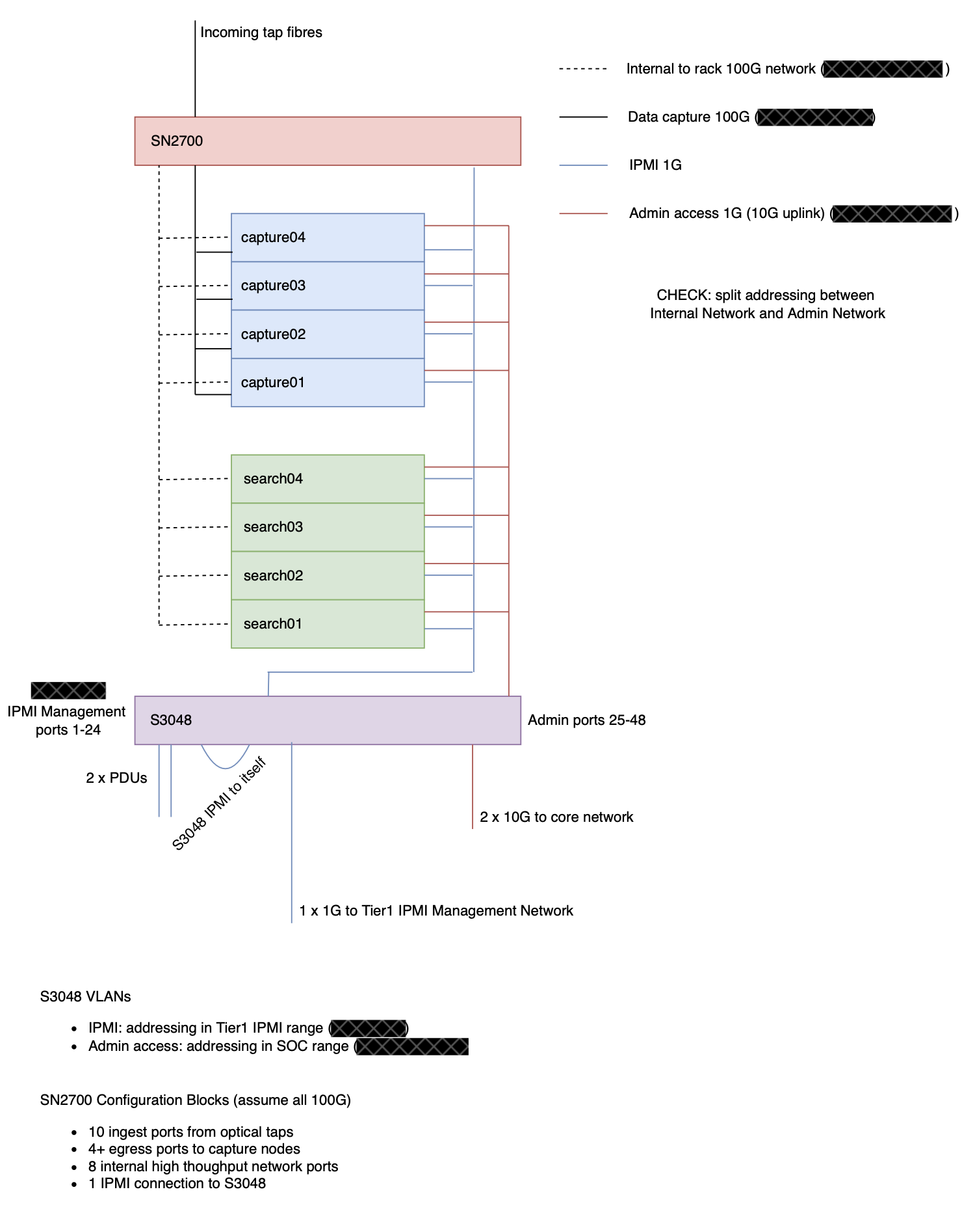
SOC Hardware Layout
Admin Network private VLAN behind site firewall
Internal 100G network
4 capture and 4 search nodes
Some services need to be accessible from the core site network to be useful (dashboards…)
  Ports opened to loadbalancers and made available from there
  Other services on the Tier-1 VMWare cluster and have monodirectional traffic from the SOC VLAN
Image © STFC Alan Ford
Notes:
To replace photo with one of your own. 1) Send the geometric shape overlay to the back – Right-Click > Send to Back > Send to Back. 2) Replace image – use the guides provided to correctly position it. 3) Send your image to the back so that the geometric overlay re-appears over the image. Remember to delete the image credit if using your own image.

Slide 7
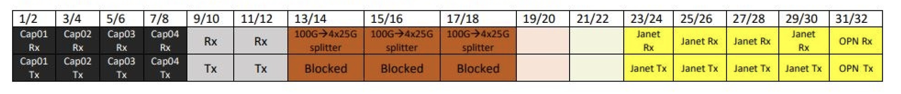
Applying the Model: Monitoring Taps
High performance 100Gb Mellanox SN2700 switch, running Cumulus OS
  Ingests the intercepted Janet and OPN network traffic (with separate Rx and Tx links)
  Load-balances and forwards packets across our Capture hosts for analysis
Selected ports are grouped into logical interfaces called a ”bonds”, operating in “balance-xor mode”
A “symmetric” hash value is calculated for each incoming packet, based on source and destination IP address >> result determines which physical port of the bond will egress the packet
  The direction a packet travels between two hosts is irrelevant in the generation of its hash value
  Ensures all packets in a given “conversation flow” are consistently routed to the same Capture node in our SOC (crucial for Zeek performance)
Image © STFC Alan Ford
Notes:
To replace photo with one of your own. 1) Send the geometric shape overlay to the back – Right-Click > Send to Back > Send to Back. 2) Replace image – use the guides provided to correctly position it. 3) Send your image to the back so that the geometric overlay re-appears over the image. Remember to delete the image credit if using your own image.

Slide 8
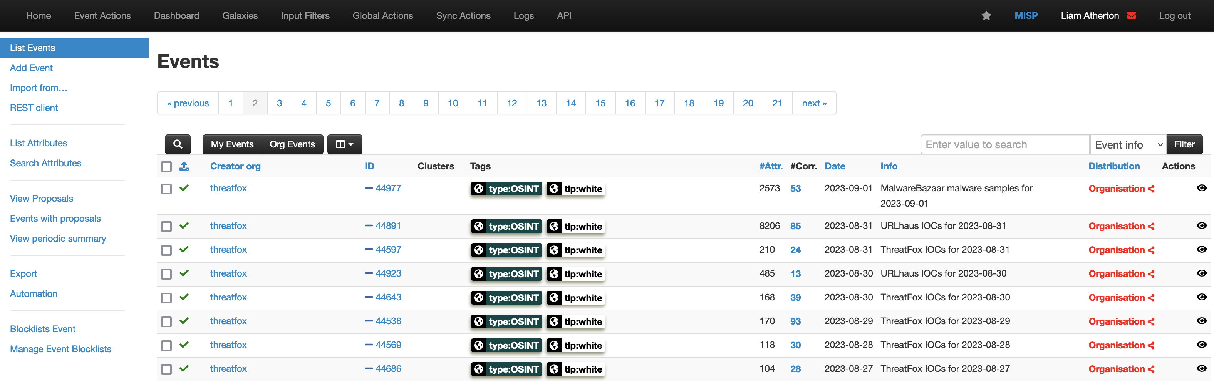
Applying the Model: Misp
MISP hosted in a more permissible network environment than the rest of SOC to allow corporate access
  This is because we don't want routing to SOC rack from outside the department
  To be hosted in the Tier1 VMWare cluster.
Deployed using Docker compose, with each component (web, database, modules) in its own container
  https://github.com/JiscCTI/misp-docker
Image © STFC Alan Ford
Notes:
Really it's the Tier 1 VMWare cluster but 'departmental' might make more sense to audience

Slide 9
Applying the Model: Zeek (Bro)
Runs on SOC Capture Nodes: (2x Mellanox ConnectX-6 dual 100Gb NICs, 2x AMD 7H12 64-core CPUs, 1TB RAM)
  Specialized hardware for Zeek monitoring, which we run in ”cluster” mode with 2 main “worker” processes
Workers each listen on a designated network interface, and reserve processor threads to perform packet analysis
  Two threads per CPU need to be left free for the host’s OS, Zeek’s manager/proxy/logger, other misc. processes
Network cards have on board encryption compute power and 63 available “ring buffers” for speeding up the pipeline
  Packets symmetrically hashed by network card immediately >> result determines which “Rx ring” packet goes to
We enable 62 of these ring ”channels” per network interface to match 1-to-1 with the thread count of the Zeek workers
  Channels manage direct storage of packets in system memory, and send out identifying ”interrupt request” (IRQ)
  IRQs are hardware signals that trigger a CPU response, i.e. fetching a network packet to read (via “socket buffer”)
  We then map every channel’s IRQ integer id-value to a specific processor thread, connecting the two elements
  Zeek’s “af_packet” plugin leverages native features of Linux sockets to load balance the fanned-out traffic across multiple processing threads attached to a single worker (standard Zeek workers don’t have multithreading)
  This feature of processing traffic across multiple NIC hardware queues is called Receiver Side Scaling (RSS)
  Linux’s irqbalance service, which normally balances IRQs across CPU threads dynamically, needs to be disabled
This configuration ensures all packets from any given monitored connection end up being processed by the same worker/core, enabling Zeek to benefit from cached memory during analysis of network sessions (increases efficiency and quality of monitoring)
        Zeek interprets information from extracted content and transaction data
        Custom scripting feature lets users modify the default criteria and methods of traffic analysis
        Outputs streamlined, descriptive set of categorized logs
Image © STFC Alan Ford
Notes:
To replace photo with one of your own. 1) Send the geometric shape overlay to the back – Right-Click > Send to Back > Send to Back. 2) Replace image – use the guides provided to correctly position it. 3) Send your image to the back so that the geometric overlay re-appears over the image. Remember to delete the image credit if using your own image.

Slide 10
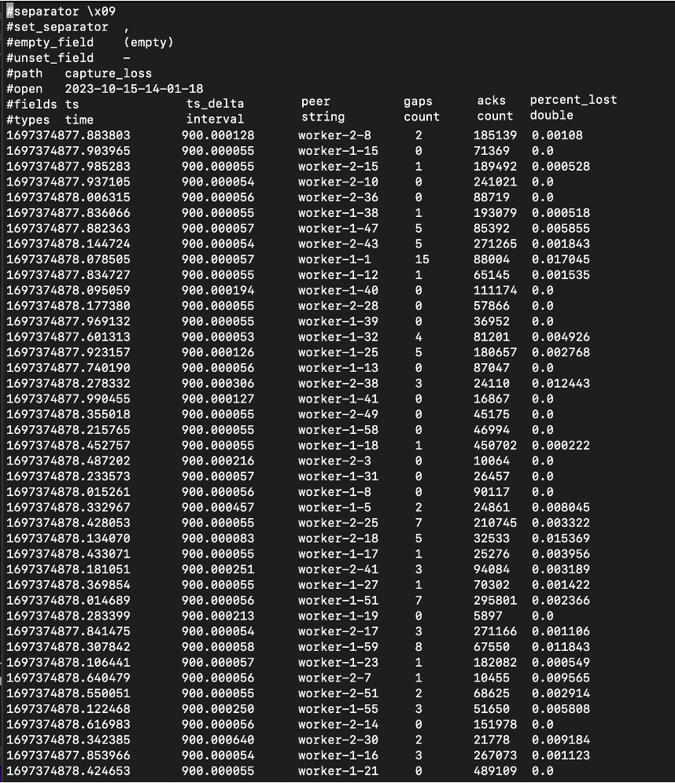
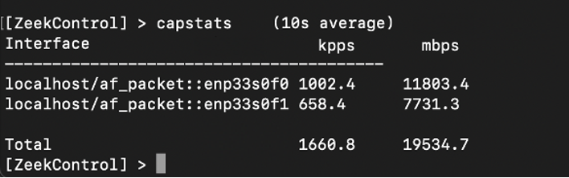
Currently monitoring both OPN RX and TX taps on a single Capture node host
Random sample snapshot of network levels ⇣ and Zeek’s capture_loss.log ⇢
Rightmost column shows each worker’s recent % of avg lost traffic, calculated using TCP sequence numbers
Configured as only 2 workers, but each separate thread acts like its own process
Result: avg. capture loss very low, mostly << 0.01%
  Almost no traffic being dropped by switch or node interfaces, host kernel, etc
  Still some room to improve certainly
  When very busy and varied Janet traffic comes into play, greater challenges are expected
  This will require further analysis, tuning and modification of Zeek + host configuration

Slide 11
Applying the Model: Kafka
Kafka collects Zeek logs and can be used to enrich data
Using Kafka 3 (no zookeeper required) via Bitnami Docker image: https://github.com/bitnami/containers/tree/main/bitnami/kafka
Using zeek-kafka plugin (https://github.com/SeisoLLC/zeek-kafka), a fork of the Apache Metron Bro plugin.
Zeek acts as a producer for Kafka
Can publish to distinct topics for each type of zeek log
Offers a range of enrichment possibilities such as custom scripts
Configuration still in development
Will run on head node
Image © STFC Alan Ford
Notes:
To replace photo with one of your own. 1) Send the geometric shape overlay to the back – Right-Click > Send to Back > Send to Back. 2) Replace image – use the guides provided to correctly position it. 3) Send your image to the back so that the geometric overlay re-appears over the image. Remember to delete the image credit if using your own image.

Slide 12
Applying the Model: Logstash
Since no plugin to write data to OpenSearch directly from Kafka, Logstash is our method to bridge the gap.
Using Docker to deploy
Using the Kafka input plugin and OpenSearch output plugin
Configuration still in development.
Will run on head node
Image © STFC Alan Ford
Notes:
To replace photo with one of your own. 1) Send the geometric shape overlay to the back – Right-Click > Send to Back > Send to Back. 2) Replace image – use the guides provided to correctly position it. 3) Send your image to the back so that the geometric overlay re-appears over the image. Remember to delete the image credit if using your own image.

Slide 13
Applying the Model: Opensearch
Runs on search nodes within the SOC rack
OpenSearch 2.4
Docker compose deployment
In production with no data currently
2 OpenSearch containers + 1 Dashboards container per host (4 hosts total)
Role-based access control provided by IRIS IAM (an instance of Indigo IAM)
How to expose OpenSearch Dashboards from within a private SOC network?
  Our solution is to amend firewall rules so that the dashboards port on each search node can communicate with only a departmental load balancer. This is made available over the RAL VPN to give staff access.
Image © STFC Alan Ford
Notes:
To replace photo with one of your own. 1) Send the geometric shape overlay to the back – Right-Click > Send to Back > Send to Back. 2) Replace image – use the guides provided to correctly position it. 3) Send your image to the back so that the geometric overlay re-appears over the image. Remember to delete the image credit if using your own image.

Slide 14
Applying the Model: Elastalert and Scripts
Work in progress
Scripts for
  long-lived network connections
  many repeated connections from same IP
  long dns queries
  larger than normal data-transfers
  Uncommon user-agent strings in http log
  IPs outside of known subnets
  Expired x509 certificates
Image © STFC Alan Ford
Notes:
To replace photo with one of your own. 1) Send the geometric shape overlay to the back – Right-Click > Send to Back > Send to Back. 2) Replace image – use the guides provided to correctly position it. 3) Send your image to the back so that the geometric overlay re-appears over the image. Remember to delete the image credit if using your own image.

Slide 15
Positive: Zeek
Collaborating with other security engineers from NIHEF/CERN
  ..and slowly starting to bring more to the table
Learning opportunity in network systems, mostly
Satisfying to get it up and running at such a high standard, without yet breaking or failing (at least for OPN links)
Optimistic start
Image © STFC Alan Ford
Notes:
To replace photo with one of your own. 1) Send the geometric shape overlay to the back – Right-Click > Send to Back > Send to Back. 2) Replace image – use the guides provided to correctly position it. 3) Send your image to the back so that the geometric overlay re-appears over the image. Remember to delete the image credit if using your own image.

Slide 16
Positive: Hackathon
WLCG SOC Hackathon
  JISC made a new MISP deployment
  Zeek RPM’s for Rocky9/RHEL9/SL9
Good to have a regular WG for SOC deployments
  (next one maybe at CERN?)
Image © STFC Alan Ford
Notes:
To replace photo with one of your own. 1) Send the geometric shape overlay to the back – Right-Click > Send to Back > Send to Back. 2) Replace image – use the guides provided to correctly position it. 3) Send your image to the back so that the geometric overlay re-appears over the image. Remember to delete the image credit if using your own image.

Slide 17
Challenge: SSO
Integrating services with Single-sign-on providers
  Had to switch from Indigo IAM to Keycloak to get MISP login working, though was ok for OpenSearch.
Image © STFC Alan Ford
Notes:
To replace photo with one of your own. 1) Send the geometric shape overlay to the back – Right-Click > Send to Back > Send to Back. 2) Replace image – use the guides provided to correctly position it. 3) Send your image to the back so that the geometric overlay re-appears over the image. Remember to delete the image credit if using your own image.

Slide 18
Positive Challenge: Configuration Management
SecOps Archetype, minimum trust config
Not built on configuration management assumptions
  No SSH as root
Challenging assumptions breaks unexpected things
  Assumption in account creation that the admin is root for ownership of ssh keys file
    Config now based on ownership by each user
  Sudo config defined groups differently in different areas
Image © STFC Alan Ford
Notes:
To replace photo with one of your own. 1) Send the geometric shape overlay to the back – Right-Click > Send to Back > Send to Back. 2) Replace image – use the guides provided to correctly position it. 3) Send your image to the back so that the geometric overlay re-appears over the image. Remember to delete the image credit if using your own image.

Slide 19
Next Steps
Deploy Misp on VMWare host
Deploy logstash and kafka to head nodes
Zeek ingesting Janet links
Discussions on how to integrate into our existing processes
Elastalert/zeek scripts
FIR (Fast Incident Response)
Image © STFC Alan Ford
Notes:
To replace photo with one of your own. 1) Send the geometric shape overlay to the back – Right-Click > Send to Back > Send to Back. 2) Replace image – use the guides provided to correctly position it. 3) Send your image to the back so that the geometric overlay re-appears over the image. Remember to delete the image credit if using your own image.

Slide 20







Science and Technology Facilities Council
@STFC_matters
Science and Technology Facilities Council
Notes:
The abstract pattern can be removed or repositioned if required. Be careful to ‘Send to Back’ so that it does not obscure any important information.

