Slide 1


Oxford University Physics Department
Computer Room Air Conditioning Upgrades
Pete Gronbech HEPiX Fall Workshop 2023 Victoria, BC

Slide 2
Outline
Local Computer Room Description
Typical electrical power load and PUE
Plan to perform upgrade with zero downtime
Supplementary A/C & testing
The upgrade
Tuning & results
Begbroke Science Park Computer Room

Slide 3
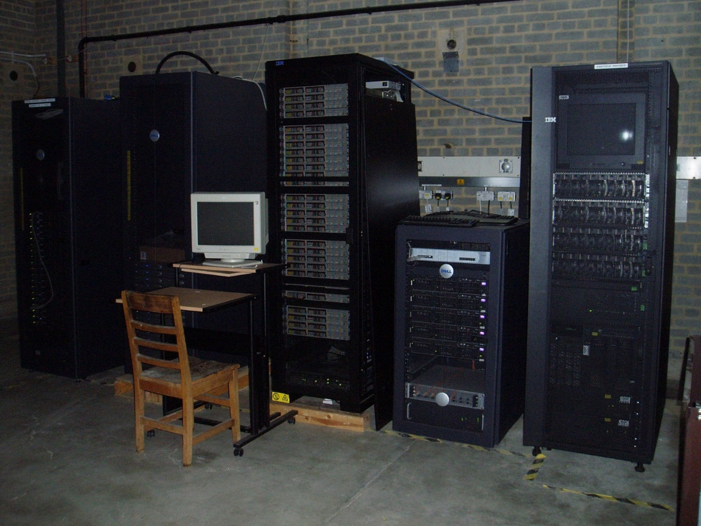
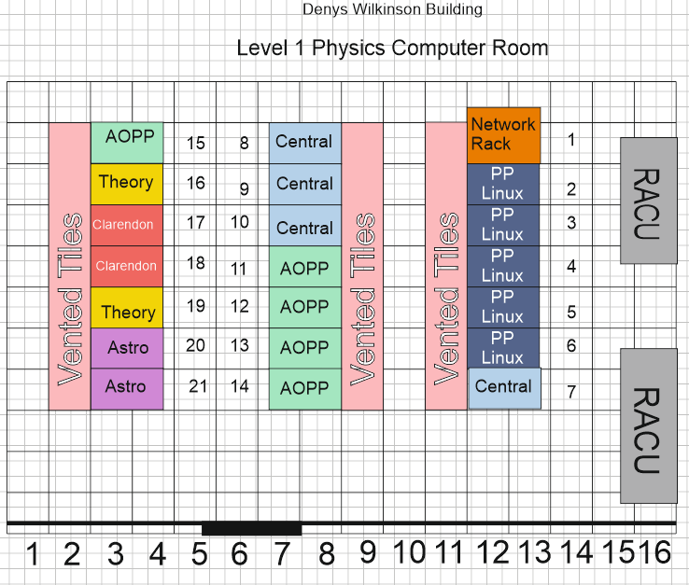
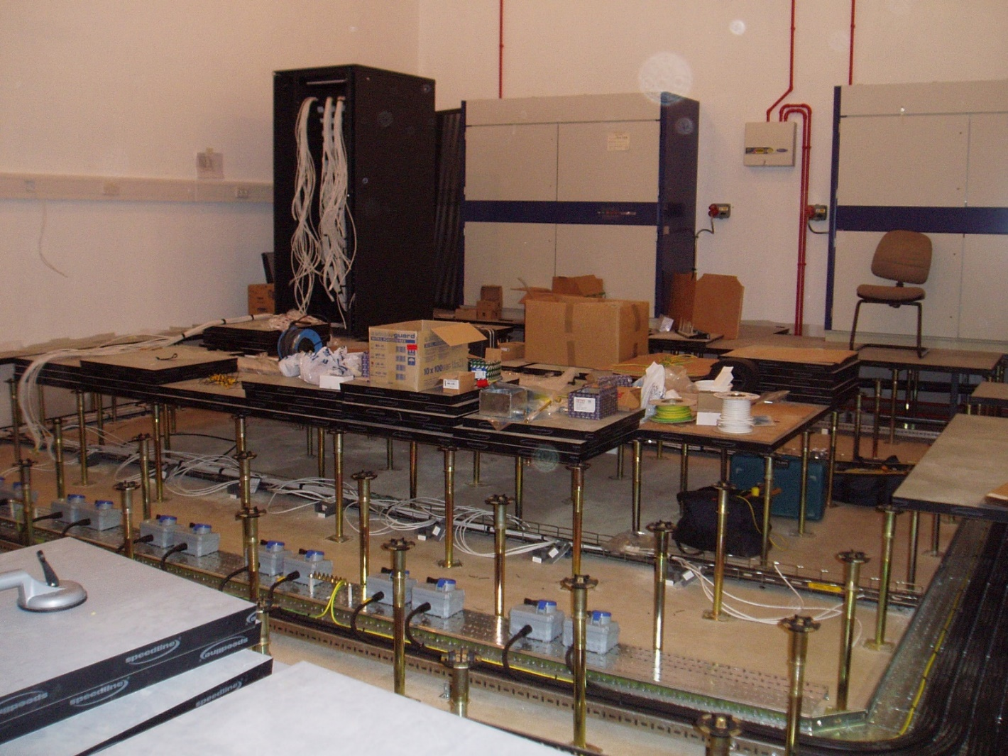
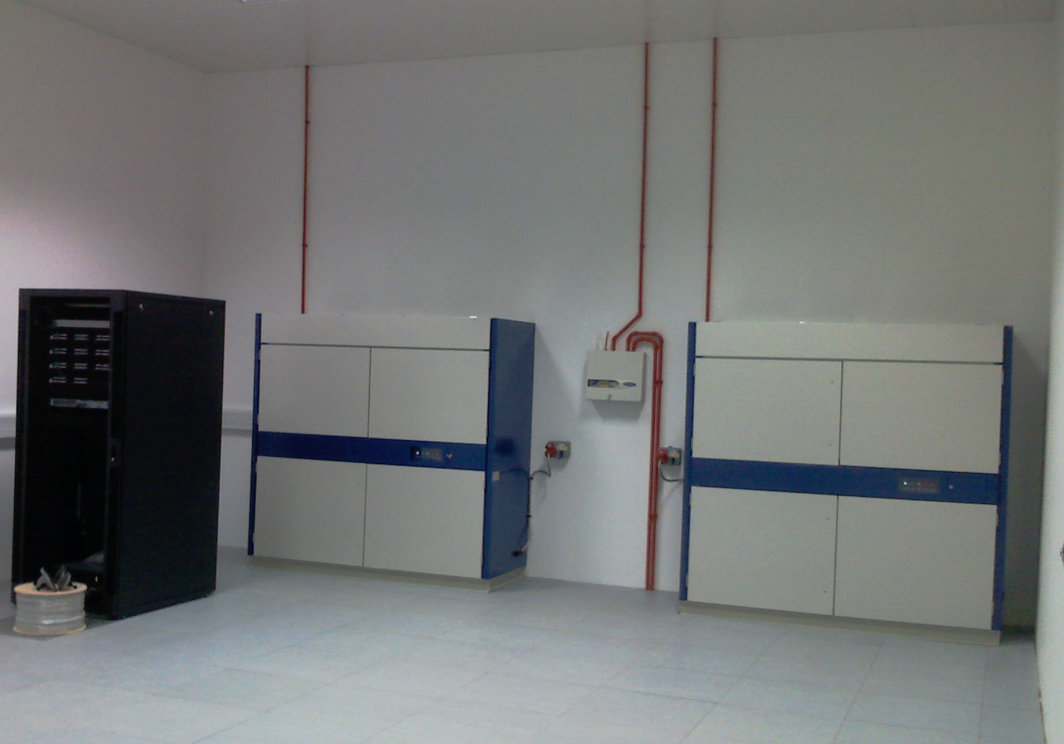


Physics department local Infrastructure room
Built in 2007
Big step up from running racks in old experimental halls
Traditional air cooled, vented tiles, DX cooling
21 rack capacity
Two 50kW RACU’s
Each rack has two 32A sockets

Slide 4
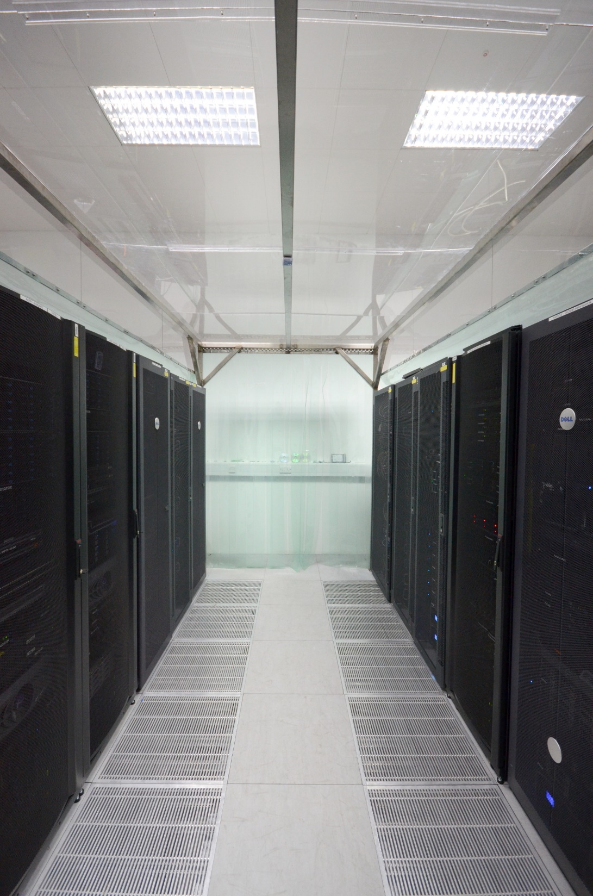
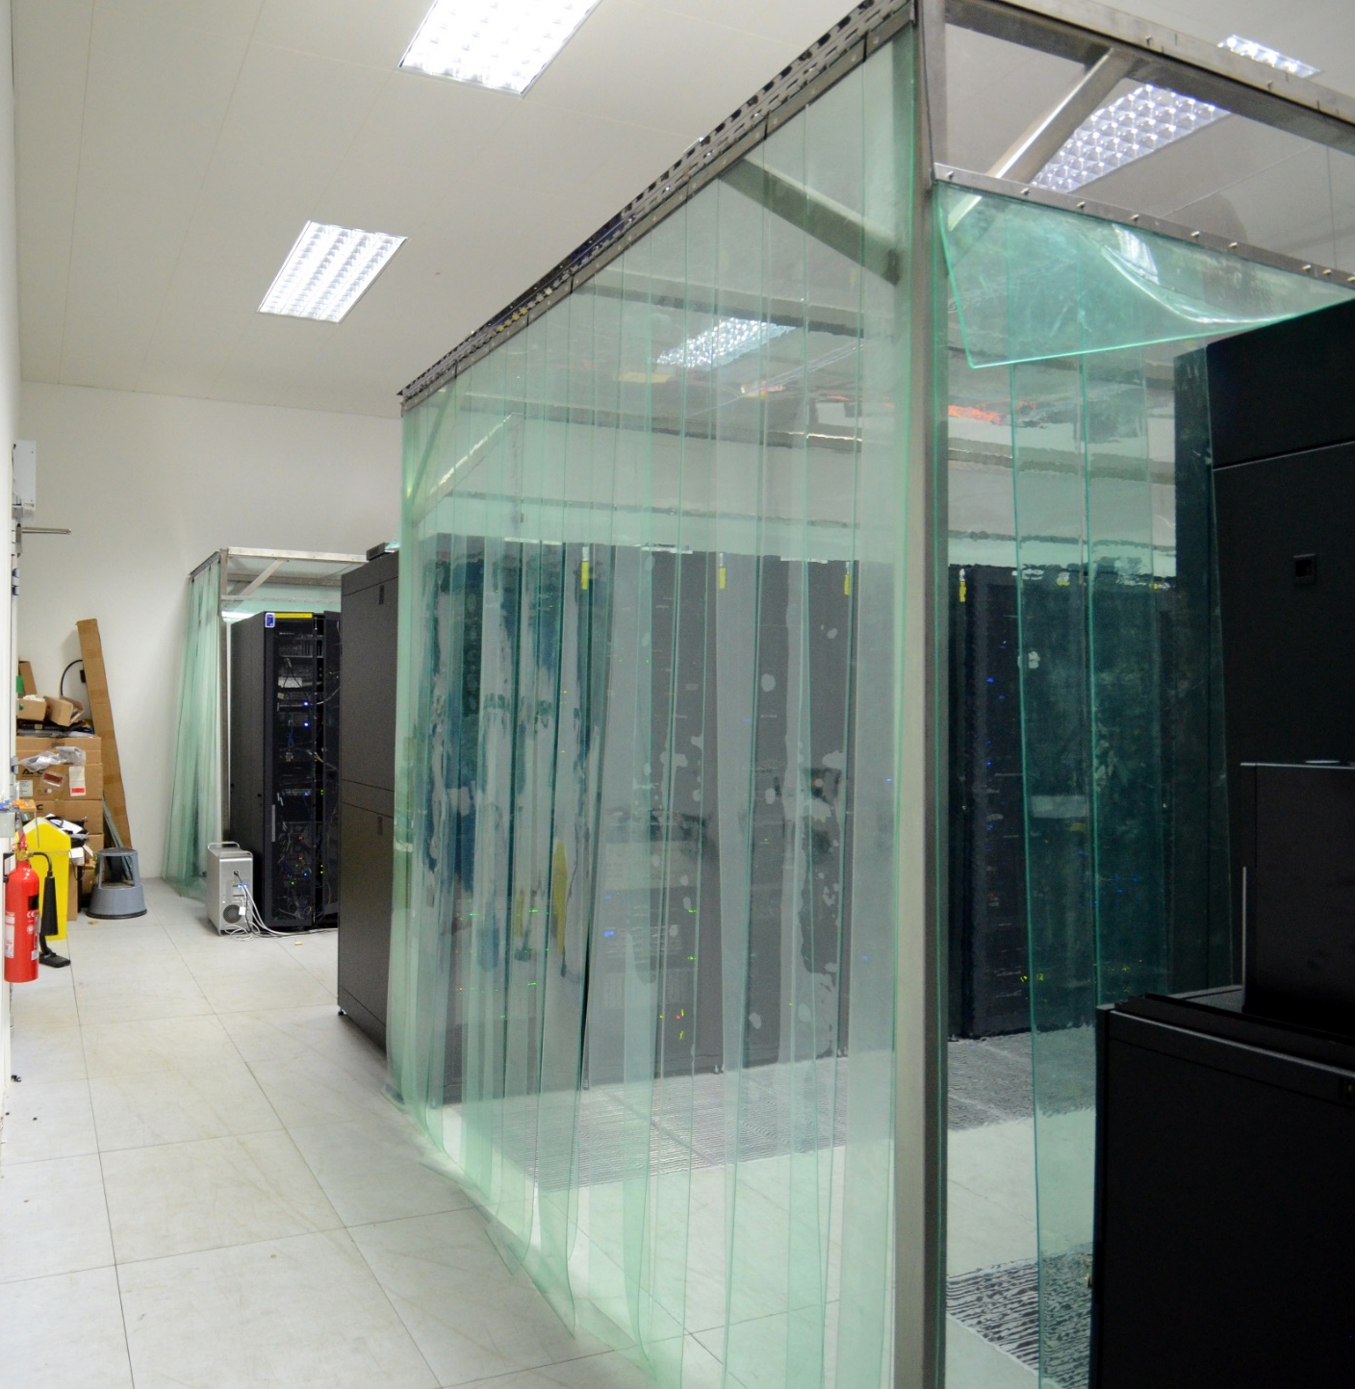
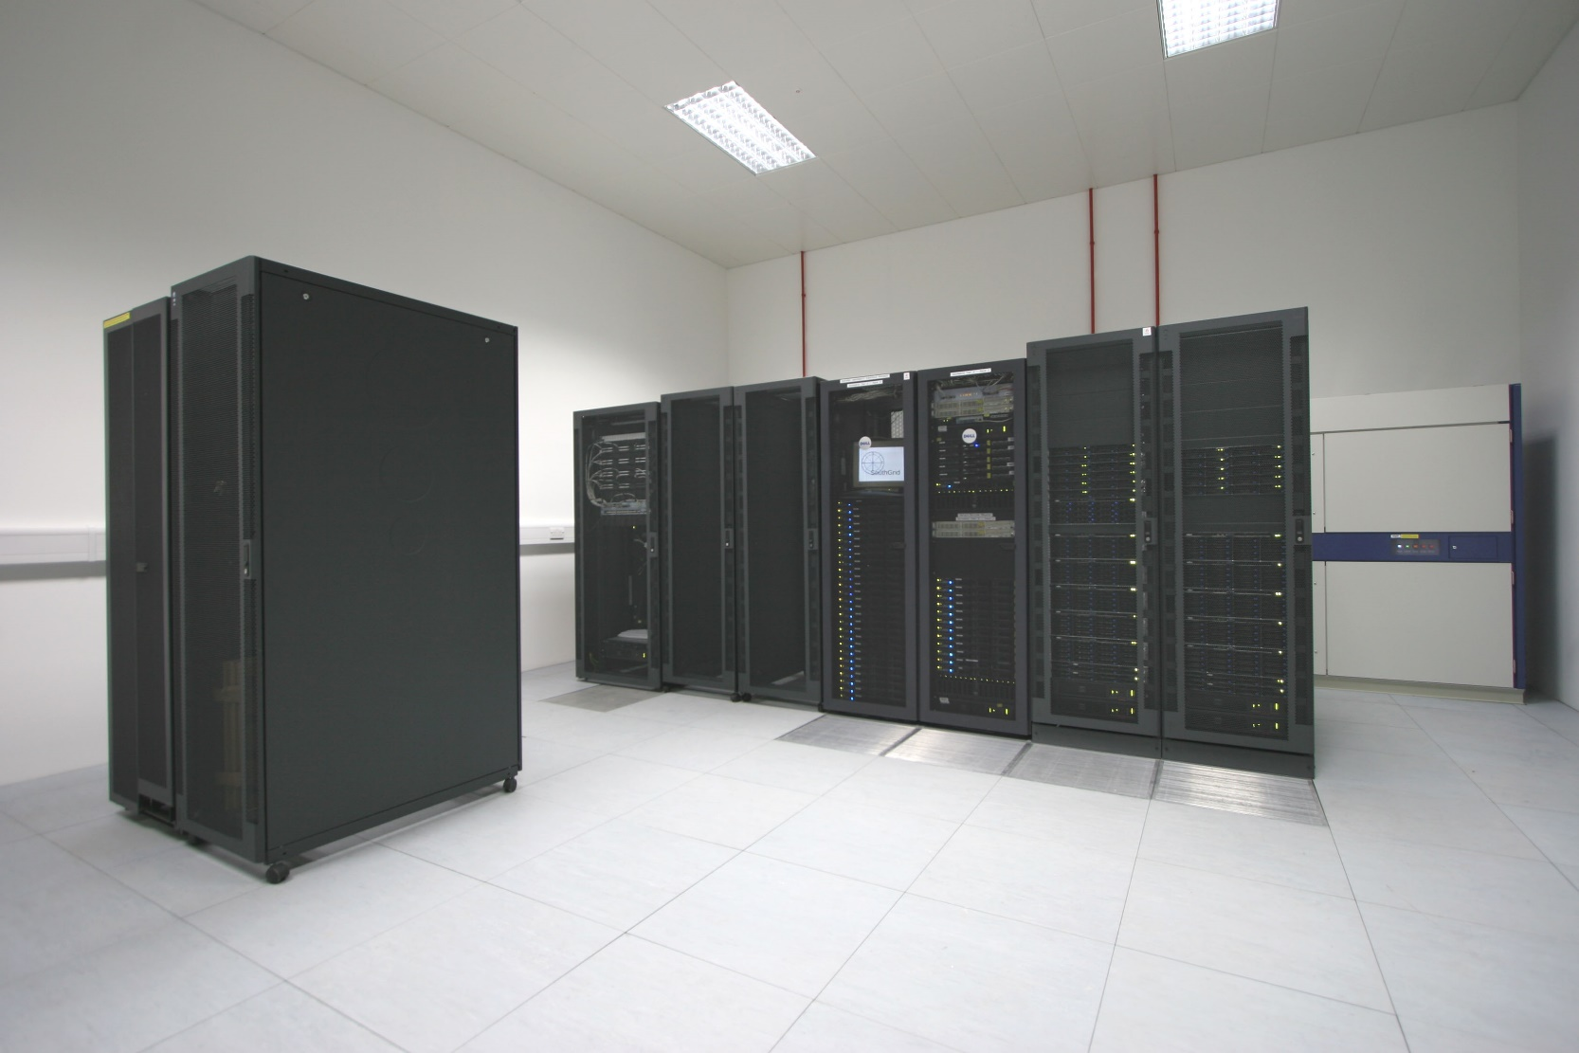
Physics department local Infrastructure room
Rapidly filled up.
All rack positions filled
Enclosed the cold aisles in 2011

Slide 5
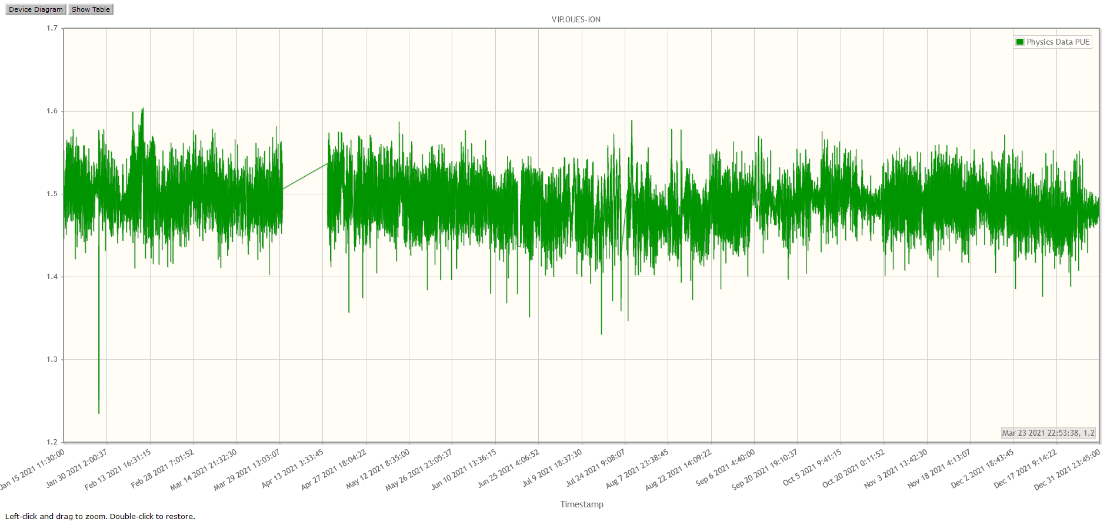
Physics department local Infrastructure room
Load frequently over 50kW, so no redundancy when changing fan belts
Fans were continuously running so needed to change belts every 6 months to avoid failure.
Units costly to run, and ~15 years old
PUE ~1.5
University Estates had a sustainability budget we could apply to have the upgrades funded.
Idea would be to replace the two units with three 45kW units giving better redundancy, increased capacity and the new units should use less power so improve the PUE. Payback period in cost savings over a few years.
First met with Estates in January 2020. Had to get metering installed to measure the PUE to show the potential savings, this was completed in December 2020.

Slide 6
Physics department local Infrastructure room
University Estates commissioned and funded the project.
One main Sub contractor to provide the design and A/C units.
  They sub-contracted out the pipe installation.
    At one stage they sub-contracted a core drilling company.
  They sub-contracted the supply of supplementary A/C.
  Yet another company performed the electrical installation.
There was no overall project manager so
the key stakeholder had to keep a very close eye on what was going on.

Slide 7
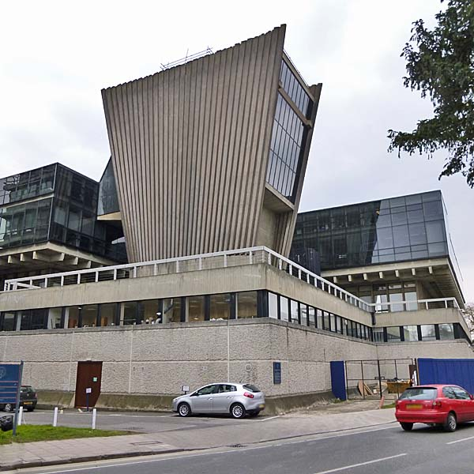
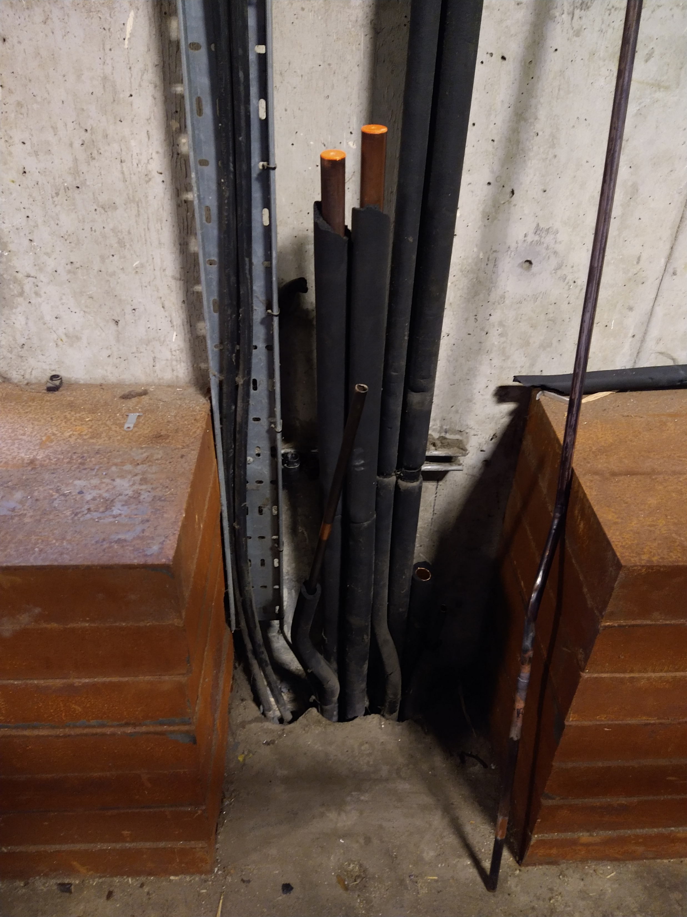
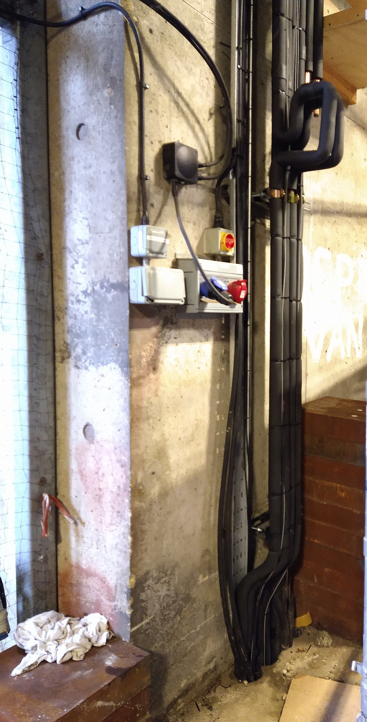
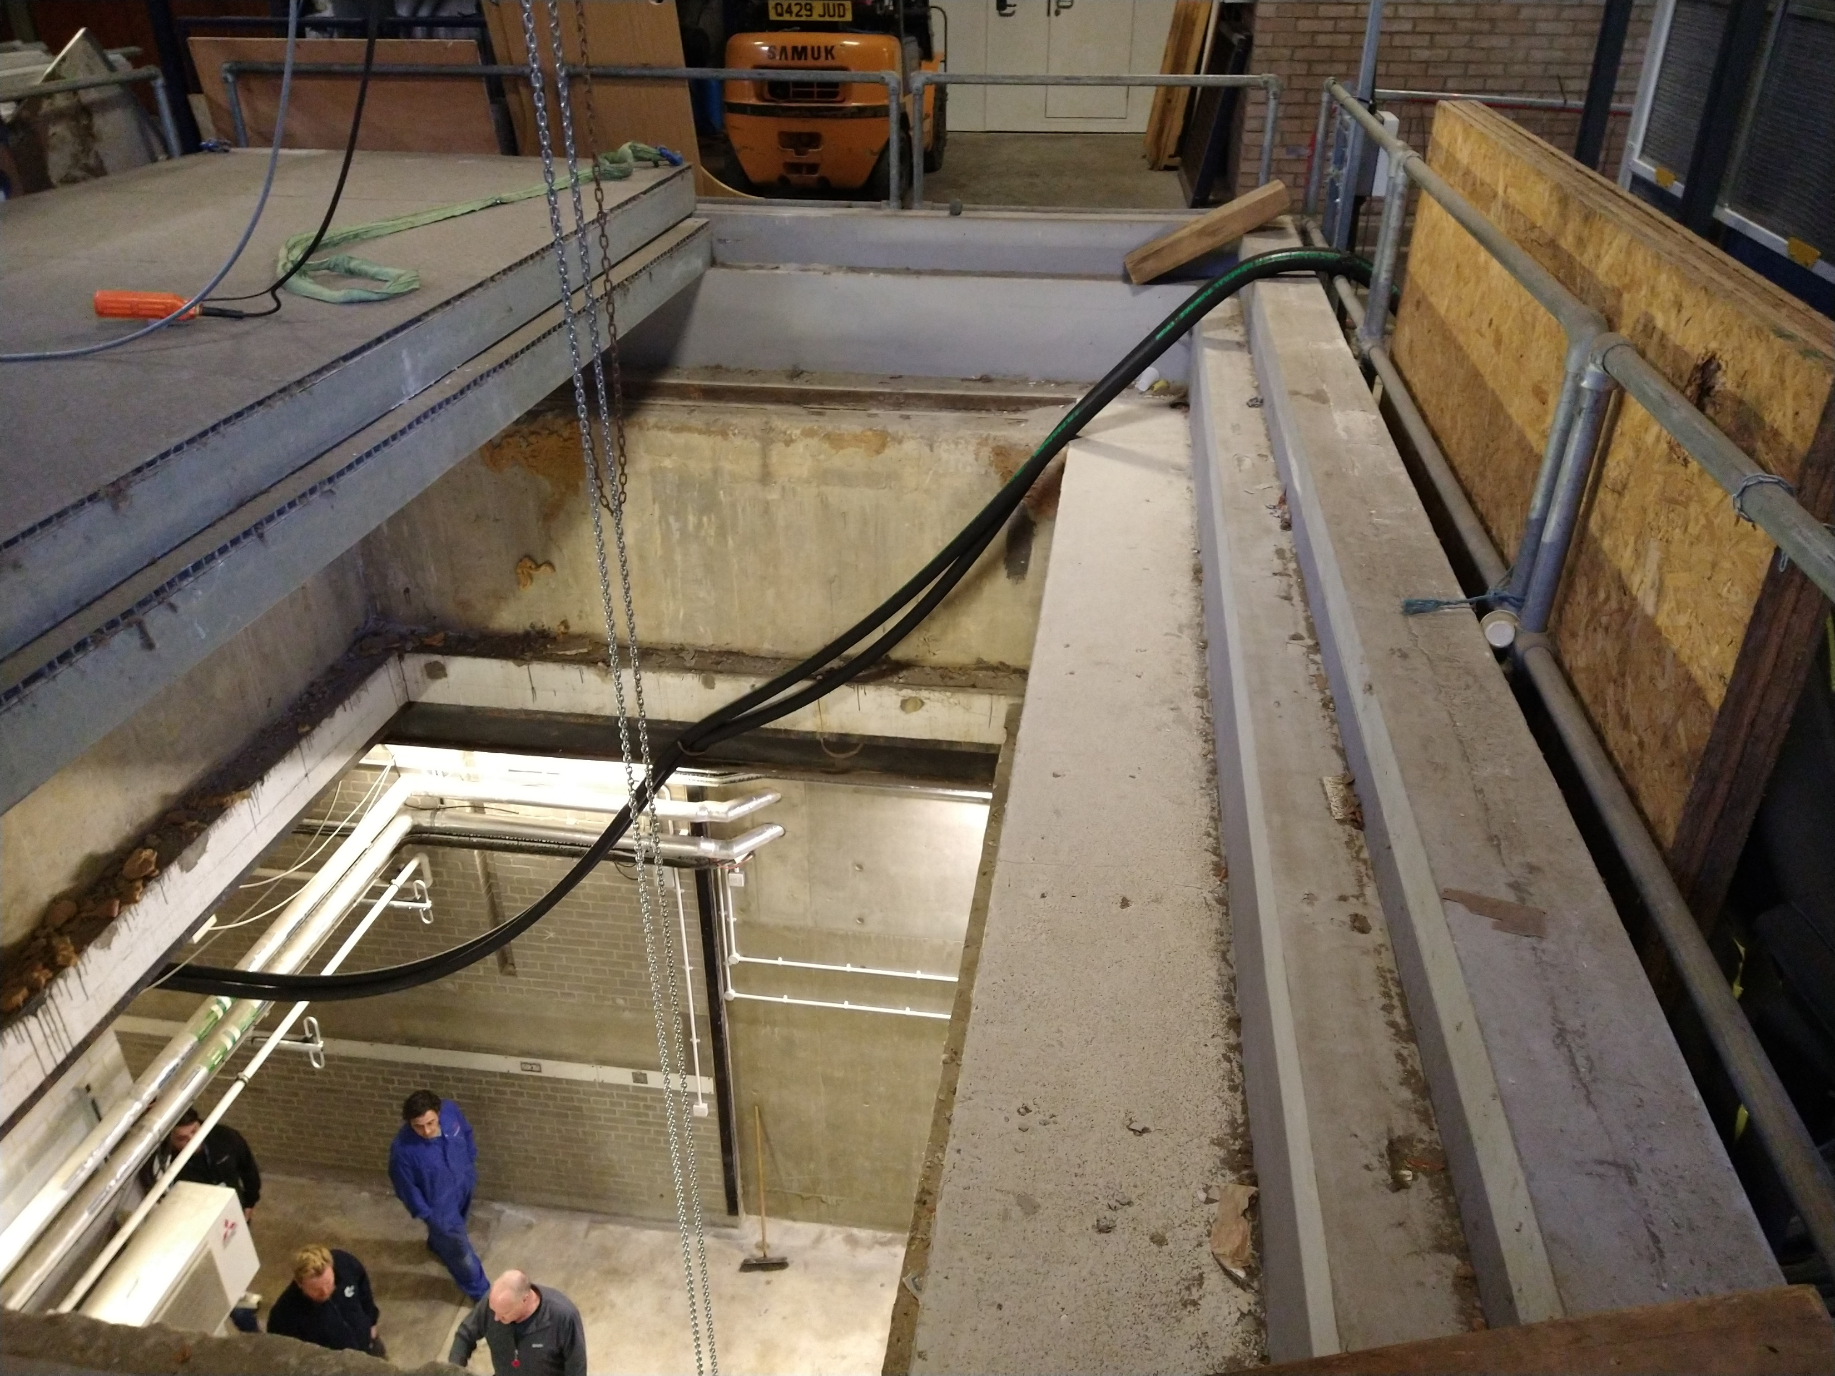
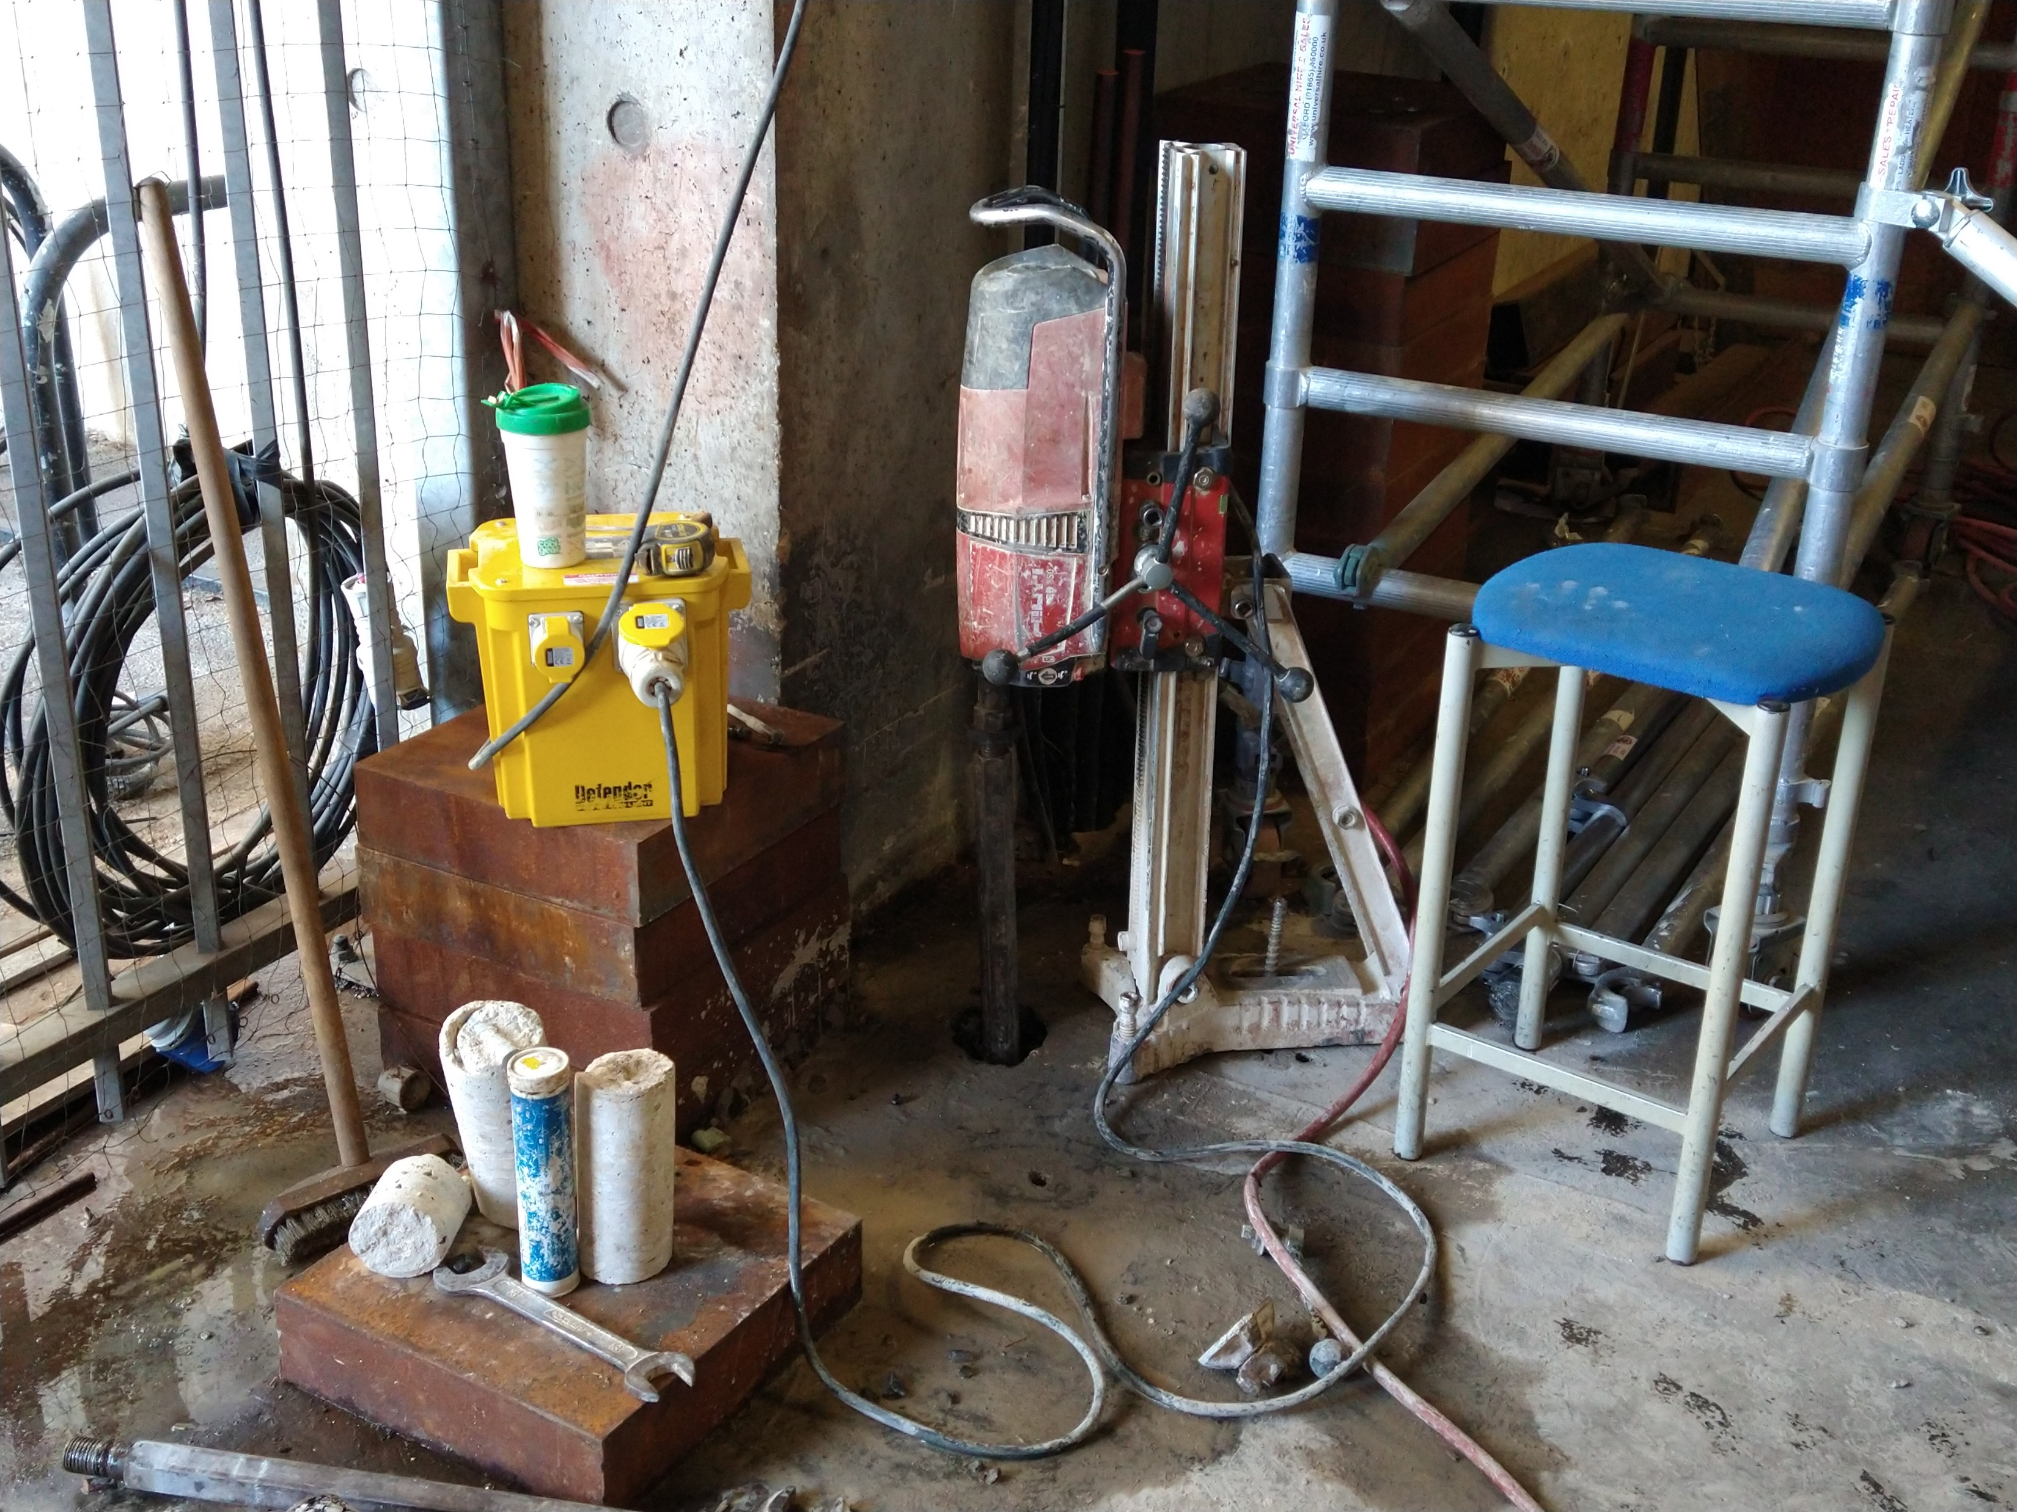
Physics department local Infrastructure room – Pipe Installation

Slide 8
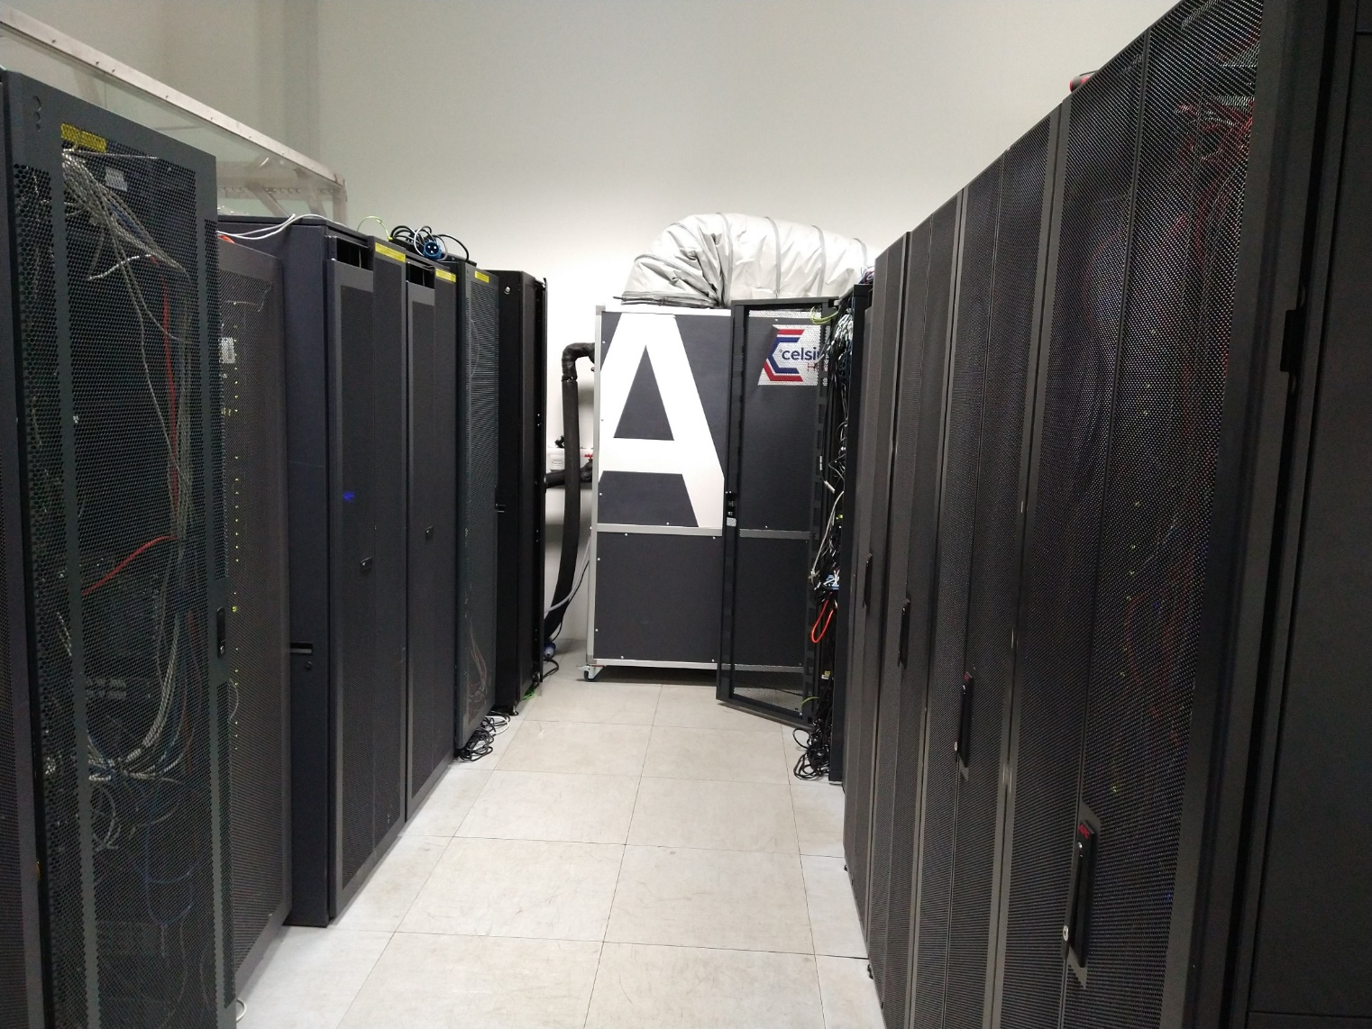
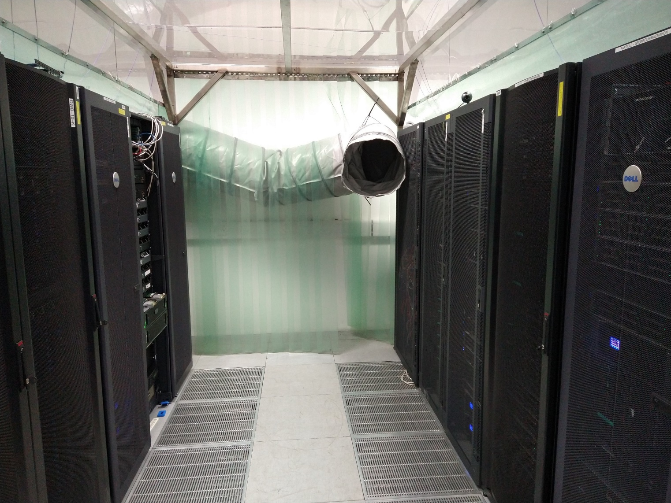
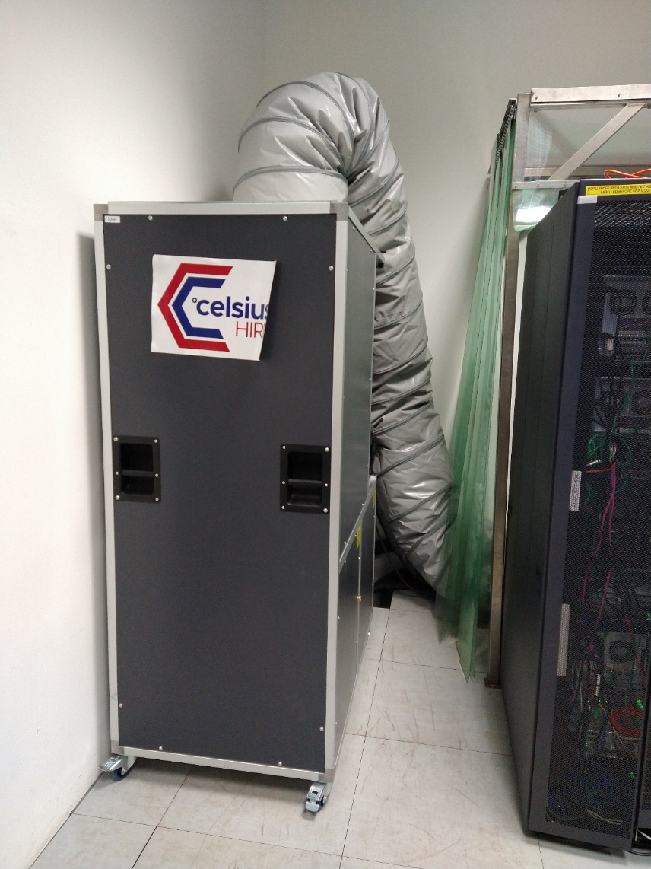
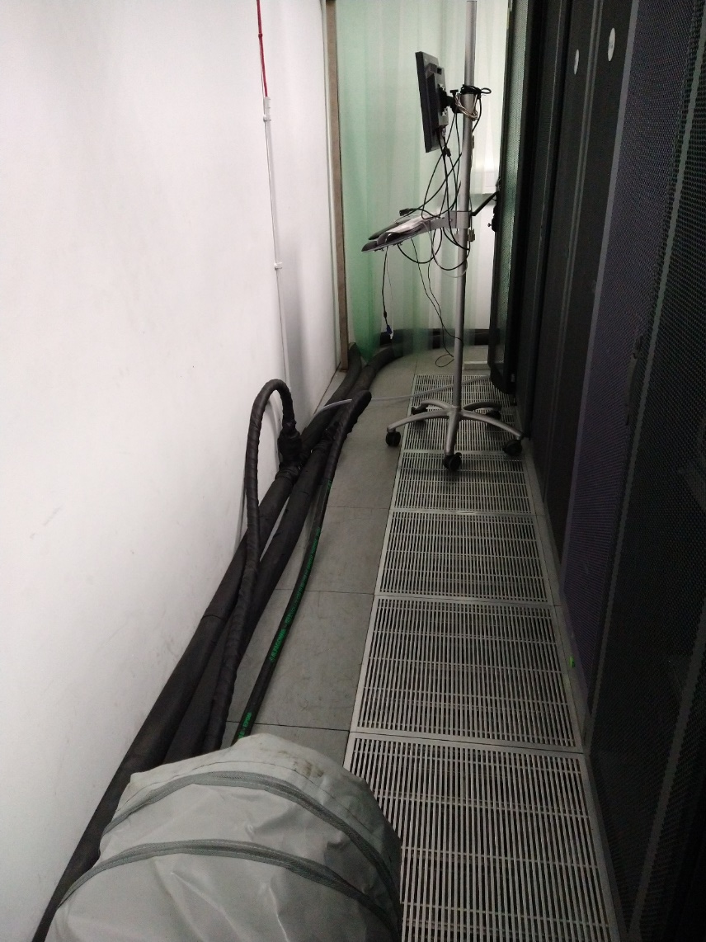
Physics department local Infrastructure room
Upgrade work started in August 2022
Had to perform the upgrade without down time.
Replace one unit at a time and provide supplementary A/C to cover the excess load.
Pictures show the cold air directed into the cold aisles, (Originally directed under floor but insufficient pressure
meant it stayed there)
They proposed rather than suppling 50kW capacity temporary units they could provide 100KW so they could do
both units at once.
I was sceptical that this setup would cope so insisted on testing it.

Slide 9
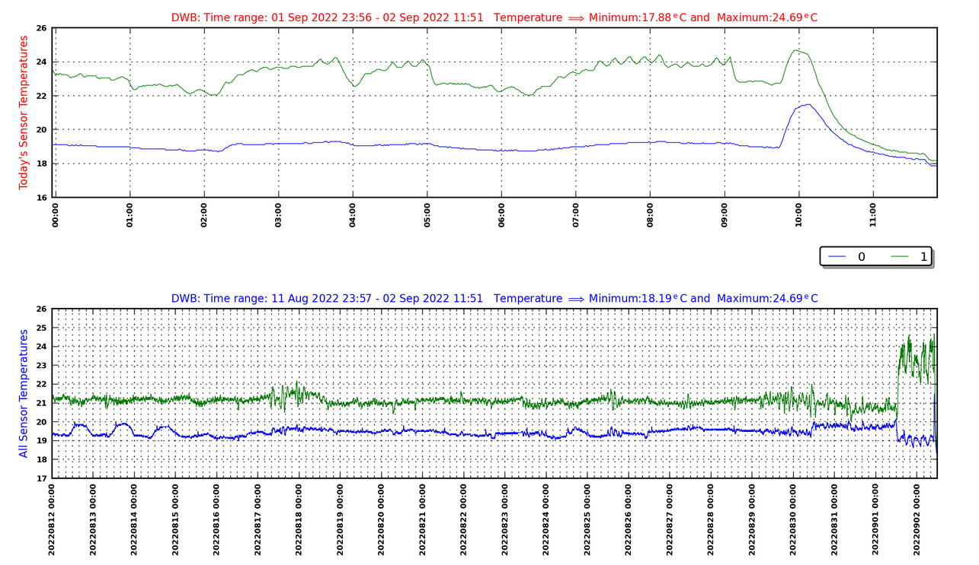
Physics department local Infrastructure room
Tested switching one of our A/C units off. Temperature rose but then stabilised.
Switching the second unit off resulted in gradual temperature increase as expected.
Contractors had to revert to the plan of replacing units one at a time.

Slide 10
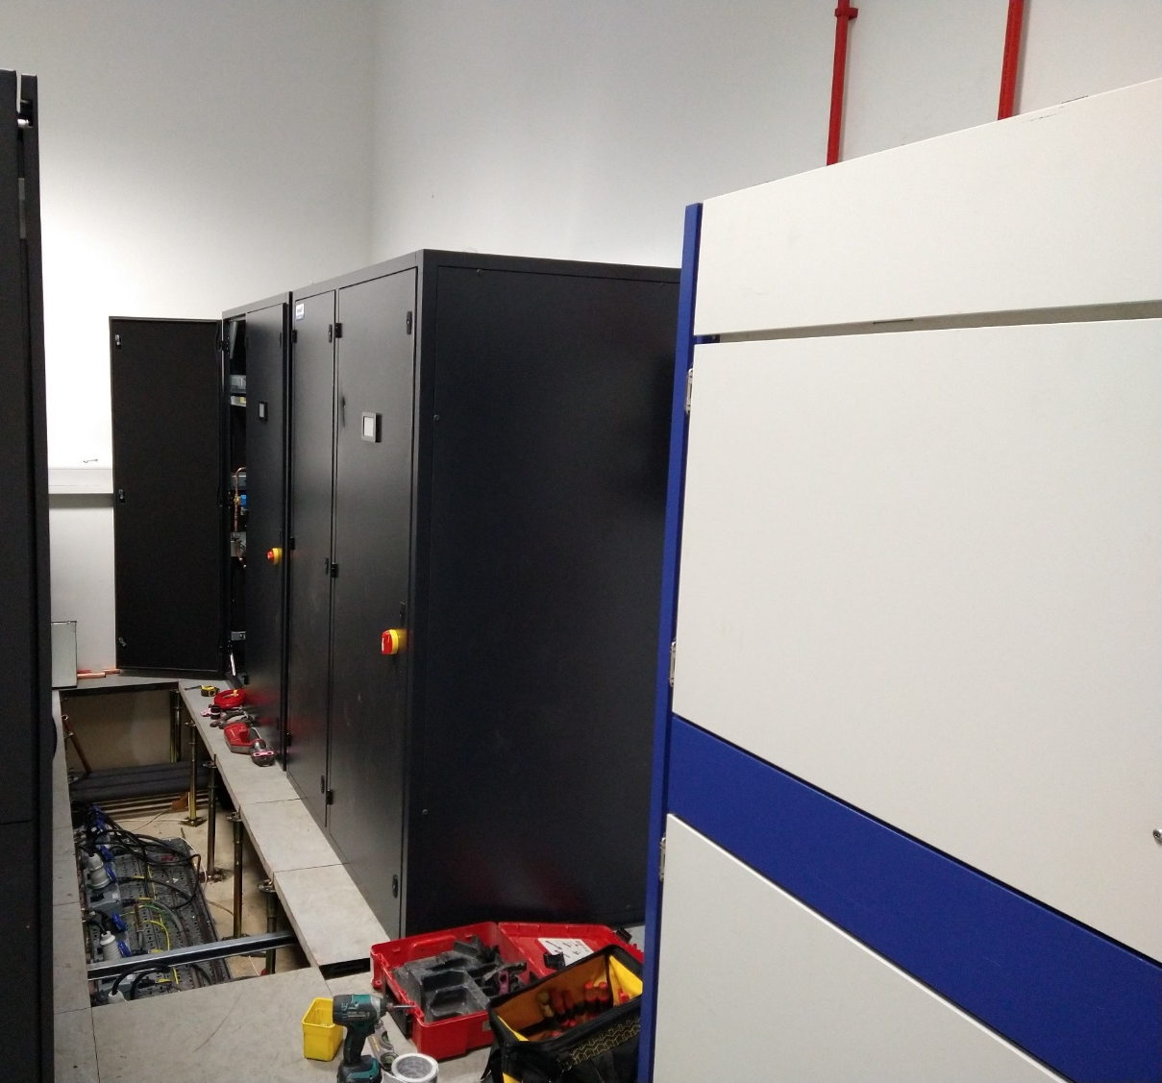
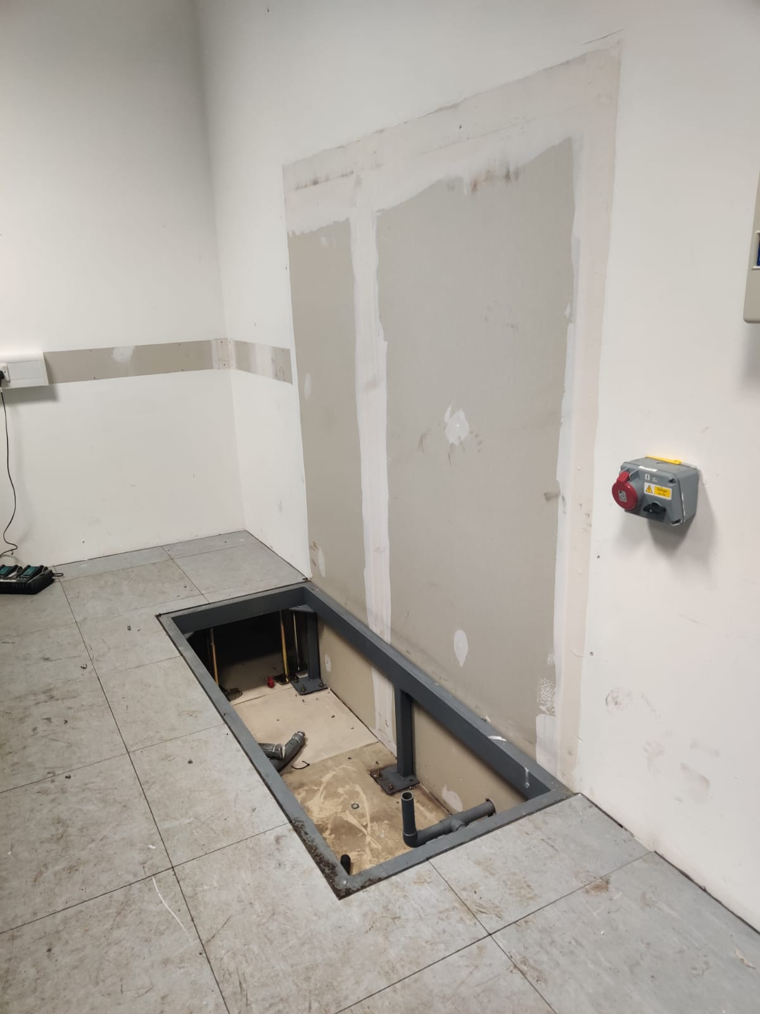
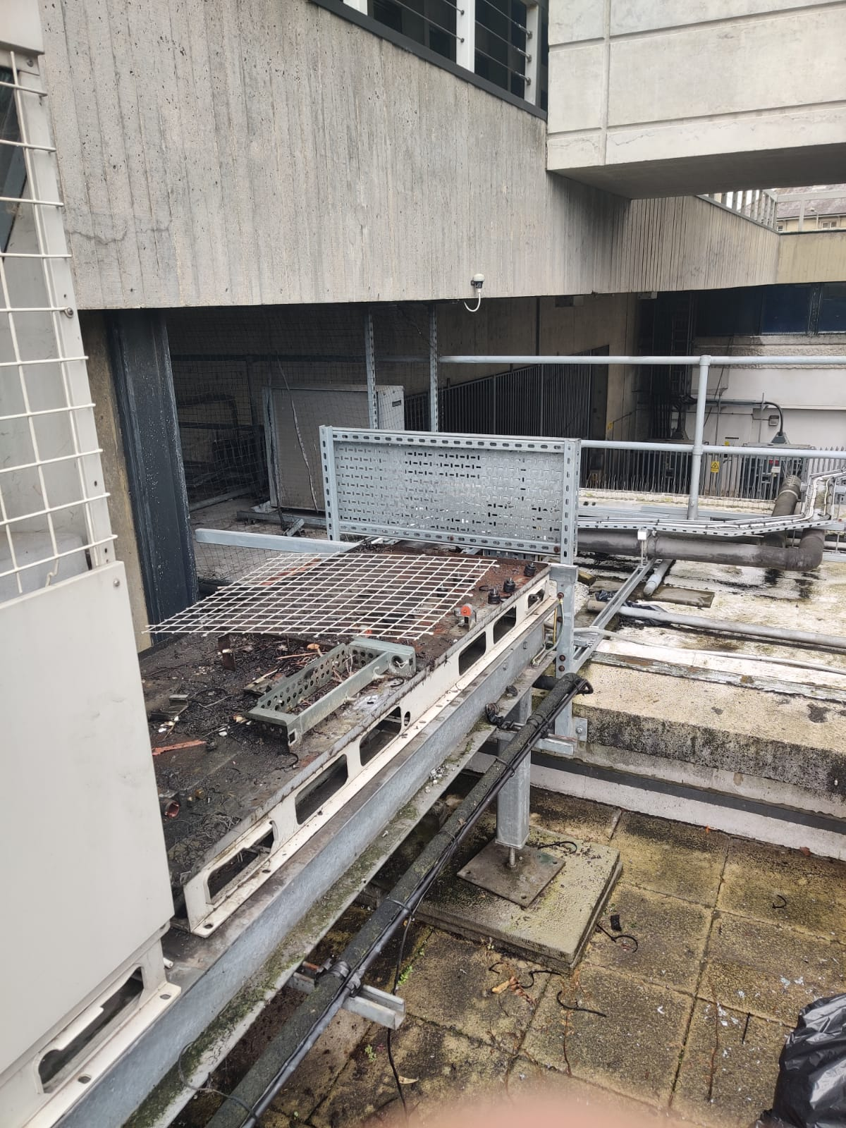
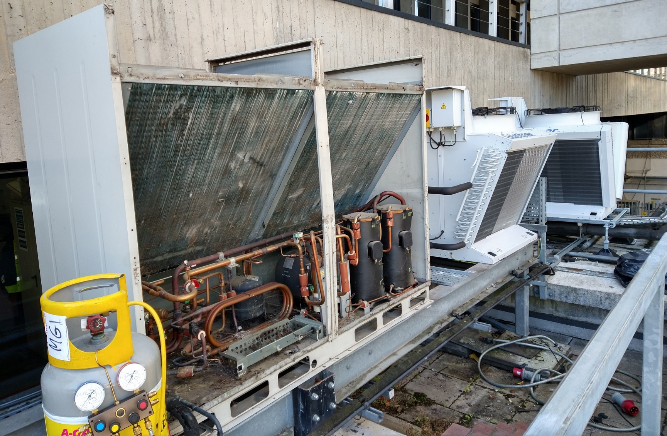
Physics - local Infrastructure room
Removed first old unit & external chiller.
Installed two new Smartcool downflow cooling units in the same space and two external units, while running the room on one old unit + the supplementary kit.
Installation of the first 2 of 3 New External Mitsubishi V coil air cooled Condensing Units (Compressor outside). Old unit being degassed.

Slide 11
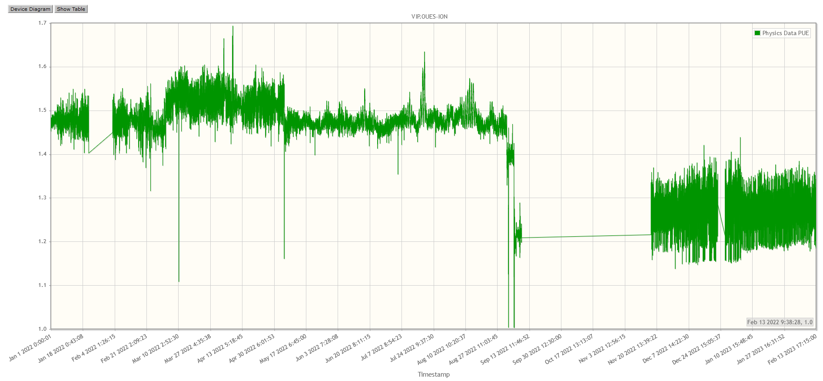
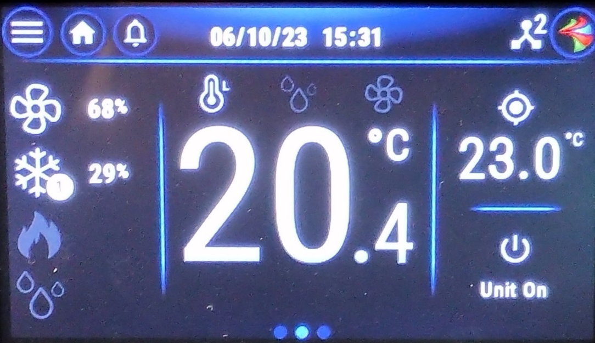
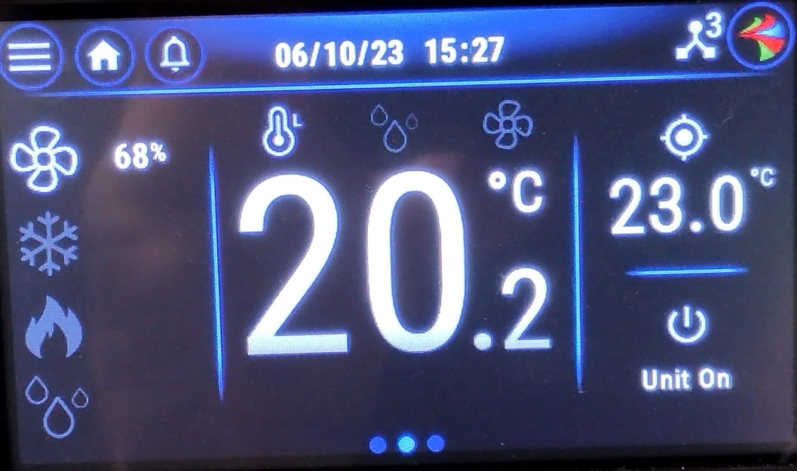
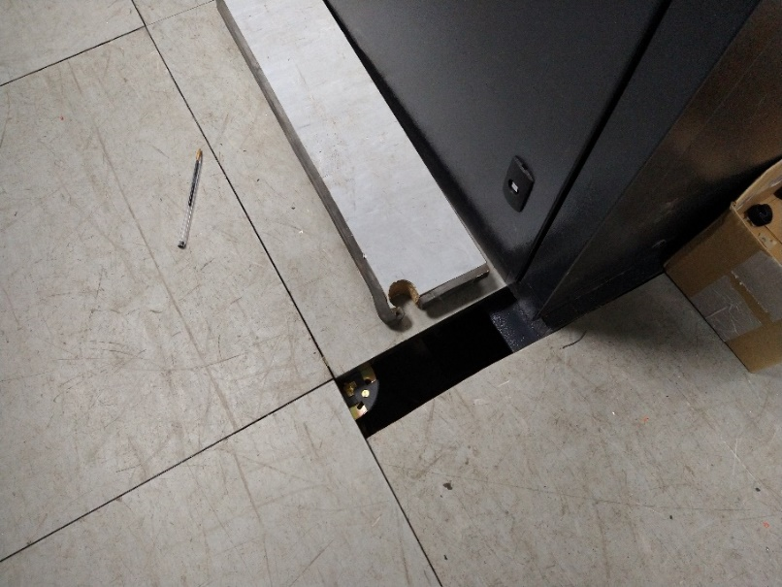
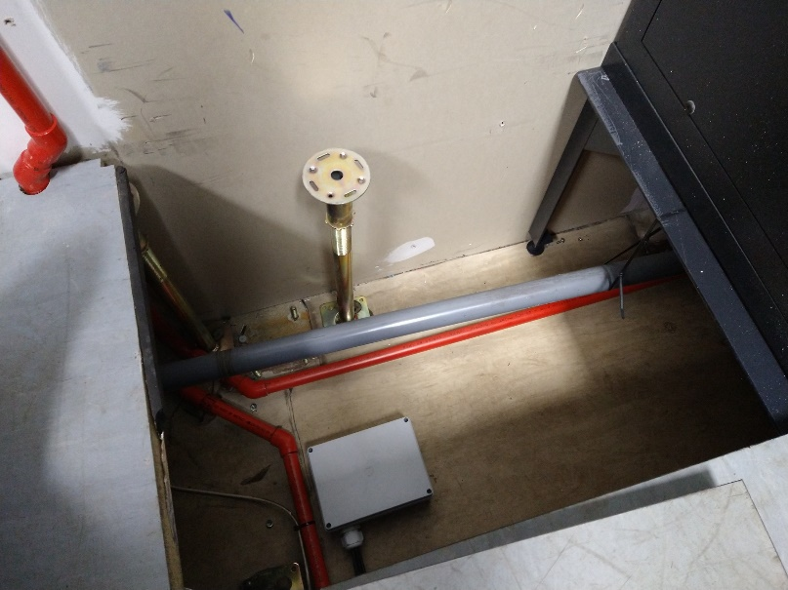
Physics - local Infrastructure room
Once the work was complete power savings were immediately noticeable
New units are more efficient
They have variable fan speed control (ie not always running at full speed)
Control setup to maintain a target cold aisle temperature of 23 degrees C using cooling as required.
PUE
1.5
1.4
1.2
Pressure control aims for a target under floor pressure.
Initially target was 22Pa which was not achievable with the gaps in the tiles.
The fans were maxed out running at 89%.
Reducing the target to 15Pa, reduced the Fan speed to 85%.

Slide 12
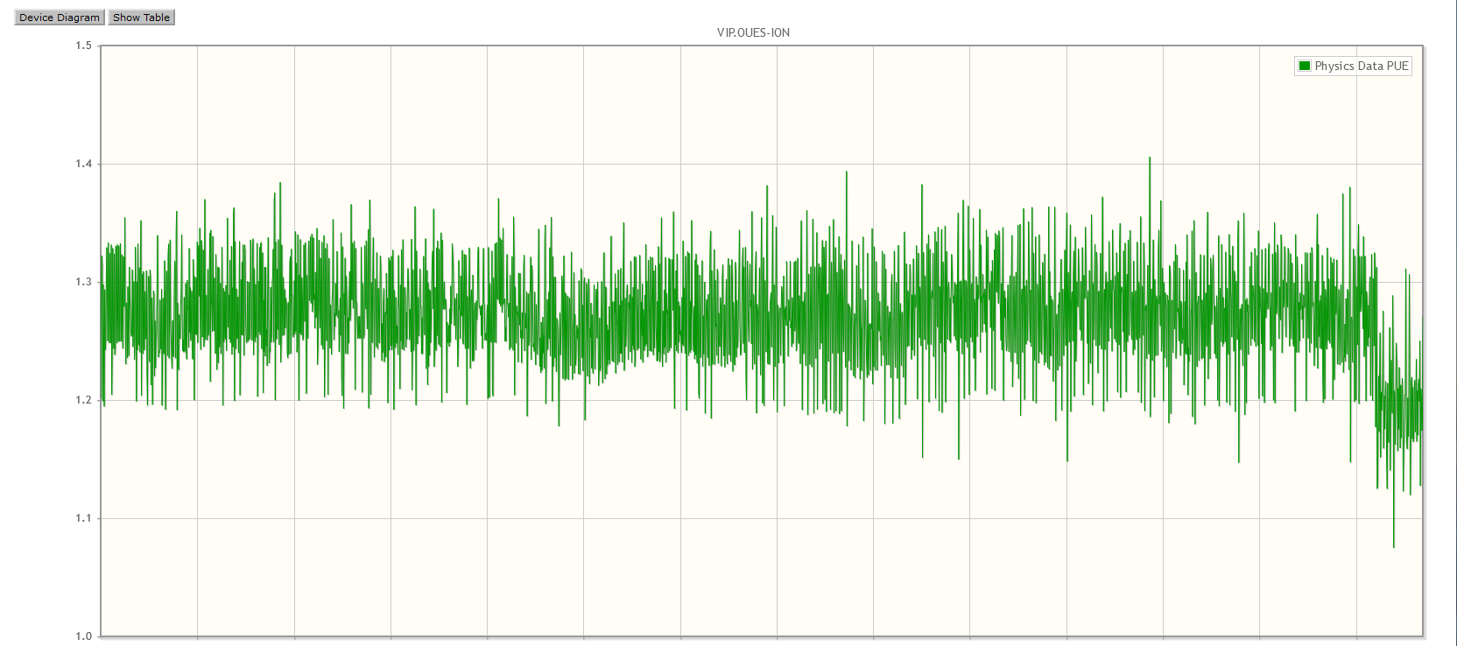
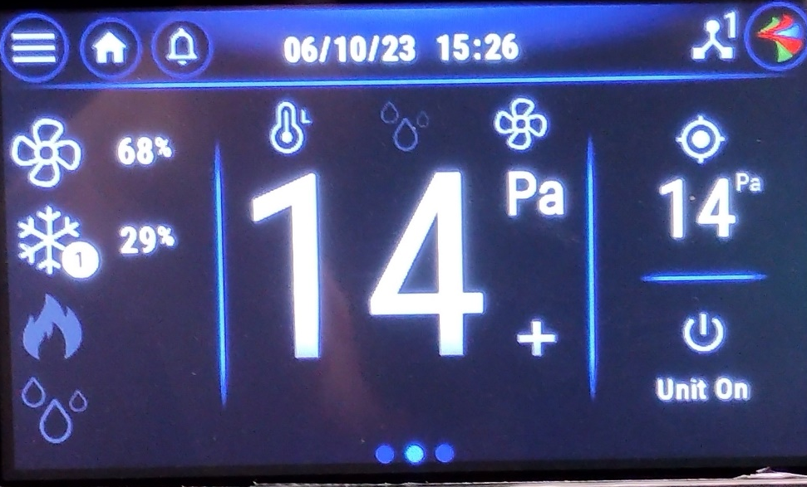
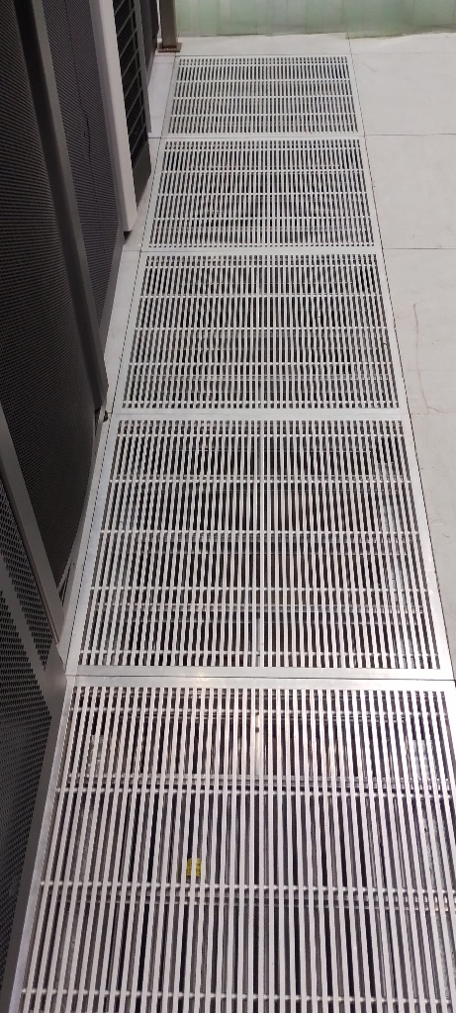
Physics - local Infrastructure room
Once missing floor tiles were fixed we could reduce the target to 14Pa, then shut some vented tiles.
This helped the under floor pressure stay higher but still provided enough flow and pressure in the cold aisles. This reduced the Fan speed from ~85% to 68%.
This is close to optimal.
The PUE is now around 1.19
PUE
1.2
The end result of this is that the average power taken by the A/C is now around 11kW compared with 25kW for the old units. At todays prices this equates to approximately:
14kW*24*365=122,640kWh = ~£44,518 (at 36.3p/kWh)
So the upgraded should pay for itself in around 3.3 years.

Slide 13
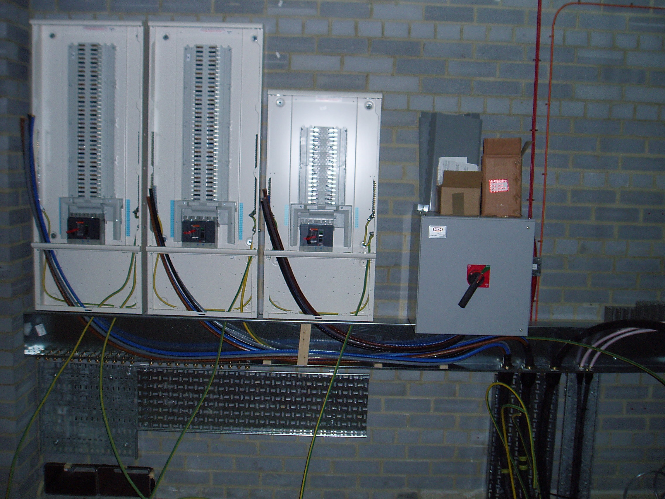
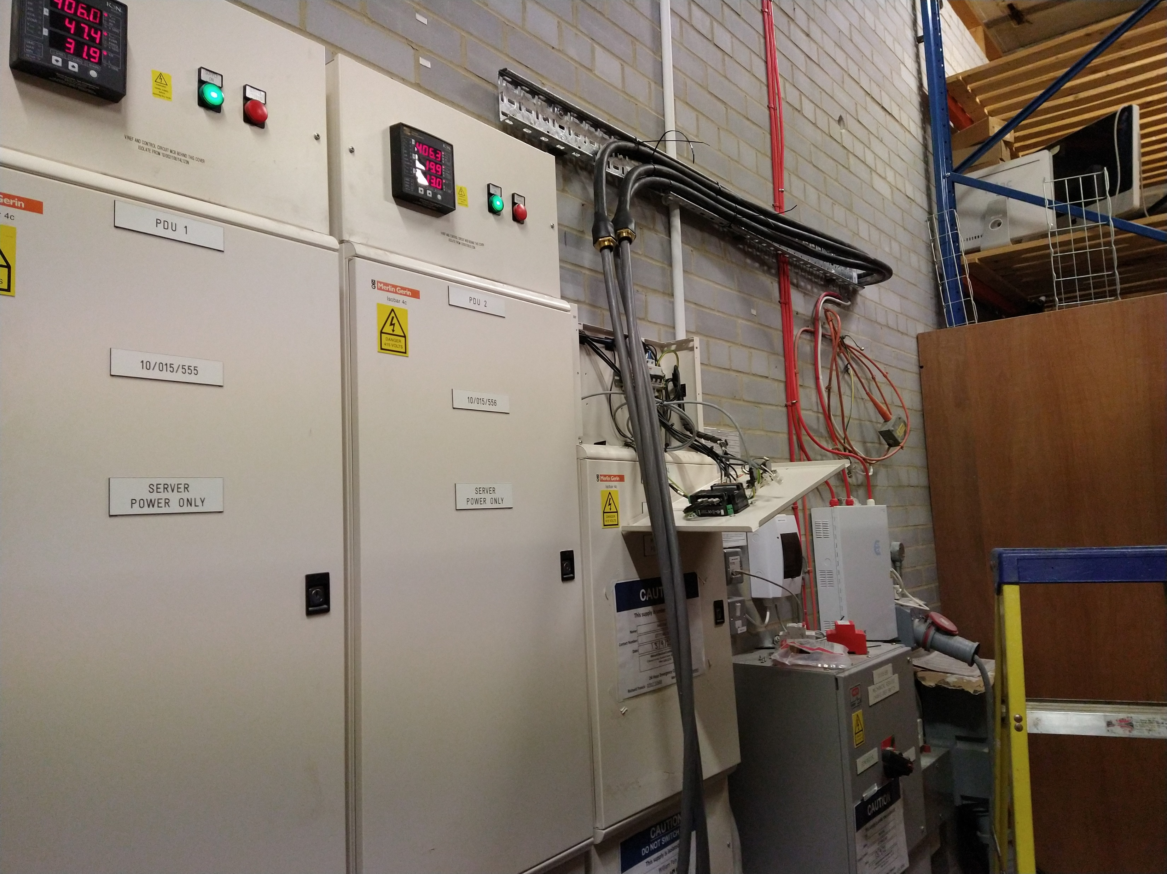
Physics - local Infrastructure room
Originally the electricians wanted to switch off all power including the computer system feeds in order
to wire in the new A/C units into the Mechanical Services switch board.
This was due to the feed coming from a common conduit as shown in the picture on the left below
taken during construction in 2007.
Managed to persuade them to route the new cables into the top of the switch board, which could be installed without switching our computers off.

Slide 14
Physics - local Infrastructure room
Final removal of electrical supply to A/C switchboard would require a power outage.
Test to see how long the room can survive without A/C when at a reduced load of 38kW.
(Normal average running load is 55kW)
This showed us we could with preparation allow the electricians to work on the Electrical distribution board
for ~25 minutes max. before the temperature got worryingly high.

Slide 15
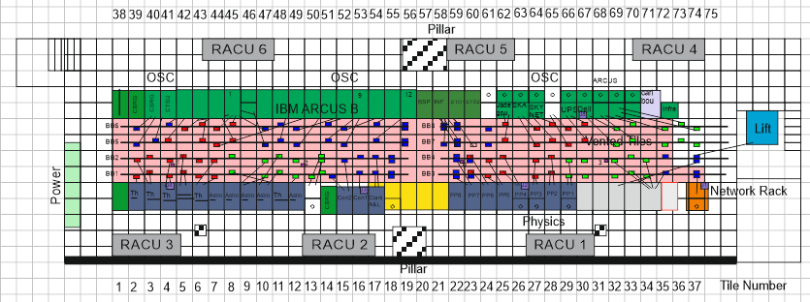
Begbroke Computer Room
Much larger room shared with the University Advance Research Computing (ARC) Service
Physics has 40% of the floor rack spaces.
Chilled water supplied from the room to six RACUs

Slide 16
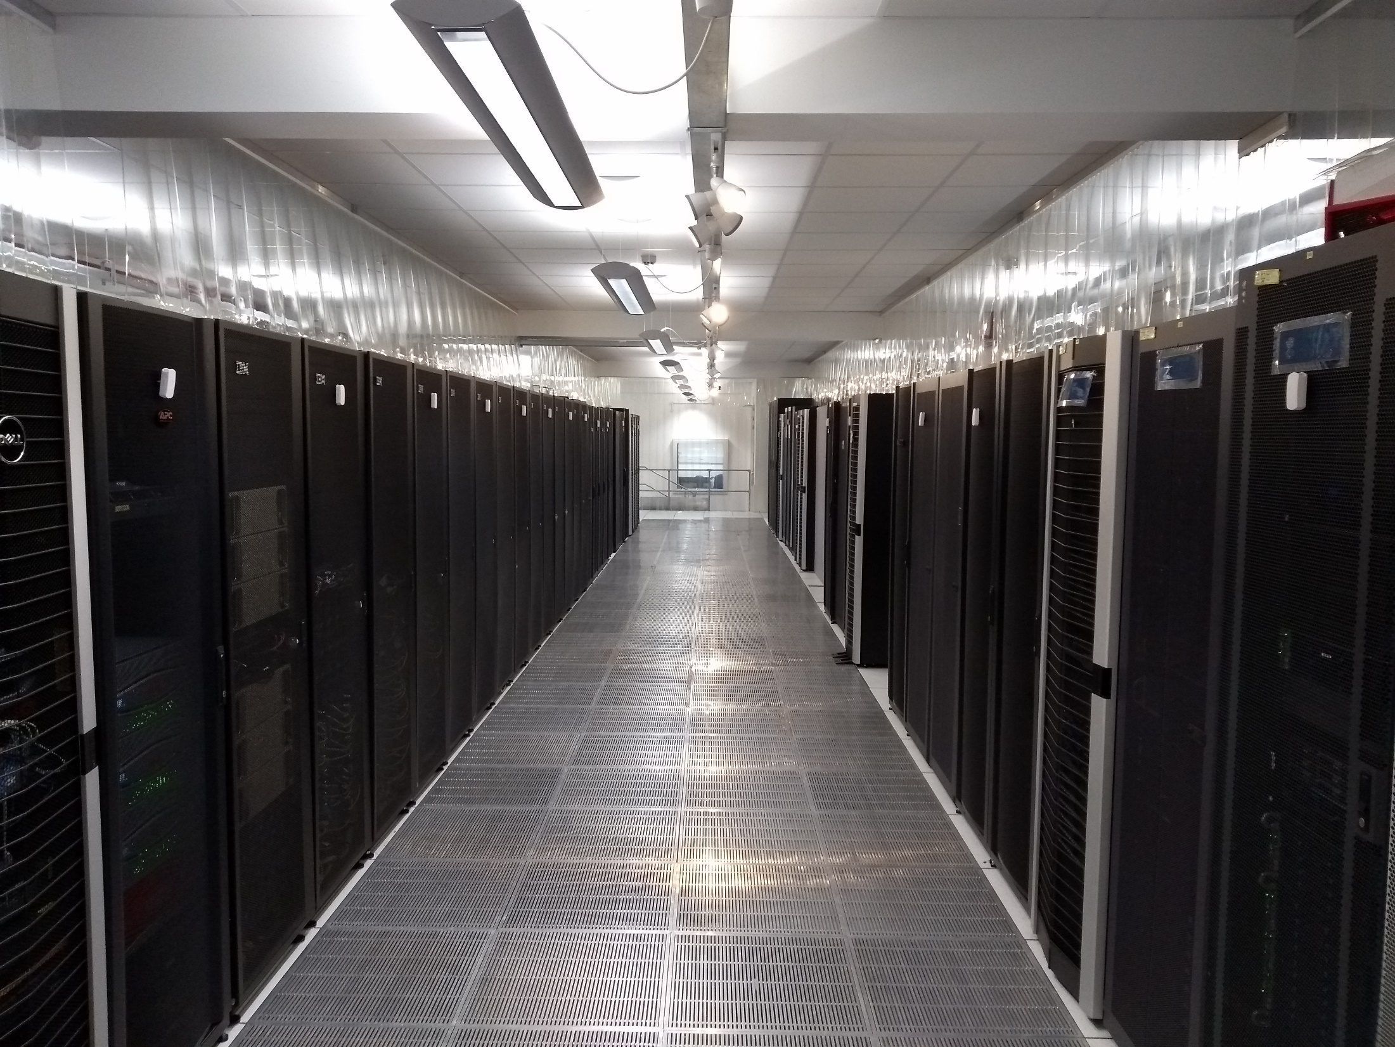
Begbroke Computer Room

Slide 17
Plan
To replace the six in room RACU’s with new ones with
  Variable speed fans
  Increased capacity (Each new unit rated approx. 200KW vs old ones 100KW)
  Possibility for pressure control
  Existing PUE around 1.5-1.6
This room had sufficient A/C overcapacity that the units could be replaced one at a time with no worry about over heating in the room.
Project started on 15th June 2022

Slide 18
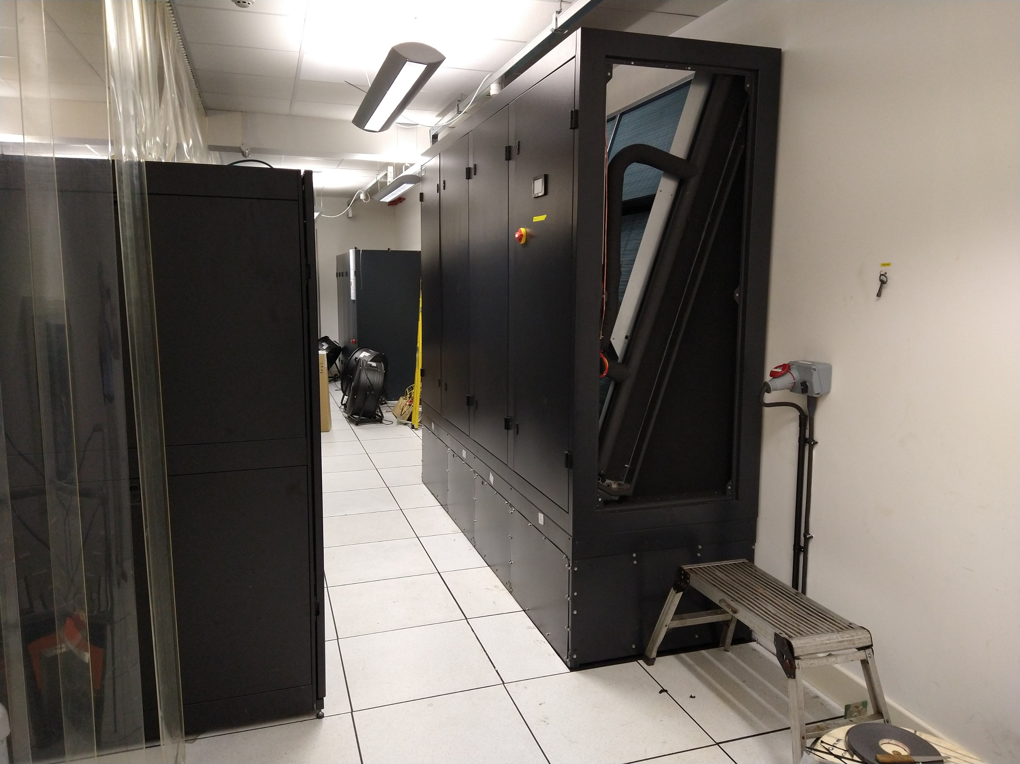
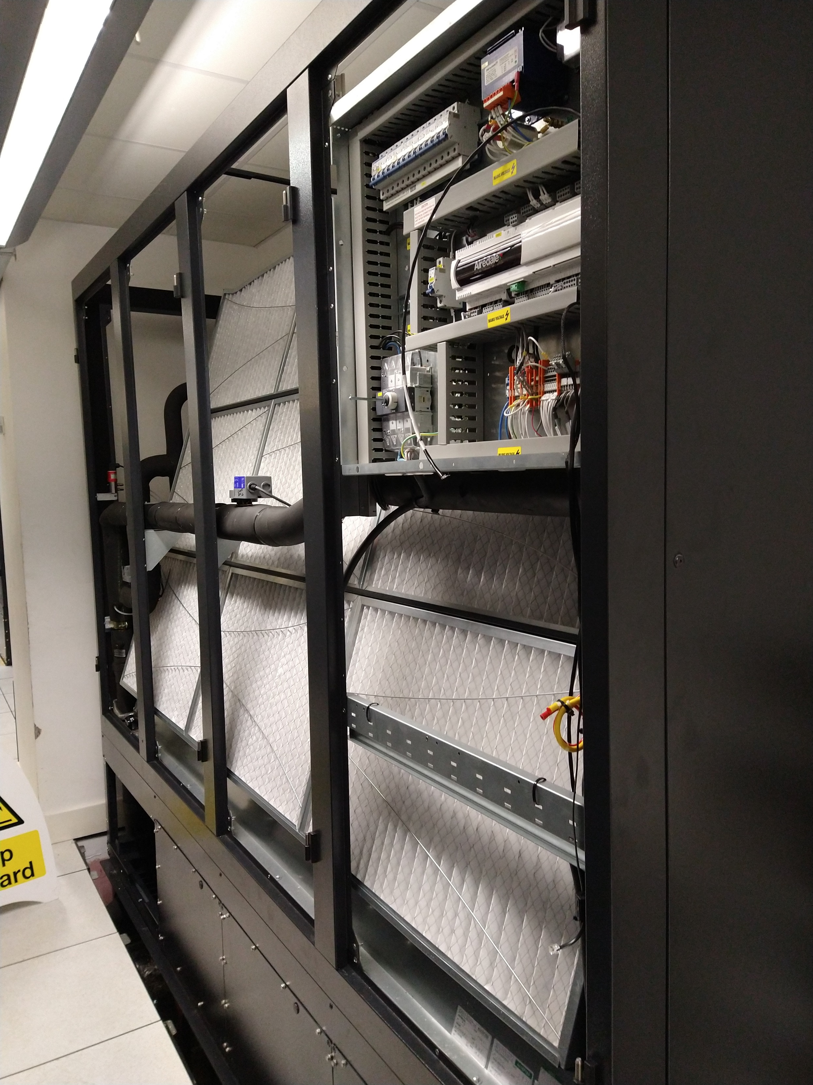
Installation

Slide 19
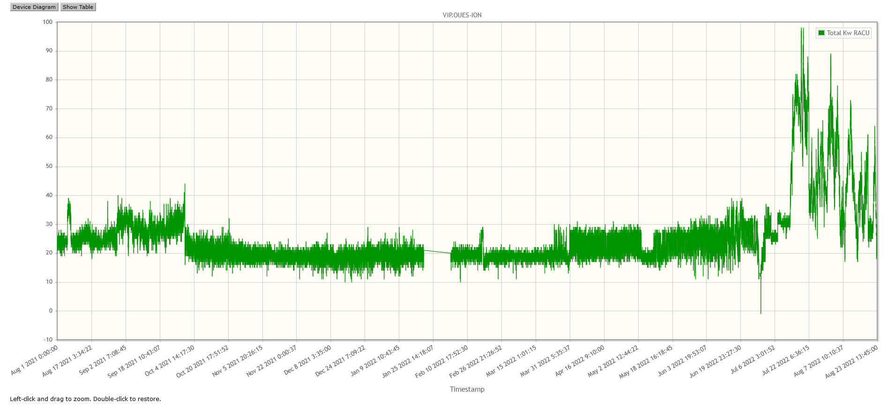
Installation of 6 units completed by August
But it was noticed that the PUE had increased, due to a dramatic increase in power taken by the RACUs. PUE was up to 1.9-2.0
Power taken by room RACUs kW
80
30
20

Slide 20
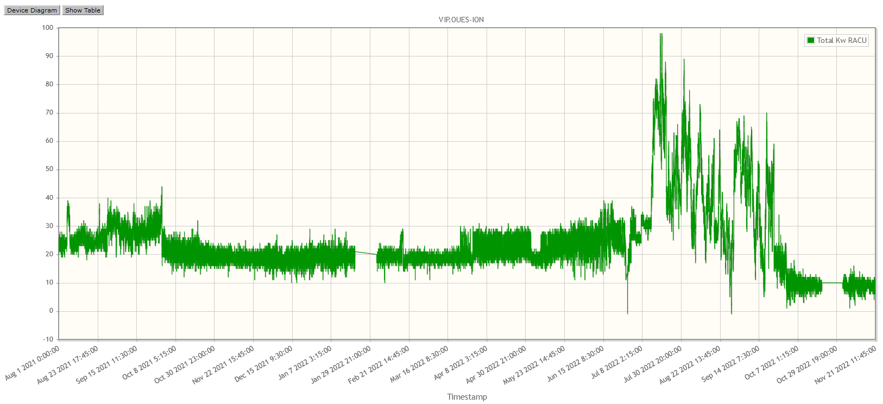
RACU Tuning
The fans in the units were running way to fast effectively blasting air through the vented tiles.
Airedale reduced Fan speed 45%->40%->35% on 29/30 Sept 2022
We found that if the fan speed was reduced too much the units switched off into a state that required an engineer to visit to restart.
Final configuration resulted in stable power consumption of 10kW vs previous 20-25kW
20
10

Slide 21
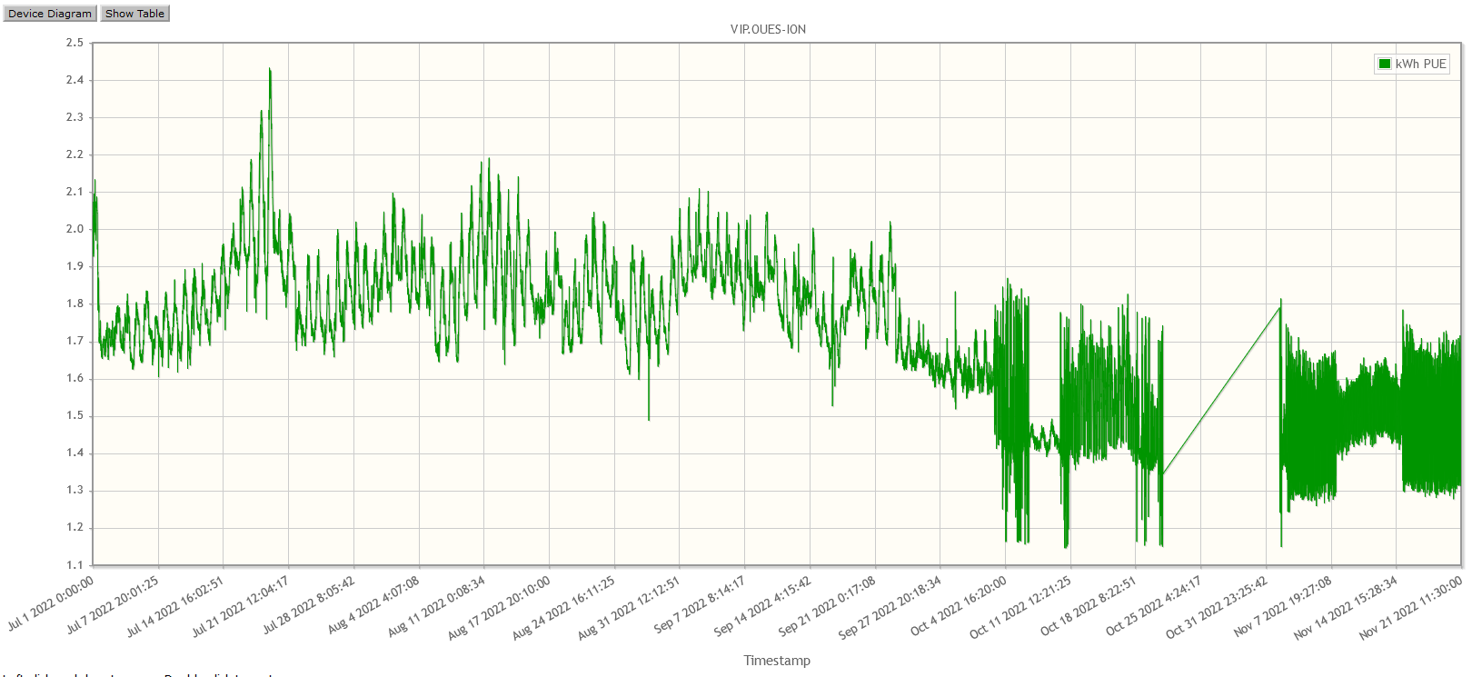
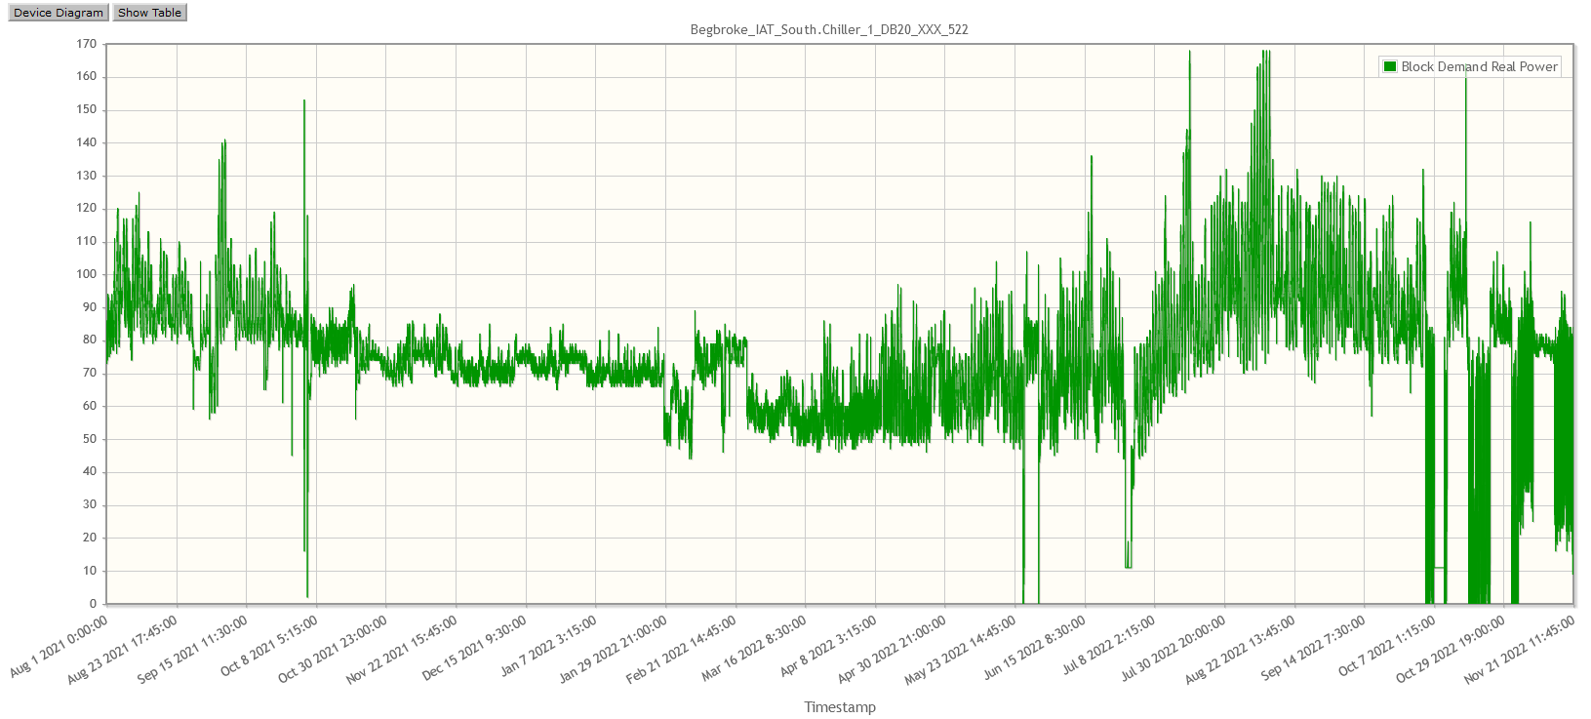
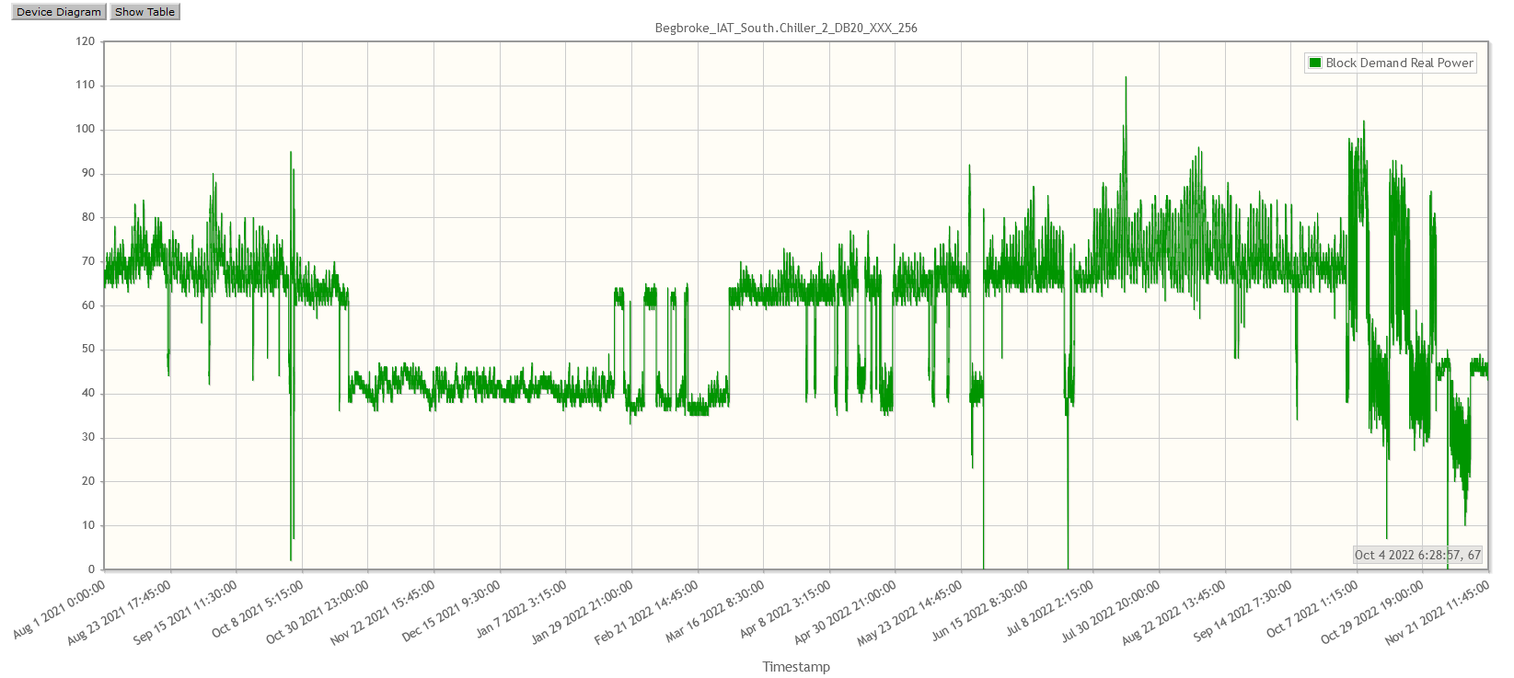
PUE still not great.
PUE is back around 1.5 average.
Big problem is that the power drawn by the Chillers on the roof is a factor of 10 more than the RACUs. (Total ~125kW)
Further work will need to done to make an effective improvement.
PUE
1.5
Chiller 1 kW
Chiller 2 kW
60 kW
50 kW

Slide 22
Some conclusions
New reliable kit has been installed with no down time.
Increased resilience and capacity has been achieved.
Gains can be made by buying new equipment.
Tuning them to meet the design goals is essential.
Need to look at the overall picture not just one area.
Key Stake Holder really needs to be hands on to ensure what is delivered is what was intended.

