Slide 1
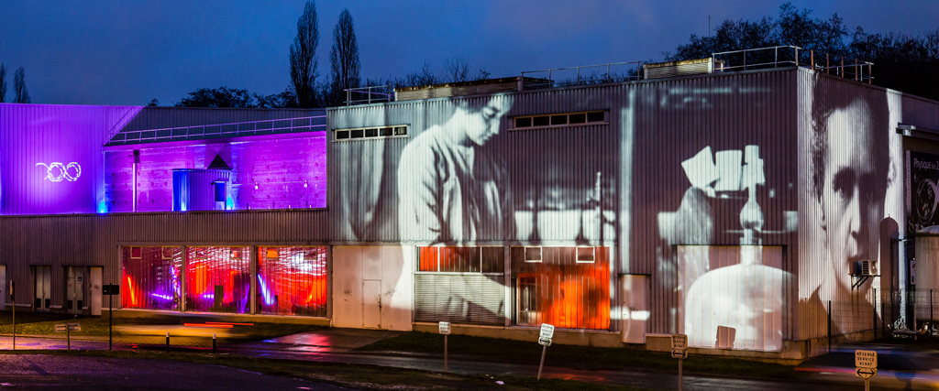
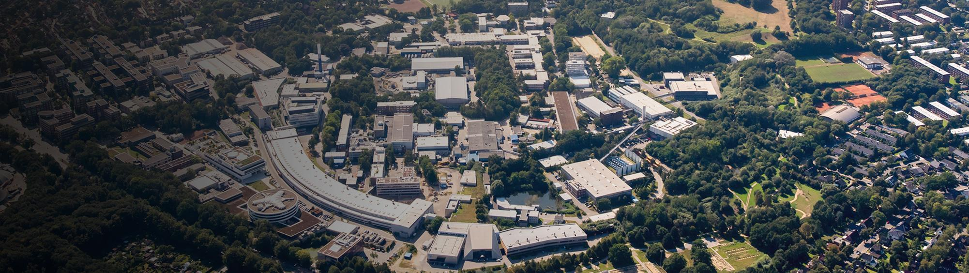

HTCondor Workshop in Europe 2023 - Highlights
19 – 22 September 2023 at IJCLab
https://indico.cern.ch/e/htcondor2023
Christoph Beyer, Thomas Hartmann, Helge Meinhard

Slide 2
Workshop in Numbers
https://indico.cern.ch/e/htcondor2023
Ninth workshop in this series, which started with a pre-GDB in December 2014 (two workshops were held on-line only)
Traditional time format: Tuesday morning to Friday lunchtime
41 attendees
  31 from this side of the Atlantic
  Travel is still hard, many institutes under budget pressure, sending one person only
  Considerably higher attendance than at 2022 edition in Cuneo, on a good way back to pre-Covid levels
  Mix of new faces and old friends (good!)
20 organisations from nine countries
28 ”scheduled” contributions by 16 presenters
Interesting wide range of talks, high quality presentations, intense discussions
The organizing committee
Chris Brew (co-chair), Christoph Beyer (co-chair), Helge Meinhard, Todd Tannenbaum, Mary Hester, Greg Thain, Michel Jouvin, Matthew West
Catalin Condurache, Antonio Puertas-Gallardo, Gabriele Fronzé, Josep Flix
Local organiser: Michel Jouvin

Slide 3
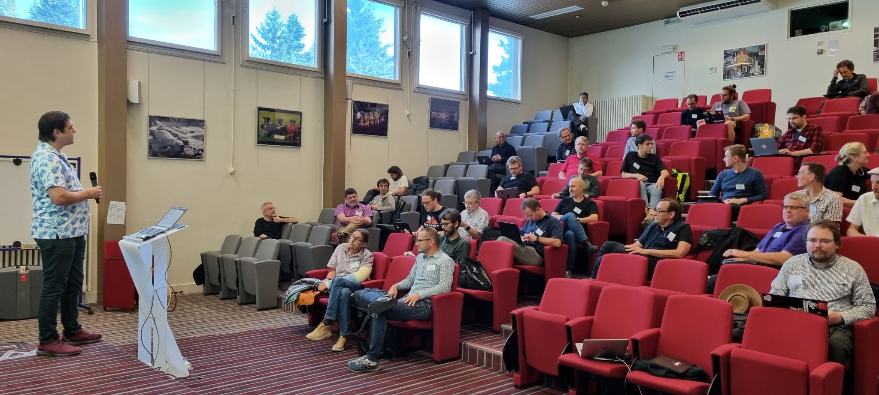
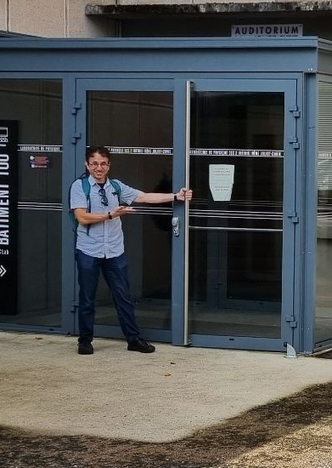
The Location
IJCLab Orsay/France

Slide 4
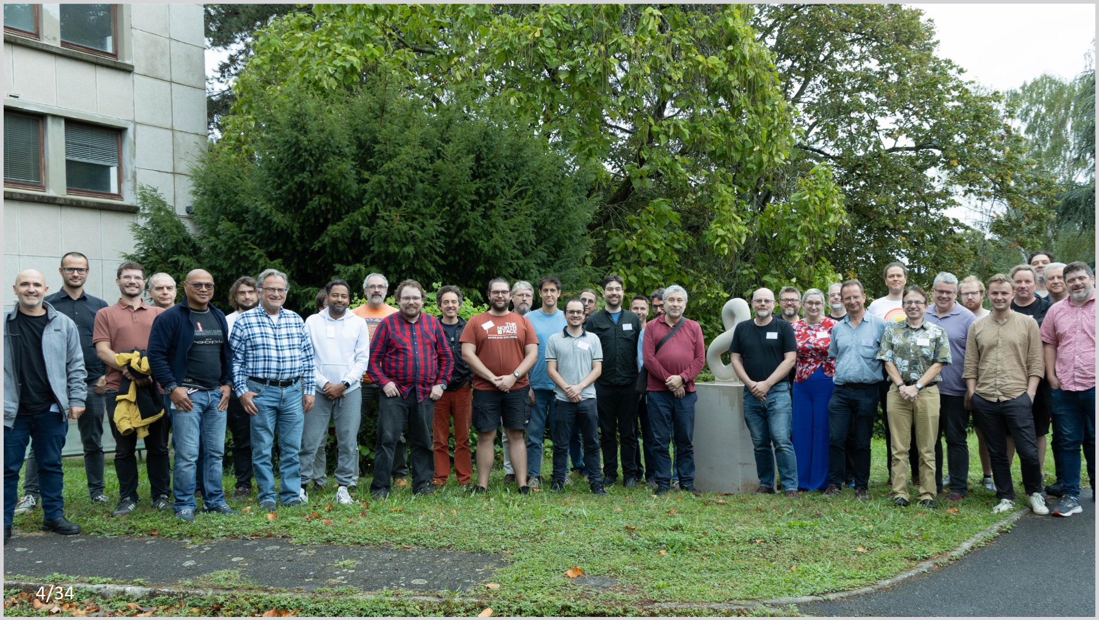
The Group Photo :)
We picked the only rainy day for the pic

Slide 5
Spontaneous Parts of the Programme
“Show us your toolbox” & “ Lightning talks”
“Show us your toolbox” by now a fixed programme point and highlight
  Filled 1.5 hours easily with spontaneous wishes to give a short presentation, had even to turn down 2 more candidates
  Good mix of entries reflecting tools and ideas of a lively community
  Monitoring and energy saving amongst the contributions
  Could be split into several more specific sessions, e.g. “show us your monitoring”, “show us your accounting” and a “general/other/miscellaneous” one
Lightning talks
  Meant as a chance for a short introduction of what people are using HTC for, like a micro-site report with one slide
  Worked out well but was more like an additional toolbox session, need to explain purpose more clearly
  Still a good idea for the first day in order to fuel coffee break discussions even further
Both spontaneous parts very lively with plenty of ideas and tools shown, well received by the audience

Slide 6
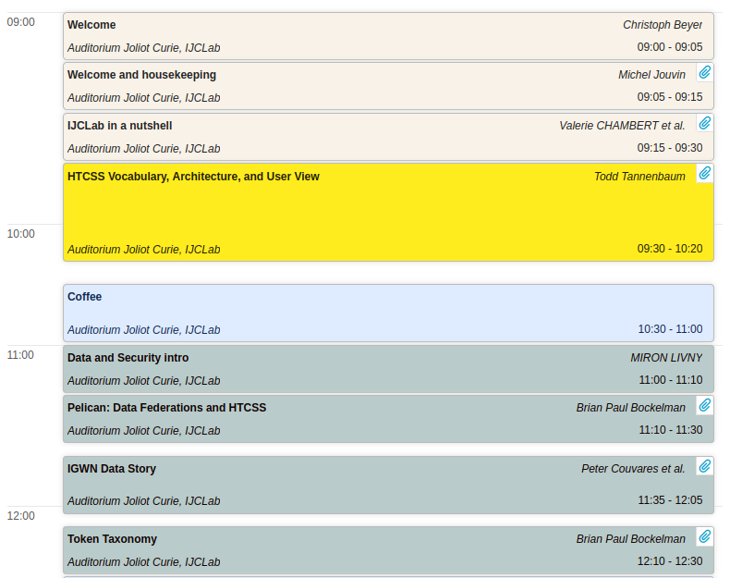
Tuesday Morning: Intro / Data and Security

Slide 7
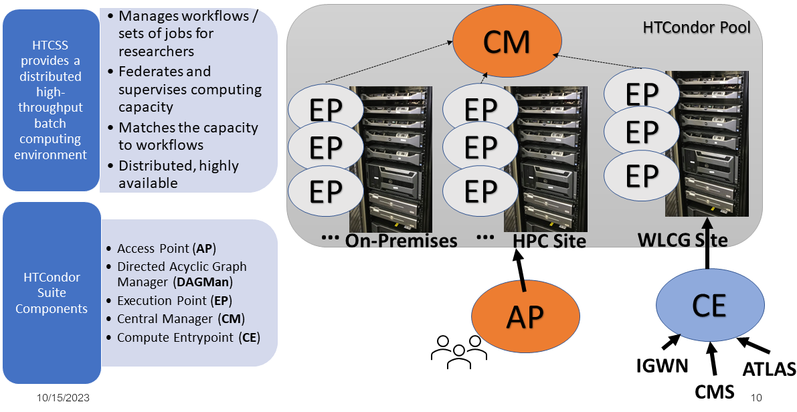
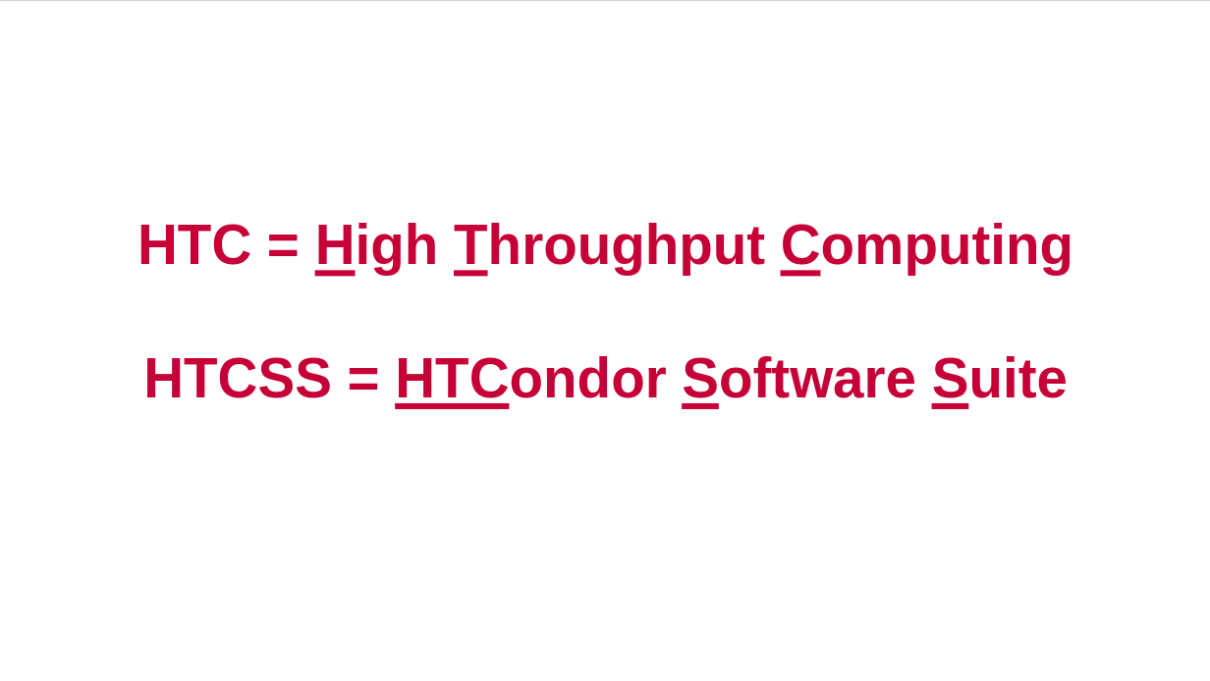
Tuesday Morning
HTCSS vocabulary, architecture and user view
Audience traditionally very admin-focused at European workshops – this one was no exception in this sense
  Vocabulary talk replaced ‘end-user-talk’
Overview, introduction of architecture, vocabulary
https://indico.cern.ch/event/1274213/contributions/5571128/attachments/2716862/4719087/intro_and_architecture.pdf

Slide 8
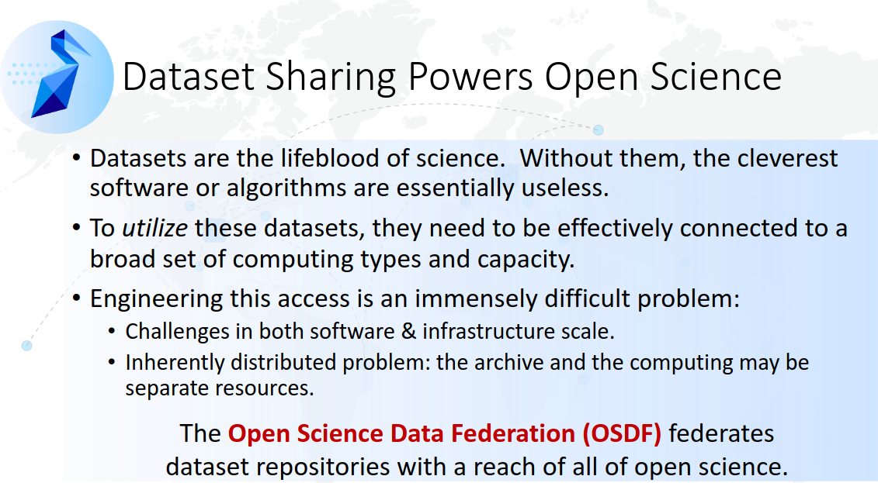
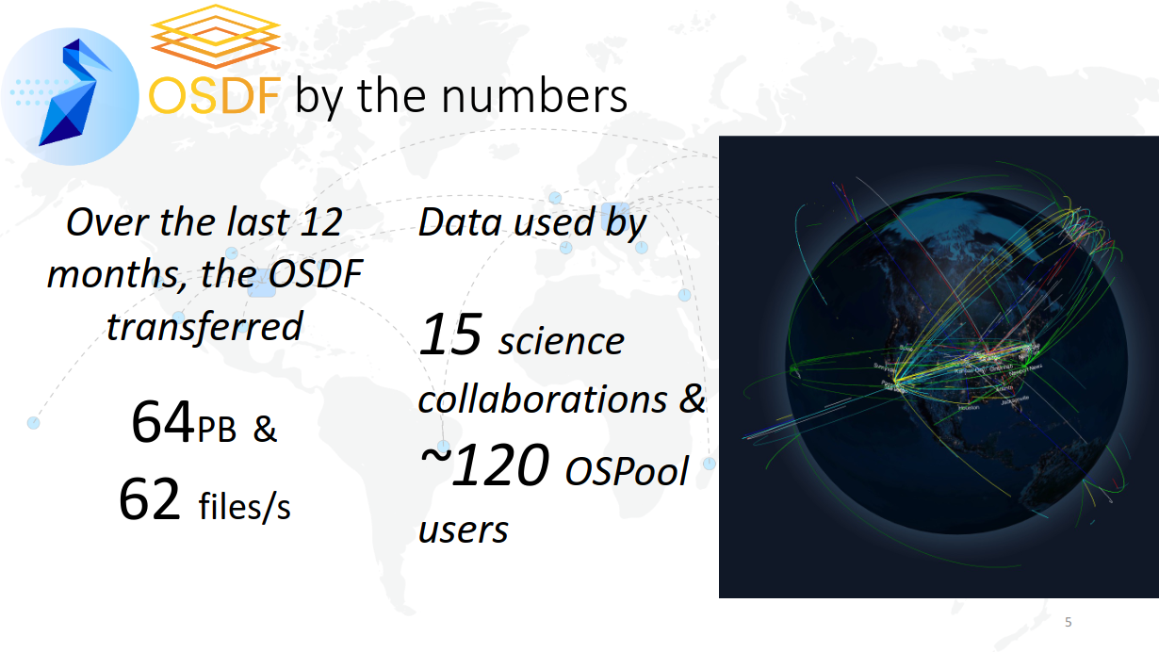
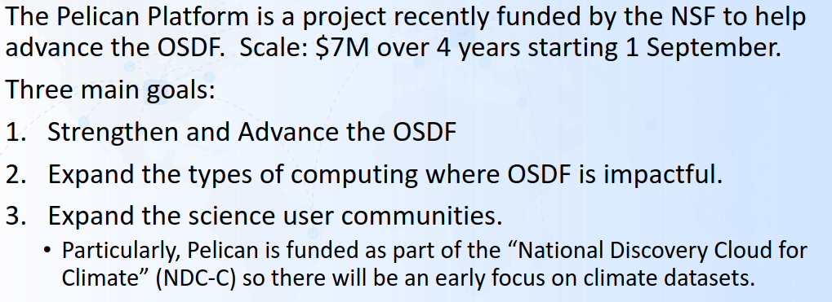
Tuesday Morning
Pelican: Advancing the Open Science Data Federation Platform
https://indico.cern.ch/event/1274213/contributions/5571141/attachments/2716597/4719454/European-HTCondor-Workshop-2023-Pelican.pdf

Slide 9
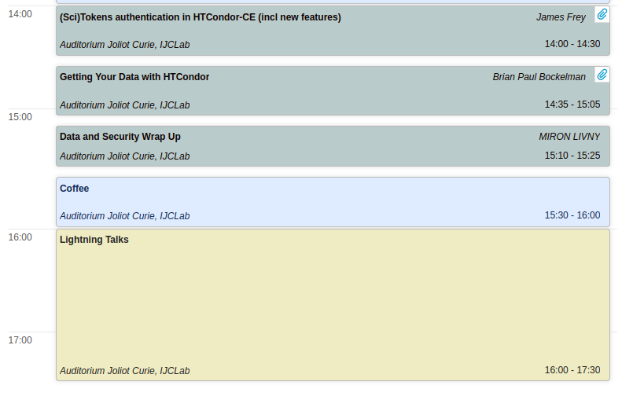
Tuesday Afternoon

Slide 10
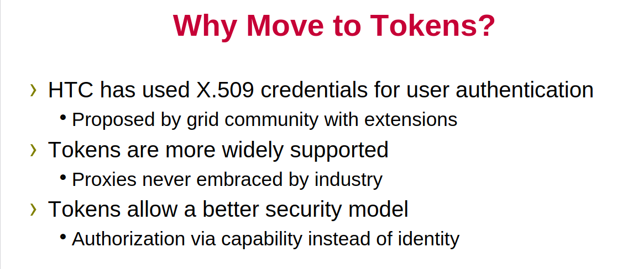
Tuesday Afternoon
(Sci)Tokens authentication in HTCondor-CE (incl. new features)
https://indico.cern.ch/event/1274213/contributions/5571156/attachments/2716926/4719205/SciTokensOnTheCE.pdf

Slide 11
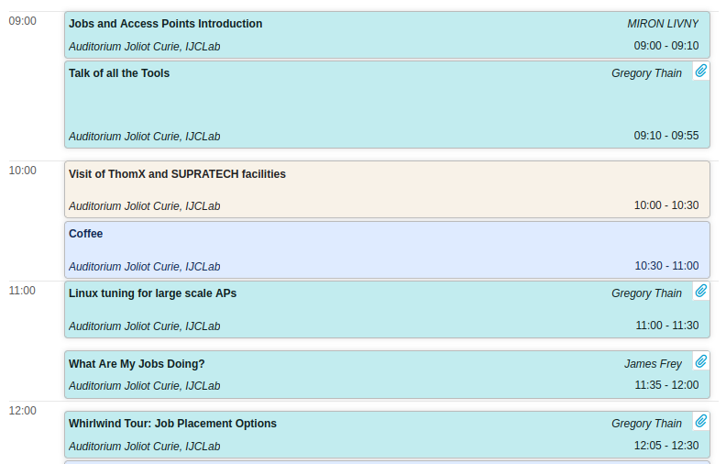
Wednesday Morning: Jobs and Access Points

Slide 12
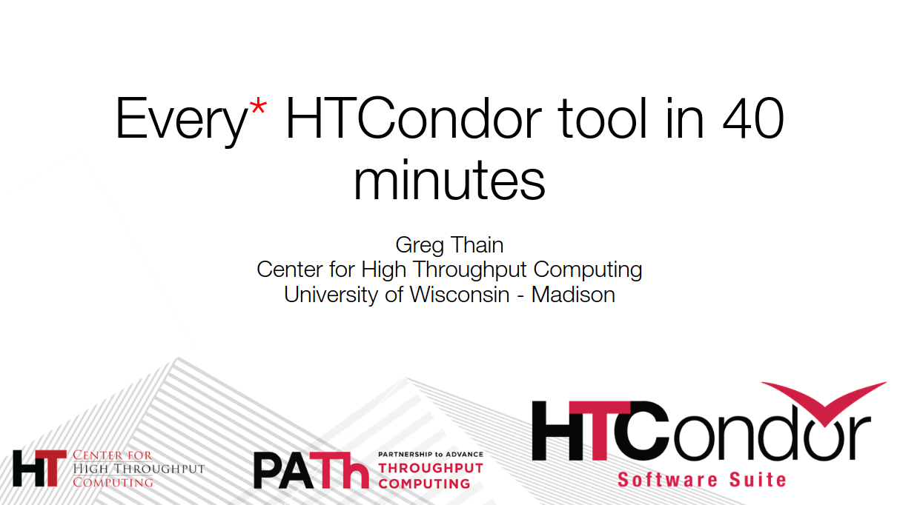
Wednesday Morning
Whirlwind tour of HTCondor tools
Excellent entry point for administrators and power users alike
https://indico.cern.ch/event/1274213/contributions/5573363/attachments/2715115/4721039/whirlwind-tour.pdf

Slide 13

Wednesday Morning
What Are My Jobs Doing?
Any user would benefit of Christina Koch’s talk (given by Jaime Frey) about how to gather informations about what the job actually does or did
Included a live demo analysing running and finished jobs
https://indico.cern.ch/event/1274213/contributions/5571145/attachments/2717809/4721048/HTCondorJobInfo-CKoch.pdf

Slide 14
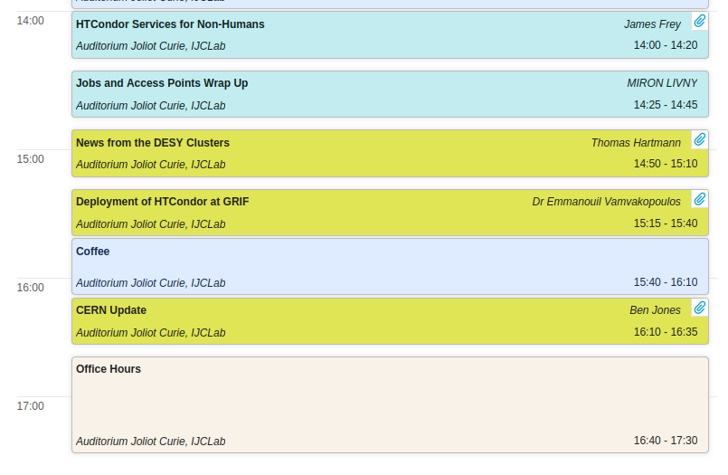
Wednesday Afternoon: User Presentations

Slide 15
Wednesday Afternoon
User presentations
Three interesting site report style talks (DESY, GRIF, CERN)
Changes in LINUX ecosystem are an issue for everyone
DESY
  Analysing job-events in KAFKA
  Scale-out of Jupyter notebooks with DASK
  Adapting to energy challenges by load shedding
GRIF
  Early adaptor of HTC (2014)
  Currently upgrading to HTC 10.X with pure token auth
  ARC CE still in use at IRFU/CEA, HTC CE in the distributed common pool
https://indico.cern.ch/event/1274213/contributions/5570407/attachments/2717928/4721764/DESYHH.pdf
https://indico.cern.ch/event/1274213/contributions/5573382/attachments/2718282/4722008/htcondor@GRIF_2023-3.pdf
https://indico.cern.ch/event/1274213/contributions/5570468/attachments/2718124/4722076/condoreu23lxbatch.pdf

Slide 16
Wednesday Afternoon
CERN
  Energy savings over Christmas
  Collector and Negotiator got ‘happier’ over time despite growth of cores and jobs
    Scaling successful due to HTCSS devs, CMS pool leading the way
  Now using bare metal (via Openstack Ironic) instead of VMs; Linux: skipping EL/* 8, using EL/* 9
    Helped by move of many user communities to containers
  Long tail of ”local” user-submitted jobs is 80% of the effort
  Possible transition scenario between interactive to batch use case:
    Login to SWAN, use notebook on small dataset, when happy and ready to submit to batch…?

Slide 17
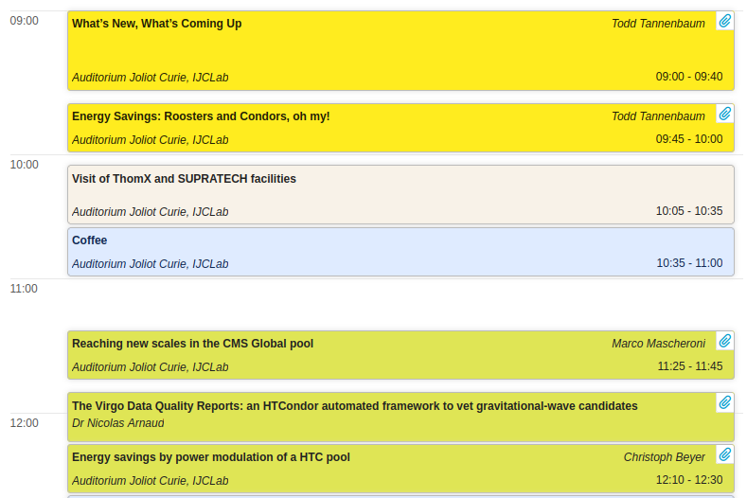
Thursday Morning

Slide 18
Thursday Morning
What’s new - what’s coming up ?
New (as of 2022) version number schema
  “Stable series” -> LTS release
    Bug fixes, 10.0.0, 10.0.1, …
  “Developer series” -> Feature Releases
    Bug fixes & new features, 10.1.0, 10.2.0, …
  New (as of 2023): Major version number = year (23.0.0, 23.1.2 etc.)
New “standard” command line user interface being developed
  “htcondor <noun> <verb>” e.g. "htcondor job submit"
  Legacy tools (condor_q etc.) not going anywhere
Event Log holds more infos e.g. about glidein site
  “htcondor eventlog read my_log_file”
Enterprise Linux 9 required work to support cgroups v2 and OpenSSL 3, now good for Intel/AMD (“x86_64”) and ARM (“aarch64”)
https://indico.cern.ch/event/1274213/contributions/5571127/attachments/2718736/4722885/Whats_New_european_workshop_2023%20-%20Copy.pdf

Slide 19
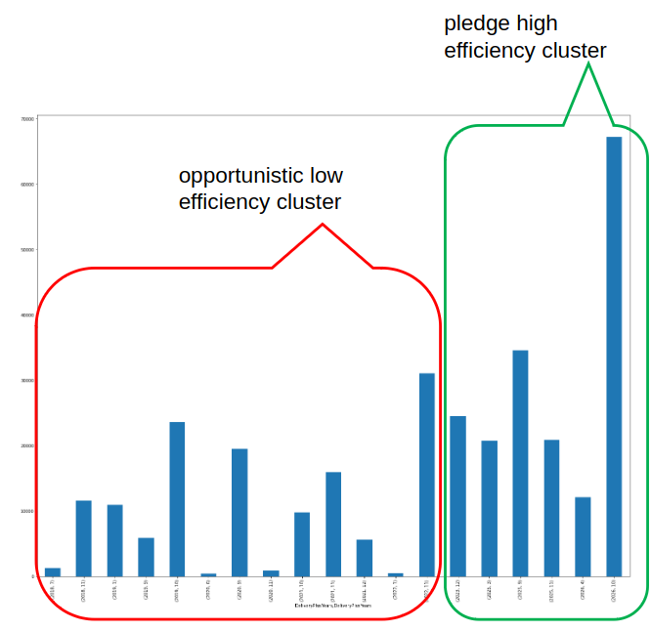
Thursday Morning
Two talks about power-management
Condor-rooster daemon meant for hibernating EPs can be used to shut off EPs
  When and how to shut off easy to implement in Hibernate policies
DESY is preparing to modulate the power consumption following a given profile off cheap/sustainable energy
Split pool in highly-efficient EPs that fullfil pledges and
an opportunistic low-efficiency part
Currently load shedding empty EPs using condor-rooster
https://indico.cern.ch/event/1274213/contributions/5571151/attachments/2718737/4722887/Power_Management_european_workshop_2023.pdf
https://indico.cern.ch/event/1274213/contributions/5570403/attachments/2718752/4722916/power_modulation_condor_pool.pdf

Slide 20
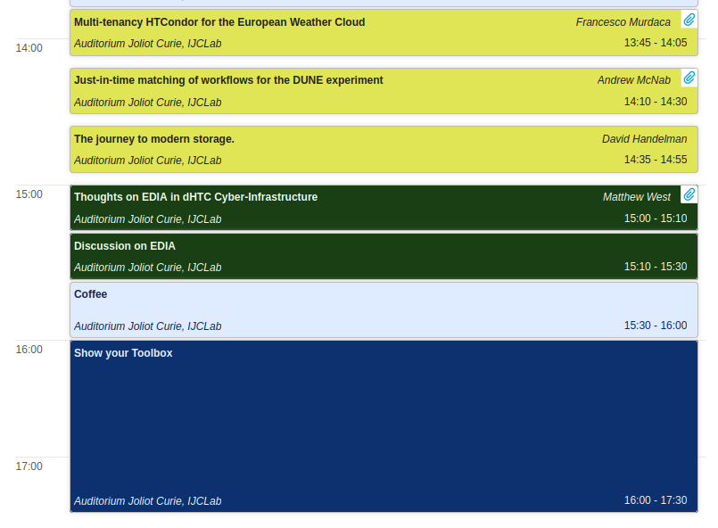
Thursday Afternoon

Slide 21
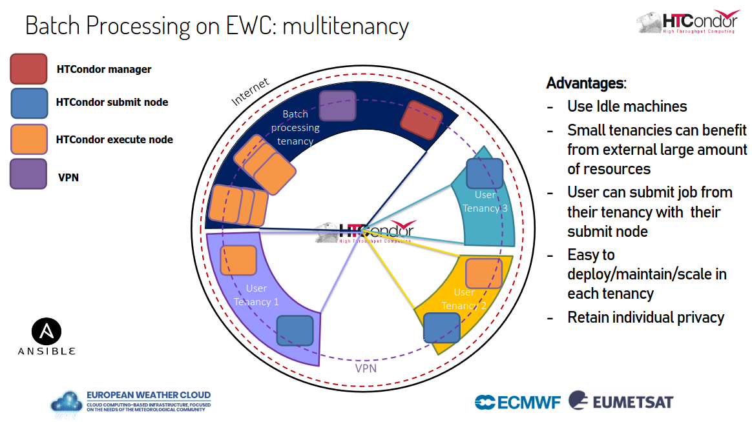
Thursday Afternoon
User presentations
European Weather Cloud: Batch Processing (EWC)
Aims to be the cloud-based collaboration platform for meteorological application development and operations in Europe and enables the digital transformation of the European Meteorological Infrastructure (EMI)
Challenging use cases, large datasets, millions of relatively small jobs
HTCondor already used internally at EUMETSAT for full mission dataset- reprocessing activities (Climate Team)
Physically separated tenancies will be joined through an overall HTC pool (currently beta)
https://indico.cern.ch/event/1274213/contributions/5570408/attachments/2719001/4723803/Batch%20Processing%20on%20EWC%20-%20HTCondor%20Europe%20Workshop%202023%20-%20Francesco%20Murdaca,%20Mike%20Grant.pdf

Slide 22
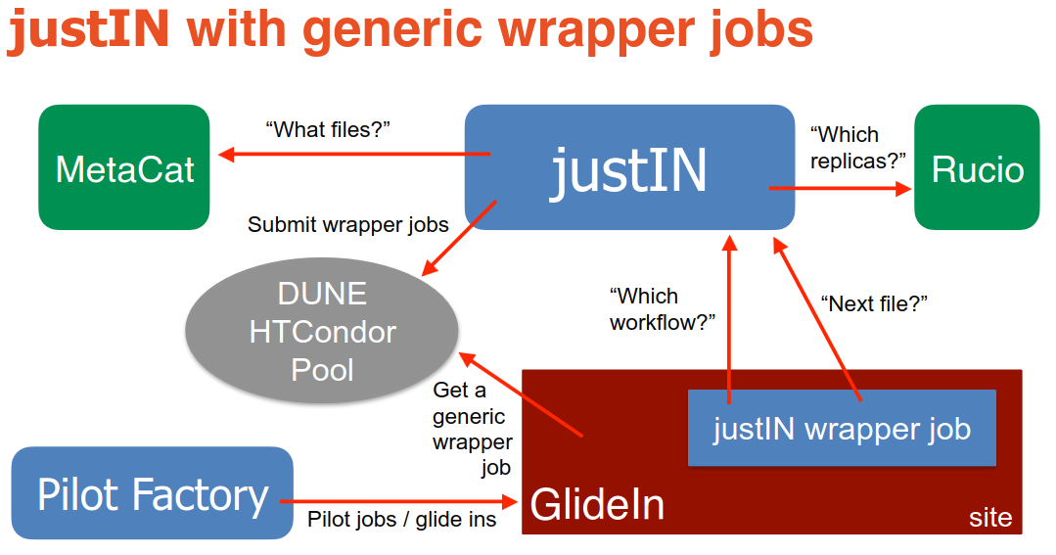
Thursday Afternoon
User presentation: Just-in-time workflow matching for DUNE
Due to DUNE’s scale and specific requirements, in 2022 Fermilab set up a dedicated HTCondor Global Pool for DUNE to allow DUNE-specific configurations
  This uses HTCondor schedds at Fermilab and offsite: BNL and RAL-PPD so far; CC-IN2P3 and CERN are planned.
To satisfy these Rucio/MetaCat/LArSoft/GlideInWMS constraints they designed a just-in-time workflow management system: justIN
Central idea: once we get a job
slot at a site, they choose and
run a workflow that needs “nearby”
unprocessed files, and feed it the
details (URLs, Rucio DIDs, …) of
nearby unprocessed files to work on.
https://indico.cern.ch/event/1274213/contributions/5570409/attachments/2719062/4723510/20230921-mcnab-dune-justin.pdf

Slide 23
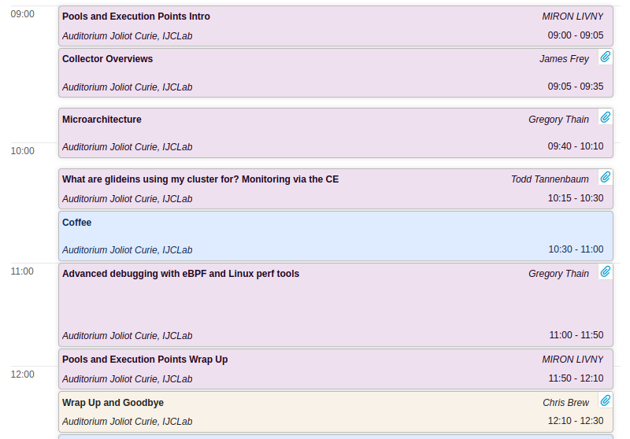
Friday Morning

Slide 24

Friday Morning
Debugging HTCondor (and much more): introduction to perf, eBPF, …
perf: Powerful debugging tool
  attach to kernel performance counters
  get debugging info directly from the kernel
eBPF: Trace the kernel yourself
  build your own
    monitoring, diagnostics, telemetry,...
    performance, security,... analyses
  replace your own kernel modules
Introduction to bpftrace
  Awk-like syntax
https://indico.cern.ch/event/1274213/contributions/5571148/

Slide 25

After the Workshop is Before the Workshop
Tentative planning for 2024
Feedback by attendees very good, workshop is considered useful
Strong commitment by the HTC developers
About 50% regular participants and 50% new faces
Very lively community profiting from the rather small-scale workshop by interacting a lot
  Proof of importance of in-person workshops
NIKHEF Amsterdam volunteered to host the next meeting
Tentative date: calendar week 39 (23-Sep-2024 to 27-Sep-2024)
  Details to be fixed; presumably start Tuesday 24-Sep-2024

Slide 26
Thank You

Slide 27
Tuesday Afternoon
(Sci)Tokens authentication in HTCondor-CE (incl. new features)
SciTokens & WLCG tokens accepted for job control
Token discovery First location with a valid token is used
Token can be in file or env ( $BEARER_TOKEN_FILE & use_scitokens = true)
Token claims in the job ad unalterable by the user
Authorizing through mapfile & plugin if needed
EGI CheckIn tokens supported out-of-the-box (plugin available)
Simple testing scenario for SciTokens in the talk
Phasing out GSI & X.509 proxy support
  X.509 proxy for user jobs supported in all versions

Slide 28
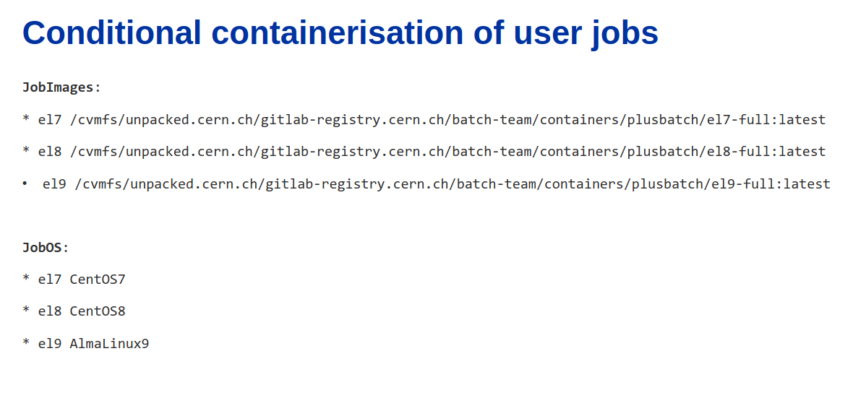
Wednesday Afternoon
CERN (cont’d)

Slide 29
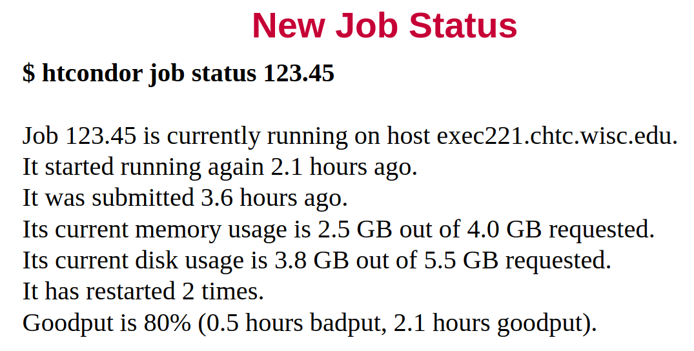
Thursday Morning
What’s new - what’s coming up ?

Slide 30
Thursday Morning
What’s new - what’s coming up ?
Event Log holds more infos e.g. about glidein site
  “htcondor eventlog read my_log_file”
Can make "+CustomAttributes" first class with knobs
  +SiteJobType = "analysis" -> SiteJobType = "analysis"
Enterprise Linux 9 ☺ ☺ ☺
  Required work to support cgroups v2 and OpenSSL 3 Processors:
• Intel/AMD ("x86_64")
• ARM (“aarch64”

Slide 31
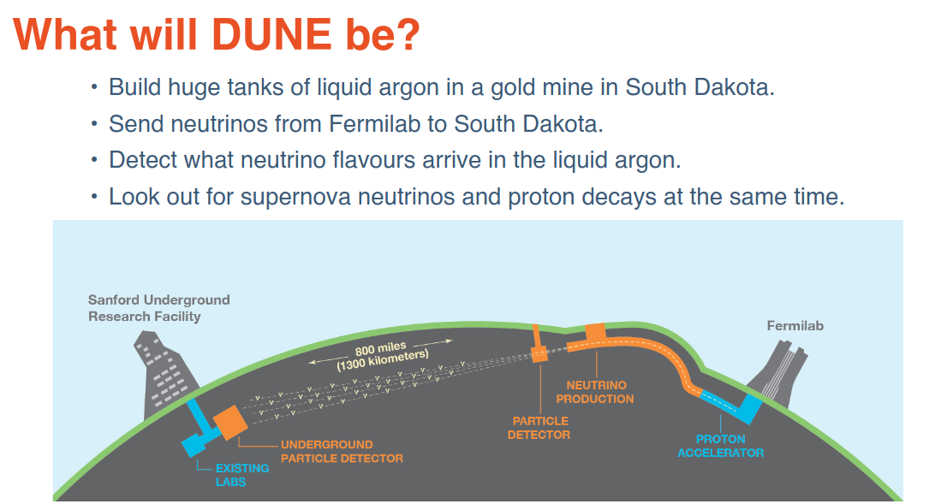
Thursday Afternoon
Just-in-time workflow matching for DUNE
https://indico.cern.ch/event/1274213/contributions/5570409/attachments/2719062/4723510/20230921-mcnab-dune-justin.pdf

Slide 32
Friday Morning
Getting ready for all tokens: debug and test token-based access
Debug (and impersonate) tokens
  condor_test_token
  clone (as admin) a token to trace the job flow
Enable X509 DN for direct submissions (no Globus)
  how to submit w/o tokens for dedicated users/certs
https://indico.cern.ch/event/1274213/contributions/5571156/
https://indico.cern.ch/event/1274213/contributions/5571155/

