Slide 1
RADiCAL Update 25.May.2023
Beam pipe section removed to allow access to NIKEF Table and Wire chamber stations. (thanks to Michael and team)
Wire chambers repositioned on stations. (thanks to Laza and team)
Safety Review went well. (thanks to Laura)
Beam established with 125 GeV electrons. (thanks to Nikos and Bastien)
  We are observing ~ 10k or more beam particles per spill in the 2 cm x 2cm trigger counter.
  Matches well with the CAEN DRS system we are using.
Beam wire chambers.
  Readout of D (upstream chamber) was found to not to function (oscillations).
  Readout of E (downstream chamber closest to RADiCAL) is functional so we can use it. Signals large, so we need 6dB attenuation on the six channels. Once incorporated, will be potentially useful for identifying electron position updtream of the RADiCAL module.
Preliminary data has been taken since 5:30, providing studies of the SiPM bias voltage settings and signals to determine optimum settings. All signals look good so far, with some additionals to be added in.

Slide 2
RADiCAL Update 25.May.2023
Run plan
  Energy scans using electrons are expected to begin late today or early Friday, starting at 125 GeV electron energy and then in descending steps 100 GeV, 75 GeV, 50 GeV, 25 GeV using the fast organic DSB1 waveshifter at shower max.
  Brief runs will follow with positive hadron beam at 50 GeV and 100 GeV.
  Then Energy scans with electrons using the very rad hard LuAG:Ce waveshifter at Shower max, again with the same energy steps as for DSB1.
  Brief runs with positive hadron beam at 50 GeV and 100 GeV.

Slide 3
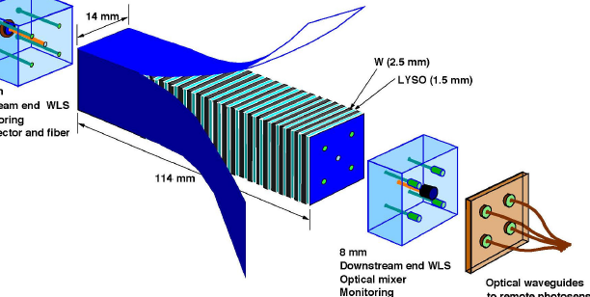
RADiCAL Module Structures

Slide 4
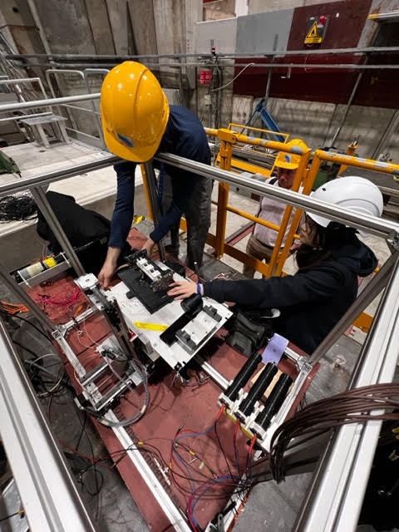
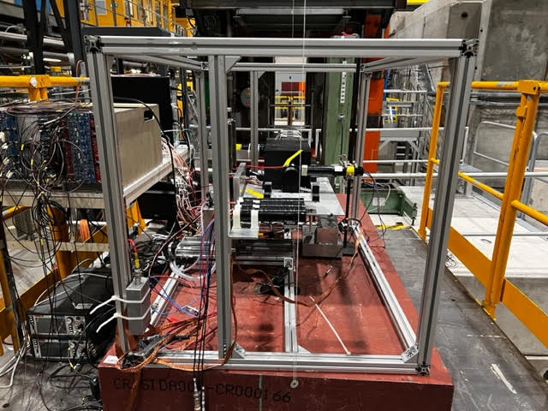
RADiCAL Beam Setup

