Slide 1
Cryogenic Applications of Sensors based on Optical Fiber Technology

Slide 2
Contents
Goals of the experiments
List of the experiments
What we measure
Overview on the experiments
Experiments
Conclusions
Next steps

Slide 3
Goals of the experiments
The feasibility of the measurements at low temperature: very first experiments to check the capability of the fibers and the sensors to stand the liquid Nitrogen LN and Liquid Helium LHe temperature (77K and 4.2K respectively).
To profit of the occasion of a prepared test of a magnet at low temperature: test strain and temperature probes (eventually also @ 1.9K)

Slide 4
Experiments
Date | Test
August 20th , 2010 | Temperature measurements with LN at 77 K
August 25th , 2010 | Temperature measurements with LHe at 4.2 K
September 17th , 2010 | Temperature measurements with LN at 77 K
September 22nd , 2010 | Temperature measurements with LN at 77 K
September 24th , 2010 | Temperature and Strain measurements with LHe at 4.2 K
September 30th , 2010 | Temperature measurements with LHe at 4.2 K
October 4th , 2010 | Temperature and Strain measurements with LHe at 4.2 K and 1.9 K

Slide 5
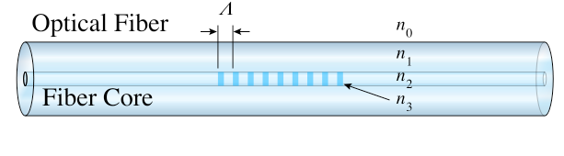
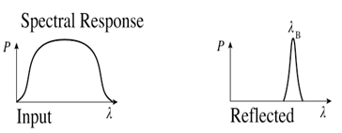
What we measure
Each “Fiber Bragg Grating” (FBG) reflects a single Bragg wavelength λB. Changes in the temperature and strain state of the fiber change the λB.
Obtaining the lambda-shift from measured λB, the following measurements are obtained in
Temperature
Strain
: temperature and strain induced Bragg wavelength shifts
α : coefficient of thermal expansion
ξ : thermo-optic coefficient
: photo elastic coefficient of the fiber

Slide 6
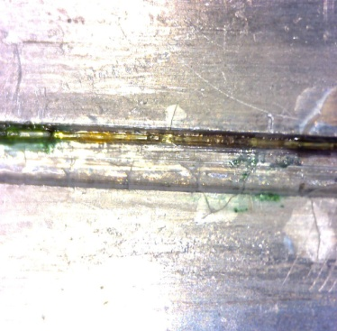
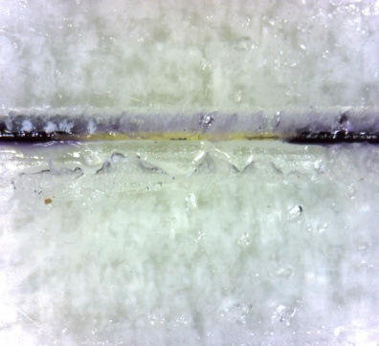
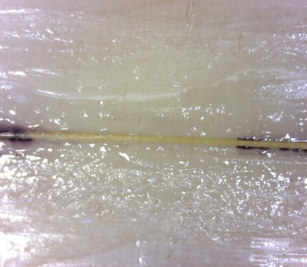
Overview
Sensors
Polymide coated and un-coated FBGs
Reference sensors :
  Temperature: PT100 and Allen Bradley
  Strain: resistive gauges XC11-3-350 in half bridge configuration
Devices
Open dewar with LN
Cryostat filled with LHe
Sm125 Optical Sensing Interrogator
Host materials
Aluminium
Ryton
Lead (a)
Plexiglass (PMMA) (b)
Teflon (c)
Aluminium shell of the magnet
(a)
(b)
(c)
FBGs glued on the samples with Loctite Super Attack Precision Glue

Slide 7
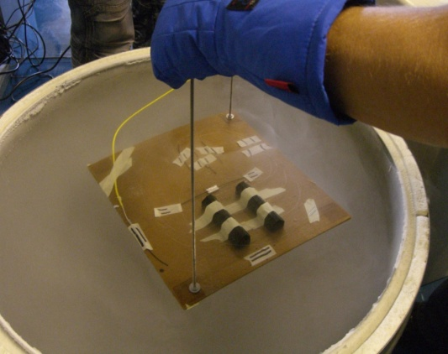
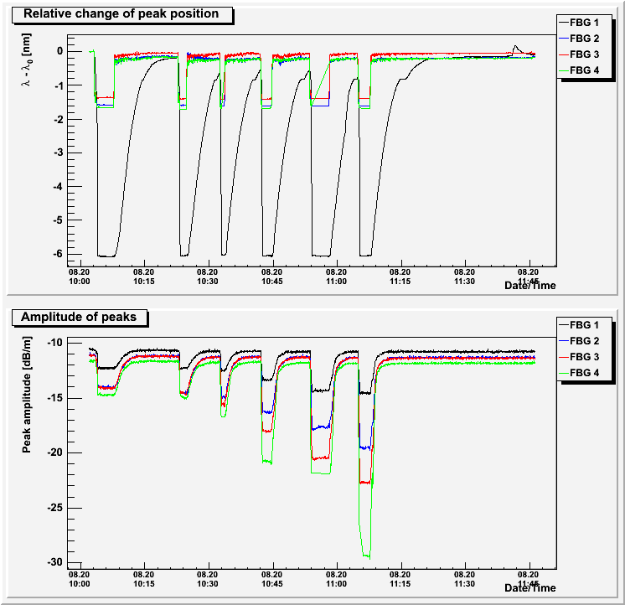
Feasibility Test at 77 K
August 20th, 2010
An array of 4 FBG fixed on a carton support:
  1. Polymide coated FBG glued on Al plate
  2. Polymide coated free FBG
  3. Uncoated free FBG
  4. Polymide coated free FBG
6 cycles of immersions in the LN at 77 K
Conclusions of the test:
reproducible peak positions
glued FBG on AL shows the biggest lambda-shift
degradation of low temperature peak amplitudes probably due to a bad sensors configuration

Slide 8
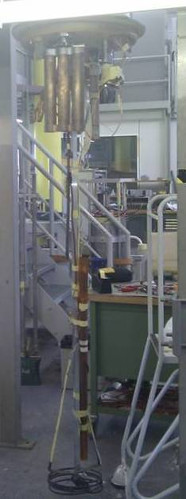
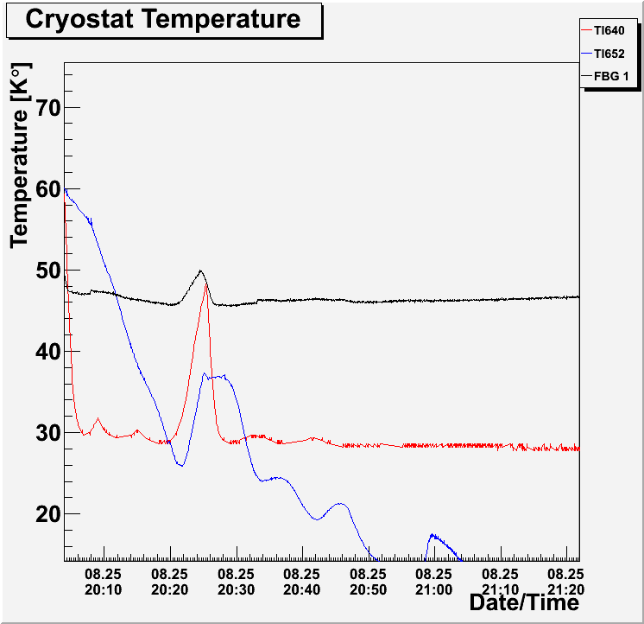
Feasibility Test at 4.2 K
August 25th, 2010
Glued FBG on Al fixed on a tube
Two reference temperature sensors
The sensors were dipped into the cryostat at 4.2 K
Conclusions of the test
glued FBG on AL becomes insensitive at around 50K
To be remarked that the reference sensor TI640 is not sensitive below 30K and TI652 is not sensitive on high temperate

Slide 9
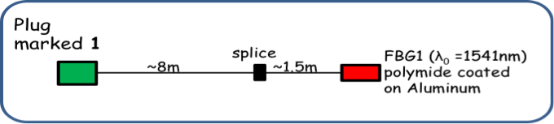
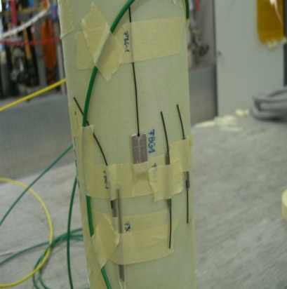
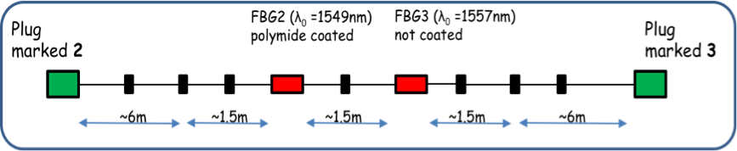
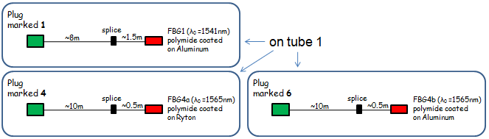
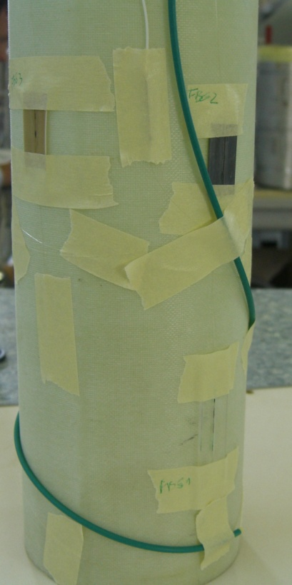
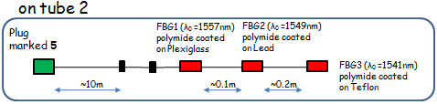
Temperature Tests at 77 K
September 17 th, 2010
  1. coated FBG1 on Al plate
  2. coated free FBG2
  3. free FBG3
The sensors and the samples where glued on Vetronite tubes
September 22 nd, 2010
  1. coated FBG4a on Ryton
  2. coated FBG4b on Al
  3. coated FBG1 on PMMA
  4. coated FBG2 on Lead
  5. coated FBG3 on Teflon

Slide 10
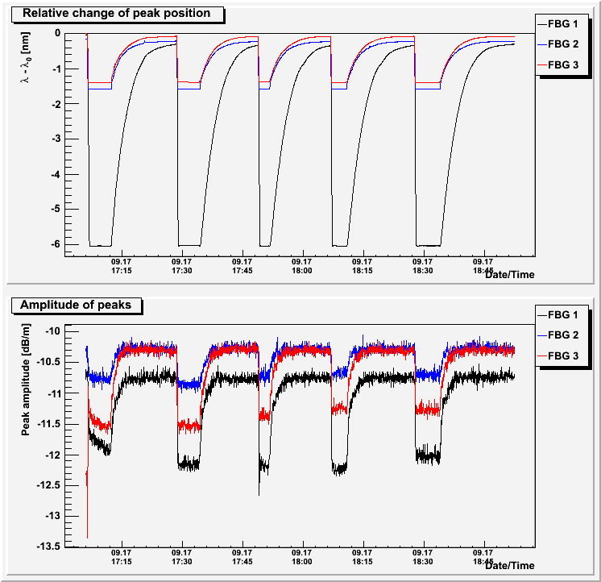
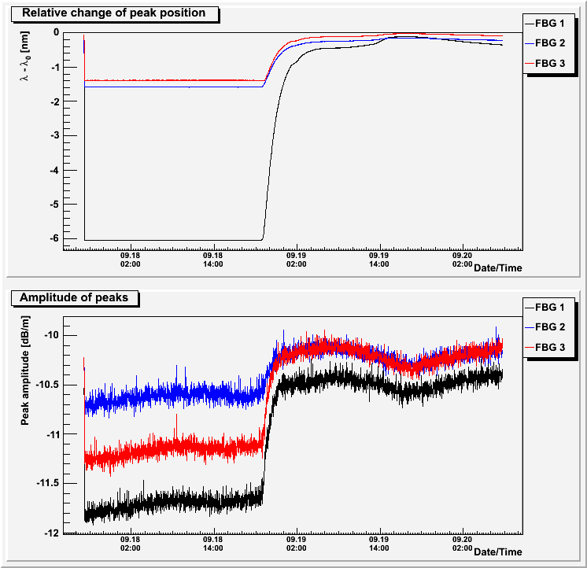
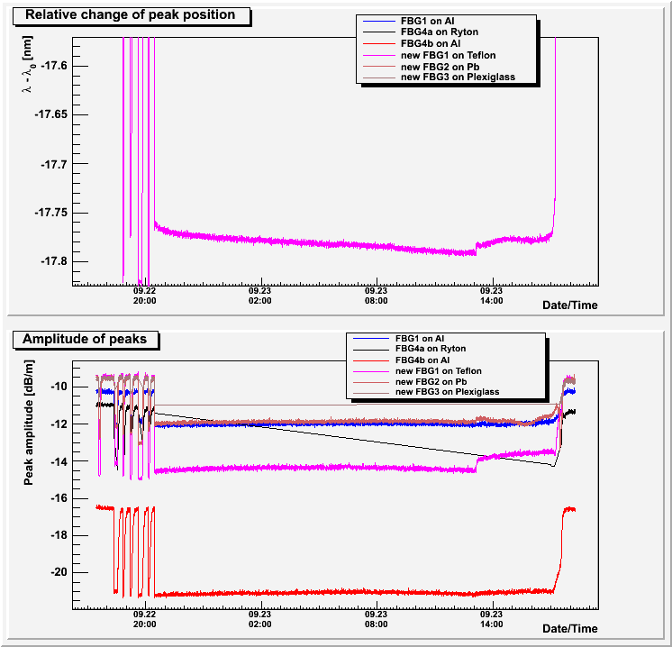
Temperature Tests at 77 K
5 cycles of immersions and a long cycle test in the LN
September 17 th
September 22 nd
Conclusions of the tests
On the 17th the sensors show to be stable at 77K and there is no degradation of amplitudes. FBG on Al shows the biggest wavelength change .
On the 22nd the sensors show to be stable at 77K and the FBG on Teflon performs the biggest wavelength change.

Slide 11
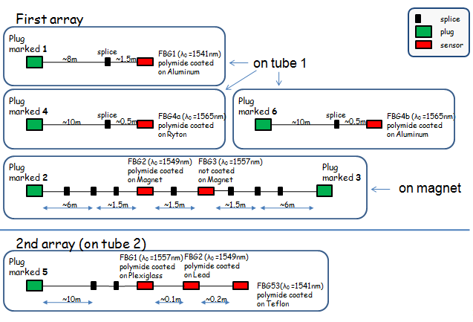
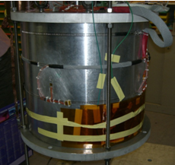
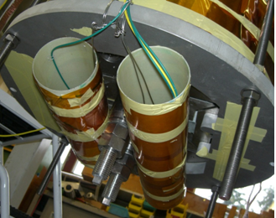
Temperature and Strain Tests at 4.2 K and 1.9 K
From September 24th to October 4th
Magnet and tubes were dipped into the cryostat

Slide 12
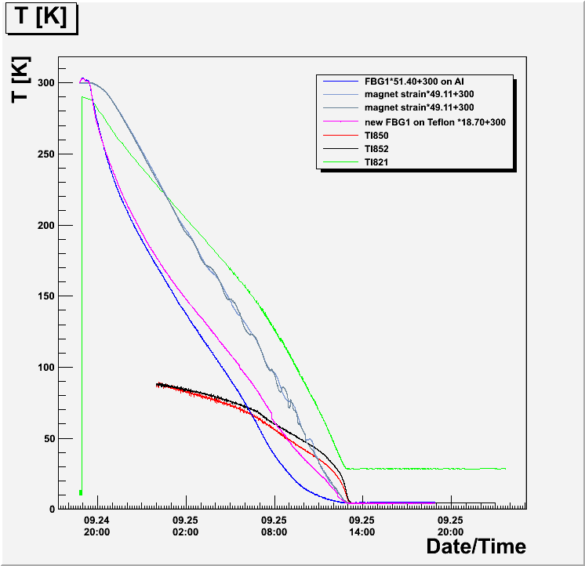
Temperature Tests at 4.2 K
Comparison between the optical fiber sensors and the reference Temperature sensors fixed into the cryostat during the cool down
To be remarked that the reference sensor TI821 is sensitive from 300K to 20K and the TI850 and the TI852 are sensitive from 20K to 1.8K
FBG on Teflon and strain FBGs change until 4.2 K is reached.
FBG1 on the Al plate starts to change its slope at around 30K.

Slide 13
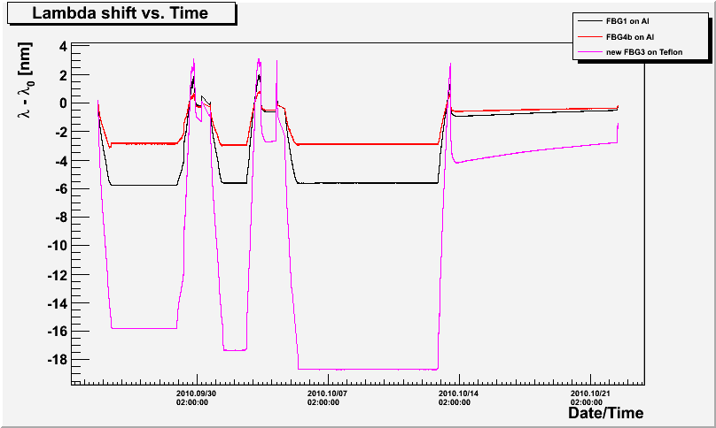
Temperature Tests at 4.2 K
Comparison between FBGs on Al and the FBG on Teflon over the whole period: different cooled down values in the different cycles but the lambda-shift seems to be the same
Conclusions of the tests
Teflon gives sensitivity to the FBG sensor at low temperature but glue and geometry of the sample might effect it’s behavior.

Slide 14
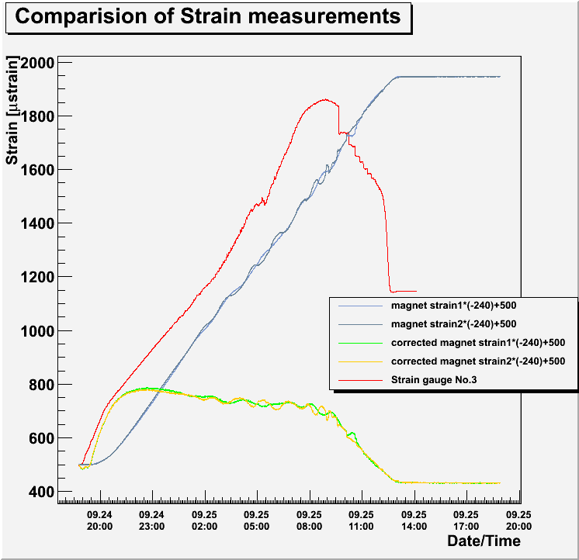
Strain Tests at 4.2 K
Comparison between the optical fiber sensors and the electrical strain gauge closer to the optical fiber sensors and fixed on the magnet.
To be remarked that FBG1 on Al was about half meter below the magnet and was not attached to the magnet’s mass
Conclusions of the tests
Quite large ‘discrepancy’ between FBG strain sensors and magnet strain gauge.
Strain measurements were not correctly set up (no temperature compensation).

Slide 15
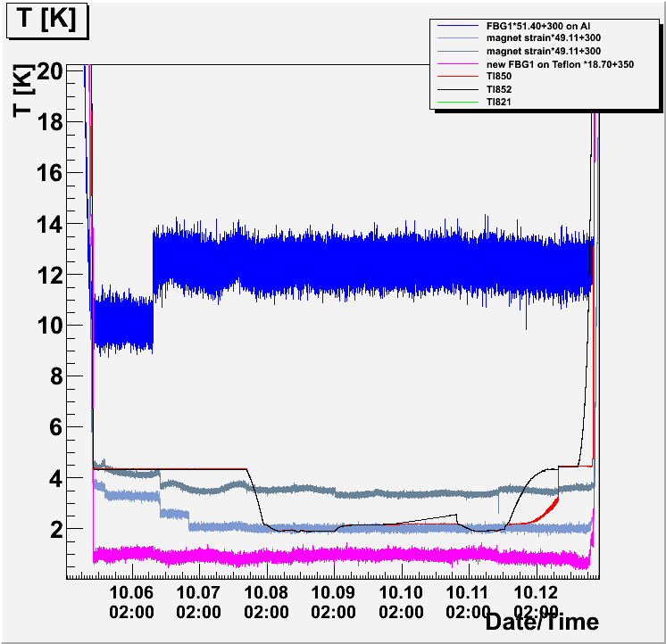
Temperature Tests at 1.9 K
Comparison between the optical fiber sensors and the reference Temperature sensors fixed into the cryostat
To be remarked that the reference sensor TI821 is sensitive from 300K to 20K and the TI850 and the TI852 are sensitive from 20K to 1.8K
Conclusions of the tests
No Sensitivity for very low temperature is seen on Teflon.
To be remarked: very low amplitude for the FBG glued on Teflon

Slide 16
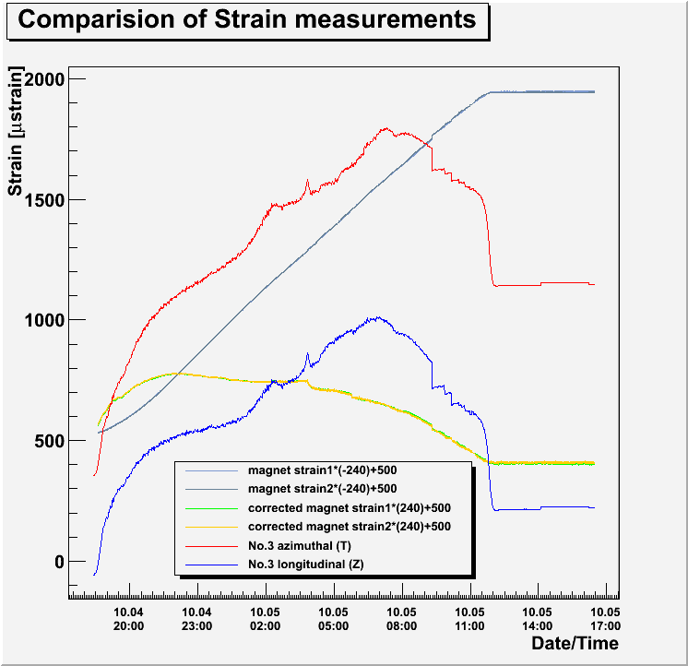
Strain Tests at 1.9 K
Comparison between the optical fiber sensors and the electrical strain gauge closer to the optical fiber sensors and fixed on the magnet.
To be remarked that FBG1 on Al was about half meter below the magnet and was not attached to the magnet’s mass
Conclusions of the tests
Quite large ‘discrepancy’ between FOS strain sensors and magnet strain gauge.

Slide 17
Conclusions
The feasibility of the low temperature sensoring up to 77K was proven of the FBG based FOS based on measurements.
Sensors can survive up to 1.9K temperature but no sensitivity under 50K. Amplification of the Λ shift is efficient with some base materials but still limitations are seen below 50 K for most of them.
Some materials can give the sensitivity up to 4.2 K. The glue between the fiber and the base material has an impact on the results at low temperature. The interface between the fiber and a base material (glues and techniques of gluing) has to be studied.
Measurements of strain is more a question of the set up (similar as for resistive gages). Measurements have been done recently by an other team at CERN EN-MME and the feasibility was demonstrated.
Statistics with different base materials and glues has to be made to prove the principle of measurements at low temperature based on FBG technique. An adequate database and data analysis technique has to be agreed. Procedure of measurements and documentation of each of them is crucial.

Slide 18
Next steps
Temperature
Measurements on the exiting fibers (and specially the one on Teflon)
  at warm to test the data acquisition and data base connection
  at low temperature
    In a LN up to 77 K
    In the cryopump up to 12K
    In LHe
Measurements on the new sensors glued on Teflon and Plexliglass
  Thermal cycles in LN
  Measurements at warm, at 77K, at 12K and only if those measurements gives a consistent and good results we would go to LHe
Strain
Measurements on the new sensors
  Thermal cycles in LN
  Installation in a cryo-traction machine and make the cool down

Slide 19
Thank you for your attention!
Grazie!
Köszönöm!
Merci!

