Slide 1
FOS4HEP activities at CERN
Workshop on Cryogenic application of FOS techniques
CERN, March 3° 2011
S. Buontempo
(on behalf of FOS4HEP group)

Slide 2
Outline
FOS @ CERN
FOS applications in CMS
R&Ds going on
FOS4HEP project
more R&Ds in “waiting list”

Slide 3
FOS @CERN
All activities triggered by a technical seminar in CMS by G. Breglio and M. Giordano in April 2009
Defined and started in July 2009 a plan of test measurements in CMS detector for both T and strain
List of additional field of interest collected: R&D program defined and started in 2010
FOS4HEP(1) project submitted in dec 2009
FOS seminar to Marta’s team by S. Buontempo in July 2010: test measurements started
FOS4HEP (2) submitted in Jan 2011

Slide 4
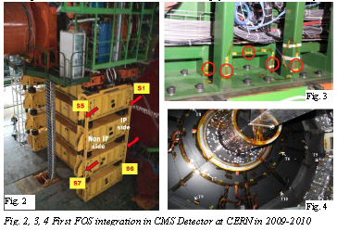
FOS in CMS
20 T FOS in CMS tracker bulkhead (fig4)
20 strain FOS in CMS HF structure
(fig 2,3)
60 T sensors in CMS cavern
See Zoltan talk

Slide 5
R&Ds going on
CRDC & Optosmart teams: sinergy of know-hows
Precise Relative Humidity up to -20C T ( CMS inner tracker environment) see P. Petagna talk
B field in different ranges: 0-0.5T (fringe field) and 3-5T (field map), see A. Gaddi talk
Cryogenic T and strain measurements, see M. Bajko talk
For all of them a precise plan of activities and applications defined and being implemented (rad hardness campaign included)

Slide 6
SX5 FOS lab
5m
Table
Fridge
New FOS lab equipped in P5 for FOS calibration and R&D tests
Dewar
4m
Rack
Cupoard
Table
Cupoard
Cupoard
Table

Slide 7
FOS4HEP project
idea is to profit of any funding call to increase the strengh of the FOS activities at CERN and in involved group sites
First proposal submitted to EU-PEOPLE-MC call in dec 2009. Final score was 76/100, over the threshold of 70/100, but not selected for negotiation phase.
Second proposal edited with help of PNO external consultancy and submitted in EU-PEOPLE-MC call in jan 2011. Result expected by May 2011.

Slide 8
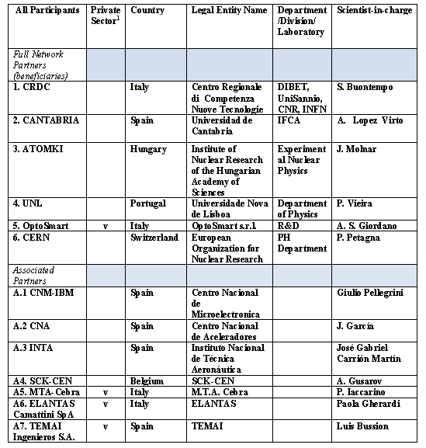
FOS4HEP
Participants
3 additional associated partners (Ansaldo SC, Babcock Noell, AMS techn.) not included due to late letter of commitment

Slide 9
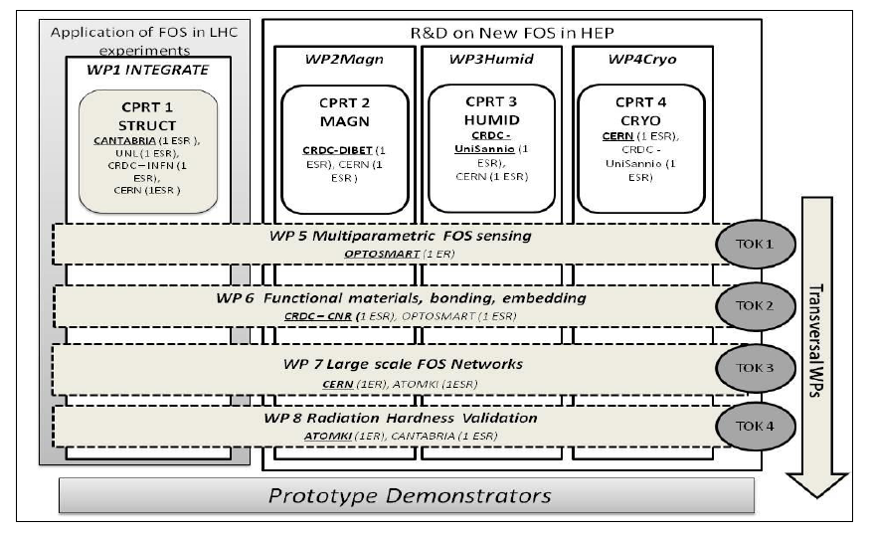
FOS4HEP architecture

Slide 10
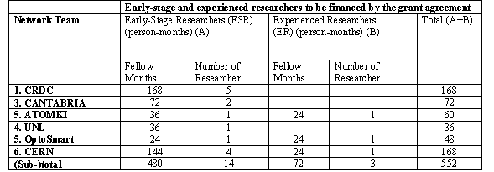
FOS4HEP Fellows

Slide 11
More R&Ds in “waiting list”
Gas leak measurements: request from R. Guida to start some prototyping activities in his lab
Dosimetry: very preliminary ideas, still to be defined the particles and ranges
Any further outcome/idea from present WS ?

