Slide 2

Notes:
WE ARE THE WORLD
1985
More than 100 million dollars collected to fight Etiopia’s famine.

Slide 3
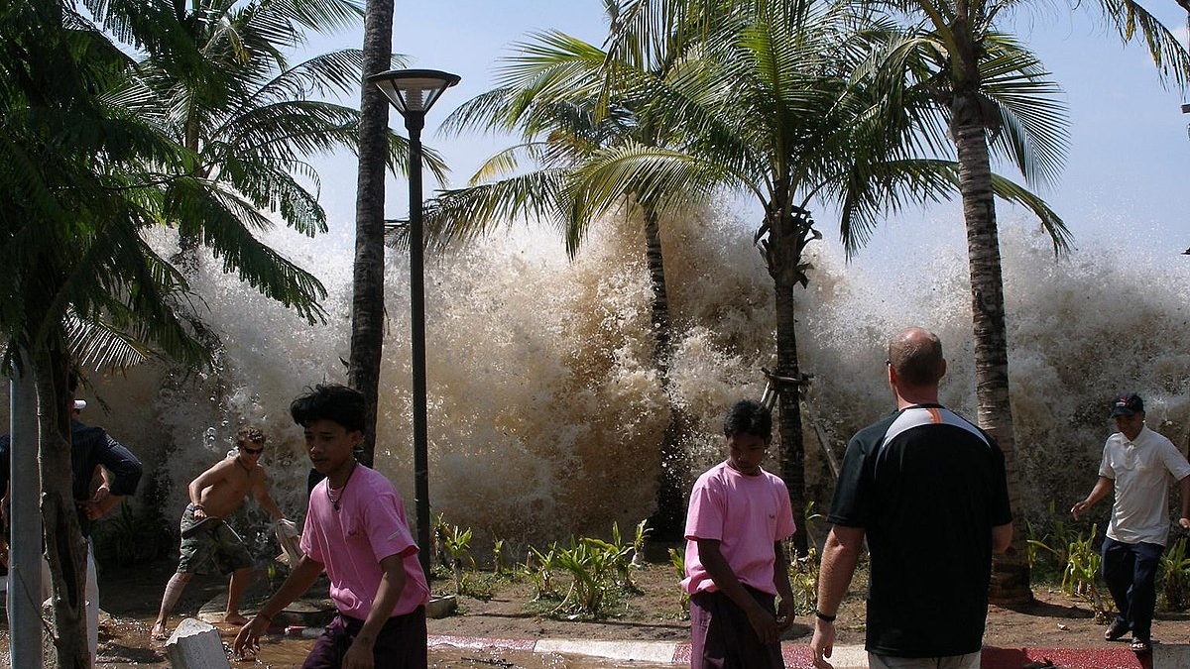
Notes:
INDIAN OCEAN EARTHQUAKE AND TSUNAMI
2004
MORE THAN 560 MILLION RAISED by ong and privates TO HELP THE locals affected by this disaster

Slide 4

Notes:
Fridays for future
2018
8 million people have attended the protests

Slide 5
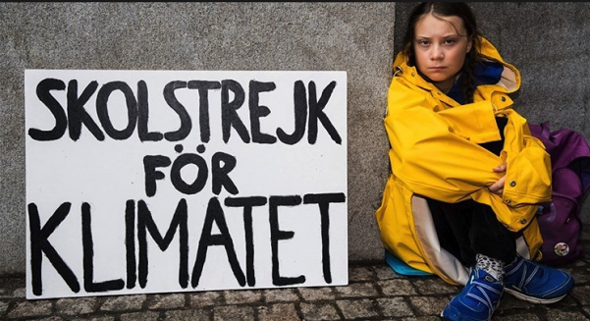
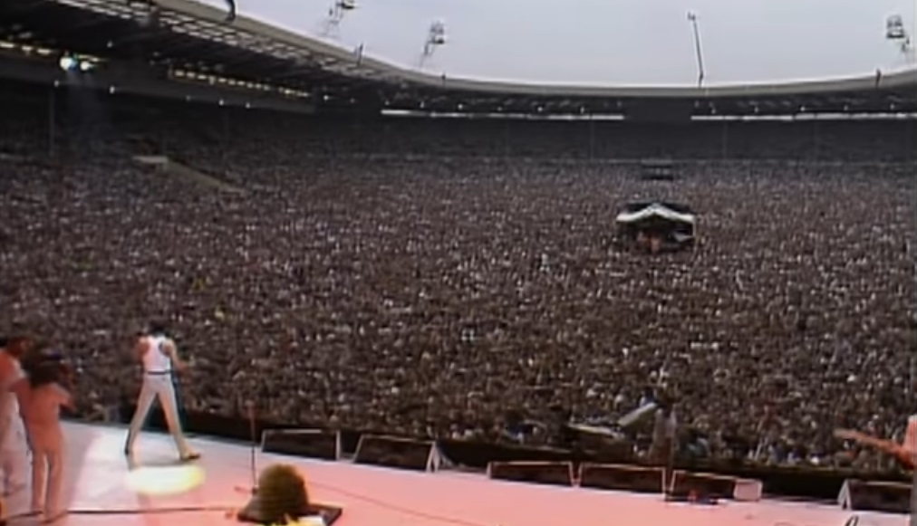
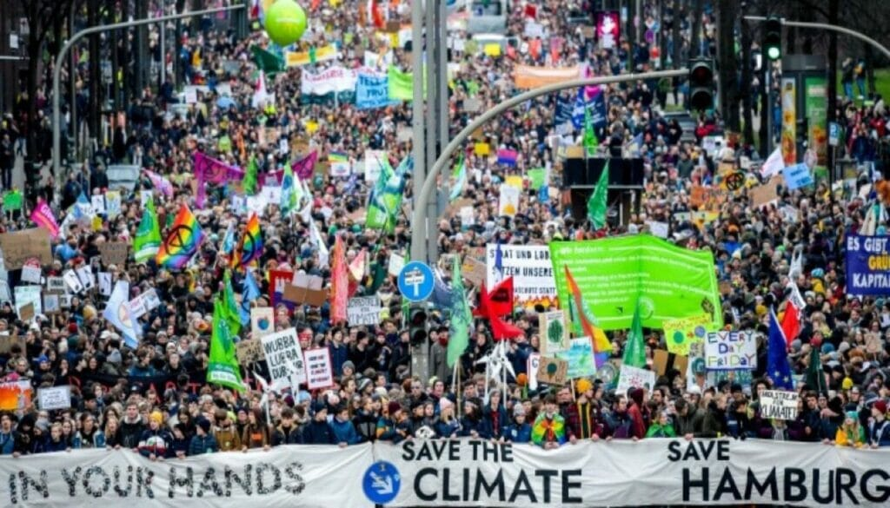
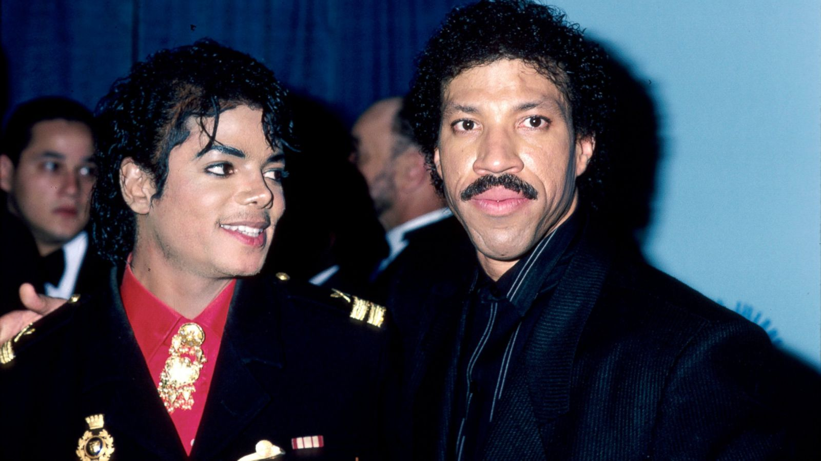
Notes:
What did all these initiatives have in common?
They had strong ambassadors
They had big visibility

Slide 6
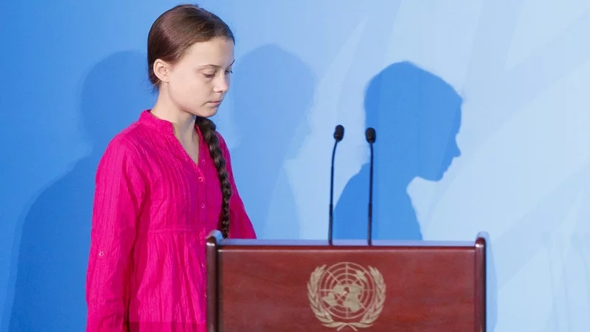
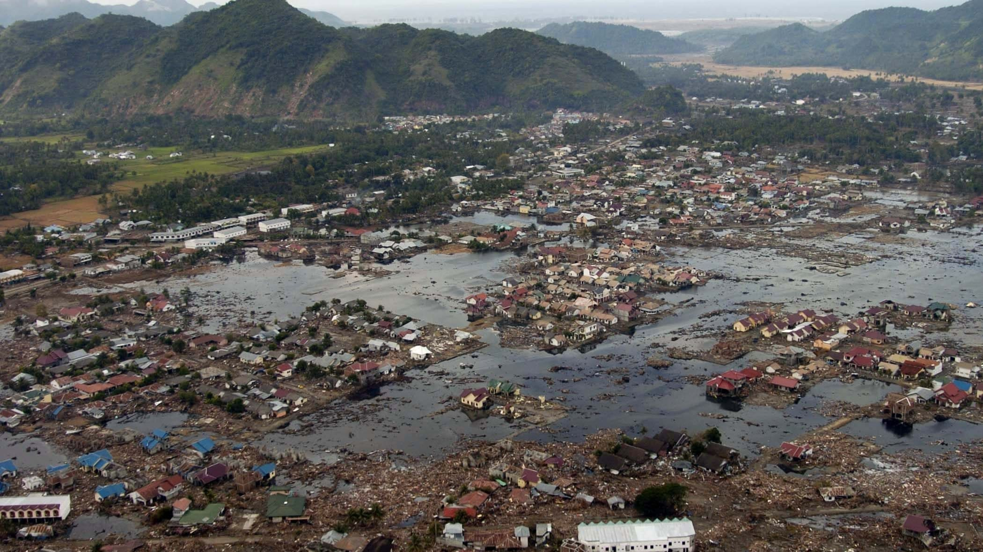
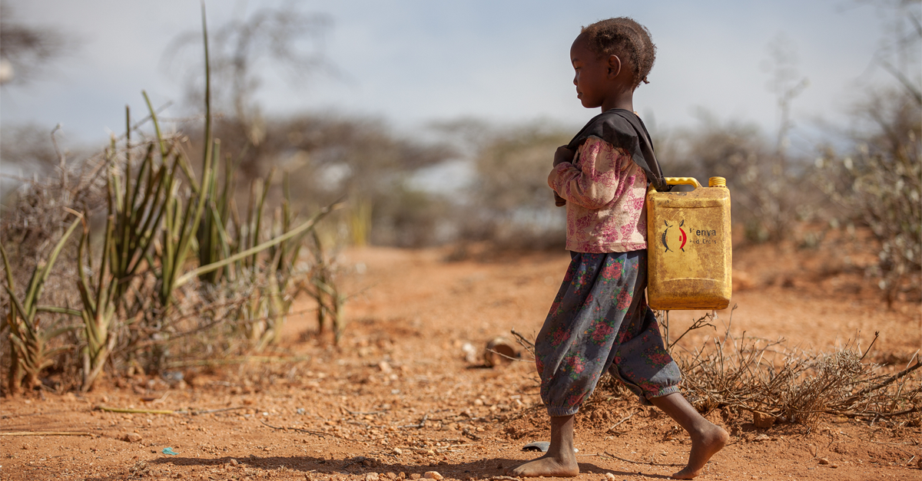

Notes:
They tackled huge problems
They were extensive

Slide 7
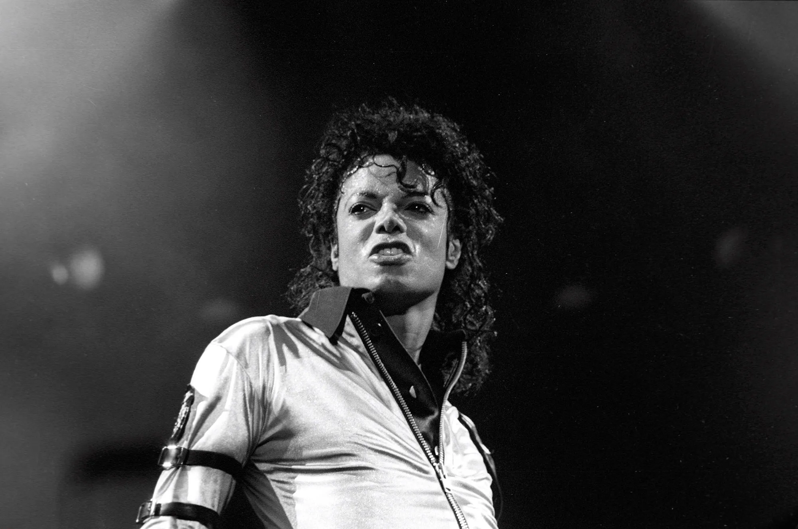

Notes:
But for every Friday For Future, for every help campaign, for every We are the world, there are hundreds of projects without a frontman like Michael Jackson.
Hundreds of projects without proper funding.
Hundreds of projects that no one knows

Slide 8
Notes:
After we analized the importance of these four pillars, we asked ourselves: why can’t we bring the same brilliance/ingredients to smaller projects, even those not represented by famous singers or those that nobody sees?

Slide 9

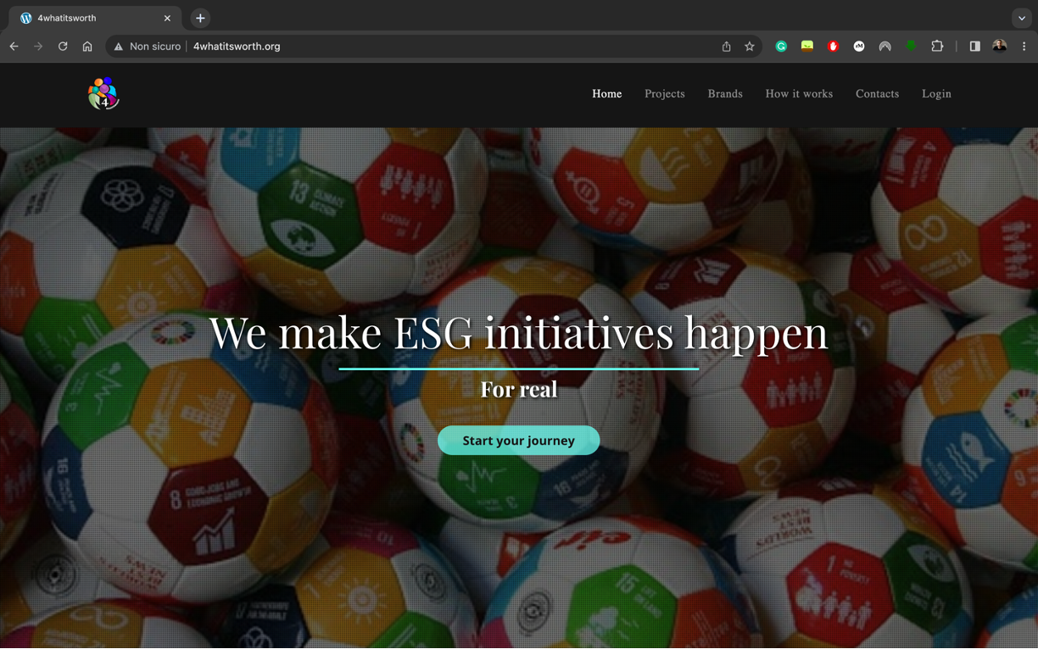

4WHATITSWORTH
Notes:
4whatitsworth – our platform – offer a chance to overcome those difficulties, giving both a boost in terms of public resonance and resources’ procurement .
Let me show you what I mean.

Slide 10

Notes:
Imagine you are the most supported team in Italy.
Imagine you have 150M follower and 580M of fan potential around the world.
Imagine you are a social phenomenon with 120 years of history.
Imagine you are Juventus.

Slide 11
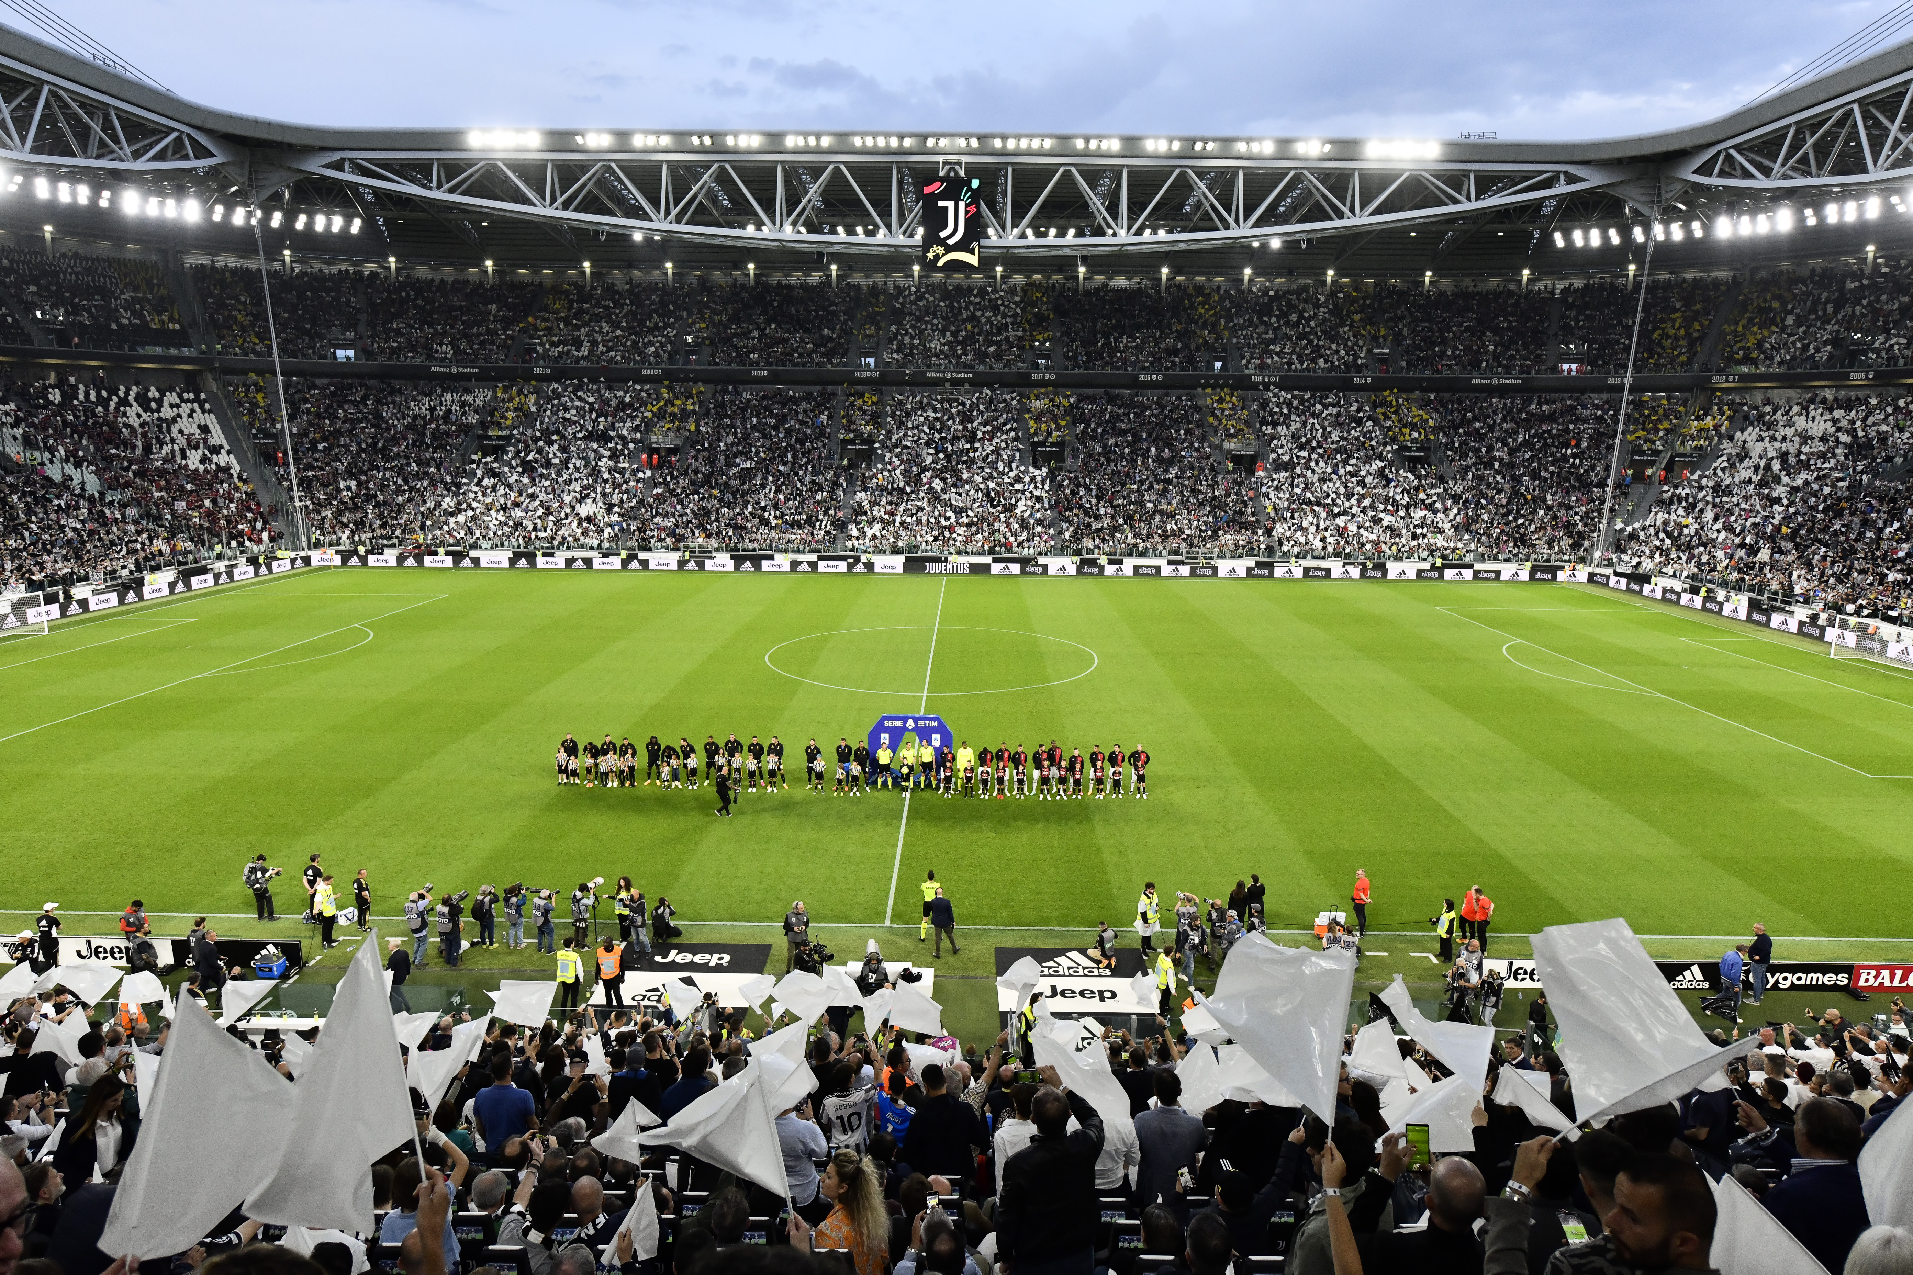
Notes:
Let’s say you want to give back to your fans some of the overwhelming love you have received and help them having a bigger impact on their community.

Slide 12
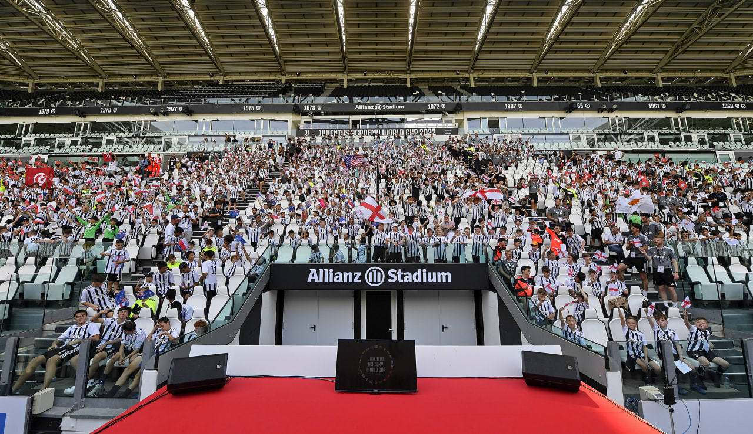
Notes:
Juventus has more than 500 fan clubs and almost 150 academies all over the world and right for this reason may support his fans in having a concrete impact and make real things happen
It is time for Juventus to empower its ambassadors

Slide 13
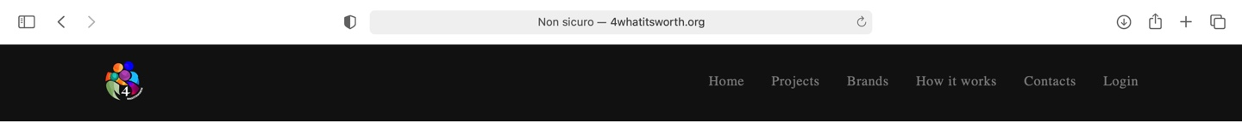











JUVENTUS
Juventus recognizes sport and football as one of the industries with significant social impact. As a club, Juventus can and wants to play an important role by strengthening initiatives and activities that generate a positive impact in the areas of education, inclusion, and the environment.
GIOCA CON ME
Notes:
In our platform, Juventus can showcase their ongoing ESG initiatives and reach an even broader public.

Slide 14
Notes:
But we offer – through a dedicated API in the desired proprietary platform, such as mygameroom.it – the possibility for ambassadors, people part of the fan club and the academies, to propose new projects in response to a Juventus call to action.
Let me show what I mean

Slide 15





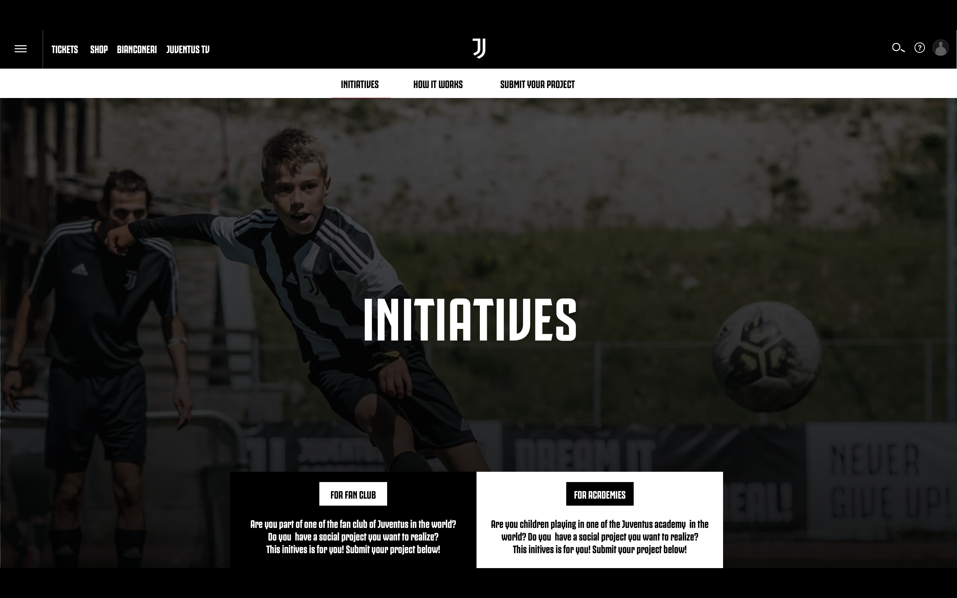
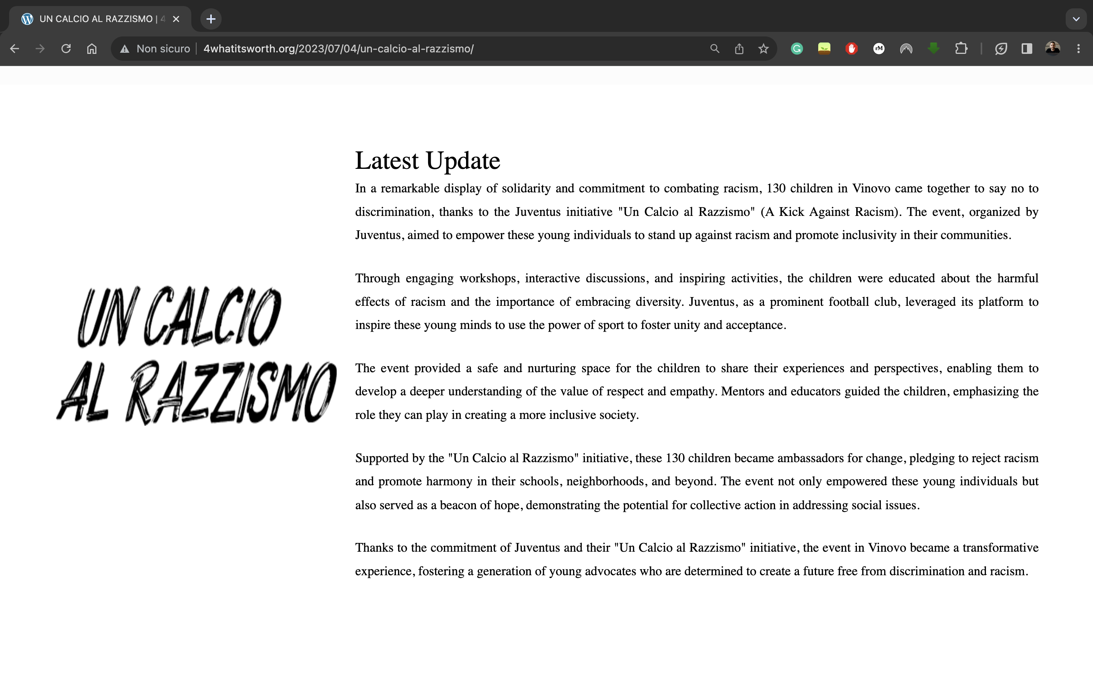


CALL FOR PROJECTS
PROPOSAL SUBMISSION
PROJECTS SELECTION
PROJECTS
UPDATES
ACTION
OWNER
Notes:
First of all, Juventus launches a call for projects in some actual ESG areas of interest.
Secondly, fan clubs and academies representatives submit their projects proposals.
After the call for projects ends, Juventus will upload all the selected projects in its dedicated section on our patform.
Why not letting the 600M followers play their part then?
Signing up, they can set their own profile and join the projects in which they believe in, by offering their time, skills or money, based on the nature of the project and follow all detailed updates.
With this dynamic, we ensure an increase on the impact and success of each and every project.

Slide 16
Everything still holds true
Notes:
A few minutes ago, I’ve asked you to put yourselves in the shoes of Juventus.
Imagine now you are Apple, or Coldplay, or Patagonia, or even Ferrari.
Everything still holds true

Slide 17
We are ready to embody the change
Are you?
Notes:
We are ready to set the stage for every project
We are ready to support those that have no fundings
We are ready to give a voice to the ones that do not have one
We are ready to embody the change
Are you?

Slide 18
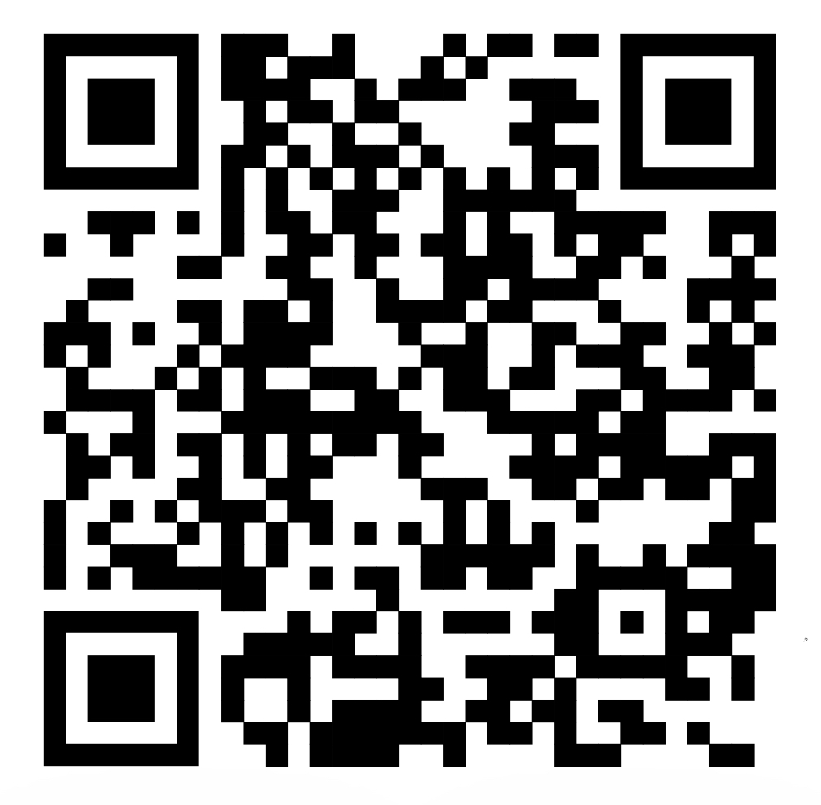
THANK YOU

