Slide 1








Galaxy Project
July 6th 2045
Notes:
Good morning everyone and welcome to this edition of Innovation 4 Change, year 2045, yes, you heard well, 2045. We are the Galaxy Project group and today we are going to show you the journey that brought us here. ->

Slide 2


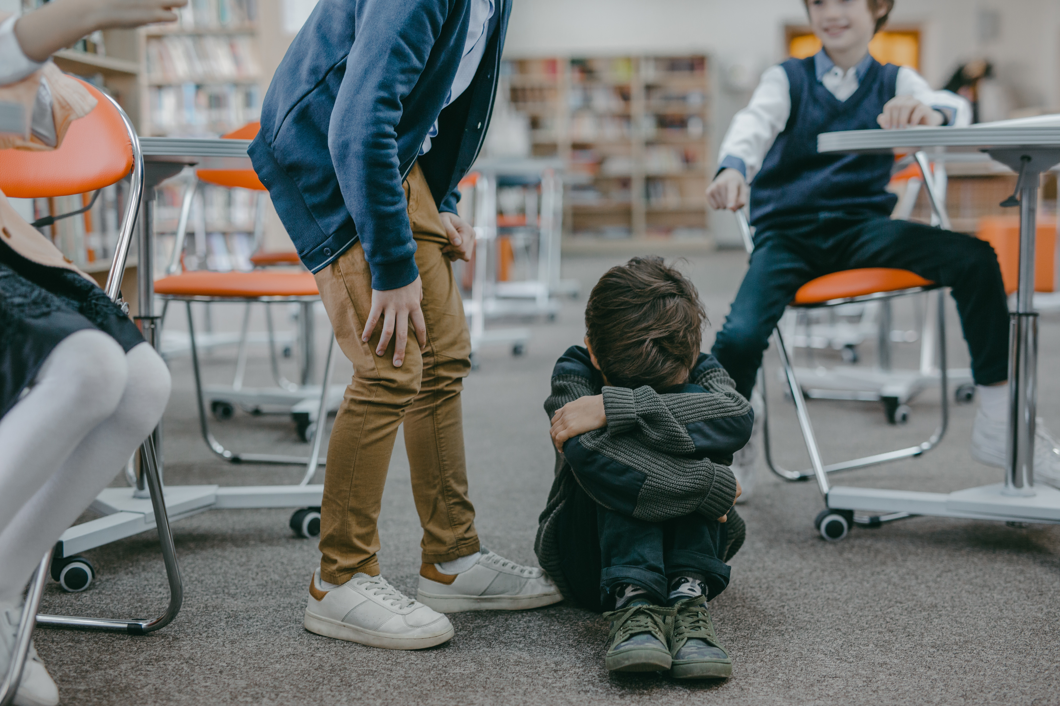




20 years ago, spring 2023,
challenged us
School Drop-Out
was a problem
12,7% in 2022
(With peaks as high as 21%)
Notes:
20 years ago, in the spring of the year 2023, Il Cielo Itinerante and Innovation 4 Change challenged us to find a way to end, once and for all the problem of school dropout. ->

Slide 3













A MULTIFACTORIAL
PROBLEM
TEACHERS
SOCIETY
STUDENTS
FAMILIES
EDUCATION
ECONOMY
Notes:
And so, brave and strong, we jumped right into the problem, trying to find the root of it. (Pause) But we found many… (Pause) The problem of school dropout arose from a multitude of problems, all interconnected and of different nature from place to place. ->

Slide 4

Nothing we have done
had an IMPACT!​
But someone was out there:
Associations
Foundations
Cooperatives
Notes:
Naive as we were we rushed to find a solution, and we did try… Multiple times… from different point of views… but nothing we did ever had a true impact. (pausa) We were trying to find a global solution to a local problem… the perfect recipe for failure.
Until, one day, we realized that we were not alone, because someone was already out there, working, day and night, fighting this problem with all its force. Associations, foundations, cooperatives… all beautiful people with a dream and a big heart, putting all theirselves into the solution. But they were still losing the battle… ->

Slide 5



ASSOCIATIONS
FOUNDATIONS
COOPERATIVES
The NEED
A NETWORK
to be CONNECTED
and VISIBLE
Progetto
GALASSIA
Notes:
But then, we realized that the actual problem was, simply, that their light was too weak! The potential was there, but they were just too disconnected from each other and difficult to find to accomplish something so big. ->

Slide 6



With LOCAL SOLUTIONS
GLOBAL APPROACH
ASSOCIATIONS
FOUNDATIONS
COOPERATIVES
Notes:
In our journey to the sky, we had just found all the pieces to build our rocket. At that point, we just needed to assemble it.
We understood that we had to fight this systemic problem with a global approach involving local solutions. ->

Slide 7



WHAT?
CONNECTION
An interactive map listing all the associations
Notes:
So what did we do? First, we connected all the associations in an interactive map of the territory, categorized by area, focus and impact. This connection was the first step to allow them to work as a greater entity rather than as separated individuals… ->​

Slide 8
Services
Best Practicies
WHAT?
Notes:
Second, we helped the associations finding the grants and gave them legal advice for the applications.
And, finally, we created an impact evaluation based on the best practices at the time, so that everyone could truly appreciate their efforts and incredible service for the community.

Slide 9



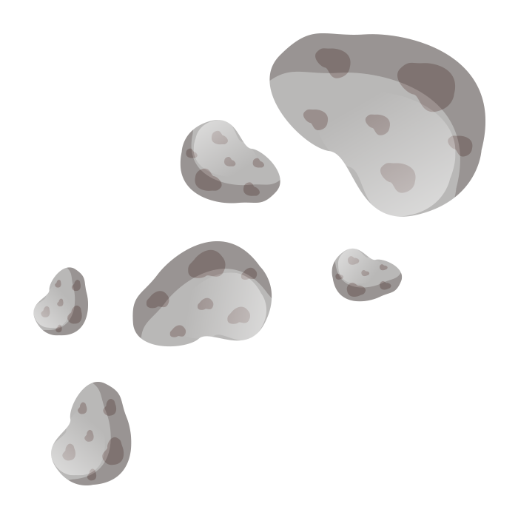

HOW?
Proprietary web scraper​
Continuous ​
collaboration ​
AI for​
impact evaluation
Notes:
Doing all of that was the easiest part, actually. All we had to do was to create a web scraper looking into the abyss of the internet to find all the associations.
And once we found them all, we created an AI-instructed algorithm to evaluate their impact.
And of course, we never stopped there, we continued to collaborate with all the associations, foundations, and good people working on the field so that no one would be left behind. ->

Slide 10

STUDENTS
The CHANGE
Collaborations
Efficiency
Promotion
Interdisciplinarity
Notes:
Our rocket was leaving the ground. We were seeing a synergy that was unthinkable just a few years before. Associations like Il Cielo Itinerante were spending less time and resourches finding the right local partners to reach their kids, inspiring more and more of them. Small, local associations were recognized for their true value without spending years of promotion, helping kids that wouldn’t have noticed them otherwise. Foundations collaborated with associations that were not even on their radar before, creating amazing interdisciplinary projects … ->

Slide 11

Today
IMPACT
STUDENTS
2023
2045
Notes:
Of course, it did start slow, that was expected. In the first year we helped only a few kids remain in school. Then the year later just a few more. And then again. Not much we were thinking… But then something changed. The young adults we helped returned what they received to the society. They understood that everyone should have had what they had and started to work with the associations that gave them a chance. This created a cascade effect and the impact grew exponentially. ->

Slide 12
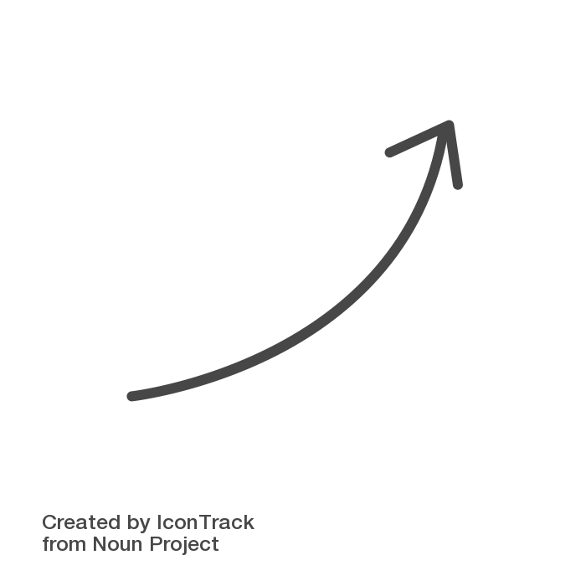

>30,000
ASSOCIATIONS
Today
July 6th 2045
Notes:
And so here we are today, the 6° of July 2045. We connected in our network more than 30 thousand associations, at least one for each city, giving all the students the help they needed. The problem of school dropout in Italy is well below the European average and we are starting to expand in the other countries. In our society everyone helps everyone else and no-one is left behind. We didn’t do much to reach this point, really, we just had to look into the dark to find the most beautiful stars that were already there from the beginning. ->
​

Slide 13


THANKS
Please keep this slide for attribution
Notes:
Thank you very much for giving us the opportunity to embarc on this journey, and to be here today remembering how it all started 20 years ago.

