Slide 1
2050
Notes:
[Mariagrazia]: 2050. That's the year EU is aiming for climate neutrality, which means having zero net greenhouse gas emissions. This doesn't mean we won't produce any more CO2 emissions, but rather that we'll be able to absorb them from the atmosphere in equal measure.​
[Francesco]: But, what are we doing to reach this “net-zero”?

Slide 2
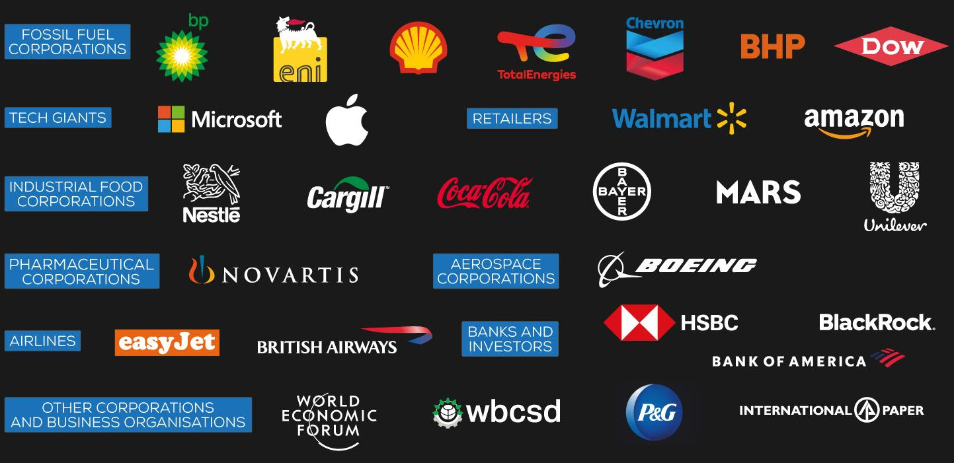
MORE THAN 1500 CORPORATIONS HAVE MADE “NET-ZERO” COMMITMENTS IN RECENT YEARS
Source Friends of the Earth International, 2022
Notes:
[Mariagrazia]: Well, more than 15hundreds companies have made “net-zero” commitments in recent years, based on carbon credits purchasing, and spending is around $2 billion per year.
[Francesco]: Amazing! So we are on the right track! Right?

Slide 3
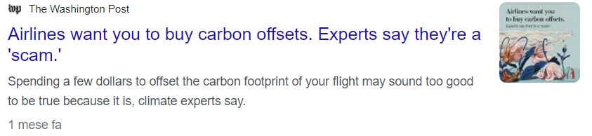
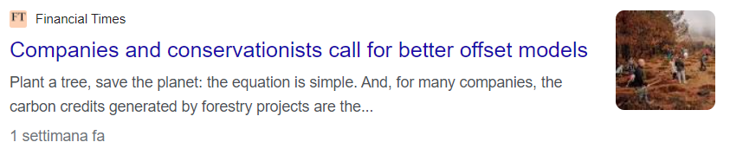
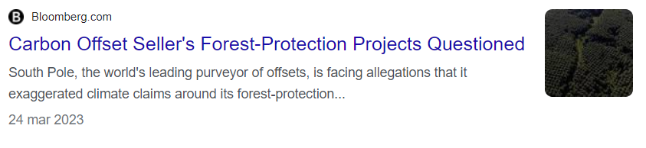
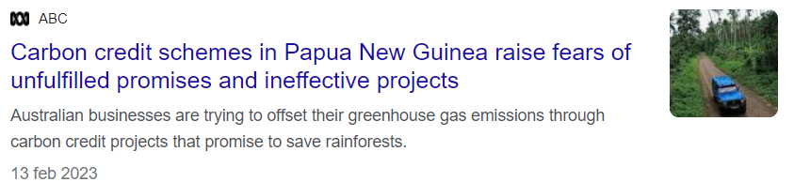
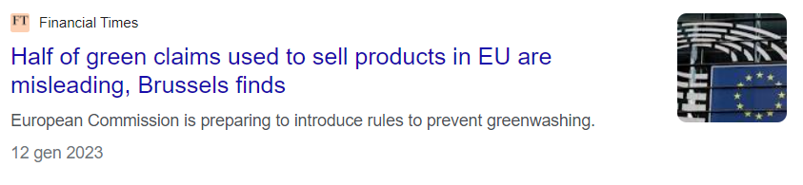
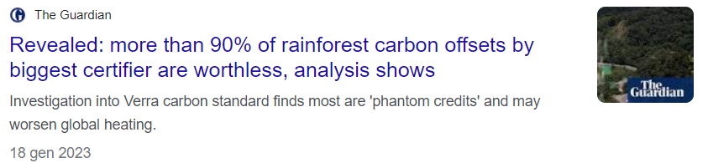
Notes:
[Mariagrazia]: Well, not exactly. It happens that such carbon credits, are inflated, overvalued, fake, or even non-existent. Let me give you a number: only 5% CO2% investment for rainforest offsets is actually successful.
[Francesco]: So, what is the truth behind the “net-zero” corporate claims?​
METTERE PERCENTUALE CREDITI VALIDI PER RAINFOREST

Slide 4
Notes:
[Mariagrazia]: Well, it seems like the current system is not a valid solution. But I can show you an alternative. We can make CO2 capture simple, accessible, and safe. And we can do it with the most natural CO2 capture process out there, right where we are, even with limited space.​

Slide 5
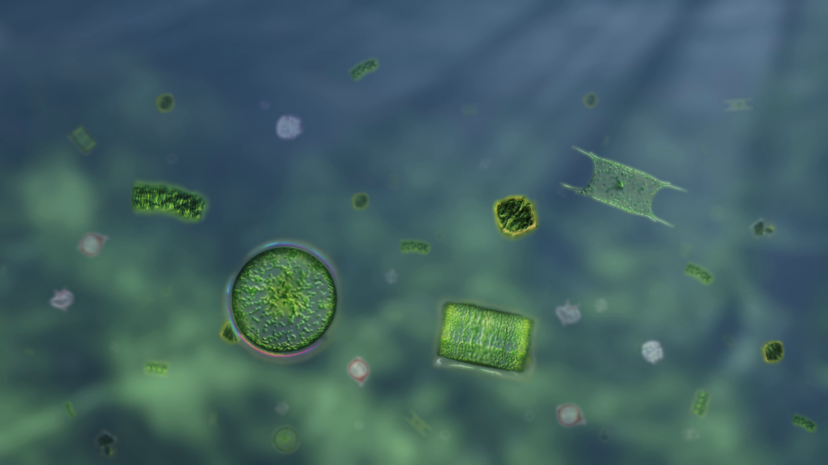
Notes:
[Francesco]: Let us introduce you to a microscopic organism: phytoplankton. It can be found in our oceans and is responsible for absorbing about 40% of the CO2 generated on our planet.
[Mariagrazia]: That's equivalent of the work that could be done by four Amazon rainforests. Now, imagine increasing the amount of phytoplankton in the world without disrupting the marine ecosystem.

Slide 6
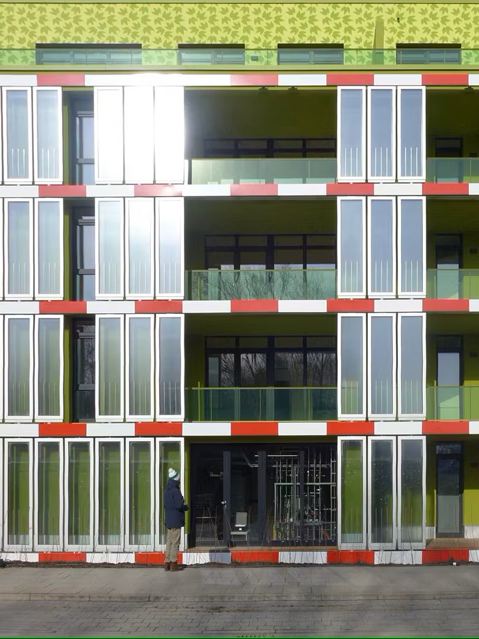
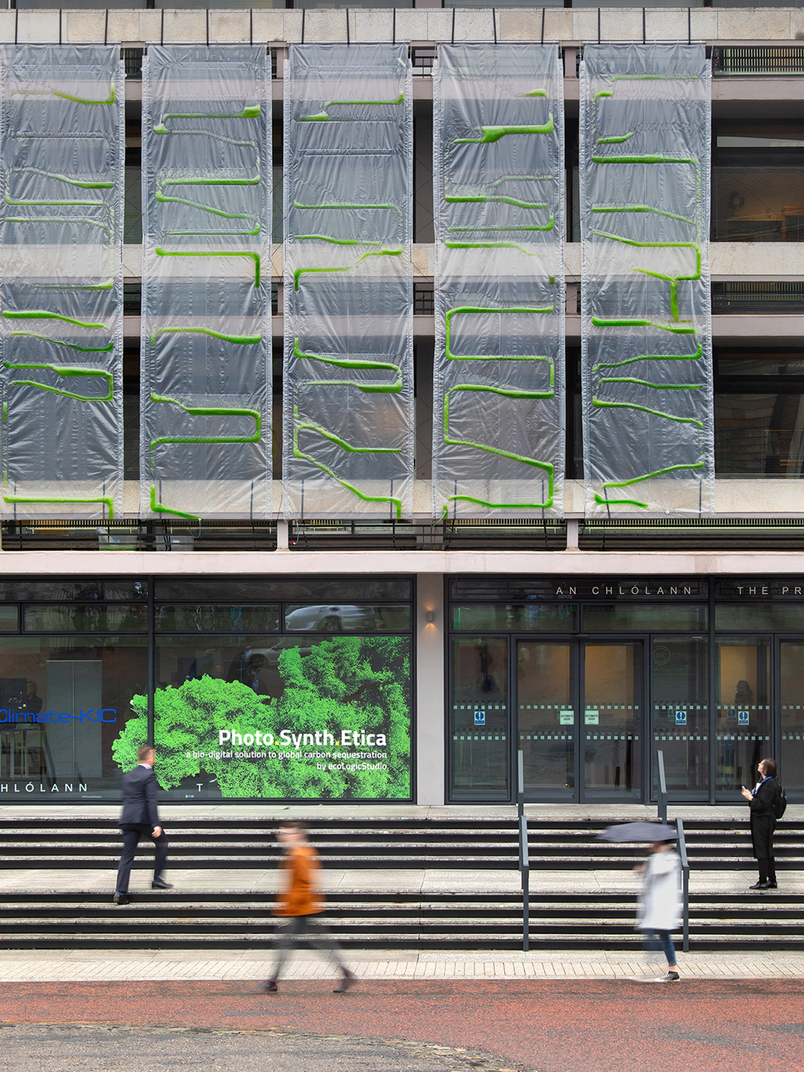
Notes:
[Francesco]: And yes, this is feasible. There are already several applications for using phytoplankton to remove CO2 from the atmosphere, as you can see this building in Hamburg or this façade in Dublin. But these architectural solutions weren’t developed with scalability and cost effectiveness in mind, as CO2 absorption is not optimized, and they need constant energy supply.
[Mariagrazia]: But we have an opportunity: we can leverage on recent technology advancements, based on last-months scientific publications, and we can take phytoplankton out of water.

Slide 7

Notes:
[Mariagrazia]: We developed PhytoMat, our phytoplankton-based solution for capturing CO2 wherever you want and with full-control of your impact.

Slide 8
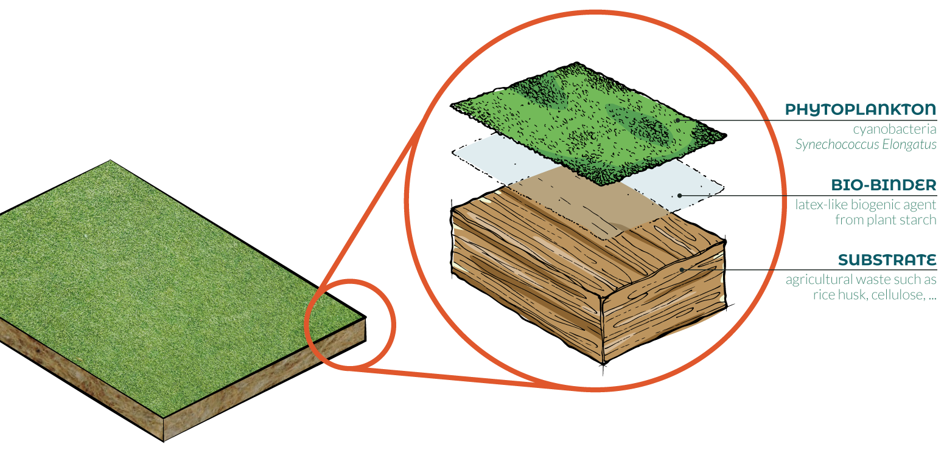
Notes:
[Francesco]: Phytomat looks like a patch of grass. It is made of a rice-straw substrate, which is 100% biodegradable. It has a layer of phytoplankton and a binder that holds the two materials together.

Slide 9
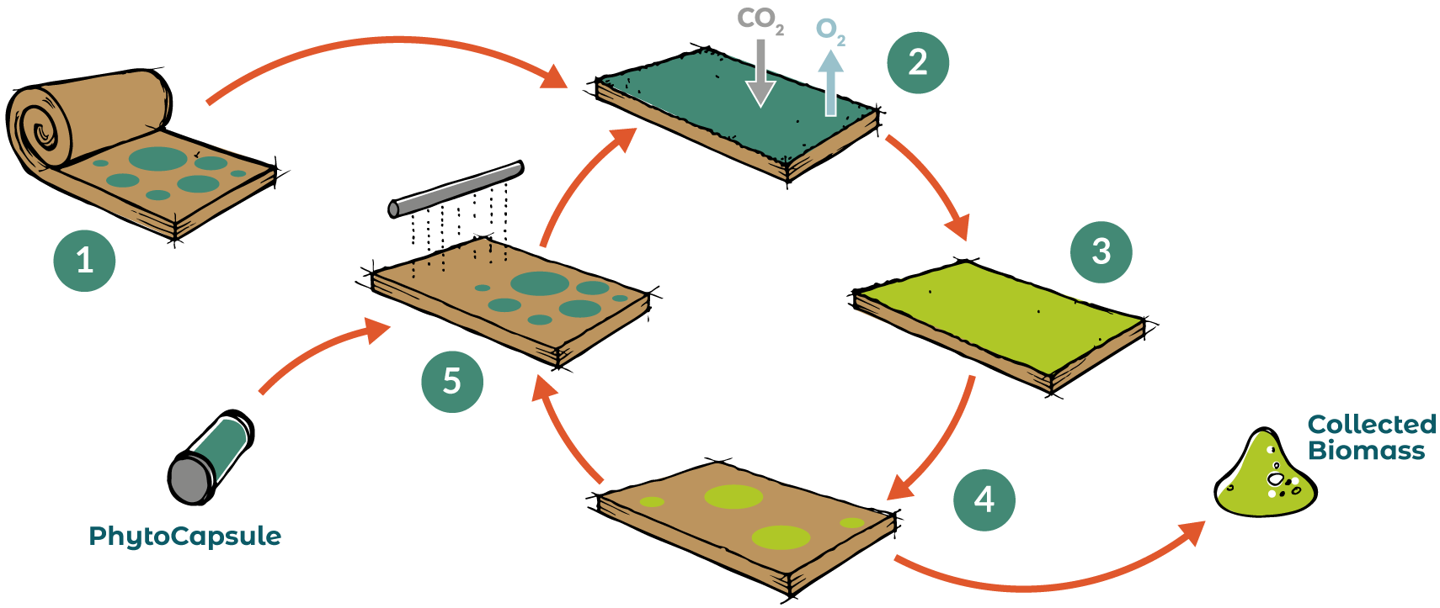
Photosynthesis
Transformation in biomass
Installation
Phytoplankton replenishment
Biomass
collection
Notes:
[Mariagrazia]: Let me ask you a question. How many of you have ever tried to grow a basil plant on your terrace? How many succeded? (Well we have some basil killers here). It's always a matter of the good amount of water, a perfect sun exposition. Well, Phytomat is much easier.
[Francesco]: For 3 months, it absorbs CO2 and produce oxygen without any supply of water or nutrients. Basically, no further effort for you. After 3 months, you only need to collect the biomass produced to measure the amount of CO2 absorbed. Then, you can recharge PhytoMat with new phytoplankton.
[Mariagrazia]: Simple, right? Probably easier than babysitting a basil plant on your terrace

Slide 10


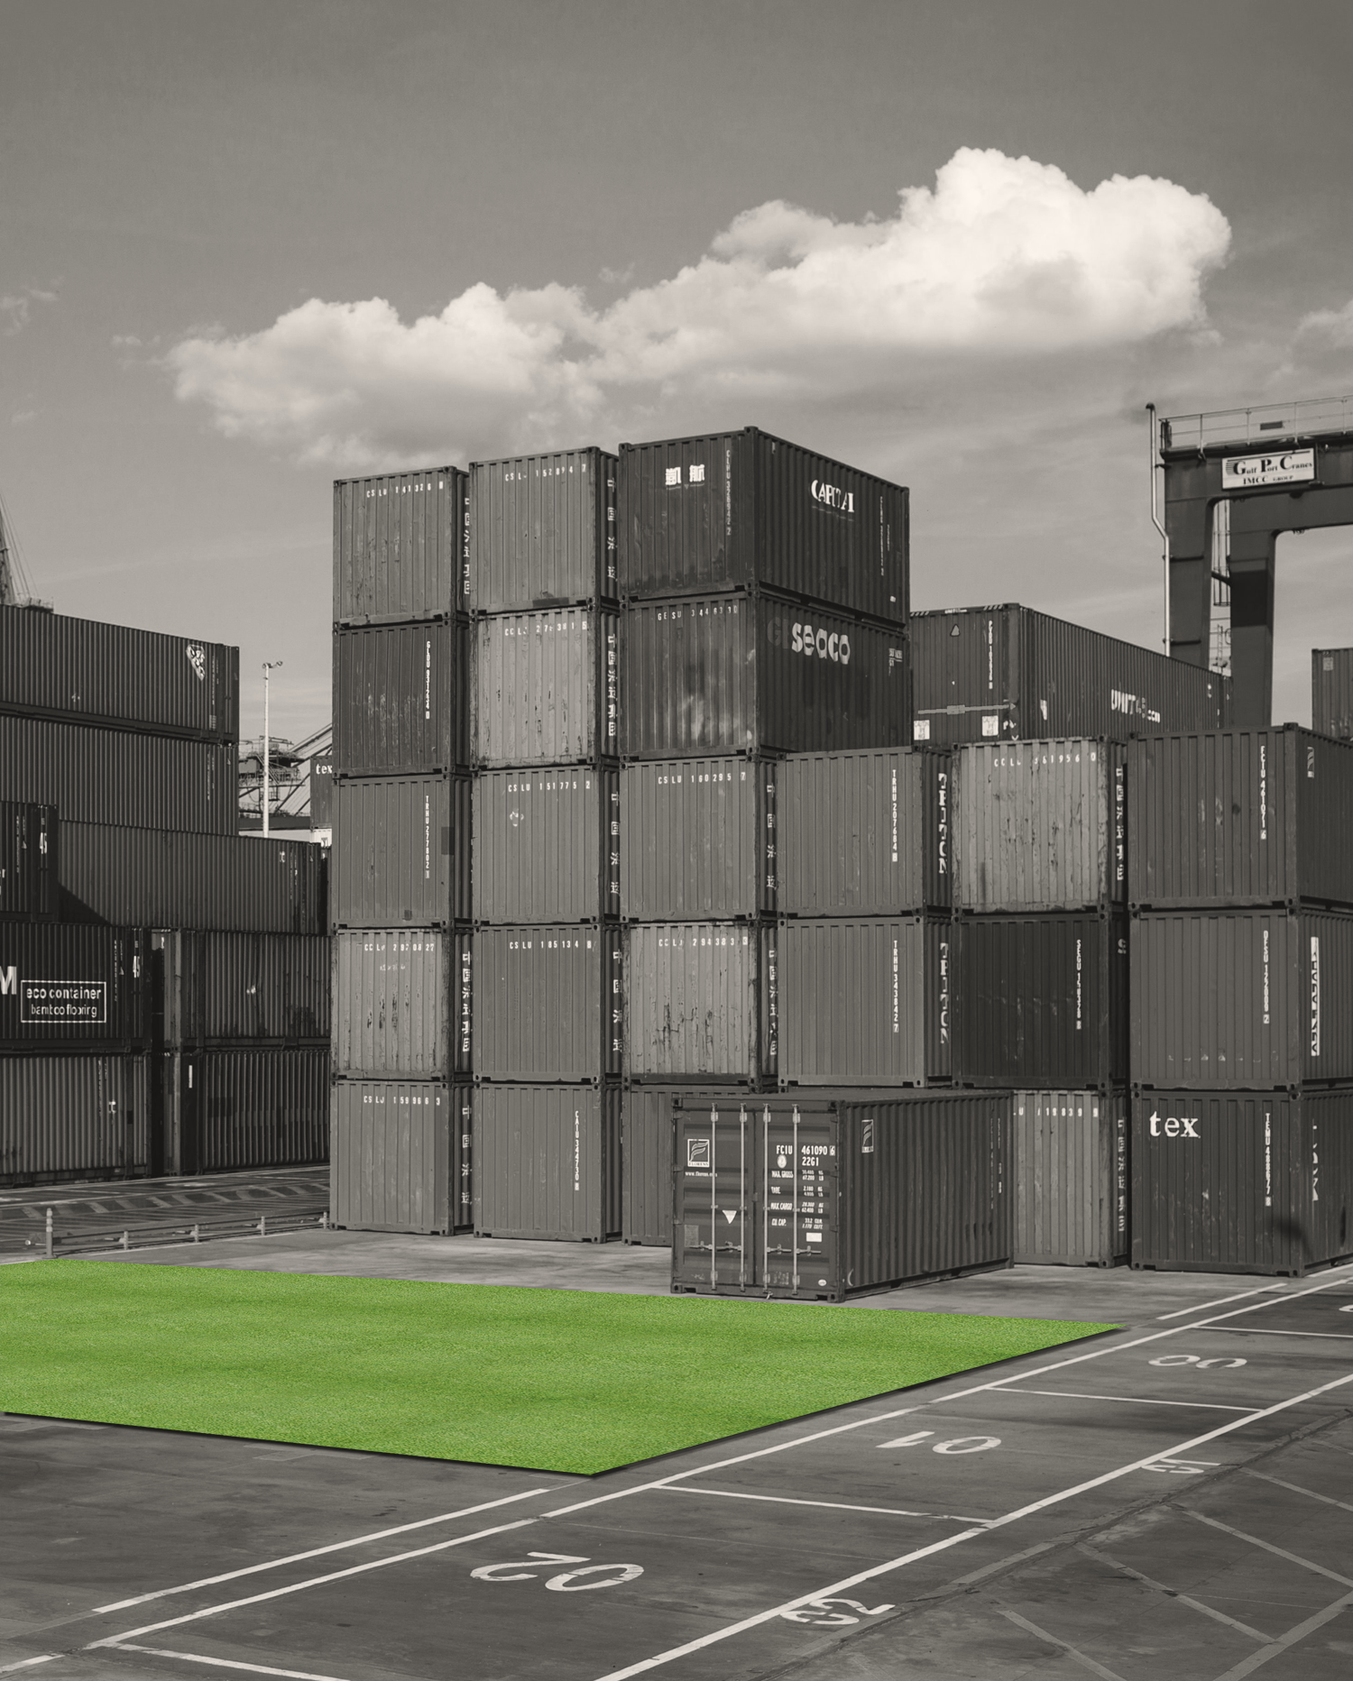
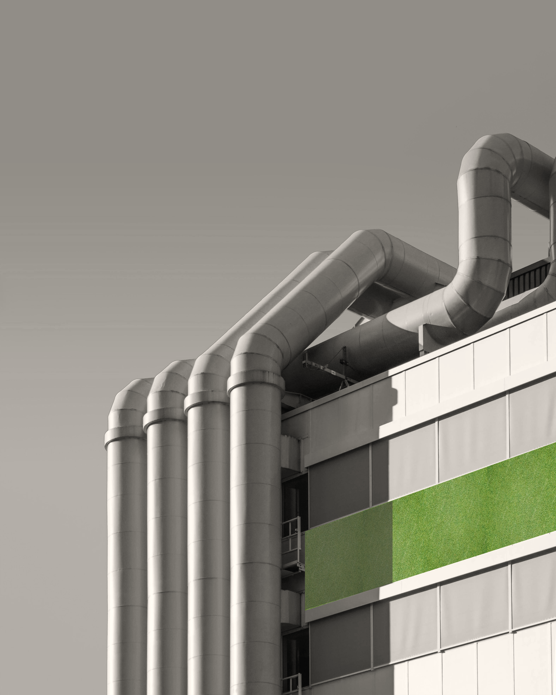
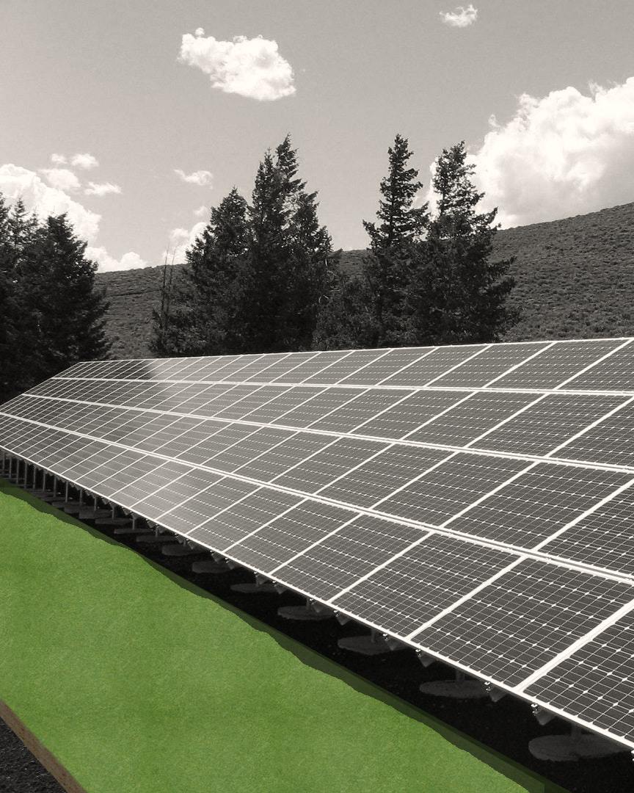
34
CO2 absorbed
by a fully grown tree
1 m²
Notes:
[Mariagrazia]: But is this actually a better solution than planting a tree? Well, with PhytoMat you can have the CO2 absorption of 34 trees packed into 1 meter square. As an example, if we were to cover the roofs and walls of all the industrial plants we would be able t
[Francesco]: However, let's not just think about offsetting our own CO2 emissions. With our support, you can play an active role in absorbing some of the emissions generated by other activities. Together, we can generate high-quality carbon credits.

Slide 11


Notes:
[Mariagrazia]: And there is a huge potential behind this concept, and it is so flexible that a large number of phyto-based applications can be designed. This is only the beginning... Now imagine: if my dress was actually made of Phytoplankton, I could be absorbing CO2 just standing here in front of you…

Slide 12
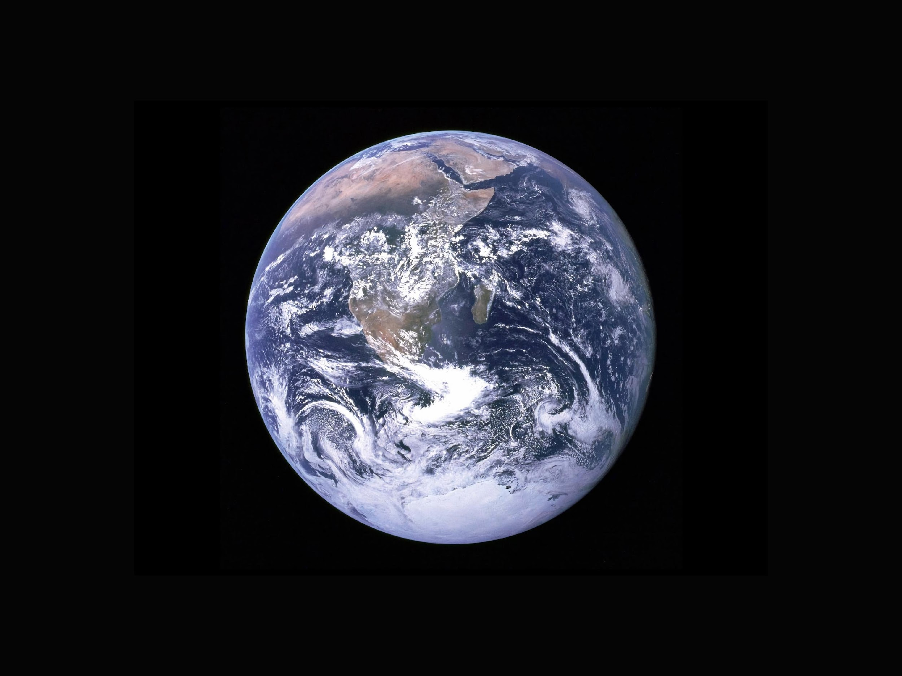
Notes:
[Francesco]: We now aspire to empower each individual to actively contribute in absorbing CO2 from the atmosphere. At the same time, if we succeed in granting companies complete control over their CO2 emissions and absorption, we would have truly revolutionized the world. We will have created a new value chain, new jobs, completely focused on a sustainable carbon cycle for our planet. Hence, the 2050 goal appears both feasible and attainable. And we strongly believe in it. Together, we can make net-zero, for real. Thank you very much.

