Slide 2
1,000

Slide 3
2,000

Slide 4
3,000

Slide 5
4,000

Slide 6
5,000

Slide 7
6,000

Slide 8
7,000

Slide 9
8,000

Slide 10
9,000

Slide 11
10,000

Slide 12
20,000

Slide 13
30,000

Slide 14
40,000

Slide 15
50,000

Slide 16
60,000

Slide 17
70,000

Slide 18
80,000

Slide 19
90,000

Slide 20
100,000

Slide 21
200,000

Slide 22
400,000

Slide 23
800,000

Slide 24
1,600,000

Slide 25
2,000,000

Slide 26
2,500,000

Slide 27
3,000,000

Slide 28
3,500,000

Slide 29
4,000,000

Slide 30
4,500,000

Slide 31
5,000,000

Slide 32
6,000,000

Slide 33
7,000,000

Slide 34
8,000,000

Slide 35
9,000,000

Slide 36
10,000,000

Slide 37
11,000,000

Slide 38
12,000,000

Slide 39
13,000,000

Slide 40
14,000,000

Slide 41
15,000,000

Slide 42
16,000,000

Slide 43
17,000,000

Slide 44
18,000,000

Slide 45
19,000,000

Slide 46
+20,000,000

Slide 47
+20,000,000
Breast cancer​, Stomach cancer,Colon cancer​, Lung cancer, Glioblastoma, Renal-cell carcinoma​, Rheumatoid arthritis​, Crohn's disease​, Thyroid cancer​, Ulcerative colitis, Non-Hodgkin's Lymphoma, Hemophilia​, Organ rejection, Stroke

Slide 49

Only 10% of the biotech patents developed in European universities succed to be out-licensed

Slide 50
WHY?

Slide 51
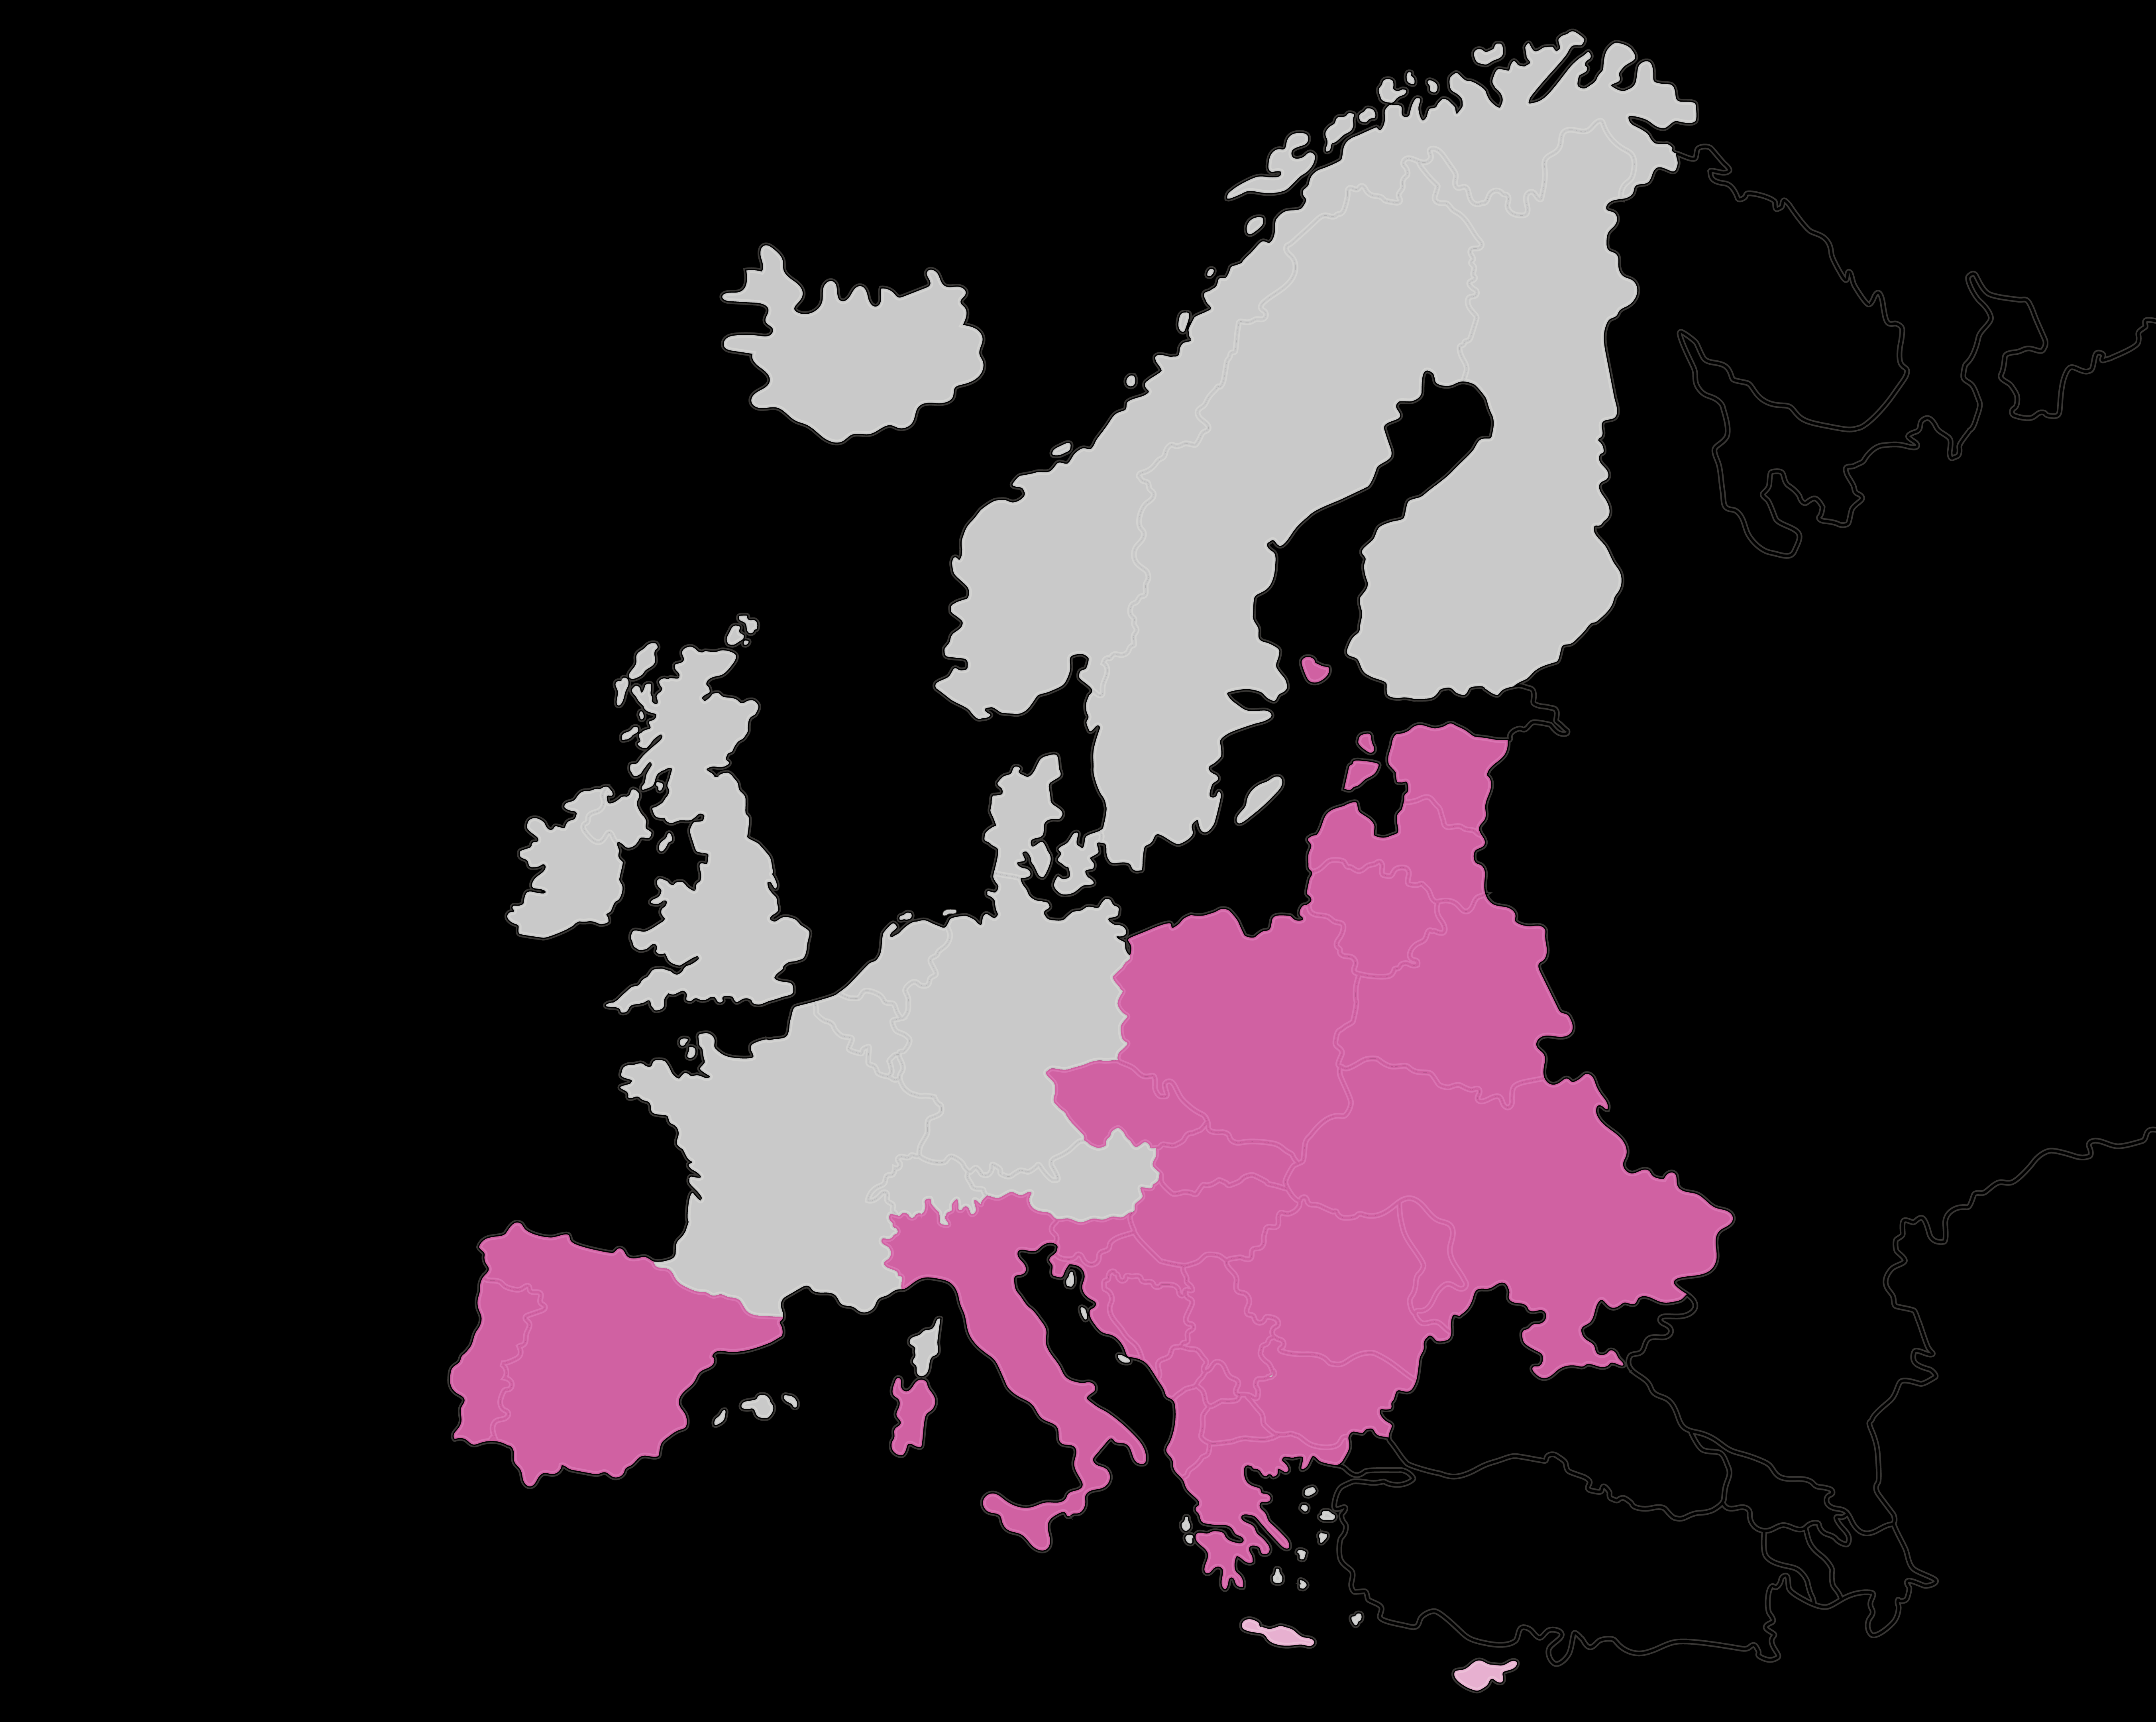


Tech Transfer Offices are usually understaffed

Slide 52
THIS IS NOT WORKING

Slide 53

CATAPULT
Catalyzing Technology Advancement through Patent Utilization and Licensing
The South and East European Netflix of Biopharma IP

Slide 54






Patents available
for exploitation
University
AI Tool
Deep learning
Semantic modeling
Topic modeling
Matching
Between Uni
and Company
Company
Need for ideas and innovation

Slide 55


POSSIBLE IMPACT IN NUMBERS
+ 1,000 Universities
+16 Countries
99% of industrial sector is SME
+ 2,300,000
Possible patients

Slide 56
1,000

Slide 57
10,000

Slide 58
50,000

Slide 59
100,000

Slide 60
500,000

Slide 61
1,000,000

Slide 62
2,000,000

Slide 63
3,000,000

Slide 64
4,000,000

Slide 65
5,000,000

Slide 66
10,000,000

Slide 67
12,000,000

Slide 68
14,000,000

Slide 69
16,000,000

Slide 70
18,000,000

Slide 71
+20,000,000

Slide 72
+20,000,000

Slide 73
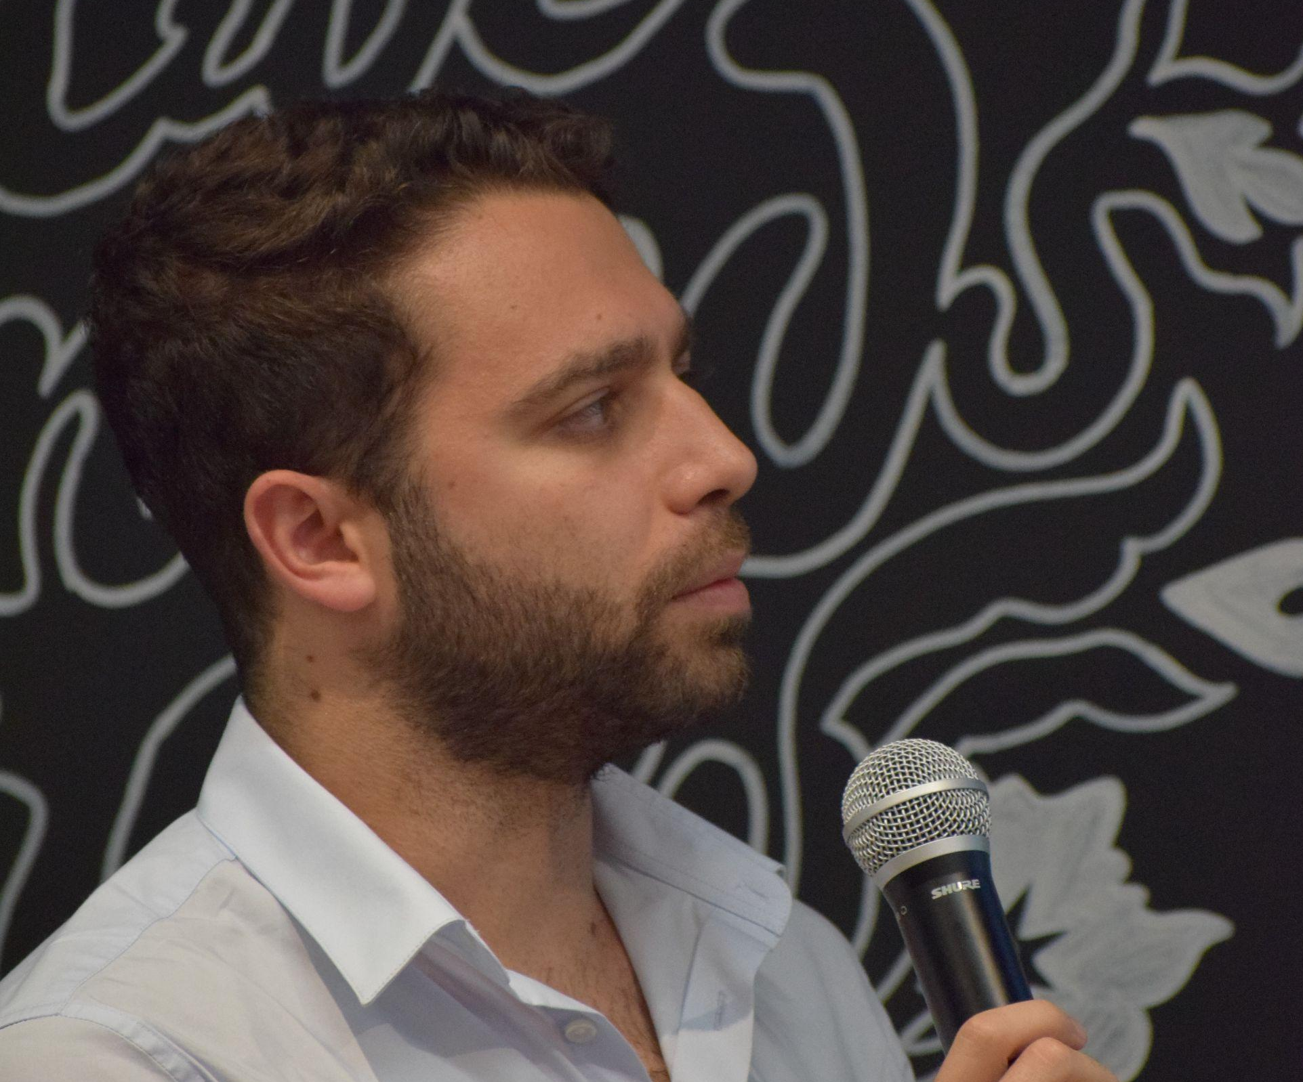
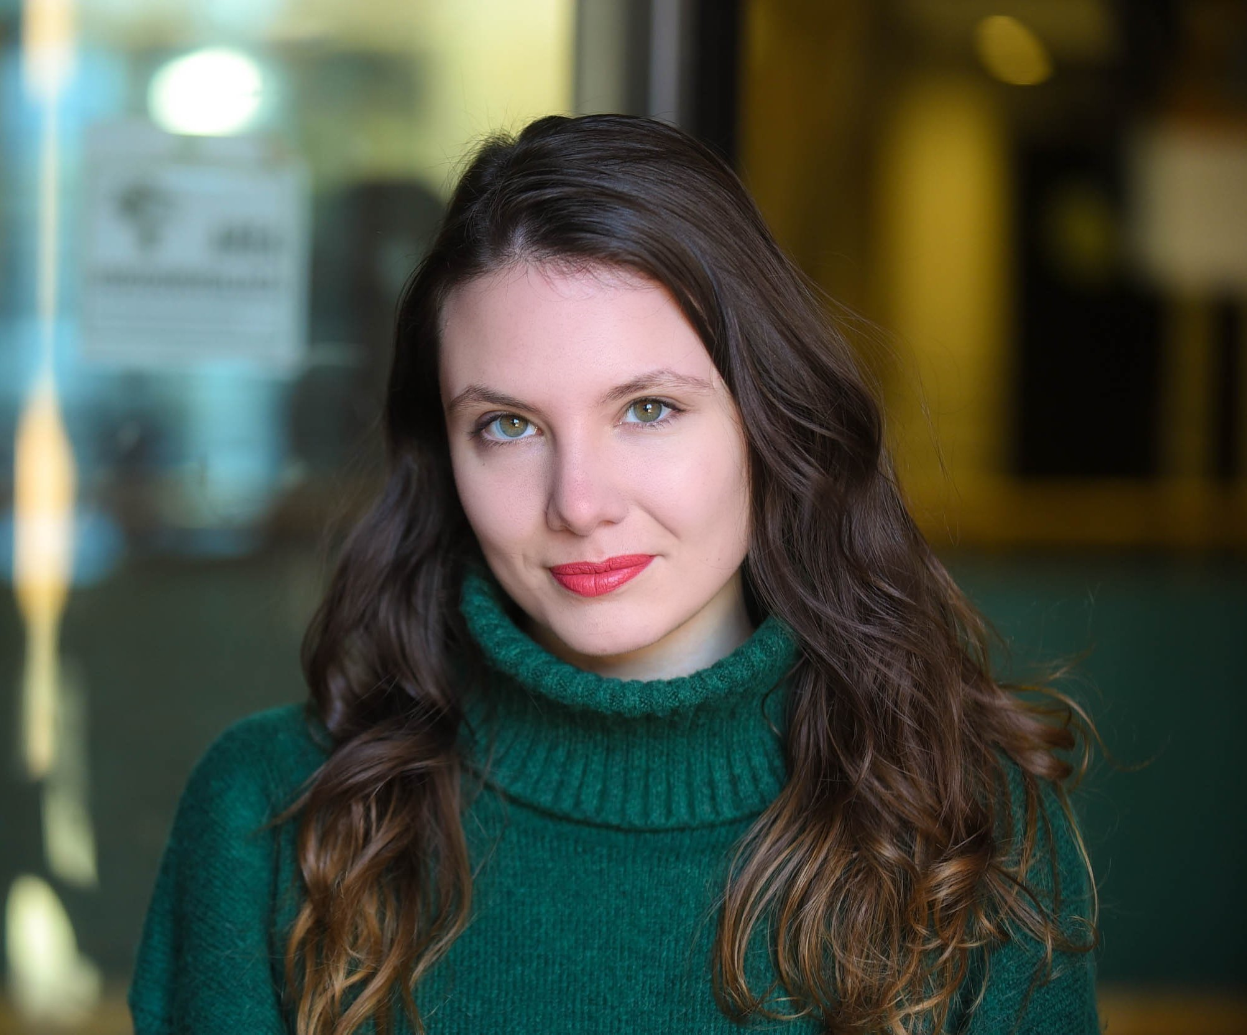
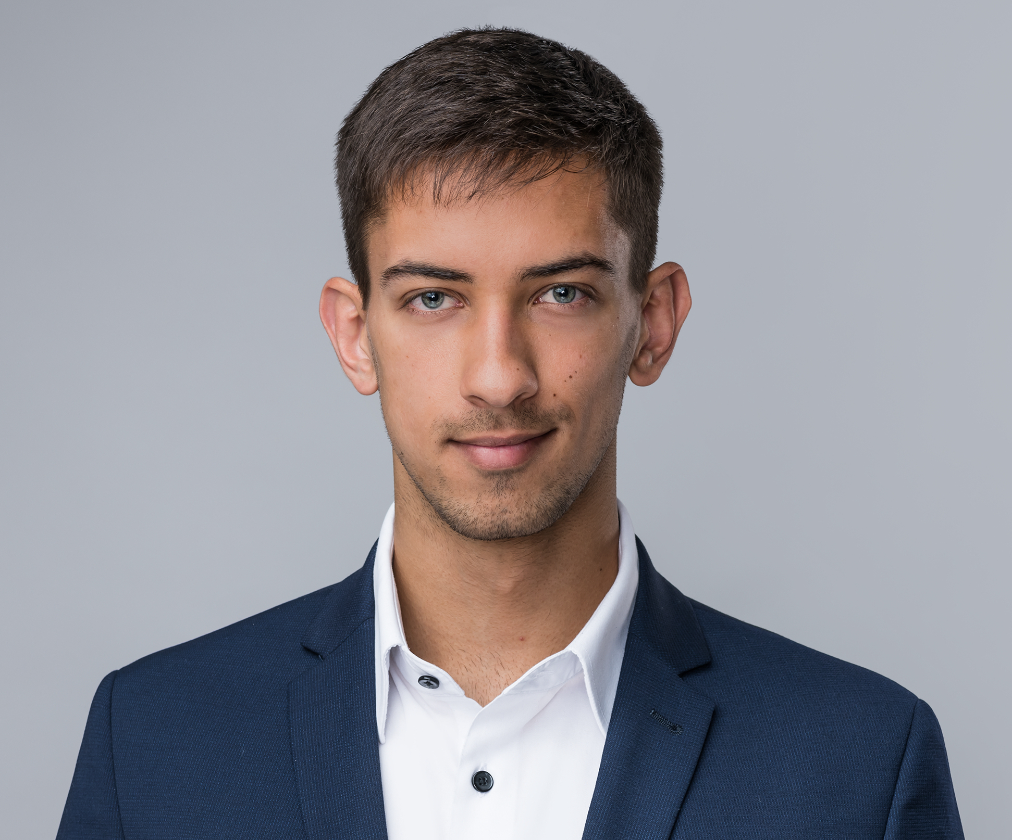
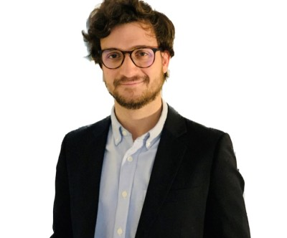

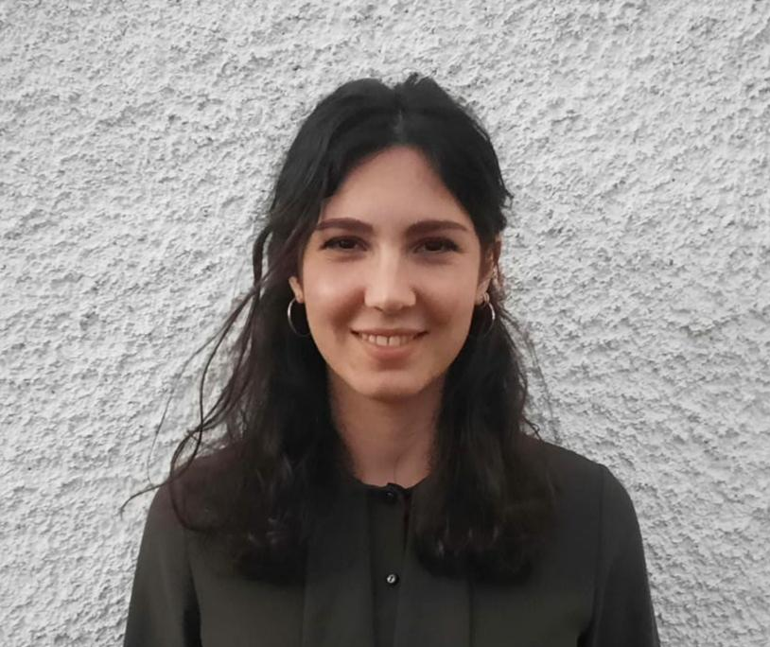
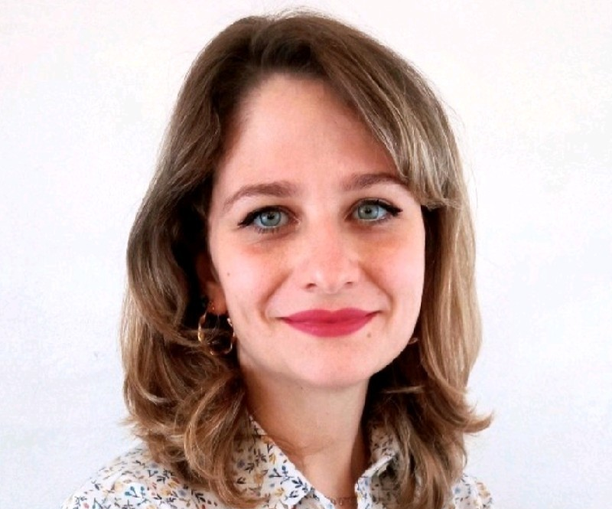
The Team
Francesco Chierici
Emily S. Turilli
Daniel Vajner
Andrea Rossi
Luigi Bottecchia
Sofia Saffirio
Giulia M. Canavesi

